Slide 1
Control, Loops, and Functions

Slide 2
Today’s Lecture Covers…
How to use if/else statements to control how your code executes
Using for loops to automate away repetitive processes and increase the reliability of your code
Creating your own functions to improve the performance and reproducibility of your code
Materials in this lecture are also covered in the text in Chapter 19 – Functions, and Chapter 21 - Iteration

Slide 3
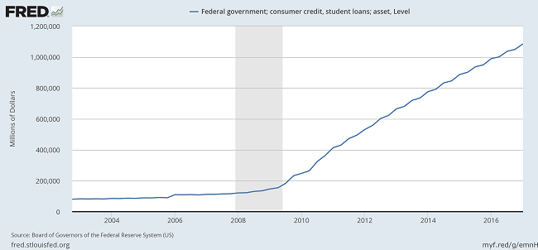
Student Loan Debt in the United States

Slide 4
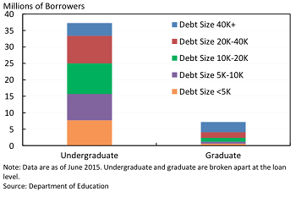
Distribution of Student Loans

Slide 5
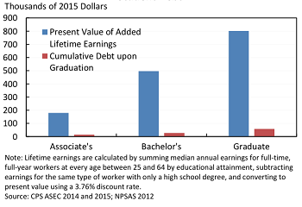
Economic Benefits of Higher Education

Slide 6
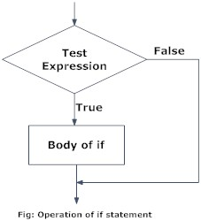
If Statements

Slide 7
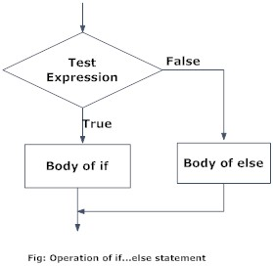
If/Else Statements

Slide 8
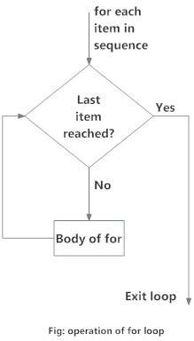
For Loops

