Slide 1
Competition or Chaos?
Donor fragmentation, aid effectiveness, and the local state — working meeting Sager & Tobin

Slide 2
The question
Does donor fragmentation (many uncoordinated donors in one place) help or hurt local development?
Literature is split: competition (innovation, choice, less donor dominance) vs chaos (transaction costs, duplication, bypassed government).
Our claim: the answer is conditional — on local state capacity — and has two faces, one material (growth/services) and one political (legitimacy).

Slide 3
Where we started — and why we pivoted
Original design: admin-region panel, fragmentation → nightlights, shift-share IV.
It did not survive honest scrutiny:
panel had collapsed to a single cross-section; log(y+0.01) fragile
the fragmentation effect dies once aid is instrumented
the descriptive correlation flips sign with a baseline control and washes out when coarsened
Feasibility audit, the key discovery: in GODAD, only the World Bank is point-geocoded (99% of precise points). Every other donor is snapped to the district centroid.
→ Fragmentation is not spatially resolvable. So we use what is precise.

Slide 4
The redesign
Treatment: precisely located World Bank projects (7,600 sites, 32 countries, staggered arrivals 1995–2018) → event study.
Moderators (district level): donor fragmentation (predetermined, non-WB) and state capacity.
Outcomes: continuous, sensor-harmonized nightlights (Regan) and 146k georeferenced Afrobarometer respondents (the political side).
Estimator: PPML (71% of cells are zero).

Slide 5
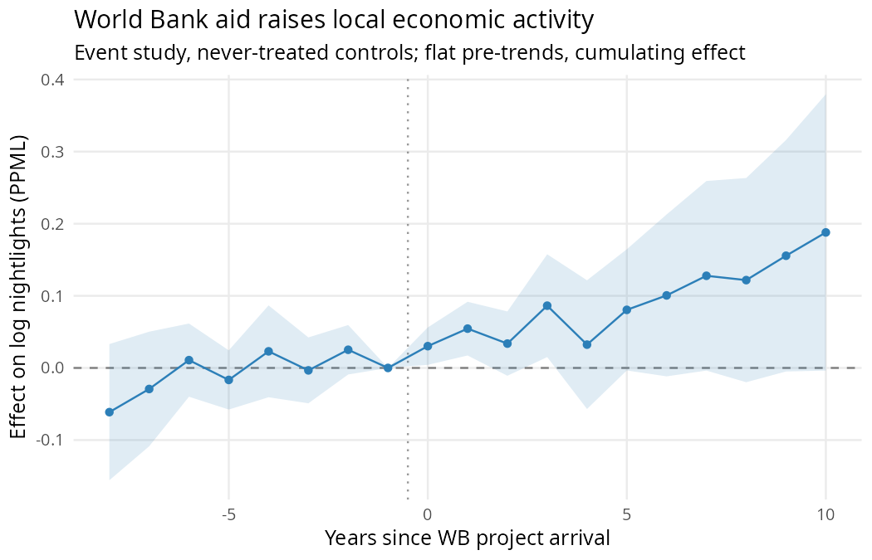
Result 1 — World Bank aid raises local activity

Slide 6
Cumulating to ~+19% luminosity by year 10. Caveat: pooled pre-trends not perfectly flat → level effect suggestive.

Slide 7
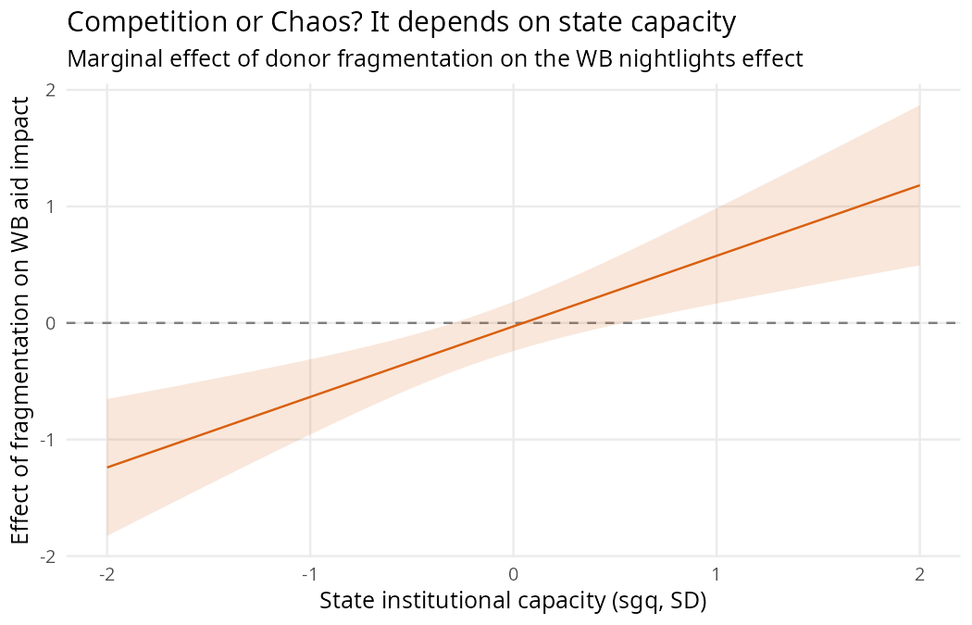
Result 2 — Competition or Chaos: it depends on capacity

Slide 8
WB × fragmentation × capacity is positive and precise.
Robust to the “is this just grid-cell power?” worry: re-estimated at the district level (honest N = 3,826; real controls) → +0.81, p = 0.0002.

Slide 9
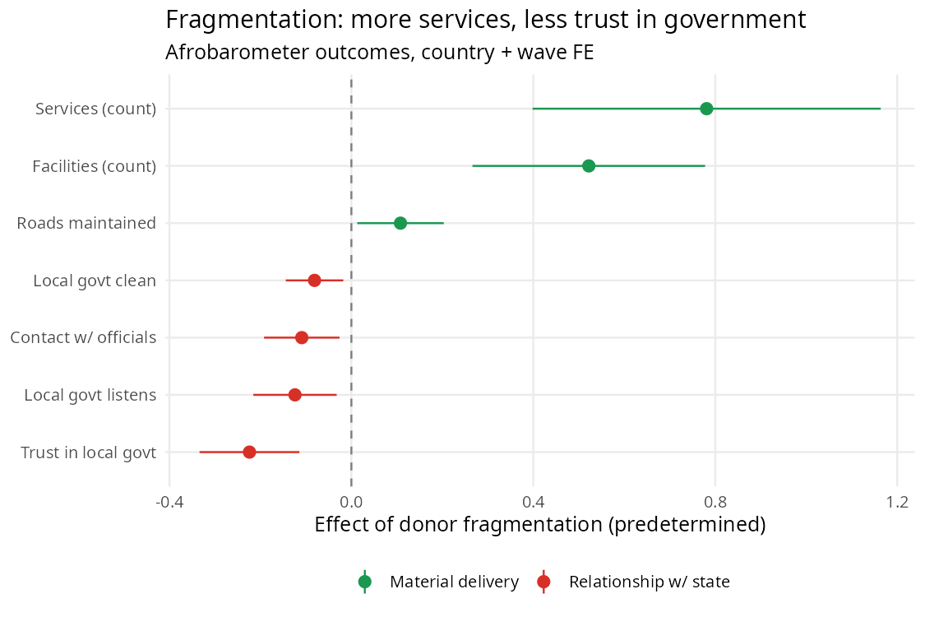
Result 3 — More services, less trust

Slide 10
Fragmentation → more services/facilities (counts) but less trust, responsiveness, contact with local government.
The accountability cost nightlights cannot see.

Slide 11
The legitimacy cost is universal
Unlike the growth effect, the trust erosion is not moderated by anything we tried:
state capacity (survey sgq) — circular for trust, so we use externals:
distance-to-core (state reach) → null
pre-colonial centralization (Murdock) → null
sector (horse race across health/educ/humanitarian/infra/gov-support) → negative everywhere
→ Wherever and in whatever form many uncoordinated donors operate, citizens trust local government less.

Slide 12
On the sector angle (our focus last time)
sector | → trust | p
humanitarian | −0.20 | 0.01
gov_support (channeled) | −0.12 | <0.001
education | −0.11 | 0.16
health | −0.08 | 0.04
infrastructure | −0.05 | 0.07
We built sector-specific district fragmentation and tested the bypass mechanism: does fragmentation in NGO-delivered social sectors erode trust, while government-channeled aid does not?
Horse race → trust (jointly, sector-frags only weakly correlated):

Slide 13
The clean “bypass-of-services” story does not hold — governance-channeled aid is the strongest negative.
But two things have merit for us to discuss:
the effect is in every sector → strong generality (supports the universal-legitimacy result)
gov-support fragmentation is the most corrosive → a different, sharper mechanism: fragmented donor involvement in governance itself undermines the state’s standing. Worth developing?

Slide 14
What’s robust vs. fragile (be honest)
Finding | Status
Material ↑ / legitimacy ↓ divergence | Solid (multiple FE, both signs)
Legitimacy cost is universal | Solid (2 external proxies + sector all null)
WB × frag × capacity (material) | Robust to N/scale/unit; specific to contemporary capacity
WB level effect | Suggestive (pre-trends not flat)
“Fragmentation lowers growth” (unconditional) | Dead (sign/scale fragile)

Slide 15
Decisions for today
Framing: lead with the divergence + universality (most robust), or the capacity-conditional “Competition or Chaos” (more classic)? — they’re complementary.
Sector direction: develop the governance-aid mechanism (gov-support most corrosive), or keep sectors as a generality/robustness result?
Identification to-do (Ethan setting up HPC): native-resolution pre-trend de-trending + Rambachan–Roth sensitivity for the WB level effect.
External institutional measure for the legitimacy×capacity question (Murdock null — is it attenuation or real?).

