Slide 1
“Societal Trust Correlations Across Institutions”
Analyzing patterns in trust and distrust across governments, scientists, journalists, and communities.
By: Ethan Shipman, Andrew Jaynes,
Seth Carter, Rafaela Peterson

Slide 2
Research Goals and Approach
Objective: To understand correlations in trust and distrust across societal institutions and identify opposing trust trends.
Key Questions:
Do patterns of distrust in science correlate with trust in alternative sources (e.g., traditional healers)?
Is there a connection between distrust in governments and trust in local communities or individuals?
Approach: Analysis of multiple datasets, including surveys and population data, to identify significant patterns.
Rafaela Peterson

Slide 3
Data Sources and Cleaning
Data Sources:
Trust surveys (cleaned data provided).
UN population statistics.
Global country-level trust indicators.
Cleaning Process:
Removing duplicates and inconsistencies.
Normalizing trust scales across datasets.
Merging datasets based on countries and time periods.
Visualization Tools:
Graphs for correlation analysis.
R-values to measure statistical significance.
Rafaela Peterson

Slide 4
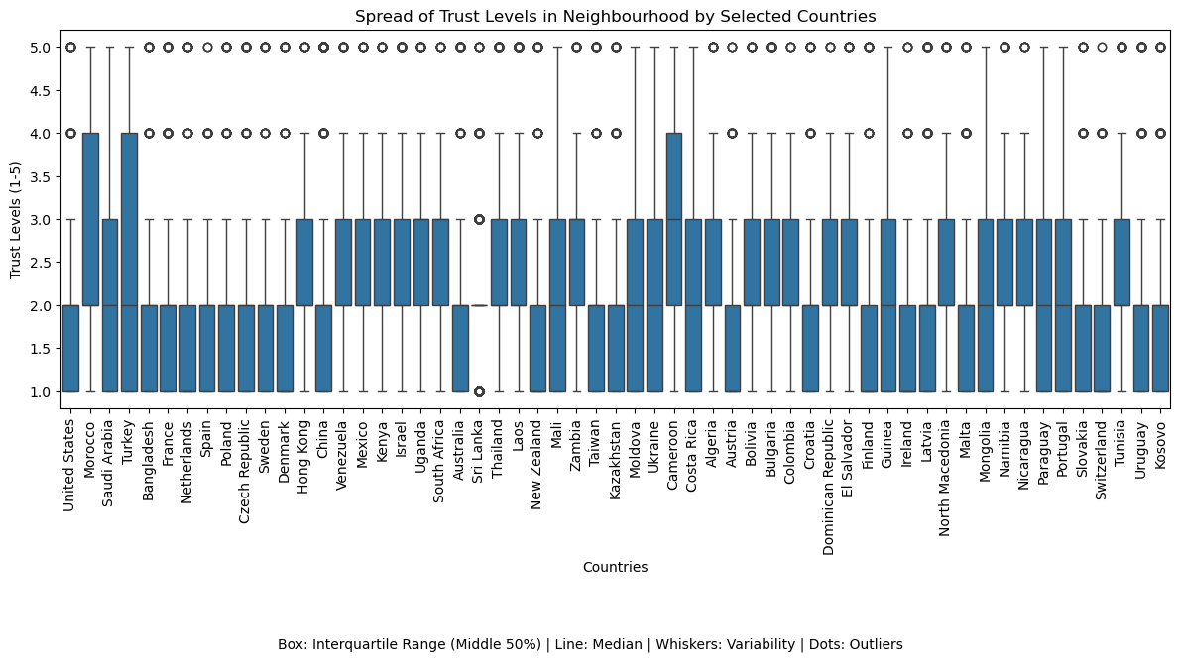
Trust Levels in Neighborhoods Across Selected Countries
Overview: The box plot shows neighborhood trust levels (1 to 5) across various countries, highlighting variability and patterns.
Key Insights: High Variability: Countries like the United States and Morocco show wide ranges of trust levels. Consistency: Countries like France and Sri Lanka have more uniform trust levels. Outliers: Some countries have extreme trust levels, indicating unique perspectives.
Implications: The patterns suggest cultural, economic, or social influences on trust. This variability could connect to trust in other societal sectors.
Andrew Jaynes

Slide 5
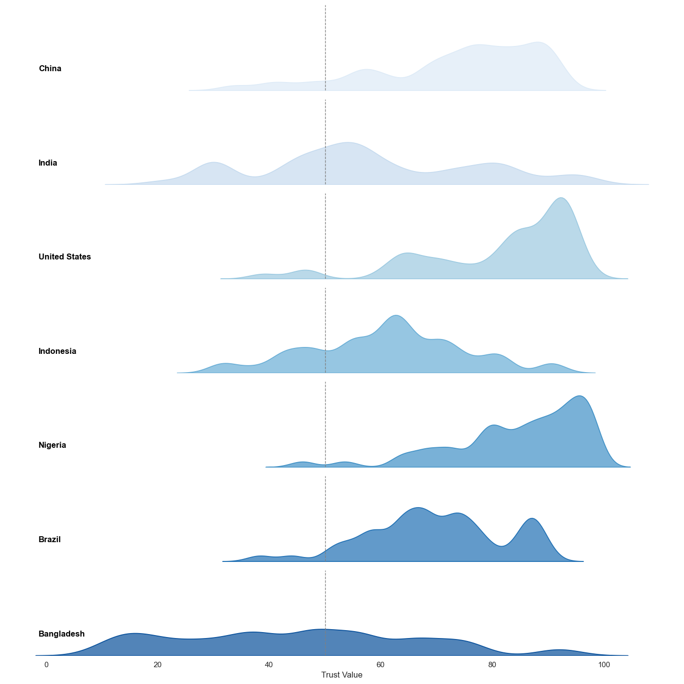
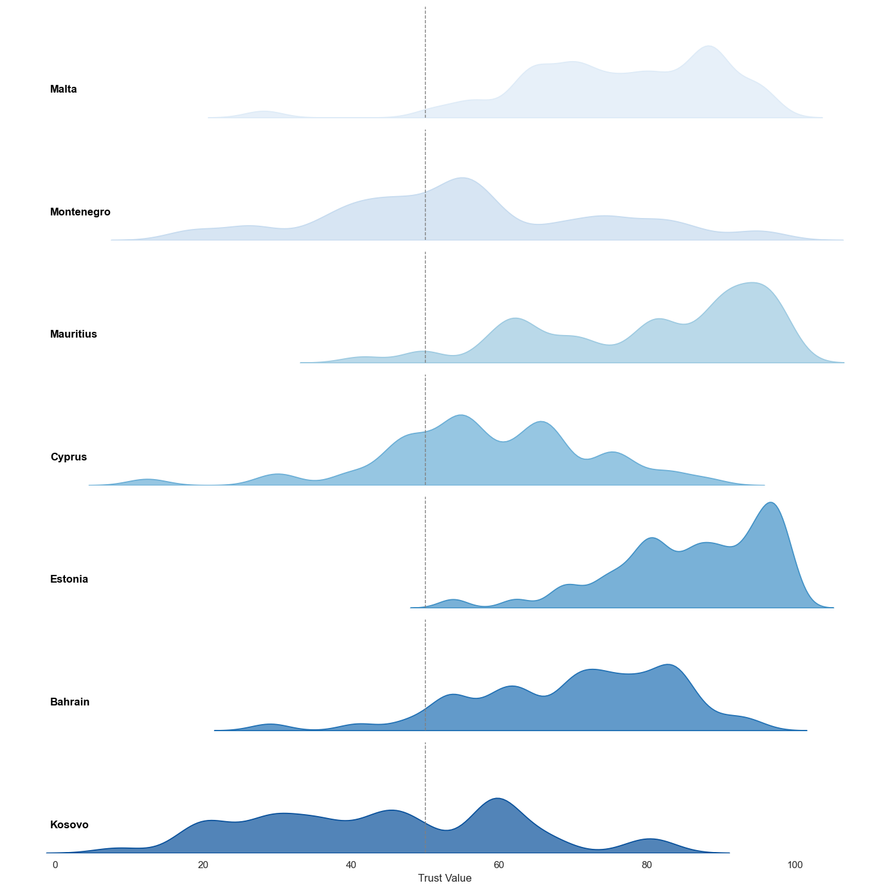
Correlation Matrix Summary
Graph: Heatmap visualizing correlations between trust variables across institutions.
Key Insight: Highlights patterns of significant positive and negative correlations, providing an overview of interconnected trust dynamics.
Additional Insight from Data: Using the cleaned merged dataset, the matrix confirms a strong negative correlation (R = -0.78) between media trust and local community trust, suggesting polarized trust patterns.
Interpretation:
Positive Correlations: High trust in governments often aligns with trust in media, suggesting institutional alignment.
Negative Correlations: Trust in local communities tends to inversely correlate with institutional trust, highlighting alternative reliance.
Outliers: Certain countries defy expected patterns, which could indicate cultural or political nuances that merit further exploration.
Seth Carter

Slide 6
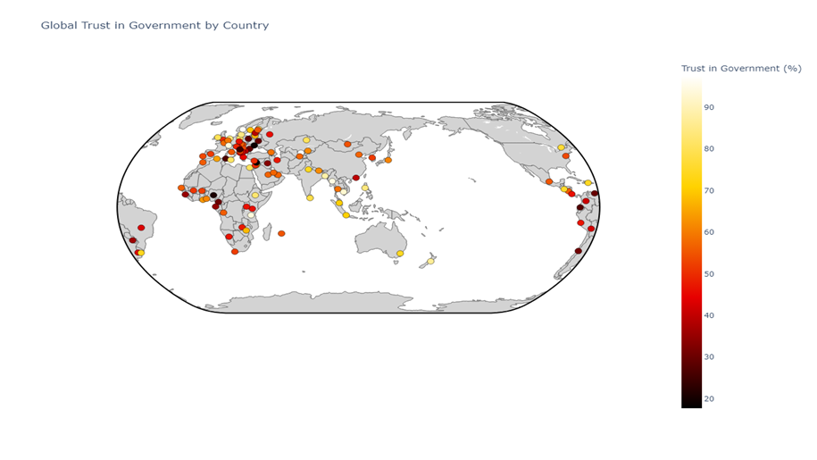
Government Trust vs. Neighbor Trust
Graph: Scatter plot showing an inverse relationship.
Key Insight: Higher government trust correlates with lower trust in neighbors, and vice versa.
R-value: R = -0.65.
Additional Insight from Data: The cleaned trust survey data suggests that this relationship intensifies in densely populated urban areas, highlighting a potential link to perceived individual autonomy.
Ethan Shipman

Slide 7
Takeaways and Next Steps
Conclusion:
Trust is complex and interconnected; distrust in one domain often correlates with increased trust in its perceived alternative.
Policymakers and communicators need to address trust gaps holistically.
Recommendations:
Engage with local communities to bridge gaps in institutional trust.
Build trust in science through culturally sensitive communication strategies.
Data Ethics:
Transparency: Ensure openness about data sources, methodology, and limitations to maintain public trust.
Privacy: Protect individual survey responses and demographic data to safeguard participant anonymity.
Bias Mitigation: Continuously review and address potential biases in data collection, processing, and analysis.
Next Steps:
Further research on causation vs. correlation.
Expand dataset for broader regional representation.
Rafaela Peterson

Slide 8
Questions

