Slide 1
Analysing districts in Paris for new shopping malls
Ethan Su

Slide 2
Introduction
Background
Grandeur Limited is one of Asia largest diversified real estate groups. Headquartered in Singapore, Grandeur owns and manages a global portfolio focusing on real estate, infrastructure and private properties.
Problems
This project aims to analyse the district and their common venues to estimate the best area to invest a shopping mall

Slide 3
Data Acquisition and Cleaning
Data Cleaning
In the first dataset from DATA France, there are many unnecessary variables such as “NSQAR, CAR.1, SURFACE, PERIMETER and etc.” These variables do not contribute to the analysis in the project and hence deemed as irrelevant and be removed from the dataset. Thus, after data cleaning, the data table comprise of “Neighbourhood, Arrondissment_num, French_Name, Latitude and Longitude”.
Second in line is to process the dataset download from Foursquare API which do not have any multiple entries, repeated data, empty cells and null values. In order to get the data from Foursquare, we need to use the identified neighbourhood French name, longitude, and lati from the previous dataset.

Slide 4
Data Analysis Methodology
Geographical Mapping
Function Creation using venues for all the neighbourhoods in Paris
Identification of the number of venues in each neighbourhood
Calculation on the number unique venues categories
Grouping rows by neighbourhood and calculate the frequency of occurrence in each category
Identify the top 10 most common venues
Conversion of data into pandas dataframe

Slide 5
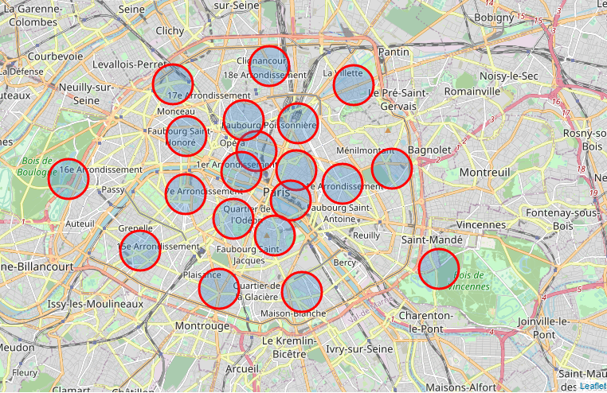
Results – Paris Neighborhood

Slide 6
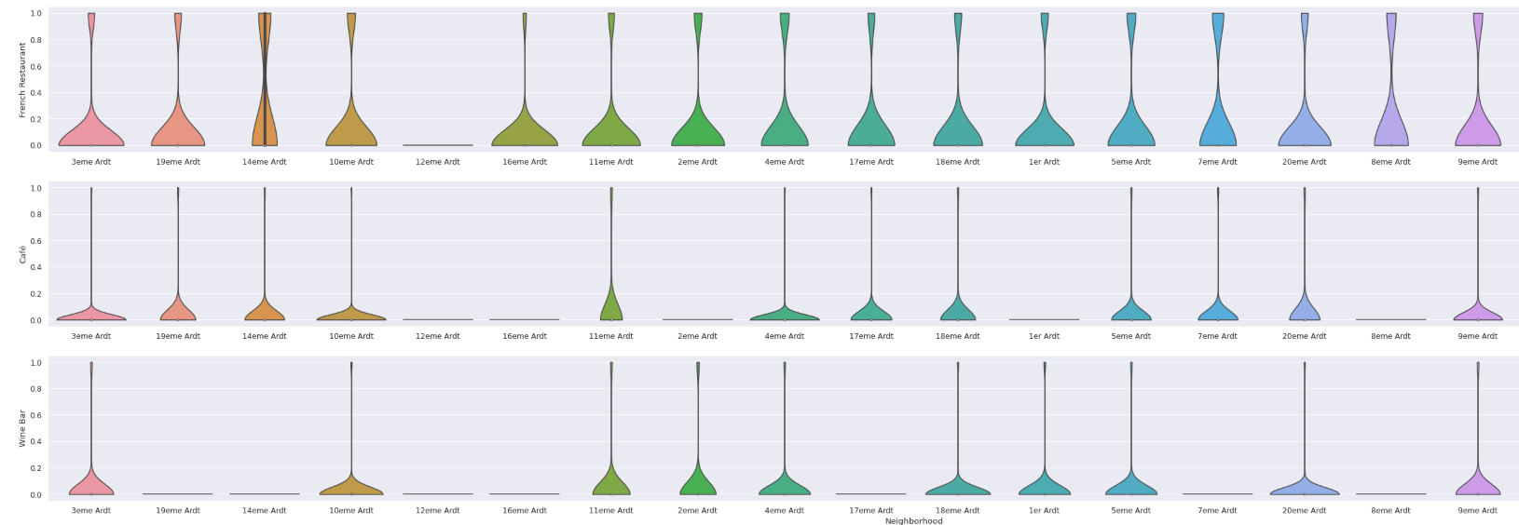
Analysis

Slide 7
Selected neighbourhood
1. 3eme Ardt
2. 10eme Ardt
3. 14eme Ardt
4. 4eme Ardt
5. 18eme Ardt
6. 11eme Ardt
7. 15eme Ardt
8. 9eme Ardt
9. 4eme Ardt

Slide 8
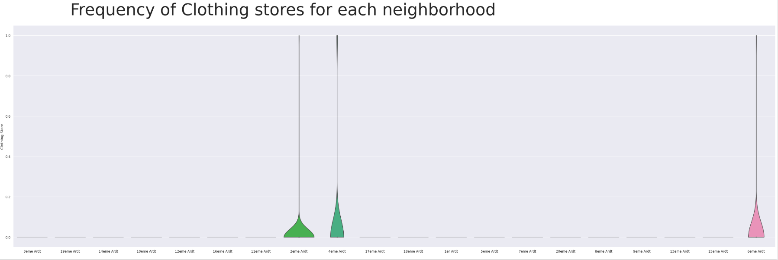
Additional features

Slide 9
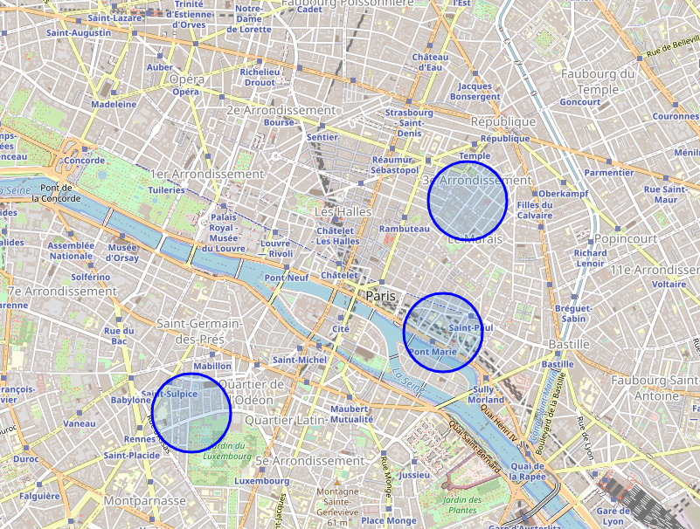
Results and Discussion
Therefore, the final 3 prospective neighbourhood that met all the criteria are:
3eme Ardt: Arrondissement 3, Temple
4eme Ardt: Arrondissement 4, Hotel-de-Ville
9eme Ardt: Arrondissement 9, Mairie du

