Slide 1

Augmented Reality Product Assembly Assistance
Ethan Timpe
CEG 7370 Distributed Computing

Slide 2
Overview
Proposal Refresher
System Architecture
Software Components
AssemblAR Server (PlayCanvas)
AssemblAR Server (Django)
PostgreSQL
PostgreSQL (ERD)
MinIO
Workflow
Questions

Slide 3
Proposal Refresher
Problem: Product assembly instructions are often hard to comprehend on a 2D page, leading to increased assembly time and time-wasting mistakes.
Solution:
Provide step-by-step assembly instructions in an AR environment.
No need for expensive VR headsets.
Vendors can collect assembly data to identify difficulties.
Use distributed cloud services to host scalable and reliable service.
Business Model:
Licensed to vendors to improve customer satisfaction

Slide 4
System Architecture
AssemblAR Server
PostgreSQL
AssemblAR Server
MinIO
AssemblAR Server
MinIO
AssemblAR Client
psycopg2
HTTP
MinIO API
MinIO
MinIO
MinIO

Slide 5
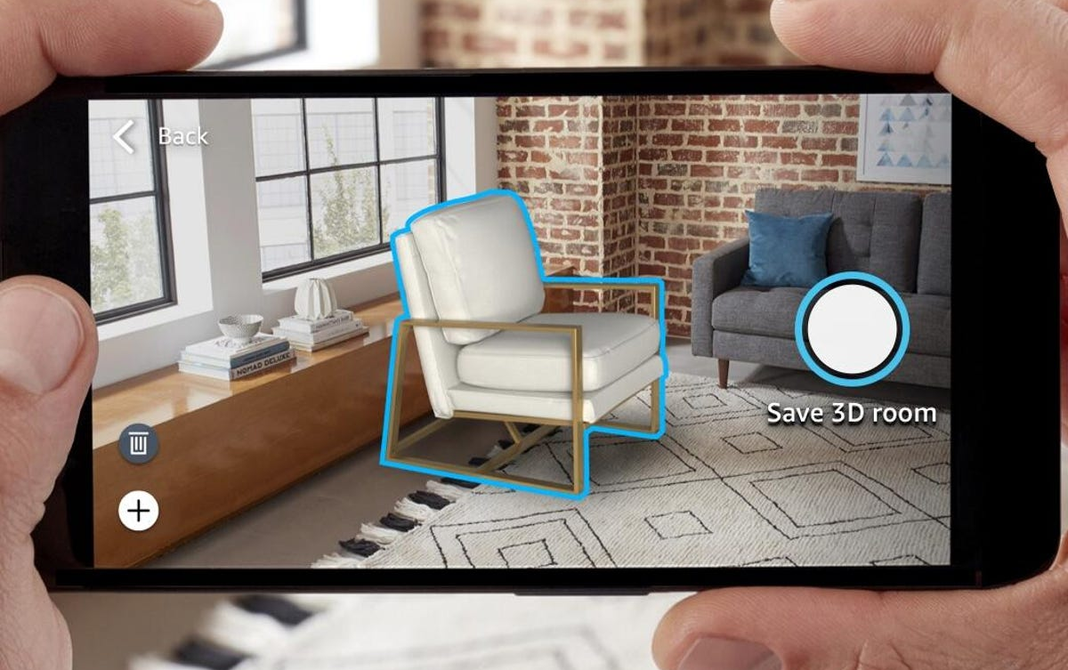


AssemblAR Server (PlayCanvas)
Web app where users view assembly instructions in their augmented reality environment
The frontend for the user
Built using PlayCanvas
Open-source 3D game engine
WebGL support
Augmented Reality support
Written in JavaScript

Slide 6



AssemblAR Server (Django)
Serves as the main backend component
Built with Django
Python web framework
Interacts with databases through Python instead of raw SQL
Built-in authentication
Designed for scalability
Django REST Framework
Extends Django functionality to expose database models as REST API

Slide 7

PostgreSQL
Open-source relational database
Stores all relational data
Built-in replication and scalability features

Slide 8
PostgreSQL Entity Relationship Diagram
organization
id
name
instruction_set
id
organization
name
instruction_step
id
instruction_step
sequence
text
part
initial_position
end_position
initial_rotation
end_rotation
scale
instruction_step_metric
id
user
instruction_step
duration
part
id
name
file_bucket
file_path
user_metric
id
age

Slide 9


MinIO
High performance AWS S3-compatible file storage
3D models stored in “buckets”
Provides a Python SDK to interact with files
Highly scalable and replicable

Slide 10
Workflow
Client
AssemblAR Server
(PlayCanvas)
AssemblAR Server
(Django)
PostgreSQL
MinIO
User visits URL
Requests static files
Responds with static files
User selects/scans instruction set
Requests instruction
Requests instruction step
Requests instruction step
Responds with instruction step
Repeat until instruction set
is complete
Requests part model
Responds with part model
Responds with part model and instruction step
Displays instruction
User completes instruction step
POST instruction metric
POST instruction set metric

Slide 11
Questions?

