Slide 1

Augmented Reality Product Assembly Assistance
Ethan Timpe
CEG 7370 Distributed Computing

Slide 2
Motivation
Problem: Product assembly instructions are often hard to comprehend on a 2D page, leading to increased assembly time and time-wasting mistakes.
Enhance user understanding of assembly instructions.
Reduce user errors.
Improve assembly efficiency.
Collect data on total time to build, time per step, complexity, etc.

Slide 3
Solution
Provide step-by-step assembly instructions in an AR environment.
Users can better visualize each step in 3D.
Stickers may be placed on each part which users scan to ensure it is the correct part.
Use of distributed cloud services to host service backend.

Slide 4
Conceptualization and Justification
Cloud-based approach permits
High availability
Elasticity
Users do not have to store large 3D models on their devices long-term.
Users are not required to have expensive VR headsets.
Instead, users can use the camera on their phone or tablet to view the instructions in their own space.

Slide 5
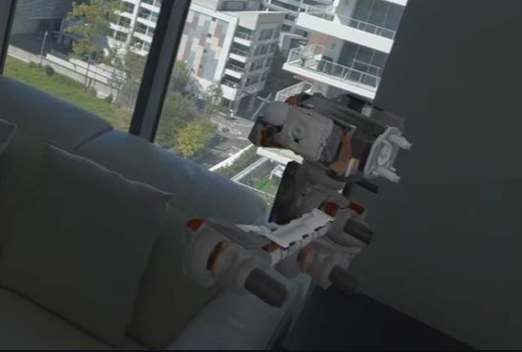
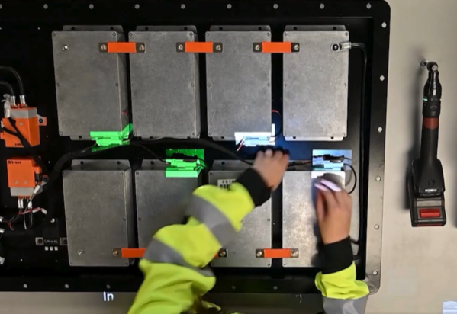
Current Market Offerings
InstructXR
Most similar to AssemblAR
Only available for Apple Vision Pro
Easemble
Offers instruction visualization in 3D
Does not support augmented reality
LightGuide
Makes use of a projection onto a workspace
Does not support 3D and requires projectors

Slide 6
Target Market and Value Propositions
Application will be marketed to vendors of furniture, electronics, anything that needs assembled.
Assembly is often the worst part of purchasing items such as furniture.
Better instructions will improve the customer experience and keep them coming back.
The promise of simpler instructions may sway customers to choose one vendor over another.
Vendors may collect various data on user assembly.
Average time to build
Average time per step
Estimated complexity

Slide 7
Business Model
Service will be licensed to vendors.
Vendors may be charged a flat yearly fee if self-hosted.
Vendors may be charged per use if hosted by AssemblAR.
May offer a free or reduced price for vendors to offer the service and gauge user response.

Slide 8




Developer Expertise
Microservice development
Docker
Kubernetes
PostgreSQL
REST APIs
XR

Slide 9
(Non)collaborative Tools
GitHub
Microsoft Office (Word, PowerPoint)

Slide 10
Questions?

