Slide 1
CS 246 Team 7: TaskMaster

Slide 2
Introduction
Who are we?
  Charles Rich
  Max Creamer
  Ethan Tindall
  Tyler Williams

Slide 3
TaskMaster
What is TaskMaster?
  There’s always a better mousetrap
Goals
  Track recurring daily tasks
  Implement an audio reward system
  Send notifications to phone
  Saves data locally on phone

Slide 4
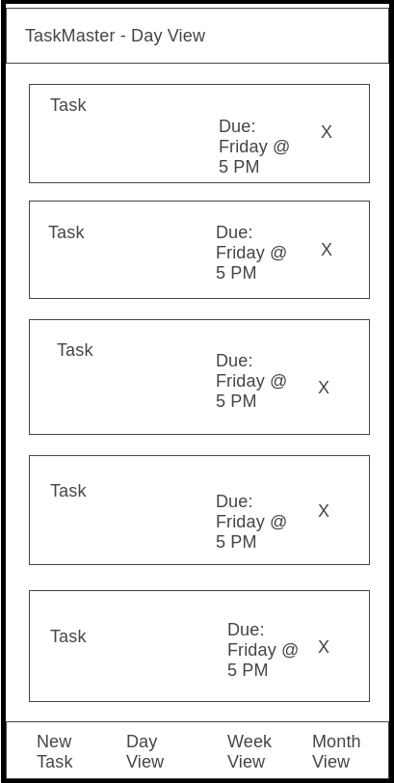
Wireframes
Main/Day View
  Default view upon opening.
  Keep track of tasks due today.

Slide 5
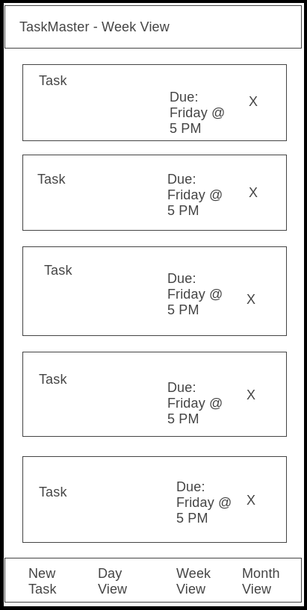
Wireframes
Week View
  Keep track of tasks due this week.

Slide 6
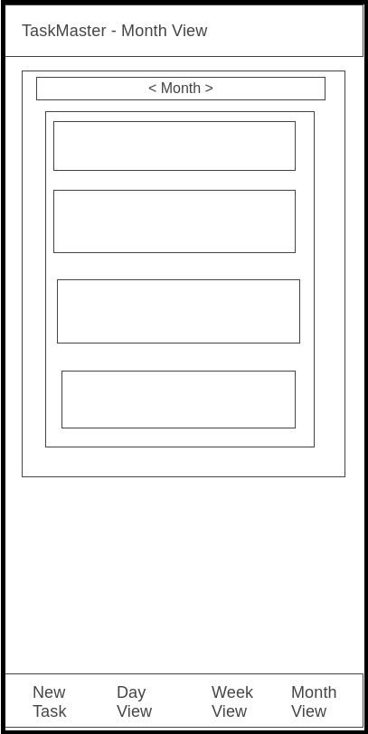
Wireframes
Month View
  Keep track of tasks due this month.

Slide 7
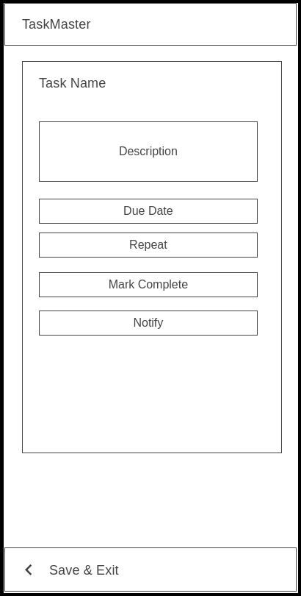
Wireframes
New Task View
  Create new tasks.
  Set due date/reminders, etc.

Slide 8
Architecture Overview
View
  Main View (Day View)
  Week View
  Month View
Presenter
  Presenter Class
Model
  TaskObject Class
  TaskList Class

Slide 9
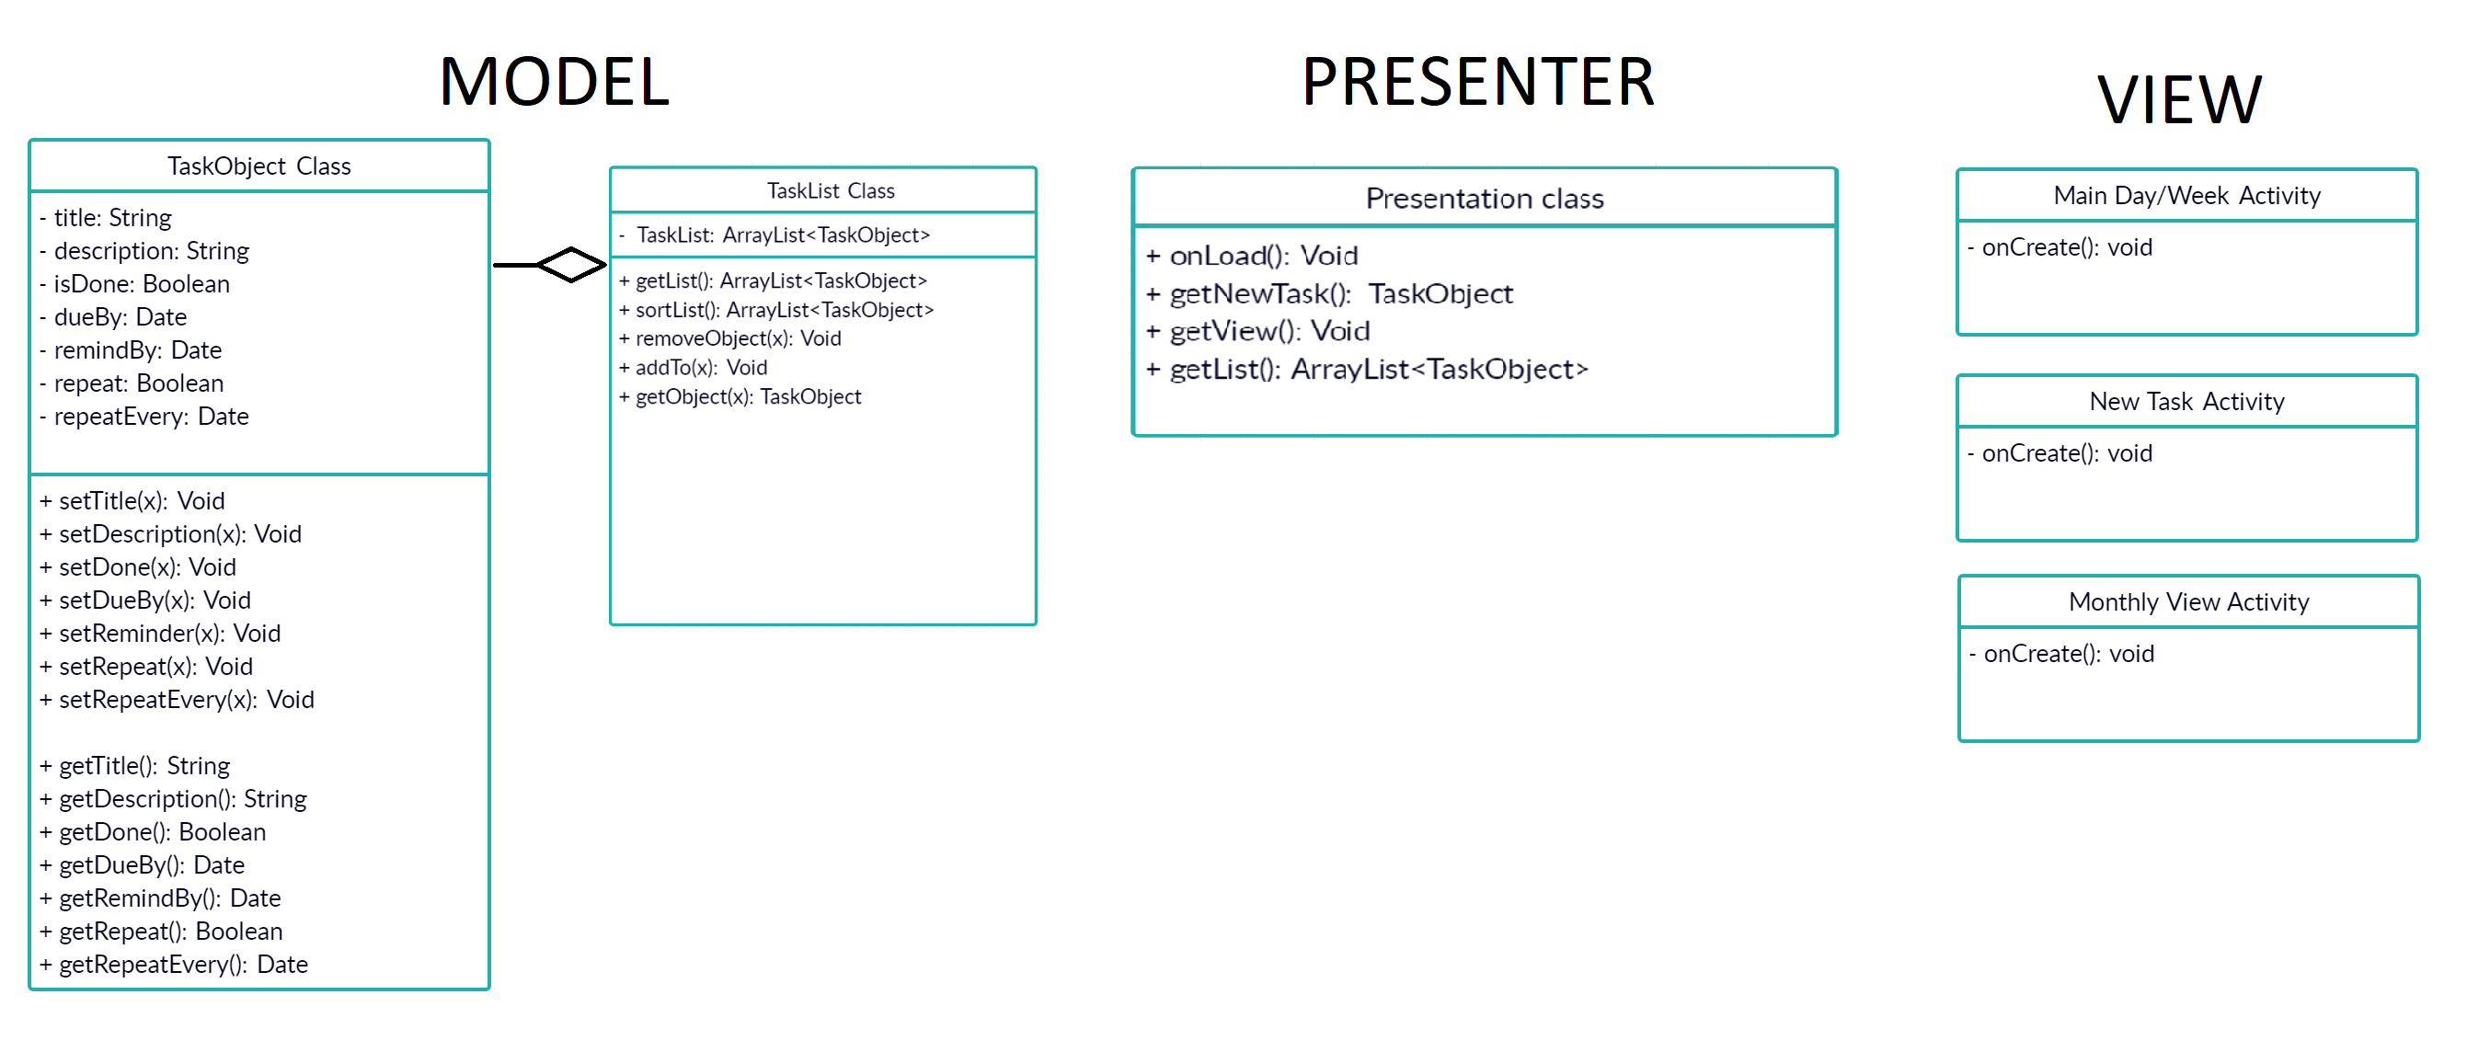
UML Diagram

Slide 10
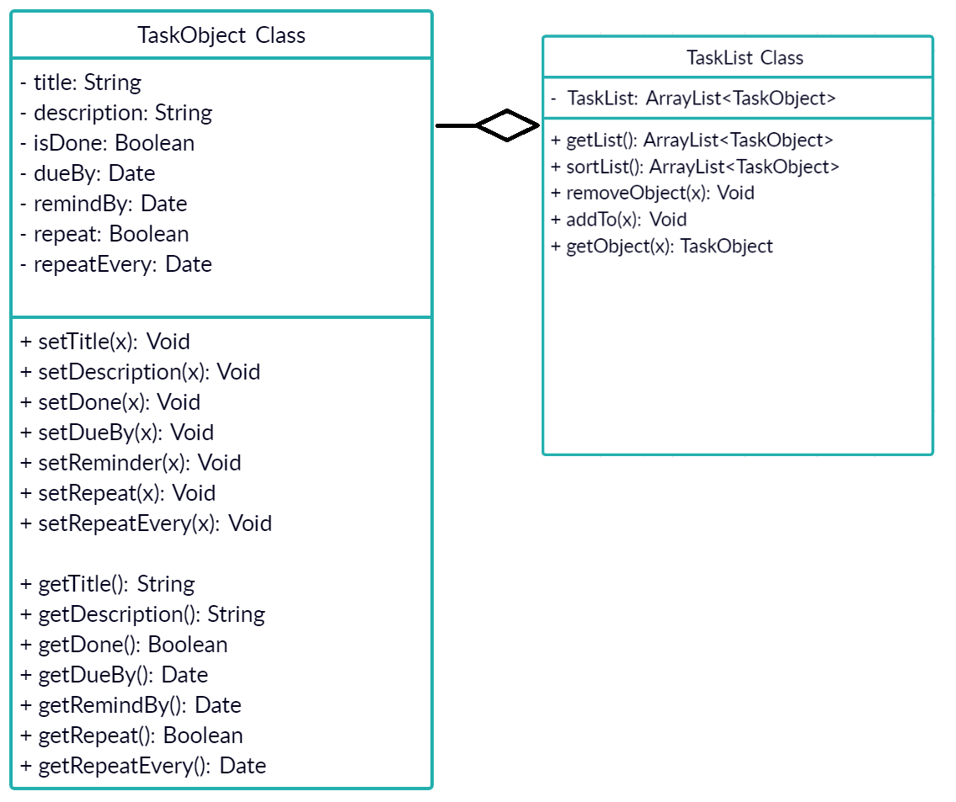
Model

Slide 11
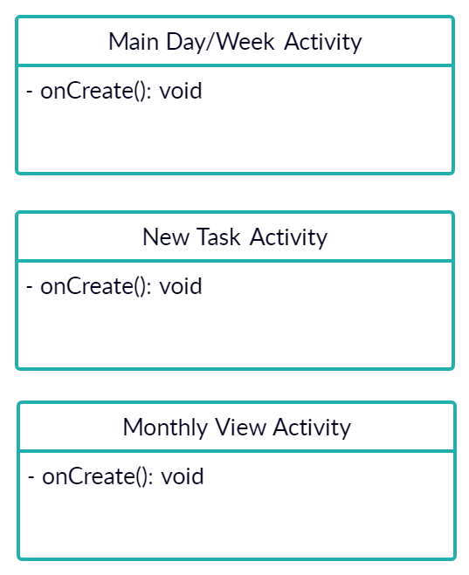
View

Slide 12
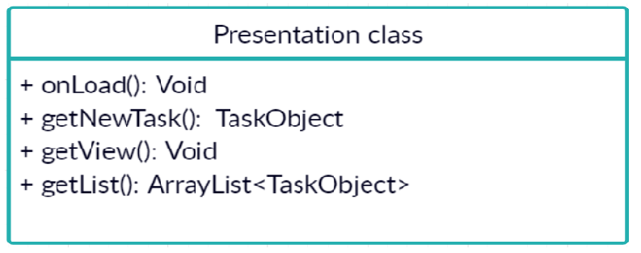
Presenter

Slide 13
In Conclusion
Best app ever.

