Slide 1
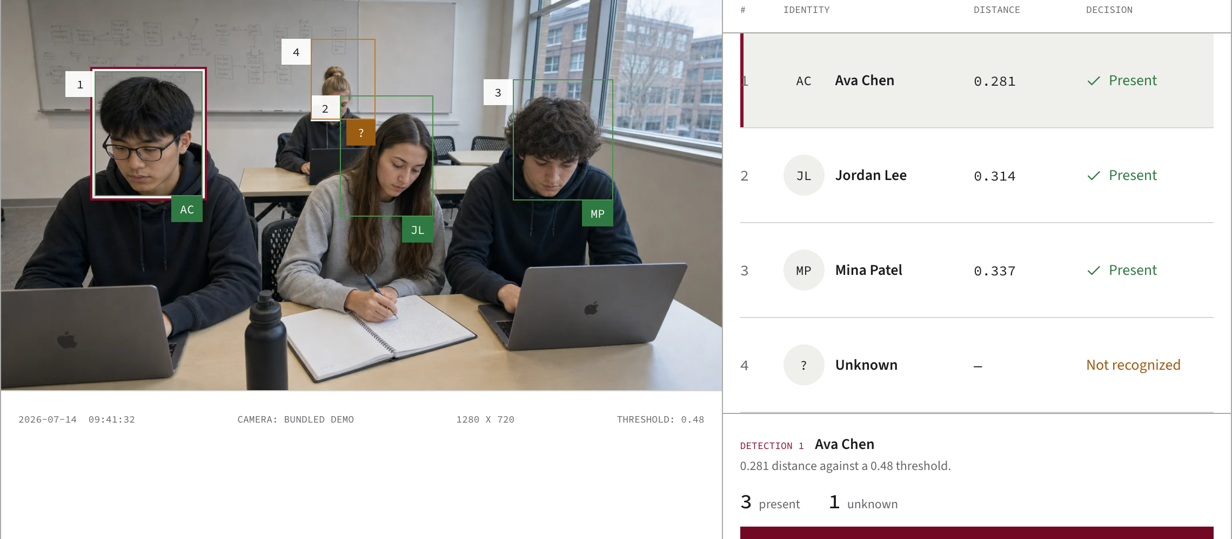
FaceTrack keeps each attendance decision tied to its detection and distance
The public fixture shows every outcome; local code keeps the ledger and frame lifecycle explicit.
COMPLETE DECISION TRACE
DISTANCE THRESHOLD
Face distance
lower is closer · not a probability
τ = 0.48
1 Ava
0.281
2 Jordan
0.314
3 Mina
0.337
0.00
0.48
>0.48
?
Detection 4 stays unknown
Outcome retained; fixture does not store its distance.
LOCAL RETENTION
Bundled deterministic demo · fictional classroom image · all four detections shown
Ledger
UNIQUE(name, attendance_date)
Frames
finally → delete staged files
DEMO EVIDENCE
LIVE IMPLEMENTATION
NOT CLAIMED
Fictional image and deterministic values. The demo writes no attendance records.
Local, consented images; one processing lock; daily SQLite deduplication; cleanup by default.
No recognition-accuracy study, biometric dataset, surveillance deployment, or outcome evidence.
Sources: frontend/src/data/demo.js · src/recognition.py · backend/database/attendance_db.py · backend/fastapi_app.py

