Slide 1
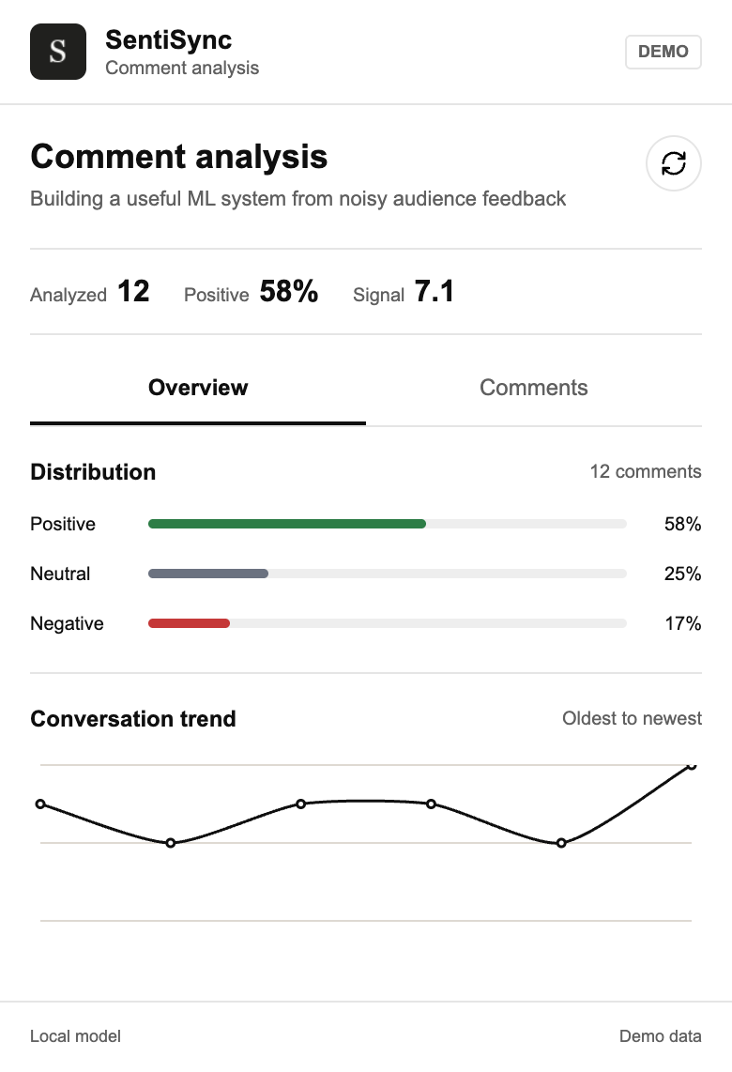
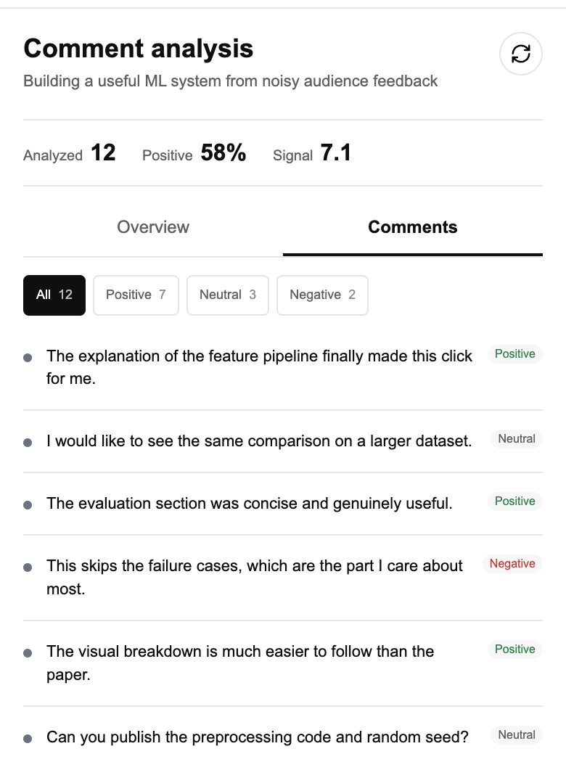
SentiSync exposes the comments behind every aggregate signal
The live path stays compact; the offline path records where the model came from.
LIVE INFERENCE
EXTENSION OVERVIEW
COMMENT-LEVEL EVIDENCE
YouTube
Flask API
Local classifier
validated video ID
≤500 comments
TF-IDF + LightGBM
loaded at runtime
open a label
OFFLINE MODEL PIPELINE
Reddit labels
DVC stages
Train / eval
Artifacts
source data
clean + split
tracked runs
model + vectorizer
Bundled demo output
Raw text and model label stay visible
EVIDENCE BOUNDARY
Screenshots show bundled demo fixtures. The classifier is trained and evaluated on Reddit labels, then applied to YouTube comments; cross-domain performance has not been measured.
Maintained paths: Flask API · DVC pipeline · TF-IDF vectorizer · LightGBM model · Manifest V3 extension

