Slide 1
Trajectory Optimization for an Inertial-Actuated Cube
Ethan Weber
MIT

Slide 2
Inspiration
M-Blocks
Cubli

Slide 3
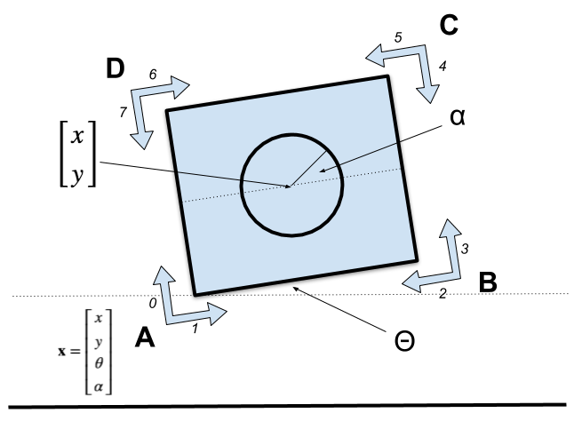
Formulation
Floating-base coordinates
Complementarity constraint

Slide 4
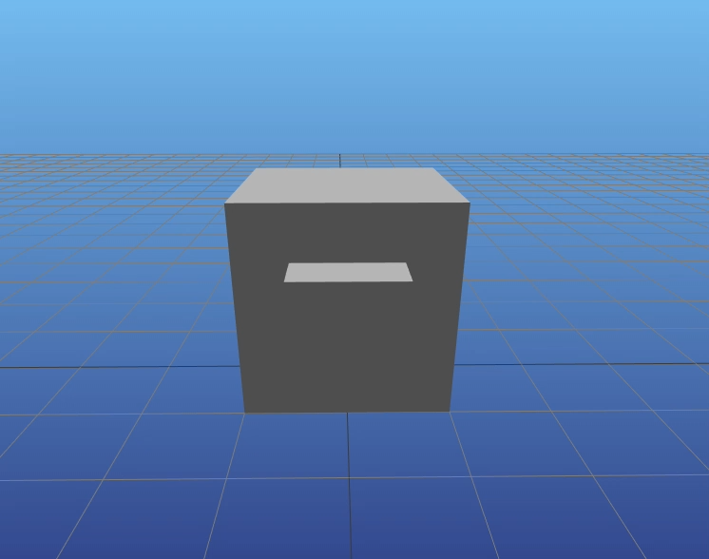
Swing Up

Slide 5
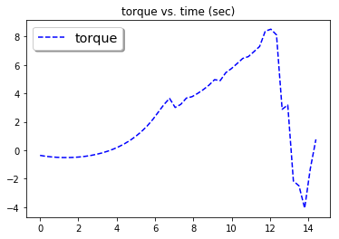
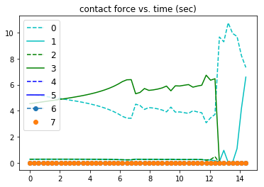
Swing Up

Slide 6
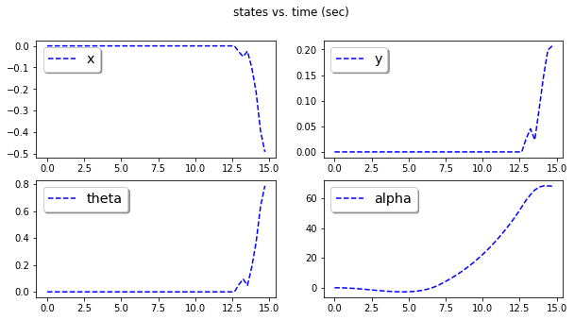
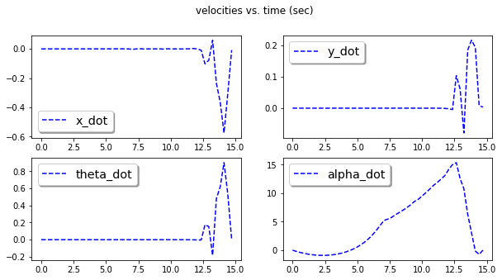
Swing Up

Slide 7
QP Controller at Upright

Slide 8
Limit Cycle

Slide 9
M-Blocks Example

