Slide 1
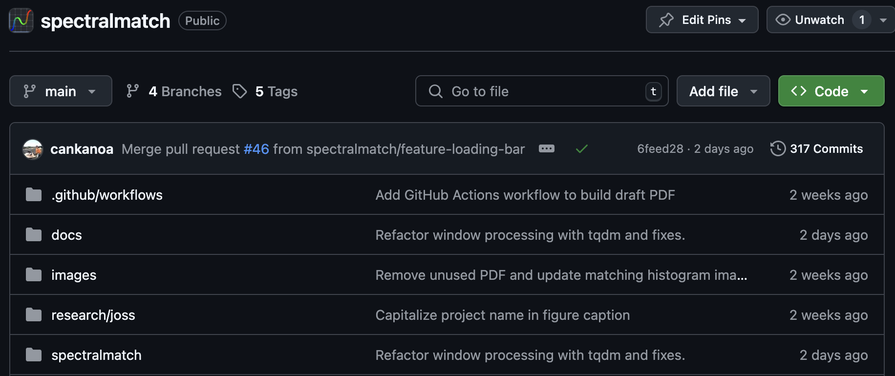
Spectralmatch: relative radiometric normalization toolkit for raster mosaics and time series
Kanoa Lindiwe
Contributors:
Joseph Percival
Ryan Perroy
Notes:
Start timer
Name
Geogrrapher UH Hilo SDAV
TCBES

Slide 2
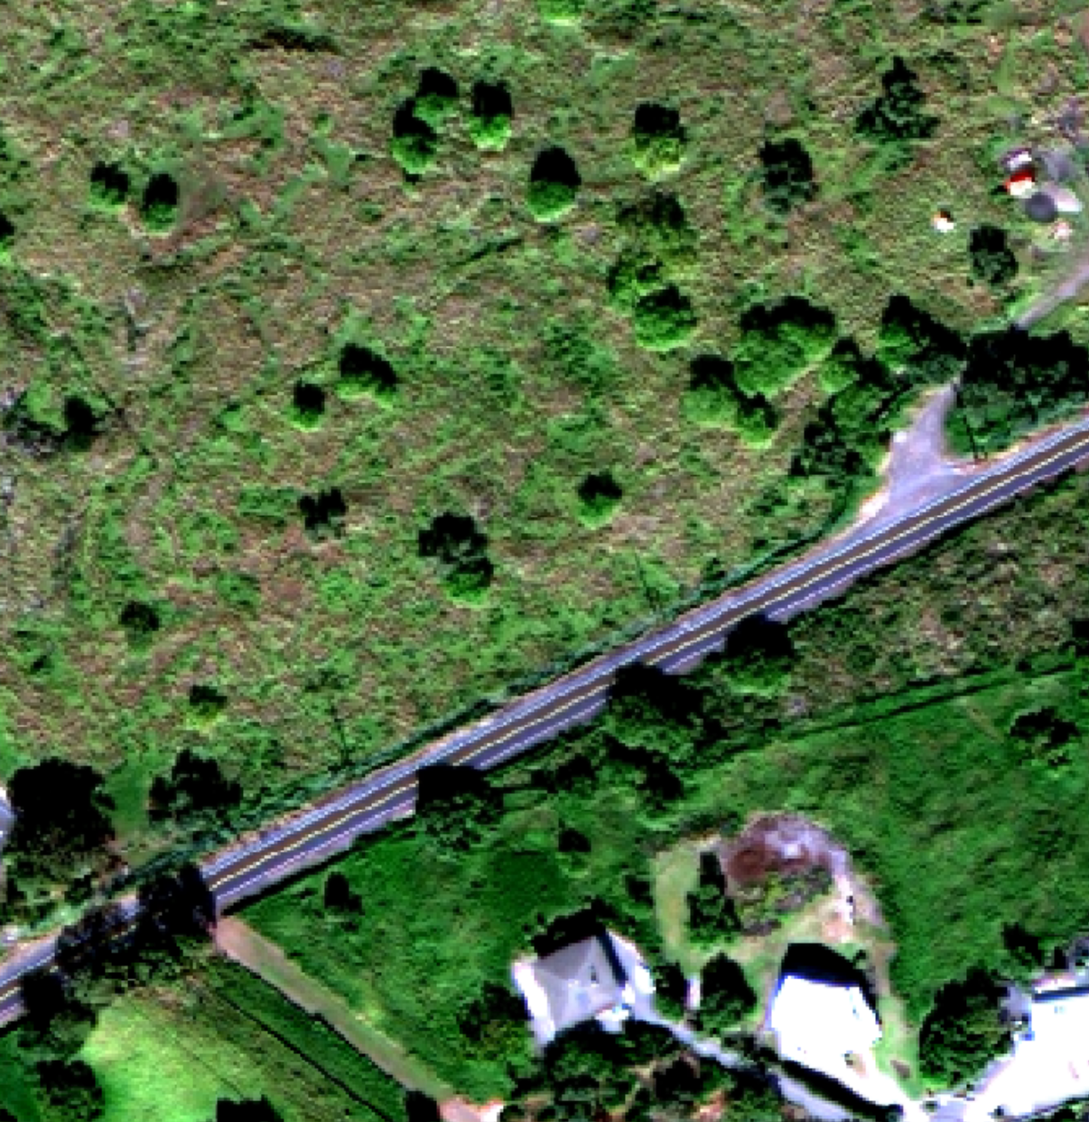
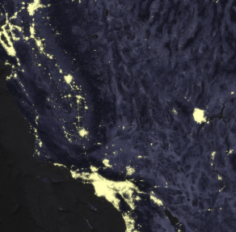
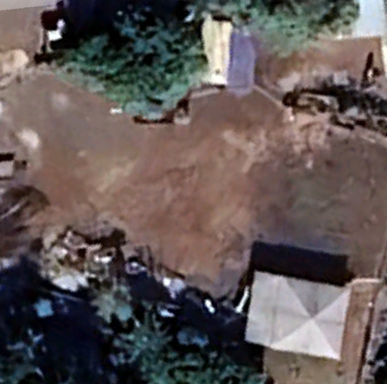
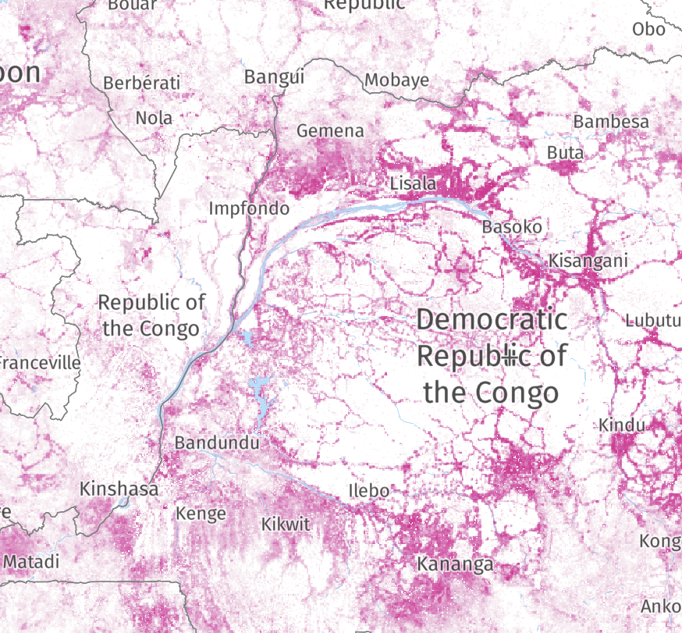
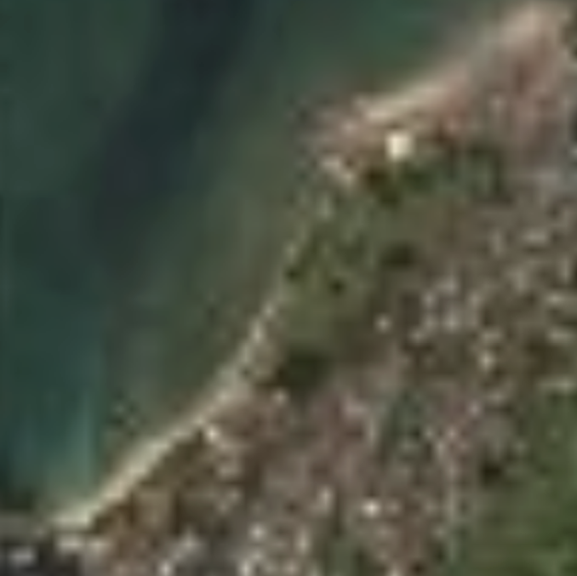
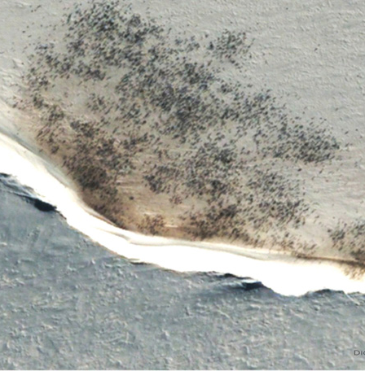
Detecting Things
Tree Species
Population Density
Object Height
Global Forest Watch
Coastal Processes
???
Notes:
\

Slide 4


Slide 5
Detecting Things
Tree Species
Population Density
Object Height
Global Forest Watch
Coastal Processes
???
Notes:
Tool for land managers/
Scaling is a challenge, spatially and temporally

Slide 6
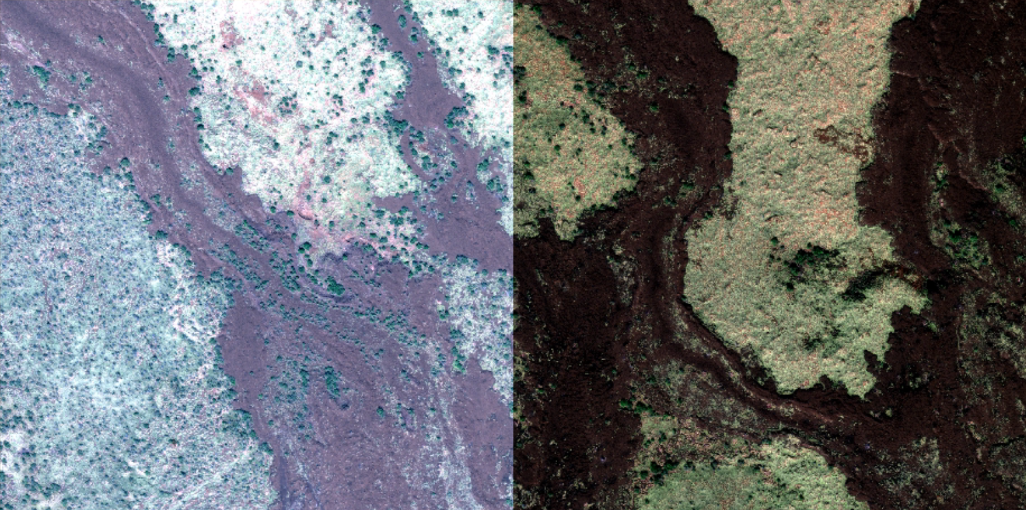
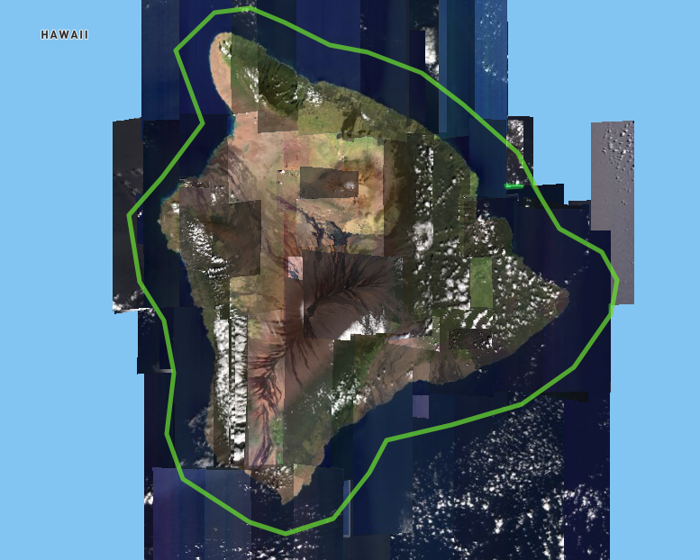
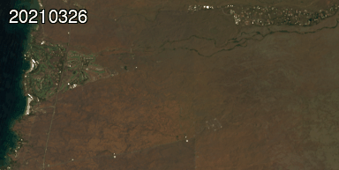
Varying acquisition conditions leads to image differences
Notes:
Multi image analysis - inter image variability
See difference in all three of these images
Problem for reliable feature detection
Atmospheric Conditions: clouds, cloud shadows, haze, smog, vog, dust, smoke, water vapor
Ground surface conditions: soil moisture, surface temperature, snow and ice cover
Perspective distortion (BRDF): solar angle, satellite viewing angle
Ozone concentration
Solar irradiance fluctuations
Sensor aging
Focusing on the top left

Slide 7
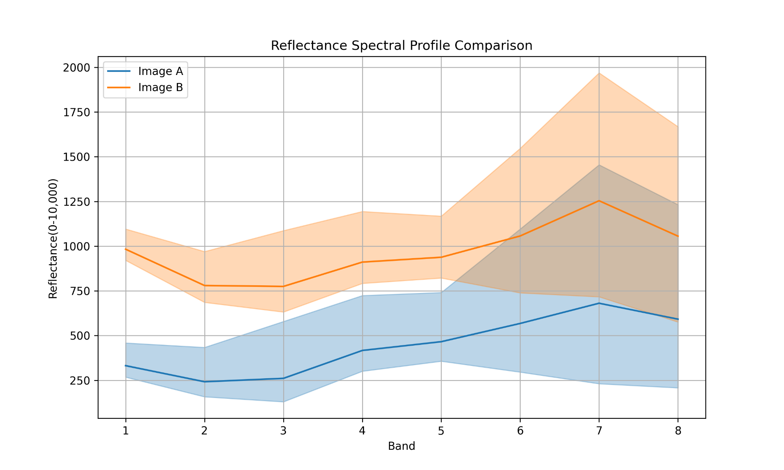
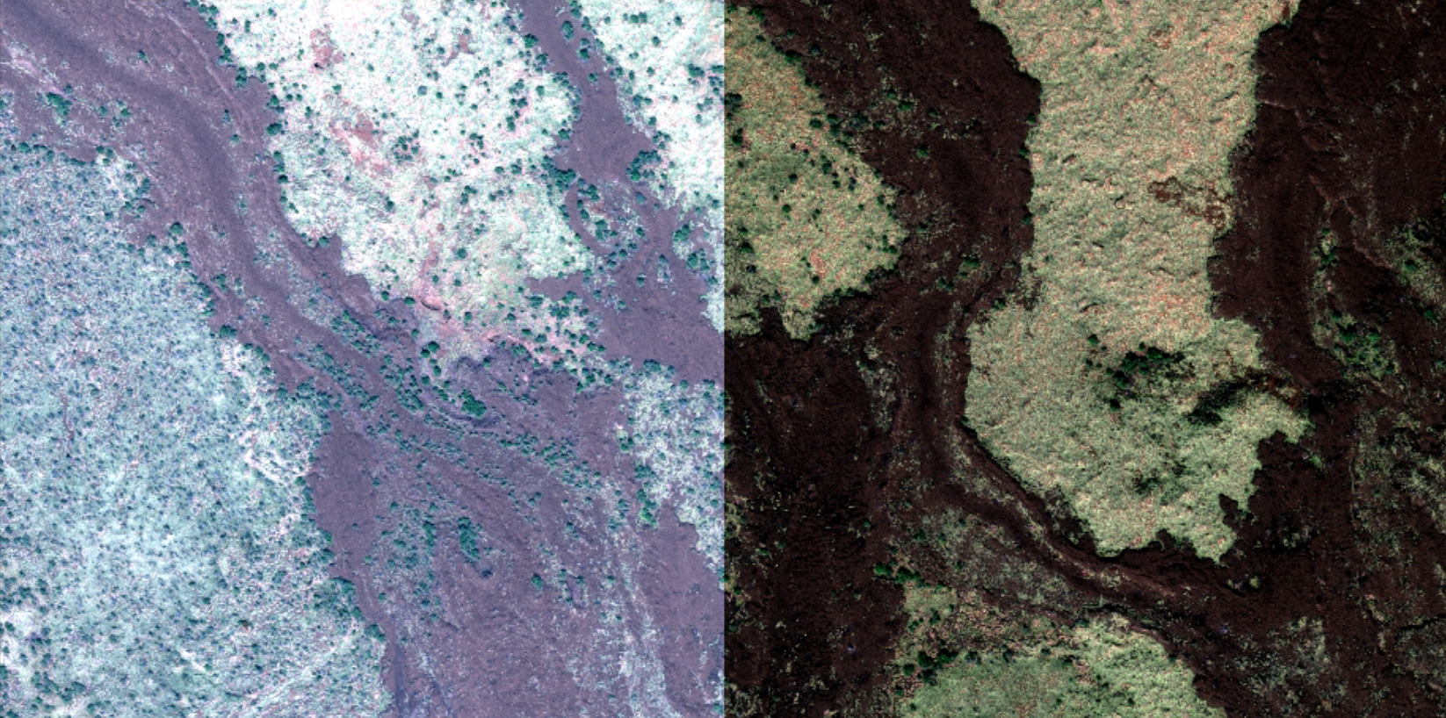
Notes:
Spread

Slide 8
Solutions
Notes:
Two categories

Slide 9
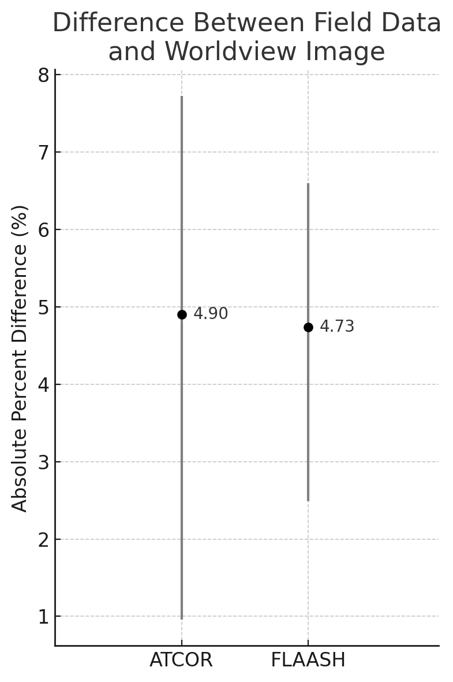
Atmospheric Correction
Complex model
Based on in-situ ancillary data
Converts digital numbers to reflectance
Data from Davaadorj (2019)
Notes:
Physical model: FLAASH, 6S, MODTRAN, ATCOR, Sen2Cor
Based on in-situ measurements: solar geometry, atmospheric conditions, and the other mentioned errors (Correct for)
Hard or impossible to acquire
FIGURE
Average of three plots
Two methods
5% error

Slide 10
Relative Radiometric Normalization
Matches images for consistency
Based on overlapping area
Pseudo Invariant Features (PIFs)
No external data
Reduces visible seams and color shifts

Slide 11
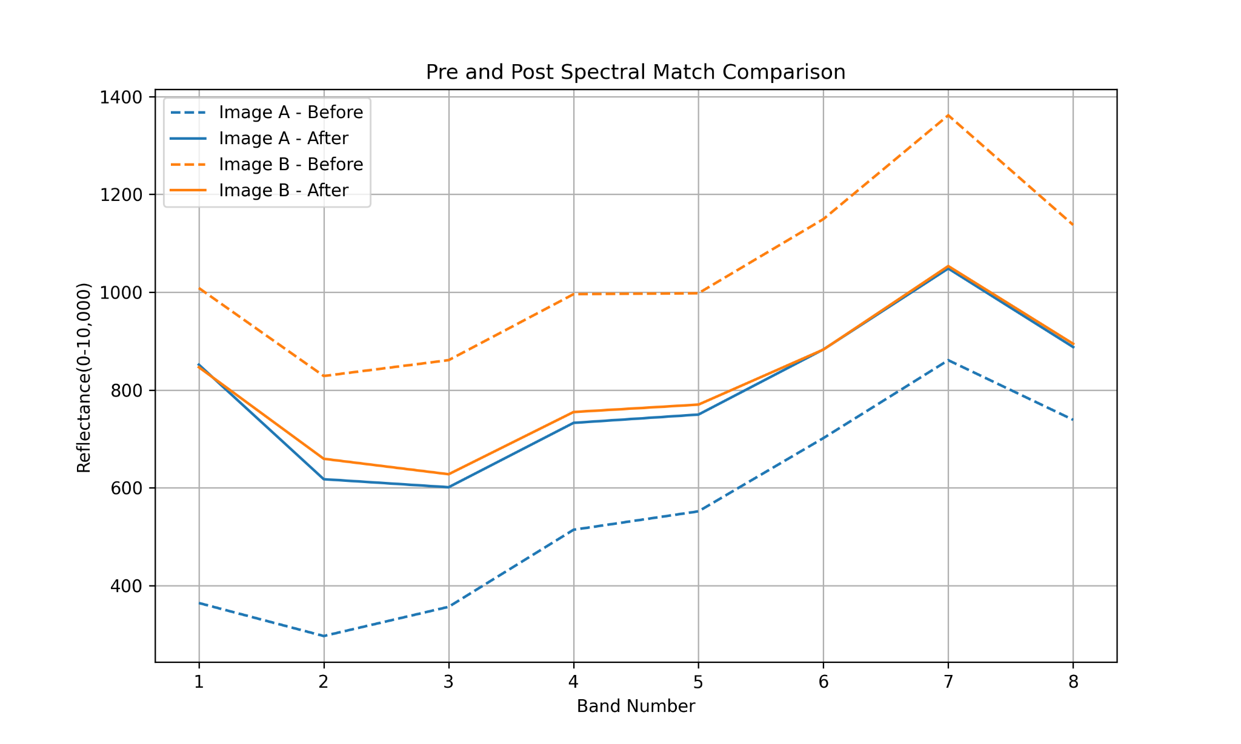

Slide 12
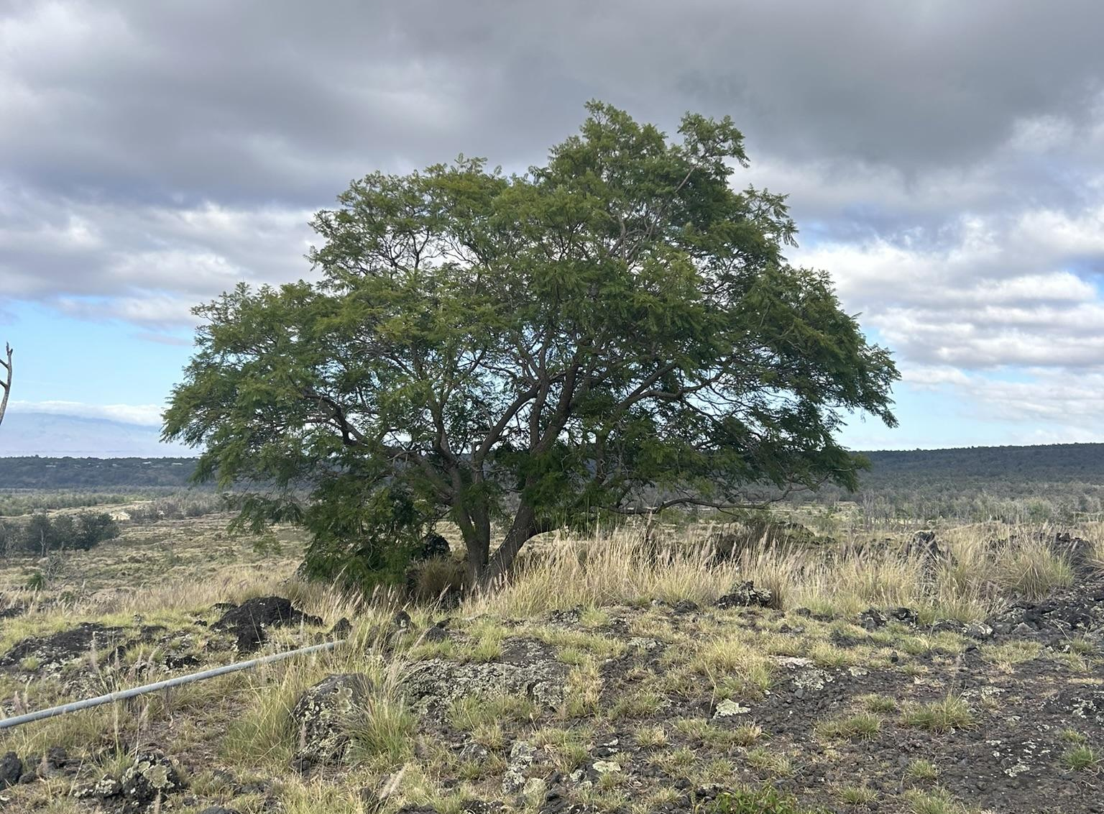
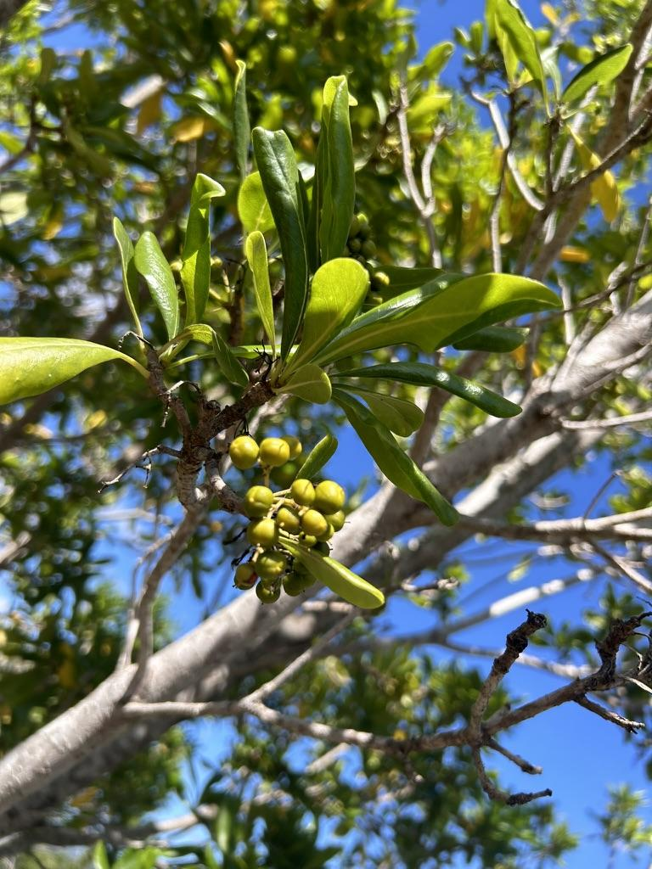
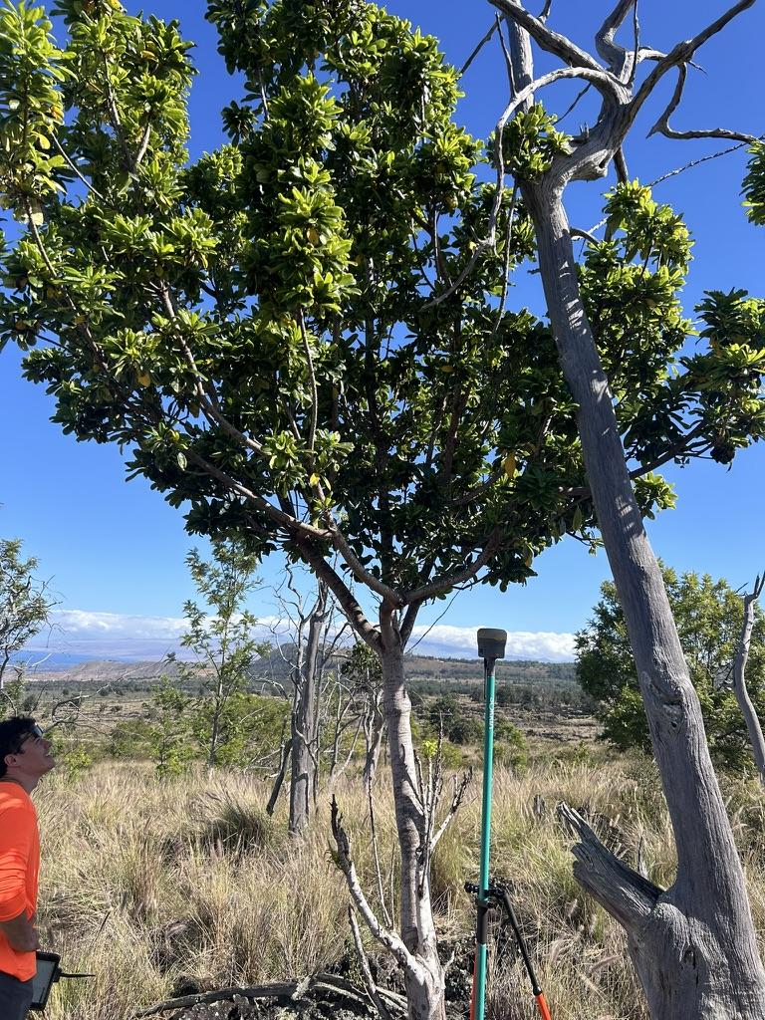
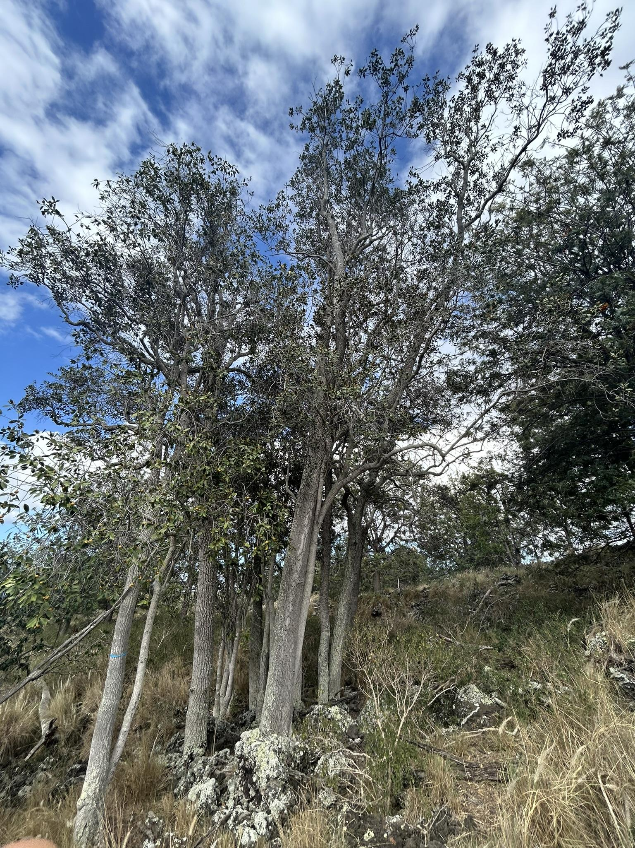
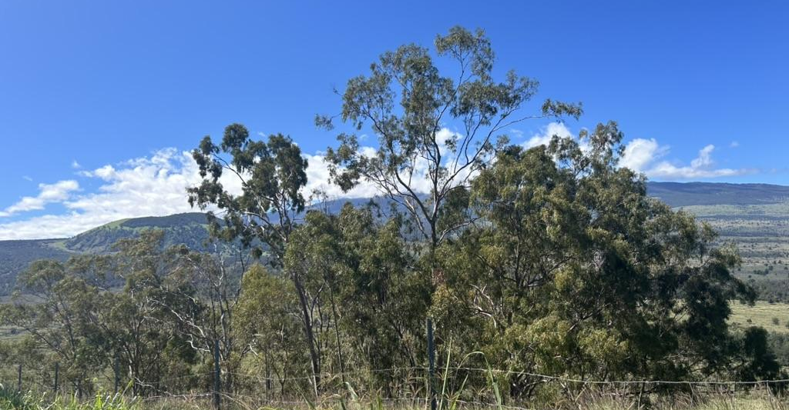
Signal from the Trees
Species-specific spectral signatures
Seasonal variations
Phenological changes
Stress responses
Forest age and biomass accumulation
Pigment composition

Slide 13
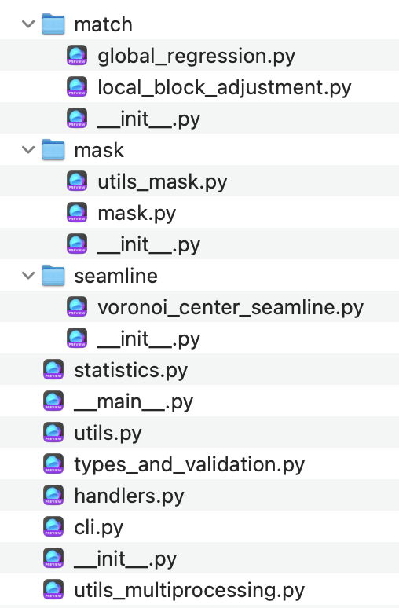
Spectralmatch
Automated, Efficient, and Scalable
Resumable Processing
Integrated Seamline and Cloud Masking
Specify Model Images
Consistent Multi-image Analysis
Sensor and Unit Agnostic
Open Source and Collaborative
Notes:
WHATS THE SOLUTION? spectralmatch
Automated, Efficient, and Scalable: Designed for large-scale workflows with no manual steps, leveraging multiprocessing and Cloud Optimized GeoTIFF support for fast, efficient processing across images, windows, and bands.
Resumable Processing: Save image stats and block maps for quicker reprocessing.
Integrated Seamline and Cloud Masking: Generate seamlines and detect clouds within the same workflow.
Specify Model Images: Includes all or specified images in the matching solution to bring all images to a central tendency or selected images spectral profile.
Consistent Multi-image Analysis: Performs minimal necessary adjustments to achieve inter-image consistency while preserving the original spectral characteristics.
Sensor and Unit Agnostic: Supports images from drones, crewed aircraft, to satellites for reliable single sensor and multi-sensor analysis, while preserving spectral integrity across all pixel units—including negative values and reflectance.
Open Source and Collaborative: Free under the MIT License with a modular design that supports community contributions and easy development of new features and workflows.
The main RRN algorithms were inspired by Yu et al., 2017

Slide 14

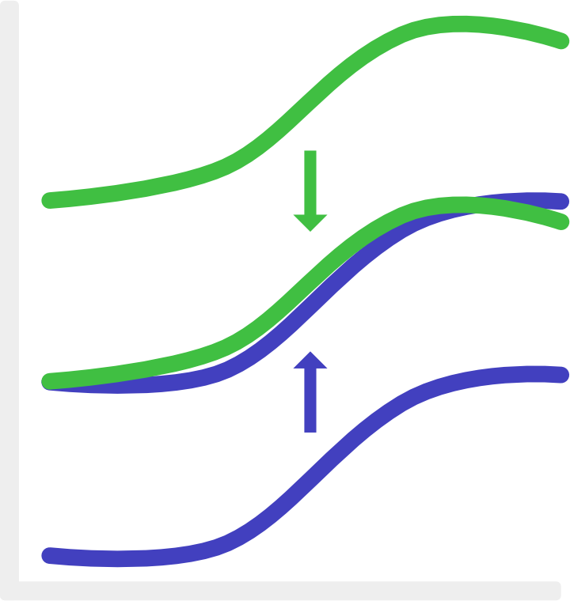
Step 1: Global Regression
A
B
Calculates mean and std for overlaps
Builds a global linear regression model from overlaps
Result: aligns images to a shared radiometric baseline that minimizes spectral differences
A
Derived from: An auto-adapting global-to-local color balancing method for optical imagery mosaic (Yu et al., 2017)
B
Notes:
Prior to step 1, spectralmatch provides preprocessing algorithms for cloud and NDVI masking.
THANK Yu et al 2017

Slide 15
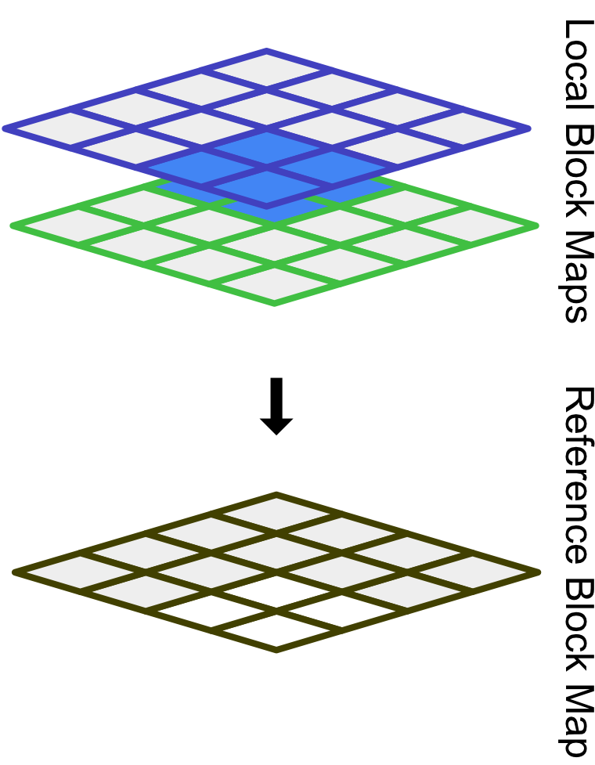
Step 2: Local Block Adjustment
Divides mosaic extent into blocks
Computes per block mean
Applies dynamic gamma correction to adjust brightness and contrast
Result: reduces visible seams
Derived from: An auto-adapting global-to-local color balancing method for optical imagery mosaic (Yu et al., 2017)
A
B
Notes:
Gamma correction

Slide 16
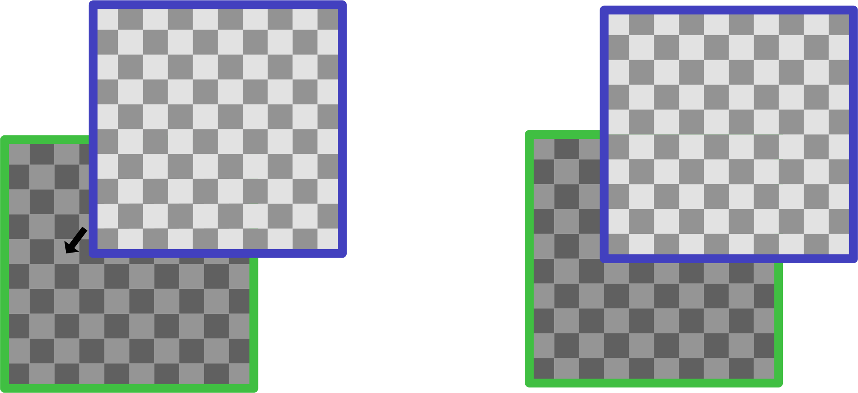
Step 3: Align Rasters
Notes:
TAP

Slide 17
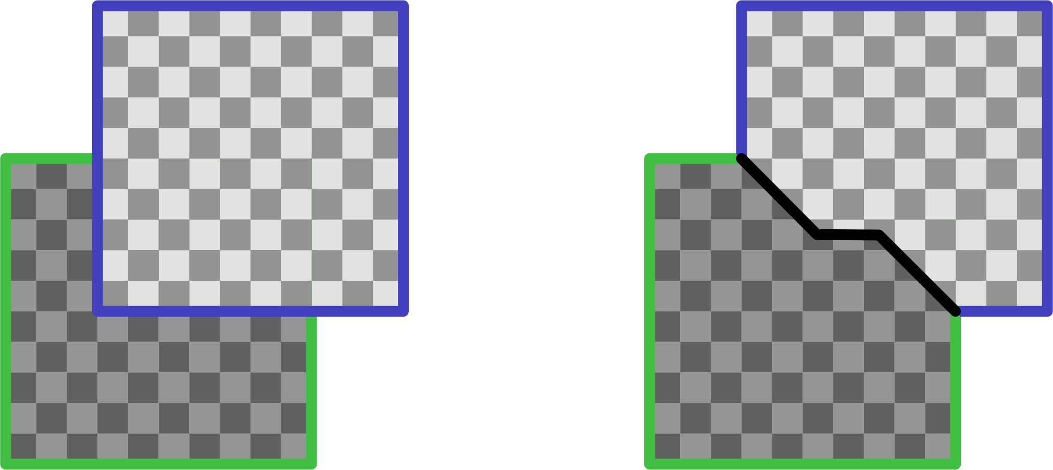
Step 4: Voronoi Center Seamlines

Slide 18
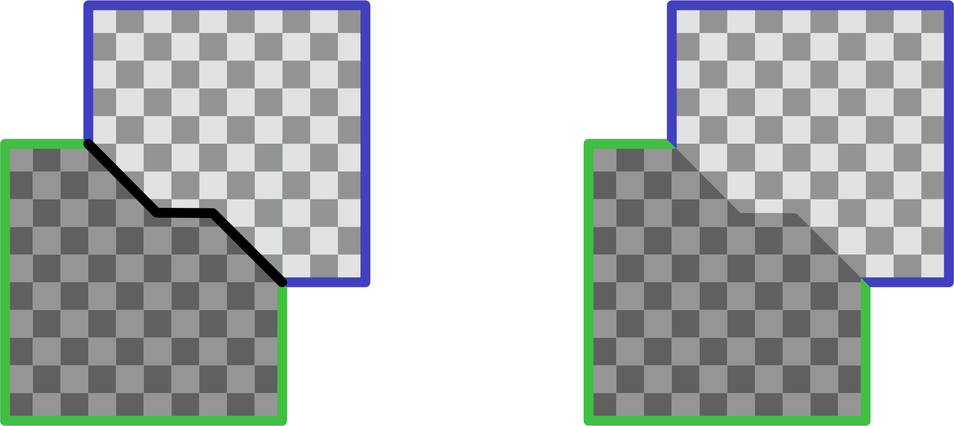
Step 5: Mask and Merge Rasters

Slide 19
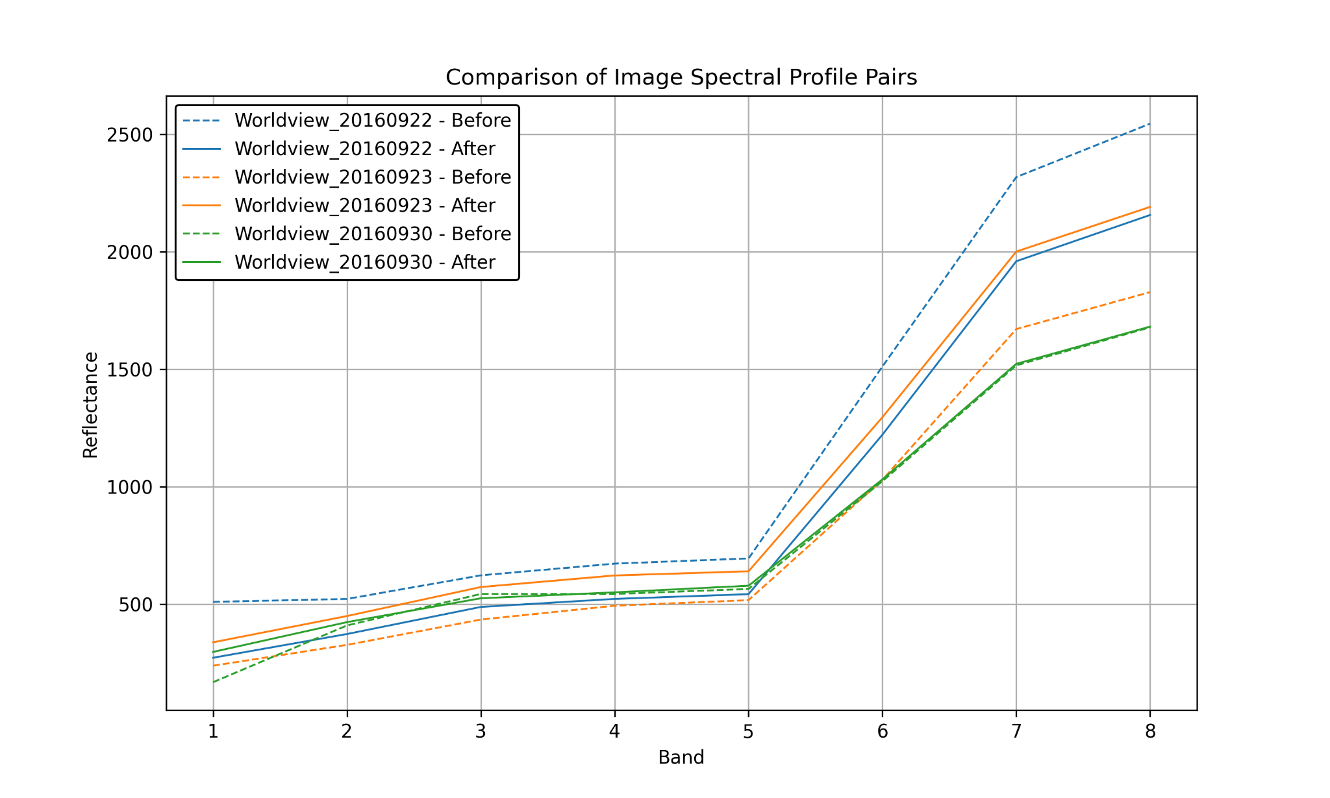
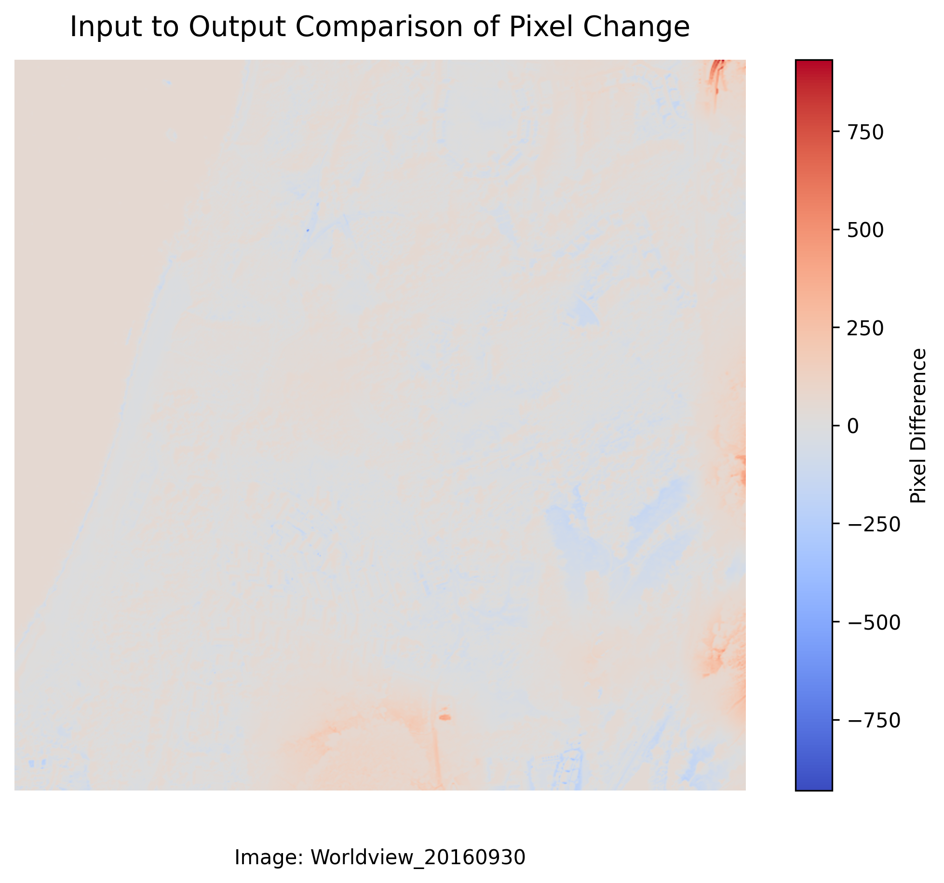
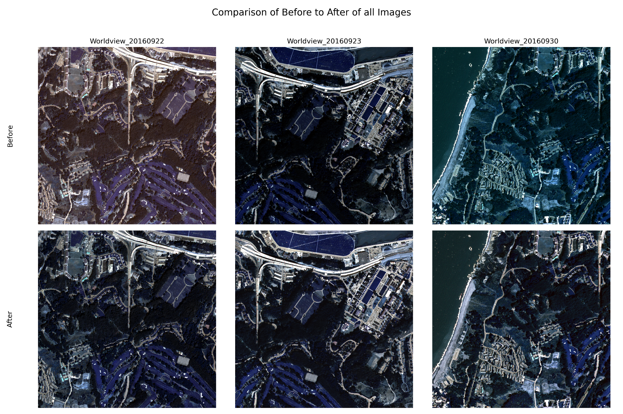
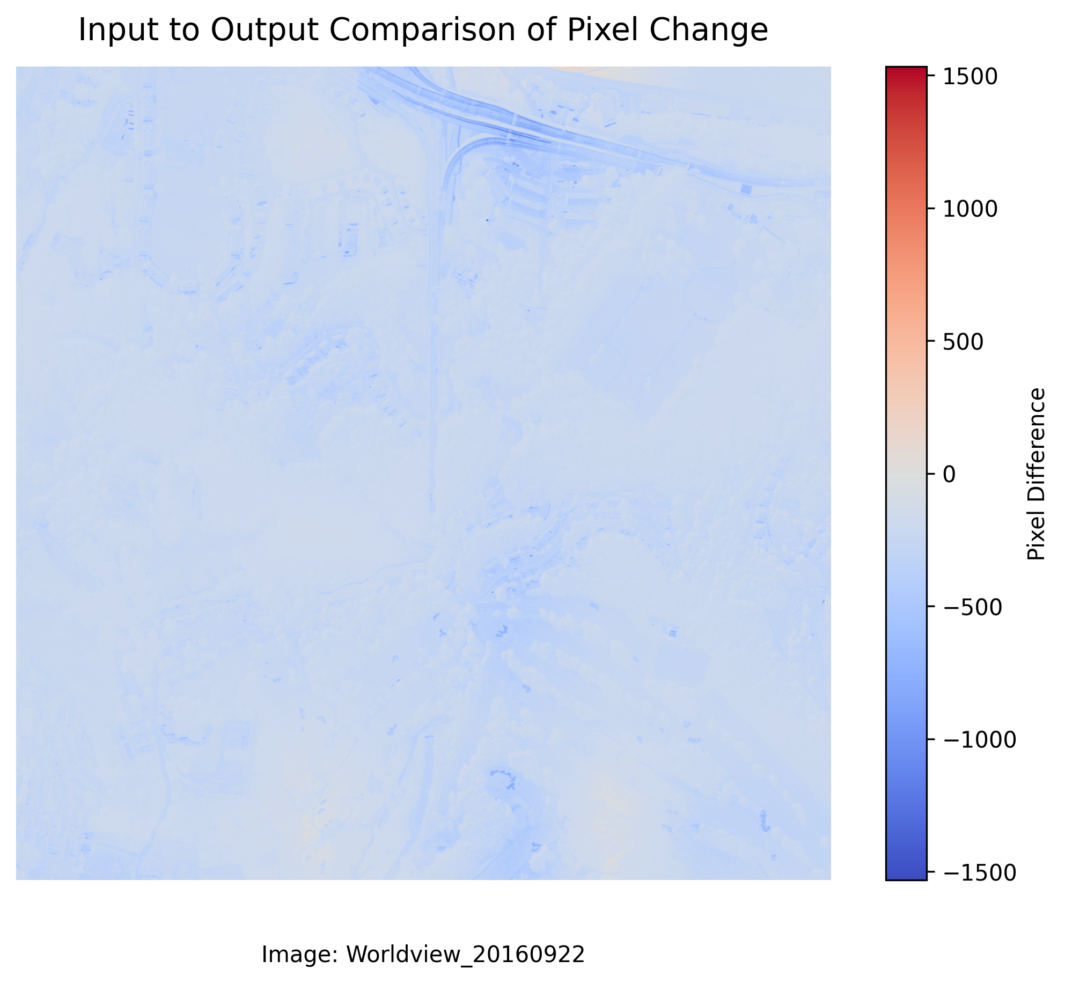
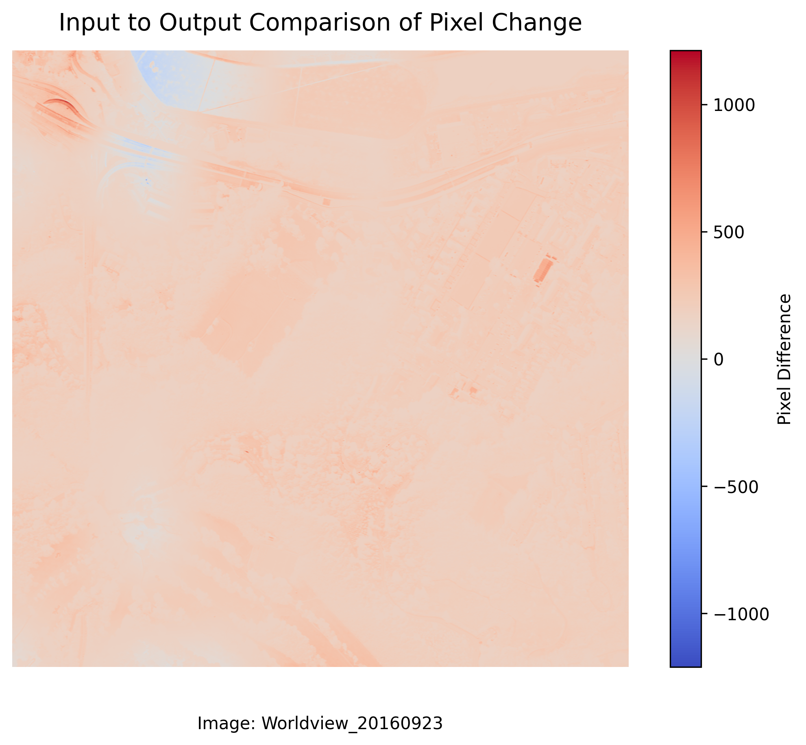
Step 6: Calculate Statistics
Notes:
Left: Pixel wise difference from start to finish
Top: spectral profile change
Bottom: Image Visualization

Slide 20
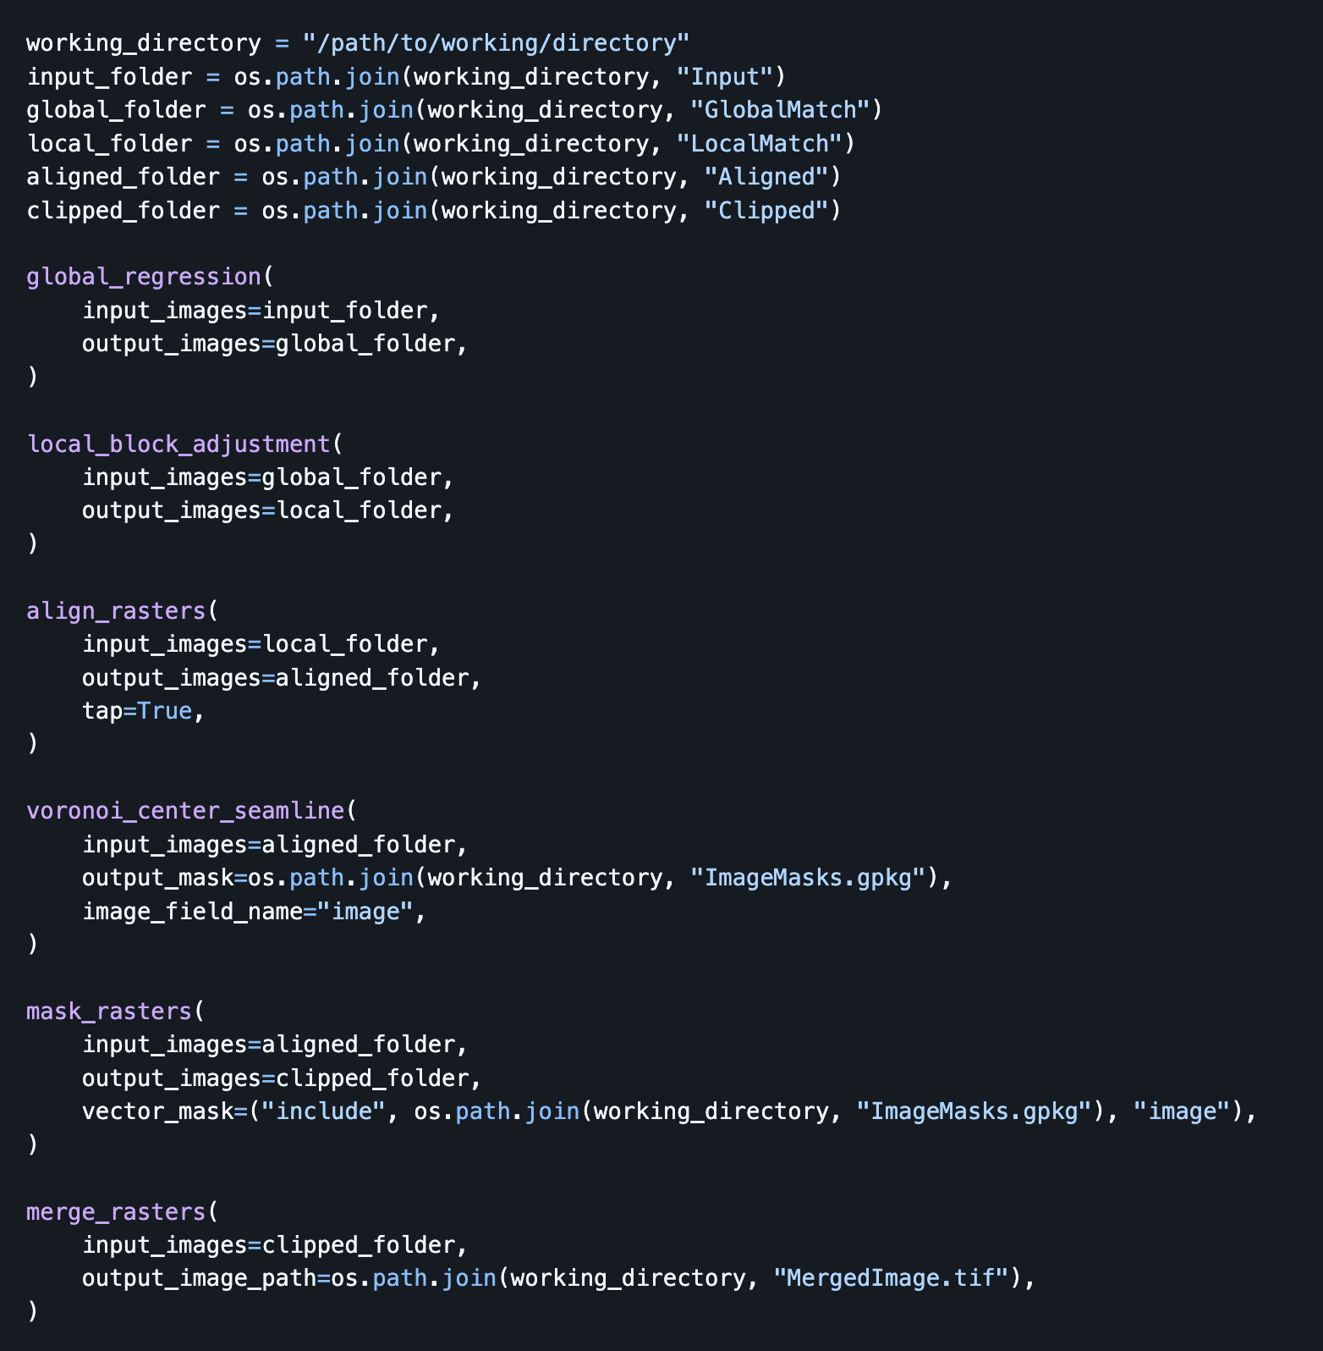
The Code
Global regression
Local block adjustment
Align rasters
Voronoi center seamline
Mask rasters
Merge rasters
Notes:
Simple and easy to use

Slide 21
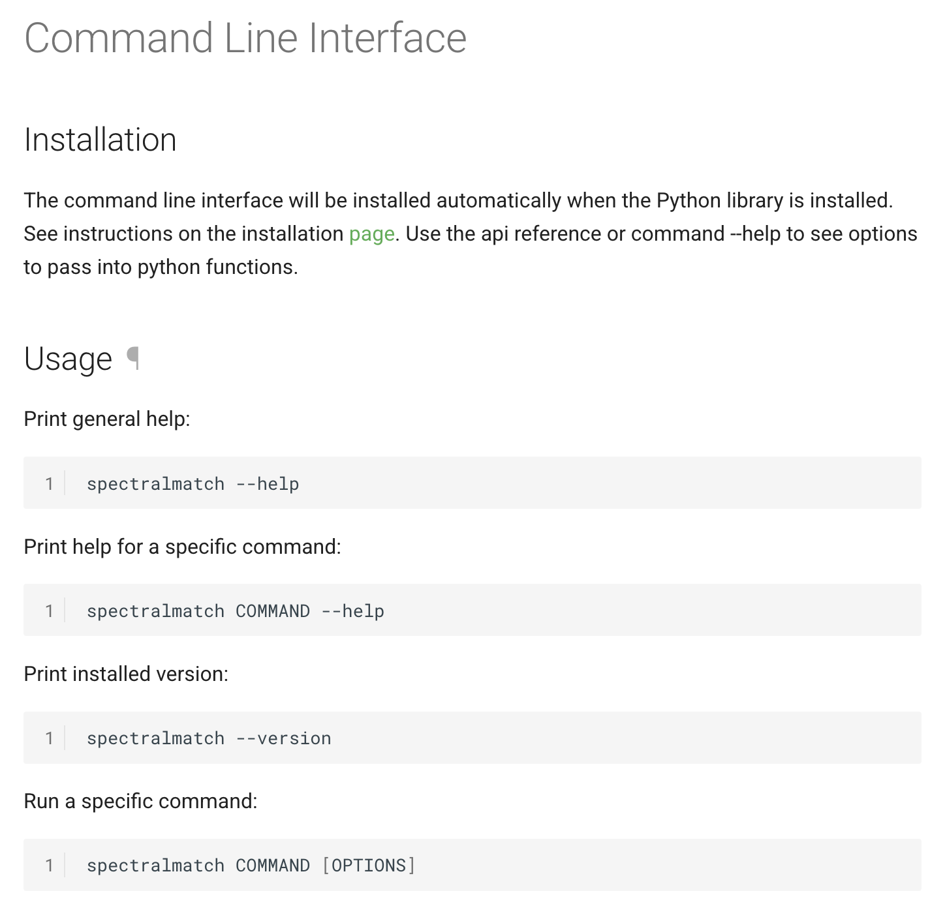
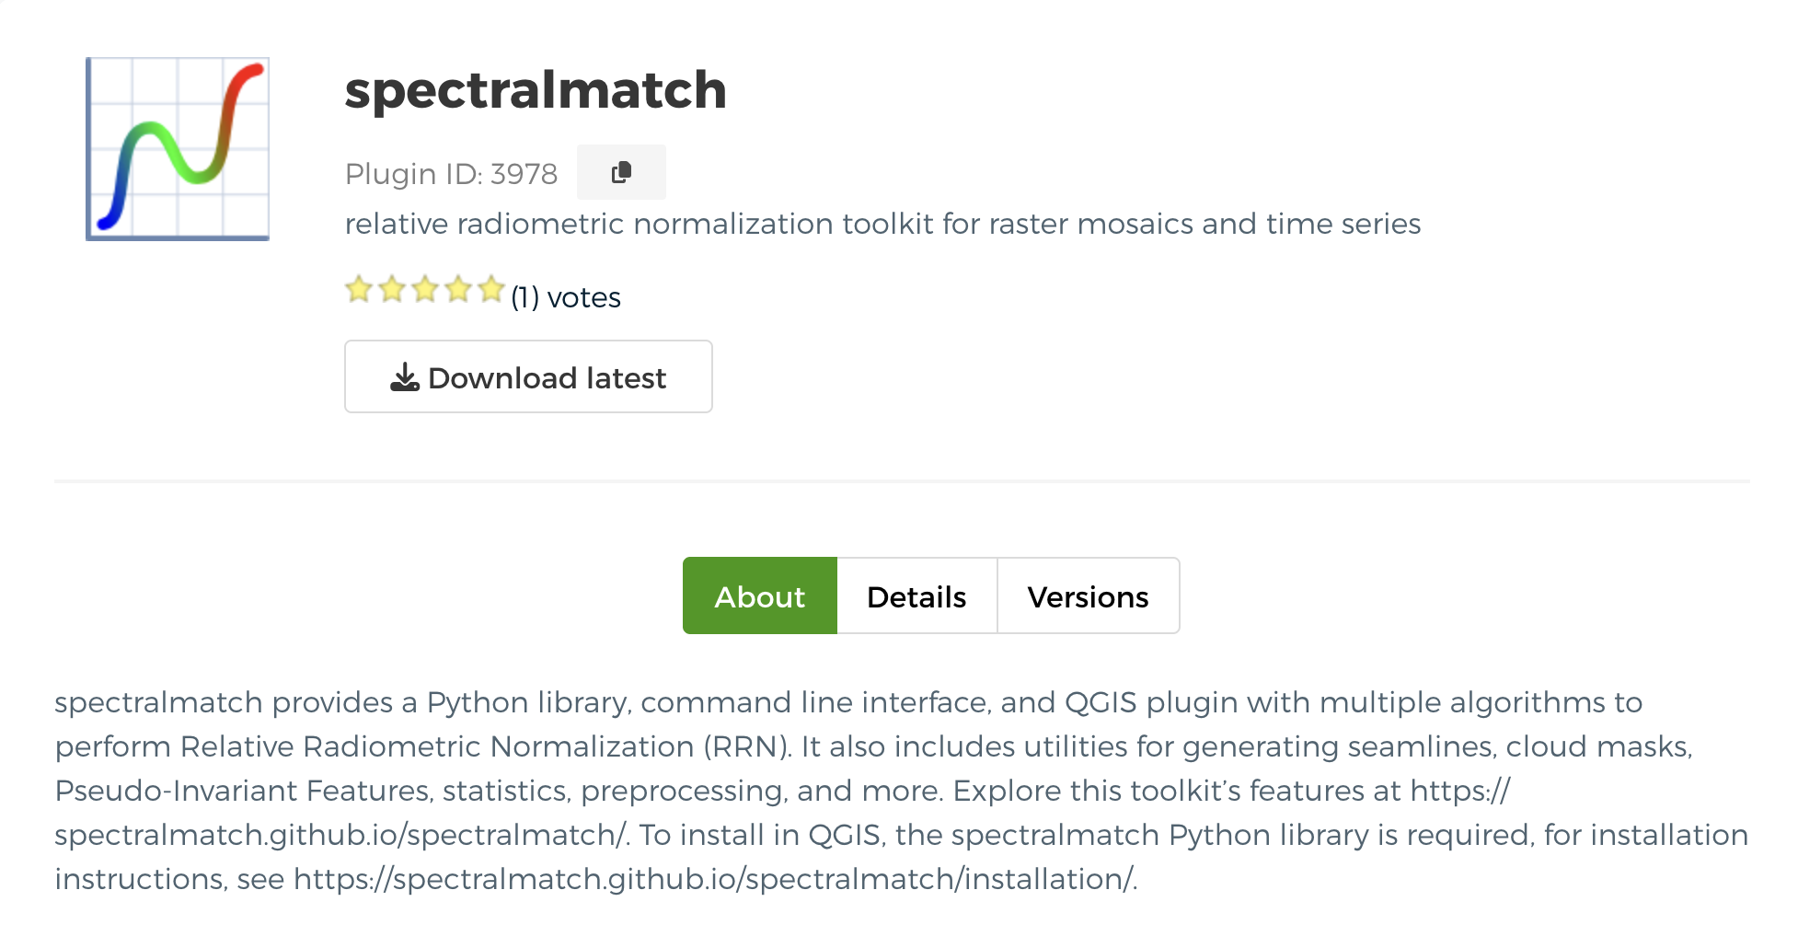
Other Ways to Use Spectralmatch

Slide 23
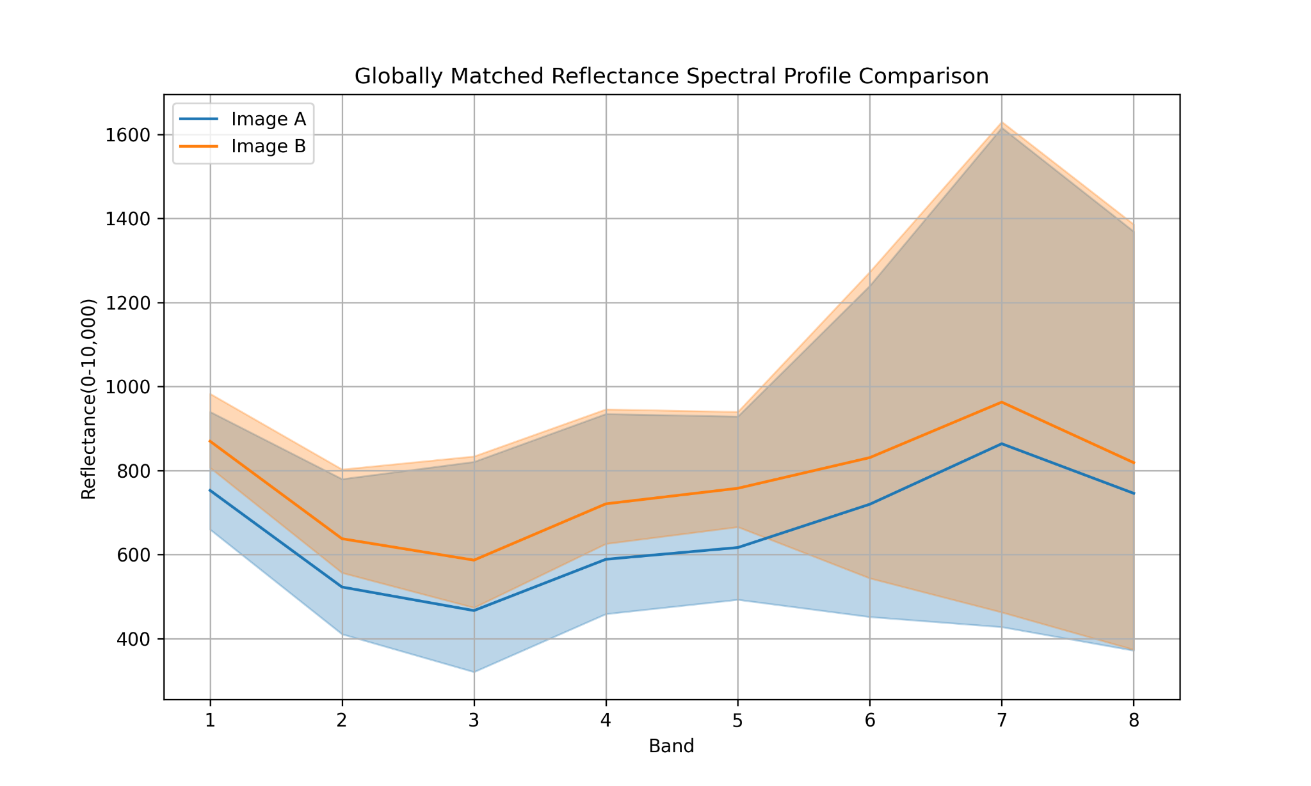
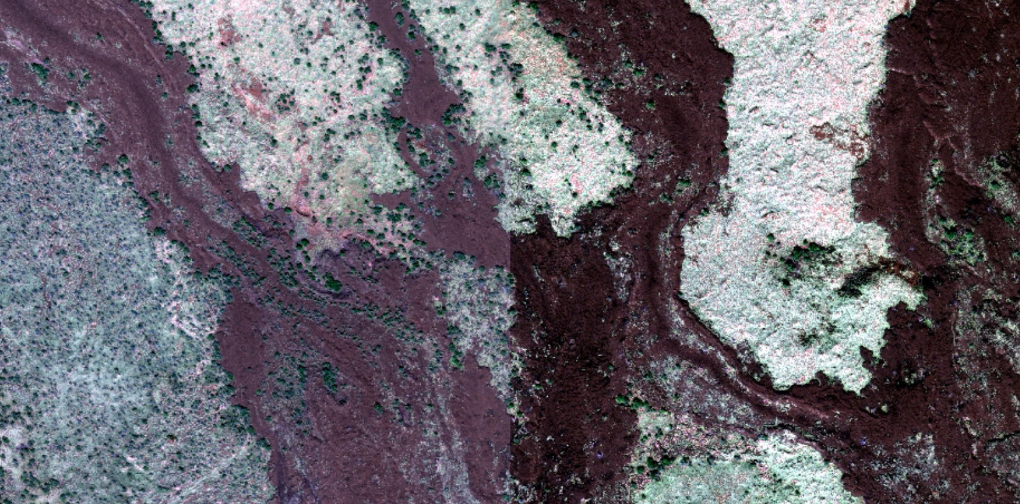

Slide 24
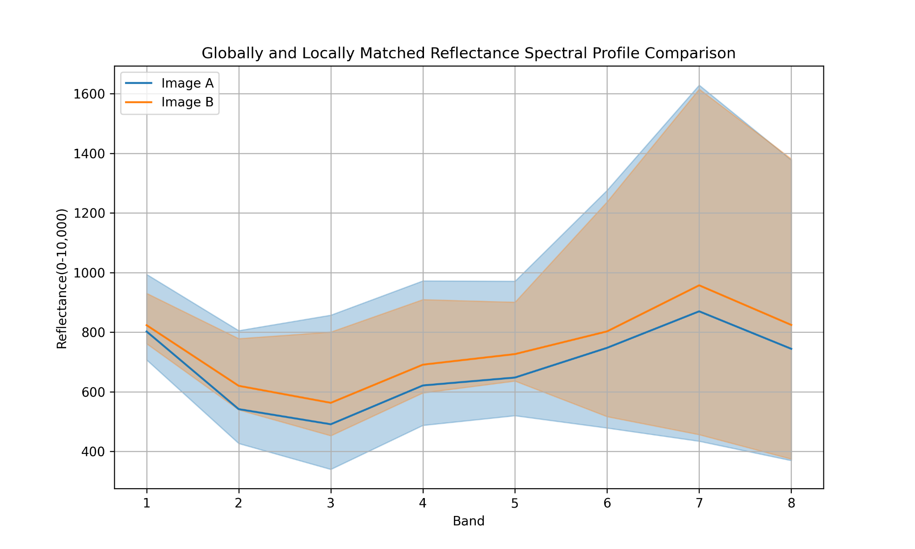
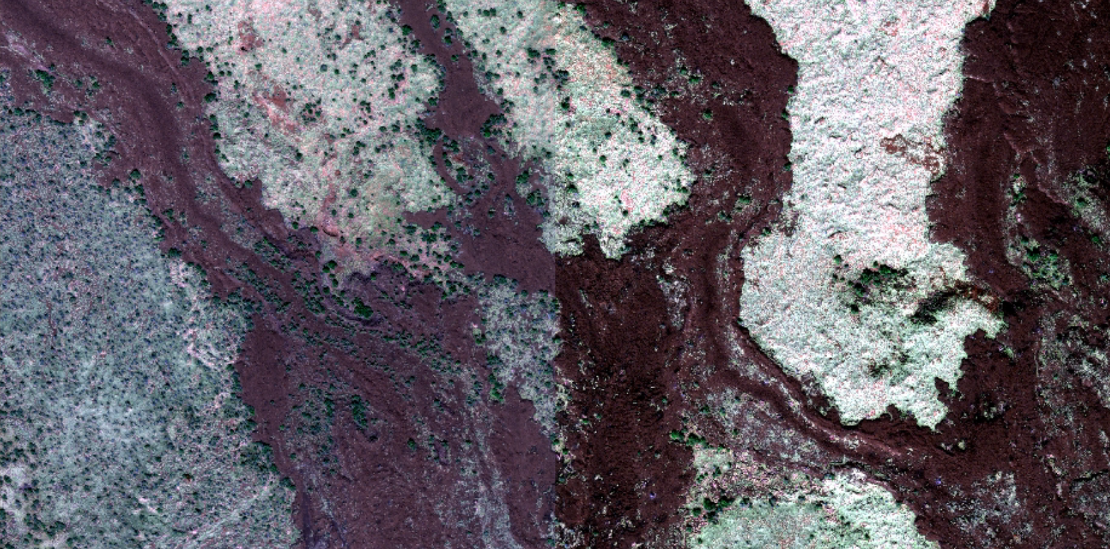

Slide 25
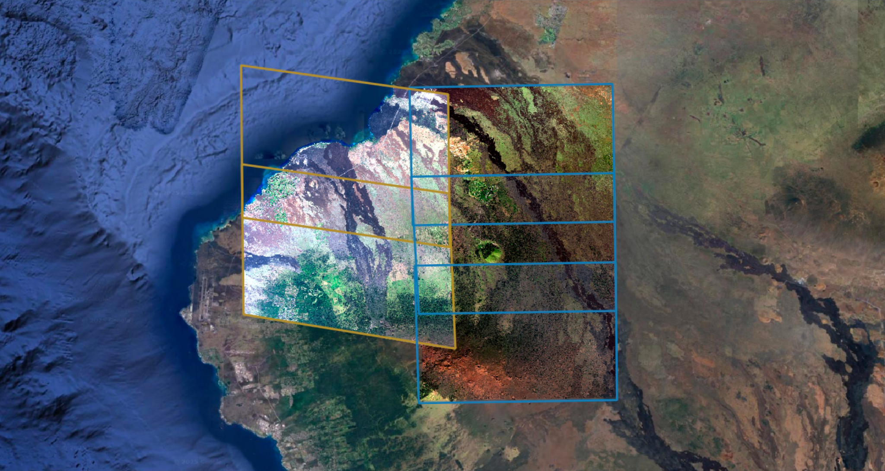

Slide 26
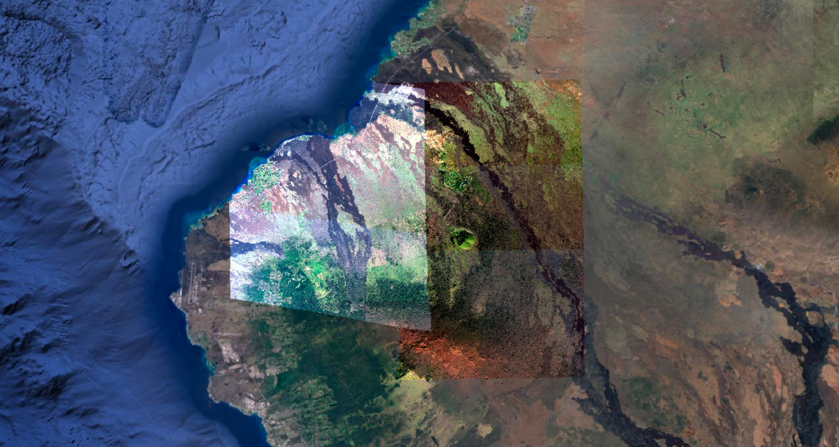

Slide 27
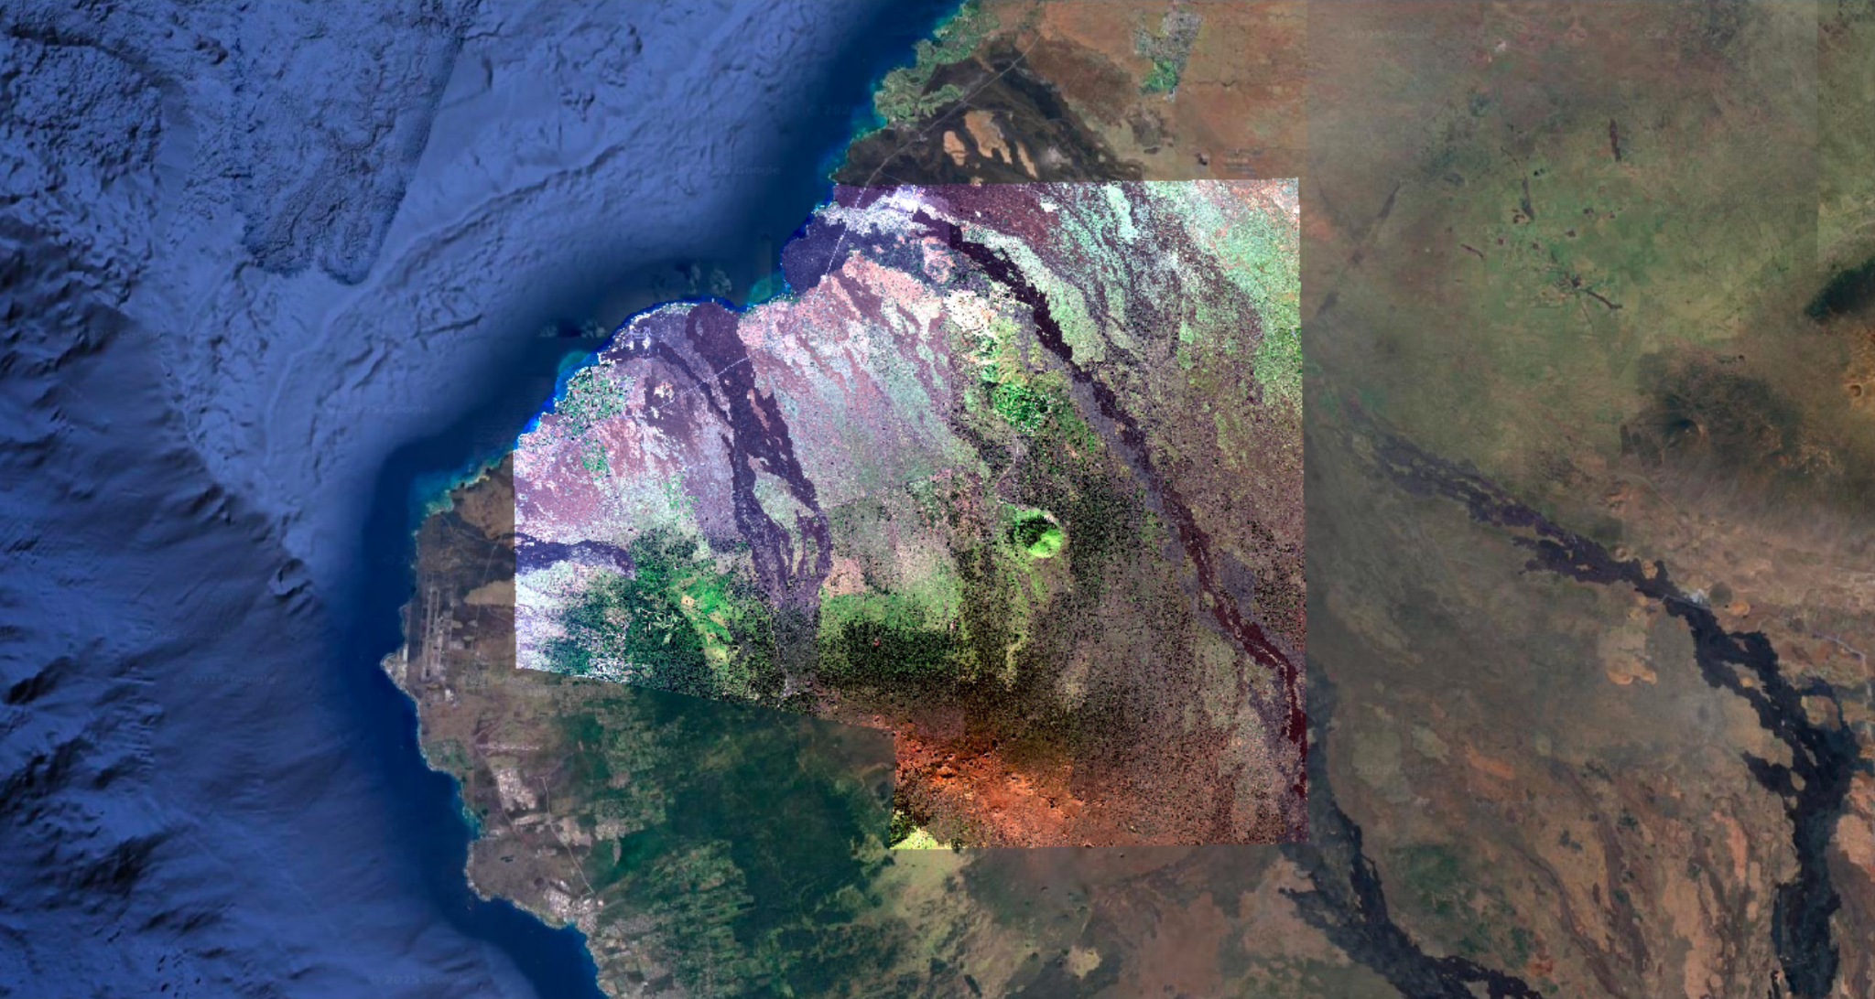

Slide 28
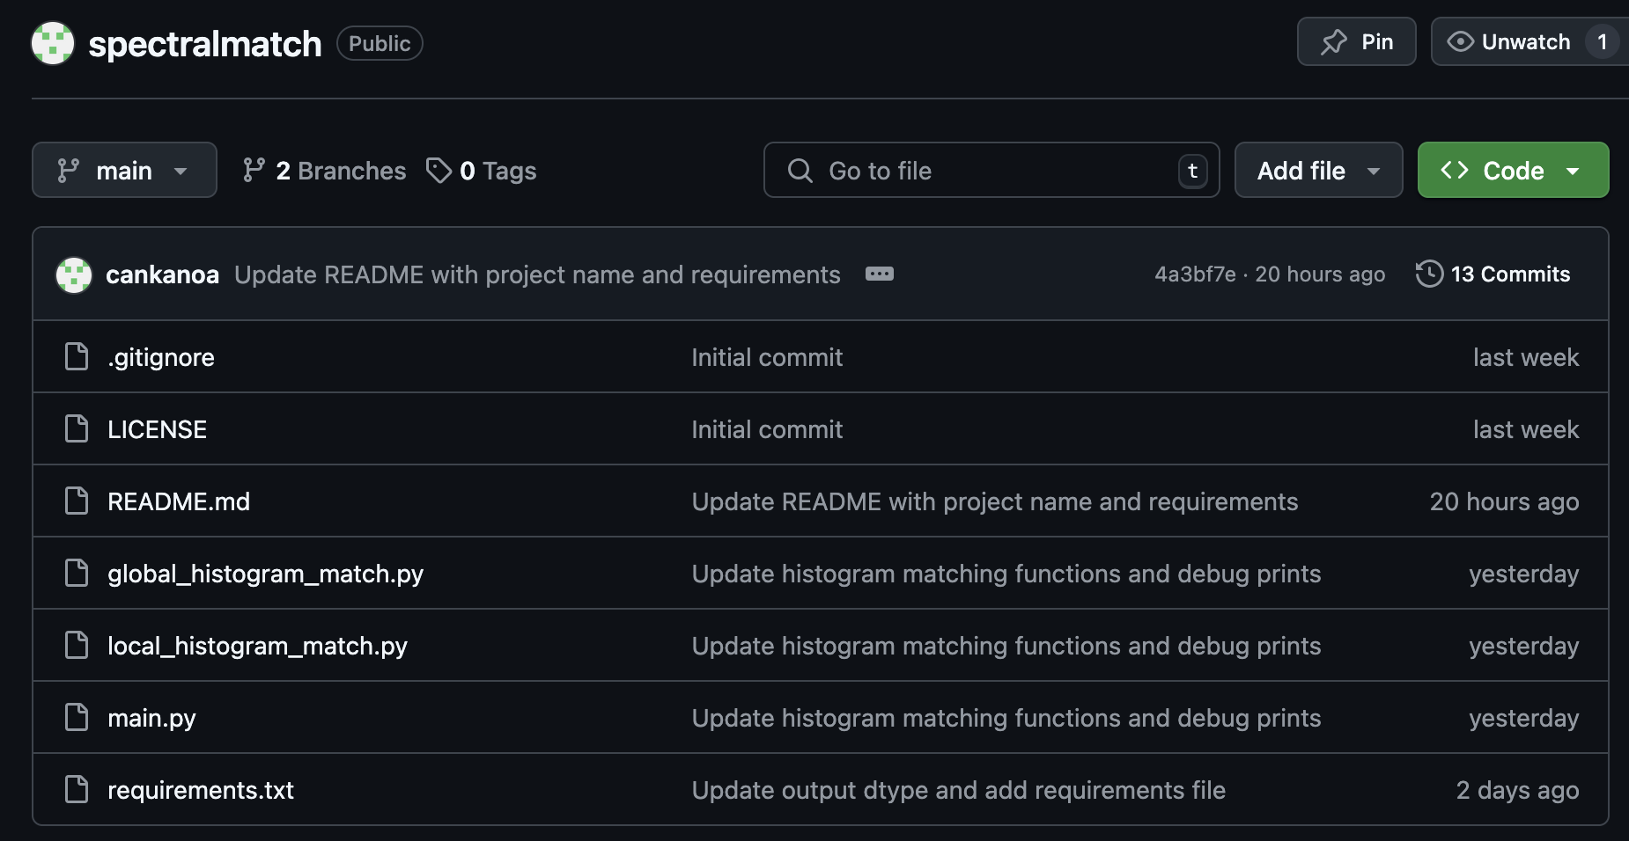
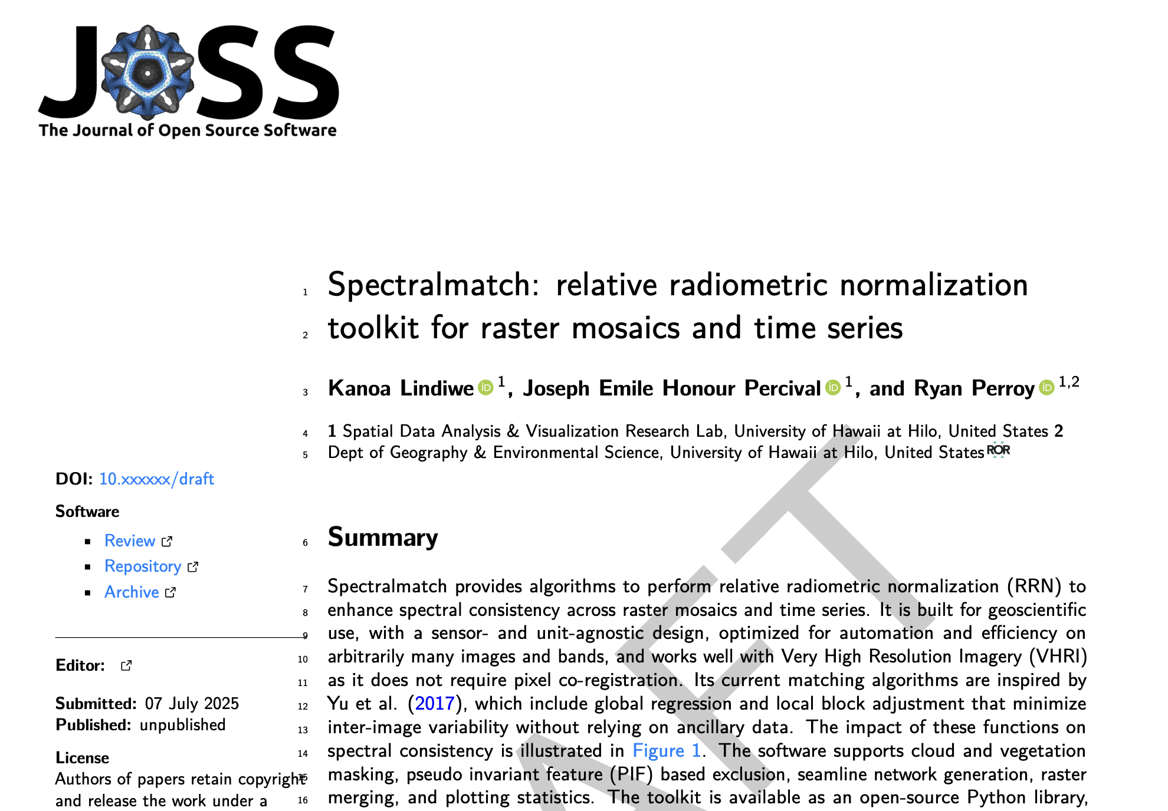
Thank You!
Docs: https://spectralmatch.github.io/spectralmatch/
Questions: klindiwe@hawaii.edu
github.com/spectralmatch/spectralmatch
Notes:
Accessible through a python library, command line interface, and QGIS plugin.

Slide 29
Global and Local Histogram Matching
Benefits
Does not assume a reference image
Consistent multi-image analysis
Seamlessly ‘blended’
Physically meaningful units
Better input for machine learning models
Script automation
Script parallelization
Large scale mosaics
Sensor agnostic
Avoids excessive color normalization
Assumptions
The true spectral profile of overlapping areas are the same
Least squares can be modeled to fit all images spectral profile
Scale and offset can effectively adjust images
The best color correction is obtained when color differences are minimized
Images are geometrically aligned and relative positions known
Global: Overlapping color differences are the same for the whole image
Local: Block level differences in color are due to global application of adjustments

Slide 30
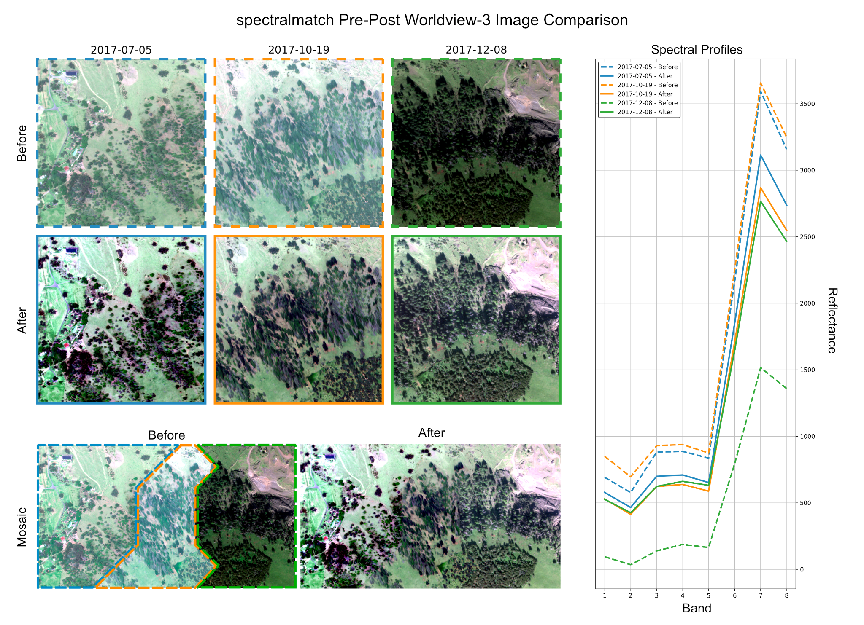

Slide 31
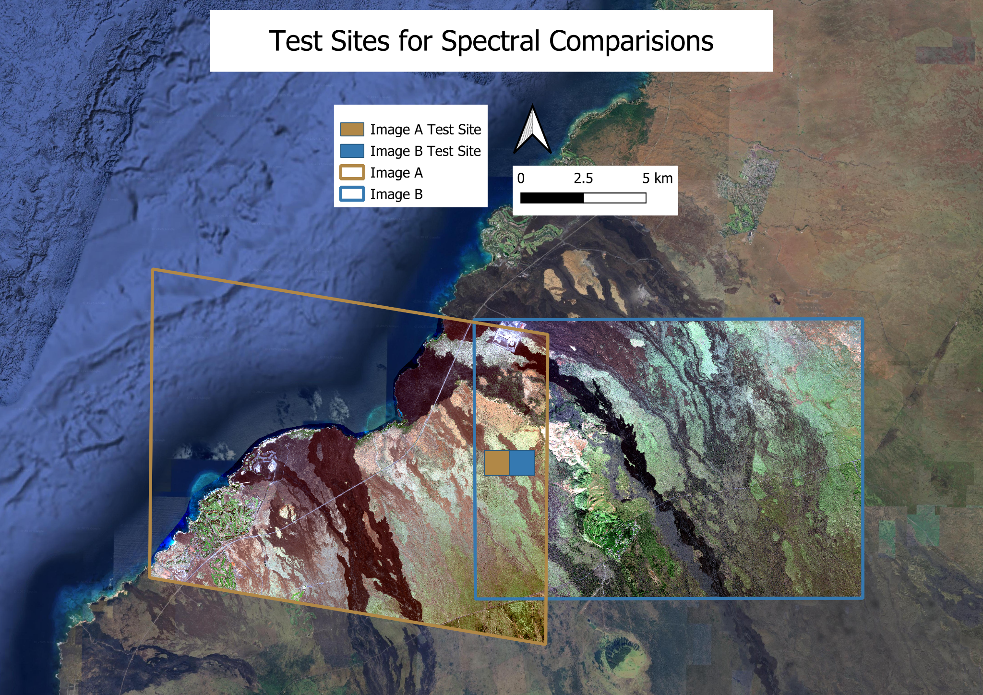

Slide 32
Helper functions
Matching
global_regression
local_block_adjustment
Seamlines
voronoi_center_seamline
Merging
align_rasters
mask_rasters
merge_rasters
Masking
create_cloud_mask_with_omnicloudmask
create_ndvi_raster
Statistics
compare_before_after_all_images
compare_image_spectral_profiles_pairs
compare_spatial_spectral_difference_band_average

Slide 33
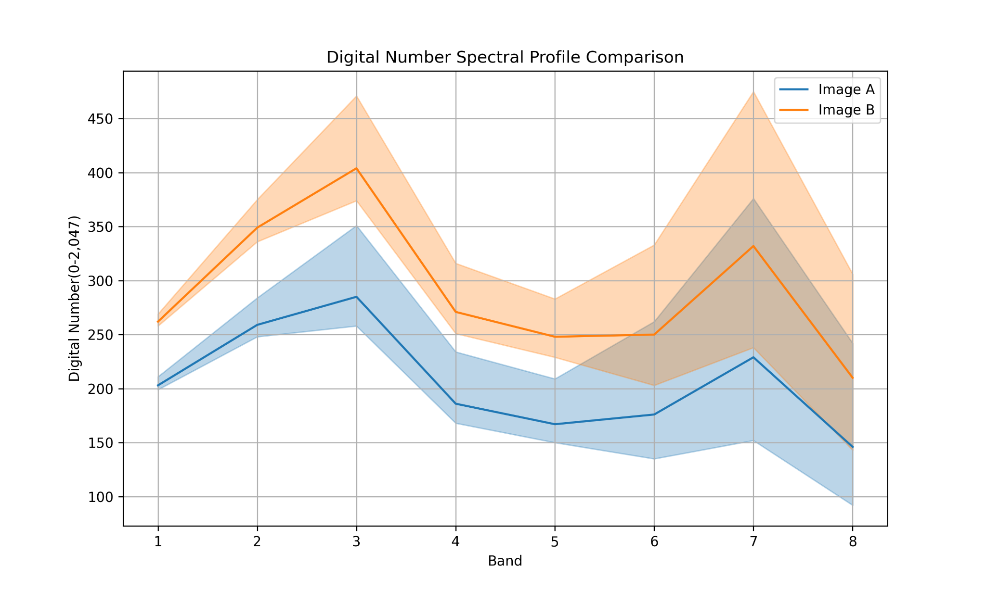

Slide 34
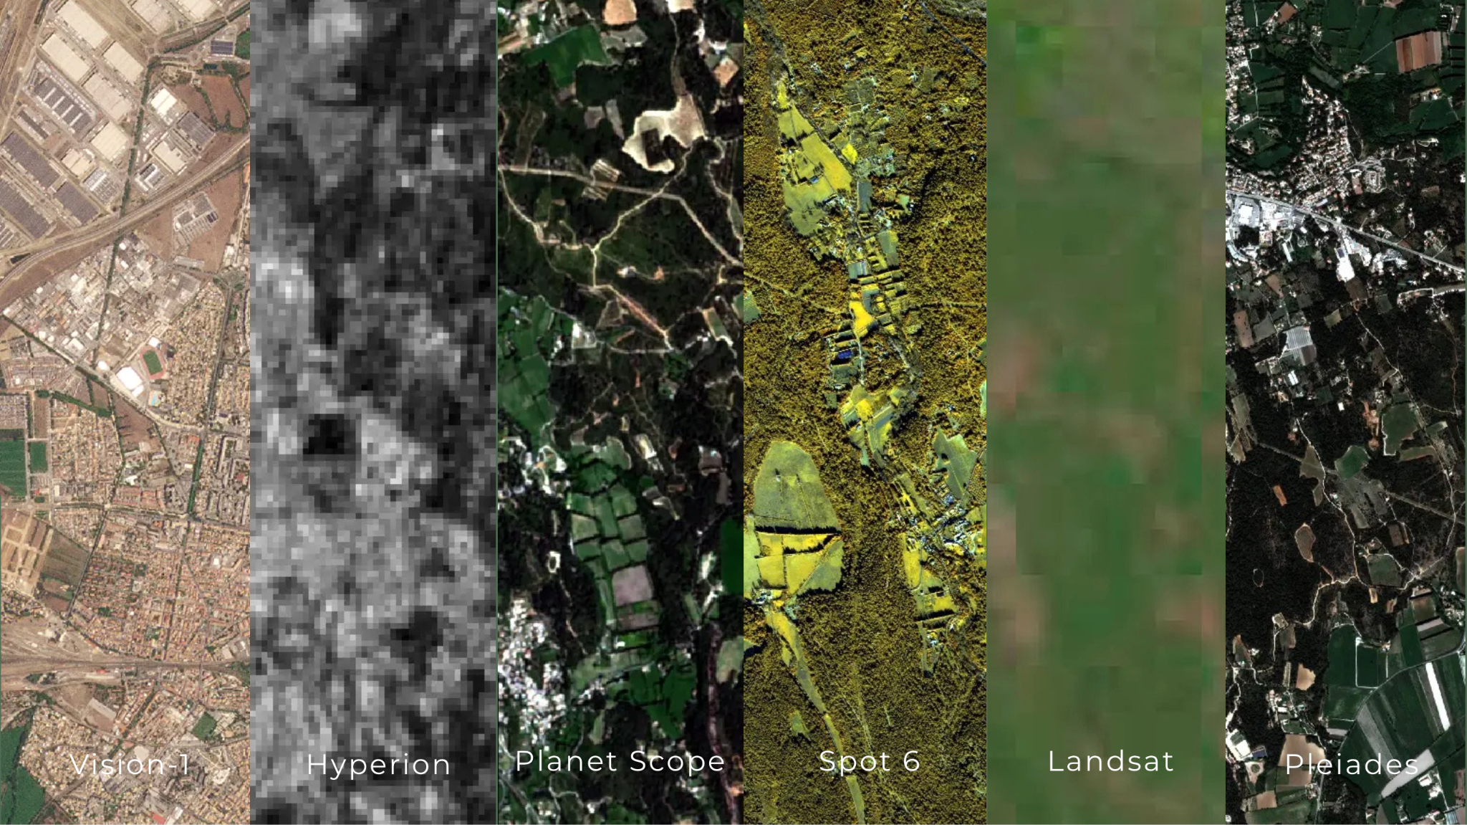
Background
Very High Resolution (VHR) Satellite Imagery provides broad coverage and high detail for land cover and land use (LCLU) analysis
Worldview 3
31cm Spatial Resolution
Notes:
Climate change impact studies (vegetation shifts, biomass estimation, wildfire assessment)
Change detection (Land use transitions, natural disaster recovery)
Urban development
Habitat mapping and monitoring
Ecosystem monitoring
Agriculture monitoring
Forest dynamics (tree mortality and diseases, deforestation, species-level classification)
We are working at species level classification

Slide 35
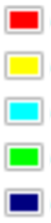
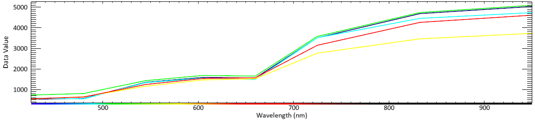
Species-level Tree Classification
Koa
‘Ōhi’a Lehua
Kolea
Manele/a'e
Māmane
Different species reflect different wavelengths of light

Slide 36
Zooming Out: Processing Pipeline for Worldview Imagery
Starts in Digital Numbers
Atmospheric correction and conversion to reflectance
Orthorectification
Pansharpening
Global and local histogram matching
Merging and Mosaicing
Notes:
Focusing on histogram matching

