Slide 1
Parallelizing Research Efforts with Hosted Git and Modern Asynchronous Workflows
Ethan Willis
Sr. Biomedical Informaticist
UTHSC Center for Biomedical Informatics

Slide 2
We'll be looking at what's called a distributed version control system (DVCS), specifically Git.

Slide 3
Agenda
Benefits to research
What's a DVCS?
Git FUNdamentals
  Concepts, Terminology
  Software Internals, Basic Commands
  Modern Workflows
A guided tutorial: Distributed Data Analysis

Slide 4
What are the benefits for research?
Parallel: Multiple versions of a project can be worked on indepedently of the main body of work.
Contribution Measurement: Each contribution is timestamped, marked with the collaborator's identity, and provides metadata on the contribution.
Datasets: Facilities for multiple versions, sharing, and dataset merging.
Data Integrity: Distributed backups, Versions, Tamper proof with cryptographic checksums.
With a proper workflow these all come together to enhance reproducibility of your work.

Slide 5
What's a DVCS?
A Distributed Version Control System provides facilities for parallel work, contribution logging, project versioning over time, version merging, and project/data integrity.
Each collaborator has their own copy of a version controlled project. (No dependence on centralized resources)

Slide 6
FUNdamentals: Git Concepts – Anatomy of a Repository
A git repository is made up of several basic components
  Branches: A set of branches. These are used to track work on a particular issue in your project.
  Commits: Sets of commits for each branch. These track the actual work performed on a particular issue.
  Network: An amalgamation of the entire project's commits and branches.

Slide 7


Slide 8
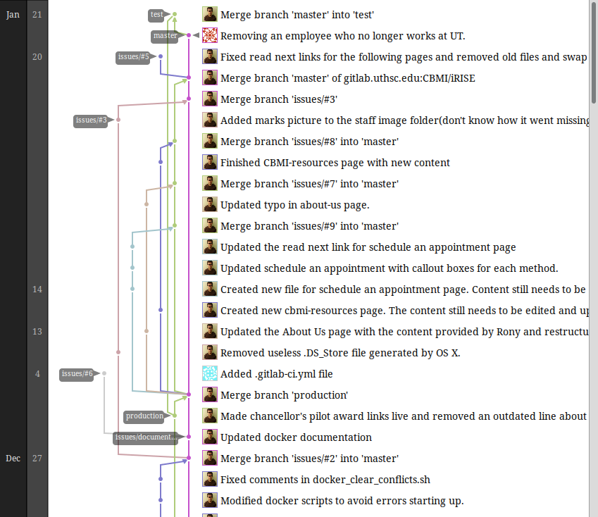
FUNdamentals: Network Model

Slide 9
FUNdamentals: Network Model
In the network model, each line is a branch.
You can think of each of these branches as different lineages of an organism.
Branches can be horizontally or vertically integrated, think of a basic version of gene transfer.

Slide 10
FUNdamentals: Network Model
Think of a network as a population. How can invididuals in this population interact, who are the individuals?
Typically work is a sequential set of changes. This is vertical transfer of information in the previous figure. This is boring.
Crossing of branches results in horizontal transfer of information. This is where the fun is.
One thing to notice - All branches eventually converge to a single branch. Typically this is called the master branch

Slide 11
FUNdamentals: Network Model

Slide 12
FUNdamentals: Branches
So as said before branches are the individuals that interact in our population(network).
Within a branch change is denoted by a unit called a commit.

Slide 13
FUNdamentals: Branches
The act of merging is used to denote the transfer of commits horizontally between branches.
What does this mean?
  Each branch can be a different area of work.
  Commits denote what work was done, by who, and when.
  Commits are shared/moved between branches to converge several avenues of work into one or more cohesive/final products.
This will be important later when we talk about workflows.

Slide 14
FUNdamentals: Commits
As stated commits are the fundamental unit of information in the git network model and within branches.
Commits are not deltas of the previous versions.

Slide 15
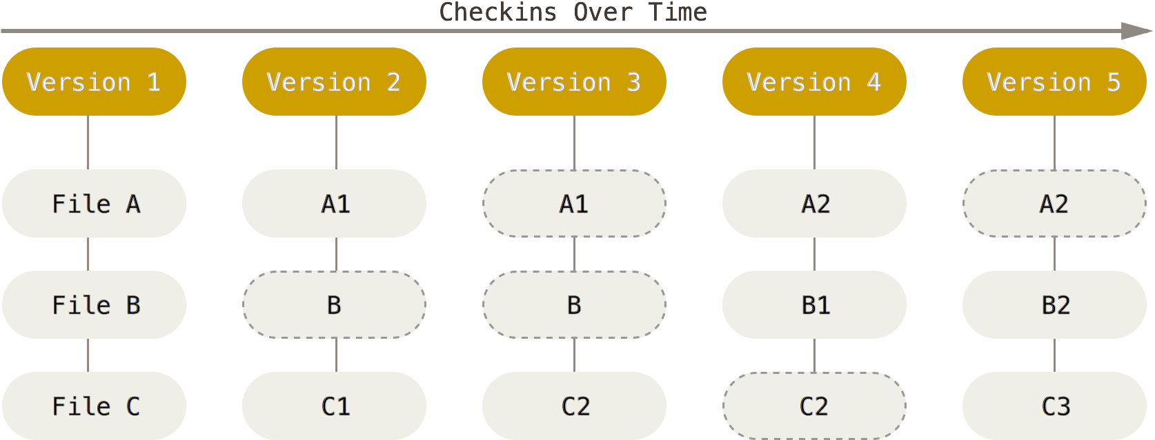
FUNdamentals: Commits
Fig 1-1: Project snapshots over time. A series of commits, where version is used in place of the word commit.
Notes:
Reading from Left to Right in the Diagram Above
Version 1 Has no files commited.
Version 2 We create files A and C and commit them creating version 1 of both A and C.
Version 3 We update file C and commit making version 2 of C.
Version 4 We update file A. We create file B. We commit our changes, which creates version 2 of A and version 1 of B.
Version 5 We update file B and file C and commit our changes. This gives us version 2 of file B and version 3 of file C.

Slide 16
FUNdamentals: Commits
Commits store information about the original author, the time a commit was applied to a project, the original creation time, and what changes were made. As well they store a commit message that is supplied by the author to describe their work.

Slide 17
FUNdamentals: Hashing
Each commit of the repository (1, 2, 3, 4, 5) are associated with a 40 character SHA-1(cryptographic) hash.
This cryptographic hash is computed as follows:
  commit_hash = sha1( commit_message, commiter, commit_time, author, autor_date, tree_hash, parent_hash )

Slide 18
FUNdamentals: Hashing
Git hash breakdown.
  commit_message: The message submitted by the commiter when applying a commit to the local repository
  committer: The name of the person applying a commit
  commit_time: The time that a commit was applied to a repository
  author: The name of the person who originally authored a commit
  author_date: The time that a commit was applied by the original author
  tree_hash: The hash of all of the files in the current repository
  parent_hash: The hash of the previous commits in the repository until this point in time
  *Note: Author and Committer can be different. Commit_time and Author_date can be different.

Slide 19
FUNdamentals: Hashing
You can use these unique hashes in order to checkout past versions of files or past versions of an entire project.
This allows you to inspect your work at a specific period in time, or even revive past work that has been overwritten.
You can checkout an entire branch or you can checkout an old commit within your current branch, aka a working branch.

Slide 20
FUNdamentals: Quick Recap
Once again git branches are composed of commits. The git network is composed of branches of a git repository.
Commit hashes are used to keep everyone honest and are used in the git log.
The git log is a history of all changes made within the current git branch
Merging is the action of sharing commits between branches.
The goal of merging is to eventually converge many areas of work into one or more end products.
Checkouts can be used to look at uniquely identified pieces of your project from various points in time.

Slide 21
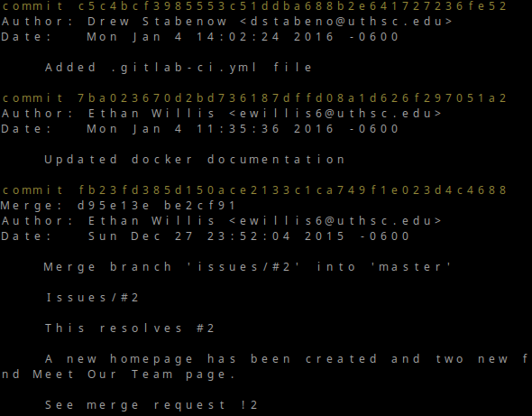
FUNdamentals: Git Concepts – git log

Slide 22
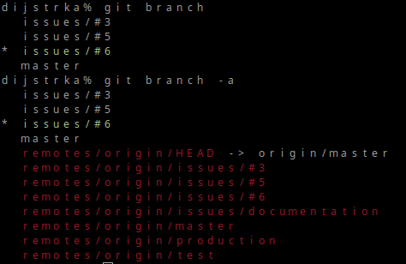
FUNdamentals: Git Concepts – git branch

Slide 23
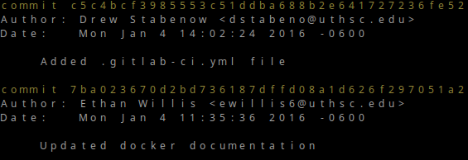
FUNdamentals: Git branch
The git log is branch specific
I was looking at the git log for the git branch named issues/#6. It contained the following commits:

Slide 24
Terminology Review
Commits: Fundamental unit of change. A snapshot of the files in a project at a point in time.
Branch: A single avenue of work that is being pursued in parallel to other work on a project.
Network: A collection of branches, commits, and the merges between them.
Repository: The actual files that store all of the information about a git network, the commits, branches, the project files, etc.
Commit hash: A sha1 hash that uniquely identifies a piece of work.
Merge: An action to share commits between different branches.
Checkout: An action to get a past version of a project.
Working Branch: The current branch that is checked out and active within a git repository.

Slide 25

Guided Tutorial – Traditional Document Editing

Slide 26
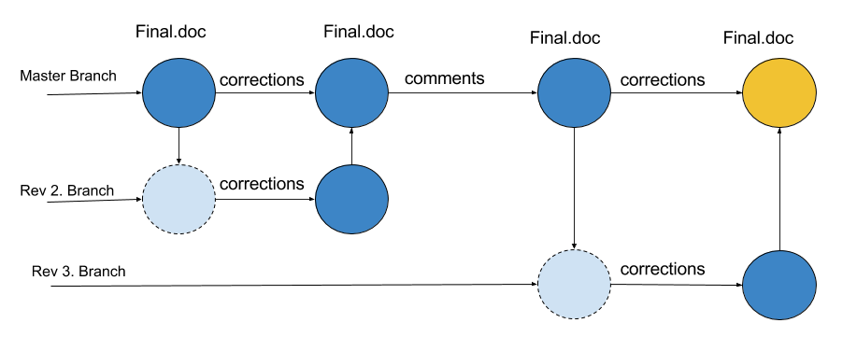
Guided Tutorial – Traditional Document Editing

Slide 27
Tutorial: High Level Git Command Categories
Committing
Branching
Checkout
Merging

Slide 28
Tutorial: Git command reference
Committing
Branching
Checkout
  git checkout <other branch name>
Merging
  git merge <other branch name>
Misc.
  git init

Slide 30
Sources
1.) Fig 1-1. ( https://git-scm.com/book/en/v2/Getting-Started-Git-Basics )
2.) Fig ( http://www.phdcomics.com/comics/archive.php?comicid=1531 )

