Slide 1
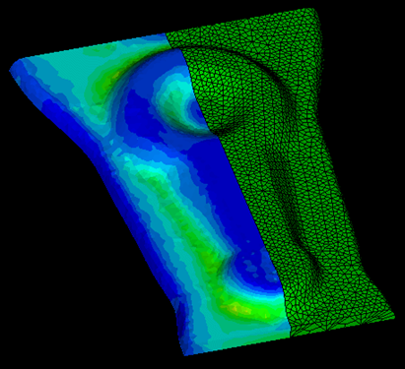
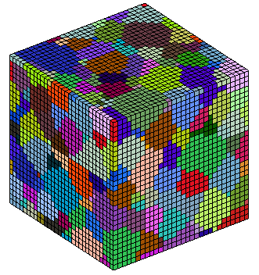
Robust optimization of deformation processes
for control of microstructure-sensitive properties
Cornell University, Nicholas Zabaras
LONG-TERM PAYOFF: Decrease processing costs and enhance properties of forged aerospace components.
OBJECTIVES
Optimization of metal forming in the presence of multi-scale uncertainties
Develop techniques for controlling microstructure-sensitive properties.
Multiscaling
Stochastic analysis and optimization
Process modeling
APPROACH/TECHNICAL CHALLENGES
Optimization: Sensitivity analysis
Representation of uncertainties: Collocation, Spectral representation
Multi-scaling: Microstructure homogenization
ACCOMPLISHMENTS/RESULTS
Robust optimization of metal forming
Modeling of multi-scale uncertainties
Design of microstructure-sensitive properties
FUNDING ($K)
FY05 FY06 FY07 FY08 FY09
AFOSR Funds 150K 150K 150K
AFOSR/DURIP 150K
TRANSITIONS
Numerous journal publications can be found in http://mpdc.mae.cornell.edu/
STUDENTS
V Sundararaghavan, Baskar G, S Sankaran, Xiang Ma
LABORATORY POINT OF CONTACT
Dr. Dutton Rollie, AFRL/MLLMP, WPAFB, OH
Notes:
The figure shows the various aspects of the multiscale modeling and stochastic optimization approach developed by our group. Thermomechanical processing of a metallic component (steering link) is shown in the left. The microstructure evolution at each point in the macroscopic material is modeled using multi-scale techniques such as homogenization. In deterministic optimization, the aim is to control properties of the material during processing by tailoring the microstructure. However, microstructures are inherently random, hence the statistical variability of fields such as temperature and stresses in the material due to uncertain microstructures need to be taken into account. The graph shows recent results (Zabaras, Journal of Comp Phys, submitted 2007) that depicts the randomness in temperature induced due to uncertain knowledge of microstructure topology. The technique to obtain such statistics is described in detail in the next slide.
Significant tools developed last year include:
Collocation techniques for representing microstructural statistics (slide 2)
2)Linear analysis techniques to represent microstructure-property-process relationships graphically.
3)Tools for mathematical representation of stochastic sensitivities using spectral and collocation techniques (slide 3)

Slide 2
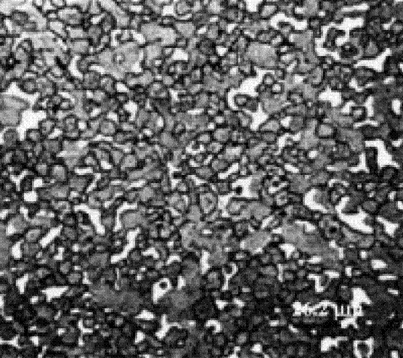
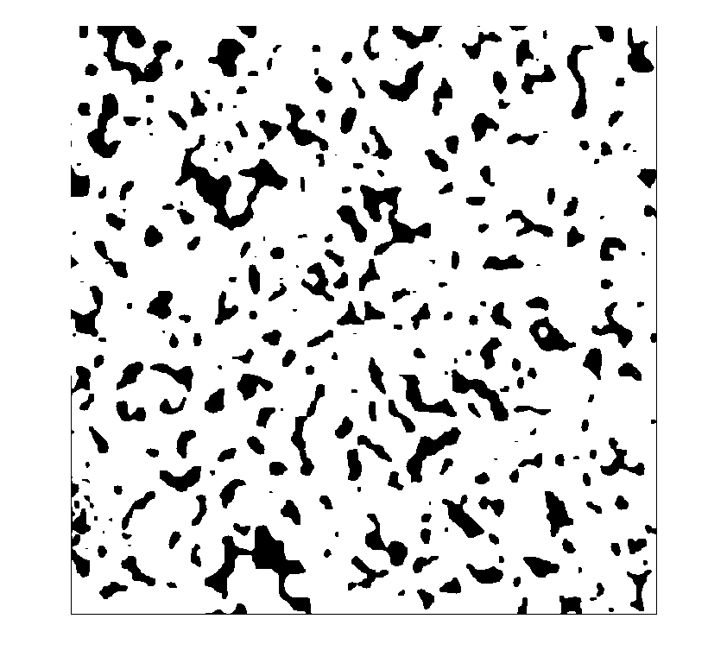
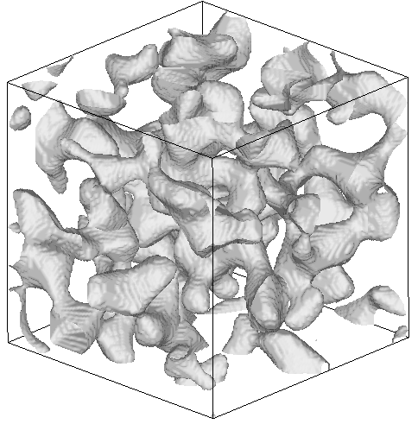
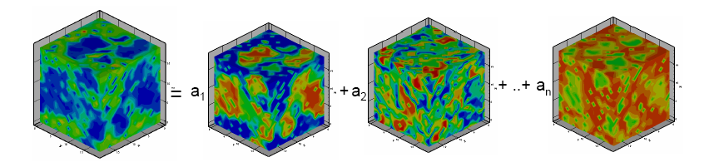
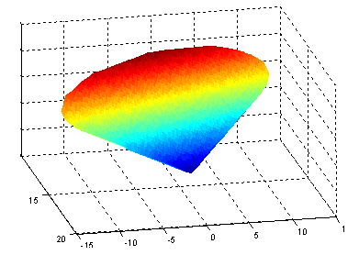
DATA DRIVEN STOCHASTIC ANALYSIS
MATHEMATICAL REPRESENTATION OF MICROSTRUCTURAL UNCERTAINTIES
Experimental image
AIM: DEVELOP PHYSICAL MODELS THAT TAKE INTO ACCOUNT MICROSTRUCTURAL UNCERTAINTIES VIA EXPERIMENTAL DATA
1. Property extraction
Extract statistical information from experimental data
3. Construct model
Construct a reduced stochastic model from the data
2. Microstructure reconstruction Reconstruct 3D realizations of the structure satisfying these properties.
Image processing
Property extraction
Principal Component Analysis
Reduced model
Imposing constraints on the coefficient space to construct the allowable subspace of coefficients that map to the microstructural space
3D reconstruction based on experimental information: Build a large data set of allowable microstructures. Reconstruction techniques include GRF, MaxEnt, stochastic optimization
Notes:
The slide consists of an overview of the current status of our data driven stochastic analysis toolkit.
The various developments are shown through this specific example above, where the topological variations in the microstructure affecting thermal diffusion is analyzed and quantified.
The only given information that we start with are some experimental two dimensional images of the microstructure (shown on the top left, a tungsten-silver metal-metal composite).
The first step is to extract pertinent statistical information about the topology of the microstructure. This includes first order statistics like volume fraction of different components, second order statistics like the two point correlations and some higher order statistics. These statistics are extracted using image processing tools.
The next step is to reconstruct accurate three dimensional realizations of microstructures that satisfy the extracted statistical information (i.e the three dimensional structures share topological properties with the experimental microstructure). This can be done using various techniques. We utilize Gaussian random fields, Maximum entropy principles, stochastic optimization and Monte Carlo methods to reconstruct these three dimensional microstructures (a representative microstructure is shown in the right hand side of the slide).
The topological information represents an infinite dimensional space of allowable microstructures. A finite dimensional approximation of this space of microstructures is constructed to use as the data driven model to solve the physical problem (in this case diffusion). The model reduction is achieved through performing a Principal Component Analysis of the reconstructed database of three dimensional microstructures. The first few most energetic eigen images represent the complete space of allowable microstructures. The topological constraints are also imposed to generate a rigorous mathematical reduced order representation of the microstructure space (shown in the image in the bottom right of the slide). Note that not any combination of the eigen-microstructures is an acceptable microstructure and thus
the random reduced space of microstructrures needs to constructed by imposing and solving optimization problems with unknown the coefficients in the principal component (POD-like) analysis.
In summary, starting from ONLY planar data, we reconstruct a reduced model of the 3D space of random microstructures. This space can Then be sampled (see next slide) using sparse grid collocation methods.

Slide 3
DATA DRIVEN STOCHASTIC ANALYSIS
MATHEMATICAL REPRESENTATION OF MICROSTRUCTURAL UNCERTAINTIES
Experimental image
AIM: DEVELOP PHYSICAL MODELS THAT TAKE INTO ACCOUNT MICROSTRUCTURAL UNCERTAINTIES VIA EXPERIMENTAL DATA
Image processing
1. Property extraction
Extract statistical information from experimental data
3. Construct model
Construct a reduced stochastic model from the data
Property extraction
2. Microstructure reconstruction Reconstruct 3D realizations of the structure satisfying these properties.
Reconstruction of the microstructure
AIM: UTILIZE DATA DRIVEN MODELS TO OBTAIN PDF’S OF PHYSICAL FIELDS THAT ARISE FROM THE RANDOMNESS OF THE TOPOLOGY AND PROPERTIES OF THE UNDERLYING MEDIUM.
Principal Component Analysis
4. Input uncertainty
Construct a reduced stochastic model from the data
5. Solve SPDE
Use stochastic collocation to solve high dimensional stochastic PDEs
Model reduction
Reduced Stochastic model
Stochastic solution through solving deterministic problem in collocation points
Smolyak interpolation
Notes:
The slide consists of an overview of the current status of our data driven stochastic analysis toolkit.
The various developments are shown through this specific example above, where the topological variations in the microstructure affecting thermal diffusion is analyzed and quantified.
The only given information that we start with are some experimental two dimensional images of the microstructure (shown on the top left, a tungsten-silver metal-metal composite).
The first step is to extract pertinent statistical information about the topology of the microstructure. This includes first order statistics like volume fraction of different components, second order statistics like the two point correlations and some higher order statistics. These statistics are extracted using image processing tools.
The next step is to reconstruct accurate three dimensional realizations of microstructures that satisfy the extracted statistical information (i.e the three dimensional structures share topological properties with the experimental microstructure). This can be done using various techniques. We utilize Gaussian random fields, Maximum entropy principles, stochastic optimization and Monte Carlo methods to reconstruct these three dimensional microstructures (a representative microstructure is shown in the right hand side of the slide).
The topological information represents an infinite dimensional space of allowable microstructures. A finite dimensional approximation of this space of microstructures is constructed to use as the data driven model to solve the physical problem (in this case diffusion). The model reduction is achieved through performing a Principal Component Analysis of the reconstructed database of three dimensional microstructures. The first few most energetic eigen images represent the complete space of allowable microstructures. The topological constraints are also imposed to generate a rigorous mathematical reduced order representation of the microstructure space (shown in the image in the bottom right of the slide). Note that not any combination of the eigen-microstructures is an acceptable microstructure and thus
the random reduced space of microstructrures needs to constructed by imposing and solving optimization problems with unknown the
coefficients in the principal component (POD-like) analysis.
In summary, starting from ONLY planar data, we reconstruct a reduced model of the 3D space of random microstructures. This space can
Then be sampled (see next slide) using sparse grid collocation methods.

Slide 4
Image processing
Property extraction
Experimental image
3D reconstruction based on experimental information: Build a large data set of allowable microstructures.
Reconstruction techniques include GRF, MaxEnt, stochastic optimization
Notes:
The slide consists of an overview of the current status of our data driven stochastic analysis toolkit.
The various developments are shown through this specific example above, where the topological variations in the microstructure affecting thermal diffusion is analyzed and quantified.
The only given information that we start with are some experimental two dimensional images of the microstructure (shown on the top left, a tungsten-silver metal-metal composite).
The first step is to extract pertinent statistical information about the topology of the microstructure. This includes first order statistics like volume fraction of different components, second order statistics like the two point correlations and some higher order statistics. These statistics are extracted using image processing tools.
The next step is to reconstruct accurate three dimensional realizations of microstructures that satisfy the extracted statistical information (i.e the three dimensional structures share topological properties with the experimental microstructure). This can be done using various techniques. We utilize Gaussian random fields, Maximum entropy principles, stochastic optimization and Monte Carlo methods to reconstruct these three dimensional microstructures (a representative microstructure is shown in the right hand side of the slide).
The topological information represents an infinite dimensional space of allowable microstructures. A finite dimensional approximation of this space of microstructures is constructed to use as the data driven model to solve the physical problem (in this case diffusion). The model reduction is achieved through performing a Principal Component Analysis of the reconstructed database of three dimensional microstructures. The first few most energetic eigen images represent the complete space of allowable microstructures. The topological constraints are also imposed to generate a rigorous mathematical reduced order representation of the microstructure space (shown in the image in the bottom right of the slide). Note that not any combination of the eigen-microstructures is an acceptable microstructure and thus
the random reduced space of microstructrures needs to constructed by imposing and solving optimization problems with unknown the
coefficients in the principal component (POD-like) analysis.
In summary, starting from ONLY planar data, we reconstruct a reduced model of the 3D space of random microstructures. This space can
Then be sampled (see next slide) using sparse grid collocation methods.

Slide 5
Principal Component Analysis
Reduced model
Imposing constraints on the coefficient space to construct the allowable subspace of coefficients that map to the microstructural space
Notes:
The slide consists of an overview of the current status of our data driven stochastic analysis toolkit.
The various developments are shown through this specific example above, where the topological variations in the microstructure affecting thermal diffusion is analyzed and quantified.
The only given information that we start with are some experimental two dimensional images of the microstructure (shown on the top left, a tungsten-silver metal-metal composite).
The first step is to extract pertinent statistical information about the topology of the microstructure. This includes first order statistics like volume fraction of different components, second order statistics like the two point correlations and some higher order statistics. These statistics are extracted using image processing tools.
The next step is to reconstruct accurate three dimensional realizations of microstructures that satisfy the extracted statistical information (i.e the three dimensional structures share topological properties with the experimental microstructure). This can be done using various techniques. We utilize Gaussian random fields, Maximum entropy principles, stochastic optimization and Monte Carlo methods to reconstruct these three dimensional microstructures (a representative microstructure is shown in the right hand side of the slide).
The topological information represents an infinite dimensional space of allowable microstructures. A finite dimensional approximation of this space of microstructures is constructed to use as the data driven model to solve the physical problem (in this case diffusion). The model reduction is achieved through performing a Principal Component Analysis of the reconstructed database of three dimensional microstructures. The first few most energetic eigen images represent the complete space of allowable microstructures. The topological constraints are also imposed to generate a rigorous mathematical reduced order representation of the microstructure space (shown in the image in the bottom right of the slide). Note that not any combination of the eigen-microstructures is an acceptable microstructure and thus
the random reduced space of microstructrures needs to constructed by imposing and solving optimization problems with unknown the
coefficients in the principal component (POD-like) analysis.
In summary, starting from ONLY planar data, we reconstruct a reduced model of the 3D space of random microstructures. This space can
Then be sampled (see next slide) using sparse grid collocation methods.

Slide 6
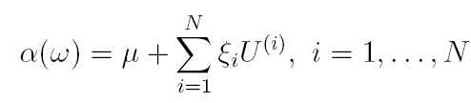
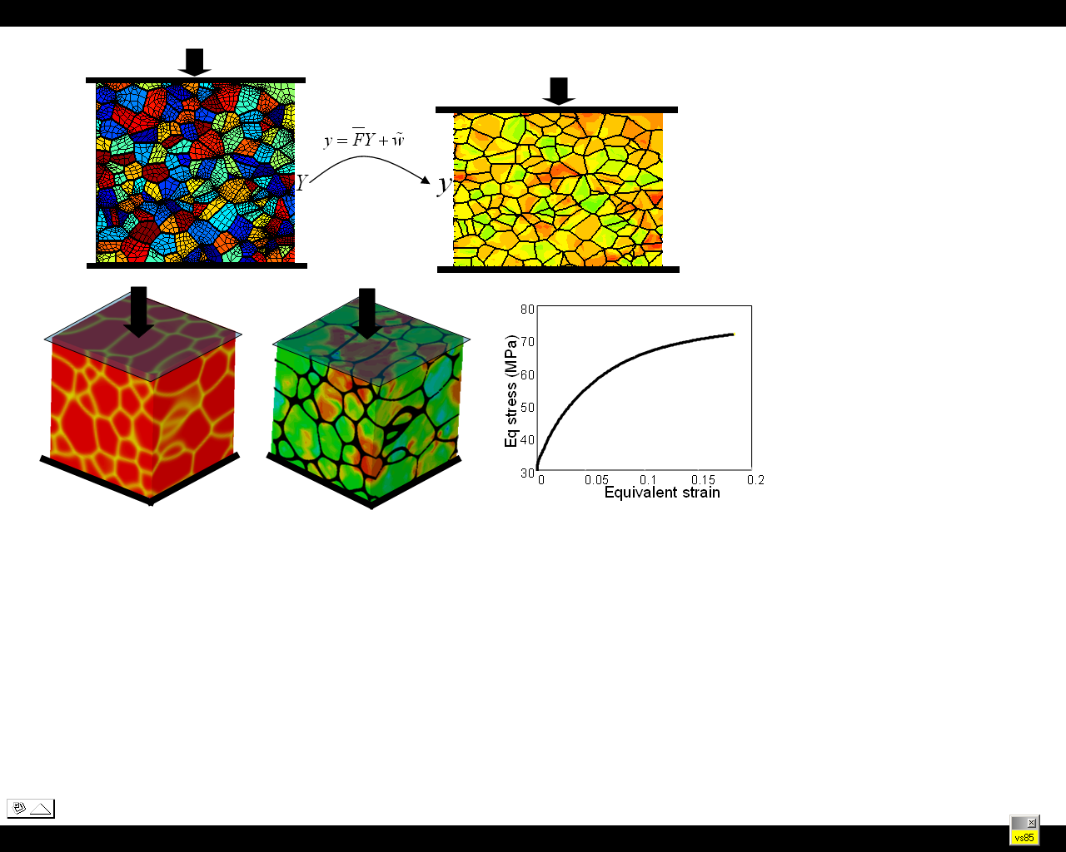
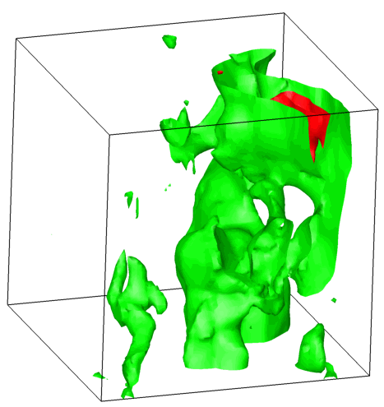
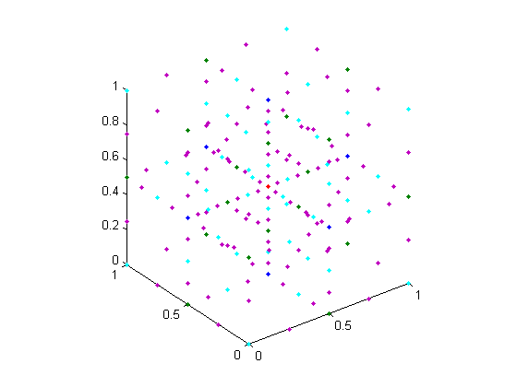
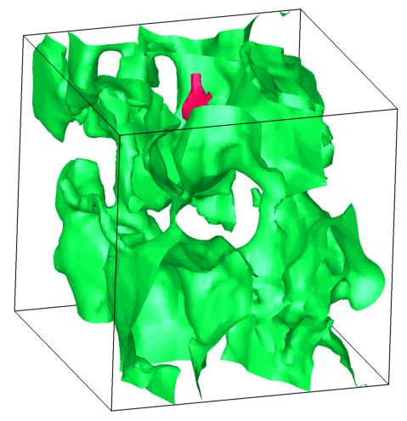
DATA DRIVEN STOCHASTIC ANALYSIS
MATHEMATICAL REPRESENTATION OF MICROSTRUCTURAL UNCERTAINTIES
AIM: UTILIZE DATA DRIVEN MODELS TO OBTAIN PDF’S OF PHYSICAL FIELDS THAT ARISE FROM THE RANDOMNESS OF THE TOPOLOGY AND PROPERTIES OF THE UNDERLYING MEDIUM.
1. Input uncertainty
Construct a reduced stochastic model from the data
2. Solve SPDE
Use stochastic collocation to solve high dimensional stochastic PDEs
Stochastic model
Develop reduced models for representing uncertainties in polycrystalline microstructures
Smolyak interpolation in reduced space
a₃
Initial microstructures
a₂
Process paths
m
A
n
R
B
Construct stochastic solution through solving deterministic problems in collocation points
PDFs and moments of dependant variable: Effect of random topology
B’
R’
m’
A’
n’
a₁
Notes:
The slide consists of an overview of the current status using data driven models to analyze thermal and deformation problems
The reduced order stochastic model serves as the input uncertainty to our stochastic analysis software. In this case we are interested in analyzing the effect of ``topological variations’’ on the thermal diffusion in the microstructure. We utilize a decoupled collocation based strategy to efficiently solve the high dimensional stochastic problem. Furthermore, the problem of multi length scale variation of properties is accounted through a variational multiscale formulation. A snapshot of probability distribution functions for two cases in the bottom center of the slide. The sharper PDF corresponds to microstructures that have the same two point correlations as the experimental image. The PDF with larger variance corresponds to the case where only the volume fractions of microstructures were used for computing microstructure reconstructions.
We are currently extending this approach for polycrystalline materials. The concept of reduced material representation has enabled creation of graphical maps (Sundararaghavan and Zabaras, Acta Materialia, 2007) that allow us to visualize the changes in microstructures when the material is being deformed as shown in the picture at the bottom right. These representations allow us to estimate the uncertainties in the final properties due to variability in microstructure.
``

Slide 7
Reduced model
Smolyak interpolation in reduced space
Stochastic model
Construct stochastic solution through solving deterministic problems in collocation points
Notes:
The slide consists of an overview of the current status using data driven models to analyze thermal and deformation problems
The reduced order stochastic model serves as the input uncertainty to our stochastic analysis software. In this case we are interested in analyzing the effect of ``topological variations’’ on the thermal diffusion in the microstructure. We utilize a decoupled collocation based strategy to efficiently solve the high dimensional stochastic problem. Furthermore, the problem of multi length scale variation of properties is accounted through a variational multiscale formulation. A snapshot of probability distribution functions for two cases in the bottom center of the slide. The sharper PDF corresponds to microstructures that have the same two point correlations as the experimental image. The PDF with larger variance corresponds to the case where only the volume fractions of microstructures were used for computing microstructure reconstructions.
We are currently extending this approach for polycrystalline materials. The concept of reduced material representation has enabled creation of graphical maps (Sundararaghavan and Zabaras, Acta Materialia, 2007) that allow us to visualize the changes in microstructures when the material is being deformed as shown in the picture at the bottom right. These representations allow us to estimate the uncertainties in the final properties due to variability in microstructure.
``

Slide 8
Construct stochastic solution through solving deterministic problems in collocation points
PDFs and moments of dependant variable: Effect of random topology
Notes:
The slide consists of an overview of the current status using data driven models to analyze thermal and deformation problems
The reduced order stochastic model serves as the input uncertainty to our stochastic analysis software. In this case we are interested in analyzing the effect of ``topological variations’’ on the thermal diffusion in the microstructure. We utilize a decoupled collocation based strategy to efficiently solve the high dimensional stochastic problem. Furthermore, the problem of multi length scale variation of properties is accounted through a variational multiscale formulation. A snapshot of probability distribution functions for two cases in the bottom center of the slide. The sharper PDF corresponds to microstructures that have the same two point correlations as the experimental image. The PDF with larger variance corresponds to the case where only the volume fractions of microstructures were used for computing microstructure reconstructions.
We are currently extending this approach for polycrystalline materials. The concept of reduced material representation has enabled creation of graphical maps (Sundararaghavan and Zabaras, Acta Materialia, 2007) that allow us to visualize the changes in microstructures when the material is being deformed as shown in the picture at the bottom right. These representations allow us to estimate the uncertainties in the final properties due to variability in microstructure.
``

