Slide 1
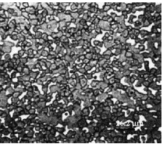
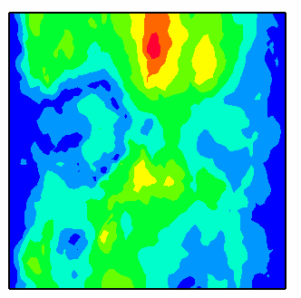
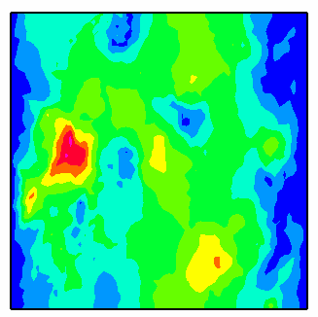
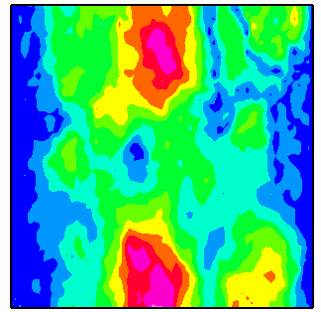
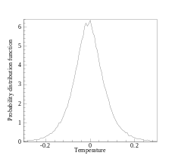
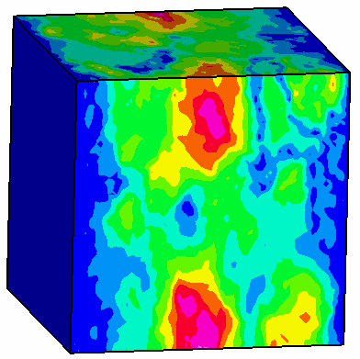
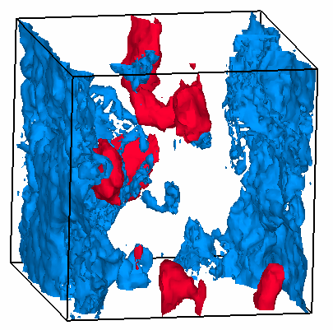
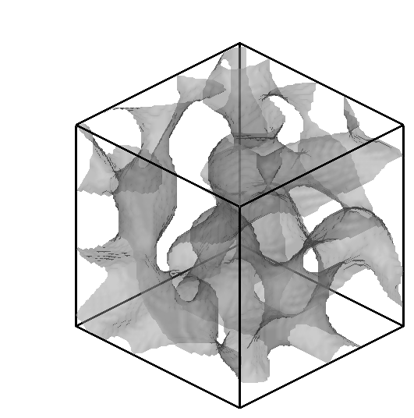
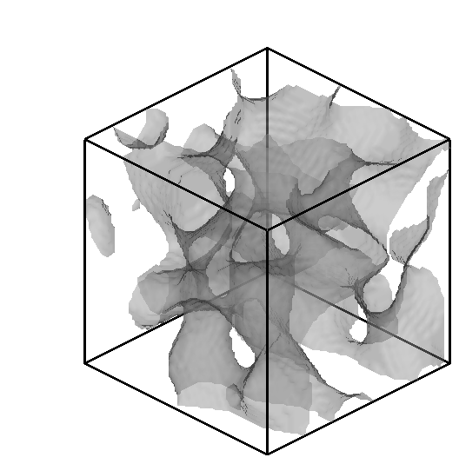
Data-driven strategies for stochastic representation of material property/structure
Cornell University, Nicholas Zabaras
Compute PDFs of dependent variables
Limited information
OBJECTIVES
Translate gappy experimental information about properties/topology into viable models that encode this uncertainty
Framework for rapid update of the stochastic solution when additional information becomes available
Develop an uncertainty quantification framework that precludes the necessity of any expert knowledge
Multiple 3D reconstructions
Reduced order stochastic model
APPROACH/TECHNICAL CHALLENGES
Non-linear techniques for generating input stochastic models. Nonlinear analysis based on the principle of Manifold learning (provides solutions where linear techniques, e.g. KLE or POD/PCA fail)
Coupling this input model with an adaptive spectral/collocation (Smolyak) based stochastic solver to investigate component performance
LONG-TERM PAYOFF:
Estimate sharp failure norms based on limited microstructural/property information
A paradigm shift in exploring multidimensional property/structure/
process maps
Provides a seamless framework for stochastic multiscale modeling and design of critical components
Notes:
1) The thermo-physical behavior of components depends on the underlying material composition/distribution (this is referred to as `structure’).
2) We can only extract limited experimental information about the microstructure/properties of a specimen (limited by time and money and infrastructure)
3) Have to use this gappy information/data to provide a good description of the physical process - when will it fail, where will it possibly fail, how will it fail, etc.
Going beyond materials, knowing the structure of a random medium is the most essential information needed to analyze flow, thermal behavior, pollution, etc.
(flow in random heterogeneous media, reservoirs, contamination, etc.)
4) The first step is to convert this limited data into mathematical stochastic models that describe this variation:
The figure showcases the methodology: we start from limited information of the topology of the micorstruture. (here given just one 2D image of a metal-metal composite), Extract pertinent lower-order statistics from the image (volume fraction of one component, two-point correlation that the material distribution satisfies ..ect.)
Then construct a viable reduced order model of the thermal property variation due to this limited information (this variation is due to the fact that all microstructures that satisfy this volume-fraction and two-point correlation are plausible). This construction is based on generating multiple sets of viable 3D microstructures. The model reduction techniques
developed here can be applied to any data-driven problem (including deterministic problems). In the context of stochastic models, KLE or POD techniques cannot be
applied (in a stochastic sense) as they lead to high-dimensionality of the underlying stochastic support space --- basically leading to intractable models.
Solve a stochastic partial differential equation with this model as input. The color picture shows the standard deviation of temperature. The plot is the probability density function of the variation of temperature at a point in the sample. These statistics are induced by the topological uncertainty arising from the limited data. Note that in computing this
variability one does not need to assume anything beyond the given data – no correlation lengths or correlation kernels, no KLE expansion, etc. etc.
This methodology has major ramifications in providing quick, sharp and accurate failure norms based on limited information.
The concept of the reduced descriptor (as a surrogate space) is a major breakthrough in exploring high dimensional rocess/property/structure maps in low-dimension.
Can naturally incorporate a multiscale framework of analysis

Slide 2
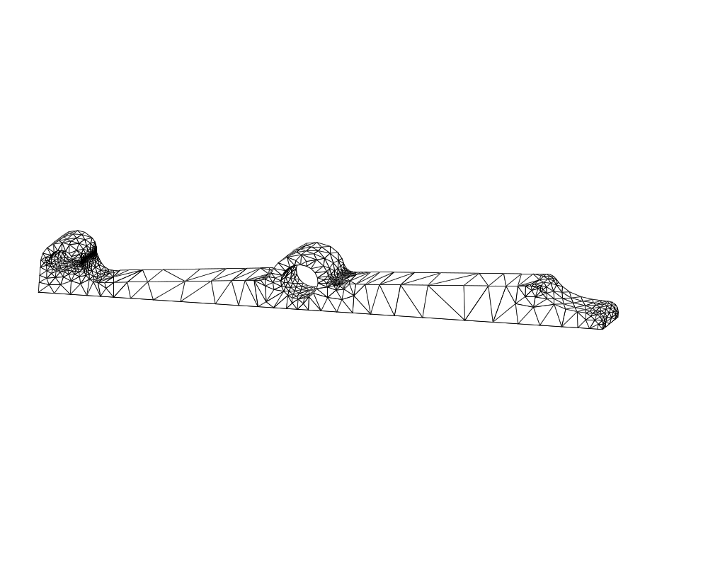
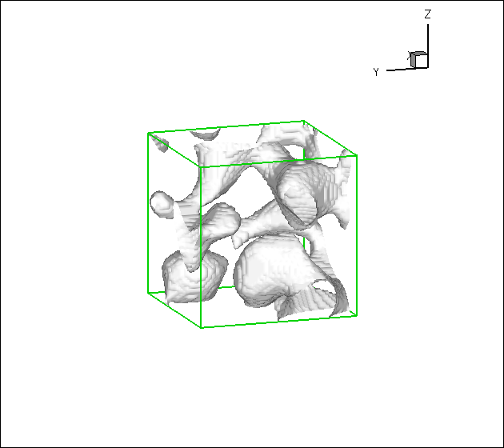
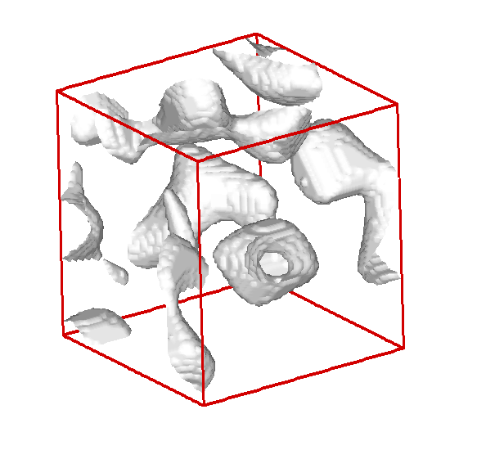
Multiscale analysis and design in the presence of uncertainty
Cornell University, Nicholas Zabaras
OBJECTIVES
Information theoretic framework for quantifying inter- and intra-scale uncertainty propagation
Probabilistic framework for predicting scale of failure and pinpoint scale of experimental interrogation
Efficient mathematical algorithms for addressing curse-of-dimensionality
Uncertainties at multiple scales
APPROACH/TECHNICAL CHALLENGES
A non intrusive multiscale framework for stochastic analysis.
Uncertainty quantification and transfer: Ideas from information theory, stochastic homogenization and multiscale methods.
Translate ideas from geometric integration and symplectic methods for accurate long term integration of SPDEs.
Discretization and adaptivity in multidimensional stochastic spaces
LONG-TERM PAYOFF:
Robust multiscale design for enhanced performance of critical components in the presence of physical uncertainty and operational variability
Advances in solution strategies for multiscale SPDEs and fast uncertainty visualization techniques to accelerate decision-making in complex systems
Notes:
1) Uncertainties and limited information encountered in multiple forms and across multiple scales. For an accurate analysis and design of critical components, one has to quantify the interaction and propagation of uncertainties.
2) The figure shows a nozzle flap:- a component in a turbine engine. There is operational variability encountered via the uncertainty in the heat flux on the flap. The exact composition of the flap (at the micro scale) is unknown (and varies across the component). With these multiple sources of uncertainty (at multiple length scales), one has to predict the maximum safe operating condition, when the flap would fail, etc.
3) Have to quantify how the uncertainty propagates across scales and interacts/changes the dynamics in the presence of other uncertainties.
4) Ideas from stochastic hoomogenization, information theory and efficient stochastic multiscale methods are utilized to develop an information-theoritic framework Information
theory allows to quantify information at each scale as well as control the propagation of information (statistics) across scales (e.g. you cannot assume arbitrary statistics in two successive scales due to the inherent physical homogenization induced as noise propagates from one scale to another.
4) This analysis naturally leads to answering the problem of where (in which scale/region) failure will occur. This has major payoffs by pinpointing the exact scale at which experimental interrogation/observation is necessary to enhance performance. Basically, if you know at which scale failure initiates, you can refine/adapt models in that scale as well as interrogate the material experimentally at that scale. Note that experimental data at one scale don’t always provide useful information at another scale – that is something we want to be able to compute (multiscale estimation).
5) Has major payoffs in design of components with enhanced performance and in accelerted decision making

