Slide 1
Racialised language in
German swimming-pool reviews
Preliminary quantitative findings | Ethel Mensah | 14 July 2026
First-pass results, meant to spark discussion — not a finished result.

Slide 2
The question
Do Google Maps reviews of German swimming pools ever describe
experiences in racial or ethnic terms?
And if so — is that spread evenly across the country, or is it concentrated in certain places, and does it line up with anything we know about those places?
This splits into three concrete research questions — the throughline for everything that follows.

Slide 3
Three research questions
RQ1
Where and when does racialised discourse concentrate — is that spatially structured, or just incidental?
RQ2
What features of a place are associated with this, net of confounding between those features?
RQ3
Does the CONTENT of racialised discourse — not just how often it happens — vary systematically by place?
This deck walks through what each of these looks like in the data so far — and closes by coming back to all three.

Slide 4
What we're looking at
1.27M
5,529
1 in 65
Google Maps reviews
of swimming pools
swimming-pool venues
across Germany
social reviews mentions
race / ethnicity / nationality
(1.5% overall)
Every review was read by a classifier that flags (a) whether it describes a social interaction at all, and (b) whether that description is racialised. We focus on the ~504,000 reviews that describe a social interaction.

Slide 5
RQ1 — WHERE & WHEN
What the reviews alone can tell us
Using nothing but the Google Maps review data itself — no outside data yet.

Slide 6
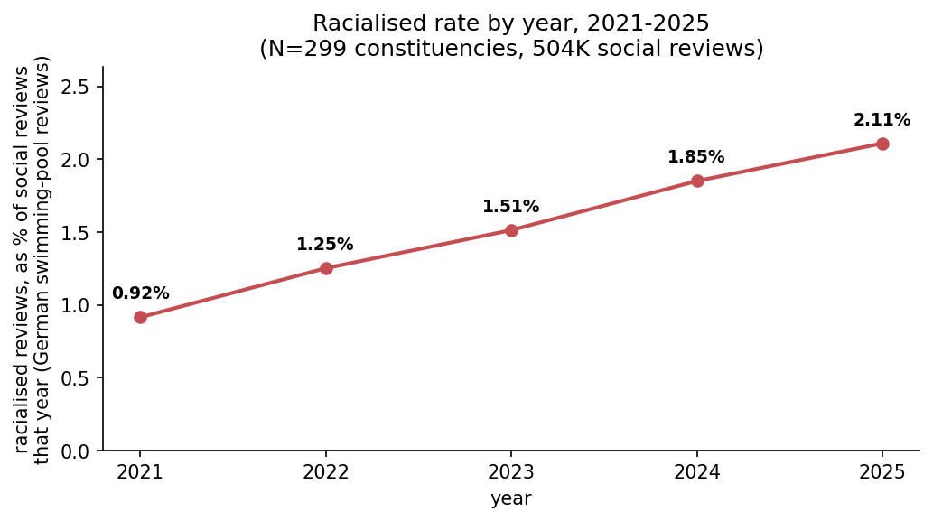
Finding 1 — it's becoming more common
The rate has more than doubled since 2021 (0.9% → 2.1%) — a steady climb, not a one-off spike.

Slide 7
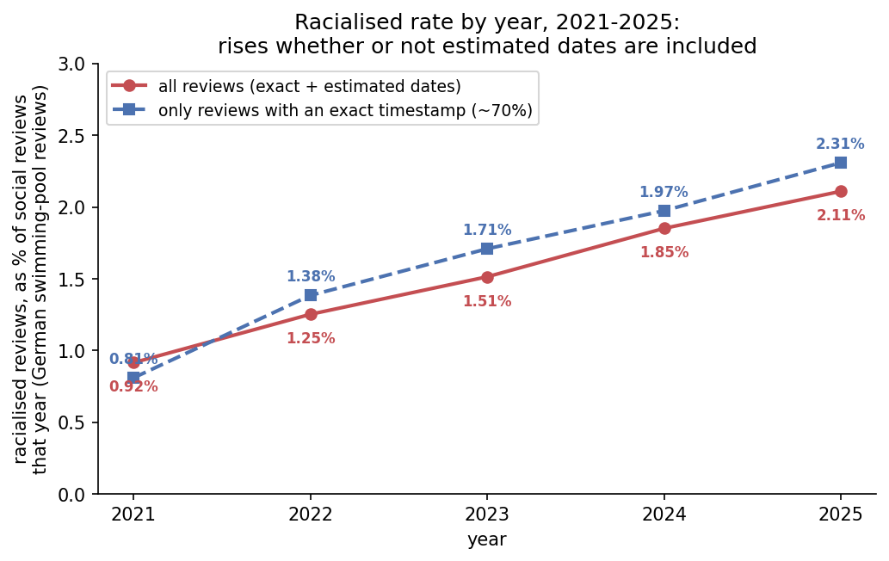
Checking ourselves — is the rise real?
Some review dates had to be estimated (Google's "2 years ago" style text). The rising trend looks the same whether we use all reviews or only the ~70% with an exact date — so it's not an artifact of the estimation.

Slide 8
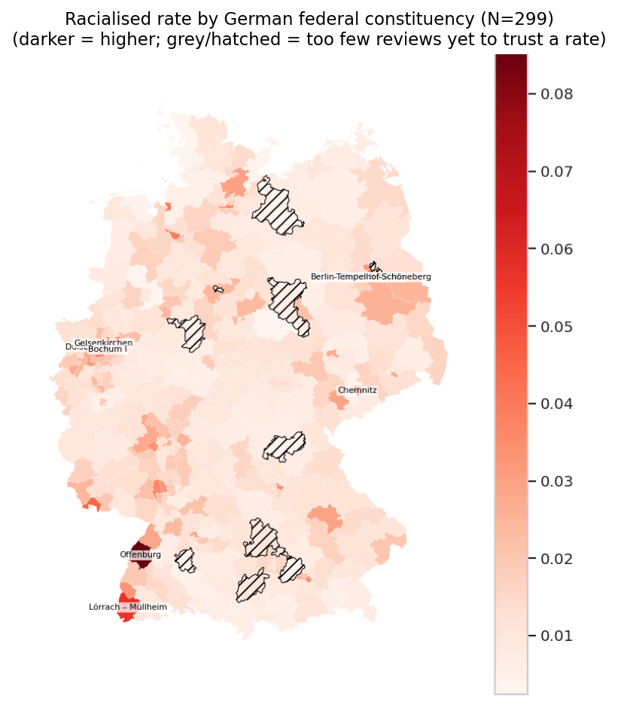
Finding 2 — it's not spread evenly
Darker = higher rate. Some constituencies stand out consistently — this is real geographic clustering, not random scatter. (Hatched areas simply don't have enough reviews yet to trust a rate.)

Slide 9
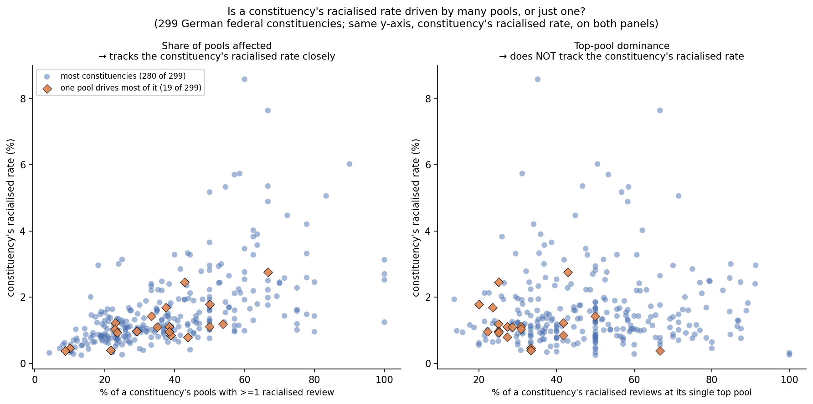
Finding 3 — it's not just one bad pool
Left: places with a higher rate are places where MORE of their pools have a flagged review — a broad pattern. Right: how much one single pool dominates has no bearing on the overall rate. Together: this is a neighbourhood-wide pattern, not a few bad venues (with a small, clearly-flagged 6% exception).

Slide 10
RQ2 — WHAT FEATURES OF A PLACE
Linking it to the neighbourhood
Joining each constituency's rate to public census, income, unemployment, and election data — does the rate track any of it?

Slide 11
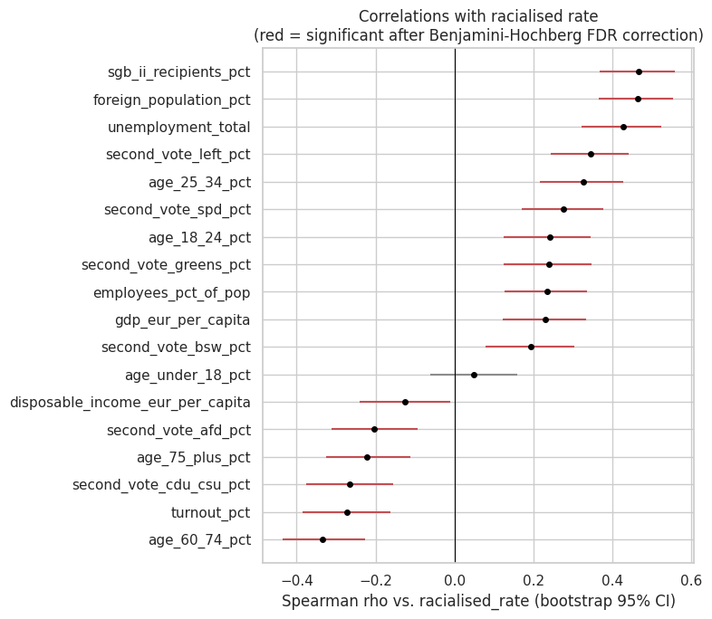
First look — what tracks with the rate?
18 socioeconomic and political measures tested at once, one at a time. Red = still stands after a strict statistical correction for testing so many things together. At first glance, 17 of 18 look related — deprivation, age, every party's vote share, even turnout.

Slide 12
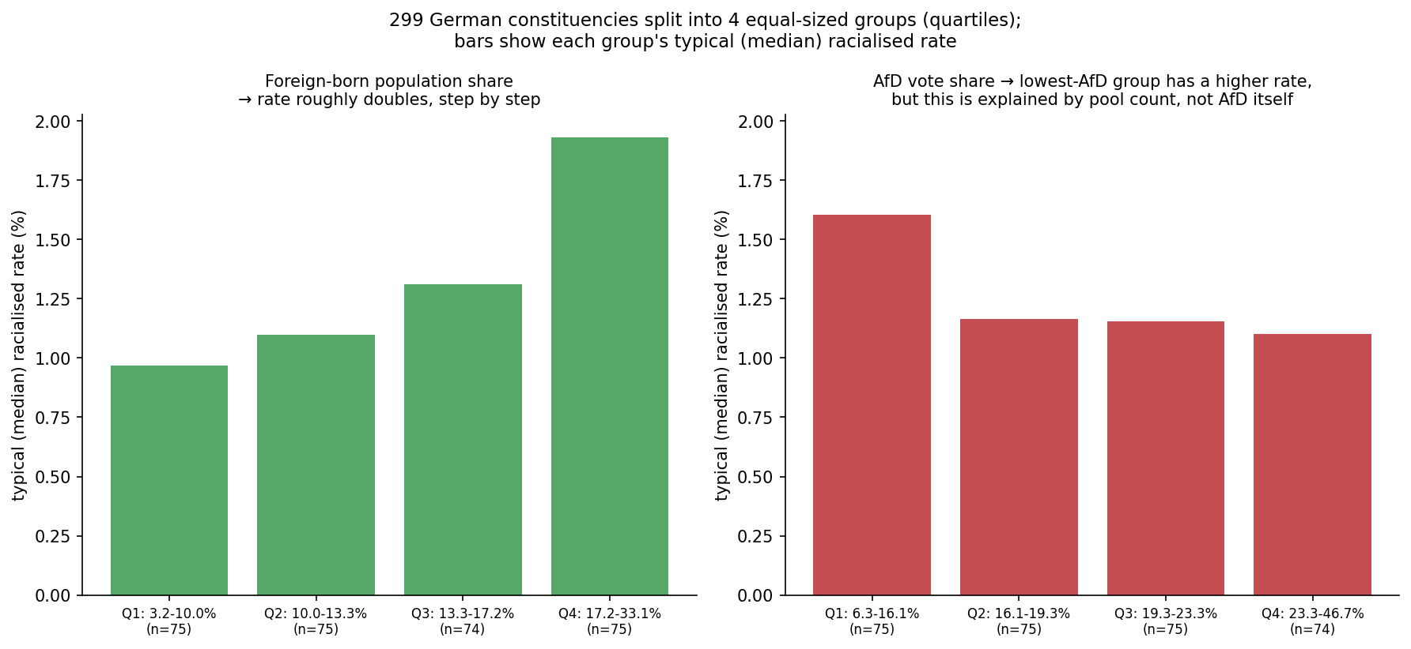
Finding 4 — where more foreign-born residents live, the rate is higher
Left: neighbourhoods with the most foreign-born residents have roughly double the typical rate of those with the fewest — a steady, statistically real step up. Right: an AfD-vote-share pattern looked interesting at first, but it's explained by pool count, not by AfD itself.

Slide 13
Putting real places on Finding 4
Highest foreign-born population share
Lowest foreign-born population share
Constituency | State | Foreign-born % | Racialised %
Frankfurt am Main I | Hessen | 33.1 | 2.53
München-Nord | Bayern | 30.4 | 1.99
Stuttgart II | Baden-Württemberg | 30.2 | 3.00
Offenbach | Hessen | 29.2 | 1.19
München-Süd | Bayern | 27.8 | 1.01
Constituency | State | Foreign-born % | Racialised %
Chemnitzer Umland – Erzgebirgskreis II | Sachsen | 3.2 | 0.39
Mansfeld | Sachsen-Anhalt | 3.7 | 1.22
Bautzen I | Sachsen | 4.0 | 0.71
Erzgebirgskreis I | Sachsen | 4.1 | 0.82
Meckl. Seenplatte II – LK Rostock III | Meck.-Vorpommern | 4.3 | 0.63
Reading it simply: the high-foreign-population end is mostly big-city constituencies (Frankfurt, Munich, Stuttgart) with rates mostly above the 1.5% national average; the low end is mostly eastern/rural constituencies (Saxony, Saxony-Anhalt, Mecklenburg-Vorpommern) with rates mostly below it. Not a perfect ladder for every single constituency — Offenbach, for instance, is high-foreign-population but has a below-average rate — which is exactly why we look at the group pattern rather than any one place.

Slide 14
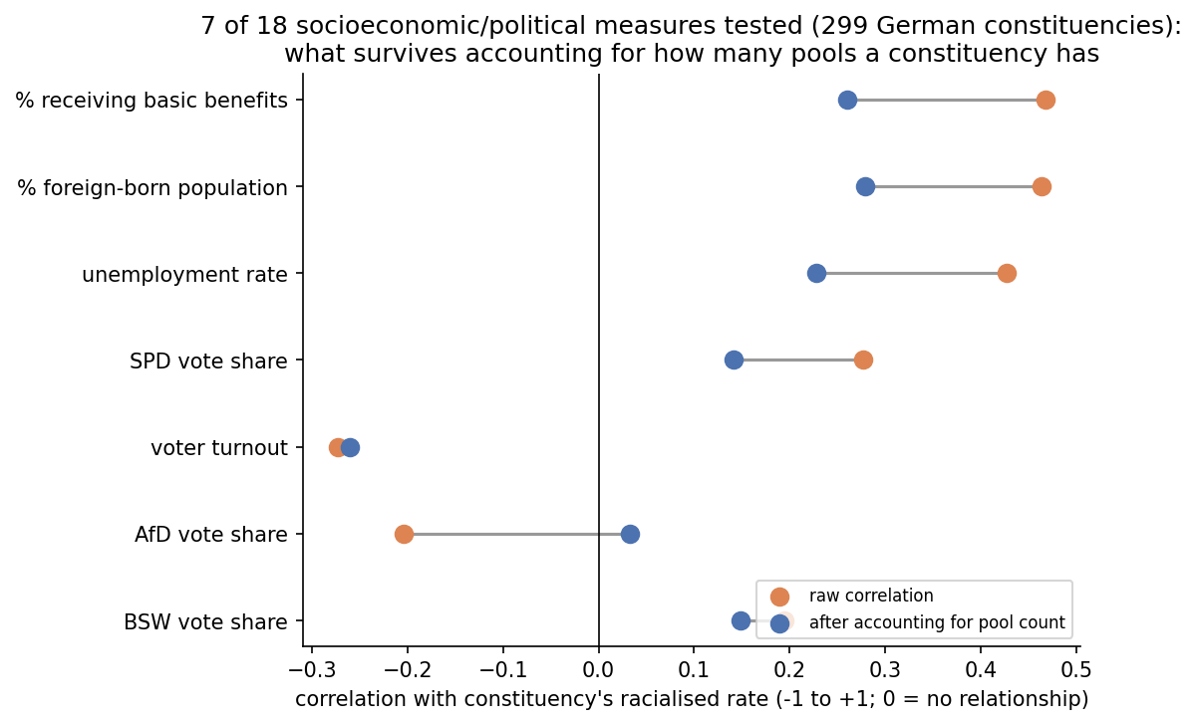
Finding 5 — most of that first look washes out
Checking all 18 against how many pools a constituency has, only 7 survive at all — and most of those shrink noticeably (orange → blue). Foreign-born population share and benefits-receipt shrink the least — the strongest, most durable signals we have so far.

Slide 15
Finding 6 — does it survive one model with everything at once?
Deprivation, pool count, age structure, vote shares, turnout — all together in a single model, rather than one at a time.
Each additional percentage point of foreign-born population in a constituency is associated with about a 3% higher racialised-review rate — even holding every other factor fixed.
Foreign-born population share is the one factor that survives cleanly — alone, after the pool-count check, and now in this combined model too.
Nothing else did as well: most factors weakened to nothing, or turned out too entangled with each other to separate (e.g. unemployment and benefits-receipt largely measure the same thing).
Honest caveat: this is the most preliminary of the findings so far — a first-pass model, still leaves some of the geographic clustering unexplained, and the piece most likely to change next iteration.

Slide 16
Coming back to the three research questions
RQ1
Where and when does racialised discourse concentrate, and is that spatially structured or incidental?
Answered — ready to write up close to as-is
A real rise over time, genuine geographic clustering confirmed statistically (not just visually), and confirmed to be a broad area pattern rather than a handful of venues.
RQ2
What features of a place are associated with this, net of confounding between those features?
First pass done — real, but incomplete
Foreign-born population share is the one predictor that survives every check, including a joint model with everything else accounted for at once. Still open: two deprivation measures too collinear to separate, and some of the geographic clustering still unexplained.
RQ3
Does the CONTENT of racialised discourse — not just how often it happens — vary systematically by place?
Not covered today — kept out to stay focused
An early look suggests themes shift modestly by region while overall tone doesn't. Worth a follow-up once the theme/approach labels have been through inter-annotator agreement checks — not finished yet.
See 04_presentation_summary.ipynb — "Research questions — what's answered, and what's next"

