Slide 1
LOVE-HUNON

Slide 2
Introduction
The most common problem of small laundry shop is they don’t know how to market their services digitally and they want to engage a strong relationship between their customers to raise their profit. This system targets all the Lavada Queen in Cebu because this is our everyday needs, we want our clothes to be cleaned. Laundry shop is marketable this day and we want them to connects trough Latest technology since these days we our surrounded with internet and smart phones.

Slide 3
Purpose and Description
This project aims to assess the service quality of Lavada Queen Laundry shop in order to improve its services to provide insights into the process of service quality measurement at Lavada Queen Laundry shop to contribute to the knowledge base in laundry service quality and practice.

Slide 4
Scope and Limitations
The scope of the project covers the Love-hunon of the Laundry shop online services System. The study will include the online connection and how it helps the customers to find nearest Laundry shop. It focuses in market, manage customers and manage wash clothes, free delivery at the given conditions.

Slide 5
Significance of the Project
Managing the shop at the same time marketing services is a big factor in creating start up business, that’s why we conduct a brainstorming on how to solve this problem that benefits both the laundry shop and the customer. The research serves as an insight on how laundry shop become marketable in terms of digital.

Slide 6
Objectives
As we gather the problems and making a pitching on it, we create Love-Hunon system to make small laundry shop marketable, earn profits, meet satisfaction of the customer, engages long term relationship and also to manages their process by automation. In customer’s side we want them to avoid time consuming in terms of location shop nearby, inquiring through real time chat, and notification for the finish laundry.

Slide 7
Theoretical Background
Love-hunon system is the collective term for various combinations of marketing, management strategies and method that are employed to keep a laundry shop profitable at the same time saves customer a lot of time. The process of this type of management is often associated with all branches of Lavada Queen Laundry Shop in Cebu who register our system.

Slide 8
Review of Related Literature
Most of the people around us are very busy in their work they maximized their time in working, in business and in earning. Sometimes or almost of the time they really have no time for household chores because they are tired after working and they just want a rest for their remaining hour.

Slide 9
Methodology
Environment
Study Locale:
The study was conducted to help laundry shop at the same time help customer in terms of laundry process. The app fill the gap of laundry shop problem of marketing aspects.
The Love-hunon team conducts interview to know what specific problems to be solved digitally. As we gather information we initiate the system to solve their problem. And as a customer they also encountered problems in laundry processing.

Slide 10
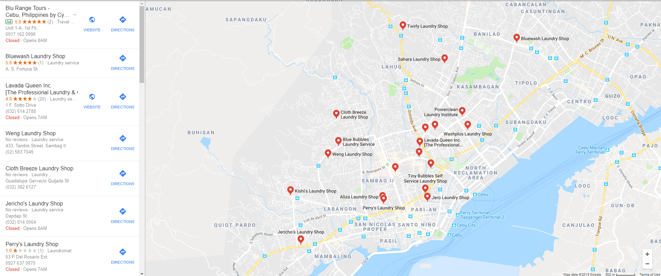
Population of the Study:
The system catered all laundry shop in Cebu City since Cebu city have many laundry shop.
As you can see in the map all pinned icon are all laundry shop in Cebu City

Slide 11
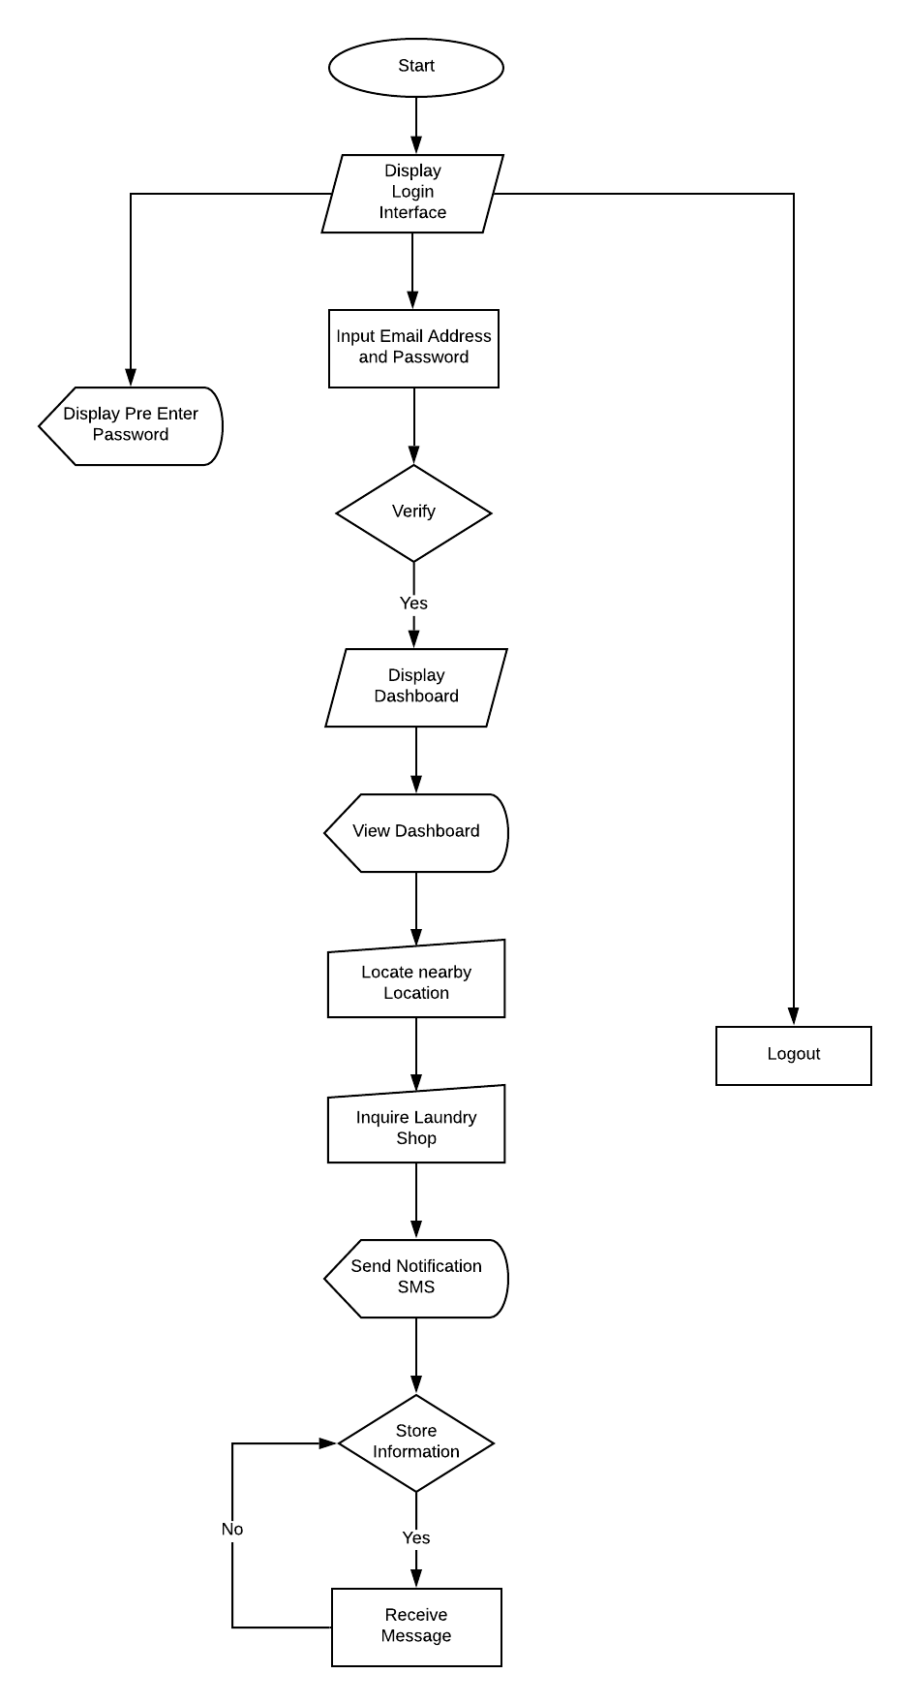
System Flowchart

