Slide 1

Intelligent Data Mining
Ethem Alpaydın
Department of Computer Engineering
Boğaziçi University
alpaydin@boun.edu.tr

Slide 2

What is Data Mining ?
Search for very strong patterns (correlations, dependencies) in big data that can generalise to accurate future decisions.
Aka Knowledge discovery in databases, Business Intelligence

Slide 3
Example Applications
Association
“30% of customers who buy diapers also buy beer.” Basket Analysis
Classification
“Young women buy small inexpensive cars.”
“Older wealthy men buy big cars.”
Regression
Credit Scoring

Slide 4
Example Applications
Sequential Patterns
“Customers who latepay two or more of the first three installments have a 60% probability of defaulting.”
Similar Time Sequences
“The value of the stocks of company X has been similar to that of company Y’s.”

Slide 5
Example Applications
Exceptions (Deviation Detection)
“Is any of my customers behaving differently than usual?”
Text mining (Web mining)
“Which documents on the internet are similar to this document?”

Slide 6
IDIS – US Forest Service
Identifies forest stands (areas similar in age, structure and species composition)
Predicts how different stands would react to fire and what preventive measures should be taken?

Slide 7
GTE Labs
KEFIR (Key findings reporter)
Evaluates health-care utilization costs
Isolates groups whose costs are likely to increase in the next year.
Find medical conditions for which there is a known procedure that improves health condition and decreases costs.

Slide 8
Lockheed
RECON Stock portfolio selection
Create a portfolio of 150-200 securities from an analysis of a DB of the performance of 1,500 securities over a 7 years period.

Slide 9
VISA
Credit Card Fraud Detection
CRIS: Neural Network software which learns to recognize spending patterns of card holders and scores transactions by risk.
“If a card holder normally buys gas and groceries and the account suddenly shows purchase of stereo equipment in Hong Kong, CRIS sends a notice to bank which in turn can contact the card holder.”

Slide 10
ISL Ltd (Clementine) - BBC
Audience prediction
Program schedulers must be able to predict the likely audience for a program and the optimum time to show it.
Type of program, time, competing programs, other events affect audience figures.

Slide 11

Data Mining is NOT Magic!
Data mining draws on the concepts and
methods of databases, statistics, and
machine learning.

Slide 12



From the Warehouse to the Mine
Standard
form
Data
Warehouse
Transactional
Databases
Extract,
transform,
cleanse data
Define goals,
data transformations

Slide 13
How to mine?
Verification | Discovery
Computer-assisted, User-directed, Top-down Query and Report OLAP (Online Analytical Processing) tools | Automated, Data-driven, Bottom-up

Slide 14
Steps:
1. Define Goal
Associations between products ?
New market segments or potential customers?
Buying patterns over time or product sales trends?
Discriminating among classes of customers ?

Slide 15
Steps:
2. Prepare Data
Integrate, select and preprocess existing data (already done if there is a warehouse)
Any other data relevant to the objective which might supplement existing data

Slide 16
Steps:
2. Prepare Data (Cont’d)
Select the data: Identify relevant variables
Data cleaning: Errors, inconsistencies, duplicates, missing data.
Data scrubbing: Mappings, data conversions, new attributes
Visual Inspection: Data distribution, structure, outliers, correlations btw attributes
Feature Analysis: Clustering, Discretization

Slide 17
Steps:
3. Select Tool
Identify task class
Clustering/Segmentation, Association, Classification,
Pattern detection/Prediction in time series
Identify solution class
Explanation (Decision trees, rules) vs Black Box (neural network)
Model assesment, validation and comparison
k-fold cross validation, statistical tests
Combination of models

Slide 18
Steps:
4. Interpretation
Are the results (explanations/predictions) correct, significant?
Consultation with a domain expert

Slide 19
Example
Data as a table of attributes
Name
Income
Owns a house?
Marital status
Default
Ali
25,000 $
Yes
Married
No
Veli
18,000 $
No
Married
Yes
We would like to be able to explain the value of one attribute in terms of the values of other attributes that are relevant.

Slide 20
Modelling Data
Attributes x are observable
y =f (x) where f is unknown and probabilistic
f
x
y

Slide 21
Building a Model for Data
f
y
x
-
f*

Slide 22
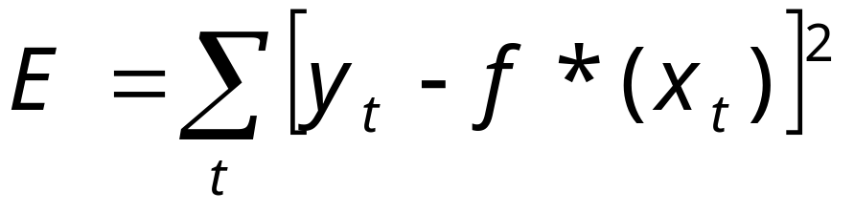
Learning from Data
Given a sample X={x_{t},y_{t}}_{t}
we build f*(x_{t}) a predictor to f (x_{t}) that minimizes the difference between our prediction and actual value

Slide 23
Types of Applications
Classification: y in {C₁, C₂,…,C_{K}}
Regression: y in Re
Time-Series Prediction: x temporally dependent
Clustering: Group x according to similarity

Slide 24
Example
savings
OK
DEFAULT
Yearly income

Slide 25
Example Solution
x₂ : savings
OK
DEFAULT
θ₂
θ₁
x₁ : yearly-income
RULE: IF yearly-income> θ₁ AND savings> θ₂
THEN OK ELSE DEFAULT

Slide 26
Decision Trees
x₁ : yearly income
x₂ : savings
y = 0: DEFAULT
y = 1: OK
x₁ > θ₁
yes
no
x₂ > θ₂
y = 0
yes
no
y = 1
y = 0

Slide 27
Clustering
savings
OK
DEFAULT
Type 1
Type 2
Type 3
yearly-income

Slide 28

Time-Series Prediction
?
time
Jan Feb Mar Apr May Jun Jul Aug Sep Oct Nov Dec Jan
Discovery of frequent episodes
Past
Future
Present

Slide 29
Methodology
Accept
best if
good
enough
Train
set
Predictor 1
Initial
Standard
Form
Choose
best
Best
Predictor
Predictor 2
Test trained
predictors on
test data and
choose best
Predictor L
Test
set
Data reduction:
Value and feature
Reductions
Train alternative
predictors on
train set

Slide 30
Data Visualisation
Plot data in fewer dimensions (typically 2) to allow visual analysis
Visualisation of structure, groups and outliers

Slide 31
Data Visualisation
savings
Rule
Exceptions
Yearly income

Slide 32
Techniques for
Training Predictors
Parametric multivariate statistics
Memory-based (Case-based) Models
Decision Trees
Artificial Neural Networks

Slide 33
Classification
x : d-dimensional vector of attributes
C₁ , C₂ ,... , C_{K} : K classes
Reject or doubt
Compute P(C_{i}|x) from data and
choose k such that
P(C_{k}|x)=max_{j} P(C_{j}|x)

Slide 34
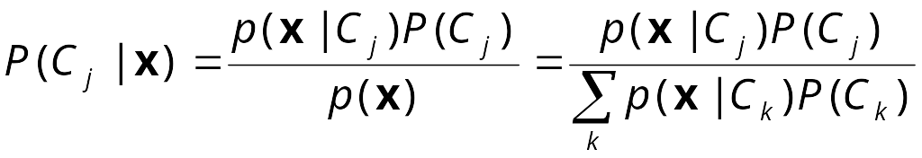
Bayes’ Rule
p(x|C_{j}) : likelihood that an object of class j has its features x
P(C_{j}) : prior probability of class j
p(x) : probability of an object (of any class) with feature x
P(C_{j}|x) : posterior probability that object with feature x is of class j

Slide 35

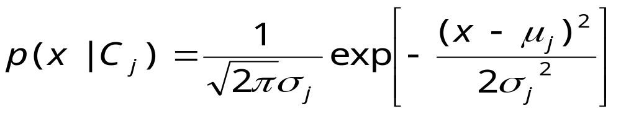
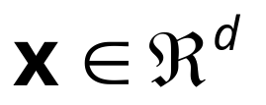
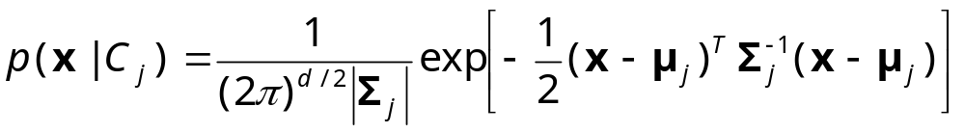
Statistical Methods
Parametric e.g., Gaussian, model for class densities, p(x|C_{j})
Univariate
Multivariate

Slide 36
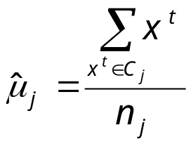
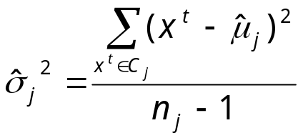
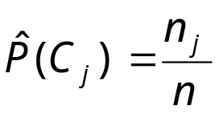
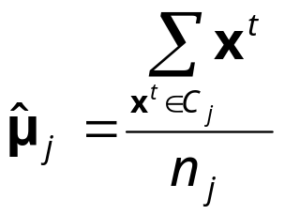
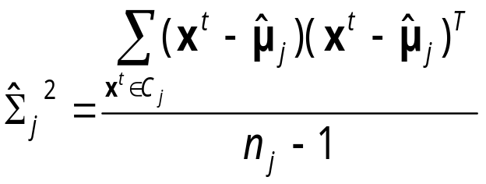
Training a Classifier
Given data {x^{t}}_{t} of class C_{j}
Univariate: p(x|C_{j}) is N (μ_{j},σ_{j}²)
Multivariate: p(x|C_{j}) is N_{d} (μ_{j},Σ_{j})

Slide 37
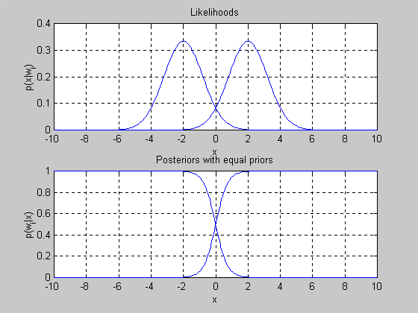
Example: 1D Case

Slide 38
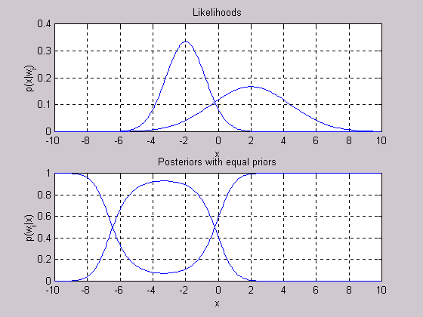
Example: Different Variances

Slide 39
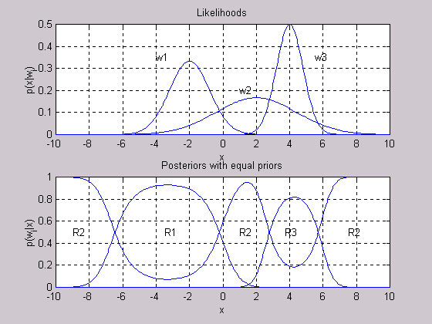
Example: Many Classes

Slide 40
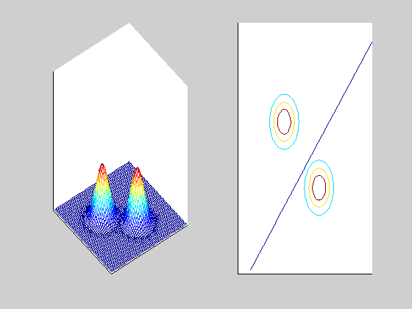
2D Case: Equal Spheric Classes

Slide 41
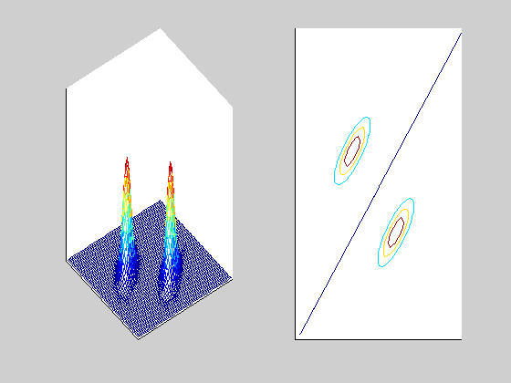
Shared Covariances

Slide 42
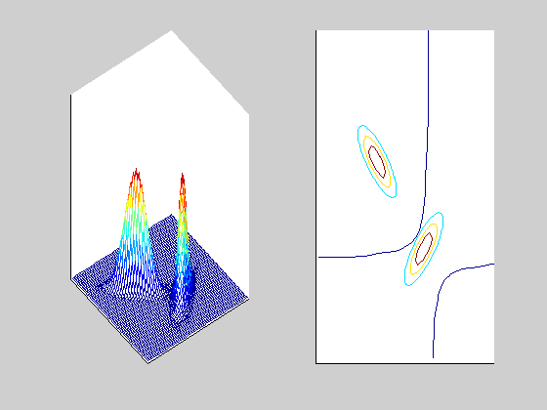
Different Covariances

Slide 43
Actions and Risks
α_{i} : Action i
λ(α_{i}|C_{j}) : Loss of taking action α_{i} when the situation is C_{j}
R(α_{i} |x) = Σ_{j} λ(α_{i}|C_{j}) P(C_{j} |x)
Choose α_{k} st
R(α_{k} |x) = min_{i} R(α_{i} |x)

Slide 44
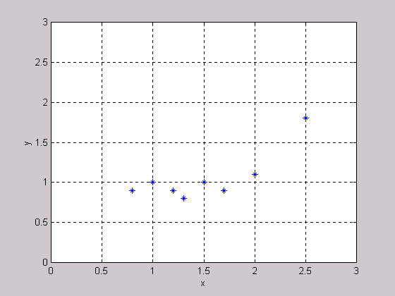
Function Approximation (Scoring)

Slide 45
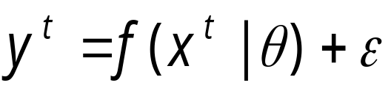
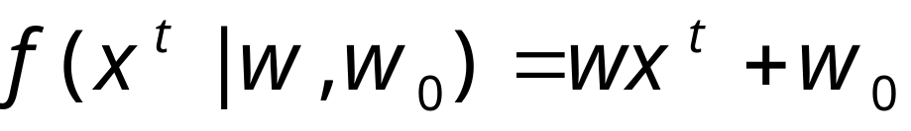
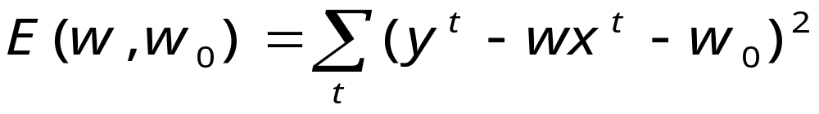
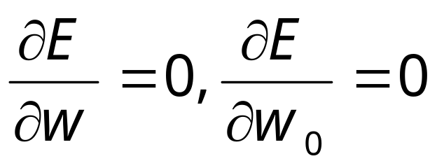
Regression
where ε is noise. In linear regression,
Find w,w₀ st
E
w

Slide 46
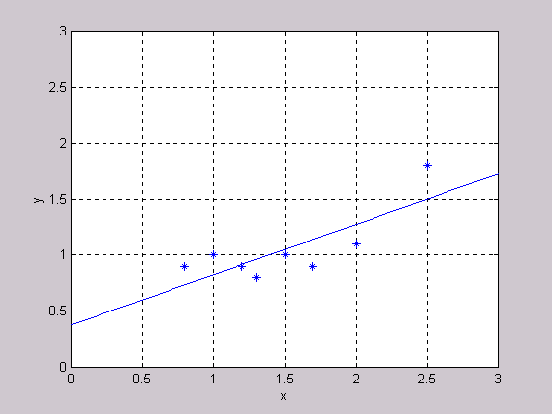
Linear Regression

Slide 47
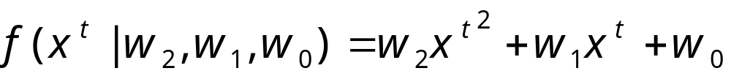
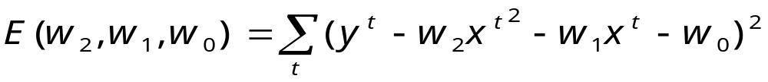
Polynomial Regression
E.g., quadratic

Slide 48
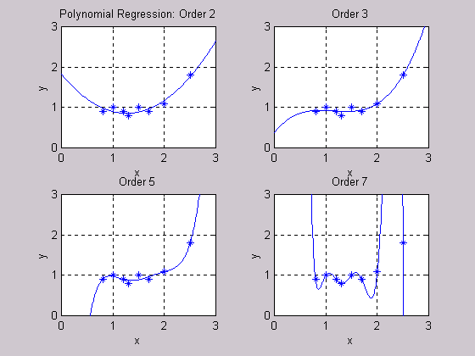
Polynomial Regression

Slide 49
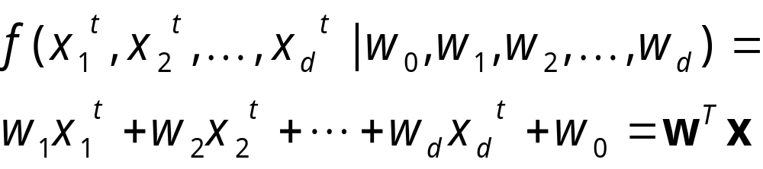
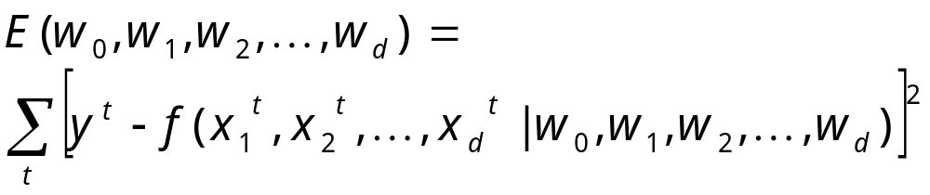
Multiple Linear Regression
d inputs:

Slide 50
Feature Selection
Subset selection
Forward and backward methods
Linear Projection
Principal Components Analysis (PCA)
Linear Discriminant Analysis (LDA)

Slide 51
Sequential Feature Selection
Forward Selection
Backward Selection
(x₁) (x₂) (x₃) (x₄)
(x₁ x₂ x₃ x₄)
(x₁ x₃) (x₂ x₃) (x₃ x₄)
(x₁ x₂ x₃) (x₁ x₂ x₄) (x₁ x₃ x₄) (x₂ x₃ x₄)
(x₁ x₂ x₃) (x₂ x₃ x₄)
(x₂ x₄) (x₁ x₄) (x₁ x₂)

Slide 52
Principal Components Analysis (PCA)
z₂
x₂
z₂
z₁
x₁
z₁
Whitening
transform

Slide 53
Linear Discriminant Analysis (LDA)
x₂
z₁
z₁
x₁

Slide 54
Memory-based Methods
Case-based reasoning
Nearest-neighbor algorithms
Keep a list of known instances and interpolate response from those

Slide 55
Nearest Neighbor
x₂
x₁

Slide 56
Local Regression
y
x
Mixture of Experts

Slide 57
Missing Data
Ignore cases with missing data
Mean imputation
Imputation by regression

Slide 58
Training Decision Trees
x₂
x₁ > θ₁
yes
no
x₂ > θ₂
y = 0
θ₂
yes
no
y = 1
y = 0
x₁
θ₁

Slide 59
Measuring Disorder
x₂
x₂
θ
x₁
θ
x₁
7
0
1
9
8
5
0
4

Slide 60
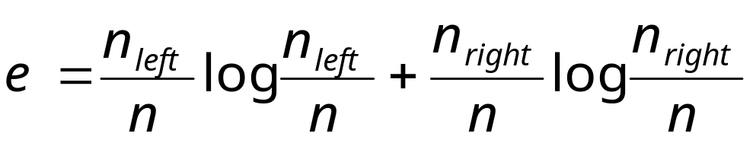
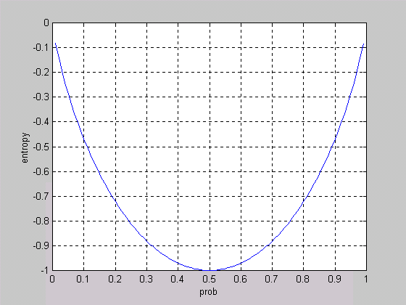
Entropy

Slide 61
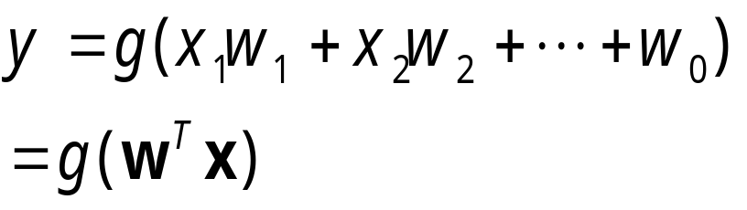
Artificial Neural Networks
x₀=+1
x₁
w₁
w₀
x₂
g
w₂
y
w_{d}
Regression: Identity
Classification: Sigmoid (0/1)
x_{d}

Slide 62
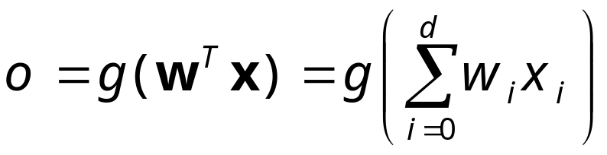
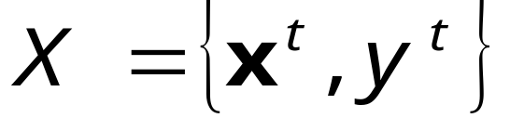
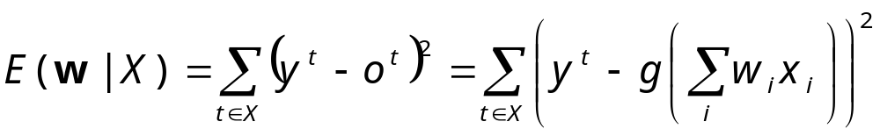
Training a Neural Network
d inputs:
Training set:
Find w that min E on X

Slide 63
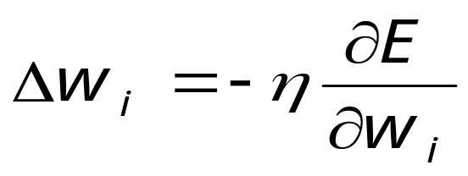
Nonlinear Optimization
E
w_{ı}
Gradient-descent:
Iterative learning
Starting from random w
η is learning factor

Slide 64
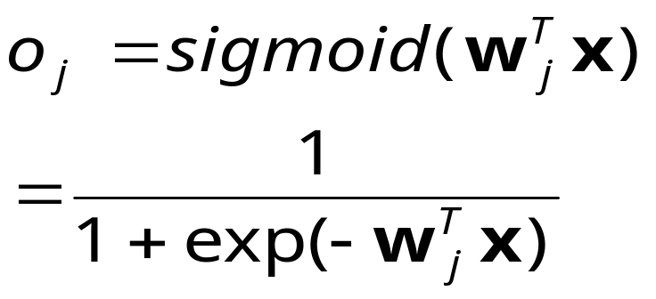
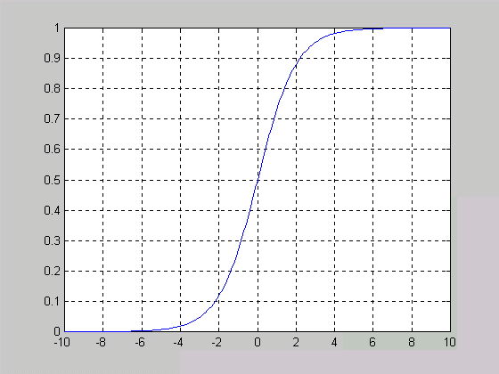
Neural Networks for Classification
K outputs o_{j} , j=1,..,K
Each o_{j} estimates P (C_{j}|x)

Slide 65
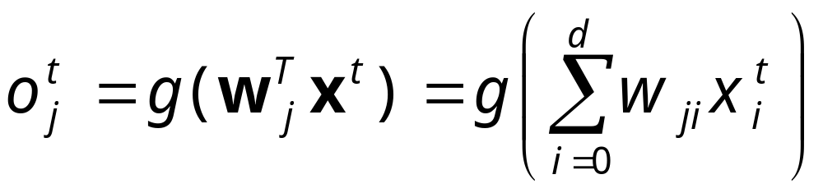
Multiple Outputs
o₁
o₂
o_{K}
w_{Kd}
x₀=+1
x₁
x₂
x_{d}

Slide 66
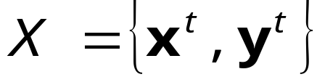
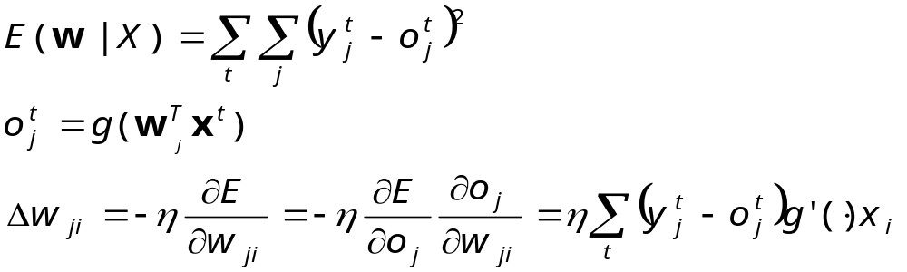
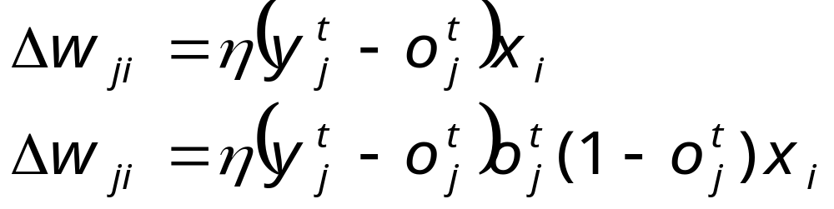
Iterative Training
Linear
Nonlinear

Slide 67
Nonlinear classification
Linearly separable
NOT Linearly separable;
requires a nonlinear
discriminant

Slide 68
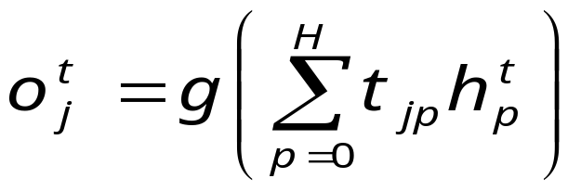
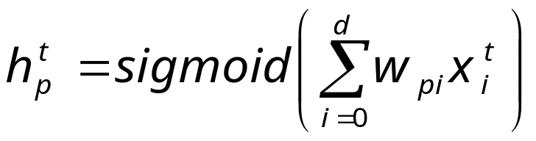
Multi-Layer Networks
o₁
o₂
o_{K}
t_{KH}
h₁
h₂
h_{H}
w_{Kd}
h₀=+1
x₀=+1
x₁
x₂
x_{d}

Slide 69
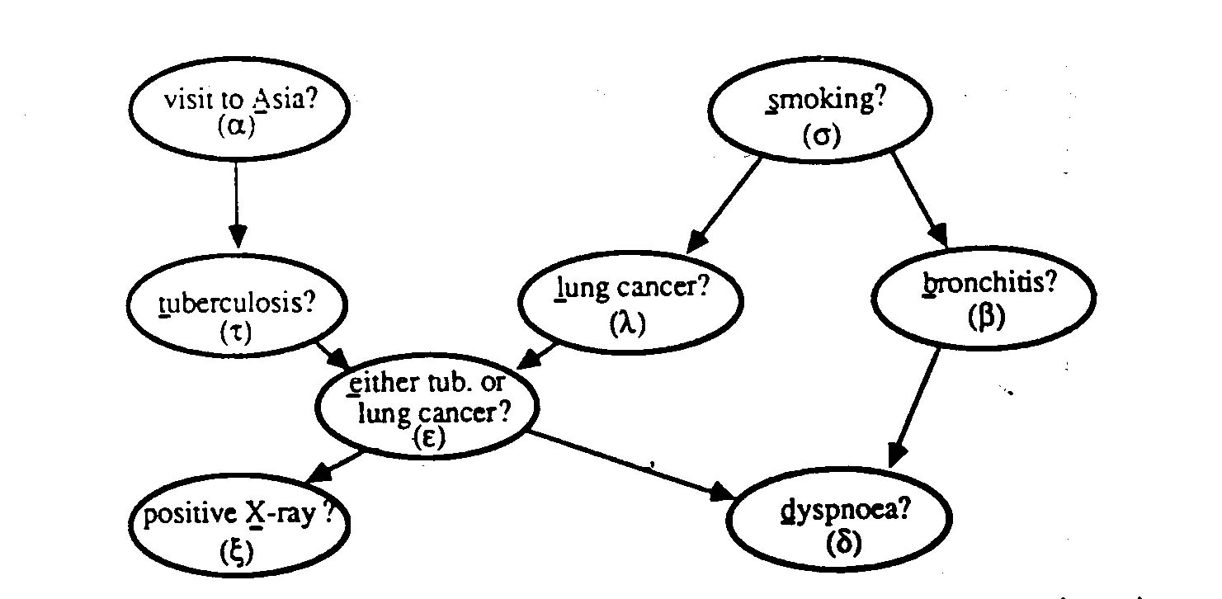
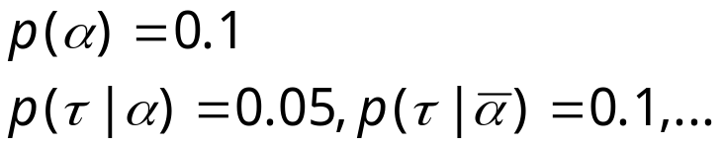
Probabilistic Networks

Slide 70
Evaluating Learners
Given a model M, how can we assess its performance on real (future) data?
Given M₁, M₂, ..., M_{L} which one is the best?

Slide 71
Cross-validation
1 2 3 k-1 k
1 2 3 k-1
k
Repeat k times and average

Slide 72
Combining Learners: Why?
Train
set
Predictor 1
Initial
Standard
Form
Choose
best
Best
Predictor
Predictor 2
Predictor L
Validation
set

Slide 73
Combining Learners: How?
Train
set
Predictor 1
Initial
Standard
Form
Voting
Predictor 2
Predictor L
Validation
set

Slide 74
Conclusions:
The Importance of Data
Extract valuable information from large amounts of raw data
Large amount of reliable data is a must. The quality of the solution depends highly on the quality of the data
Data mining is not alchemy; we cannot turn stone into gold

Slide 75
Conclusions: The Importance of the Domain Expert
Joint effort of human experts and computers
Any information (symmetries, constraints, etc) regarding the application should be made use of to help the learning system
Results should be checked for consistency by domain experts

Slide 76
Conclusions: The Importance of Being Patient
Data mining is not straightforward; repeated trials are needed before the system is finetuned.
Mining may be lengthy and costly. Large expectations lead to large disappointments !

Slide 77
Once again: Important Requirements for Mining
Large amount of high quality data
Devoted and knowledgable experts on:
  Application domain
  Databases (Data warehouse)
  Statistics and Machine Learning
Time and patience

Slide 78

That’s all folks!

