Slide 1

Talent Management Exploratoty Data Analysis
DDSAnalytics
Team Thundercats

Slide 2
Project Abstract
Employee turn over is costly. It can impede companies' short term and long term growth and significantly affect their performance.
Being able to understand HR data patterns and relevant factors we can gain a competitive edge in the talent management market.
Tasked with exploratory data analysis, our team will try to determine trends in employees attrition as the first step toward using data science as a tool to upend the traditional approach to human resources management.

Slide 3
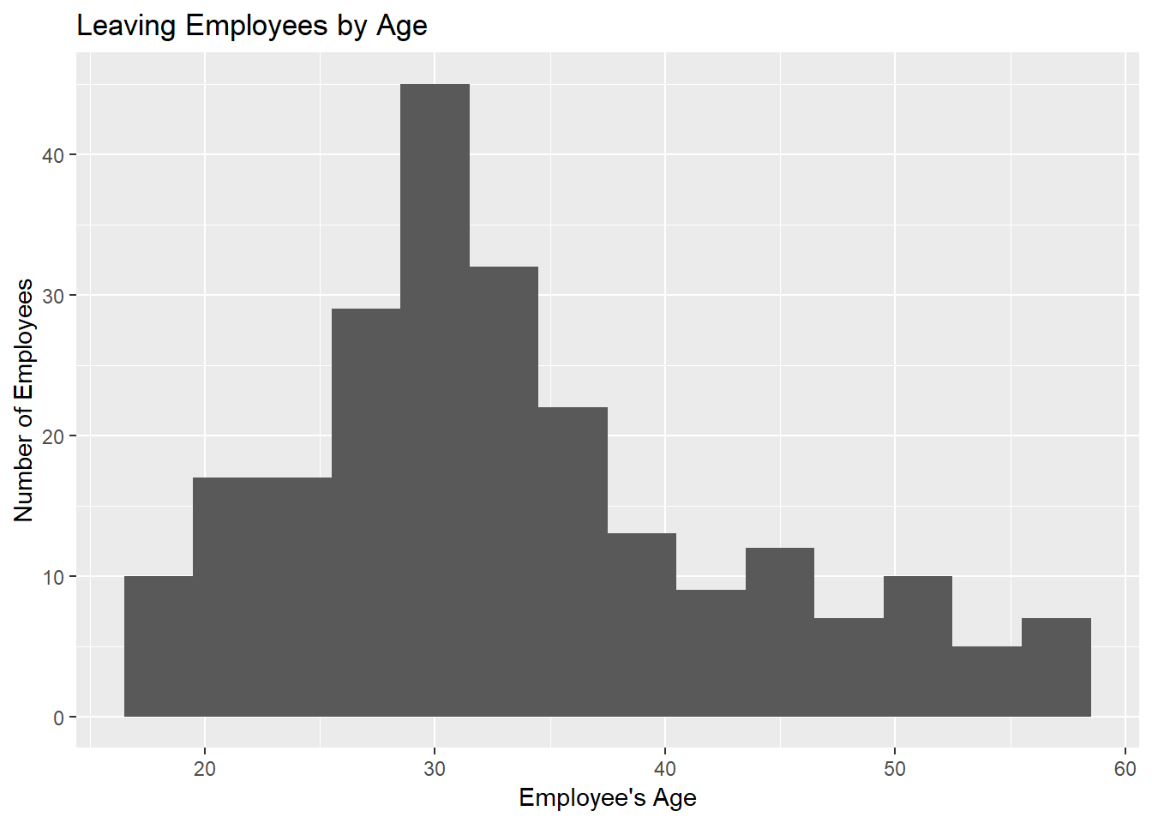
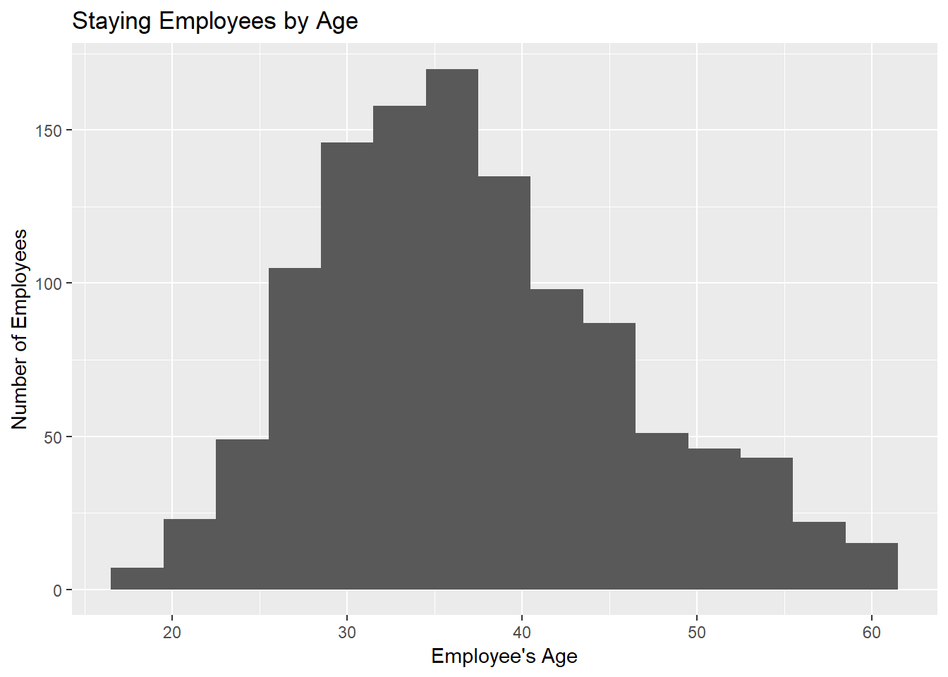
Attrition By Age

Slide 4
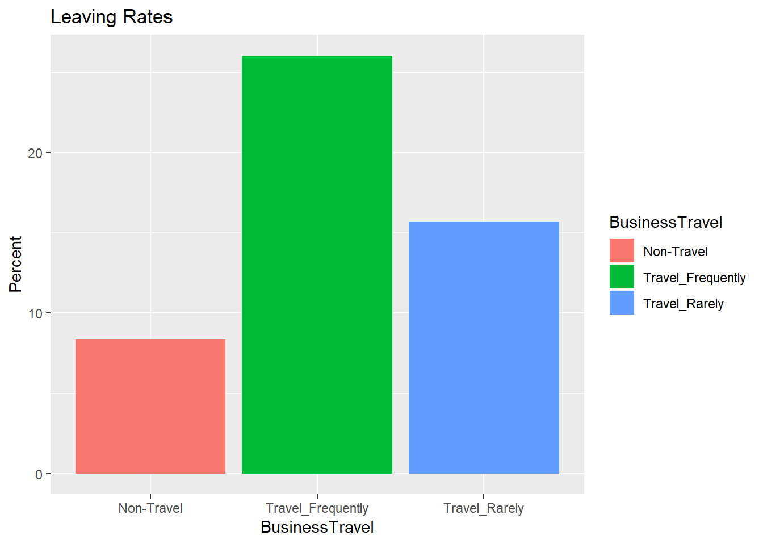
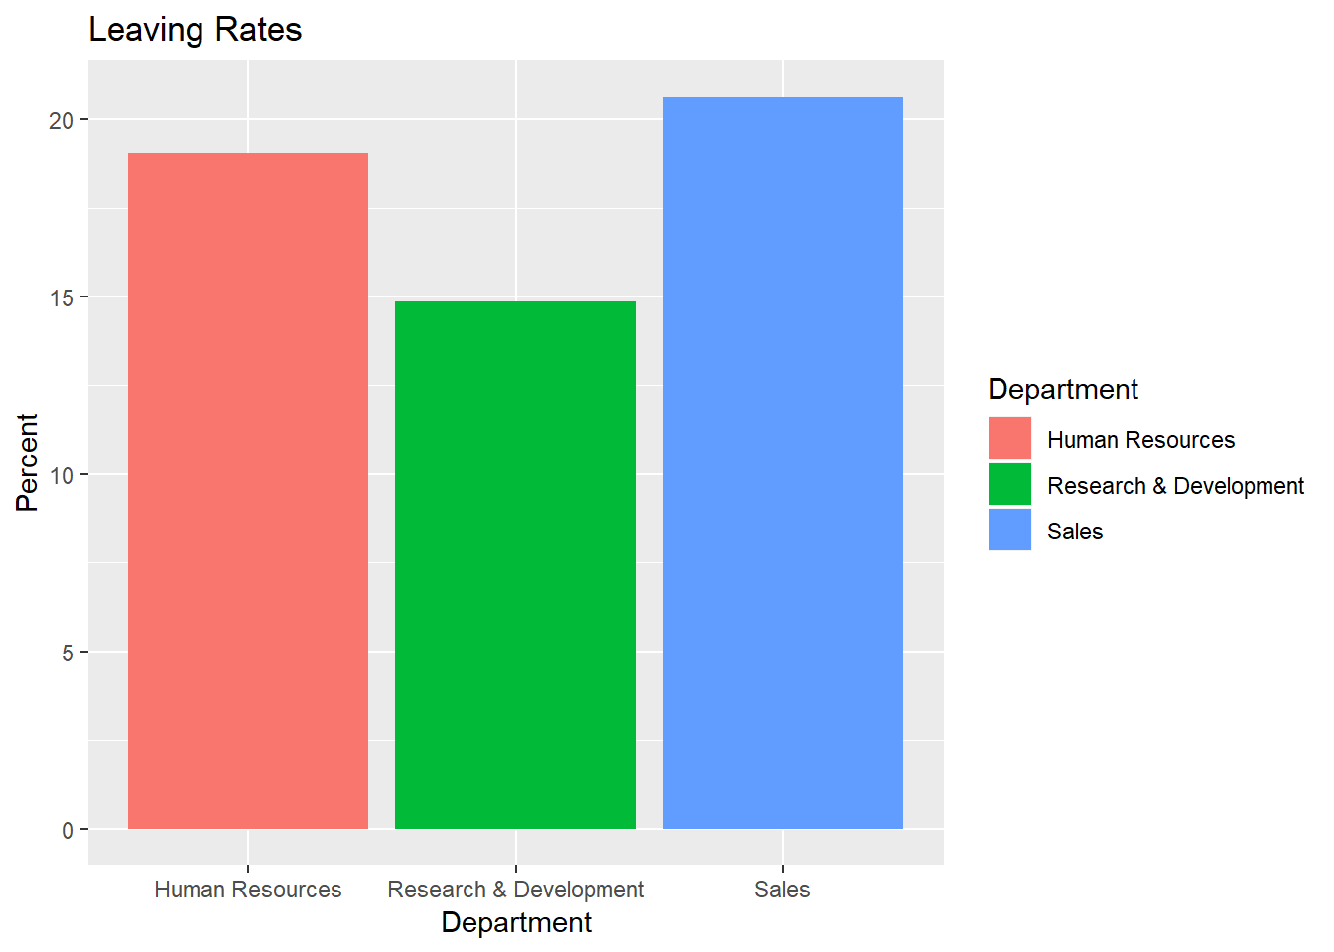
Attrition Rate By Category

Slide 5
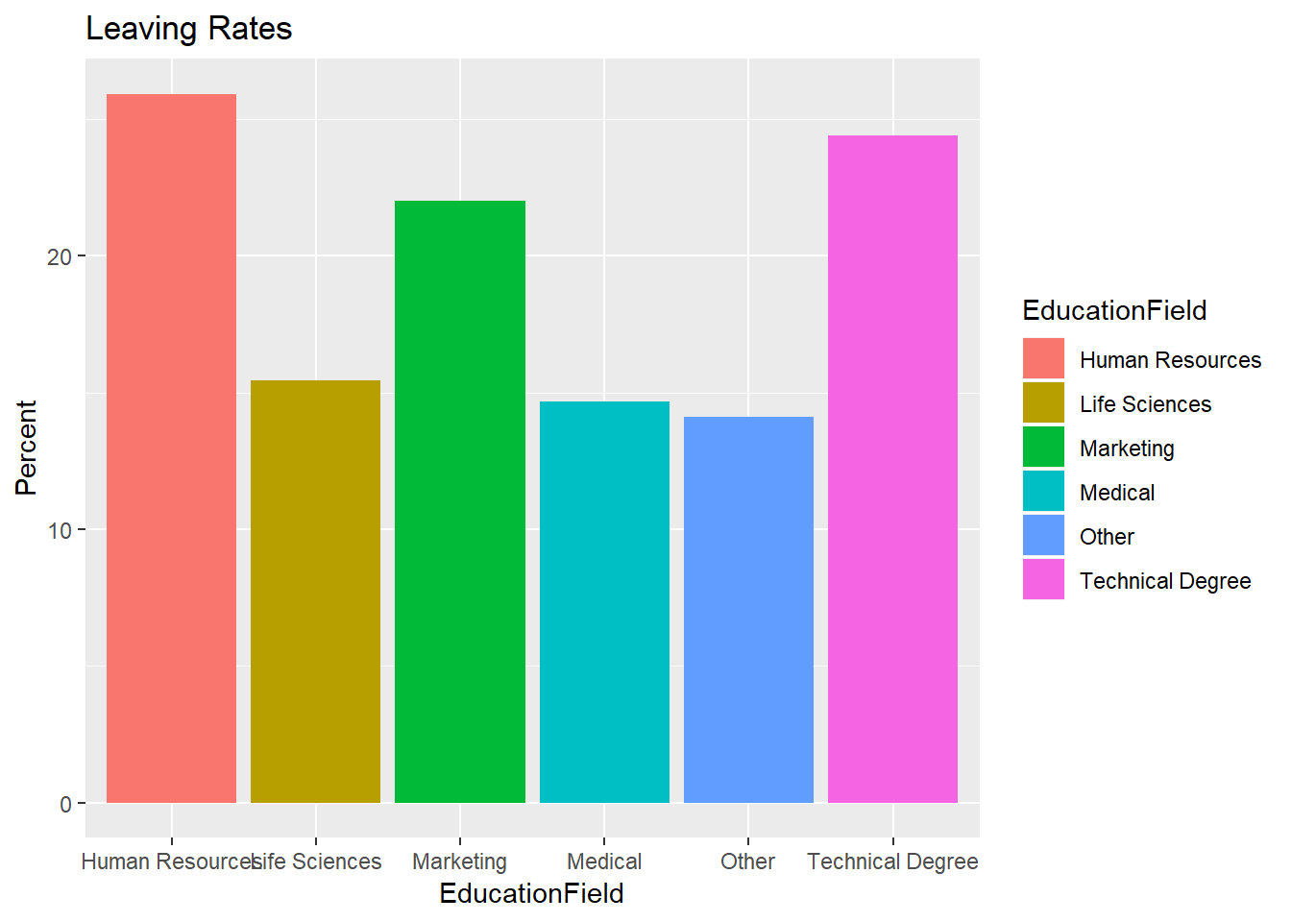
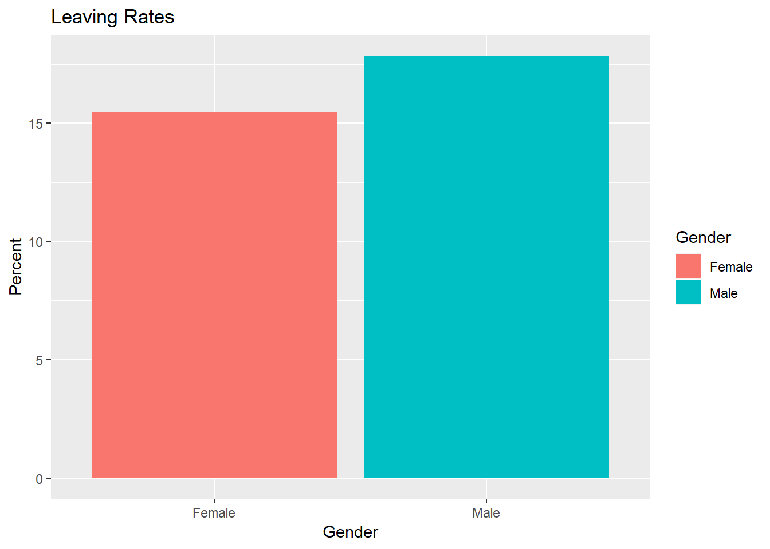
Attrition Rate By Category (cont.)

Slide 6
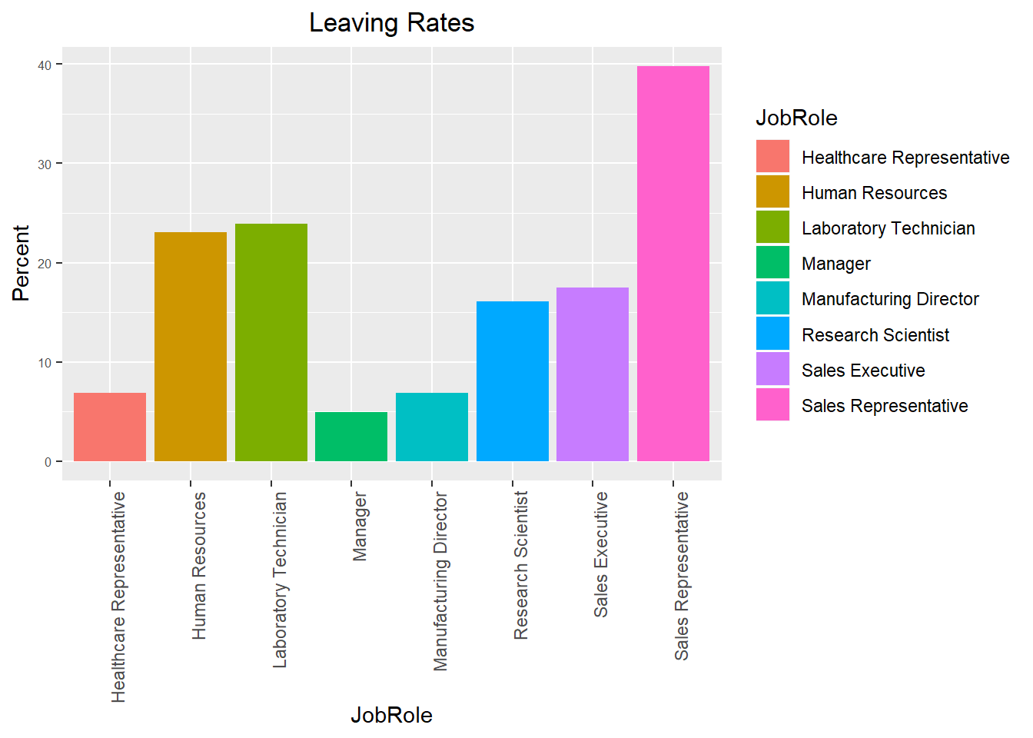
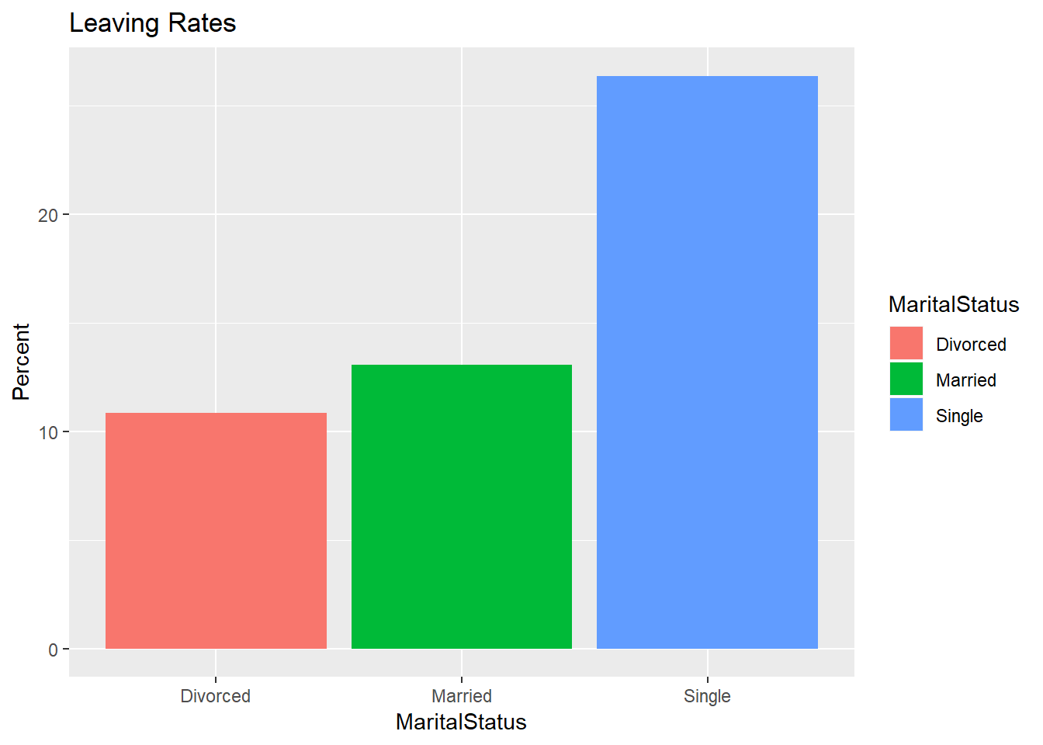
Attrition Rate By Category (cont.)

Slide 7
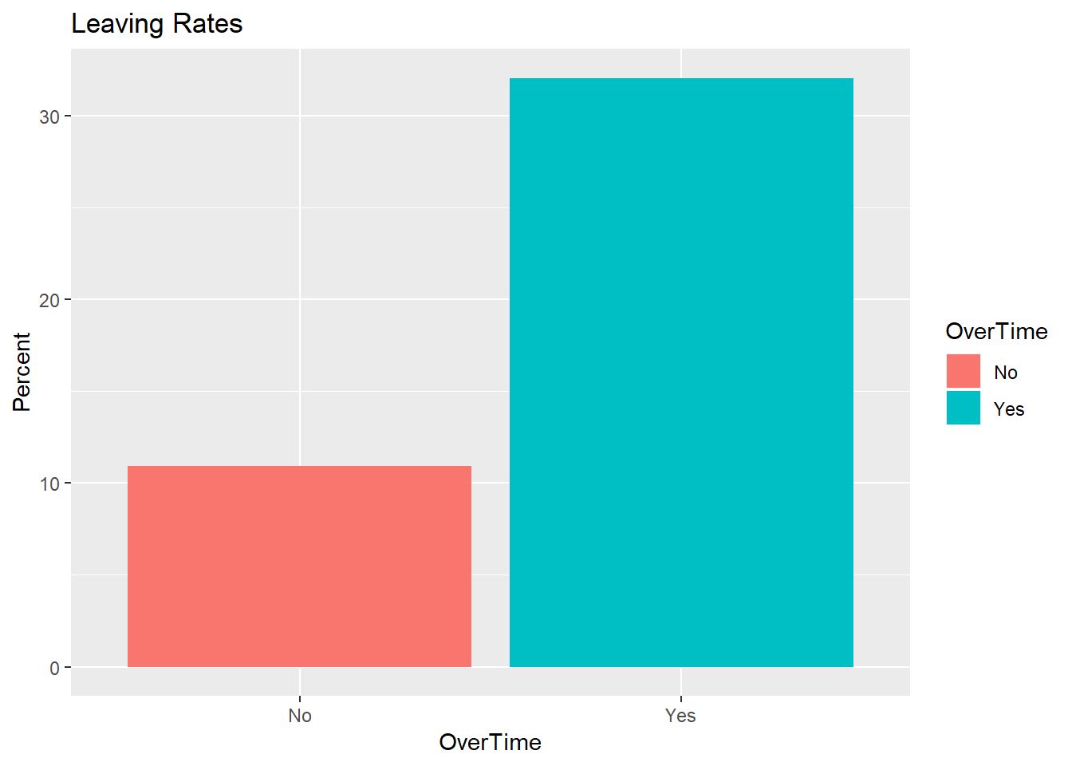
Attrition Rate By Category (cont.)
Top Attrition by Category:
Working As Sale Rep.: 39.76
Working Overtime: 32.06
Single : 26.39
Travel Frequently: 26.04
Working as Lab Technician: 23.94
Working as Human Resources: 23.08

