Slide 1
Part III
Adding a Proposal
&
Viewing the DAPP

Slide 2
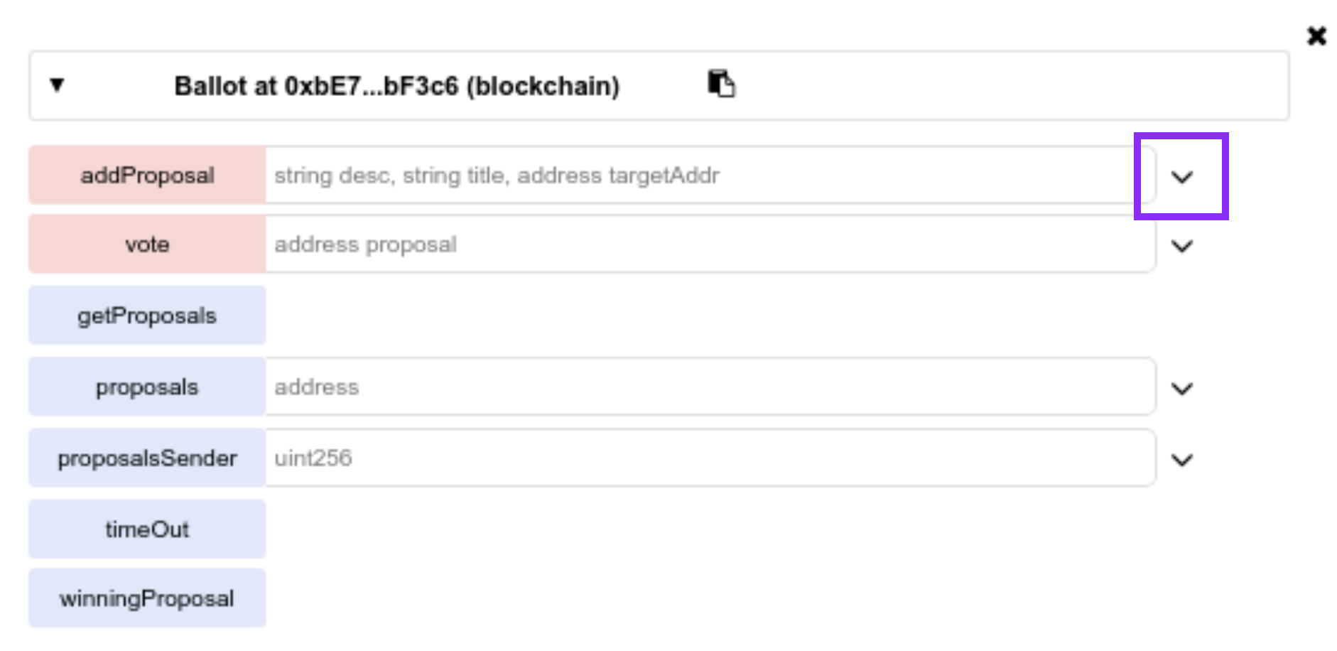
Add a new proposal
Expand addProposal function
( when dependencies.js is the active file )

Slide 3
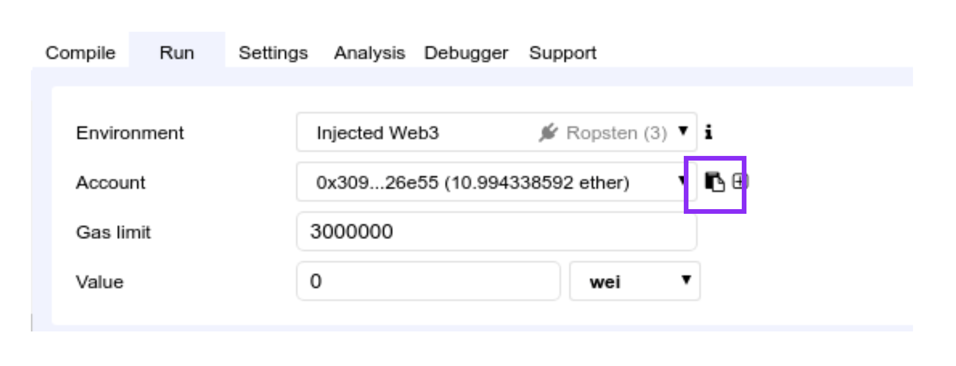
Copy your address
Run tab: Account
( when dependencies.js is the active file )

Slide 4
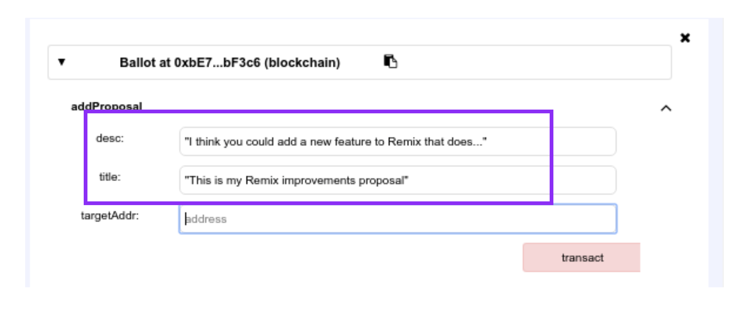
Type a proposal
Run tab: Account
( when dependencies.js is the active file )

Slide 5
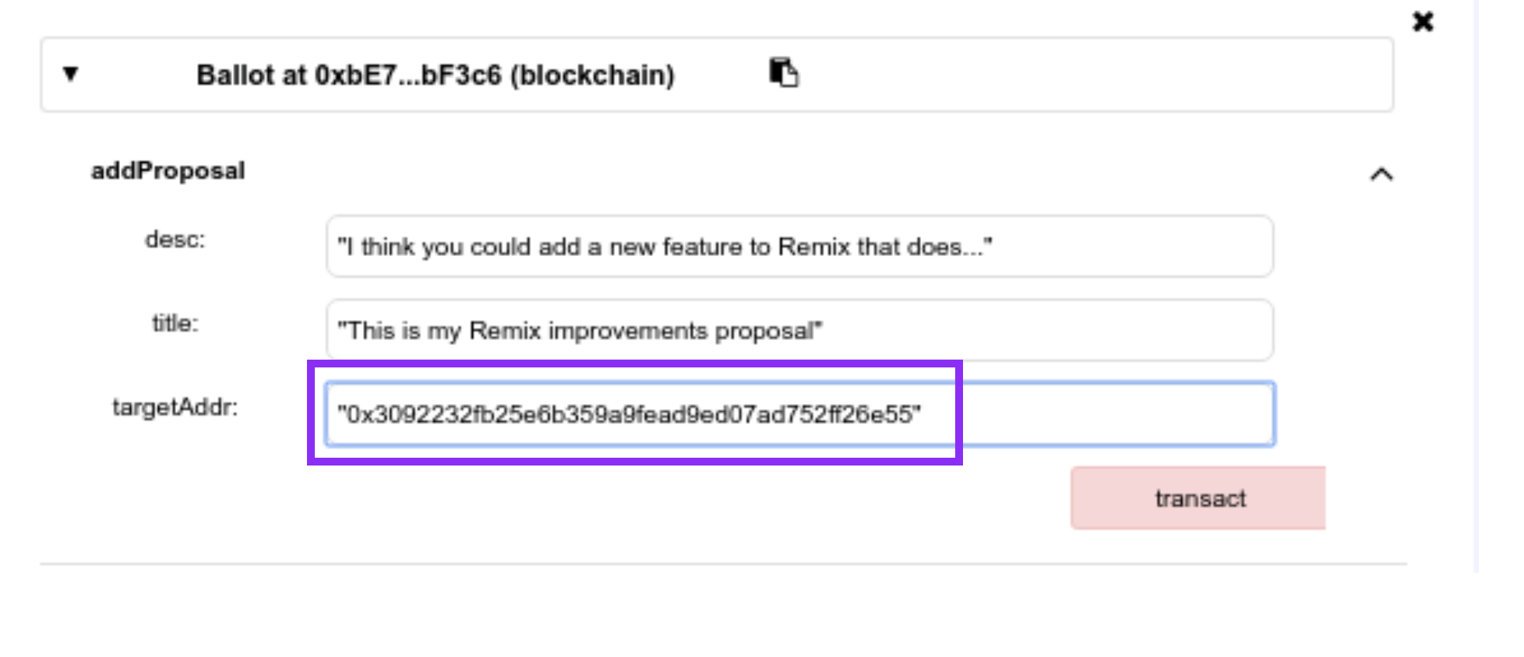
Add your address
Paste the address
( when dependencies.js is the active file )

Slide 6
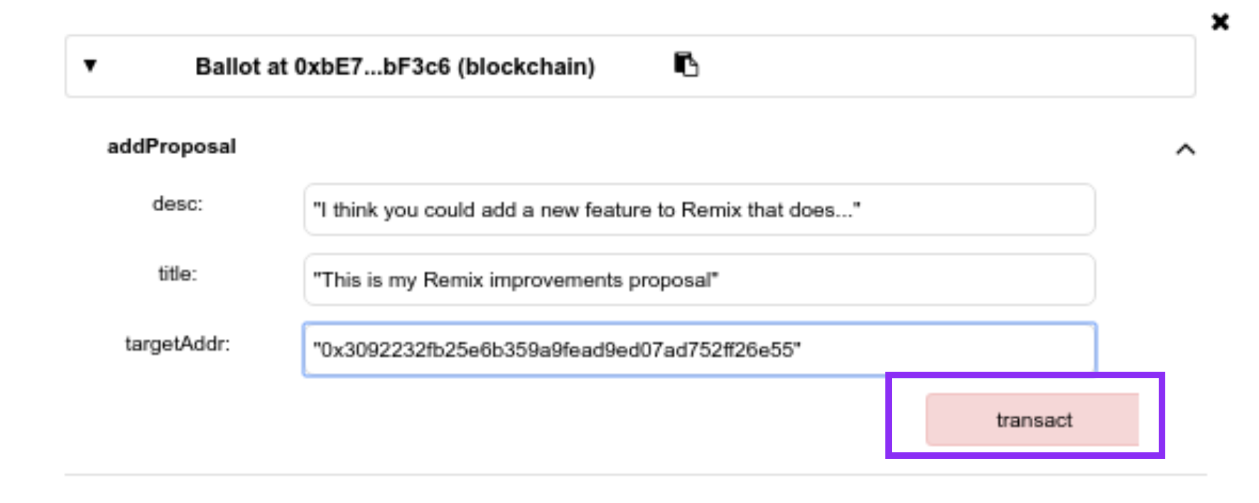
Execute addProposal
Hit the transact button

Slide 7
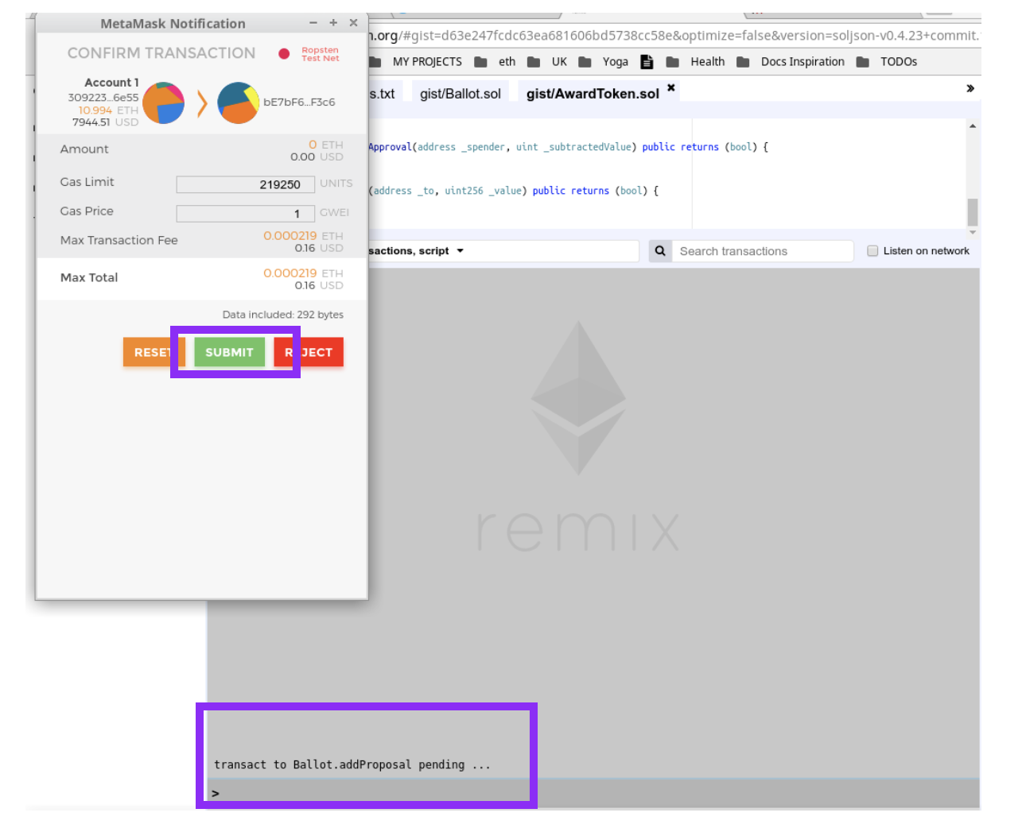
Confirm the transaction
Submit button
( when dependencies.js is the active file )

Slide 8
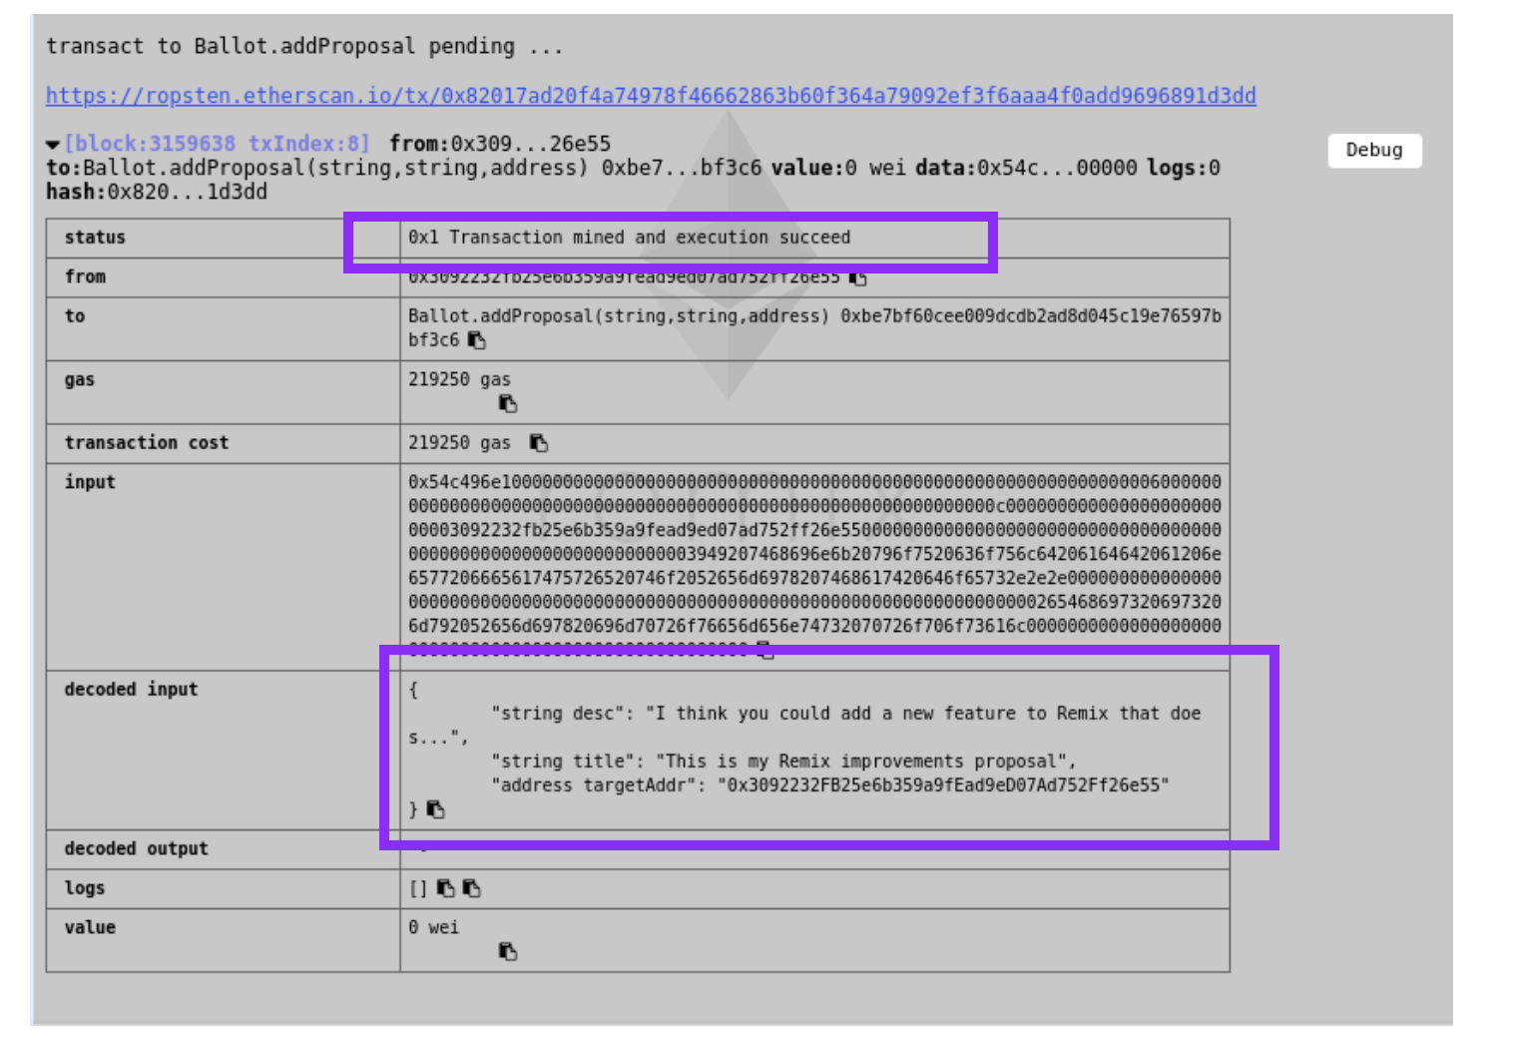
Check if tx succeeded
Terminal logs in Remix
( when dependencies.js is the active file )

Slide 9
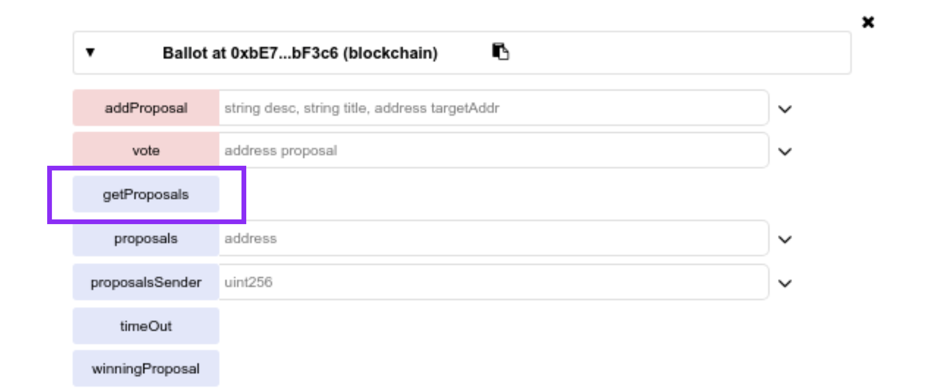
Execute getProposals
getProposals call
( when dependencies.js is the active file )

Slide 10
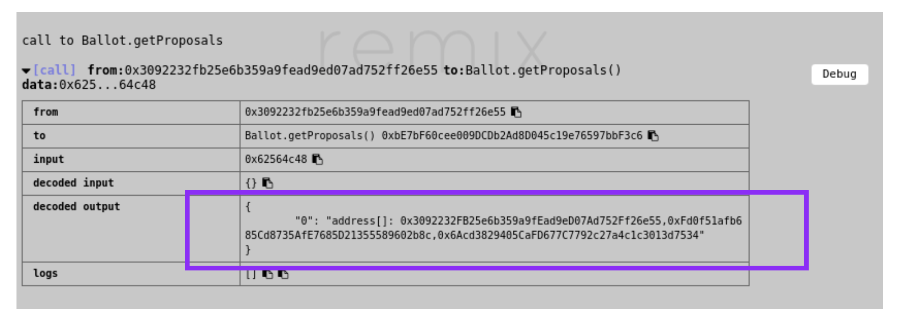
See Proposals Addresses
well in so far there will only be 1 address
( when dependencies.js is the active file )

Slide 11
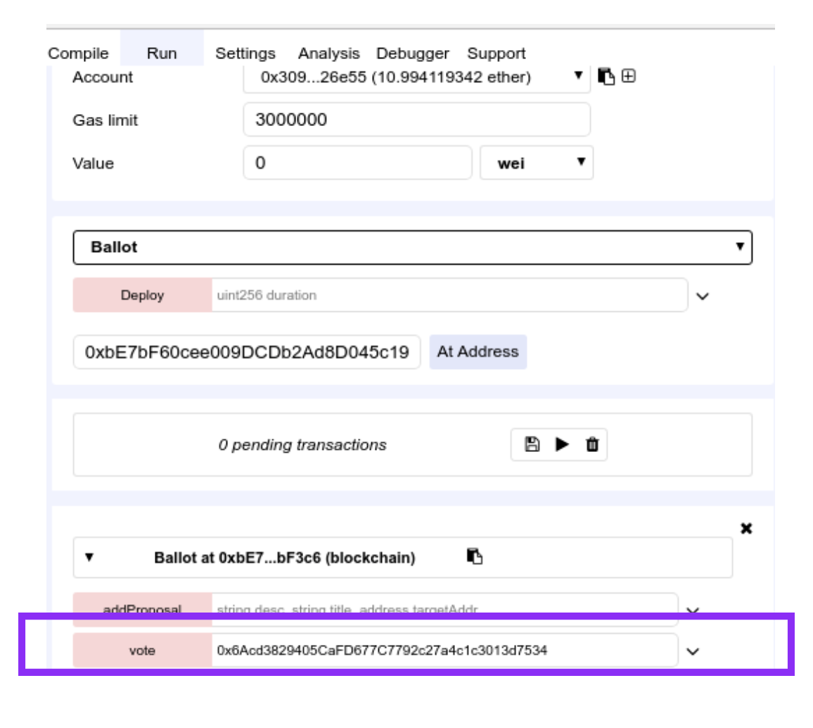
Vote for one Proposal
Paste Proposal Address you want to vote for
( when dependencies.js is the active file )

Slide 12
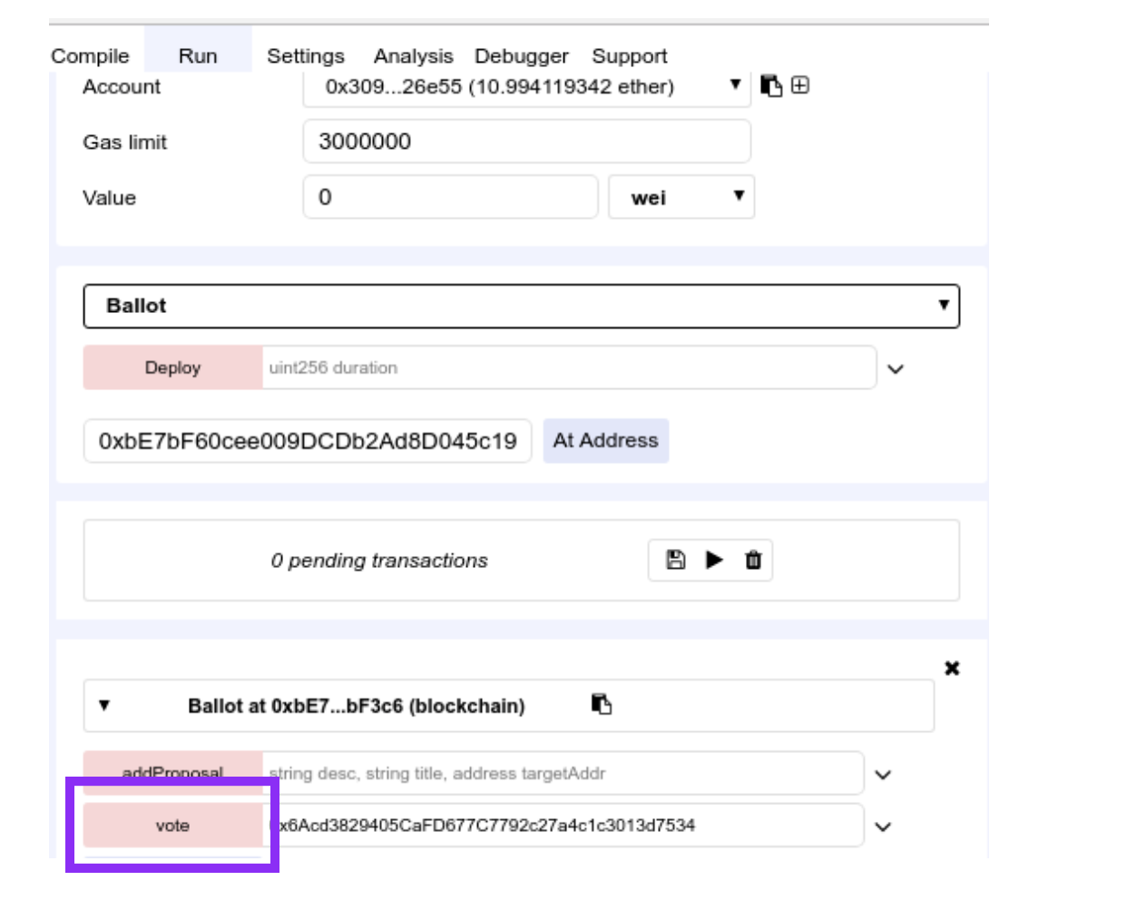
Execute vote transaction
vote button
( when dependencies.js is the active file )

Slide 13
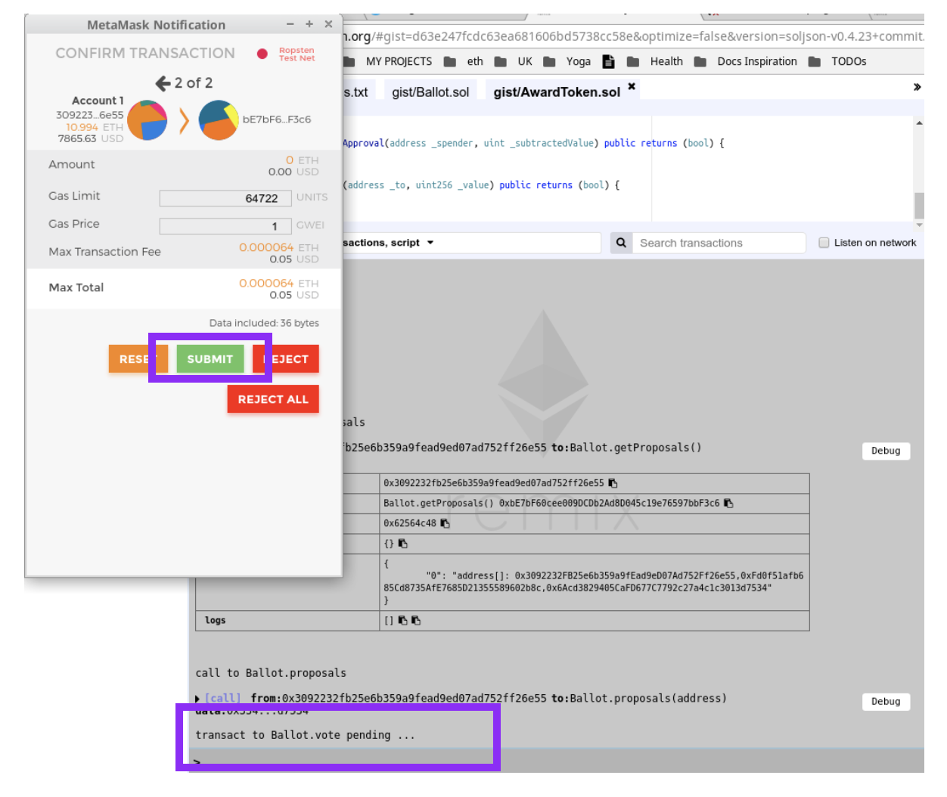
Confirm the transaction
Submit button
( when dependencies.js is the active file )

Slide 14
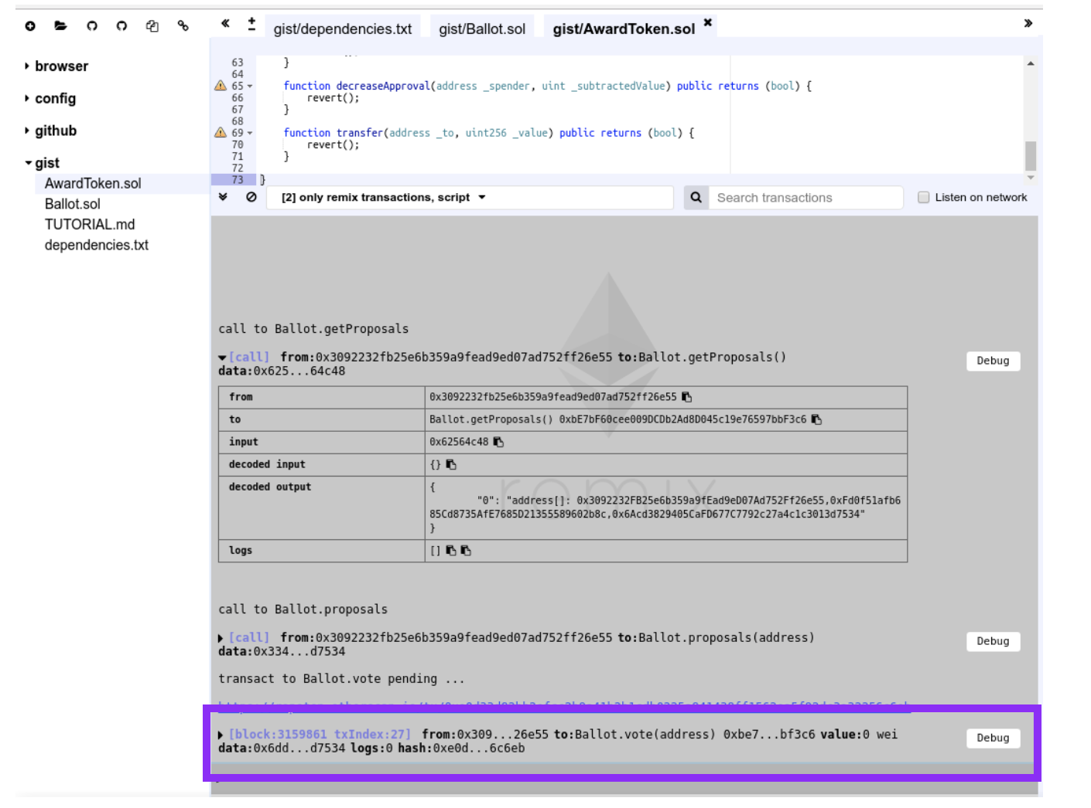
Check if tx succeeded
Terminal logs in Remix
( when dependencies.js is the active file )

Slide 15
Now let's try it out connecting a frontend
http://bit.ly/remix-voting
( when dependencies.js is the active file )
To access our Award Token from this frontend - you need the address of the Award Token.
Go to ethereum/remix-workshop to access the award token I just deployed

Slide 16
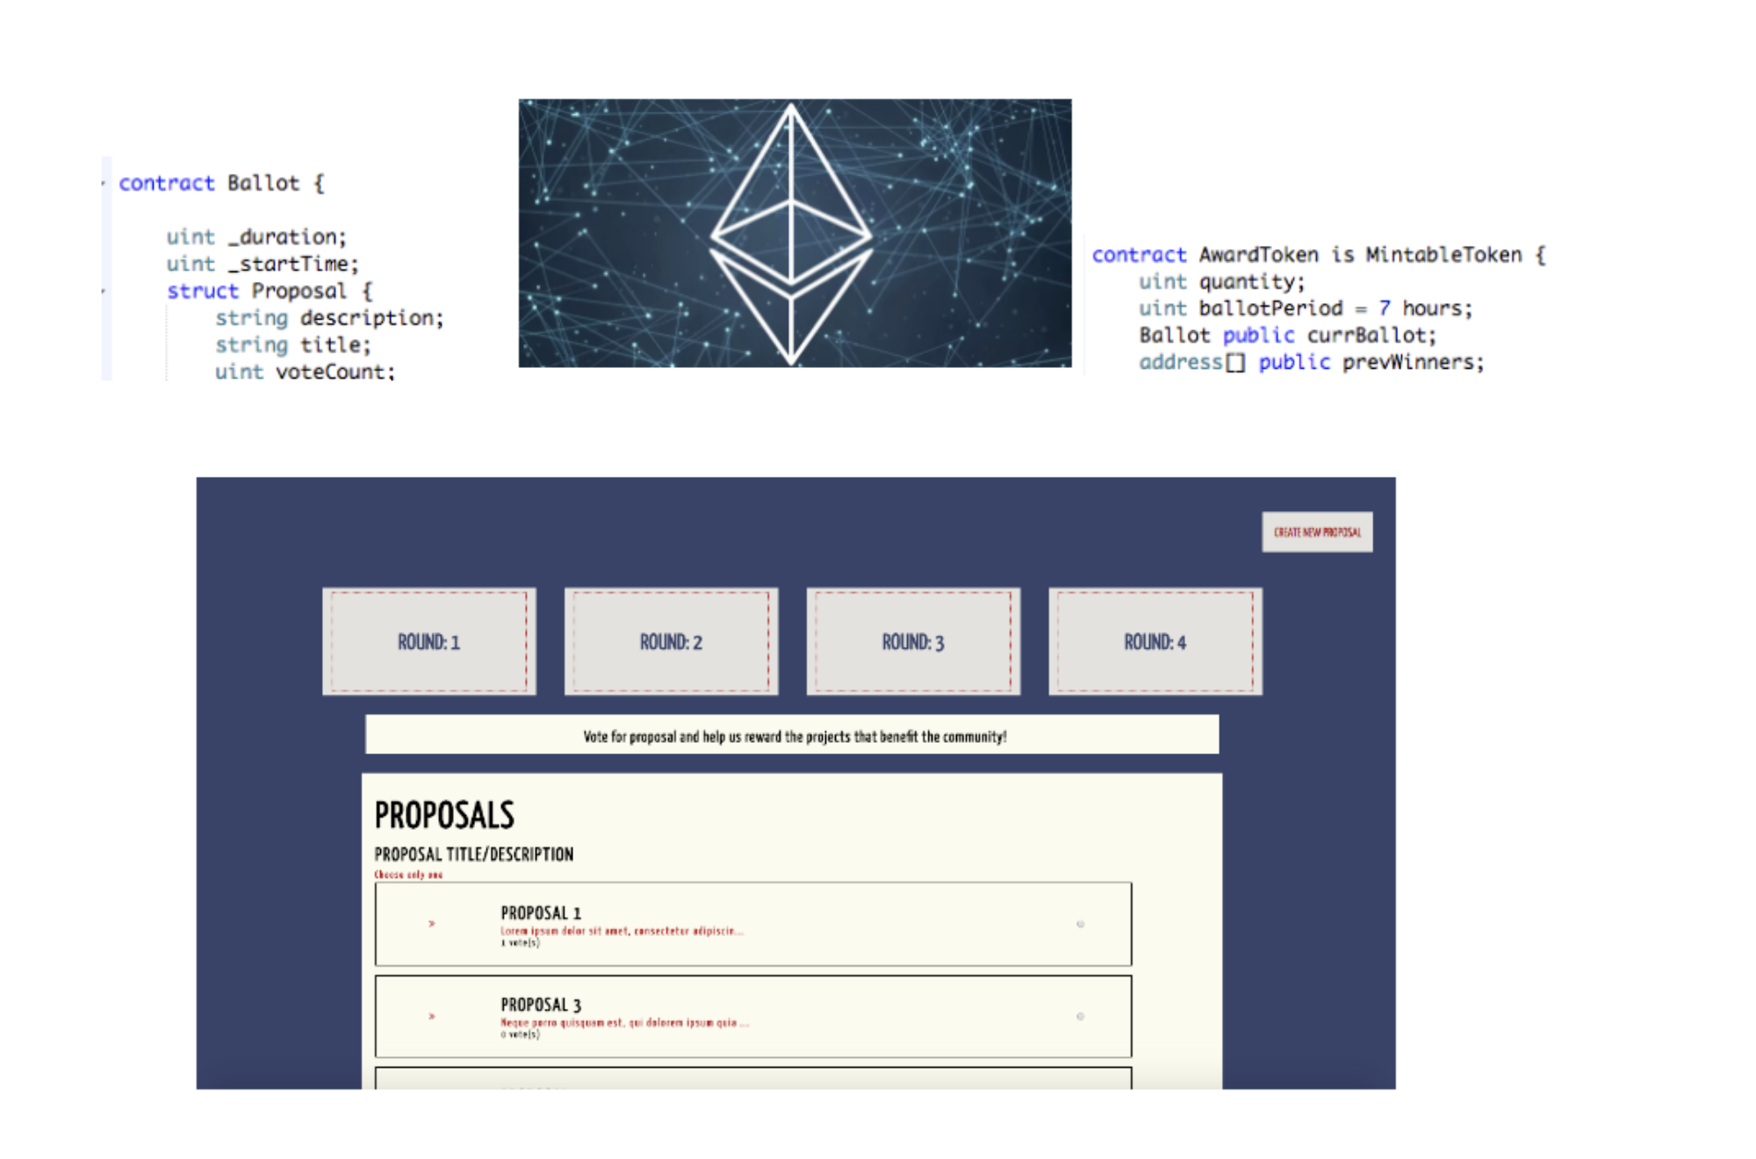

Slide 17
Let's check results
http://bit.ly/remix-voting

Slide 18
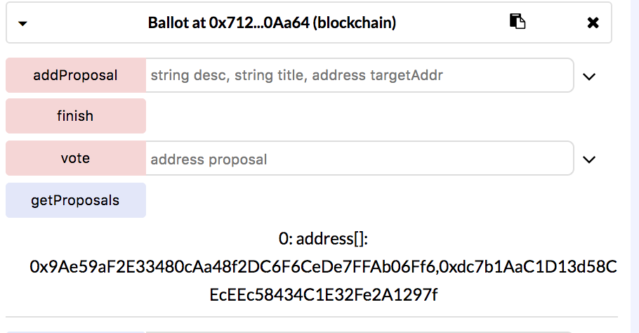
Check the state of the contract
2 proposals have been added

Slide 19
Thank you
@ninabreznik @ryestew @yann300
@serapath @lianahusikyan @iurimatias
http://bit.ly/remix-workshop-repository

