Slide 1
Part II
Deploy & AtAddress

Slide 2
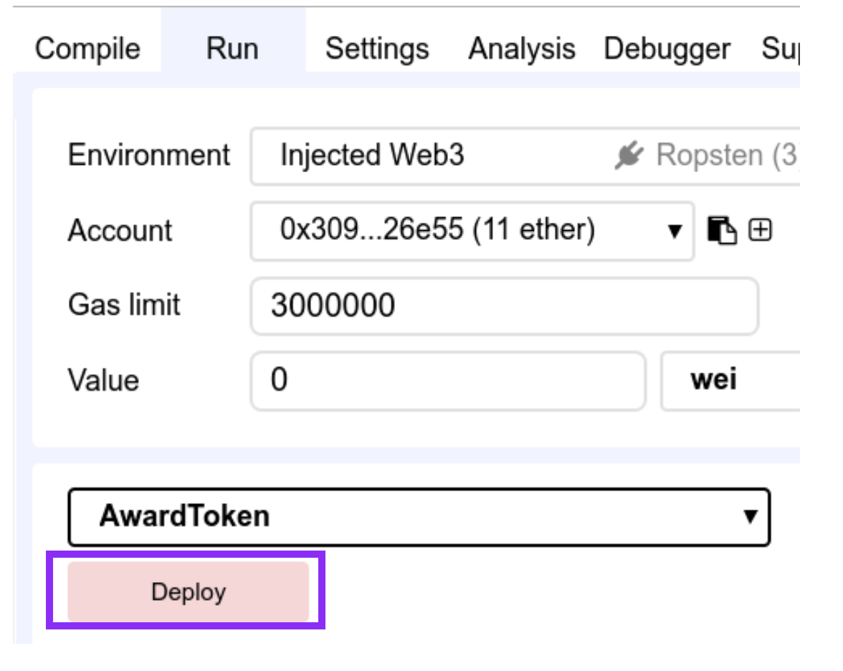
Deploy the contract
Run tab: Deploy button
( when dependencies.js is the active file )

Slide 3
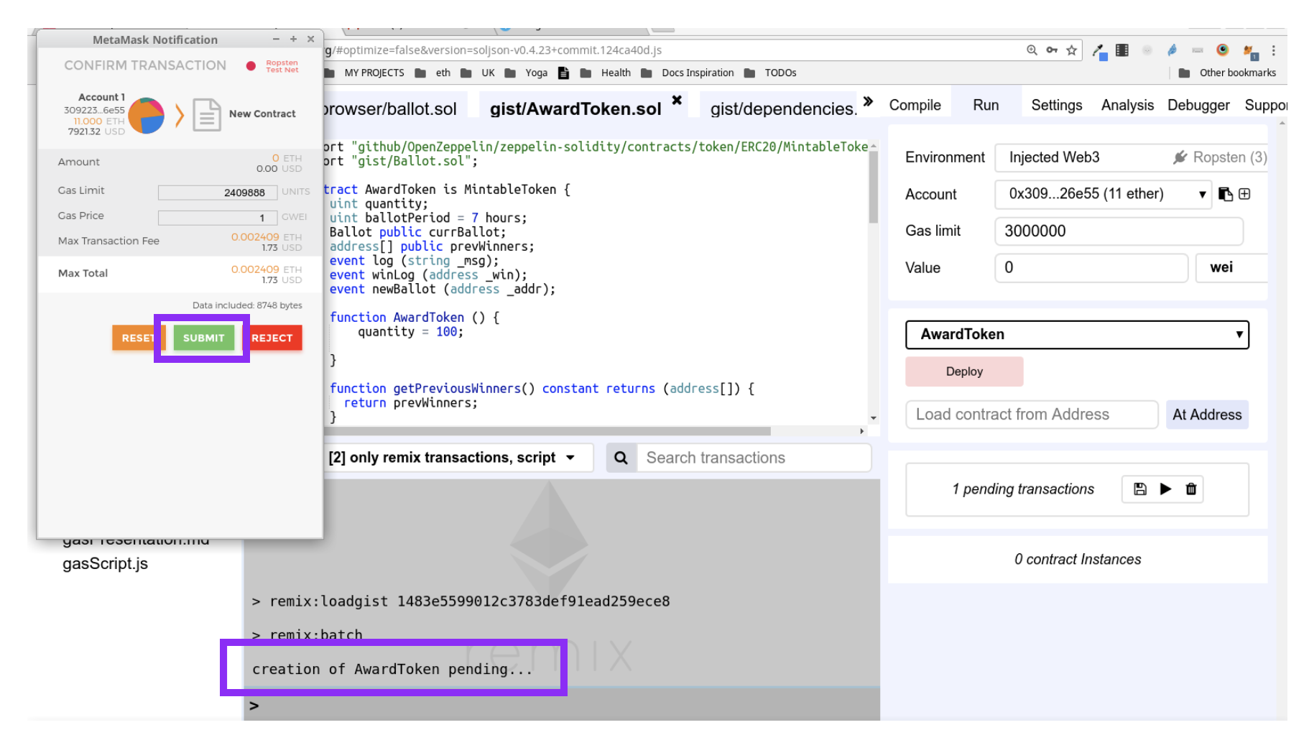
Confirm the transaction
Submit button
But make sure you put in a gas price!
( when dependencies.js is the active file )

Slide 4
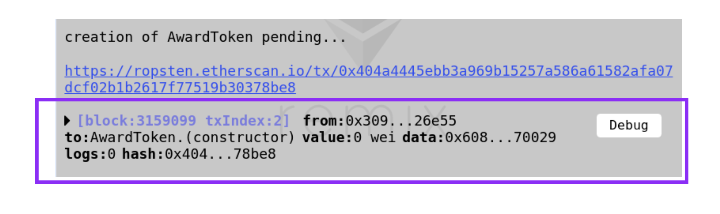
Check if tx is mined
Terminal logs in Remix
( when dependencies.js is the active file )

Slide 5
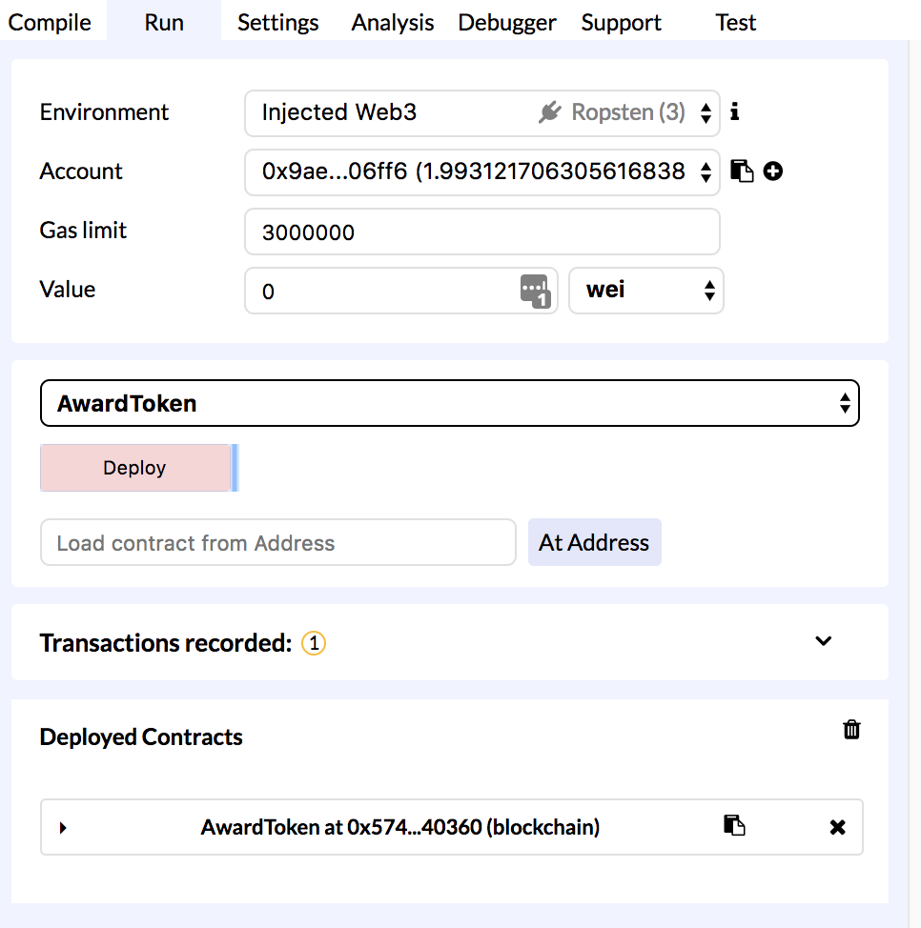
Click to see the contract’s UI
On the deployed contract
( when dependencies.js is the active file )

Slide 6
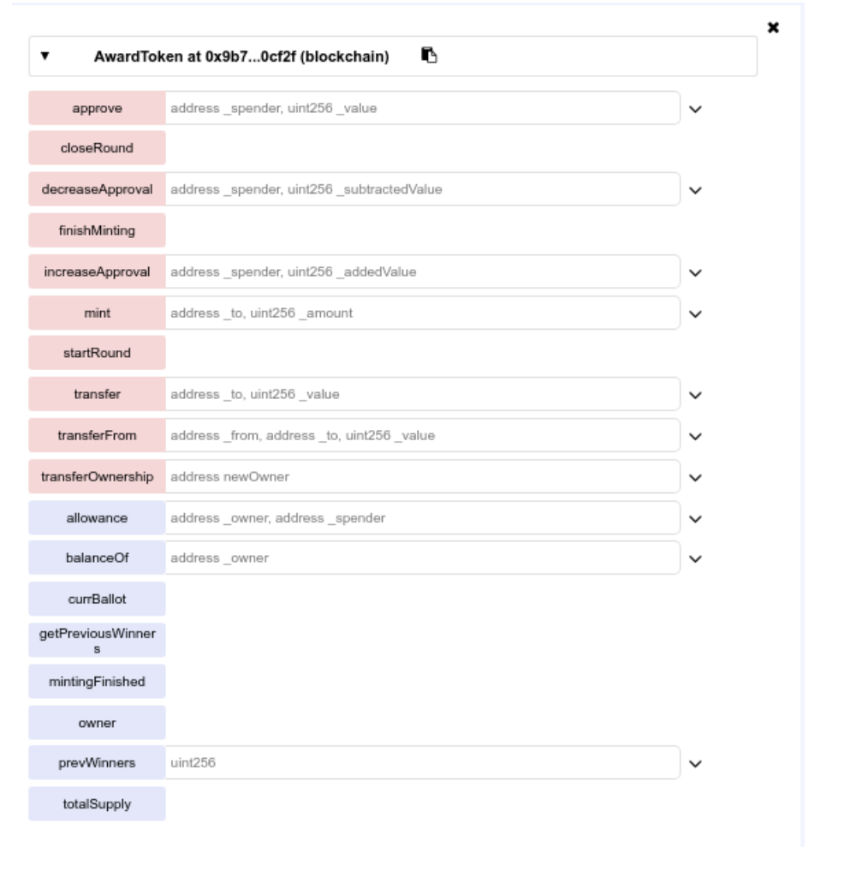
Behold!
The Interactive UI for AwardToken.sol contract
( when dependencies.js is the active file )

Slide 7
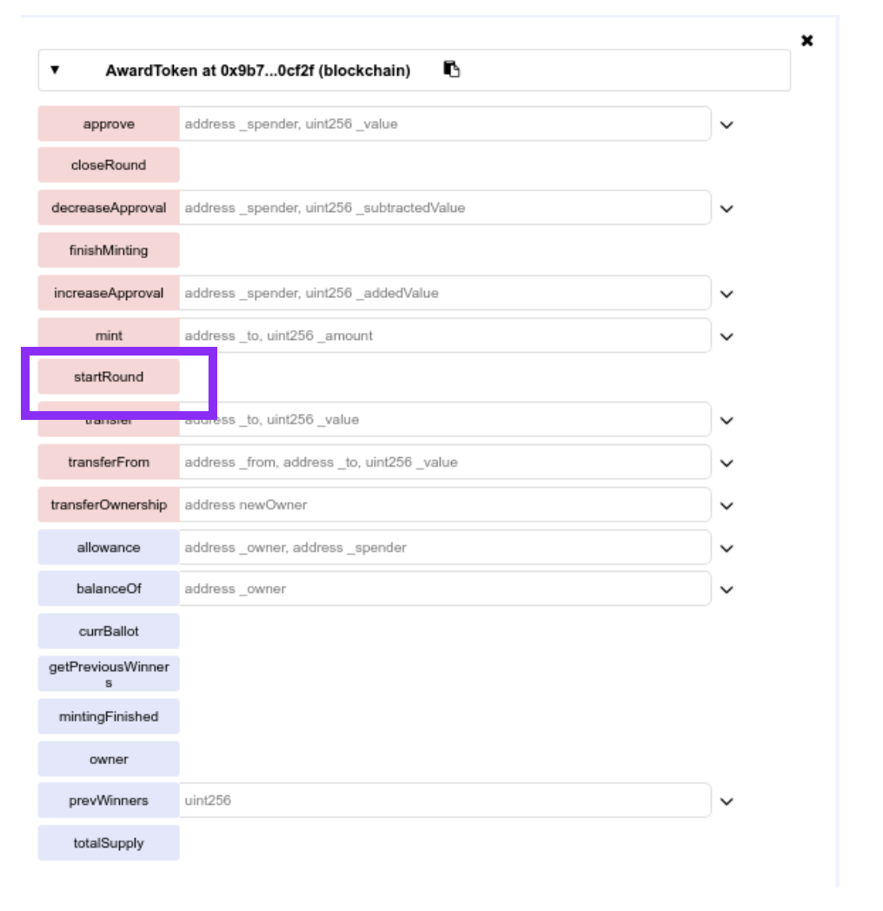
Execute startRound
Its a payable function
( as opposed to a call function - which is free)

Slide 8
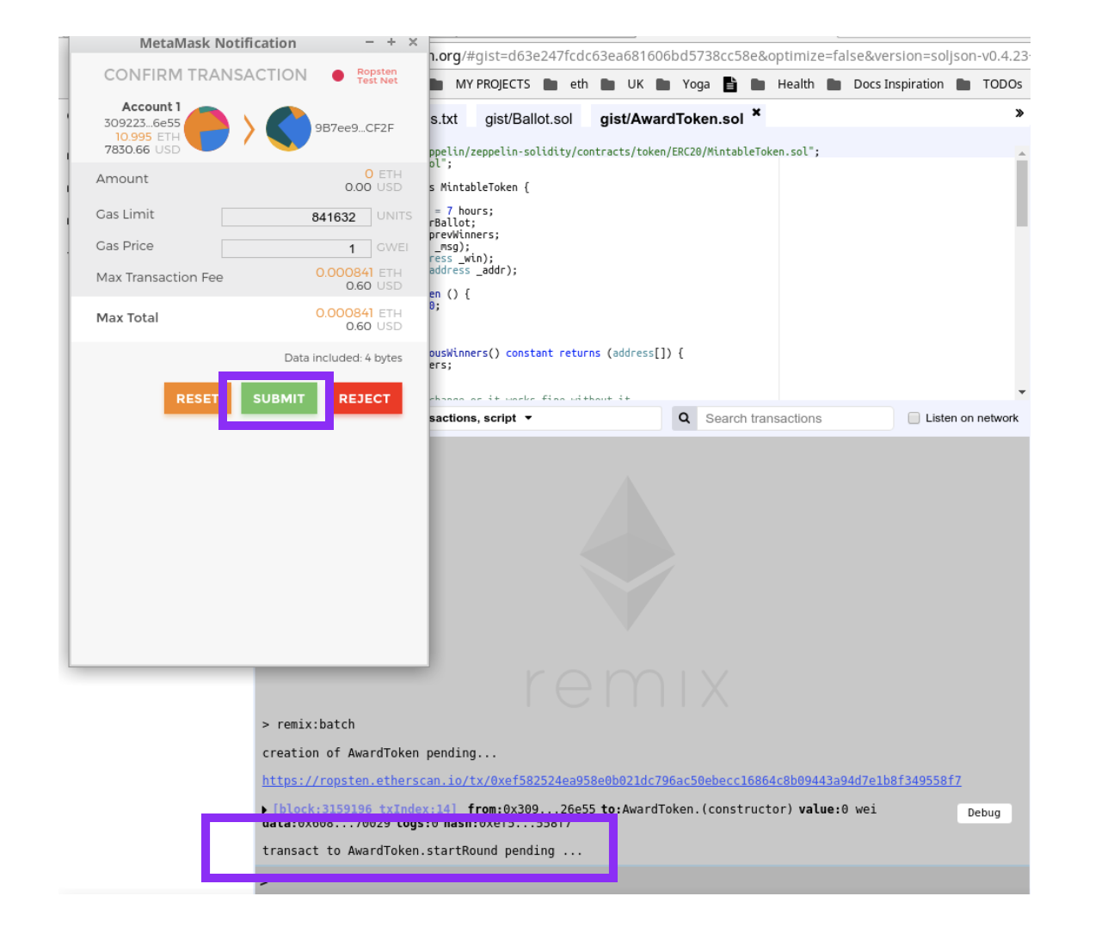
Confirm the transaction

Slide 9
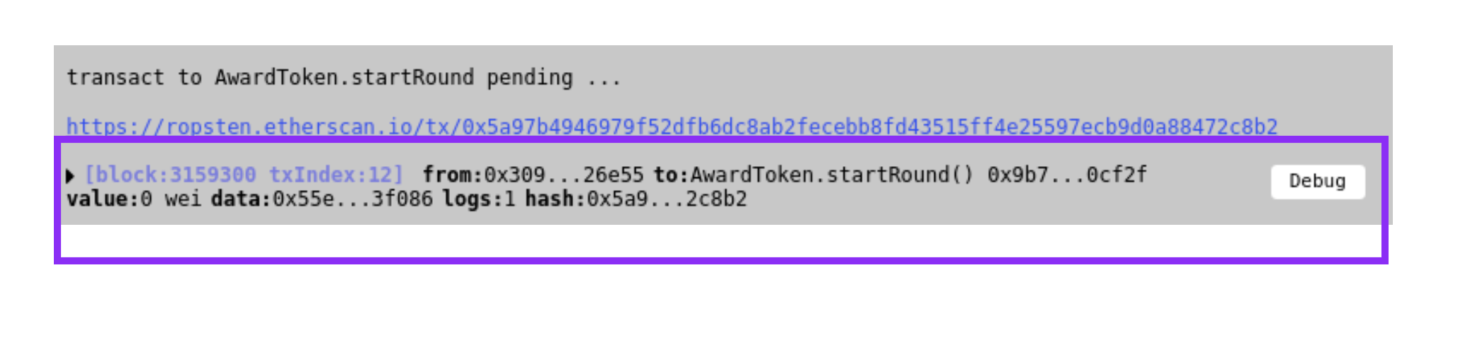
Check if tx is mined
In the terminal logs in Remix

Slide 10
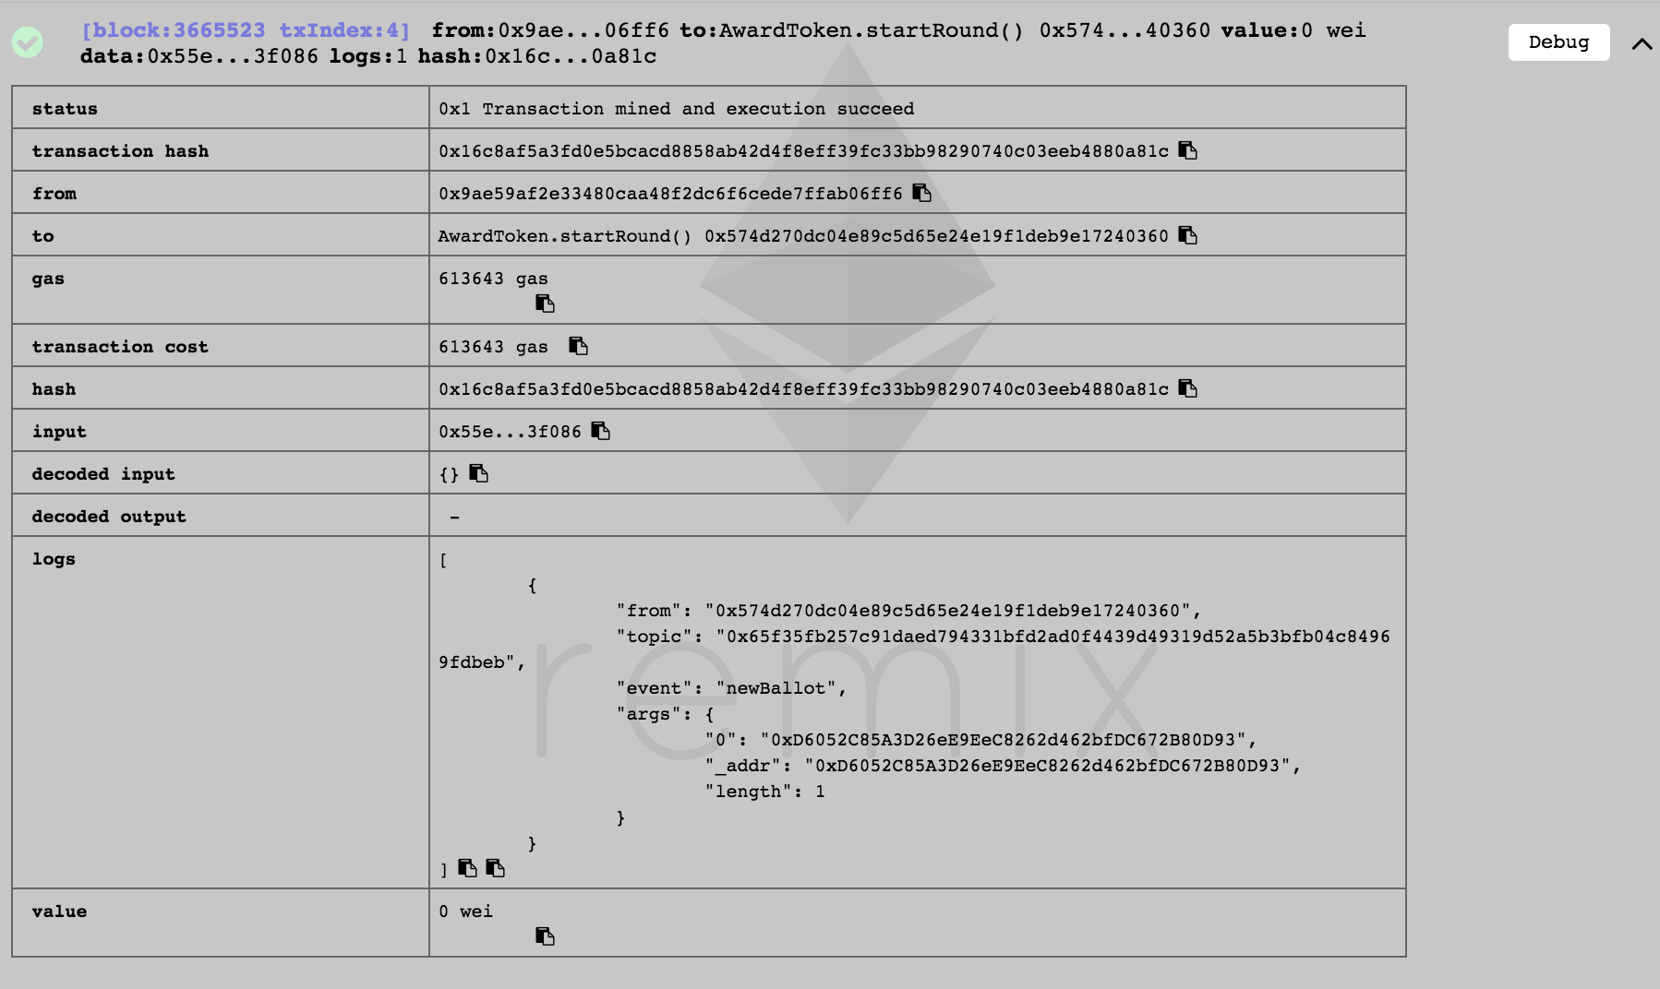
Expand tx log
to see the logs
( when dependencies.js is the active file )

Slide 11
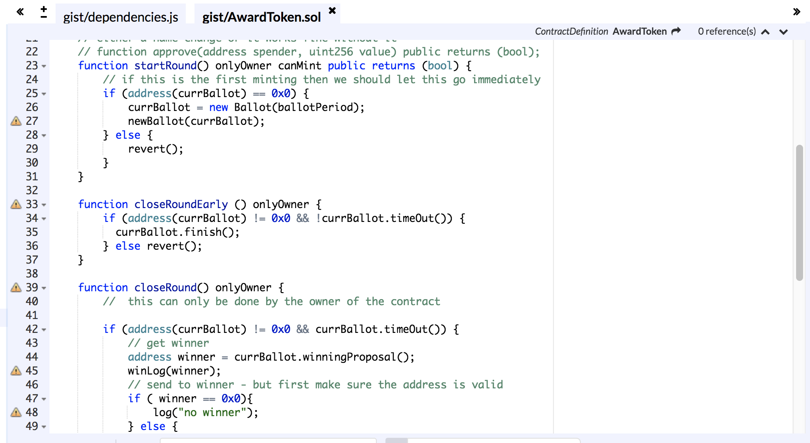
Take a look at the startRound function in the editor
– just to see what it is doing...

Slide 12
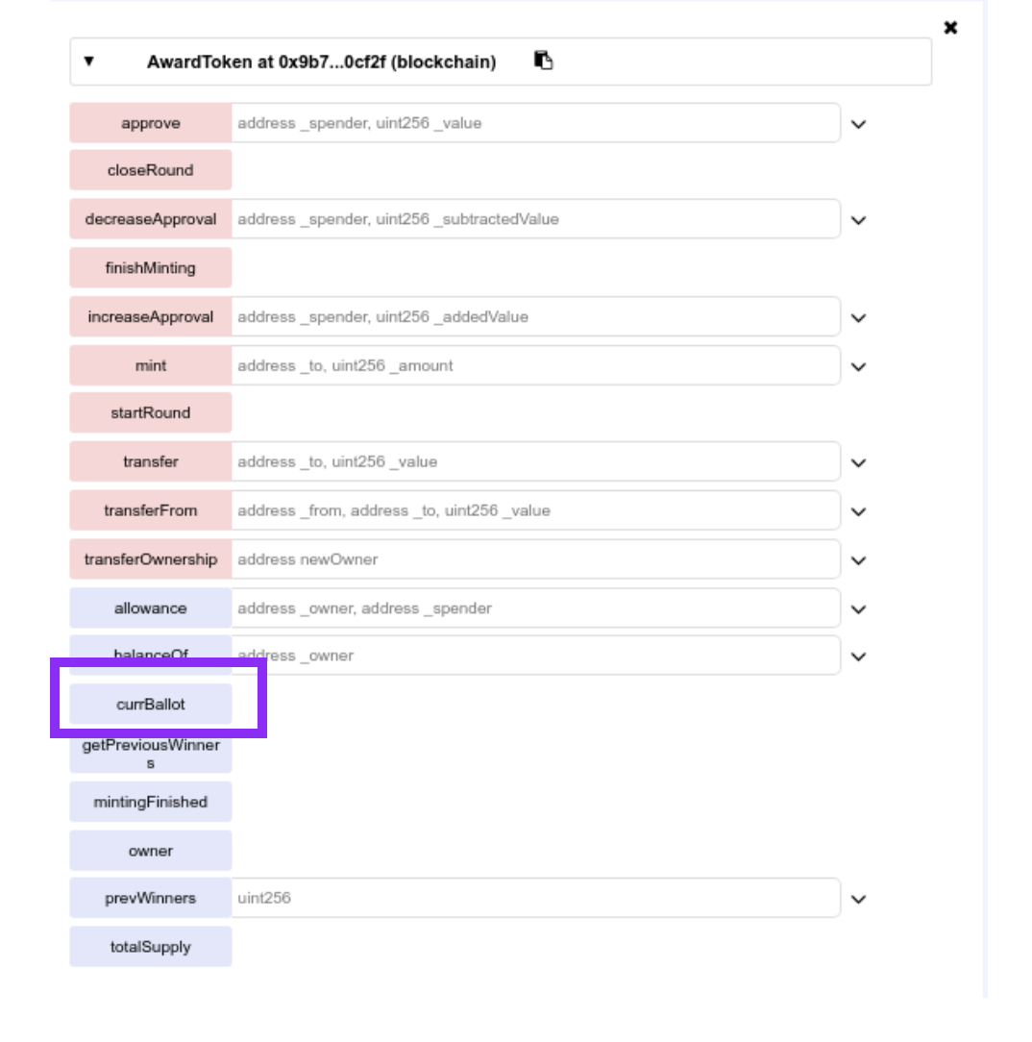
Get ballot's address
Execute currBallot call
( when dependencies.js is the active file )

Slide 13
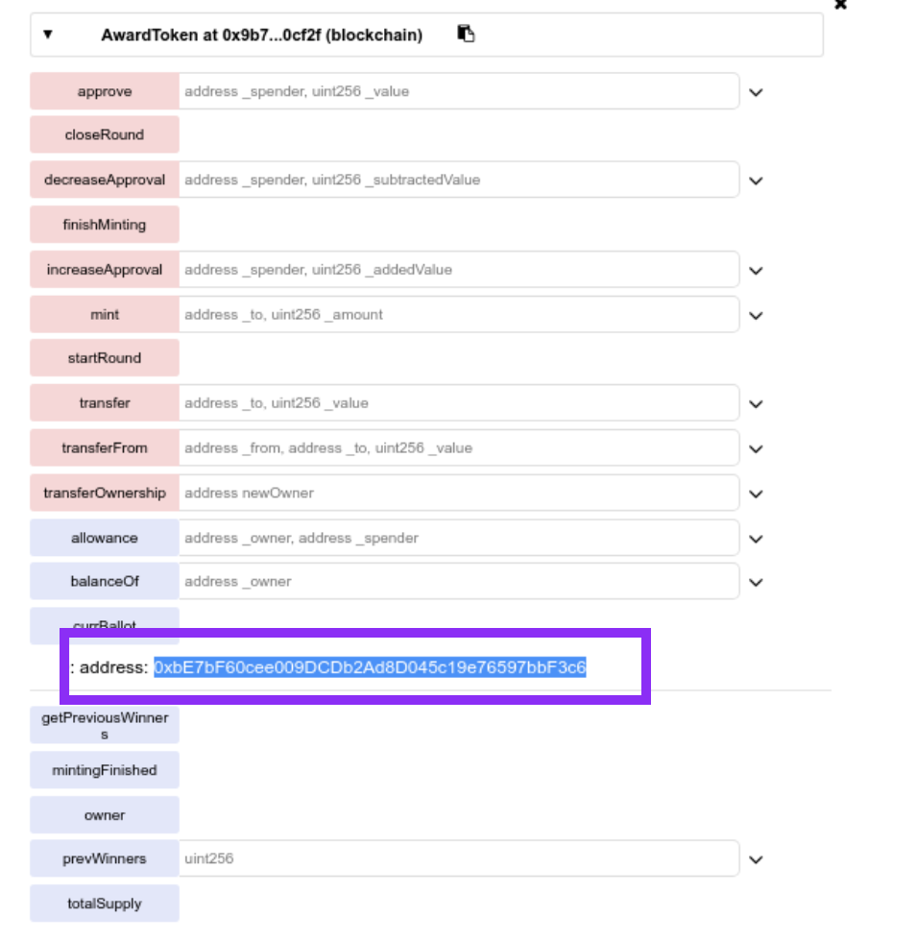
Copy ballot's address
currBallot output
( when dependencies.js is the active file )

Slide 14
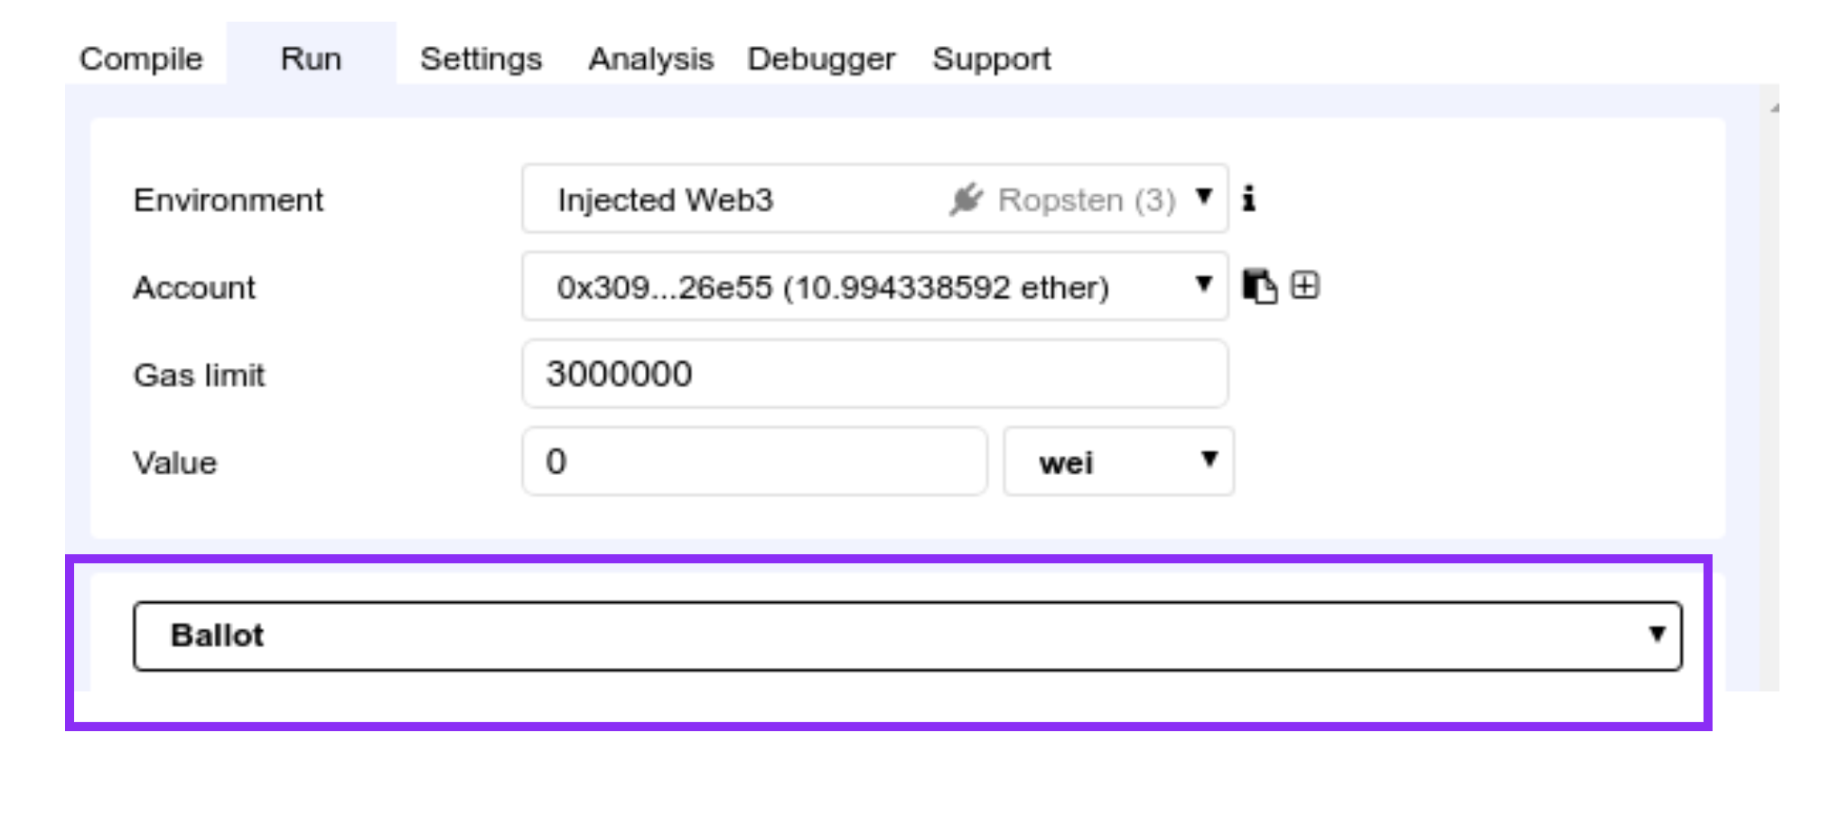
Switch to Ballot
Run tab: dropdown
( when dependencies.js is the active file )

Slide 15
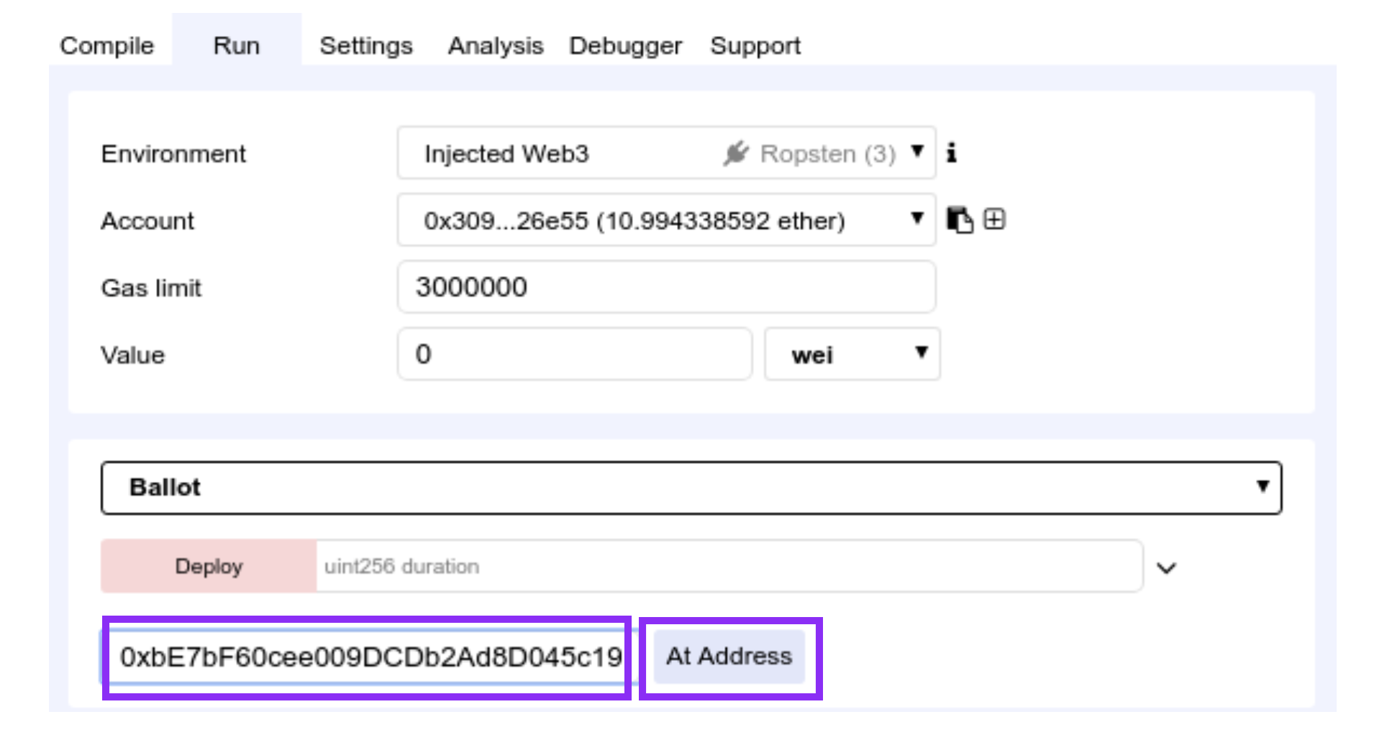
Access Ballot contract
Paste address + click At Address
( when dependencies.js is the active file )

Slide 16
Access Ballot contract
Paste address + click At Address
( when dependencies.js is the active file )

Slide 17
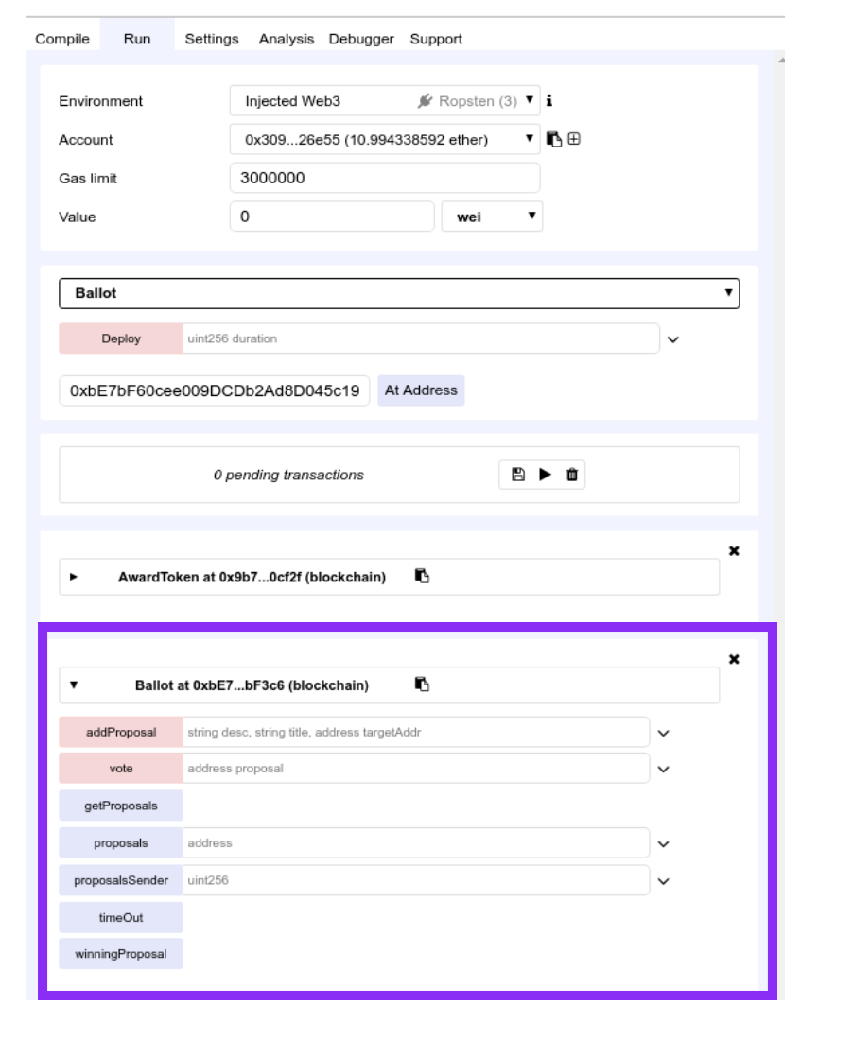
See autogenerated UI
( you might need to scroll down)
• Interact with all the functions in the contract
• And all the functions in the inherited contracts

