Slide 1
Debugging transactions
This walkthrough tutorial covers debugging transaction using Remix IDE

Slide 2
Debugging transactions
We will use the AwardToken in this tutorial as a short example for debugging the AwardToken.

Slide 3
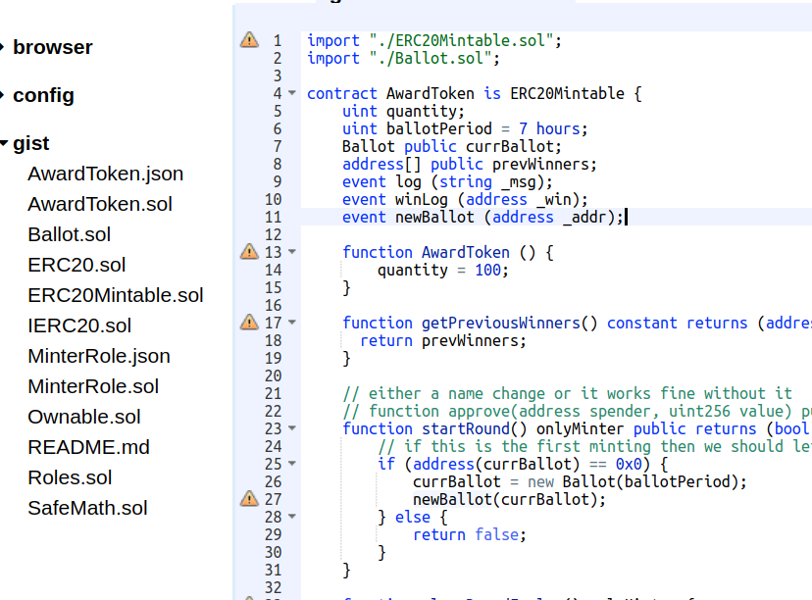
Debugging transactions
Let’s keep the loading process simple,
Run in the terminal
remix.loadgist('add9633c2b0101f6fda0aadcfe350f60')

Slide 4
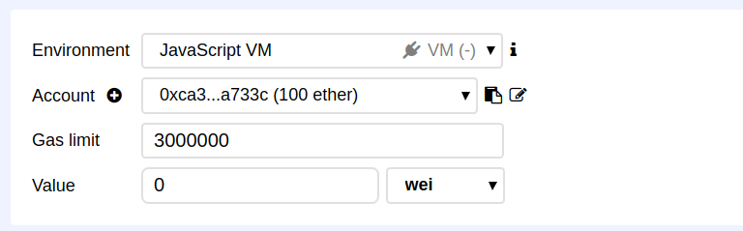
Debugging transactions
In the run tab, make sure the JavaScript VM is selected in the environment section.

Slide 5
Debugging transactions
Deploy the AwardToken

Slide 6
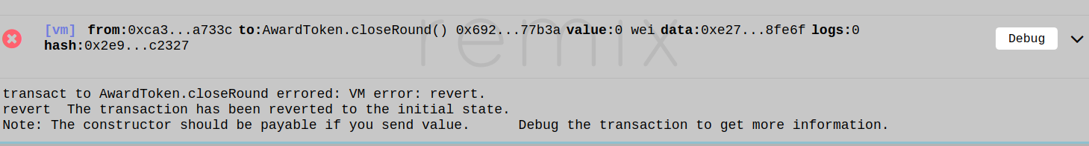
Debugging transactions
Let’s try a function which should fail ;)
Execute ‘CloseRound’, it should fails because the round is not even started.
But let’s debug it.

Slide 7
Debugging transactions
Click on ‘debug’

Slide 8
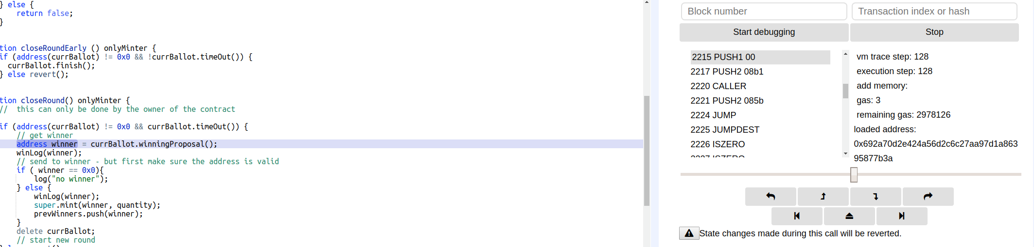
Debugging transactions
Use the slide or the navigation action to go forward or backward.

Slide 9
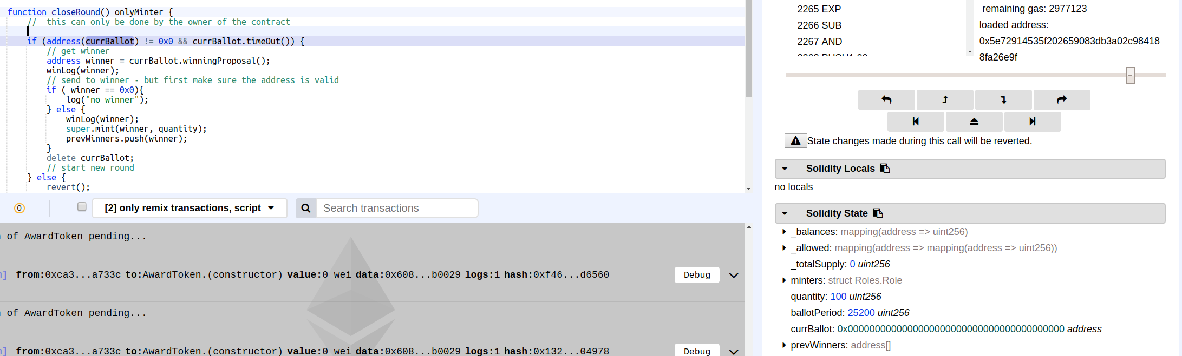
Debugging transactions
Solidity local variables and state variable can also help figuring out why the transaction fails.

Slide 10
Debugging transactions
Now we just let you try to find why it has failed :-)
Let’s continue a little bit...

Slide 11
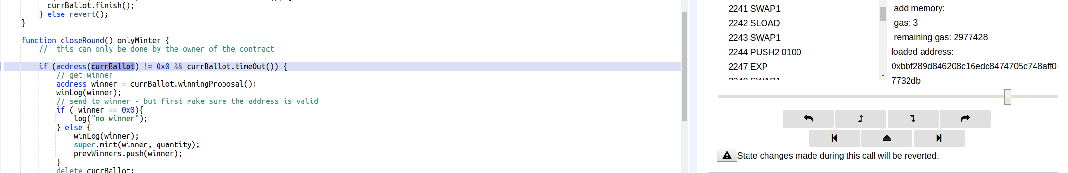
Debugging transactions
Moreover adding breakpoint and clicking on ‘jump to next breakpoint’ would help reaching the part of code you want to verify.

Slide 12
Debugging live transactions
The Ethereum Foundation and Infura are maintaining nodes dedicated on providing debugging support.
Supported networks are: Mainnet, Ropsten and Rinkeby.
it allows:
  deploying contract and debugging it against a “live” network (in comparison to the JavaScript VM).
  Take any “recent” transactions and debug it with source highlighting support. let’s dig a bit in that direction:

Slide 13
We just deployed the AwardToken contract yesterday and called the ‘startRound’ through the following transaction:
https://ropsten.etherscan.io/tx/0x3ec898b5c0e0fdfa48e5414ce20850552bbb7391f962dce09b1924f2a1f43bd2

Slide 14
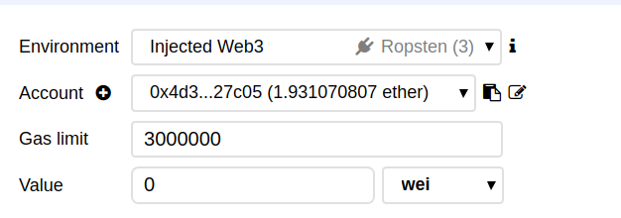
We already have the source code, but it would be easy to copy/paste the code from EtherScan (if the contract is verified).
Anyway,
Please switch to Ropsten

Slide 15
Take the following transaction hash:
0x3ec898b5c0e0fdfa48e5414ce20850552bbb7391f962dce09b1924f2a1f43bd2

Slide 16
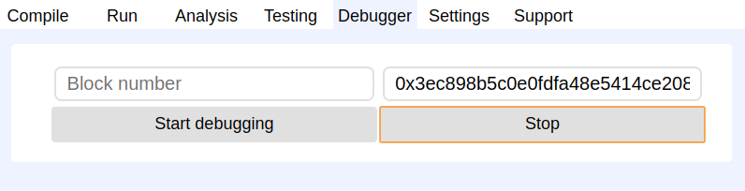
Select the debugger tab
input the transaction hash, and start debugging

