Slide 1
A Beginner’s Intro to Remix
(version with all files in the GIST)
NINA BREZNIK
@ninabreznik
ROB STUPAY
@ryestew
YANN LEVREAU
@yann300
ALEX PRAETORIUS
@SERAPATH
IURI MATIAS
@iurimatias
IURI MATIAS
@iurimatias
IURI MATIAS
@iurimatias
IURI MATIAS
@iurimatias
IURI MATIAS
@iurimatias
LIANA HUSIKYAN
@lianahusikyan

Slide 2
Part 1
Setup, Tour, Loading Contracts, & Compiling

Slide 3
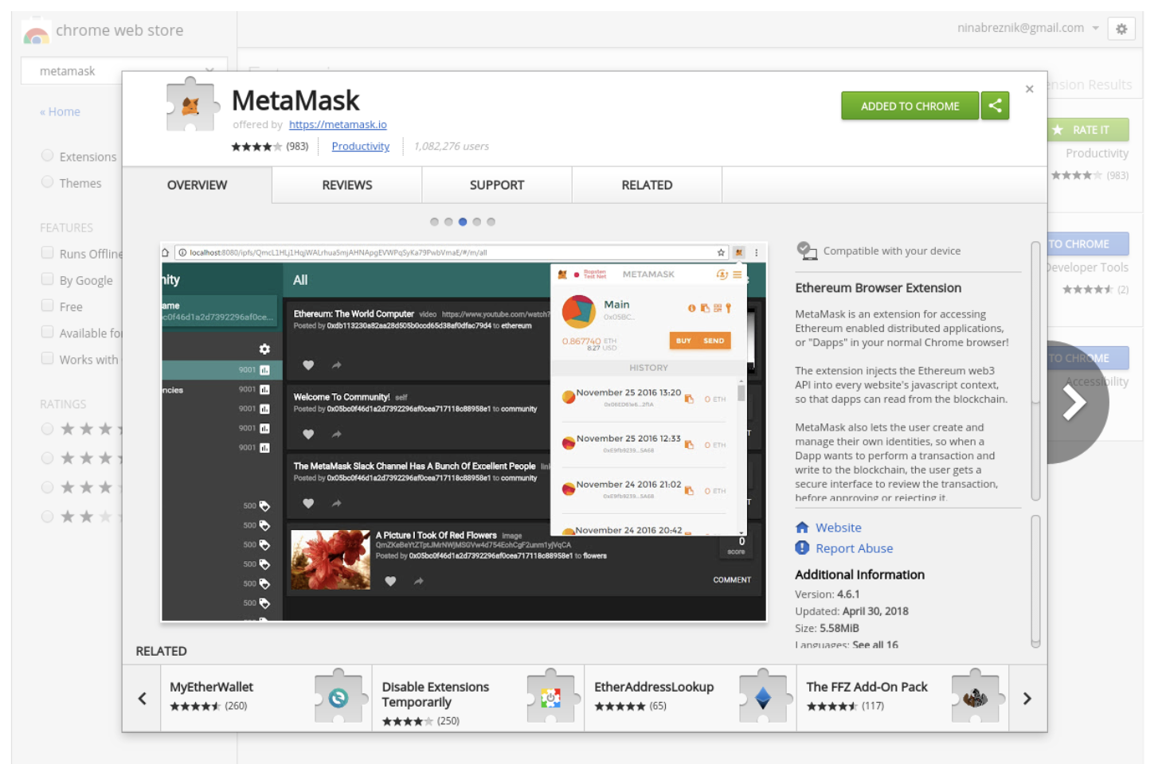
Install Metamask
chrome.google.com/webstore

Slide 4
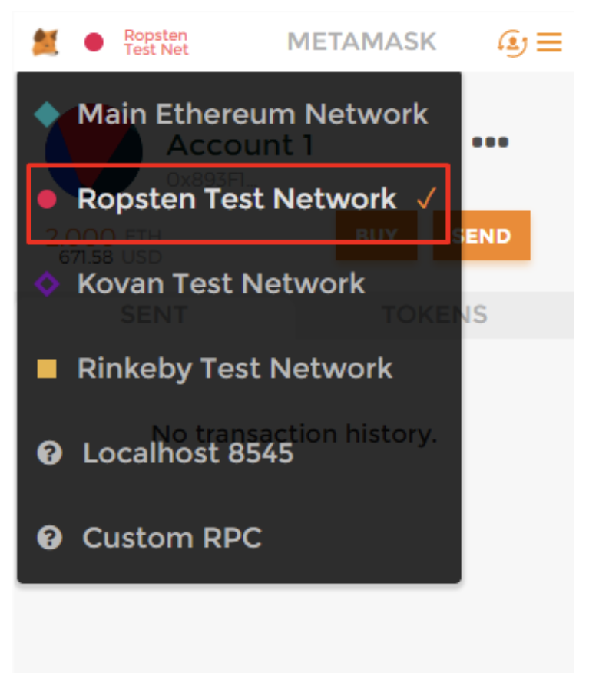
Login to Metamask
And choose Ropsten Test Network

Slide 5
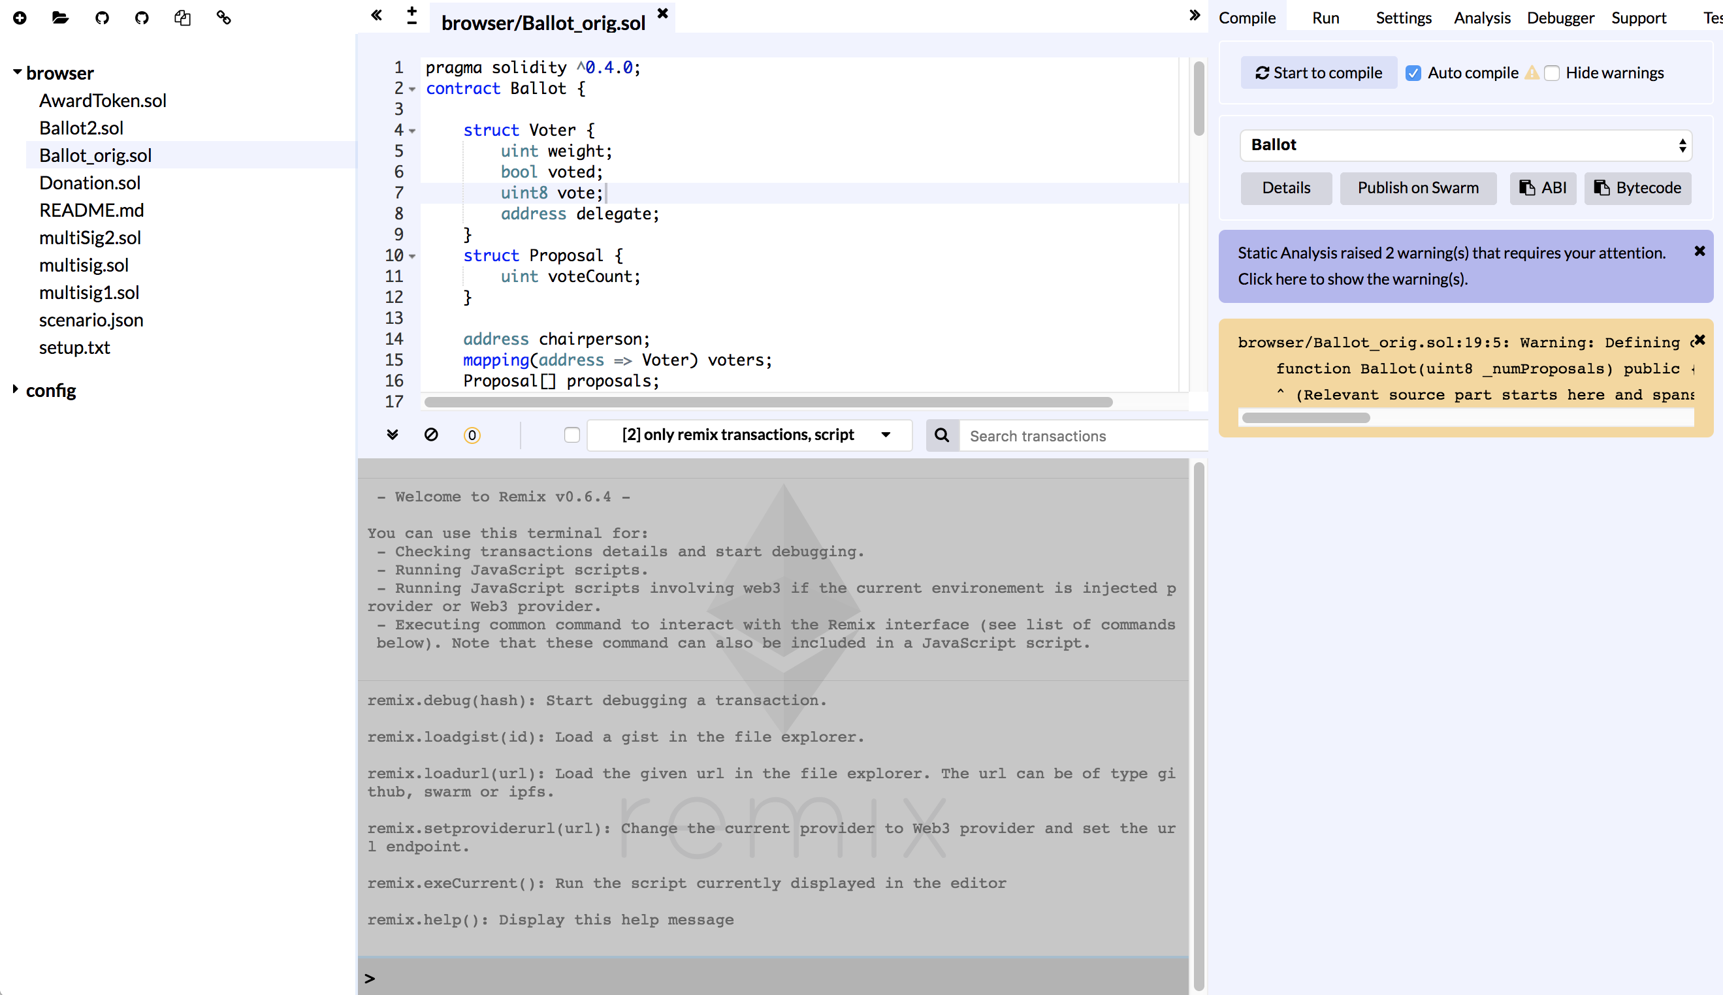
Remix Tour
https://remix.ethereum.org
File Explorer
Compile Tab (active)
Editor
Terminal
Console

Slide 6
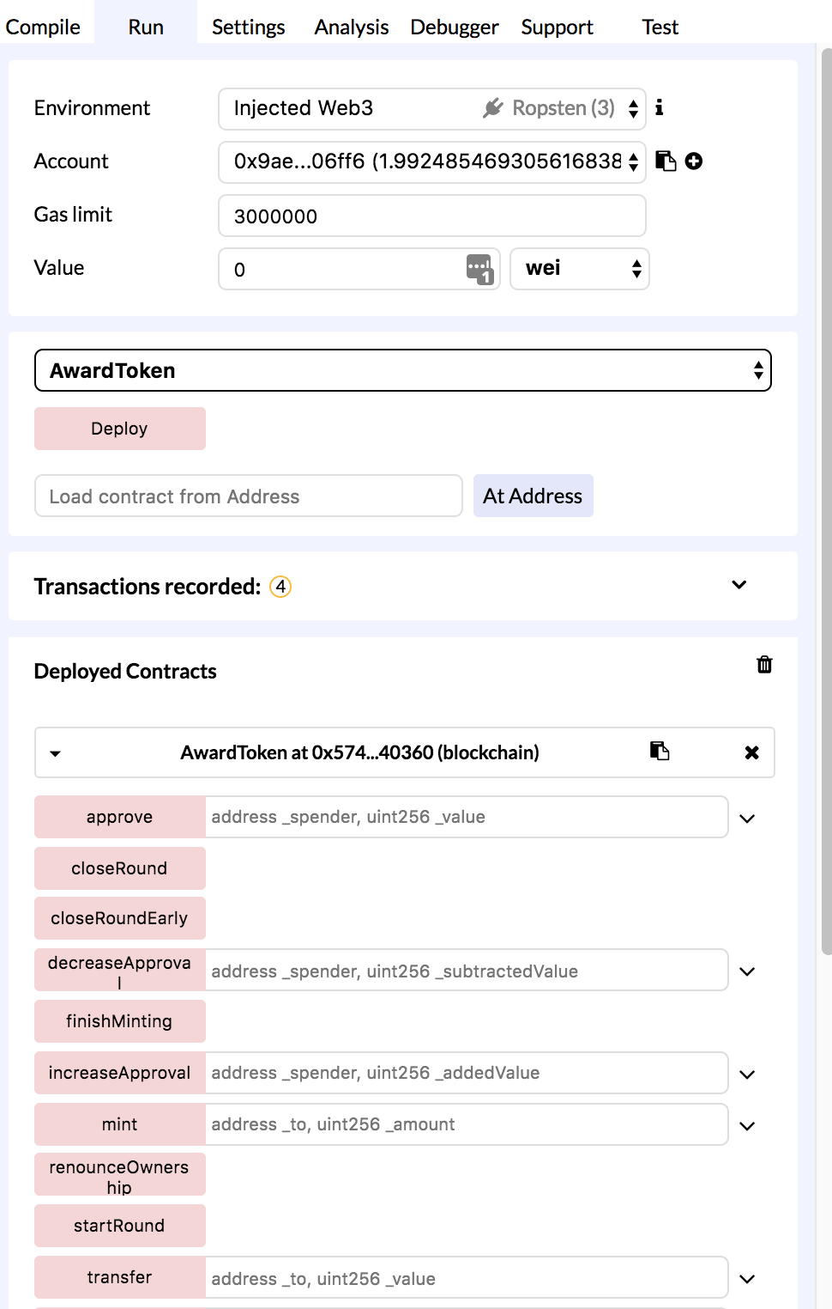
Run Tab
Editor
Terminal
Universal DAPP
UI to the Contract
Console

Slide 7
Remix Commands
https://remix.ethereum.org

Slide 8
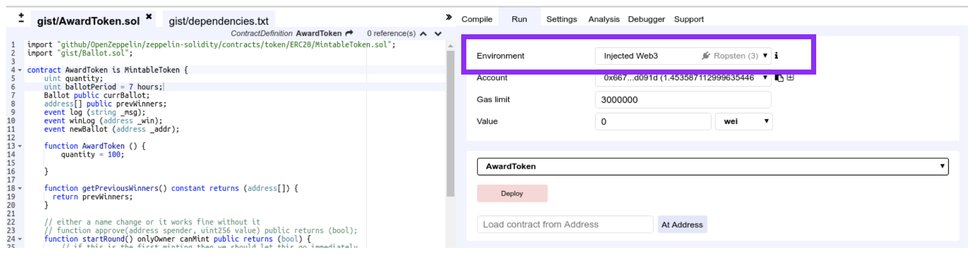
Set environment
Run tab-> Environment:
Javascript VM - a simple and quick environment – only visible to your machine
Injected web3 (Ropsten) – or whatever testnet you have setup in metamask
Web3 Provider
Choose: Injected web3 (Ropsten)

Slide 9
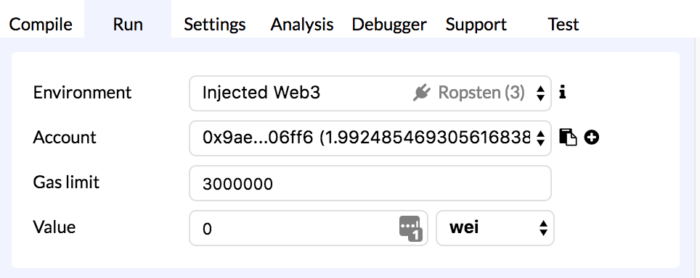
Get some TEST ether
http://faucet.ropsten.be:3001/
But FIRST:
Copy your address - here or in Metamask

Slide 10
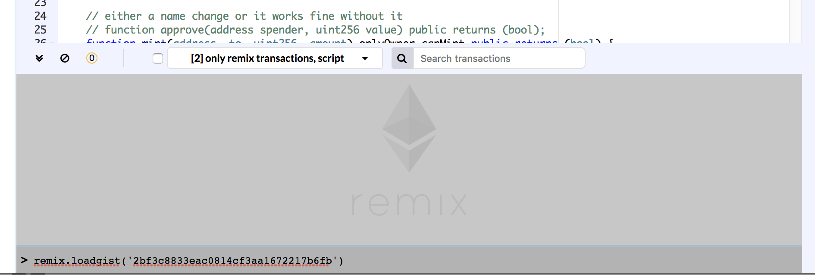
Load files to Remix
remix.loadgist('add9633c2b0101f6fda0aadcfe350f60')
here in the console

Slide 11
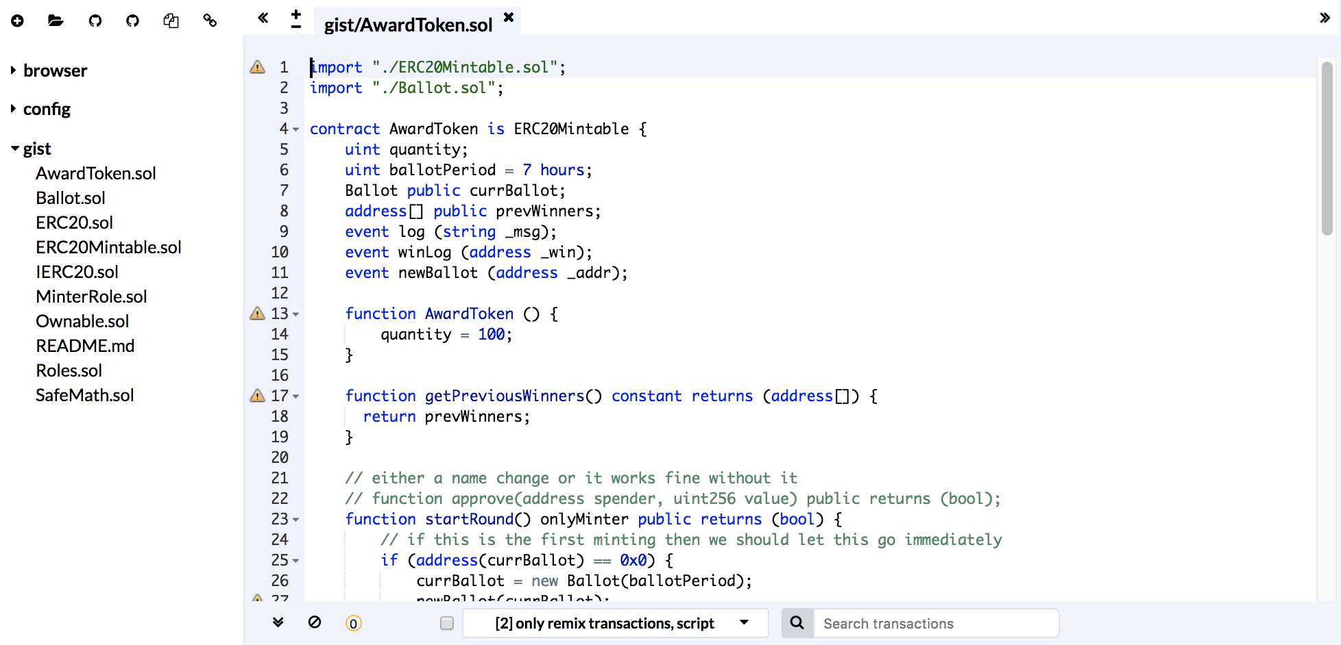
Open file
gist/AwardToken

Slide 12
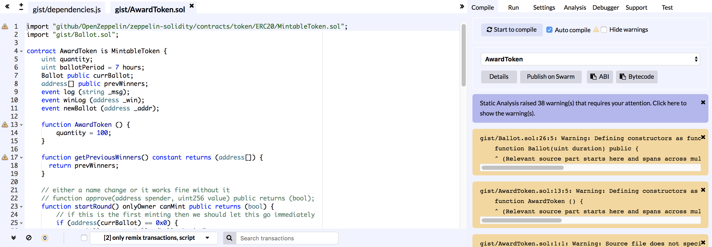
Compile the contract
Compile tab: Start to compile button
( when dependencies.js is the active file )

Slide 13
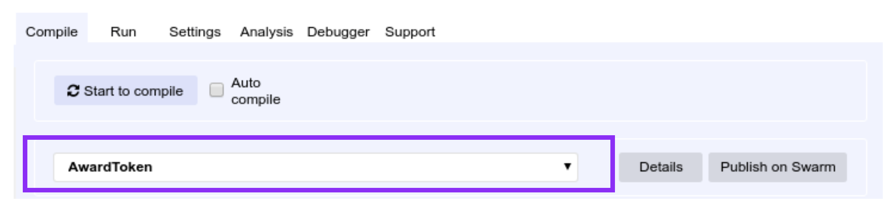
See compiled contracts
AwardToken + all dependencies
( when dependencies.js is the active file )

Slide 14
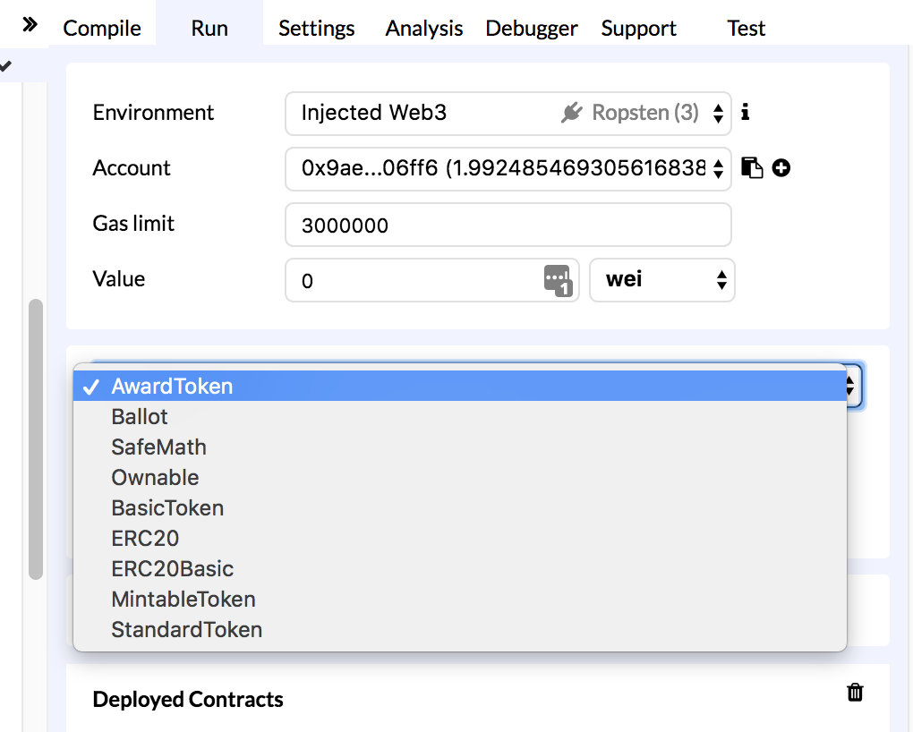
Imported Contracts

