Slide 1
Multiple ways of loading files intro to Remix
This tutorial covers the same info as the basic deployment tutorial – but it teaches you 3 different routes of getting access to the files we want to import:
• Through using remixd – which allows remix to look into a specific folder ( that you specify) on your hard drive. In this tutorial we will use this along with using NPM
• Using the remix console to download files in a github repo
• Using the Zeppelin plugin for remix, that imports the contracts through https
This tutorial assumes some knowledge of Remix.
At the end of this tutorial, you could, if you fancy, continue to part 2 of the basic deployment tutorial.

Slide 2
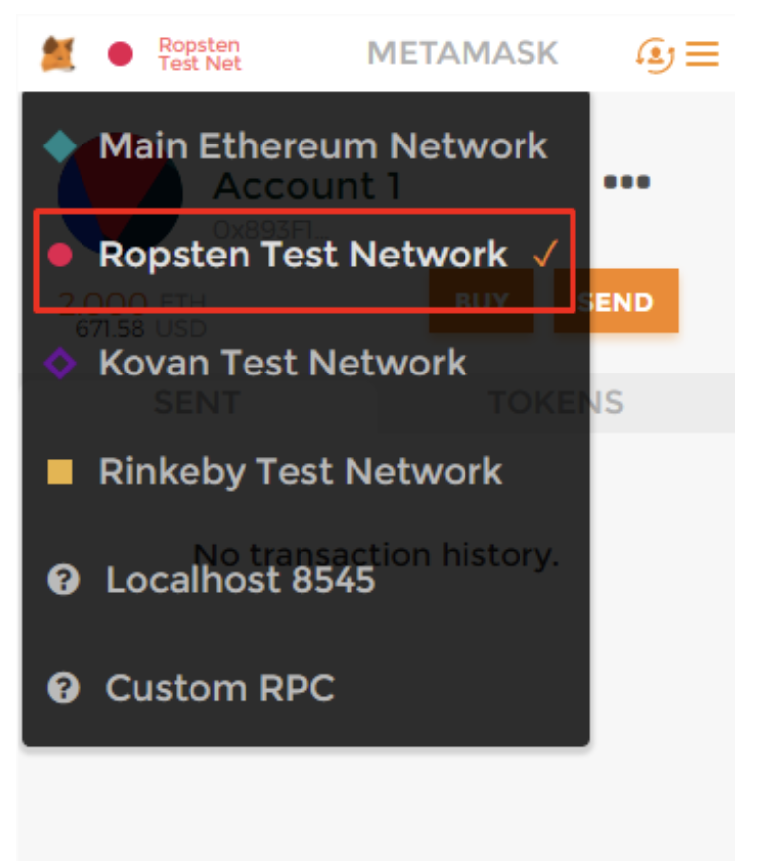
Login to Metamask to choose Ropsten

Slide 3
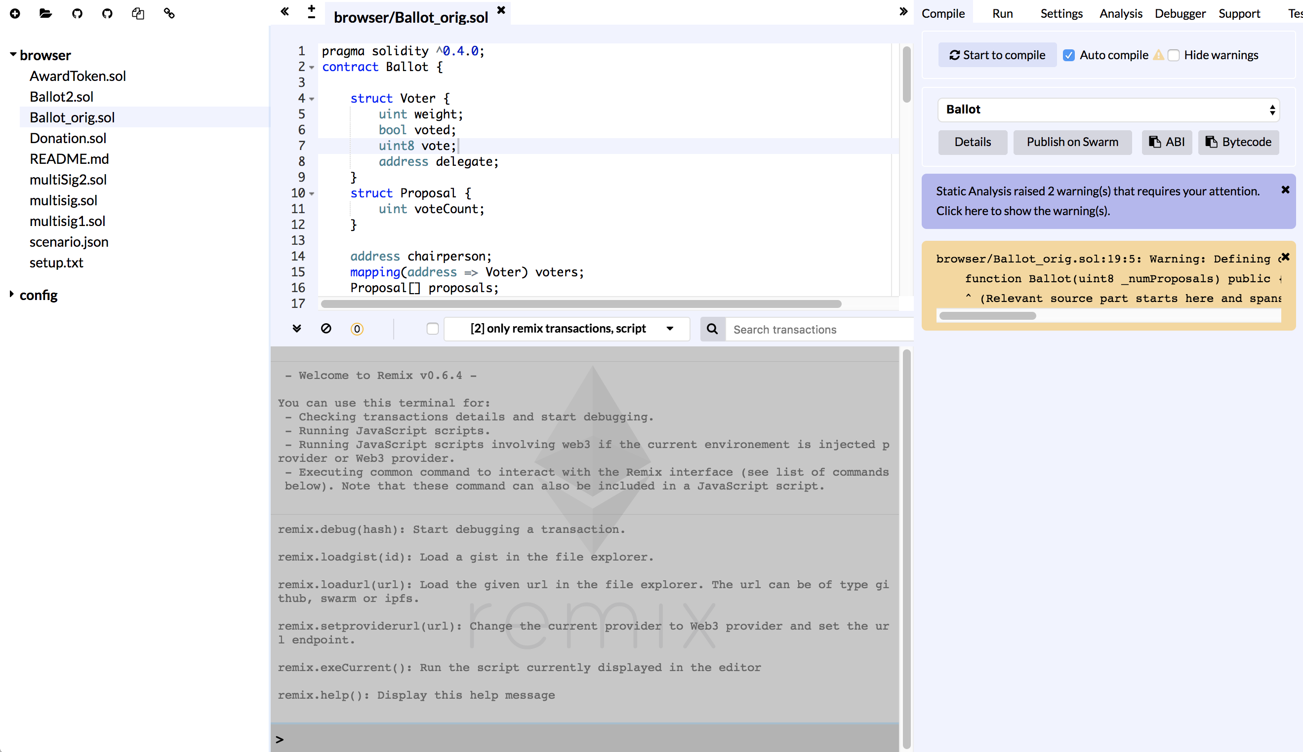
Remix Tour
https://remix-alpha.ethereum.org
File Explorer
Compile Tab (active)
Editor
Terminal
Console

Slide 4
Remix Commands
https://remix-alpha.ethereum.org

Slide 5
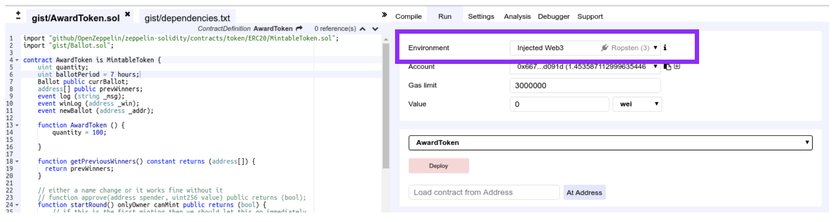
Set environment
Run tab-> Environment:
Javascript VM - a simple and quick environment – only visible to your machine
Injected web3 (Ropsten) – or whatever testnet you have setup in metamask
Web3 Provider
Choose: Injected web3 (Ropsten)

Slide 6
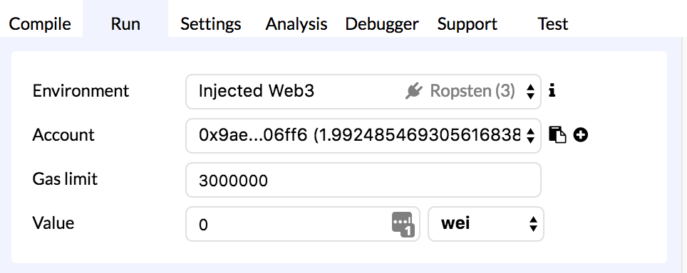
Get some TEST ether
http://faucet.ropsten.be:3001/
But FIRST:
Copy your address - here or in Metamask

Slide 7
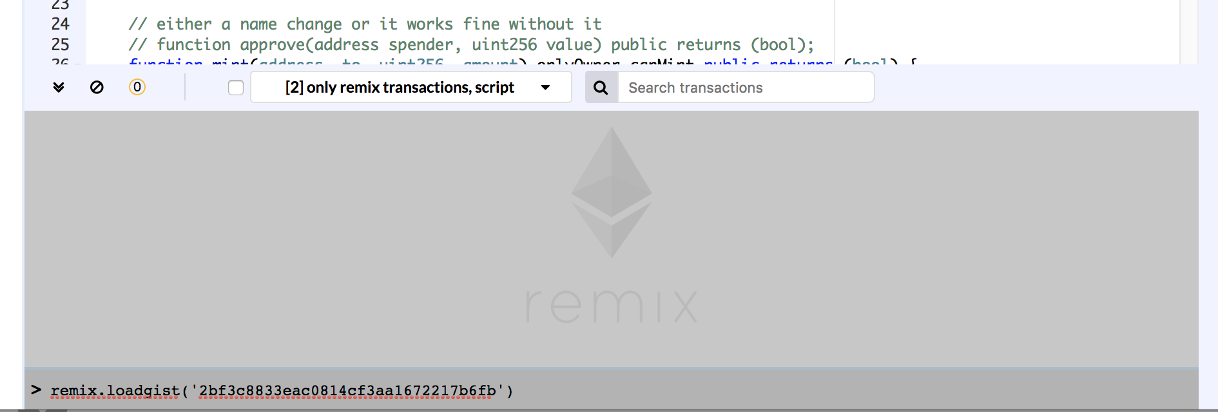
Load files from a GIST
remix.loadgist('21cad99396f8c78ecf229834f1b6eaeb')
here in the console

Slide 8
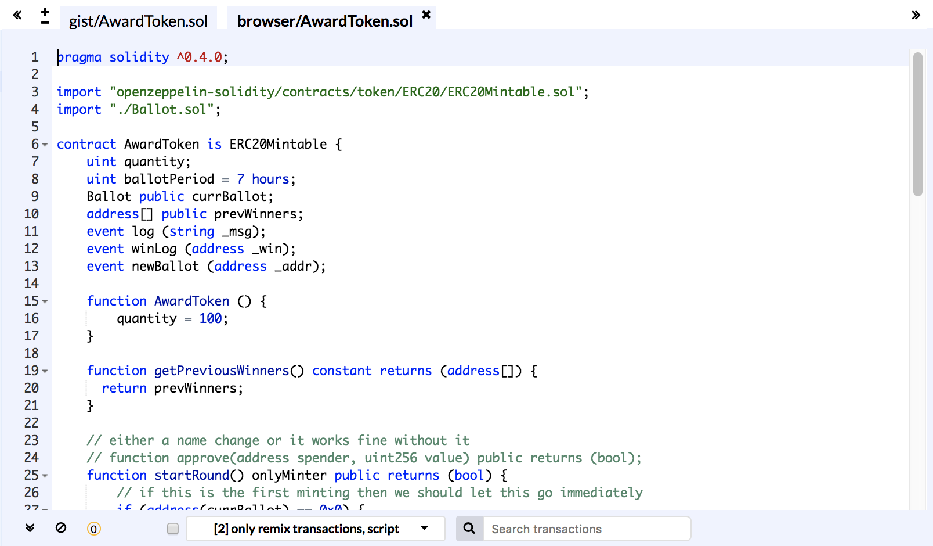
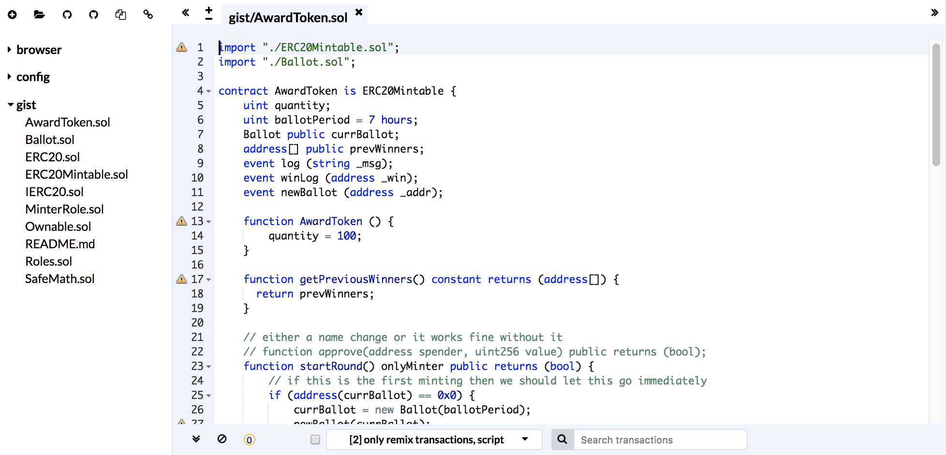
Open file
gist/AwardToken
Setup to access local files
and npm modules

Slide 9
Setup for remixd:
To access local files on your computer
and npm modules
In a Terminal / Console
(not inside remix but on your computer)
cd to a directory where you want to install the npm modules. (typically your project’s directory)
Type these commands:
npm init -y
npm install -g remixd ( to install it globally)
npm install -E openzeppelin-solidity
( the npm module openzeppelin-solidity contains the contracts that we need for awardToken.sol)

Slide 10
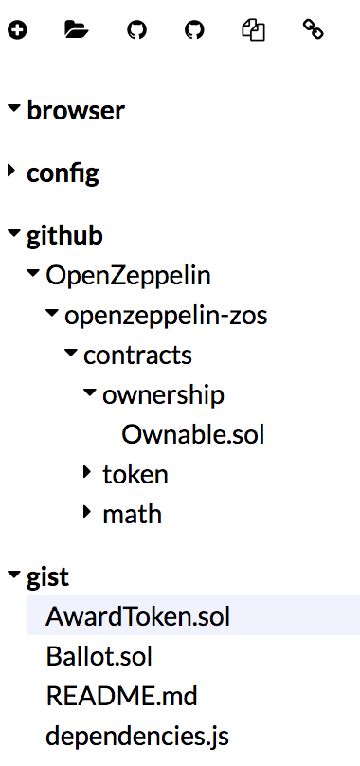
Get Remixd Running!
In a Terminal / Console
And in your project’s directory
Type:
remixd -s ./ --remix-ide https://remix.ethereum.org
( or http://remix-alpha.ethereum.org or what ever version of remix you are on)
Then go to remix and turn on remixd by clicking the link icon at the top of the File Explorer ( top left of Remix)

Slide 11
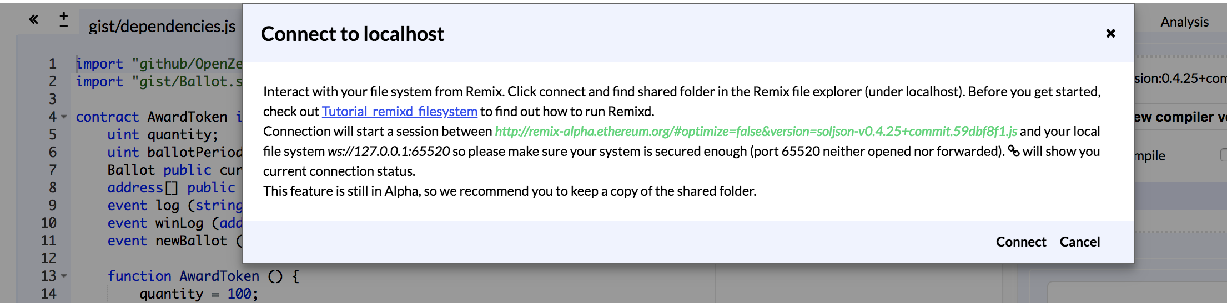
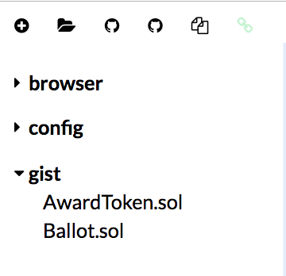
Click ‘Connect’
Then the link icon should turn light green.

Slide 12
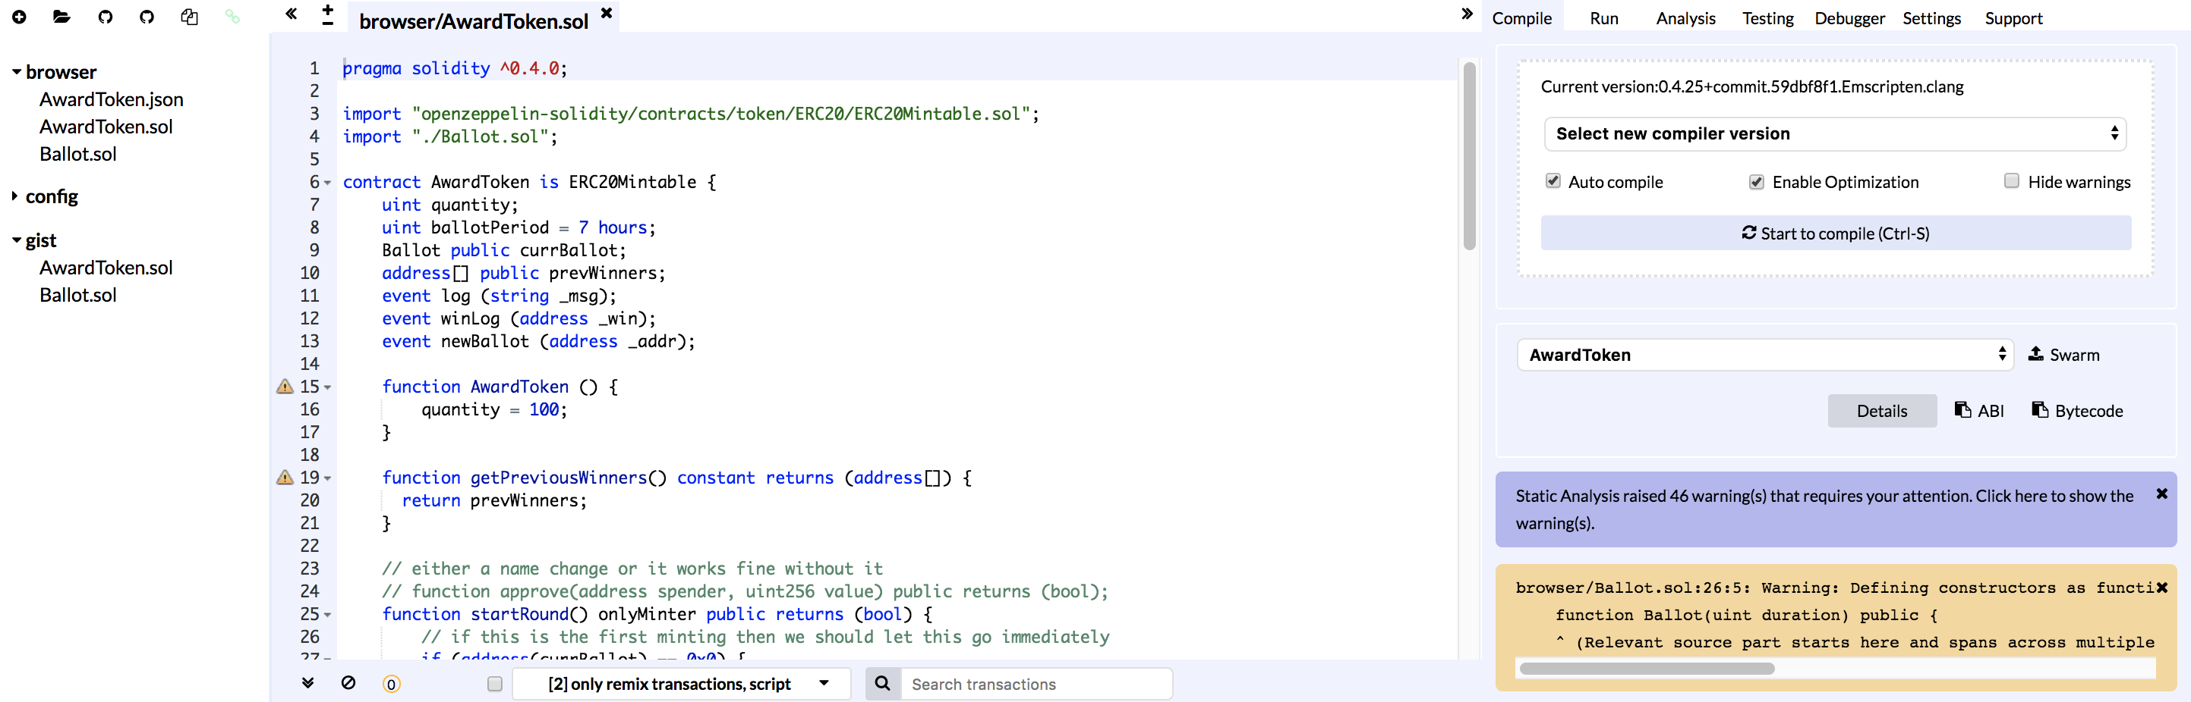
Compile AwardToken
Make sure that AwardToken.sol is the active file in the terminal.
Click the “Start to compile” button

Slide 13
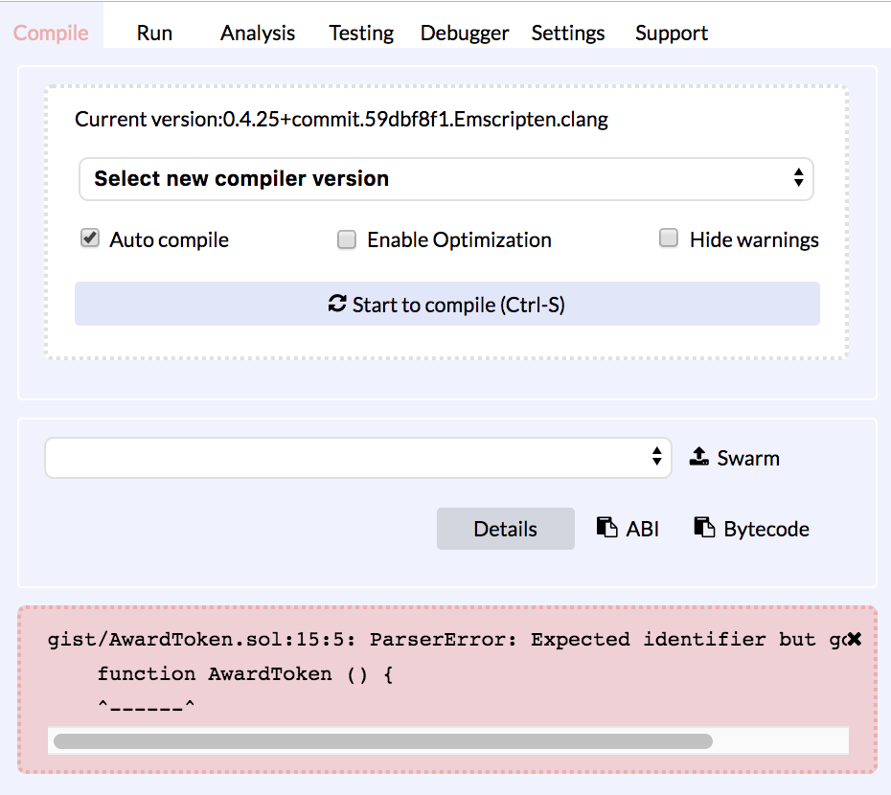
If you have no compilation errors ( in pink) then...
SUCCESS!!
Compilation errors look like this:
Compile is now orange
Error is pink

Slide 14
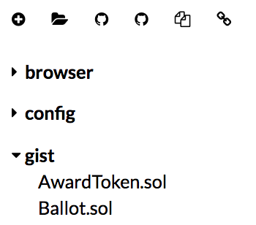
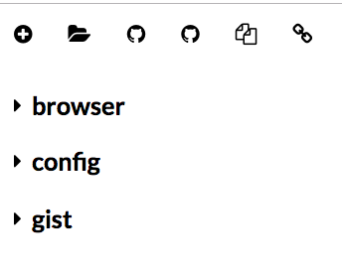
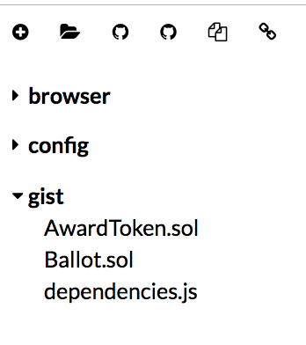
Load from GITHUB
In the console type:
remix.loadgist('1d3250ca532b5f1e3ed4f52b18feb602')
To see the new file loaded you need to open and close the caret next to gist :

Slide 15
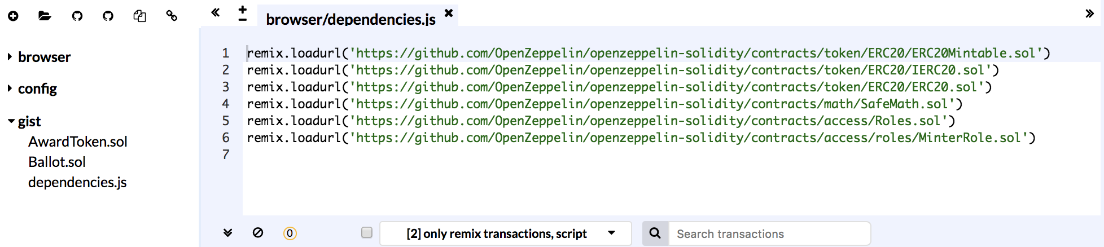
Load up the dependencies
1. Click dependencies.js to make it the active file
( it will appear in the editor)
2. In the console type: remix.exeCurrent()
-or-
copy each line of the dependencies.js into the console to load each file of the github repo
3. Open and close the caret next to githubto see the loaded files.

Slide 16
Update the code to point to the github repos
1. Go to AwardToken and update line 3
Replace:
import "openzeppelin-solidity/contracts/token/ERC20/ERC20Mintable.sol";
With:
import "github/OpenZeppelin/openzeppelin-solidity/contracts/token/ERC20/ERC20Mintable.sol";
Now you are pointing to the downloaded repo in remix.
Hit the “start to compile” button on the compile tab.
And there shouldn't be any errors… ( famous last words).

Slide 17
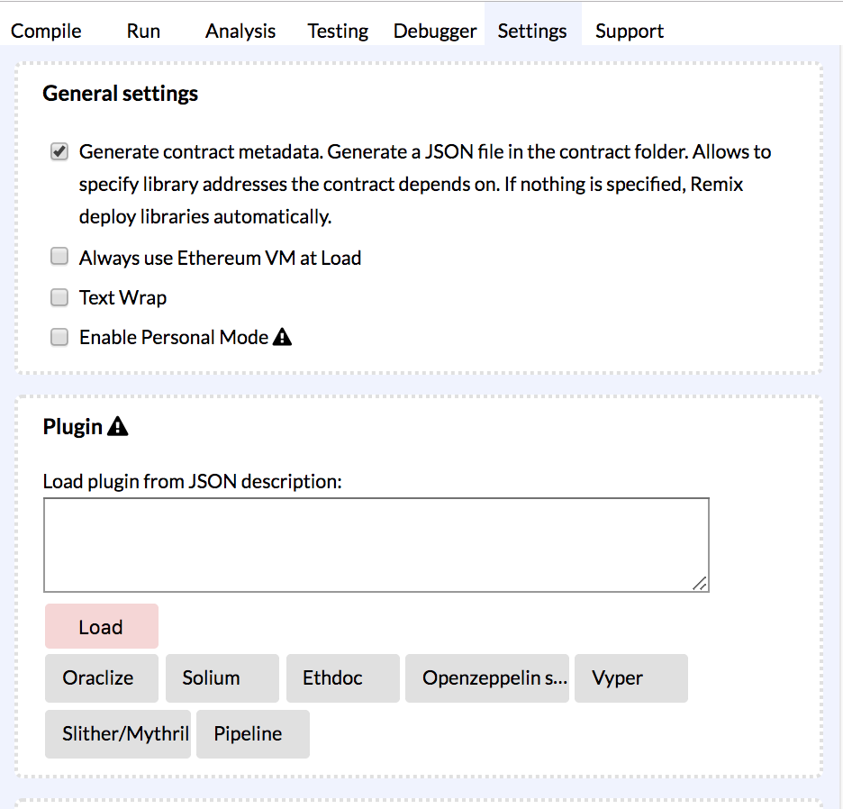
Load files from a url – via the Zeppelin plugin
Click the Openzeppelin plugin button in the settings tab

Slide 18
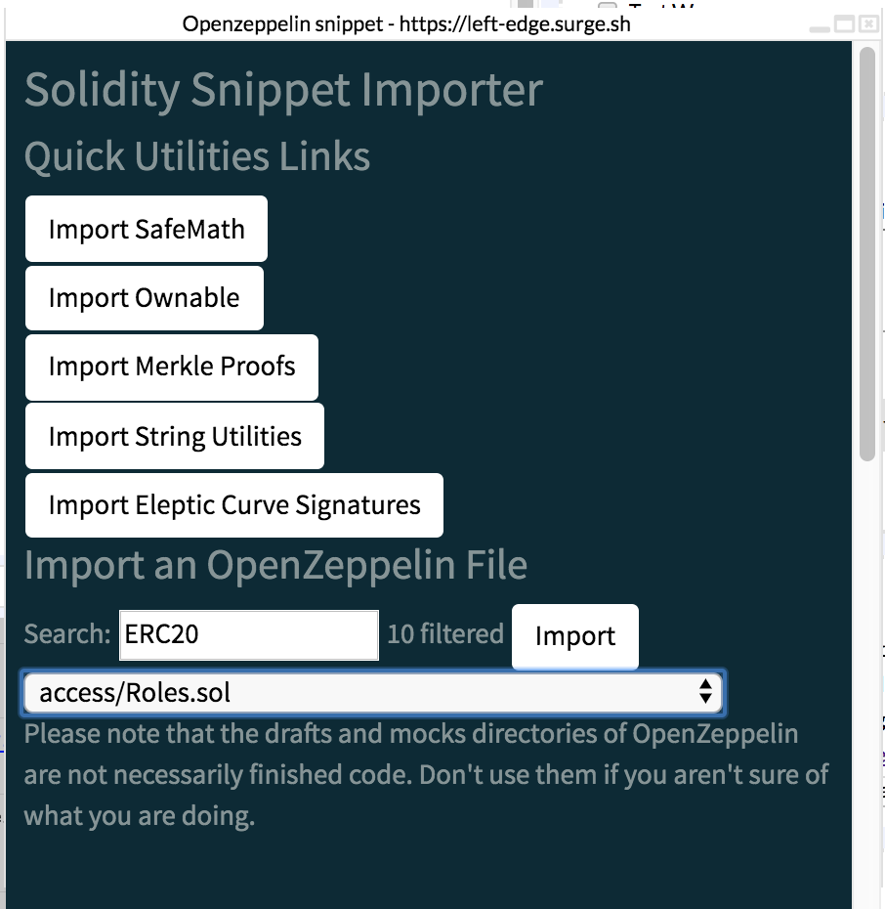
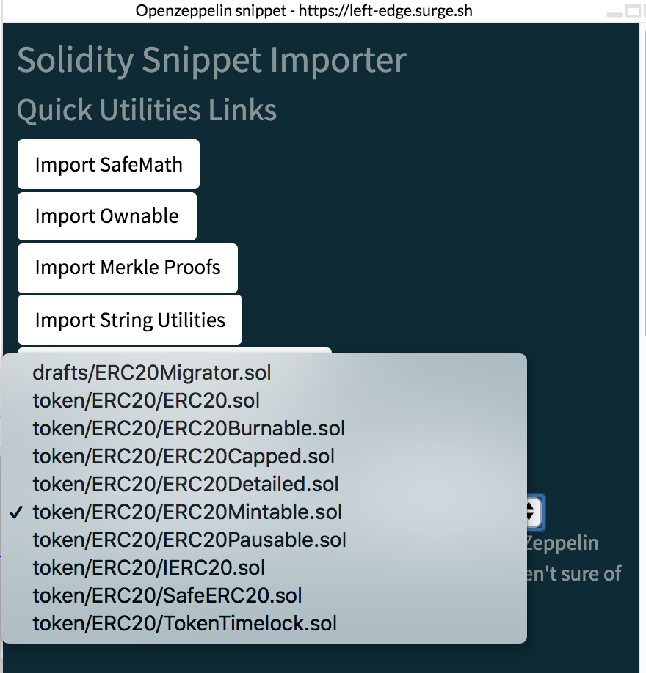
Choose ERC20Mintable.sol
1. In the window that pops up – input: ERC20 in the Search box.
2. In the select box – choose ERC20Mintable.sol & click Import

Slide 19
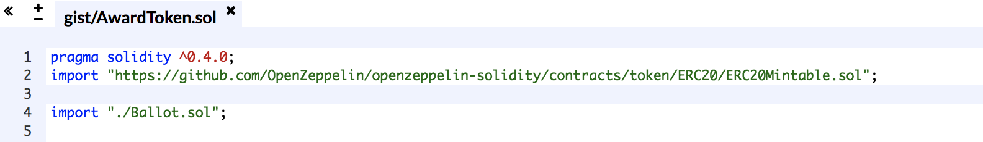
Update AwardToken.sol
The Zeppelin plugin has written a new line in AwardToken that imports ERC20Mintable.sol via https.
So, delete this line:
import "github/OpenZeppelin/openzeppelin-solidity/contracts/token/ERC20/ERC20Mintable.sol";
AwardToken's import lines should look like this:
Then hit the compile button and it should work... ( again famous last words)

Slide 20
Thank you
@ninabreznik @ryestew @yann300
@serapath @LianaHus @iurimatias @GrandSchtroumpf
http://bit.ly/remix-workshop-repository

