Slide 1
Proxy Contract
This walktrough tutorials covers the basics of using a proxy contract.
Proxy contract allows to save gas at deployment time.

Slide 2
Introduction
This document has been heavily inspired from
https://blog.gnosis.pm/solidity-delegateproxy-contracts-e09957d0f201
Please check it out ;)

Slide 3
Rationale
Storing contract code at creation time can cost up to:
200 * max_byte_code_length gas
200 * 24576 = 4915200
4915200 * 10 gwei = 49152000 gwei = 0.049152 ether = 9 EUR
see https://github.com/ethereum/EIPs/blob/master/EIPS/eip-170.md for more infos on max_byte_code_length.

Slide 4
Proxy Contract
Using Proxy Contract pattern allows to save gas at deployment time.
Useful when a lot of instances of the same contract require to be deployed.

Slide 5
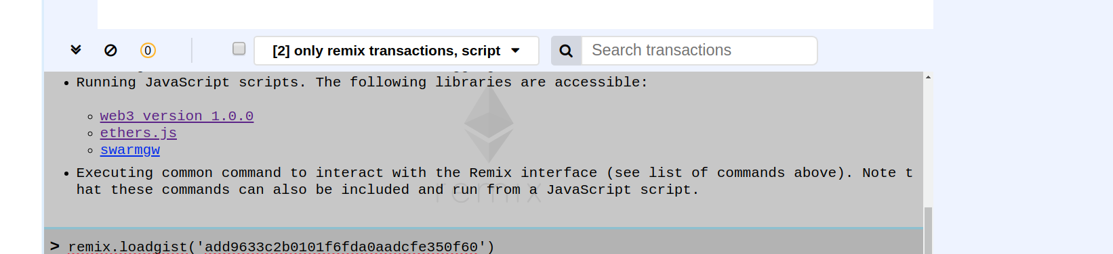
Let’s Start to Proxy the AwardToken
Load the AwardToken code by running the command:
remix.loadgist('add9633c2b0101f6fda0aadcfe350f60')

Slide 6
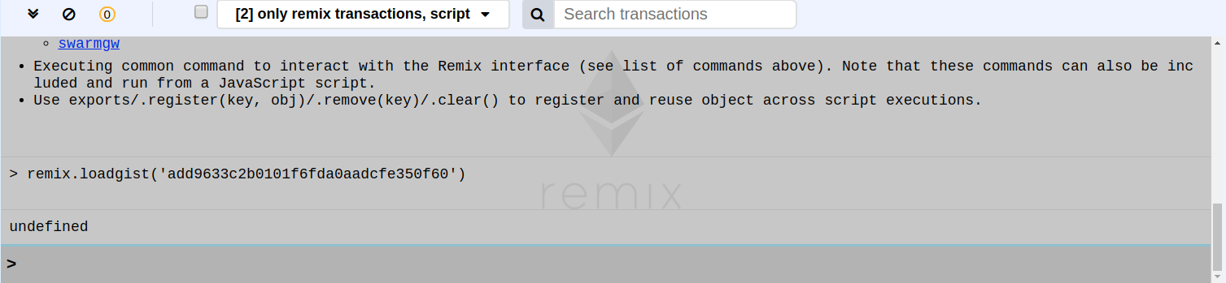
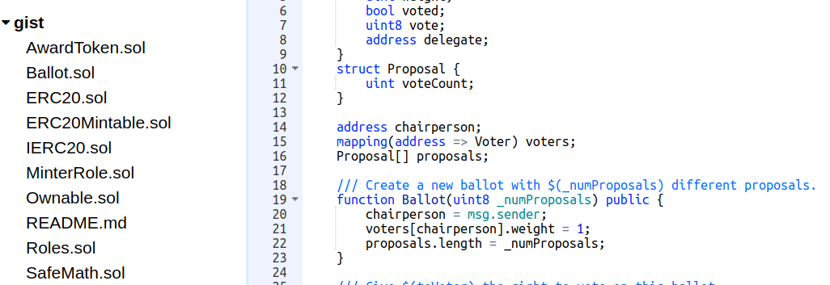
AwardToken
select AwardToken.sol
In the gist explorer

Slide 7
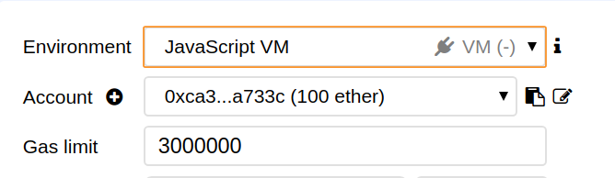
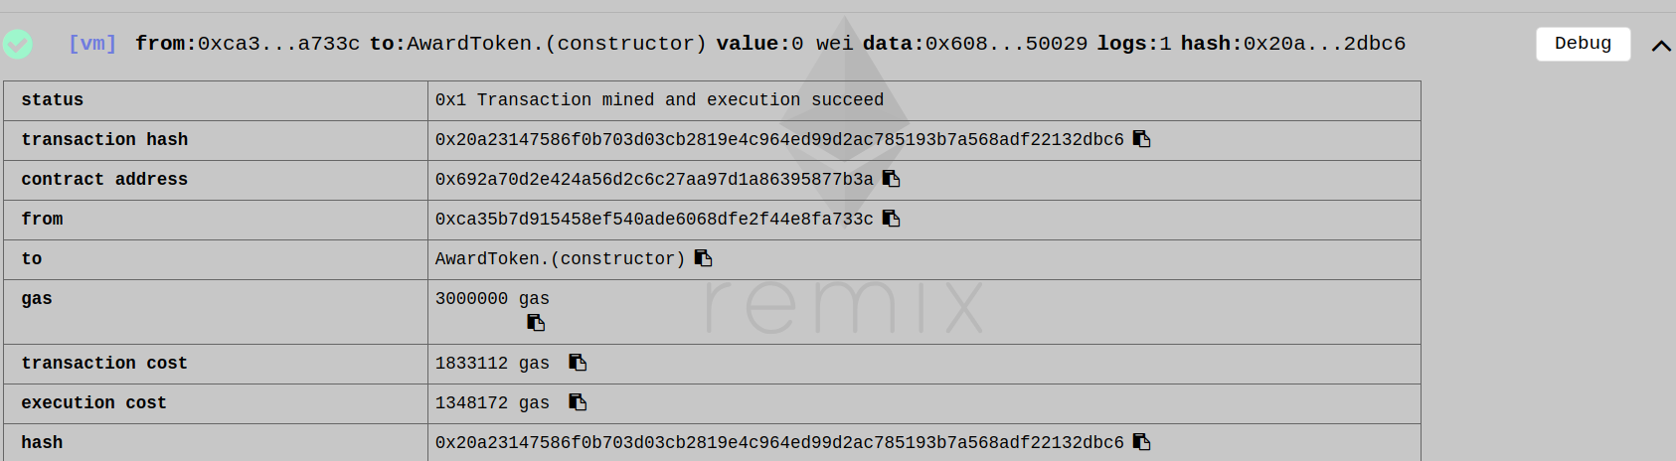
Deploy AwardToken
Deploy the contract on the JavaScript VM. The transaction cost should be around:
1833112 gas * 10 gwei * 0.000000001 = 0,01833112 eth = 3,7 euros

Slide 8
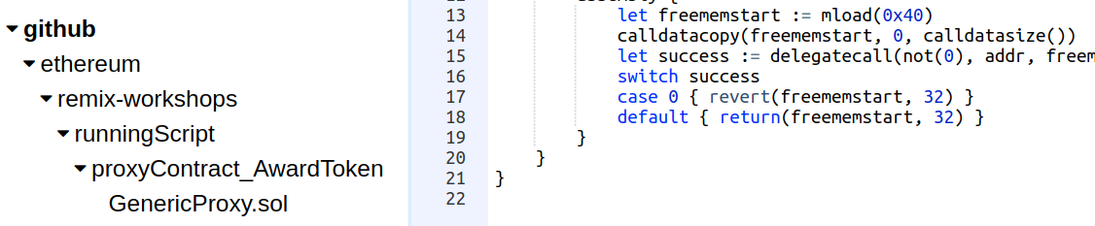
Loading a generic proxy
Run in the console:
remix.loadurl('https://github.com/ethereum/remix-workshops/proxyContractAwardToken/GenericProxy.sol')

Slide 9
Generic Proxy?
The plan is to deploy the generic proxy and link it to the AwardToken.
We keep the same functionality but with less code to deploy and therefore more gas saved.
- Instead of implementing all the function of AwardToken, we use the anonymous function to forward the call to the AwardToken code -

Slide 10
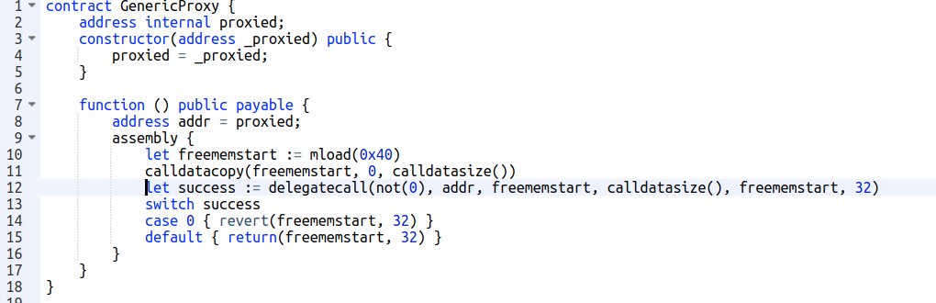
Generic Proxy
The forwarding happens line 12. see “delegatecall”.
We call the code of AwardToken (which is stored at the address “proxied”) while keeping the same context (msg.sender and storage)

Slide 11
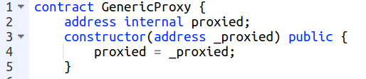
Generic Proxy
Create a new file in the browser explorer (Proxy.sol for instance) and paste the code of the generic proxy to it.
(We are copying it into the browser explorer so that we can edit it.)
We can “theoretically” use it as it is, by deploying this proxy contract with the address of an AwardToken as constructor parameter.
While the “forwarding call” will work, the Proxy contract is NOT usable due to a different storage layout between Proxy and Awardtoken contract (see next slide)

Slide 12
Storage layout
The reason is that the state declaration of both contracts (Proxy and AwardToken) are completely different.
We have:
one state variable of type address for the proxy contract.
an ERC20 like state declaration for the AwardToken.
They both get “merged” in a single messy state.

Slide 13
Storage layout
While a “forwarding call” is a necessary first step, the “forwarding call” does not change anything on the storage declaration.
We need to tell the Proxy how the AwardToken state looks like ;)

Slide 14

Storage layout
For doing that, the easiest way is to create a data contract (contract representing the state):
Create a file named AwardTokenData.sol, and write an empty contract named AwardTokenData.
Copy the state (including events) from the AwardToken contract to AwardTokenData contract.
Don’t forget that AwardToken is an ERC20Mintable and will require some import:

Slide 15
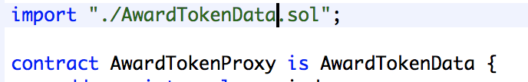
Storage layout
The file that we had just created called Proxy.sol - we can now rename to AwardTokenProxy.
Make sure AwardTokenProxy inherits from AwardTokenData
With this setup, AwardToken also now inherits from AwardTokenData

Slide 16
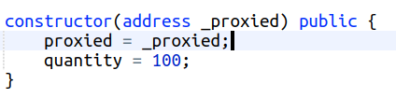
Initialization
An important issue remains.
If we deploy the AwardTokenProxy now, we would not execute the AwardToken constructor. AwardTokenProxy does not inherit AwardToken.
The solution is to simply put the AwardToken constructor code in the AwardTokenProxy constructor – in our case the assignment of “quantity”

Slide 17
Initialization
An important issue remains.
If we deploy the AwardTokenProxy now, we would not execute the AwardToken constructor. AwardTokenProxy does not inherit AwardToken.
The solution is to simply put the AwardToken constructor code in the AwardTokenProxy constructor – in our case the assignment of “quantity”

Slide 18
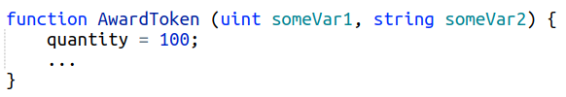
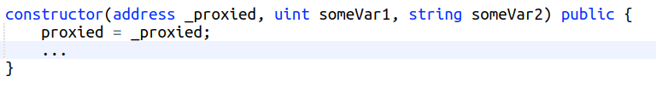
Initialization
If the master contract has input parameters, you'd need to use the same input parameters in the same order BUT after the address parameter.
e.g if the master contract is
The constructor of the Proxy contract is going to be:

Slide 19
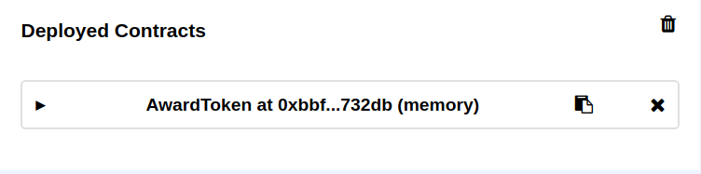
Deploy
Now that’s it!
Compile and deploy AwardToken - this is our master contract.

Slide 20
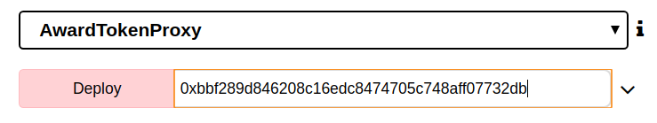
Deploy
Deploy AwardTokenProxy - using the master contract address
it should cost around 924496 gas.
924496 gas * 10 gwei * 0.000000001 = 0,00924496 ETH = 1.85 EUR

Slide 21
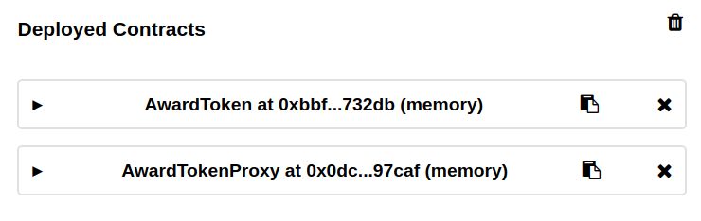
Deploy

Slide 22
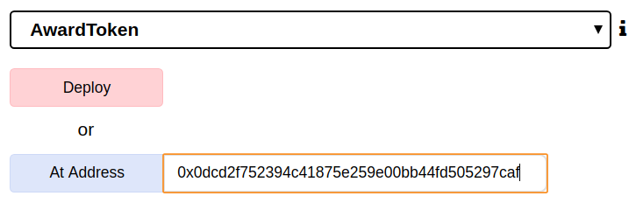
Deploy
Use the “At Address” action to access the proxy as the AwardToken. (in this case we input the address of AwardTokenProxy)

Slide 23
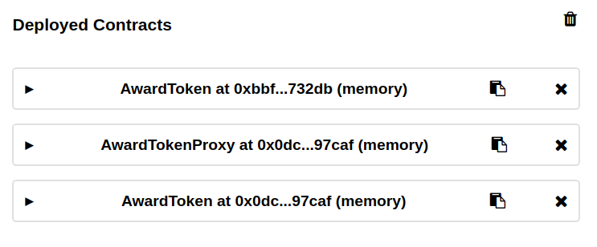
Deploy

Slide 24
Please be sure to check the following post:
https://blog.gnosis.pm/solidity-delegateproxy-contracts-e09957d0f201

Slide 25
Please be sure to check the following post:
https://blog.gnosis.pm/solidity-delegateproxy-contracts-e09957d0f201

