Slide 1
Continuous Integration
This walktrough tutorial covers the basics of using remix libraries
in your Continuous Integration

Slide 2
Continuous Integration
Remix libraries are located in
https://github.com/ethereum/remix
They can be used for several purposes:
  Compiling solidity file
  Running static Analysis
  Running unit testing
  Debugging transaction

Slide 3
Continuous Integration
We will cover in these slides how to:
  Compile solidity files
  Run static analysis
  Run Solidity unit testing
  … in your Continuous Integration.

Slide 4
Continuous Integration
Remix libraries are JavaScript libraries thus they need to be run in a JavaScript runtime (e.g node).
All the Remix libraries are deployed to NPM:
  https://www.npmjs.com/package/remix-solidity
  https://www.npmjs.com/package/remix-analyzer
  https://www.npmjs.com/package/remix-tests

Slide 5
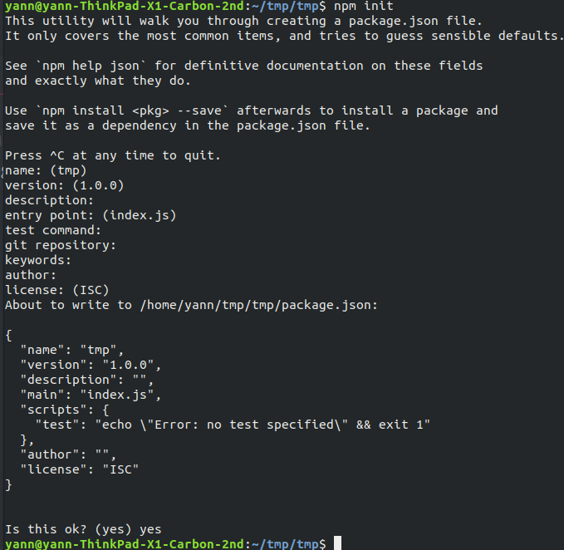
Continuous Integration
For the purpose of this tutorial, we will create a new NPM package.
Run npm init in the console, and validate all the default parameters.

Slide 6
Continuous Integration
We will import 3 files:
  Sample.sol – source contract.
  Sample_test.sol – solidity unit testing.
  main.js – Continous Integration script.

Slide 7
Continuous Integration
Please download all the files from
https://github.com/ethereum/remix-workshops/tree/master/continuous_integration
and put them in the working folder.

Slide 8
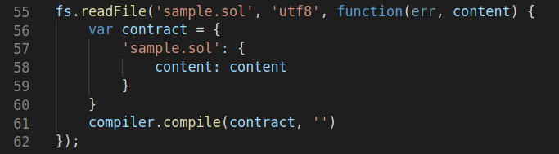
Continuous Integration
Let’s look at main.js. It include 3 steps:
  Compiling the main solidity file – line 61

Slide 9
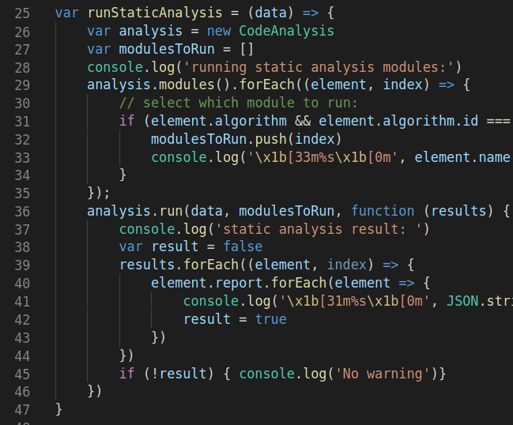
Continuous Integration
  Running static analysis against some selected modules – line 36
  that way it is possible to trigger a failure of integration process if some specific reports are returned.

Slide 10
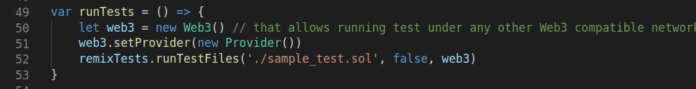
Continuous Integration
  Running unit tests – line 52
  Please see sample_test.sol
  Note that the ‘testing’ tab of Remix IDE (remix.ethereum.org) execute the exact same library.
For the Remix IDE related documentation:
https://remix.readthedocs.io/en/latest/unittesting_tab.html

Slide 11
Continuous Integration
  For simplicity of this tutorial, main.js does not include a linter.
  Please check out Solium:
  https://www.npmjs.com/package/solium

Slide 12
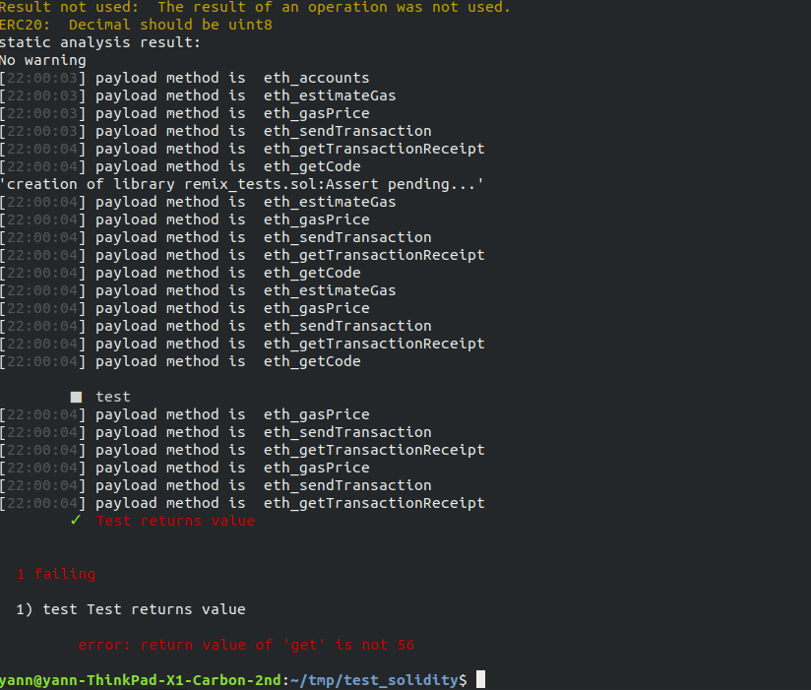
Continuous Integration
  Finally, let’s run node main.js
Fix the error in unit testing
And re execute main.js

