Slide 1
Deploy with libraries
It is very often require that a contract need to interact with one or more libraries. This walkthrough tutorial covers this use case.

Slide 2
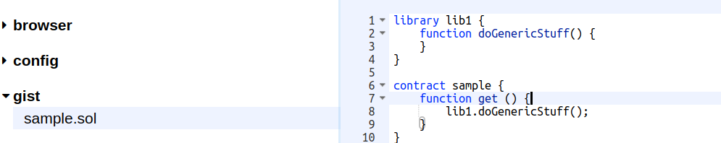
Deploy with libraries
We will use a very basic example:
Run in the terminal
remix.loadgist('c230a699a7ed7ea55254bad7a01ac97a')

Slide 3
Deploy with libraries
We are going to:
  Deploy the library
  Use the metada file to reference the library address. That reference will be use at deployment time to link the contract to the library.
  Deploy the contract

Slide 4
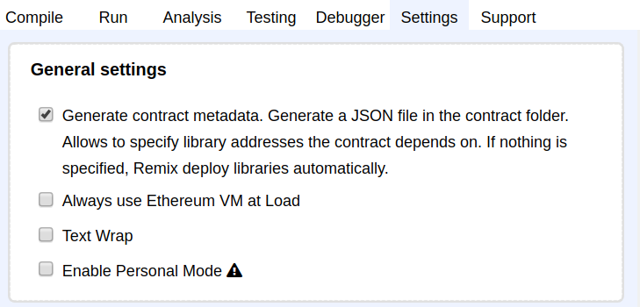
Deploy with libraries
First we need to activate the metadata file generation

Slide 5
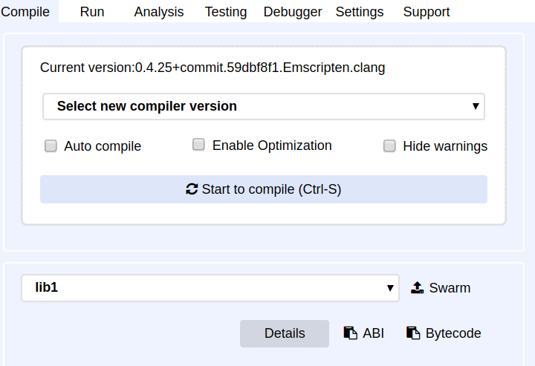
Deploy with libraries
Start compiling

Slide 6
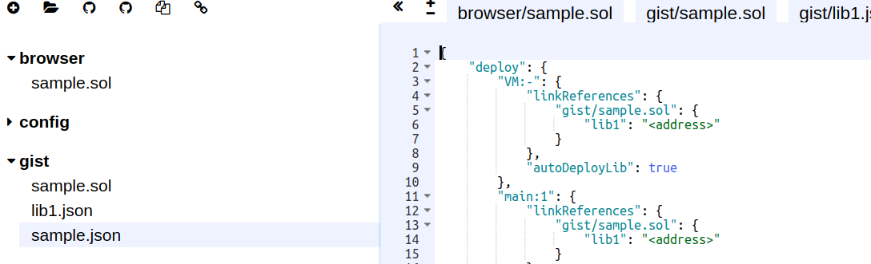
Deploy with libraries
“sample.json” should be available.

Slide 7
Deploy with libraries
The metadata file contains:
  compilation result data (bytecode, sourcemap),
  the contract abi
  the libraries linkage (that the interesting part for us now ;) )

Slide 8
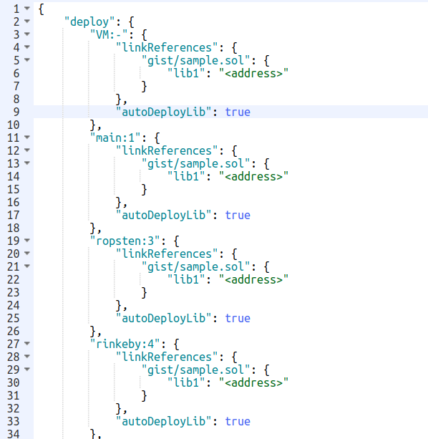
Deploy with libraries
Note that the config is duplicated for each network (Ropsten, Mainnet, Rinkeby, etc..)
and that it is still possible to
automatically deploy the libraries.

Slide 9
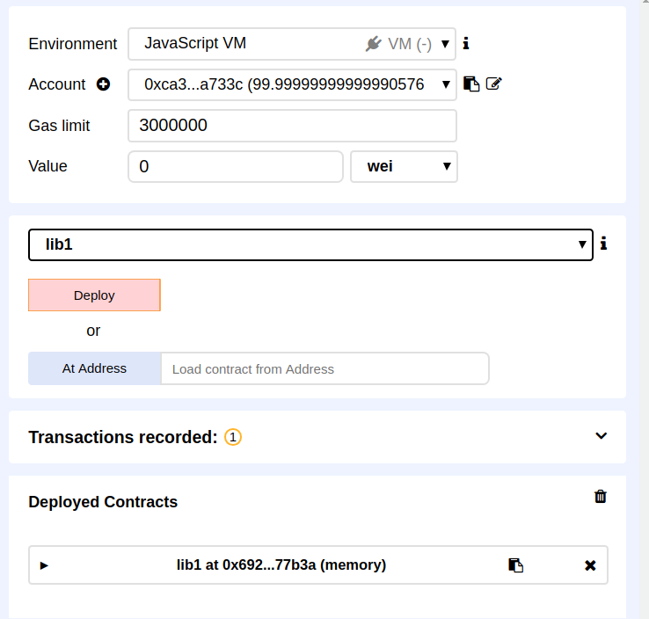
Deploy with libraries
Start compiling and in the “Run” tab, deploy the library.

Slide 10
Deploy with libraries
Start compiling and in the “Run” tab, deploy the library.

Slide 11
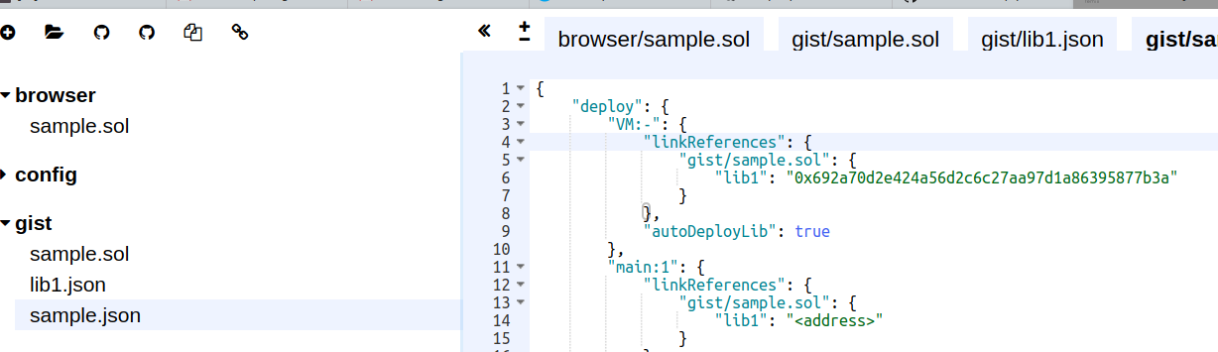
Deploy with libraries
Copy the library address and use it for specifying the address in the metadata file.
Note that the network should match the one you are actually connected to.
In the above example, we use the “JavaScript VM”.

Slide 12
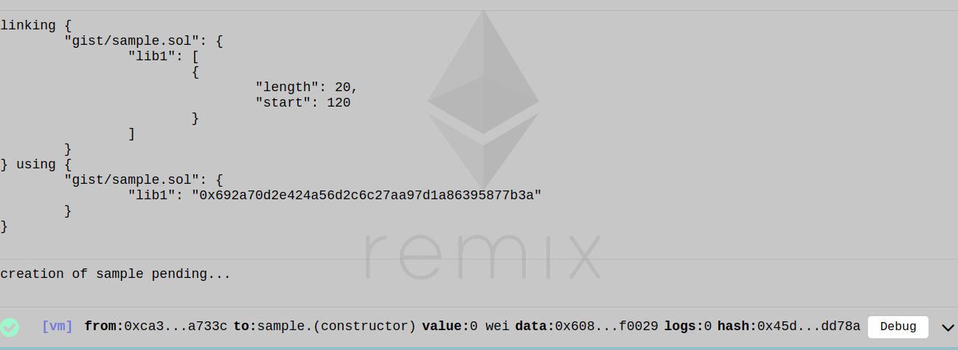
Deploy with libraries
Compile Sample.json and deploy it. You can check that Remix is correctly linking the library

