Slide 1
Deploy Proxy Contract using a script
These walkthrough slides are related to the previous walkthough “ProxyContract” but can be done separately.
We are here going to deploy the proxy contract using a script rather than the UI interface.

Slide 2
Deploy using script
Let’s first load all the dependencies from github.
Run in the terminal:
remix.loadurl('https://github.com/ethereum/remix-workshops/runningScript/proxyContract_AwardToken/loadAwardProxyDependencies.js')
This script will be used to retrieve all the solidity contracts

Slide 3
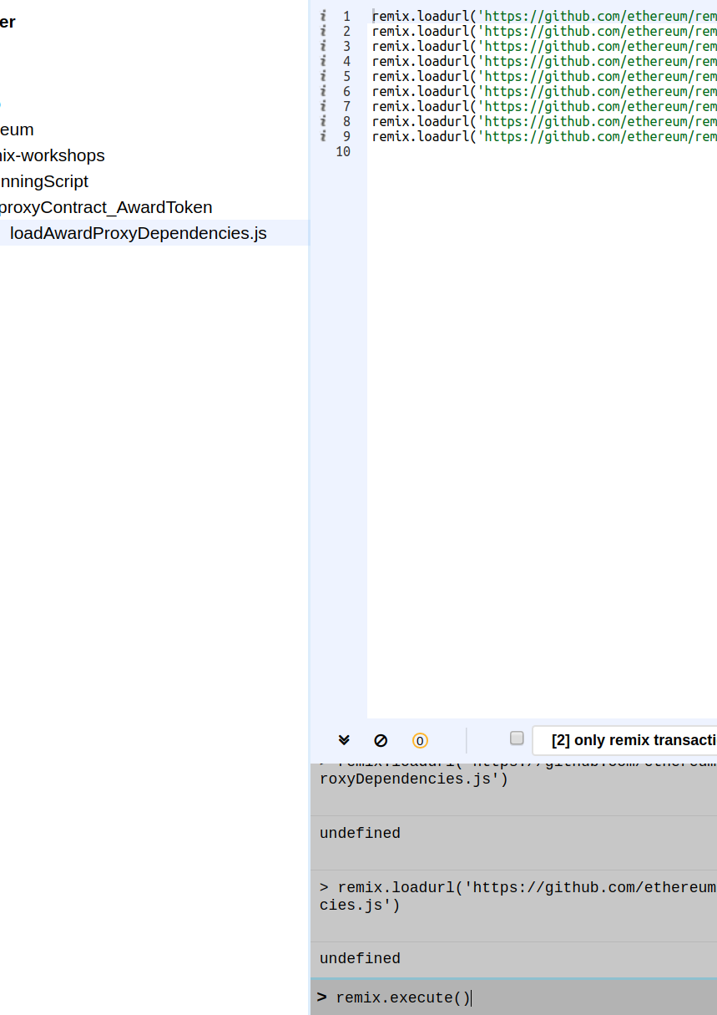
Deploy using script
Then, select it in the explorer and run
remix.execute()
fold / unfold the github
explorer and the
contracts should be
visible.

Slide 4
Deploy
Then we load the deployment scripts:
run in the terminal:
remix.loadurl('https://github.com/ethereum/remix-workshops/runningScript/proxyContract_AwardToken/global.js')
remix.execute('github/ethereum/remix-workshops/runningScript/proxyContract_AwardToken/global.js')
The above is 1) loading the script “global.js” from github and 2) executing it in a sandbox JavaScript runtime.
That’s a generic JavaScript script which setup all you need for logging the deployment result in a file and deploy a contract.

Slide 5
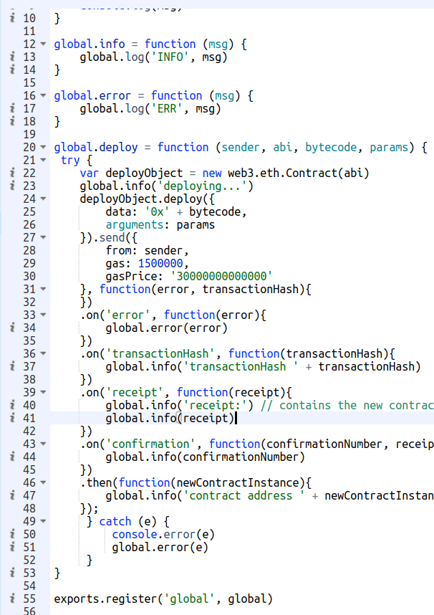
Deploy
See the last statement:
exports.register(‘global’, global)
this allows to use the “global” variable
within other execution context.

Slide 6
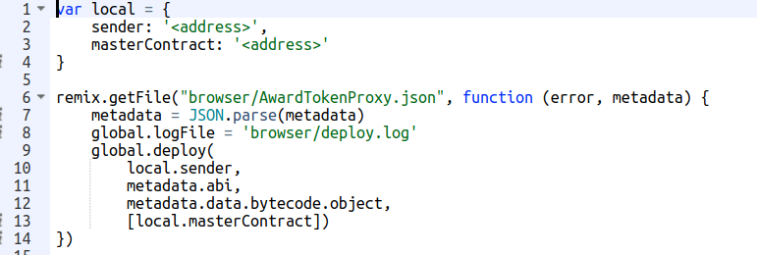
Deploy
Then we load the script that will actually deploy:
remix.loadurl('https://github.com/ethereum/remix-workshops/runningScript/proxyContract_AwardToken/deploy.js')
See that “sender” and “masterContract” still need to be defined and that we need the abi and bytecode of AwardTokenProxy.

Slide 7
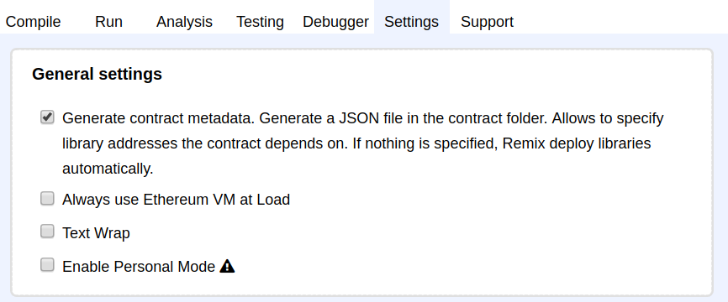
Deploy
For Deploying, we need the abi and bytecode accessible from the script. The contract metadata file is already on github so we don’t need to generate it.
In case generating this file is needed, the “Generate contract metadata” should be checked in the settings.

Slide 8
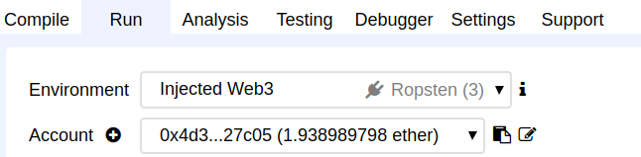
Deploy
We need the AwardToken master contract deployed:
Select a test network on Metamask, switch to it in Remix.
Compile and deploy the AwardToken (this is our master contract).

Slide 9
Deploy
As we need to modify deploy.js
create a new file in browser explorer and copy the content of deploy.js to it.

Slide 10
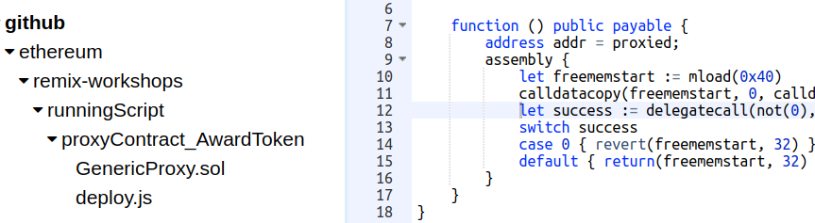
Deploy
Update the `local` JavaScript variable with the transaction sender (that your metamask account) and the address of the master contract.
Select deploy.js and run remix.execute().
you can also check the deployment log in browser/deploy.log

Slide 11
Deploy
Check in deploy.log for the transaction hash, and the contract address.

Slide 12
Please be sure to check the following post:
https://blog.gnosis.pm/solidity-delegateproxy-contracts-e09957d0f201

