Slide 1

Etherisc
Smart insurance applications on the blockchain
Blockchain Startup Contest
Graz, 28 November 2016

Slide 2
Opportunity and vision
Insurance is a trillion dollar market and ripe for disruption.
Blockchain enables more efficient insurance processes.
We build smart insurance applications which are
  cost-effective
  highly automated
  provably fair
  highly customizable
Notes:
(no long-term relations, coordination, independent deployment)

Slide 3
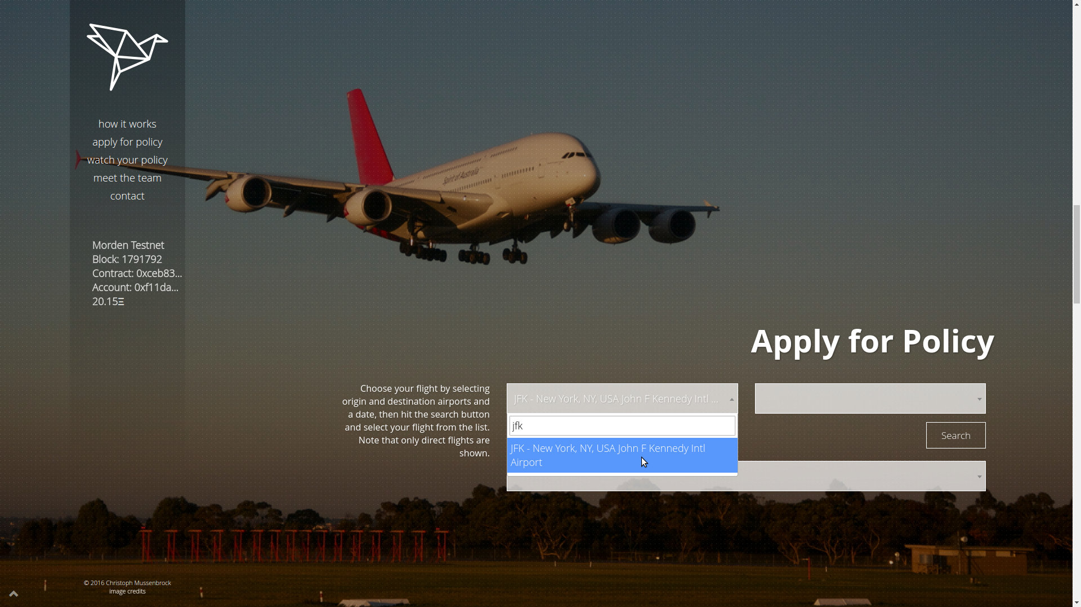
Our solution: Flight delay, fdd.etherisc.com
We launched the first operational insurance application on the Ethereum blockchain in September 2016 for devcon2.
Fully automated insurance process with a great user experience.
Notes:
(no long-term relations, coordination, independent deployment)

Slide 4
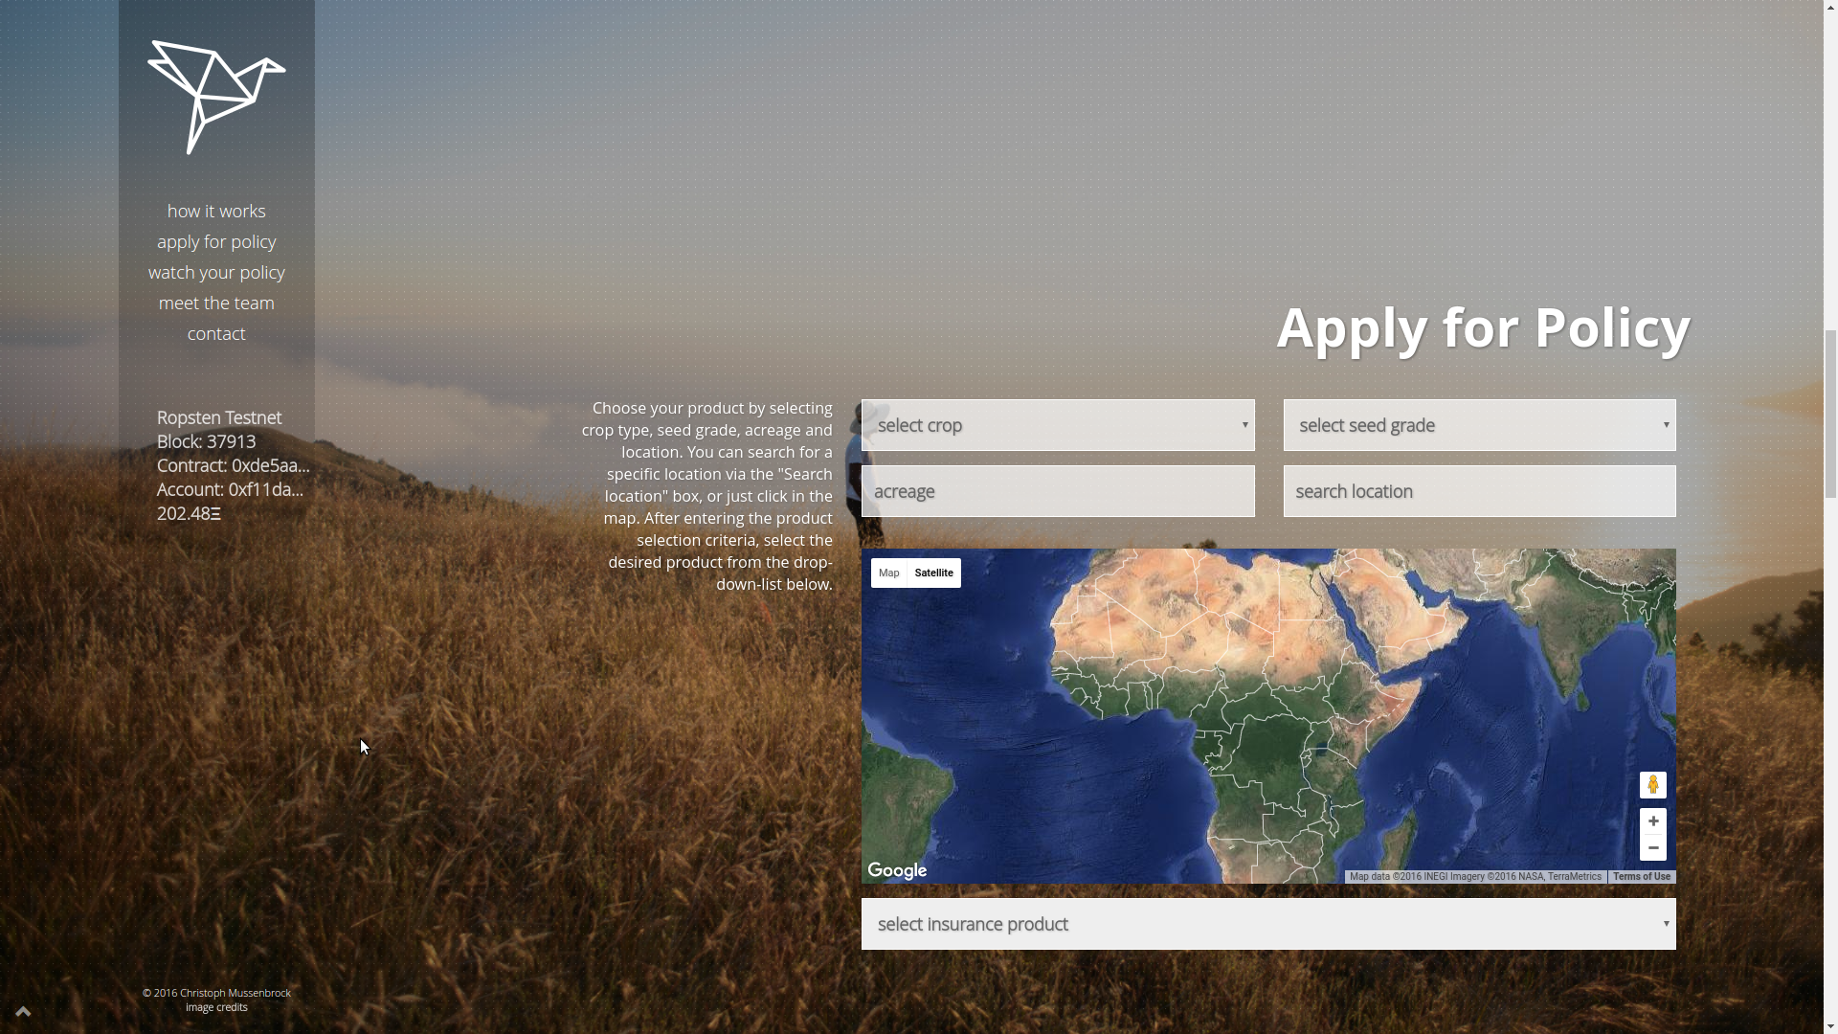
Our solution: Crop insurance, crop.etherisc.com
Same model of parametric insurance, easy to apply to other verticals
Notes:
(no long-term relations, coordination, independent deployment)

Slide 5
Current status
First paying customer is a German financial service provider.
Expanding to more verticals: Life insurance, health insurance.
Creating a peer-to-peer market for risk sharing
with a token model for investors.
Incorporated in the UK, now incorporating in Germany.
We apply for regulatory sandbox approval with the FCA in the UK.
More opportunities in the pipeline, large insurance companies.
Notes:
(no long-term relations, coordination, independent deployment)

Slide 6
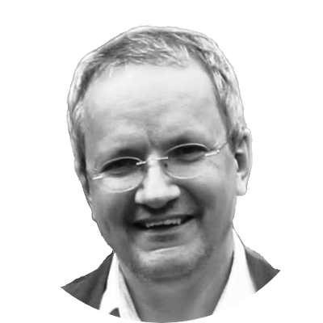

Team
Christoph Mussenbrock – Former CEO of parcIT GmbH, providing risk management solutions for cooperative banks, many years of work experience in banking and insurance in Germany.
Christoph has a master’s degree in mathematics and wrote his thesis on formal software and hardware verification.
https://www.linkedin.com/in/christoph-mussenbrock
Stephan Karpischek – Managing director at disrupt consulting, a digital strategy consulting cooperative. Former business analyst for blockchain innovation at UBS, many years of work experience in IT, consulting and education in Austria, Switzerland and UK.
Stephan has a PhD in Information Management from ETH Zurich and wrote his thesis on mobile applications for the Internet of Things.
https://www.linkedin.com/in/karpischek
Notes:
(no long-term relations, coordination, independent deployment)

Slide 7
Etherisc
Smart insurance applications on the blockchain

Slide 8
Media
Lessons learned from our Flight Delay Dapp: https://medium.com/the-future-requires-more/flight-delay-dapp-lessons-learned-a59e4e39a8d1
Demo video: https://www.youtube.com/watch?v=ED1-HaWEnRs
News article on Flight Delay Dapphttps://www.cryptocoinsnews.com/blockchain-disrupt-air-travel-insurance-flightdelay/
Q&A with coinfund: https://www.youtube.com/watch?v=baRg0iCPrK8
Notes:
(no long-term relations, coordination, independent deployment)

Slide 9
Contact us!
Web: https://fdd.etherisc.com
Email: contact@etherisc.com
Phone: +49 160 908 333 92 (Christoph)
    +43 664 191 80 46 (Stephan)
Notes:
(no long-term relations, coordination, independent deployment)

Slide 10


