Slide 1

Etherisc
Decentralized insurance applications
etherisc.com
EDCON
Paris, 18 February 2017

Slide 2
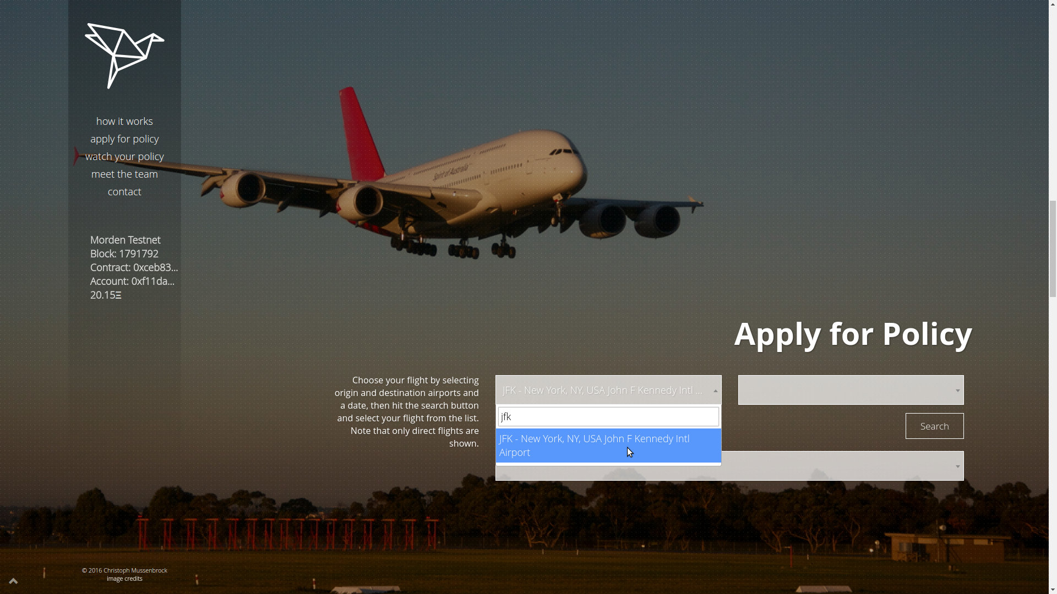
Flight delay dapp, fdd.etherisc.com
We launched the first operational insurance application on the Ethereum blockchain in September 2016 for devcon2.
Fully automated insurance process with a great user experience.
Notes:
(no long-term relations, coordination, independent deployment)

Slide 3
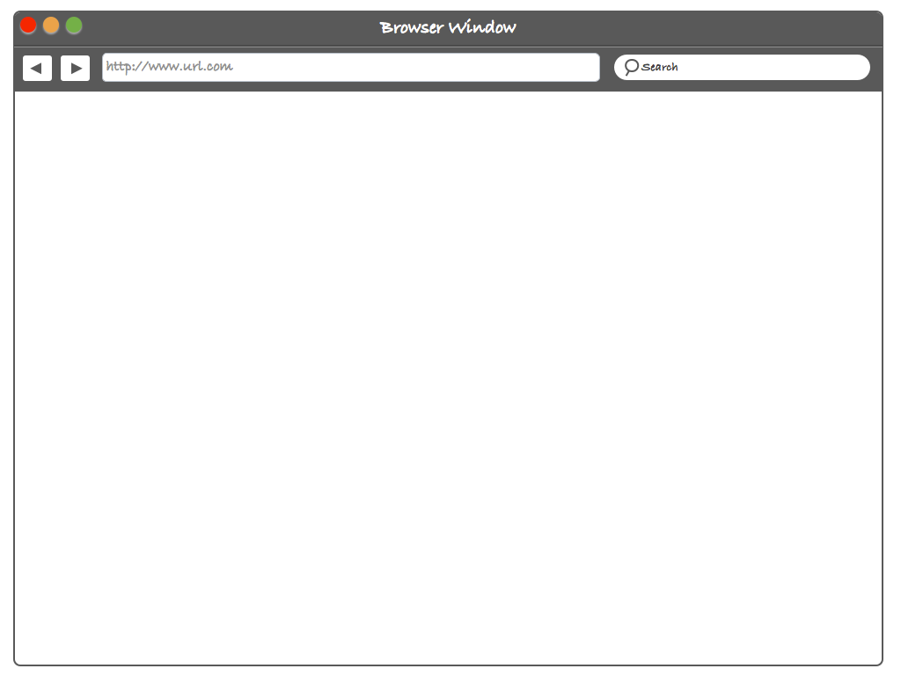






General architecture
Meta
mask
FlightDelay JS + HTML
Oraclize
FlightDelay
contracts
FlightStats
Frontend
Server
Notes:
(no long-term relations, coordination, independent deployment)

Slide 4
FlightDelay contracts
User
New Policy
Underwrite
Payout
Ledger =
holding Funds
Access Control
Database
Controller = Contract registry

Slide 5
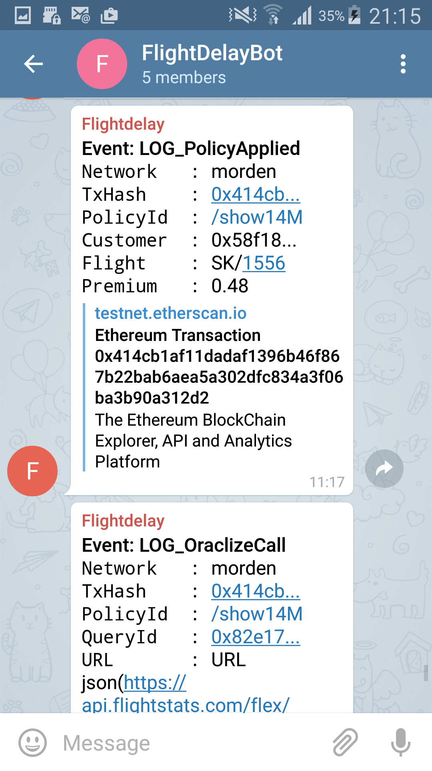
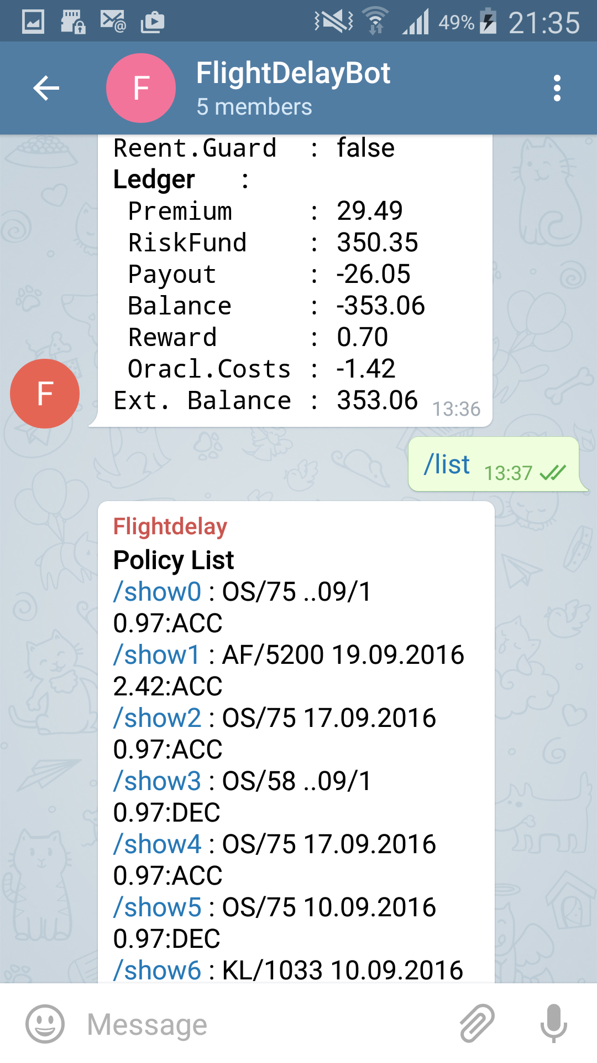
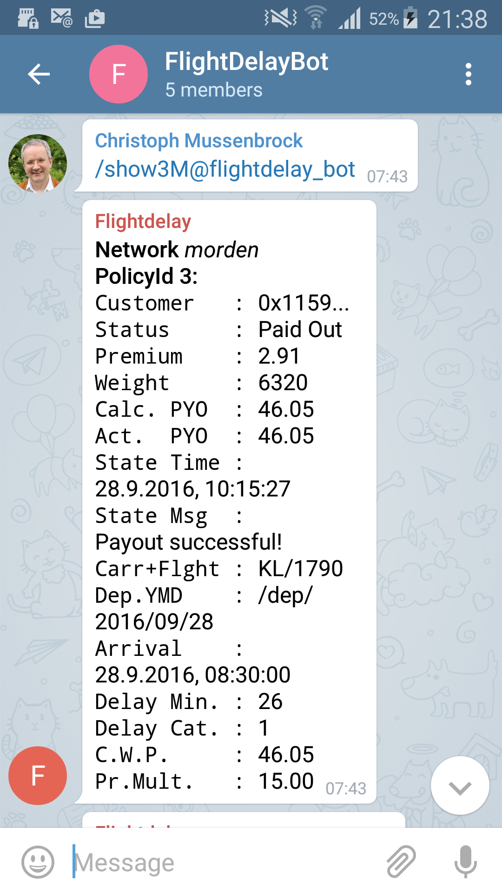
Monitoring

Slide 6
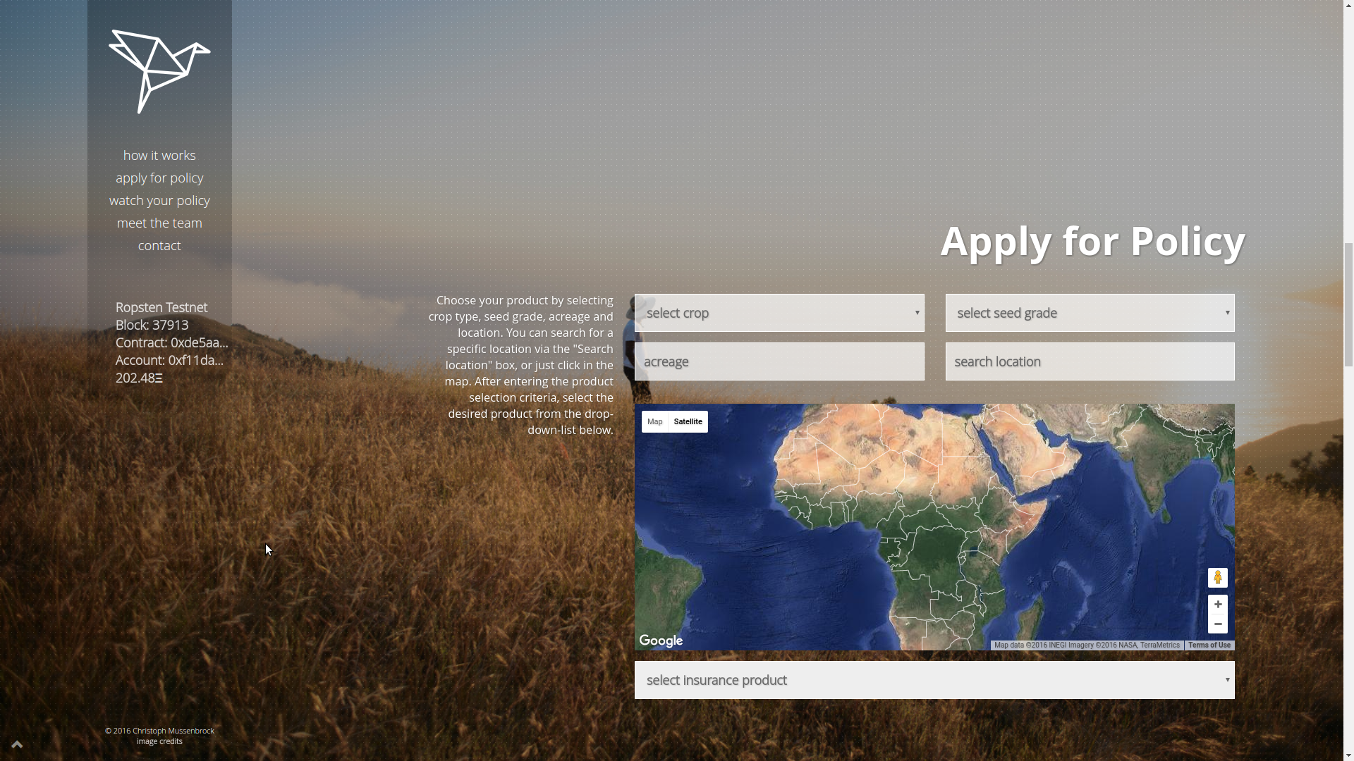
Crop insurance, crop.etherisc.com
Same model of parametric insurance, easy to apply to other verticals
Notes:
(no long-term relations, coordination, independent deployment)

Slide 7
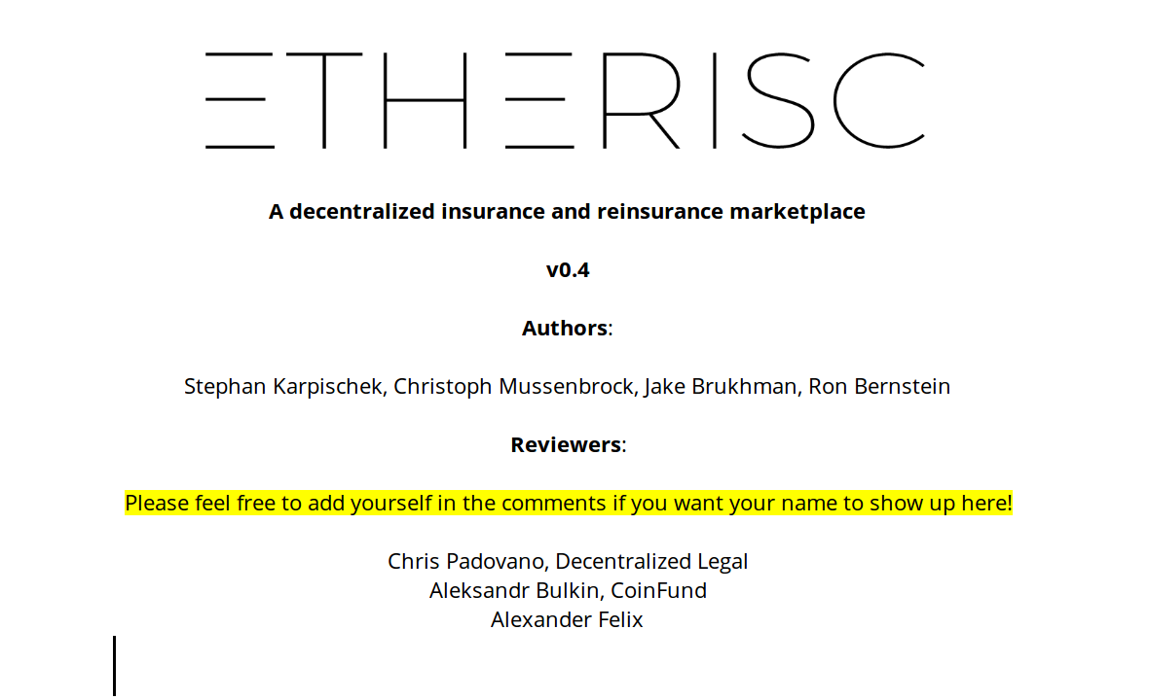
Decentralized insurance market
https://etherisc.com/whitepaper
Token model for investors to provide capital for risk pools
Whitepaper, simulation, testing now
Notes:
(no long-term relations, coordination, independent deployment)

Slide 8
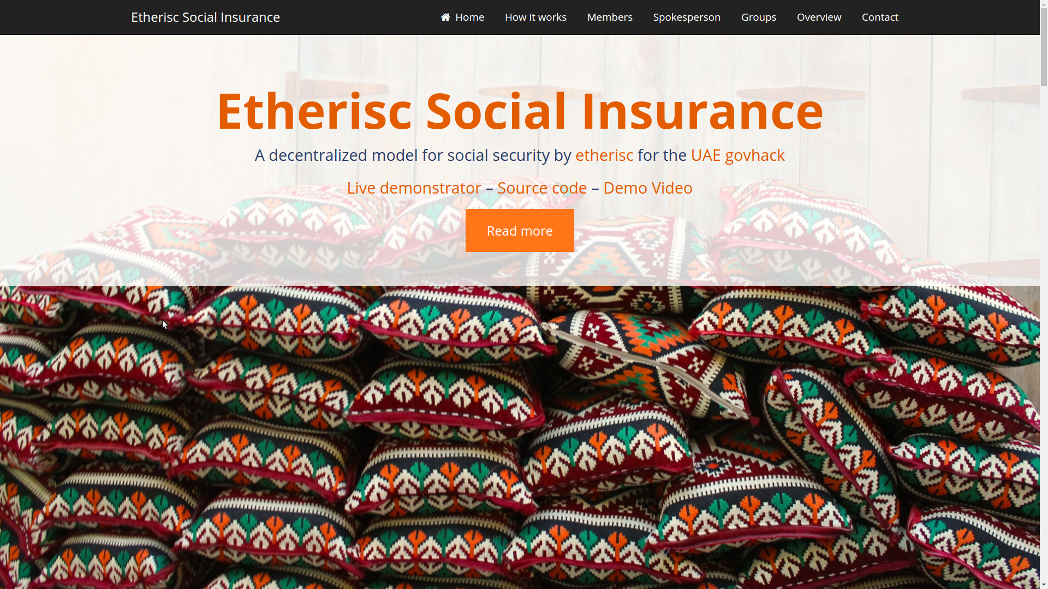
https://govhack.etherisc.com
Simple social security, affordable and accessible for anyone
Mutual pools using local social structures
Peer assessment to check for claims
Notes:
(no long-term relations, coordination, independent deployment)

Slide 9
Successful competitions
Winner blockchain startup contest 2016, Graz, Vienna.
Most funded project at hack.ether.camp
One of top 5 companies selected for AIA blockchain challenge
Notes:
(no long-term relations, coordination, independent deployment)

Slide 10

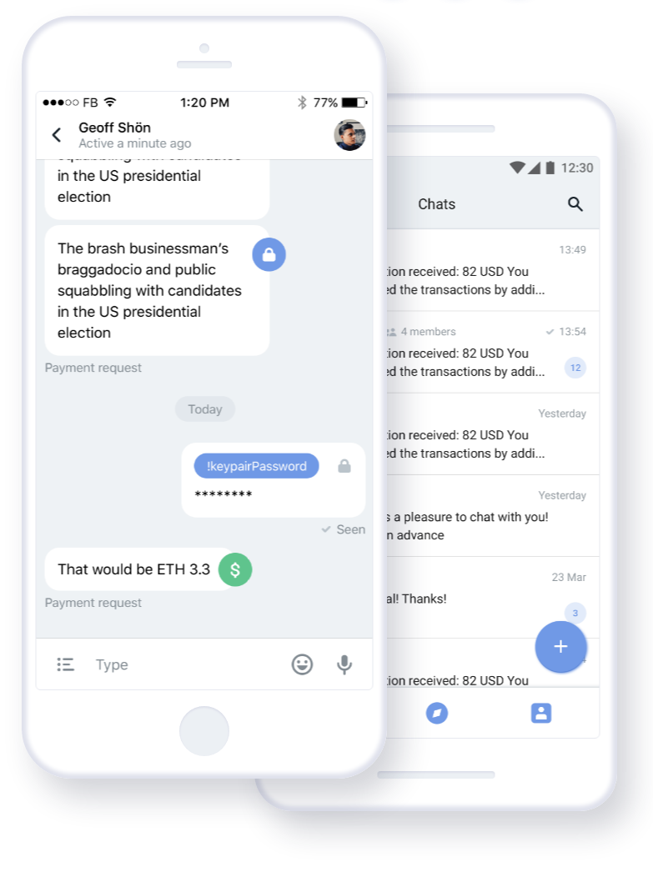

Roadmap
Testing token market
Security audits and bug bounties
Regulatory competition
Fiat bridge
Ramp up team & funding

Slide 11
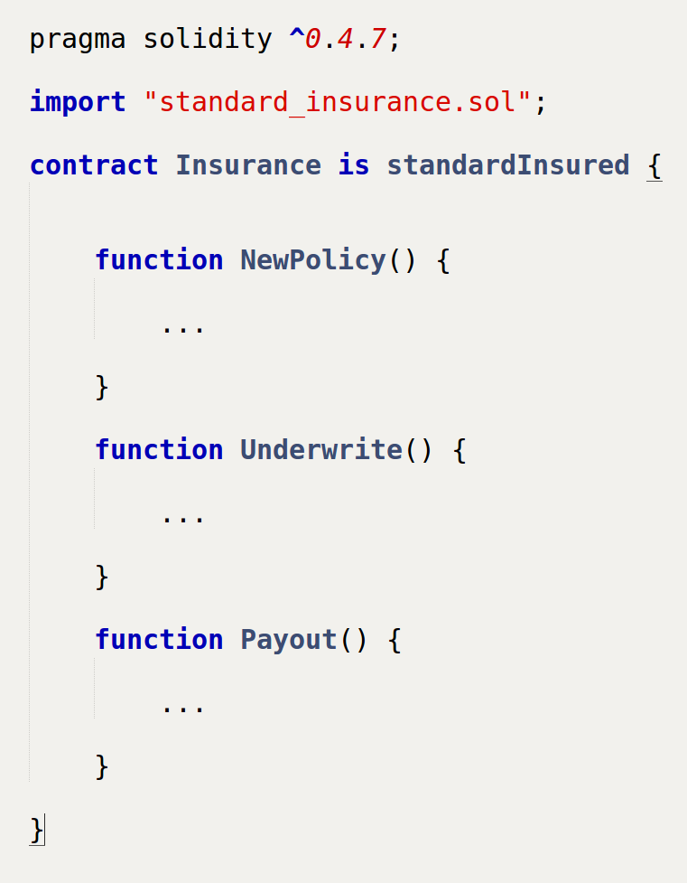
Our vision
import “standard_insurance.sol”
An open standard for
the insurance value chain
Product/Service Developement
Marketing
and Sales
Policy
Administration
Claims
Management
Asset
Management
Reinsurance
Notes:
(no long-term relations, coordination, independent deployment)

Slide 12


Team
Christoph Mussenbrock – Former CEO of parcIT GmbH, providing risk management solutions for cooperative banks, many years of work experience in banking and insurance in Germany.
Christoph has a master’s degree in mathematics and wrote his thesis on formal software and hardware verification.
https://www.linkedin.com/in/christoph-mussenbrock
Stephan Karpischek – Managing director at disrupt consulting, a digital strategy consulting cooperative. Former business analyst for blockchain innovation at UBS, many years of work experience in IT, consulting and education in Austria, Switzerland and UK.
Stephan has a PhD in Information Management from ETH Zurich and wrote his thesis on mobile applications for the Internet of Things.
https://www.linkedin.com/in/karpischek
Notes:
(no long-term relations, coordination, independent deployment)

Slide 13
Etherisc
Decentralized insurance applications
etherisc.com
contact@etherisc.com
@etherisc_
gitter.im/etherisc

