Slide 1
EtherPocket
Linux in your pocket
Native ARM64 Linux on a phone
with a touch desktop and Linux applications.
Reference device: OnePlus 7 Pro 5G GM1920
Engineering port · documented status as of 3 November 2026
01
Notes:
Sources: README.rst, docs/PROJECT.md, docs/STATUS.md. This English translation preserves the documented status of 3 November 2026. It does not represent a new hardware test. Repository: https://github.com/etherneco/ether-pocket

Slide 2
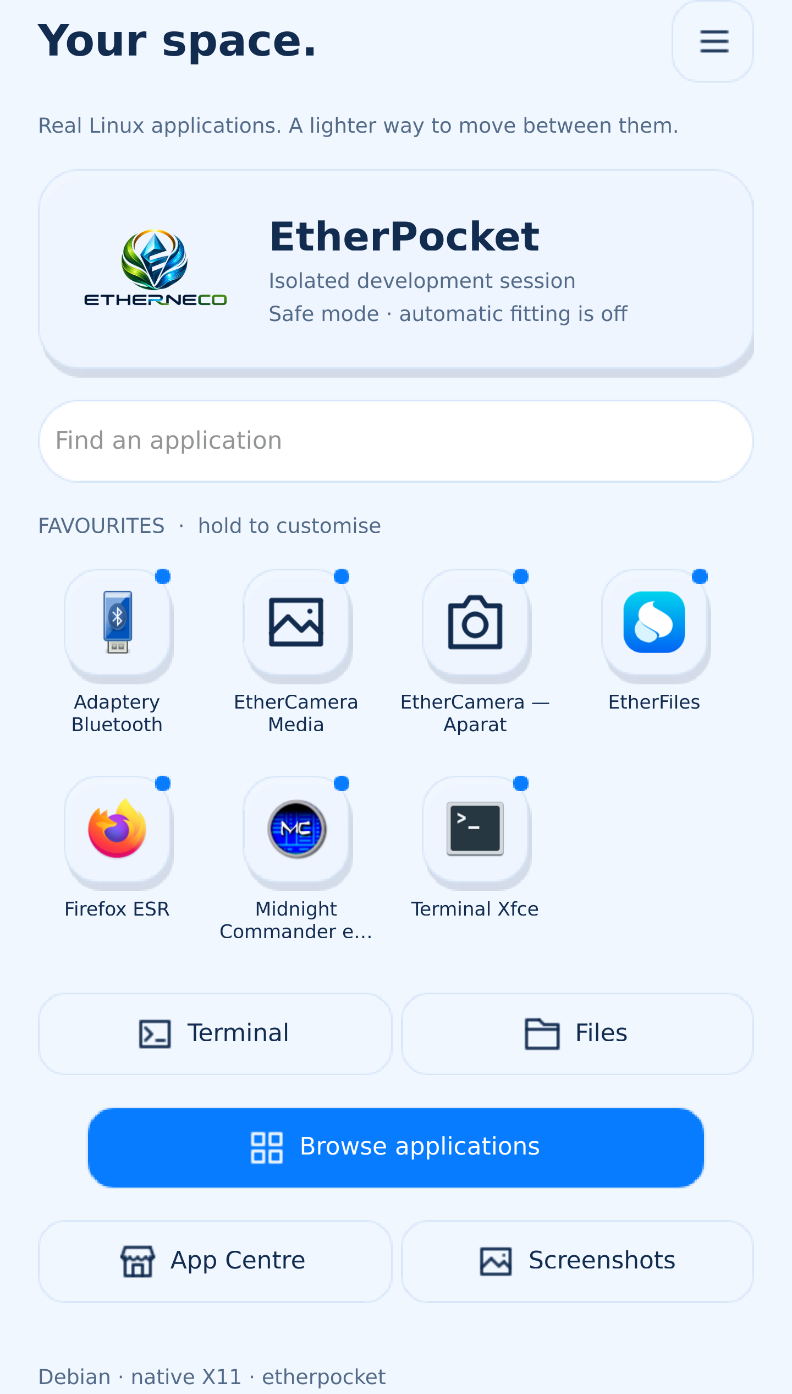
A touch desktop for Linux
EtherShell
Application launcher, window controls,
settings and quick controls.
The on-screen keyboard responds to editing.
Layouts adapt to the screen width.
Mobian/Debian ARM64, systemd, Xorg and Qt 6.
Android has a separate system in the dual-boot setup.
02
Notes:
Sources: docs/ui-polish-2026-10-29.rst, docs/etherkeyboard-2026-10-29.rst, docs/ethershell-2.0.rst. Screenshot: evidence/ui-polish/portrait/shell-home.png, 29 October 2026, isolated development session. Interface appearance does not establish all hardware capabilities. Original screenshot labels are preserved.

Slide 3
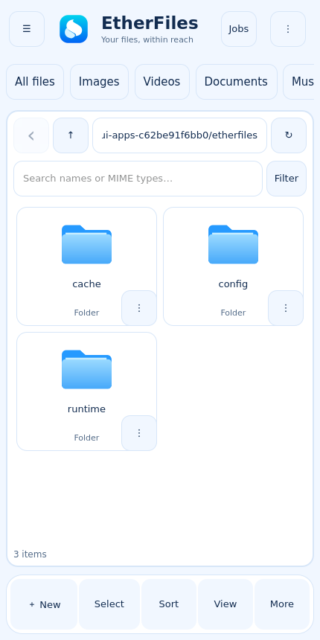
Files and basic multimedia
EtherFiles
Local files, trash, search and previews.
SFTP, SMB and WebDAV connections.
USB exchange disk for Windows transfers.
EtherCamera
Rear IMX586: preview, JPEG and H.264 video.
Basic capture path, with autofocus unverified.
03
Notes:
Sources: etherfiles/README.rst, docs/etherfiles-network-2026-10-17.rst, docs/usb-storage-2026-10-16.rst, docs/ethercamera-spectra-driver-2026-10-20.rst. Screenshot: evidence/ui-polish/apps/etherfiles.png, 29 October 2026, isolated test profile. Camera verification concerns the physical rear Sony IMX586. AF, OIS, HDR, flash and front camera remain unverified.

Slide 4
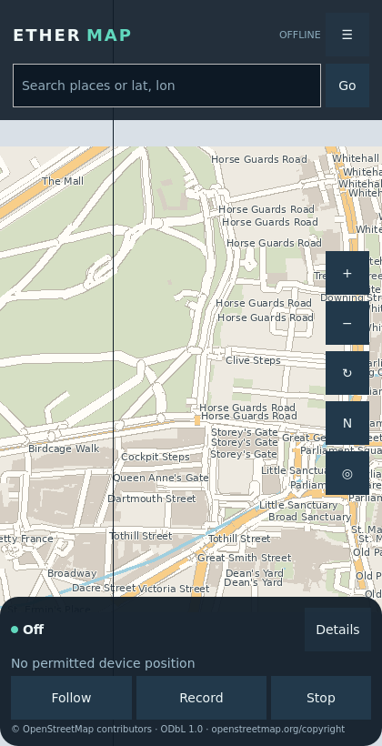
Offline maps
EtherMAP
Local MBTiles maps and saved places.
Track recording and GPX support.
Routing and search after provider setup.
Location has separate permissions.
GNSS observed satellites, but a valid
position fix remains unverified.
04
Notes:
Sources: docs/ethermap-device-delivery-2026-10-21.rst, docs/etherlocation-delivery-2026-10-20.rst. Screenshot: evidence/ui-polish/apps/ethermap.png, 29 October 2026. Map data copyright OpenStreetMap contributors, ODbL 1.0, https://www.openstreetmap.org/copyright. Visible attribution is preserved. The tested view contains no injected position.

Slide 5
Internet and Windows integration
EtherMobile
Visible LTE connection progress.
Checks the service and actual interface.
Recorded HTTPS test: 200 through epcell0.
EtherPocket Control
View and control the X11 desktop from Windows.
Mouse, Unicode input, PNG screenshots and SSH.
Default: 8 FPS, without audio forwarding.
05
Notes:
Sources: docs/mobile-data-progress-2026-11-03.rst, docs/etherpocket-control-2026-10-29.rst. LTE: interface-bound HTTPS returned 200 through epcell0 after service stop/start. IPA adapter: giffgaff.com/IPv4, roaming blocked, no further reboot in that test. Windows Control uses SSH with host verification and existing administrator access for agent installation. No audio, clipboard synchronization or video recording.

Slide 6
Project status and development
Engineering port
Working elements include the desktop, files, offline maps,
basic camera capture and a verified LTE data session.
Remaining acceptance gates
Call audio, GNSS fix, sensors, suspend, GPU and glasses.
Backups and releases require commissioning.
github.com/etherneco/ether-pocket
06
Notes:
Sources: docs/STATUS.md, docs/etherphone-real-call-2026-10-21.rst, docs/ethersensors-delivery-2026-10-21.rst, docs/etherpower-delivery-2026-10-19.rst, docs/etherbackup-delivery-2026-10-21.rst, docs/etherupdate.rst, README.rst. No completion dates are promised. Private data, keys, firmware and raw evidence remain outside the repository.

