Slide 1

Berlin Ethereum Meetup
swarm
25th May 2016 presentation by
Viktor Trón, Dániel A. Nagy & Aron Fischer

Slide 2
Swarm

Slide 3
A (very quick) introduction to Swarm

Slide 4
A (very quick) introduction to Swarm
1. Get data into the swarm

Slide 5
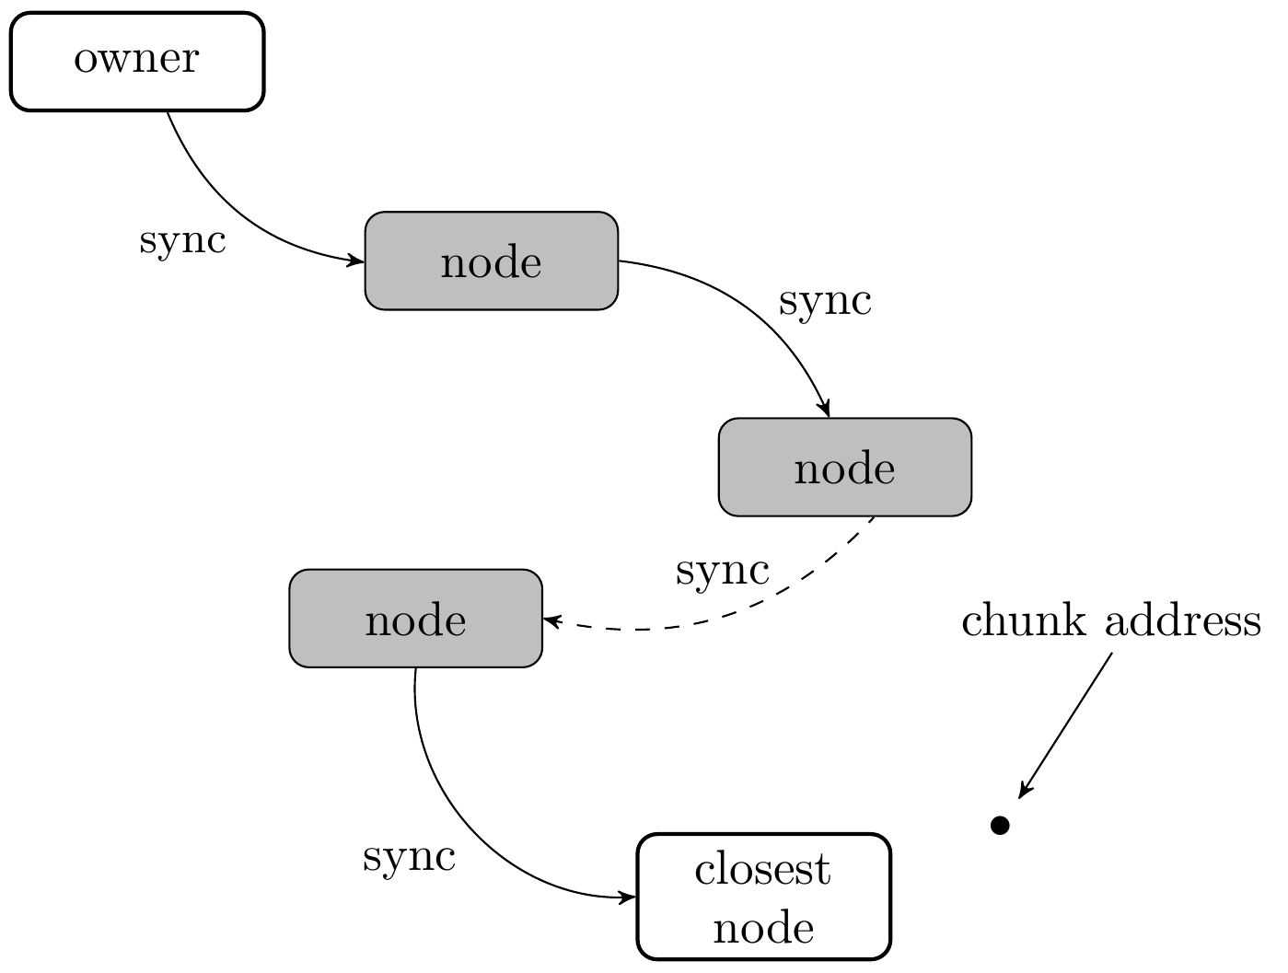
A (very quick) introduction to Swarm
Data is chopped up into chunks.
Chunks are forwarded node-to-node (sync)
Chunks end up with node whose address is closest to chunk hash

Slide 6
A (very quick) introduction to Swarm
2. Get data out of the swarm

Slide 7
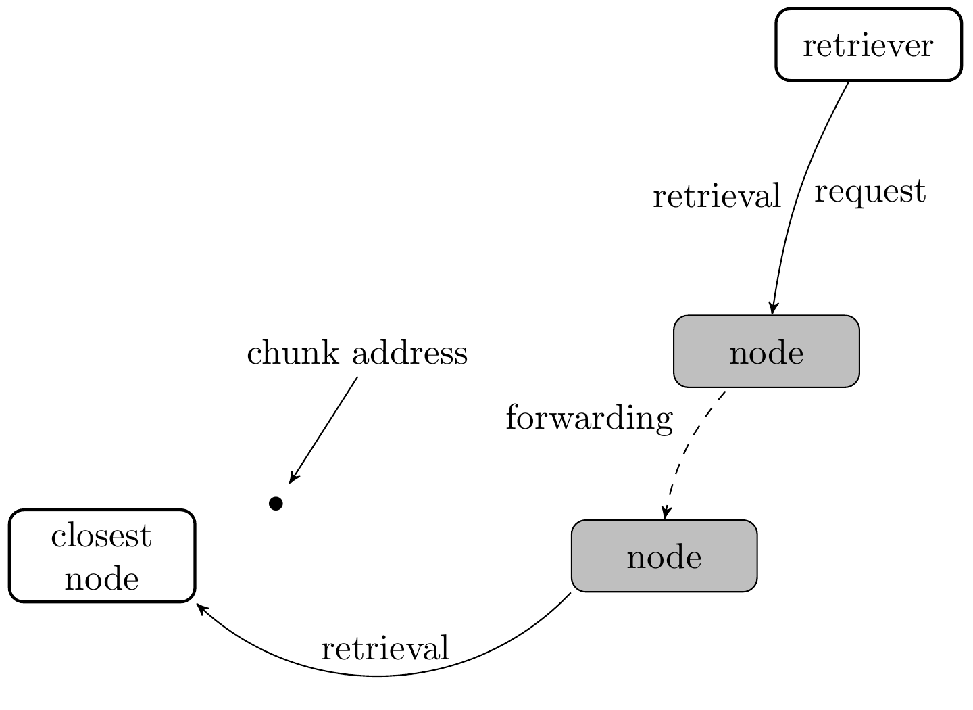
A (very quick) introduction to Swarm
Retriever makes a request to a closer connected node
Nodes pass on requests
Forwarding ends when chunk is found. Chunk is passed back.

Slide 8
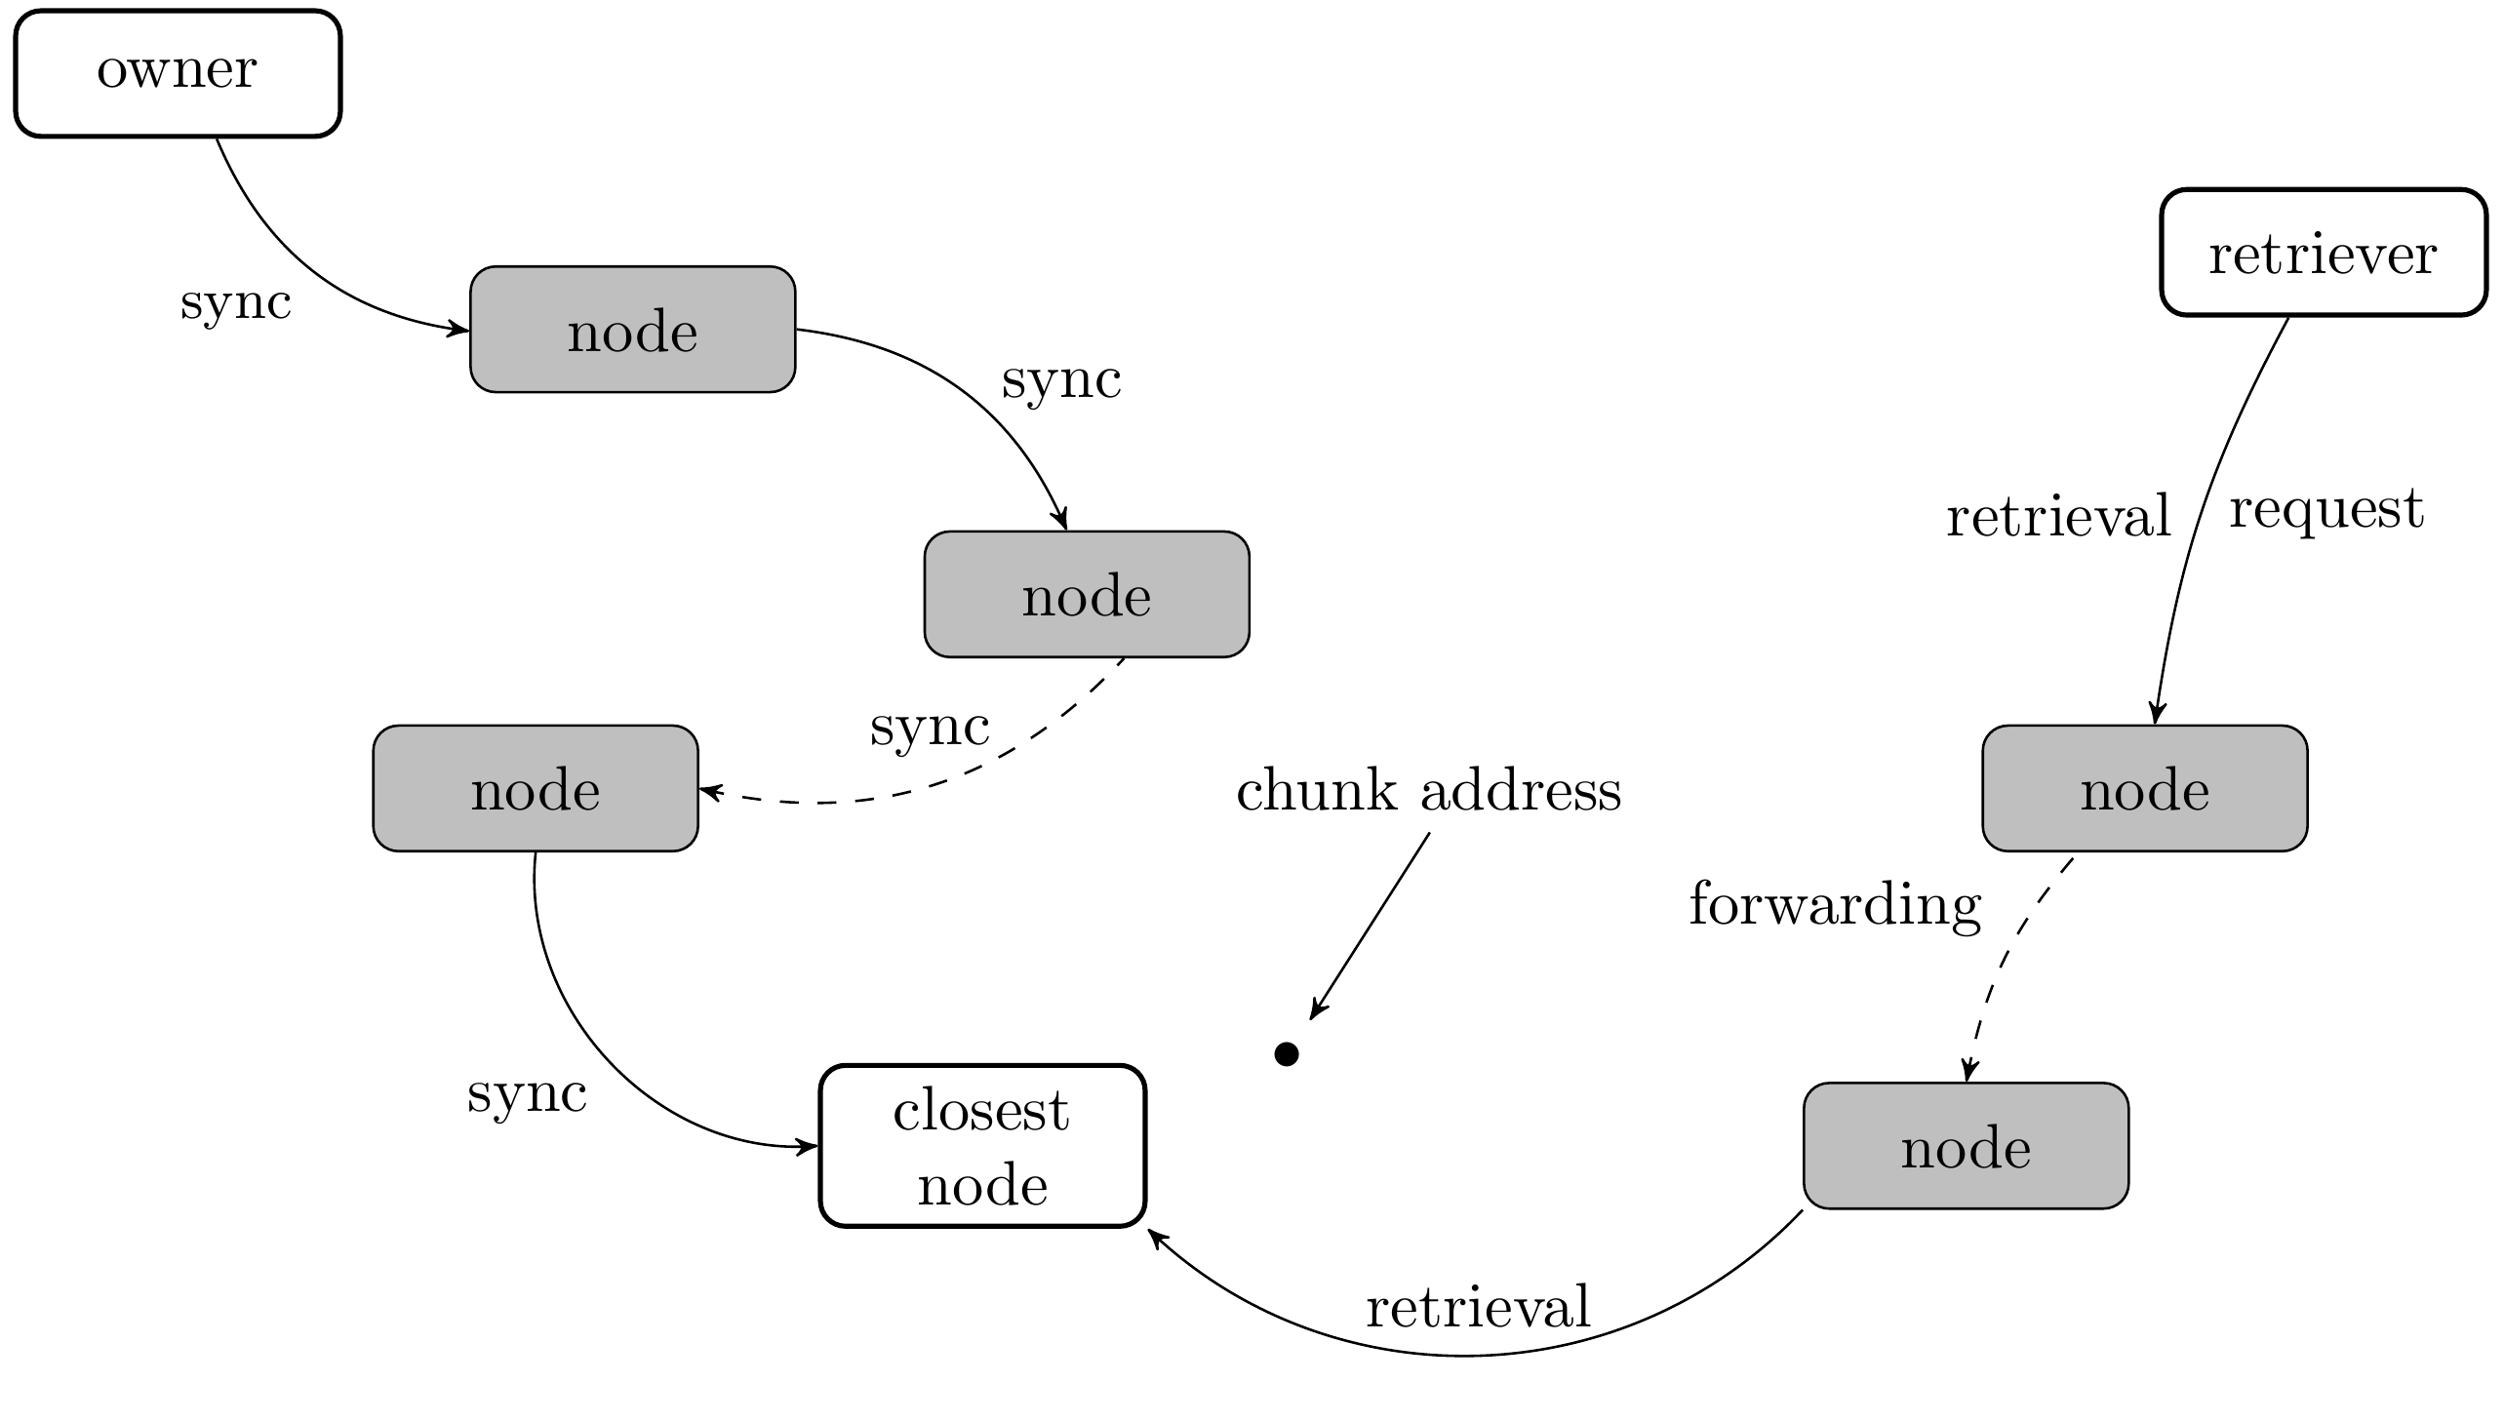

Slide 10
Incentivisation in SWARM

Slide 11
A brief history of:
Web Hosting and Incentivisation

Slide 12
A brief history of:
Web Hosting and Incentivisation
Web 1.0

Slide 13
A brief history of:
Web Hosting and Incentivisation
Web 1.0
          Start a web server
          Upload content

Slide 14
A brief history of:
Web Hosting and Incentivisation
Web 1.0
          Start a web server
          Upload content
1. Content is unpopular
- pay costs of maintaining webserver

Slide 15
A brief history of:
Web Hosting and Incentivisation
Web 1.0
          Start a web server
          Upload content
1. Content is unpopular
- pay costs of maintaining webserver
2. Content becomes popular

Slide 16
A brief history of:
Web Hosting and Incentivisation
Web 1.0
          Start a web server
          Upload content
1. Content is unpopular
- pay costs of maintaining webserver
2. Content becomes popular
- bandwidth costs skyrocket
- server crashes / goes offline

Slide 17
A brief history of:
Web Hosting and Incentivisation
Web 1.0
          Start a web server
          Upload content
1. Content is unpopular
- pay costs of maintaining webserver
2. Content becomes popular
- bandwidth costs skyrocket
- server crashes / goes offline
...but at least you owned your own content.

Slide 18
A brief history of:
Web Hosting and Incentivisation
Web 2.0

Slide 19
A brief history of:
Web Hosting and Incentivisation
Web 2.0
          Upload content to the ‘cloud’
          - cheap/free
          - scalable

Slide 20
A brief history of:
Web Hosting and Incentivisation
Web 2.0
          Upload content to the ‘cloud’
          - cheap/free
          - scalable
But…

Slide 21
A brief history of:
Web Hosting and Incentivisation
Web 2.0
          Upload content to the ‘cloud’
          - cheap/free
          - scalable
But…
          Content owned by the service providers
          All users are tracked and spied on; providers profit off the data.
          Centralised control: surveillance and censorship.

Slide 22
A brief history of:
Web Hosting and Incentivisation
Peer to Peer Networks?

Slide 23
A brief history of:
Web Hosting and Incentivisation
Peer to Peer Networks
eg. Bittorrent
          Content is distributed among peers
          Distribution scales automatically
          Hashing ensures data integrity
          No central point of failure / no servers

Slide 24
A brief history of:
Web Hosting and Incentivisation
Peer to Peer Networks
eg. Bittorrent
          Content is distributed among peers
          Distribution scales automatically
          Hashing ensures data integrity
          No central point of failure / no servers
But:
Downloads start slowly (high latency)
No incentive to provide content: “seeding”

Slide 26
Swarm Incentive System

Slide 27
Swarm Incentive System
Bandwidth
Storage

Slide 28
Swarm Incentive System
Bandwidth
- accounting for bandwidth used in the p2p setting
- compensating nodes based on the bandwidth they provide
Storage
- allow for long-term storage of data in the swarm
- provide proper compensation to nodes for storing data

Slide 29
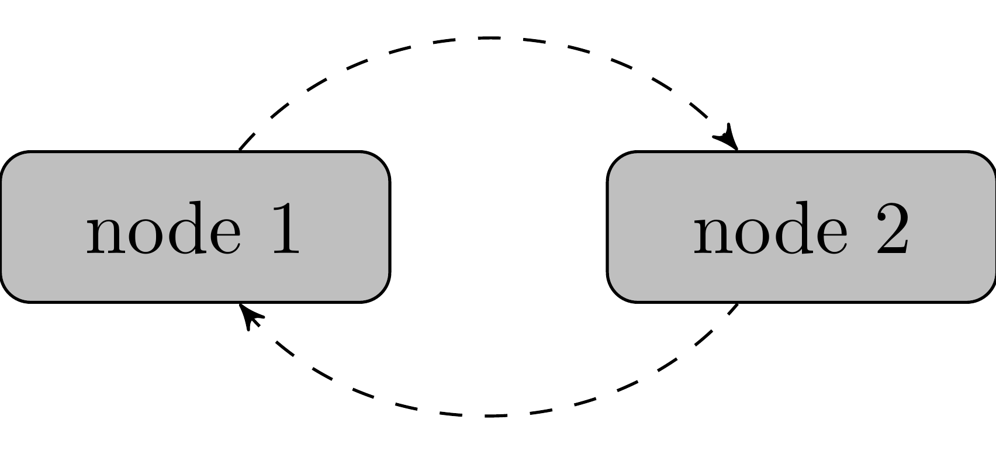
Swarm Incentive System
Bandwidth
Bandwidth accounting is per-peer

Slide 30
Swarm Incentive System
Bandwidth
Bandwidth accounting is per-peer
Number of chunks supplied
Number of chunks received

Slide 31
SWAP – Swarm Accounting Protocol

Slide 32
SWAP – Swarm Accounting Protocol
Keeps track of number of chunks provided/received per peer
Can trade chunk-for-chunk or chunk-for-payment
Payments are made using the swarm chequebook contract on the blockchain
  (cheques are cumulative: you only ever have to cash the last one, thus saving transaction costs)

Slide 33
SWAP – Swarm Accounting Protocol
Big picture:
If you download a lot of content, you pay your peers for providing it.
If you host popular content, you will earn fees from your peers for making the content available.

Slide 34
SWAP – Swarm Accounting Protocol
Big picture:
If you download a lot of content, you pay your peers for providing it.
If you host popular content, you will earn fees from your peers for making the content available.
Swarm is auto-scaling.
-interplay of routing protocol and per-chunk payment between peers means that popular content will be widely distributed thereby increasing available bandwidth while decreasing latency

Slide 35
Swarm Incentive System
Storage

Slide 36
Swarm Incentive System
Storage
The Problem:
I want to deploy my content only once:
“upload and disappear”.
I want to make sure the content remains available
years into the future even if it is not popular content.

Slide 37
Swarm Incentive System
Storage
The Problem:
I want to deploy my content only once:
“upload and disappear”.
I want to make sure the content remains available
years into the future even if it is not popular content.
Solution:
Pay certain nodes to keep your data.

Slide 38
Swarm Incentive System
Storage
The Problem:
I want to deploy my content only once:
“upload and disappear”.
I want to make sure the content remains available
years into the future even if it is not popular content.
Solution:
Pay certain nodes to keep your data.
-Nodes that sell such promises-to-store must have a
deposit locked on the blockchain.
-Nodes that loose content, loose their deposit.

Slide 39
Swear and Swindle

Slide 40
SWEAR – Swarm Ensured Archival
Nodes register with the SWEAR contract and pay a deposit.

Slide 41
SWEAR – Secure Ways of Ensuring Archival
Nodes register with the SWEAR contract and pay a deposit.
Registered nodes can sell receipts for chunks received.

Slide 42
SWEAR – Swarm Enforcement and Registration
Nodes register with the SWEAR contract and pay a deposit.
Registered nodes can sell receipts for chunks received.
Receipts are promises that the data remains available in the swarm.

Slide 43
SWEAR
Nodes register with the SWEAR contract and pay a deposit.
Registered nodes can sell receipts for chunks received.
Receipts are promises that the data remains available in the swarm.
“Upload and Disappear” made possible by the system of ‘guardians’

Slide 44
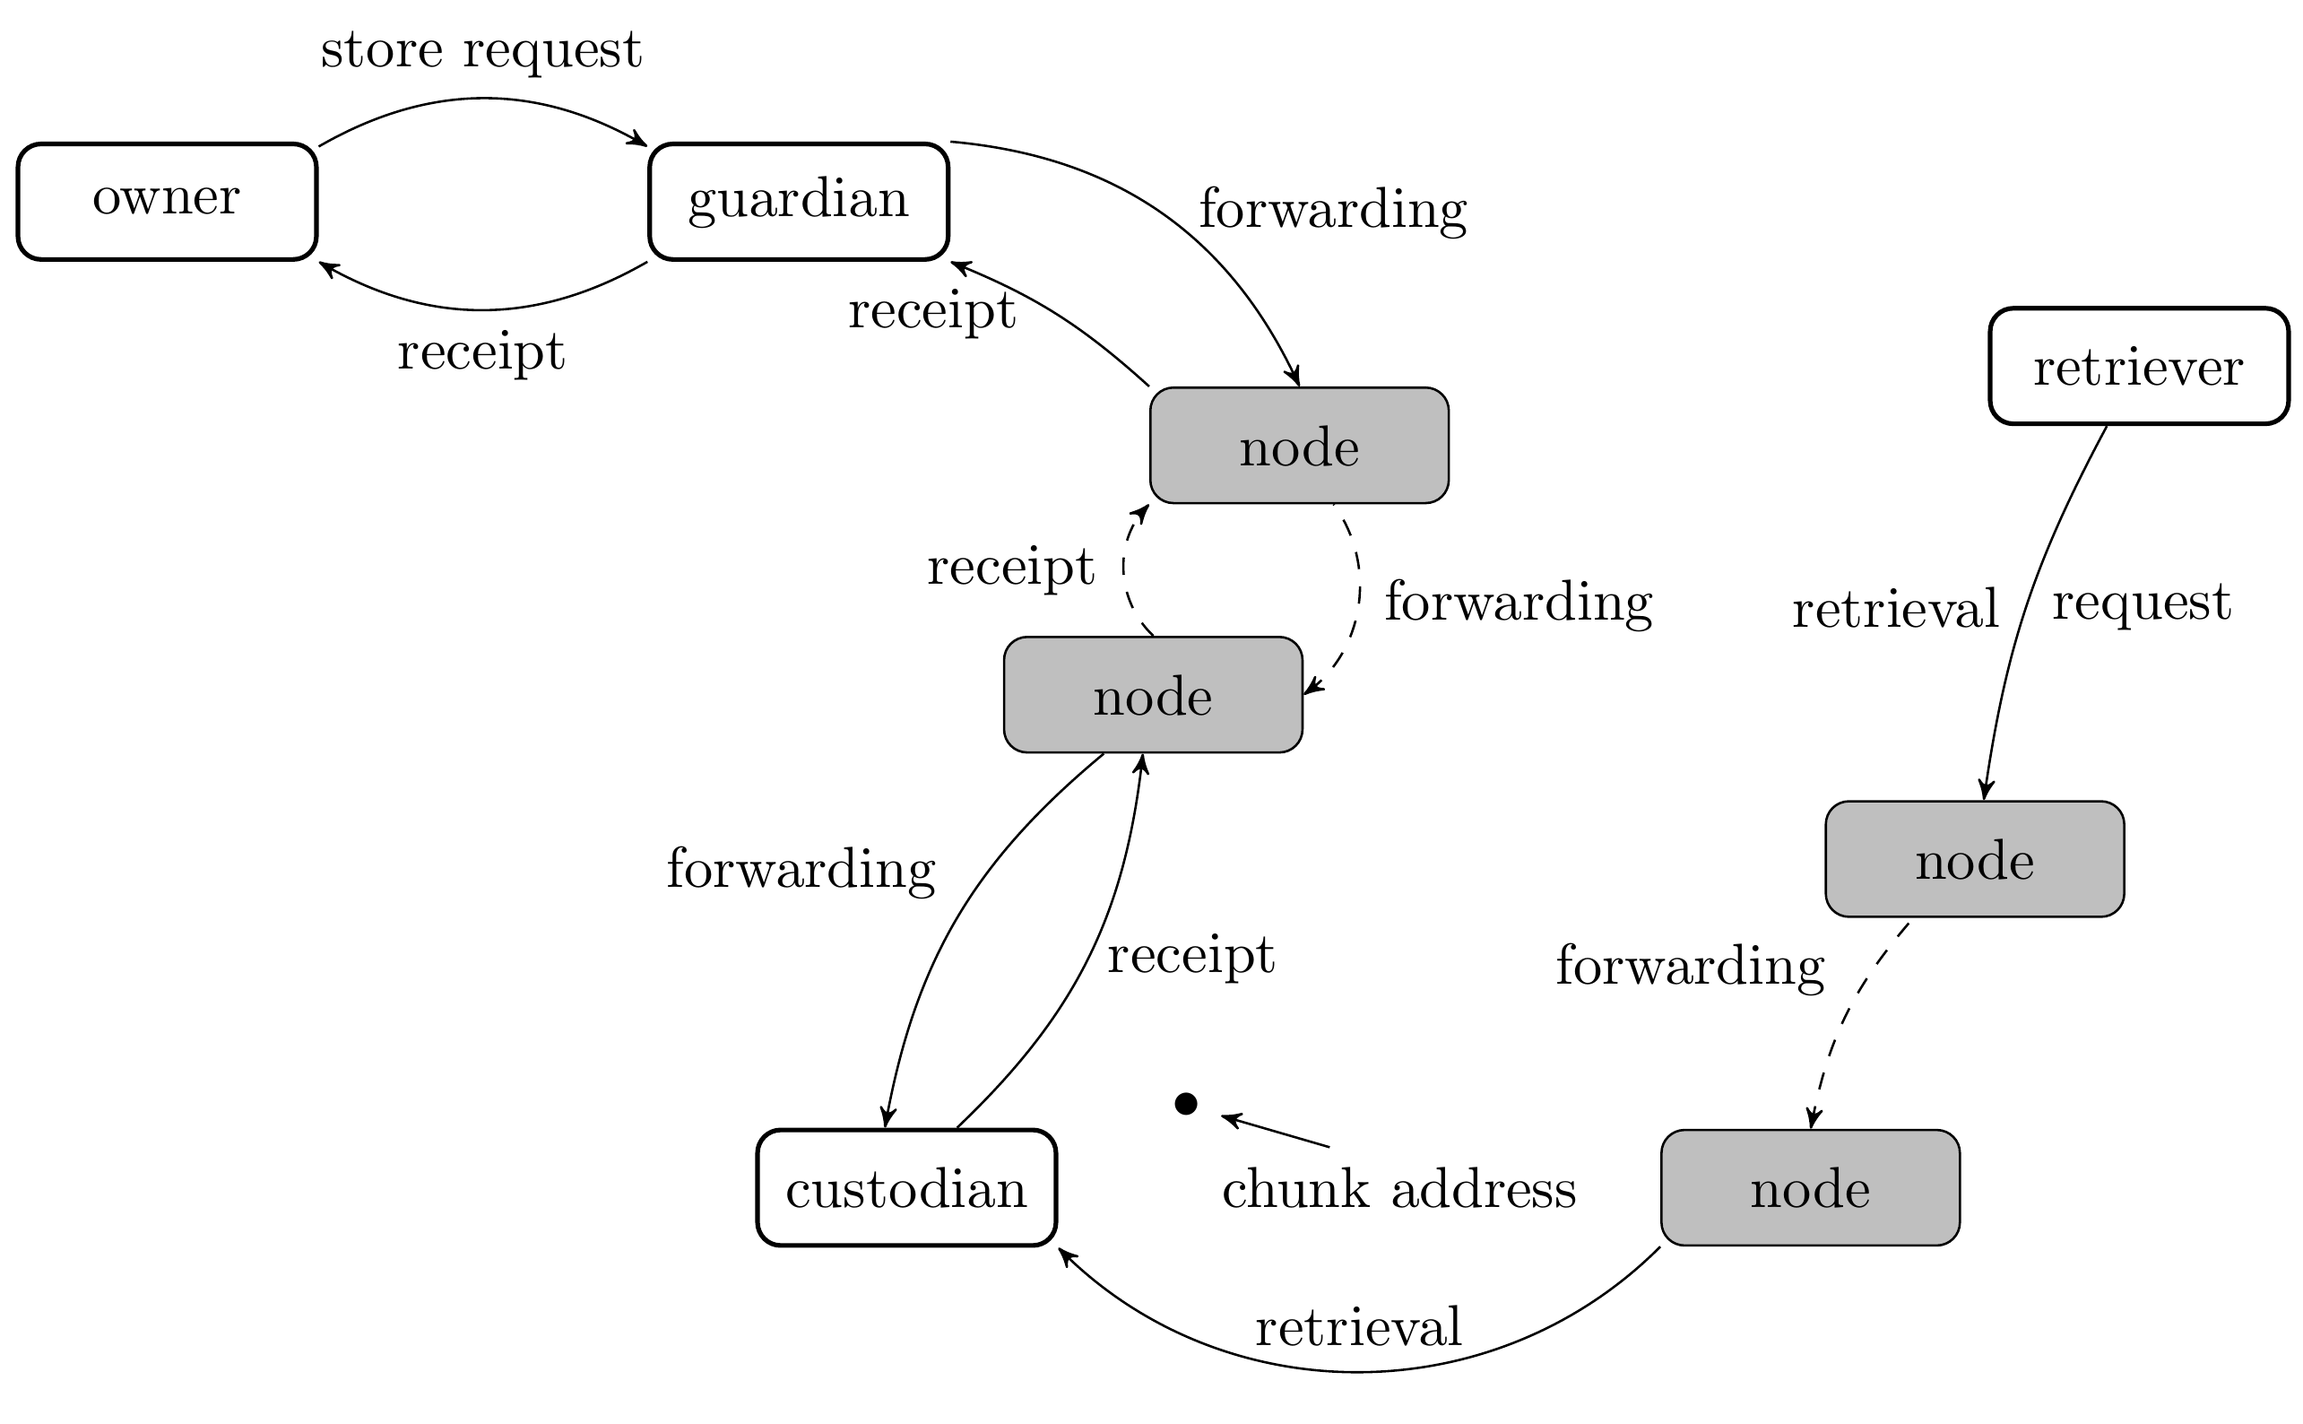
Storing content in the swarm:

Slide 45
What if the data cannot be found?

Slide 46
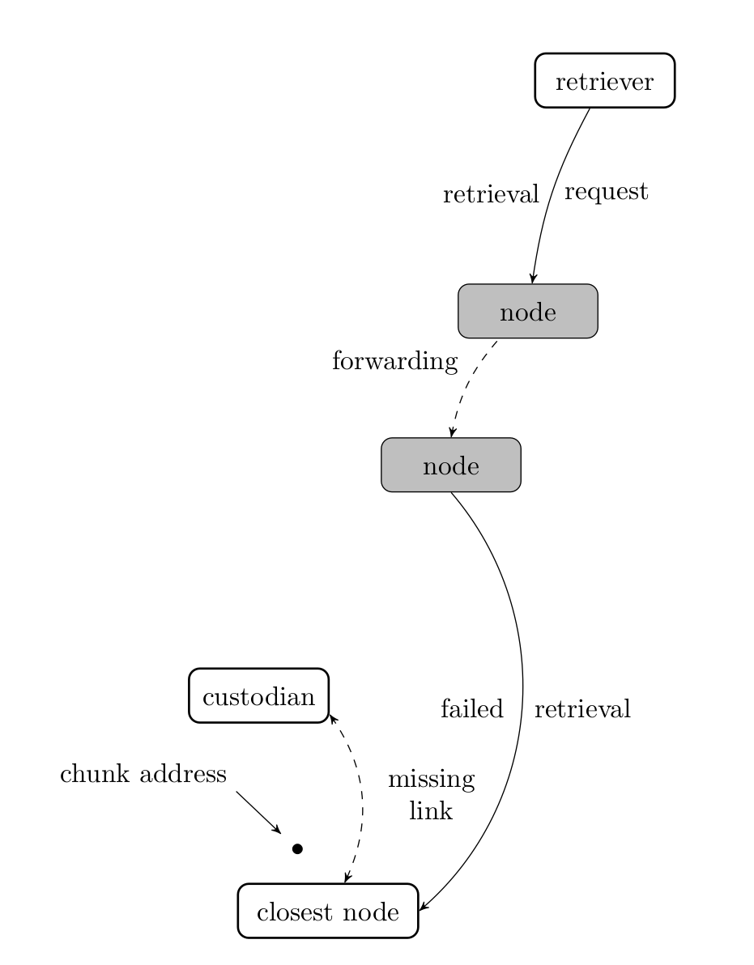
Example:
Chunk is not actually ‘lost’ -
It is still in the swarm,
but lookup fails because
chunk never reached
the closest node.

Slide 47
SWINDLE

Slide 48
SWINDLE – Secured with Insurance Deposit
Litigation and Escrow

Slide 49
SWINDLE
Issue ‘challenges’ to the guardian to show proof-of-custody of the chunk shown in the receipt.

Slide 50
SWINDLE
Issue ‘challenges’ to the guardian to show proof-of-custody of the chunk shown in the receipt.
Guardian can defend themselves by showing proof-of-custody or guardian will forward a challenge to the next node.

Slide 51
SWINDLE
Issue ‘challenges’ to the guardian to show proof-of-custody of the chunk shown in the receipt.
Guardian can defend themselves by showing proof-of-custody or guardian will forward a challenge to the next node.
Chain of receipts ends up with either
  A node storing the chunk (custodian)

Slide 52
SWINDLE
Issue ‘challenges’ to the guardian to show proof-of-custody of the chunk shown in the receipt.
Guardian can defend themselves by showing proof-of-custody or guardian will forward a challenge to the next node.
Chain of receipts ends up with either
  A node storing the chunk (custodian)
  A node that should have the chunk but lost it.

Slide 53
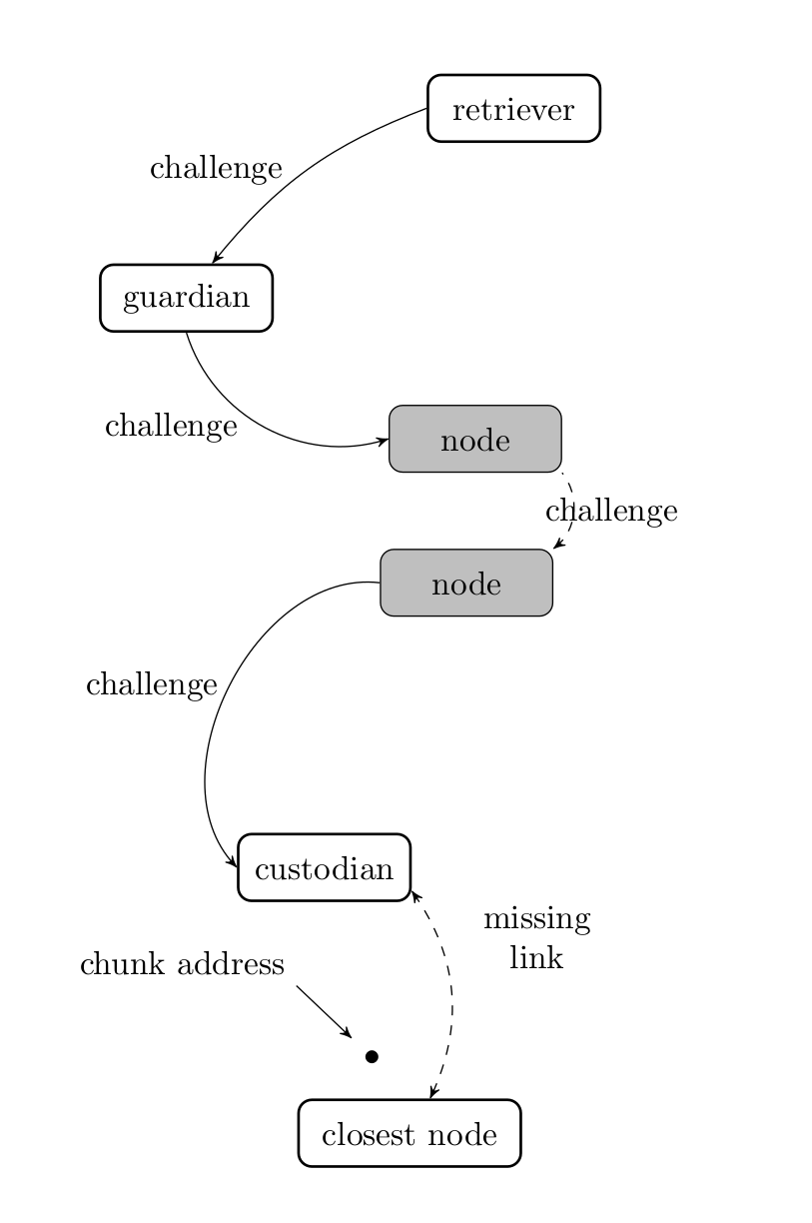
Retriever challenges guardian
Guardian challenges the node that it bought a receipt from.
Nodes forward challenges until the custodian is found.

Slide 54
Results of Litigation

Slide 55
Results of Litigation
The Custodian is found; the missing link is identified; the swarm is repaired

Slide 56
Results of Litigation
The Custodian is found; the missing link is identified; the swarm is repaired
The Chunk is indeed lost and the offending node is punished (loss of deposit)

Slide 58
Dealing with Data Loss

Slide 59
Preparing your data with
Erasure Codes

Slide 60
Preparing your data with
Erasure Codes
Idea: When preparing your file for the swarm – i.e. when generating the swarm chunk merkle tree – generate extra ‘redundancy chunks’ so that all data can be recovered even if individual chunks are lost.

Slide 61
Preparing your data with
Erasure Codes
Idea: When preparing your file for the swarm – i.e. when generating the swarm chunk merkle tree – generate extra ‘redundancy chunks’ so that all data can be recovered even if individual chunks are lost.
Benefits:
Owner can set their own redundancy parameters
Swarm can repair itself following data loss

Slide 62
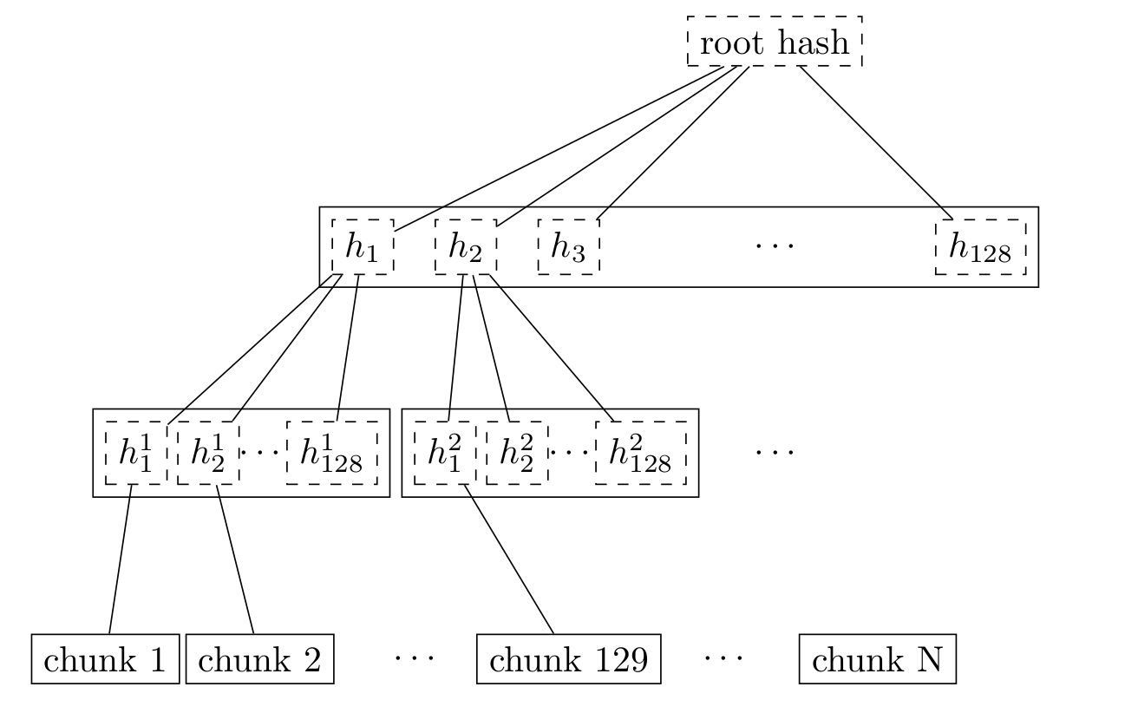
Ordinary Swarm Chunk Merkle Tree

Slide 63
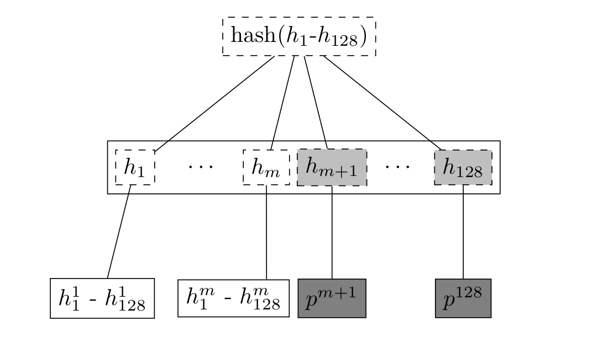
Adding Parity Chunks via Erasure Coding

Slide 64
Potential Benefits:
All chunks in the tree are equally important for retrieval.
Any node can repair swarm if data loss is discovered.
Requesting all chunks (data + parity) can greatly reduce latency. This could lead to more responsive dapps.

Slide 65
But Erasure coding is not enough, especially for large data sets you have to be able to monitor and repair.
Swarm includes an audit system able to identify missing chunks.

Slide 66
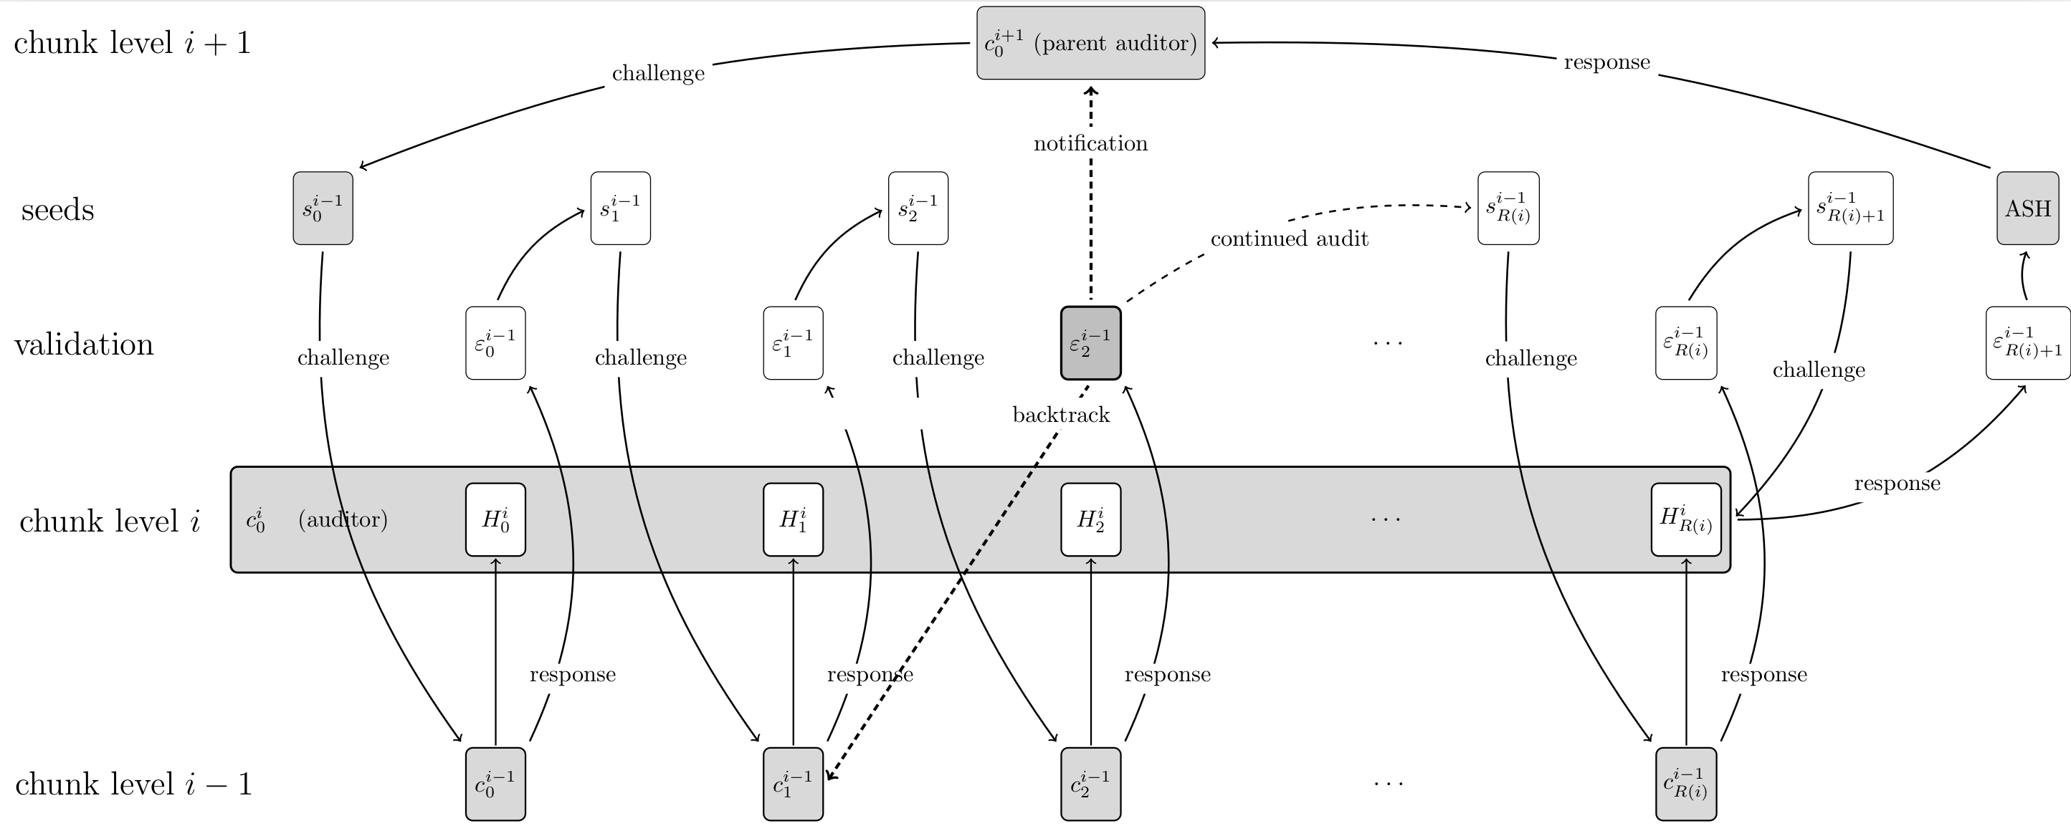
But Erasure coding is not enough, especially for large data sets you have to be able to monitor and repair.
Swarm includes an audit system able to identify missing chunks.

Slide 67
But Erasure coding is not enough, especially for large data sets you have to be able to monitor and repair.
Swarm includes an audit system able to identify missing chunks.

Slide 68
But Erasure coding is not enough, especially for large data sets you have to be able to monitor and repair.
Swarm includes an audit system able to identify missing chunks.
The same auditing system is used as a condition to periodically release payments for long-term storage agreements.
Idea: “each new payment requires a proof (audit) that the data is really still available”

Slide 69
SWAP • SWEAR • SWINDLE

Slide 71
The Web3 Experience

Slide 72
swarm: Basic architecture
Well-separated layers connected by simple APIs:
Swarm-hosted Đapps
Swarm-hosted Đapps
Virtual, content-addressed webserver
Random-access arbitrary-length files
Chunk (fixed-size block) storage

Slide 73
swarm: Web3 user experience
Familiar: hypertext with multimedia in a browser
  Interactive, responsive, intuitive
Personalization and identity management
  Selectable personae, identities
  Part of browser, not application
Legal and financial interactions
  Binding agreements
  Payment with provable receipts
  Rate-limits, confirmations with passwords, etc.

Slide 74
Swarm: Đapp mechanics
Current root hash registered on block chain
Most static and dynamic data in Swarm
Global state changes on block chain
Local state changes stored locally
  Optionally backed up in swarm and/or block chain
Business logic gets executed locally
  But verified globally by means of Ethereum

Slide 75
Swarm: Đapp example #1 distributed photo album
Web-app & data hosted in swarm
  Root hash of collections published on block chain
  Long-term incentives make sure it is not gc'd
  Short-term incentives drive publishing costs down
  High performance irrespective of popularity
No concurrent editing
  Each collection is only edited by one contributor
  All editing is done by the editor's computer
No comments or ratings

Slide 76
Swarm: Đapp example #2 distributed social network
Personalization: list of followed contributors
  E.g. friends contributing comments, likes, etc.
  Their number is limited
Content is rendered by traversing this list
  For each post, friend list is scanned for comments to this post
  Single root hash on the block chain for each participant, changes with editing, publishing, commenting
Requests for following through block chain

Slide 77
Swarm: Đapp example #3 distributed map/encyclopedia
No “official truth”, forking is cheap
  Alternative perspectives face no prohibitive costs
  Continued “rebasing” keeps all versions up-to-date
  No edit wars, no blackouts
Groups or individuals can have own versions
  Registered on the block chain by root hash
  Requires some editor work, but not much
Few versions of individual records
  Opinions on any single topic tend to cluster around a few alternatives

Slide 78
What’s next? (Roadmap)

Slide 79
SWARM

