Slide 1

London Ethereum Meetup
swarm and web3
9th June 2016
Viktor Trón

Slide 2
A brief history of:
Web Hosting and Incentivisation
Web 1.0
          Start a web server
          Upload content
1. Content is unpopular
- pay costs of maintaining webserver
2. Content becomes popular
- bandwidth costs skyrocket
- server crashes / goes offline
...but at least you owned your own content.

Slide 3
A brief history of:
Web Hosting and Incentivisation
Web 2.0
          Upload content to the ‘cloud’
          - cheap/free
          - scalable
But…
          Content owned by the service providers
          All users are tracked and spied on; providers profit off the data.
          Centralised control: surveillance and censorship.

Slide 4
A brief history of:
Web Hosting and Incentivisation
Peer to Peer Networks
eg. Bittorrent
          Content is distributed among peers
          Distribution scales automatically
          Hashing ensures data integrity
          No central point of failure / no servers
But:
Downloads start slowly (high latency)
No incentive to provide content: “seeding”

Slide 5
swarm: Basic architecture
Well-separated layers connected by simple APIs:
Swarm-hosted Đapps
Swarm-hosted Đapps
Virtual, content-addressed webserver
Random-access arbitrary-length files
Chunk (fixed-size block) storage

Slide 6
A (very quick) introduction to Swarm
1. Get data into the swarm

Slide 7
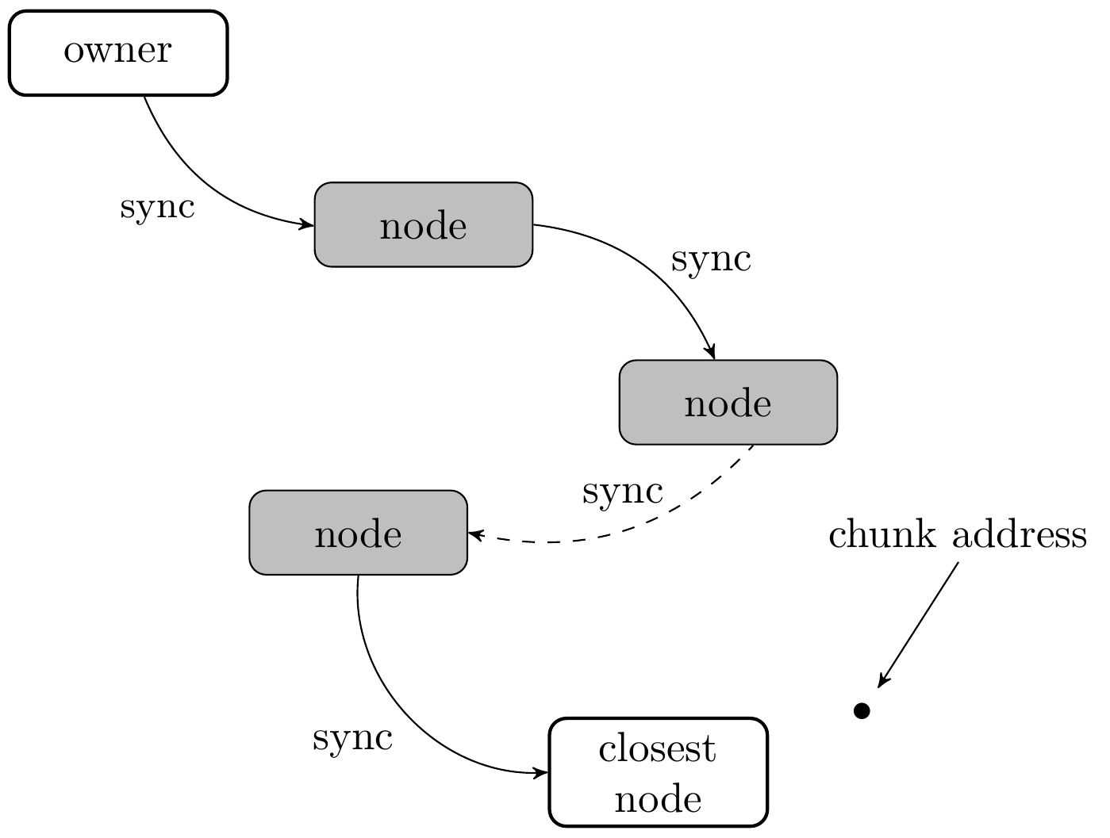
A (very quick) introduction to Swarm
Data is chopped up into chunks.
Chunks are forwarded node-to-node (sync)
Chunks end up with node whose address is closest to chunk hash

Slide 8
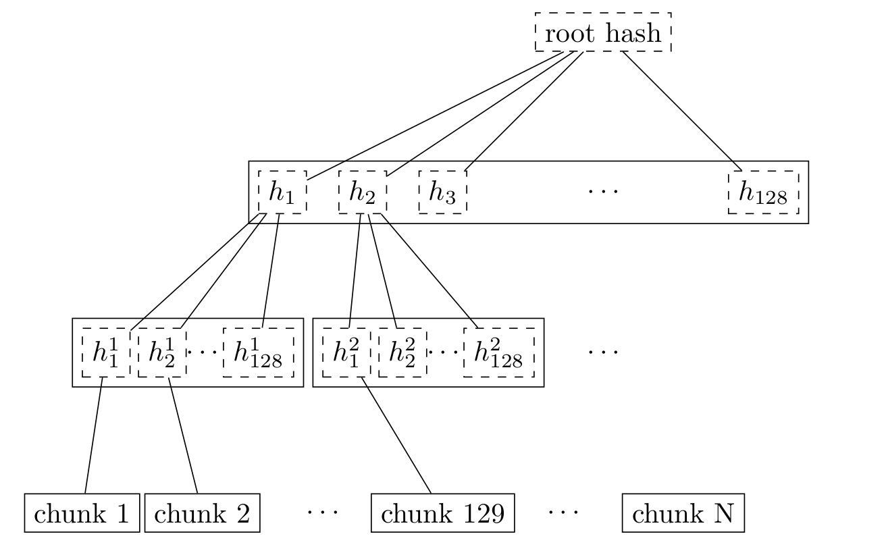
Ordinary Swarm Chunk Merkle Tree

Slide 9
A (very quick) introduction to Swarm
2. Get data out of the swarm

Slide 10
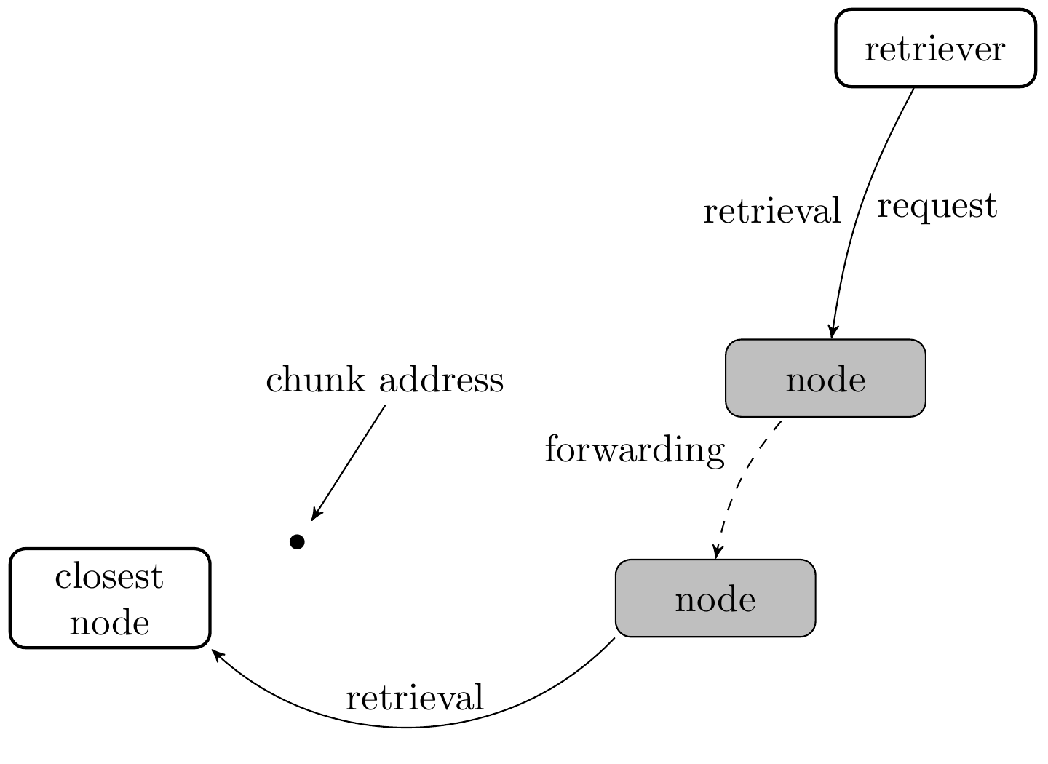
A (very quick) introduction to Swarm
Retriever makes a request to a closer connected node
Nodes pass on requests
Forwarding ends when chunk is found. Chunk is passed back.

Slide 11
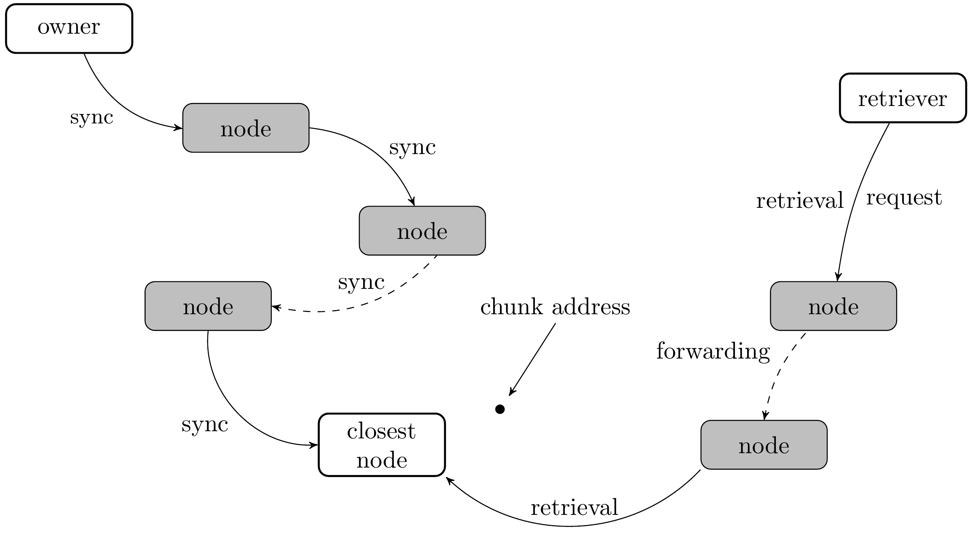

Slide 12
SWAP • SWEAR • SWINDLE
incentivisation in SWARM

Slide 13
Swarm Incentive System
Bandwidth
- accounting for bandwidth used in the p2p setting
- compensating nodes based on the bandwidth they provide
Storage
- allow for long-term storage of data in the swarm
- provide proper compensation to nodes for storing data

Slide 14
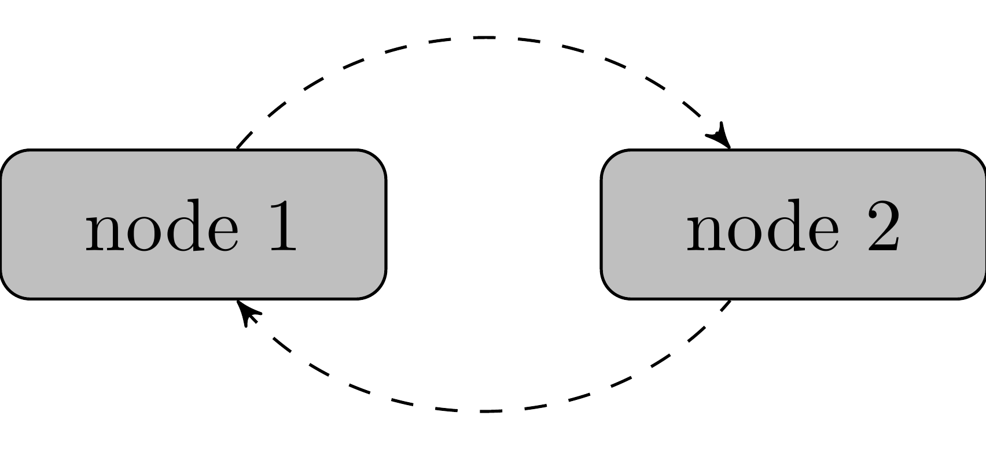
Swarm Incentive System
Bandwidth
Bandwidth accounting is per-peer
Number of chunks supplied
Number of chunks received

Slide 15
SWAP – Swarm Accounting Protocol

Slide 16
SWAP – Swarm Accounting Protocol
Keeps track of number of chunks provided/received per peer
Can trade chunk-for-chunk or chunk-for-payment
Payments are made using the swarm chequebook contract on the blockchain
  (cheques are cumulative: you only ever have to cash the last one, thus saving transaction costs)

Slide 17
SWAP – Swarm Accounting Protocol
Big picture:
If you download a lot of content, you pay your peers for providing it.
If you host popular content, you will earn fees from your peers for making the content available.
Swarm is auto-scaling.
-interplay of routing protocol and per-chunk payment between peers means that popular content will be widely distributed thereby increasing available bandwidth while decreasing latency

Slide 18
Swarm Incentive System
Storage
The Problem:
I want to deploy my content only once:
“upload and disappear”.
I want to make sure the content remains available
years into the future even if it is not popular content.
Solution:
Pay certain nodes to keep your data.
-Nodes that sell such promises-to-store must have a
deposit locked on the blockchain.
-Nodes that loose content, loose their deposit.

Slide 19
Swear and Swindle

Slide 20
SWEAR
Nodes register with the SWEAR contract and pay a deposit.
Registered nodes can sell receipts for chunks received.
Receipts are promises that the data remains available in the swarm.
“Upload and Disappear” made possible by the system of ‘guardians’

Slide 21
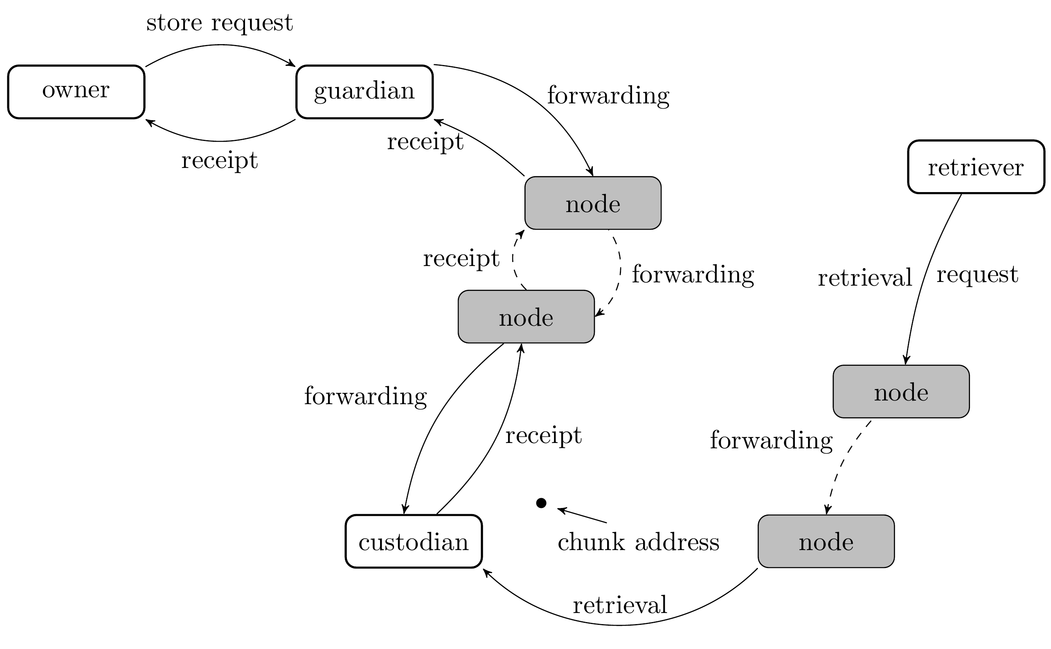
Storing content in the swarm:

Slide 22
What if the data cannot be found?

Slide 23
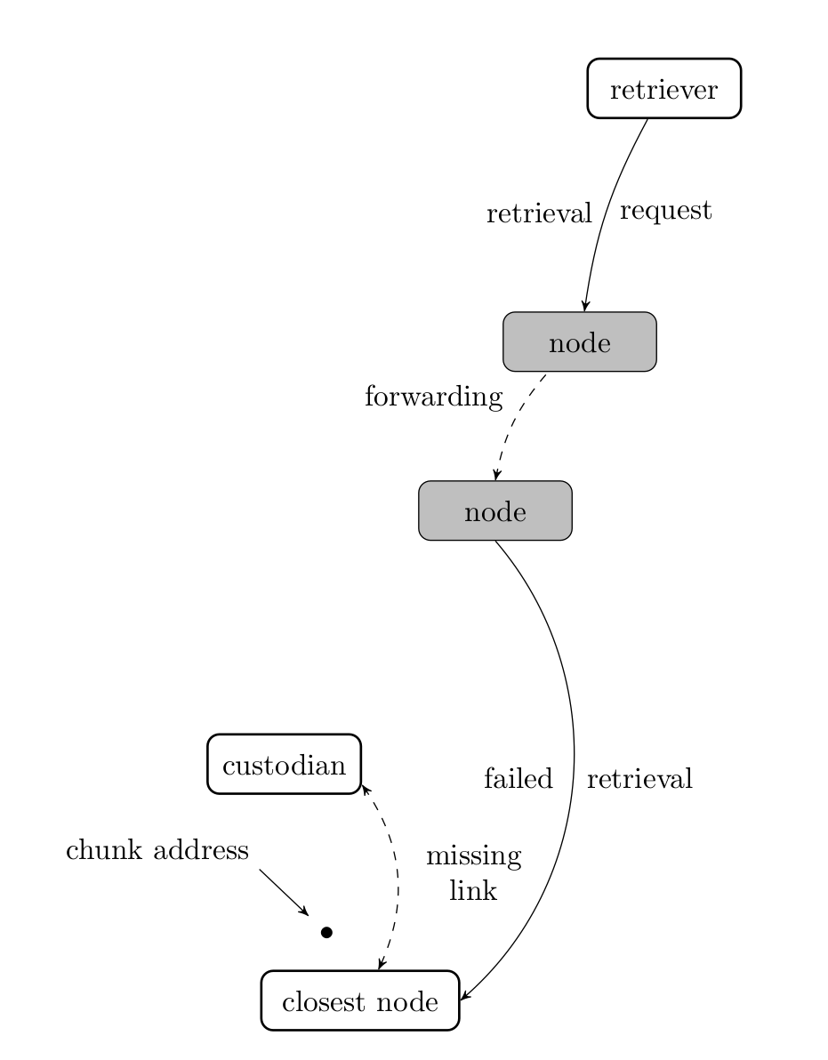
Example:
Chunk is not actually ‘lost’ -
It is still in the swarm,
but lookup fails because
chunk never reached
the closest node.

Slide 24
SWINDLE

Slide 25
SWINDLE – Secured with Insurance Deposit
Litigation and Escrow

Slide 26
SWINDLE
Issue ‘challenges’ to the guardian to show proof-of-custody of the chunk shown in the receipt.
Guardian can defend themselves by showing proof-of-custody or guardian will forward a challenge to the next node.
Chain of receipts ends up with either
  A node storing the chunk (custodian)
  A node that should have the chunk but lost it.

Slide 27
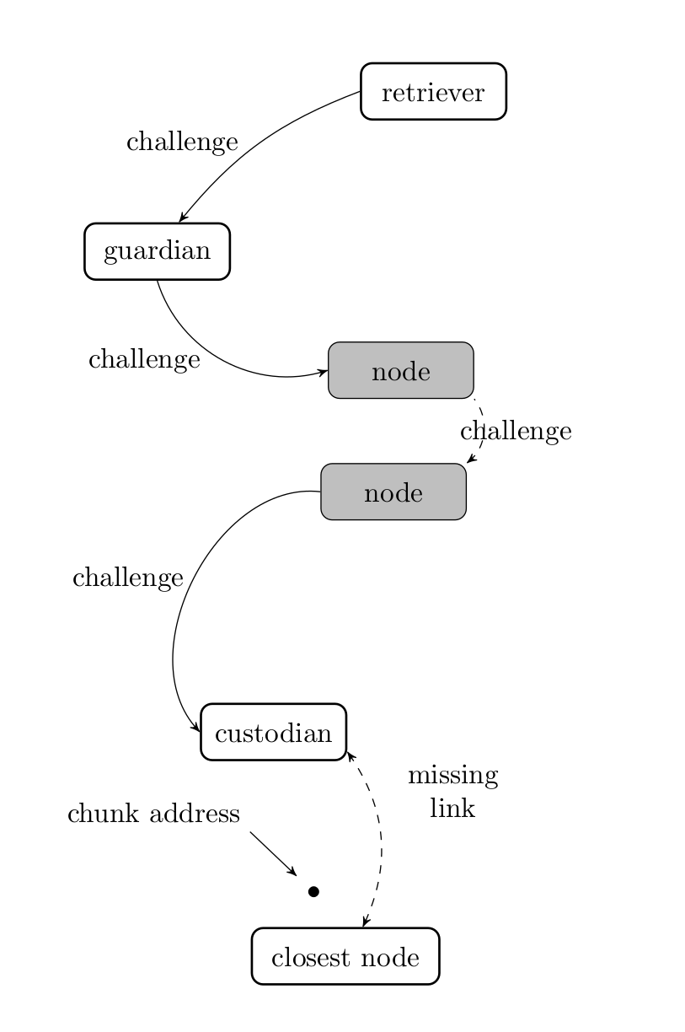
Retriever challenges guardian
Guardian challenges the node that it bought a receipt from.
Nodes forward challenges until the custodian is found.

Slide 28
Results of Litigation
The Custodian is found; the missing link is identified; the swarm is repaired
The Chunk is indeed lost and the offending node is punished (loss of deposit)

Slide 29
Dealing with Data Loss

Slide 30
Preparing your data with
Erasure Codes
Idea: When preparing your file for the swarm – i.e. when generating the swarm chunk merkle tree – generate extra ‘redundancy chunks’ so that all data can be recovered even if individual chunks are lost.
Benefits:
Owner can set their own redundancy parameters
Swarm can repair itself following data loss

Slide 31
Ordinary Swarm Chunk Merkle Tree

Slide 32
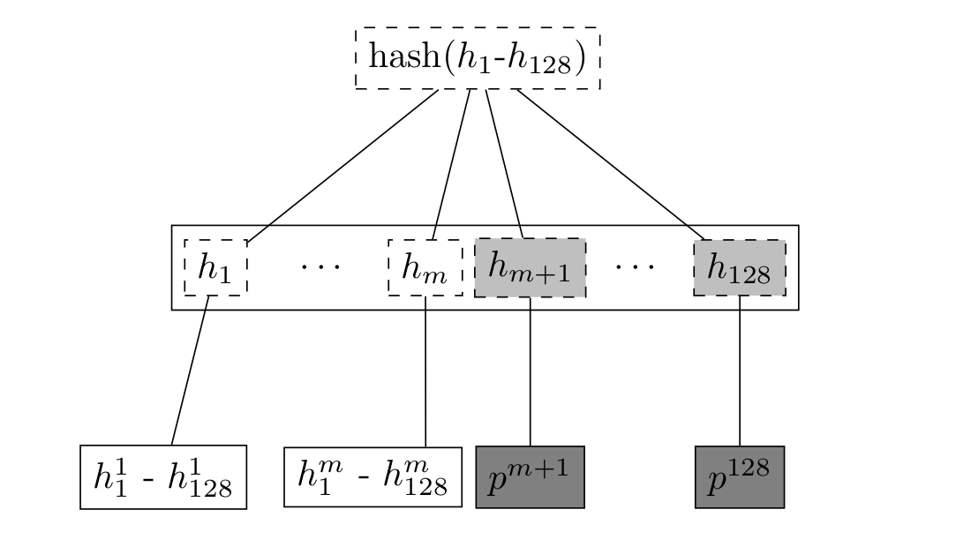
Adding Parity Chunks via Erasure Coding

Slide 33
Potential Benefits:
All chunks in the tree are equally important for retrieval.
Any node can repair swarm if data loss is discovered.
Requesting all chunks (data + parity) can greatly reduce latency. This could lead to more responsive dapps.

Slide 34
But Erasure coding is not enough, especially for large data sets you have to be able to monitor and repair.
Swarm includes an audit system able to identify missing chunks.

Slide 35
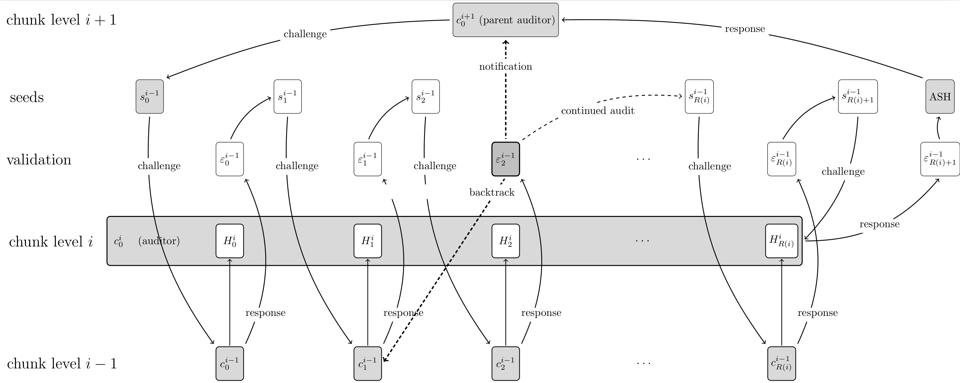
But Erasure coding is not enough, especially for large data sets you have to be able to monitor and repair.
Swarm includes an audit system able to identify missing chunks.

Slide 36
But Erasure coding is not enough, especially for large data sets you have to be able to monitor and repair.
Swarm includes an audit system able to identify missing chunks.
The same auditing system is used as a condition to periodically release payments for long-term storage agreements.
Idea: “each new payment requires a proof (audit) that the data is really still available”

Slide 37
SWAP • SWEAR • SWINDLE

Slide 38
The Web3 Experience

Slide 39
swarm: Basic architecture
Well-separated layers connected by simple APIs:
Swarm-hosted Đapps
Swarm-hosted Đapps
Virtual, content-addressed webserver
Random-access arbitrary-length files
Chunk (fixed-size block) storage

Slide 40
swarm: Web3 user experience
Familiar: hypertext with multimedia in a browser
  Interactive, responsive, intuitive
Personalization and identity management
  Selectable personae, identities
  Part of browser, not application
Legal and financial interactions
  Binding agreements
  Payment with provable receipts
  Rate-limits, confirmations with passwords, etc.

Slide 41
Swarm: Đapp mechanics
Current root hash registered on block chain
Most static and dynamic data in Swarm
Global state changes on block chain
Local state changes stored locally
  Optionally backed up in swarm and/or block chain
Business logic gets executed locally
  But verified globally by means of Ethereum

Slide 42
Web3 experience

Slide 43
What’s next? (Roadmap)

