Slide 1
ST1511 CA1: Machine Learning Workflow
Part A: Machine Status Classification
Part B: Housing Price Regression
Name: Ethan Chuwa Si Xuan
AdminNo: P2508638
Class: DAAA/FT/1B/04

Slide 2
Problem Definition and Tasks
Part A: Machine Status Classification
Predict whether a machine is Normal (0) or Abnormal (1) using sensor data
Task Type: Binary Classification
Target Variable: Machine Status
Main Metric: Recall (Class 1) → prioritises detecting faulty machines
Other metrics used: F1-score, Precision, Accuracy, ROC-AUC
Why Recall: Missing a faulty machine (FN) is costly hence we will focus on detecting all faults.
Part B: Housing Price Prediction
Predict House sale price ($) from numerical and categorical property features
Task Type: Regression
Target Variable: Price ($)
Main Metric: MAPE (%) → interpretable %, fair across price ranges
Other metrics used: MAE, RMSE, R²
Why MAPE: Allows error comparison across cheap vs expensive houses.

Slide 3
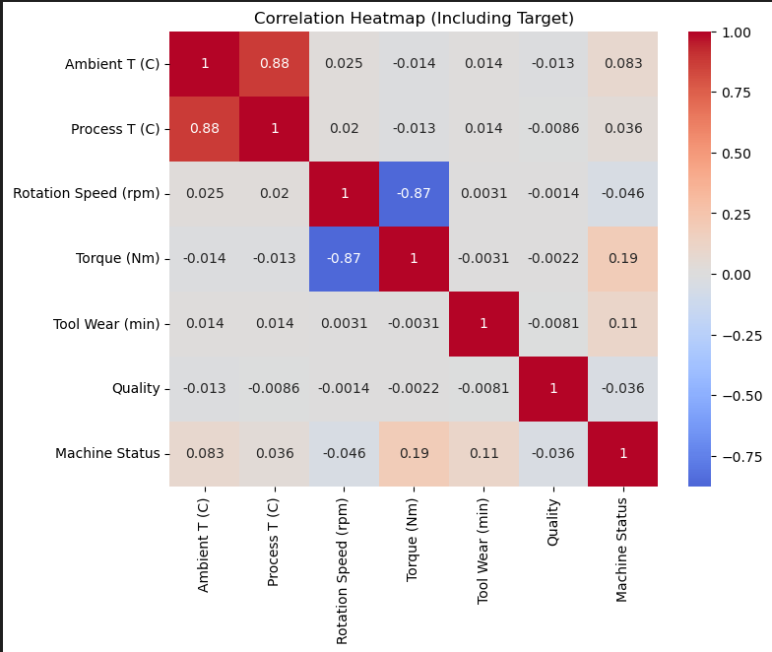
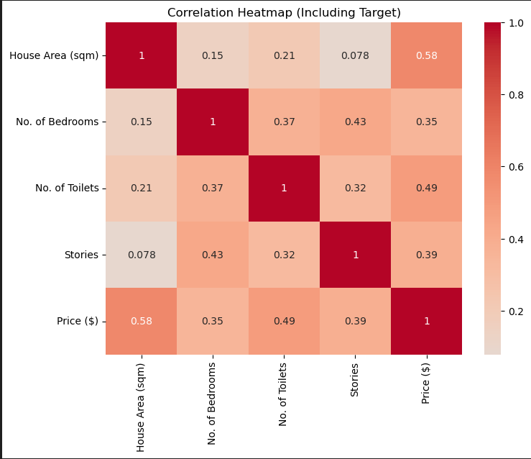
Exploratory Data Analysis and Data Understanding
Part A
Inspected dataset structure using .info() and .describe() to understand data types ranges and missing values.
Checked class distribution in part A and target distribution in part B to identify imbalance and skew.
Visualised numerical features to assess outliers, skewness, and spread (e.g., temperature, torque, house size, prices).
Plotted correlation heatmaps to identify relationships between features and target variables in both tasks.
EDA insights guided decisions like log transformation for part B, scaling for both and undersampling for part A
Identified patterns:
Part A: Some features show relationship with machine status.
Part B: Sale Price shows strong relationships with size and moderate relationship to number of toilets and stories.
Part B

Slide 4
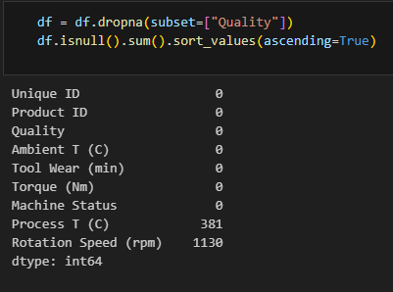
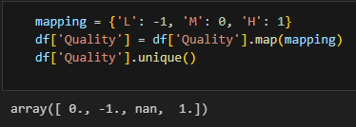
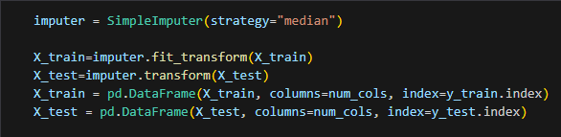
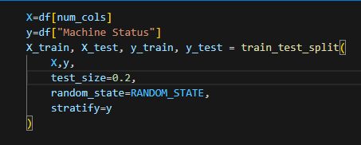
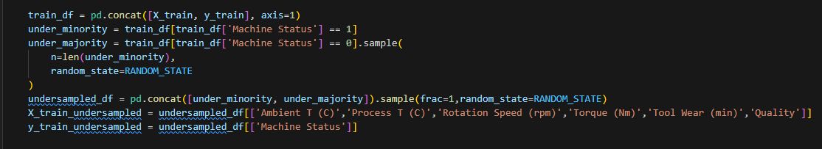
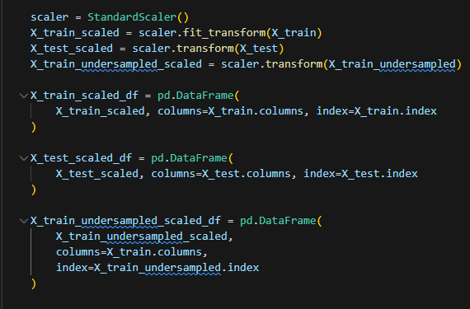
Data Cleaning and Processing (Part A)
Ordinal Encoding is first applied to ‘Quality’ feature wher H>M>L=1>0>-1.
NaN values in ‘Quality’ are dropped as they do not provide meaningful contribution.
Data is then split into X_train, y_train, X_test, y_test.
NaN values in X_train and X_test (Process T (C) and Rotation Speed (rpm) are then imputed with median using SimpleImputer().
Data in train set is then undersampled.
X_train and X_test and X_train_undersampled are then scaled to standardize features using StandardScaler().

Slide 5
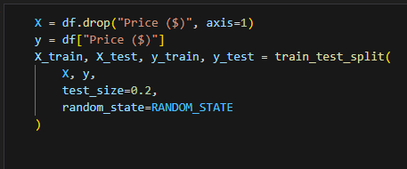
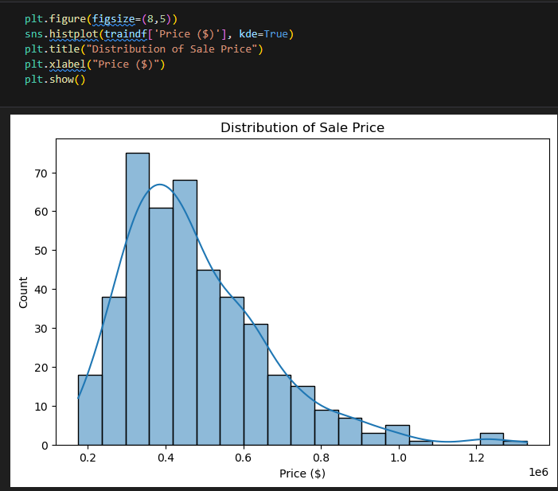
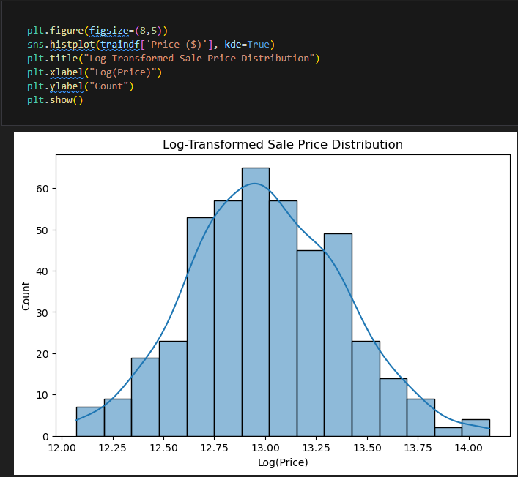
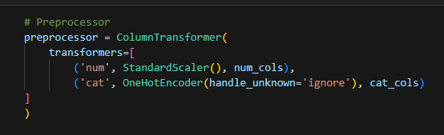
Data Cleaning and Processing (Part B)
Data is first split into X_train, X_test, y_train, y_test
Target feature’s distribution is found out to be skewed, hence log-transformation is applied to make the distribution normal.
Preprocessor using pipeline is then set up for later use that scales numerical features using StandardScaler() which is important for regularization models and encodes categorical features using OneHotEncoder to convert them into a machine readable format.
The preprocessor also prevents data leakage.

Slide 6

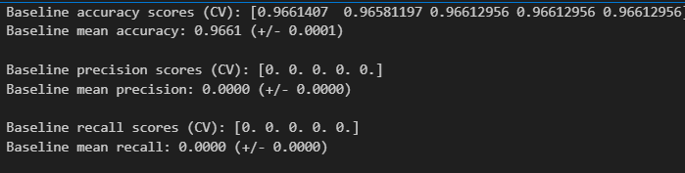
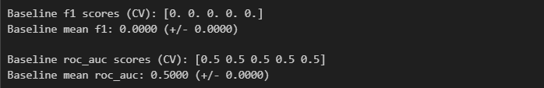
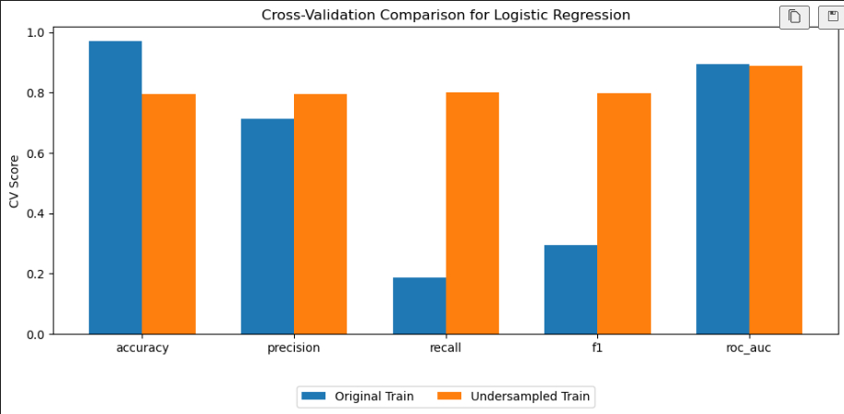
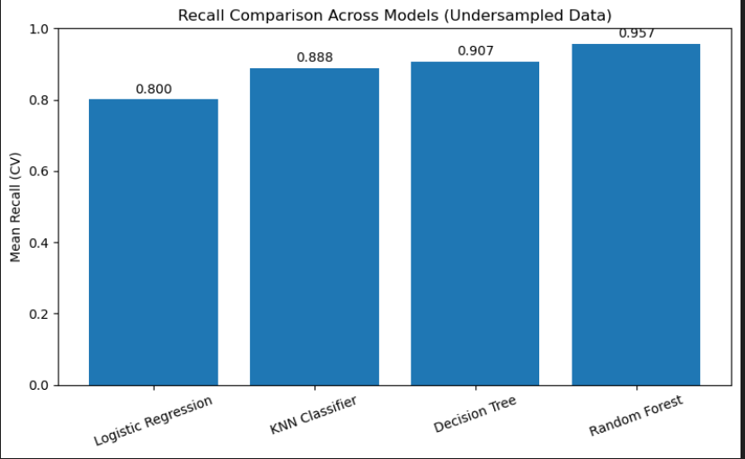
Model evaluation (Part A)
kf is first set up using StratifiedKFold
Dummy baseline is then created using DummyClassifier() and metrics are calculated using cross_val_score(). This is so that we can compare our models to this baseline later on.
A total of 4 models are then evaluated using cross_val_score() using both original imbalanced data and undersampled data. Metrics are then compared using bar charts.
Models performed better consistently on the undersampled data hence we compare undersampled data’s recall (Our primary metric) across all models to see which model performed the best.
The 2 best models are then chosen to proceed with hyperparameter tuning.

Slide 7
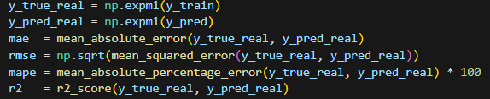
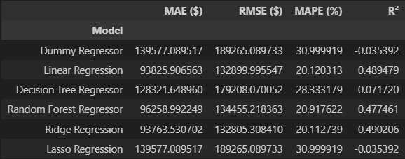
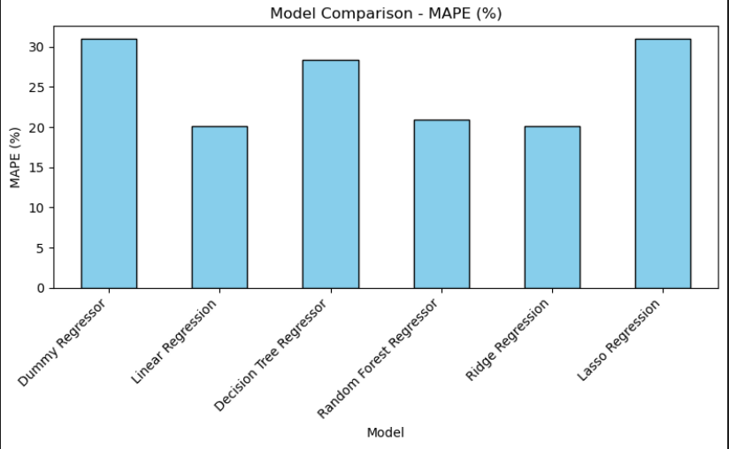
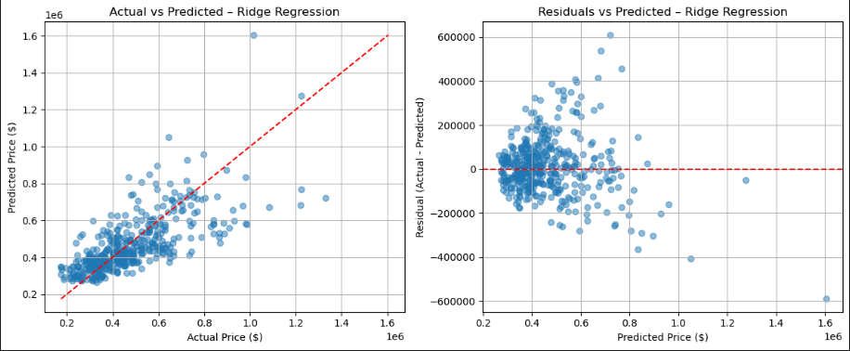
Model evaluation (Part B)
kf is first set up using Kfold
5 models are then chosen alongside dummy regressor to be evaluated using cross_val_predict().
Since log transformation was applied to target feature, extra steps were taken to calculate actual metrics.
MAPE is then compared across all models using a bar chart.
Actual vs Predicted and Residuals vs Predicted plots are also plotted for the 3 best models (Lowest MAPE) to understand whether predictions are accurate and whether model errors are random or patterned.
Best 3 models are then chosen to proceed with hyperparameter tuning.

Slide 8
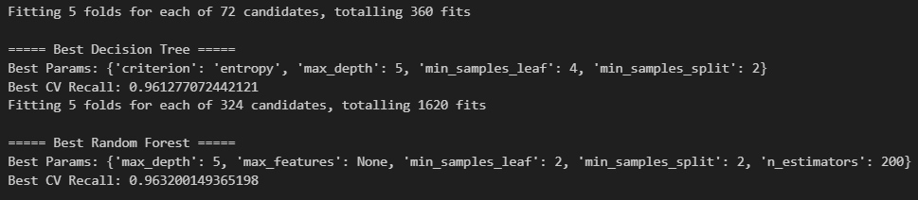
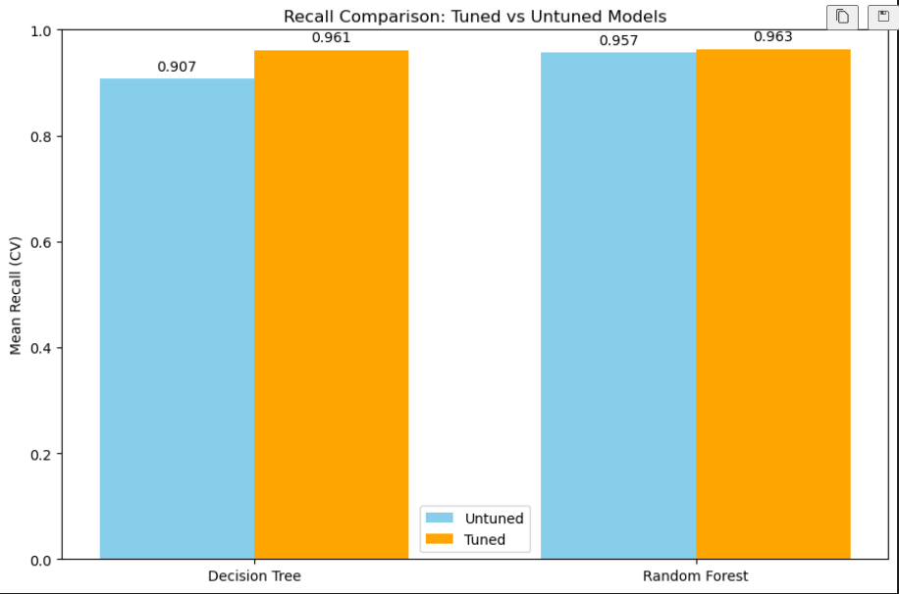
Hyperparameter Tuning (Part A)
Decision Tree and Random Forest Classifier were chosen for hyperparameter tuning due to them having higher recall scores.
GridSearchCV was used to search for the best parameters to maximise recall.
Cross validation is then used to evaluate model’s performance and a bar chart is then plotted to compare results from tuned and untuned models. It can be seen that both models have increased recall scores after hyperparameter tuning.

Slide 9
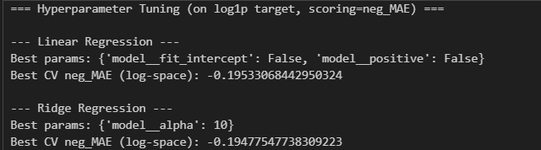

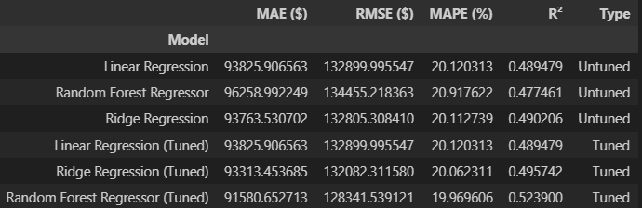
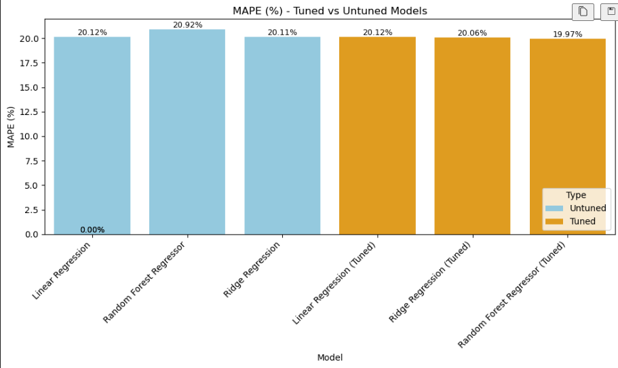
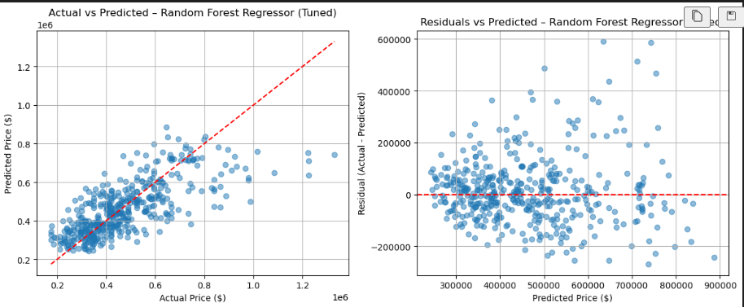
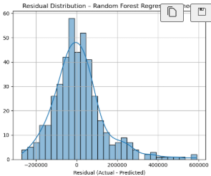
Hyperparameter Tuning (Part B)
Linear Regression, Ridge Regression and Random Forest Regressor were chosen for hyperparameter tuning due to them having lower MAPE scores.
GridSearchCV is then used to search for best parameters to improve MAE score.
Tuned models are then evaluated using cross_val_predict() again to compare scores to untuned models.
It can be seen that Linear Regression had no improvement due to parameter space being too small, Ridge regression improving only slightly, most likely because model was already close to optimal pre-tune and random forest had the most improvement out of the three.
Actual vs Predicted and Residuals vs Predicted plots are also plotted again to visualise prediction accuracy and error patterns.
Residual Distribution graph is also plotted to see whether model is biased or not.

Slide 10
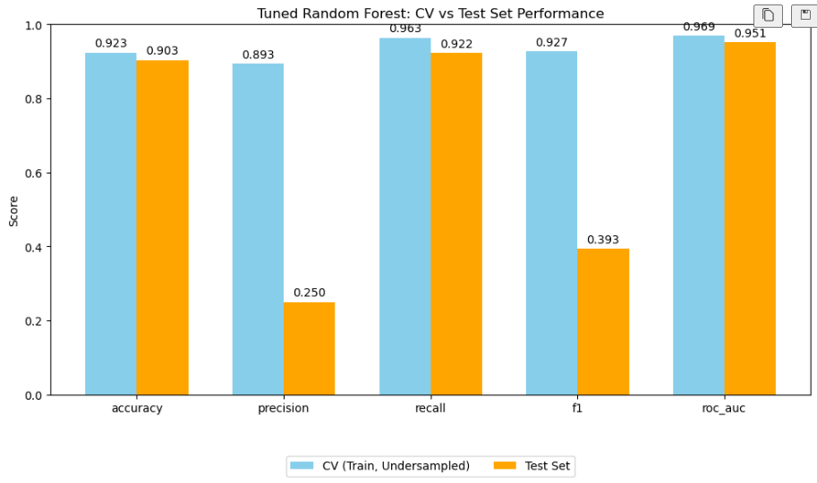
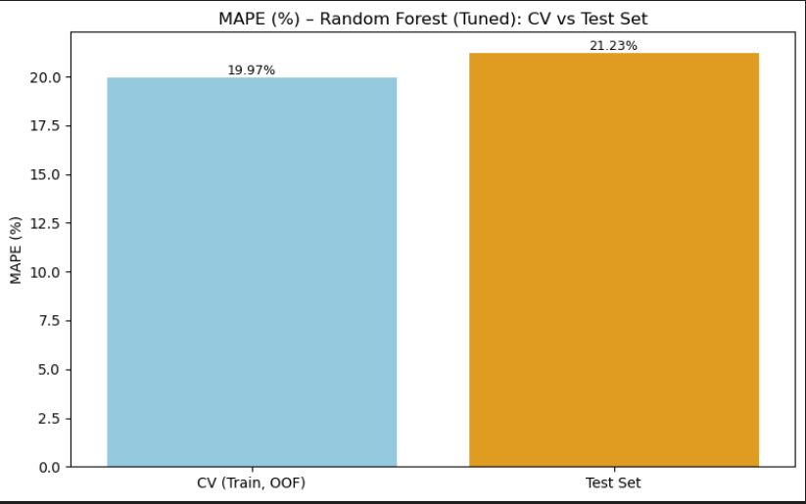
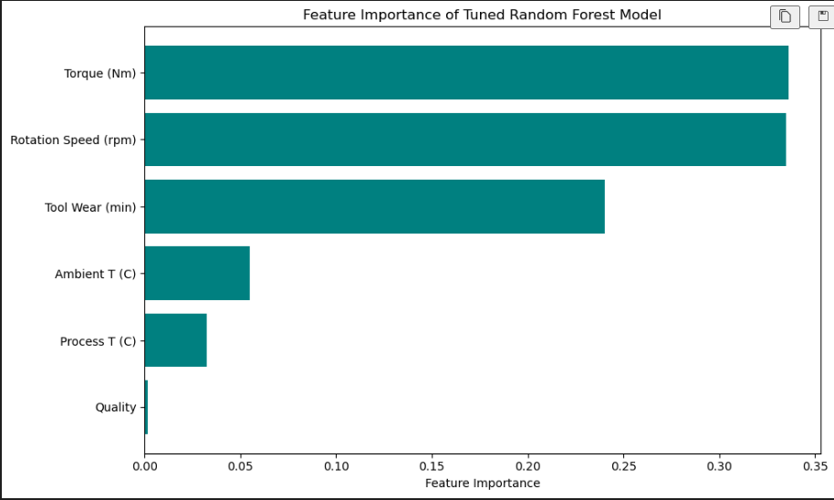
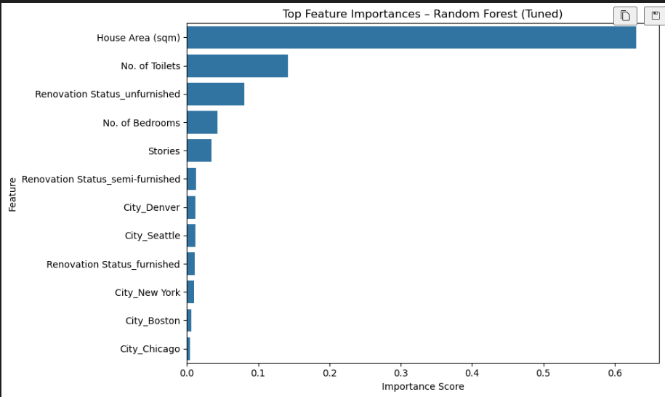
Conclusion
Part A
Chose random forest as it has the best results after hyperparameter tuning
Compared tuned cv to tuned test results to check reliability.
Recall is shown to be lower.
Part B
Chose random forest as it has the best results after hyperparameter tuning.
Compared tuned cv to tuned test to check reliability.
Model on test set did slightly worse but is expected as test result contains unseen data.
Model still retains reasonable predictive accuracy and generalises quite well.
Feature Importance
Part A
Torque (0.336) & Rotation Speed (0.335) → Most important; together contribute ~65% of model decisions; strong indicators of mechanical load.
Tool Wear (0.240) → Also highly important; wear progression strongly linked to machine faults.
Temperatures (Ambient 0.055, Process 0.032) → Low importance; weaker influence on machine status.
Quality (0.001) → Almost no impact; not useful for predicting faults.
Overall: Model relies mainly on mechanical + wear-related features, confirming these are key for fault detection.
Part B
House Area (~63%) → Most important; main driver of price differences.
No. of Toilets (~14%) → Strong indicator of home value.
Renovation Status → Meaningful but secondary; unfurnished has highest impact.
Bedrooms & Stories → Moderate contributors tied to size/livability.
City features (<2%) → Minimal influence compared to physical attributes.
Overall: Price prediction is dominated by structural and size-related features, with location and renovation status playing smaller supporting roles.

