Slide 1
WEALTHLINE
Software Metrics-Driven, AI-Powered Personal Finance Management System
TEAM
K Druthendra
G Sai Santhosh
P Siva Kiran
Shaik Nihal
23MIS0213
23MIS0227
23MIS0674
23MIS0491
Live: wealthline-eight.vercel.app · Code: github.com/ethical0101/Personal-Finance-Management-System

Slide 2
PROBLEM STATEMENT
People stop tracking money because it is tedious
Manual entry kills the habit
Numbers without decisions
Unchecked AI
Typing every expense is slow, so records go stale and budgets are ignored.
Charts show last month. Users need “can I afford this today?”
AI that touches money must be verified by code and confirmed by the user.
Our two questions
Product: how do we cut the effort of recording spending, keep budgets current automatically, and give users a reason to open the app daily?
Engineering: how do we use software metrics to plan, monitor and predict the quality and risk of building it?
Wealthline
2

Slide 3
INTRODUCTION AND ABSTRACT
Scan a bill. Stay on budget. Measure the engineering.
Wealthline: a full-stack web app (React + Node + MongoDB, deployed on Vercel) for personal finance.
Photograph a bill → AI reads merchant, date, total, category, items → server shows the budget impact and duplicate warning → user confirms.
Everyday tools: safe-to-spend, subscription detector, goal ETA, what-if, health score, Ask AI.
Anomaly detection (z-score) and spending forecast (exponential smoothing).
A Python metrics program (GQ(I)M, decision tree, control chart, correlations, Bayesian networks) is embedded in the app.
Measured on our test sets and reported honestly, including what does not work.
Wealthline
3

Slide 4
SUMMARY
What was built and what we measured
Area | Delivered
Bill scanning | Photo → Gemini vision → verified fields → budget impact → confirm
Budget manipulation | Saved bills update the category budget; auto-budget from history
Daily-use features | Safe-to-spend, subscriptions, goal ETA, what-if, month-end projection, health score, Ask AI
AI methods | z-score anomalies, exponential-smoothing forecast, LLM extraction / advice / Q&A
Metrics program | GQ(I)M, ISO 25010, defect taxonomy, decision tree, I-MR chart, 3 correlations, 2 Bayesian networks
UI | Full redesign: warm canvas, pastel tiles, icon rail, docked AI assistant; light / dark / mobile
Bill totals exact on 100% of 10 test bills · anomaly precision 0.984 · forecast MAPE 13.76% vs 15.95% (regression)
Wealthline
4

Slide 5
METHODOLOGY — PLANNING AND CLASSIFICATION
Plan with GQ(I)M, classify with measurable rules
GQ(I)M + ISO 25010
Defect taxonomy
Statistics
Goal → Questions → Indicators → Metrics. Quality attributes: suitability, efficiency, reliability, maintainability, security.
Error (human) → Fault (code) → Failure (behaviour) → Bug (report). Defect density = defects per KLOC.
Box plot, I-MR control chart, Pearson / Spearman / Kendall, t-test.
Task | Classes | Method
Module defect-proneness | High / Low | Decision tree (depth 3)
Unusual expense | Normal / Anomaly | z = (x − μ) / σ, flag if |z| ≥ 2.5
Bill category / is it a bill? | User's categories / Bill, not a bill | Vision LLM, constrained output, checked by server
Project risk | Low / Medium / High | Bayesian network
Wealthline
5

Slide 6
METHODOLOGY — SCANNING AND FORECASTING
Bill scanning: AI reads, code checks, user confirms
Cache lookup (hash of image + categories) → Gemini vision with model fallback and retry → JSON fields.
Server checks: total > 0, date plausible (flags dates far from today), category exists, duplicate (same date and amount).
Budget impact computed from stored transactions: spent before / after, % of limit, over-by amount.
Nothing saved until the user confirms; image never stored.
Forecast: exponential smoothing S(t) = 0.4·x(t) + 0.6·S(t−1) — chosen after a 2,400-forecast backtest beat linear regression.
Bayesian risk model: requirement volatility + team experience → schedule delay + defect density → project risk.
Wealthline
6

Slide 7
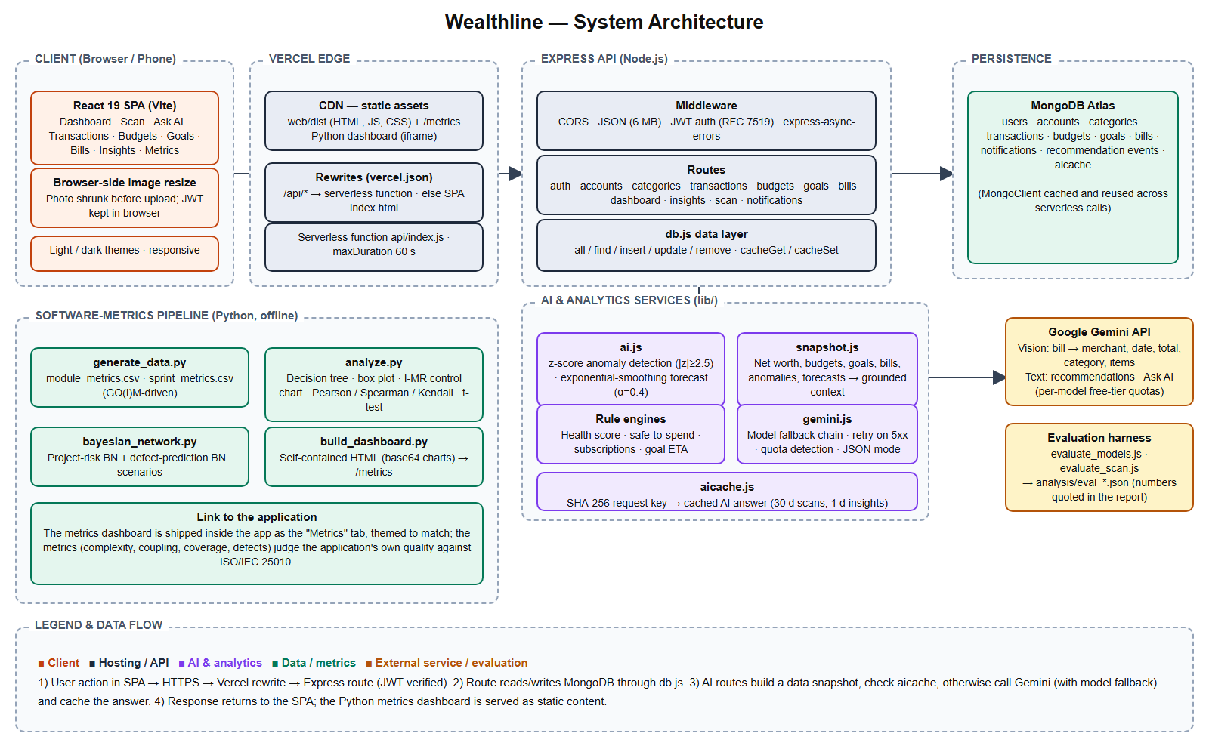
ARCHITECTURE DIAGRAM (DETAILED)
System architecture
Client → Vercel edge (CDN + rewrite) → Express API (JWT) → AI services (z-score, smoothing, Gemini with fallback + cache) → MongoDB Atlas. Python metrics pipeline is embedded as the Metrics tab.
Wealthline
7

Slide 8
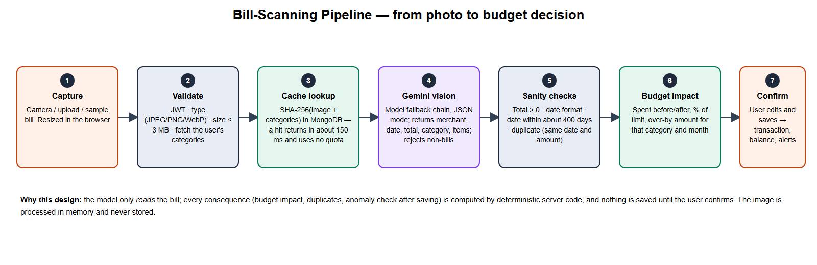
ARCHITECTURE DIAGRAM — SCAN FLOW
Bill-scanning pipeline
Wealthline
8

Slide 9
PROPOSED SYSTEM
Proposed system: the app does the boring work
Scan a bill
Safe to spend today
Subscription detector
Photo → ready-to-save expense with budget impact
One daily number you can trust
Finds forgotten recurring charges
Goal ETA + what-if
Health score
Ask AI
Turns advice into a decision
0–100 with a four-part breakdown
Plain-English questions on your own data
Also: auto-budget, month-end projection, anomaly alerts, CSV export, light / dark / mobile, Metrics tab.
Wealthline
9

Slide 10
DATASET / DATABASE DESCRIPTION
Dataset and database
Source | Content
MongoDB Atlas “wealthline” | users, accounts, categories, transactions, budgets, goals, bills, notifications, recommendation events, aicache
data/module_metrics.csv | 12 modules: LOC, complexity, CBO, LCOM, coverage, errors, faults, defects, failures, delay, defect density
data/sprint_metrics.csv | 16 weekly sprint observations for the control chart
report/eval_receipts/ | 10 labelled bills (2 hard) + 1 non-bill, with ground truth
Simulations (seed 20261026) | 300 anomaly trials × 200 transactions; 300 forecast series × 8 forecasts
Metrics datasets and evaluation bills are synthetic, created for this course. Demo login: demo@gmail.com / 12345678
Wealthline
10

Slide 11
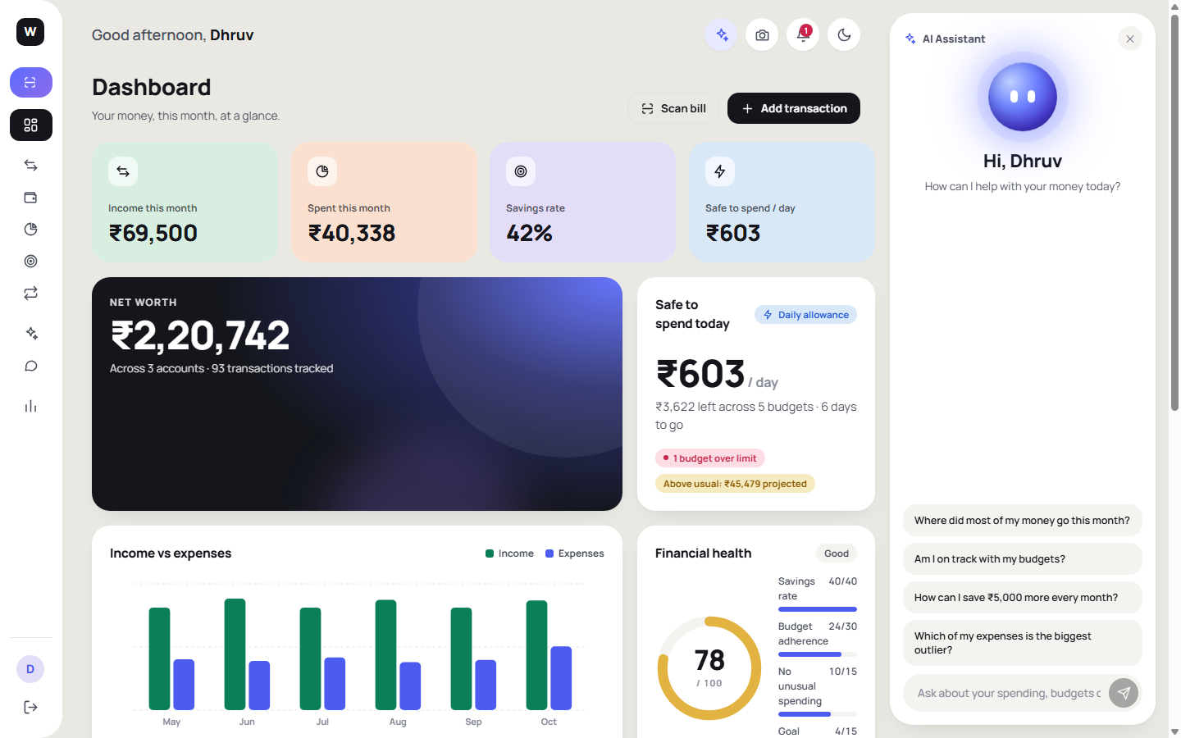
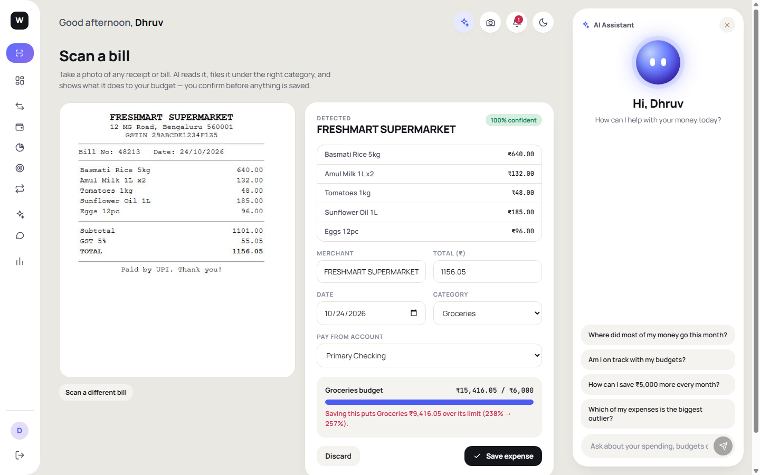
SCREENSHOT OF WORKING MODEL
Working model
Dashboard: health score, safe-to-spend, trend
Scan result: extracted fields + budget impact warning
Wealthline
11

Slide 12
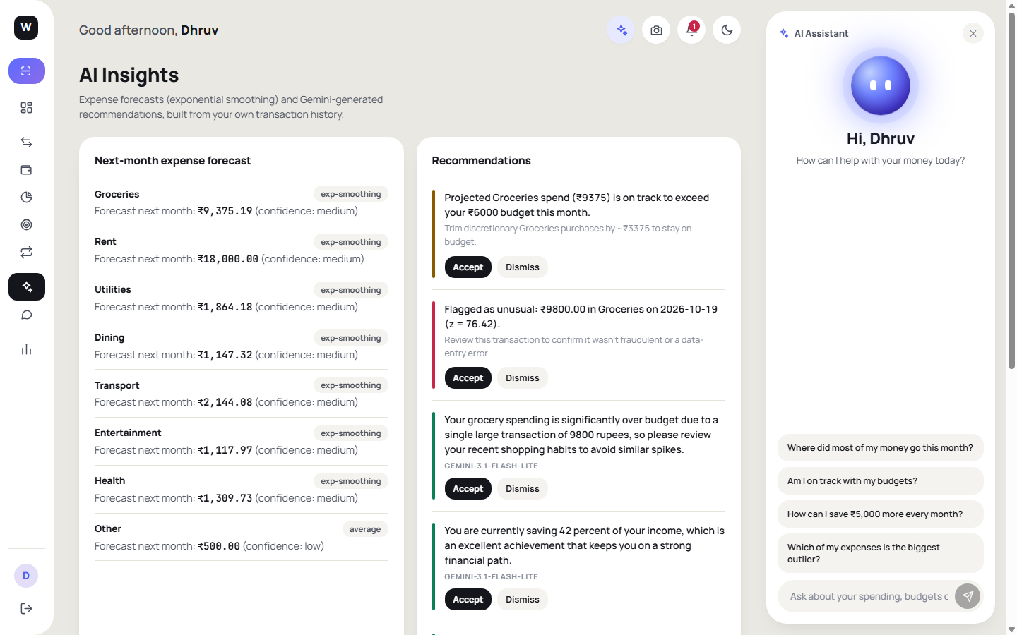
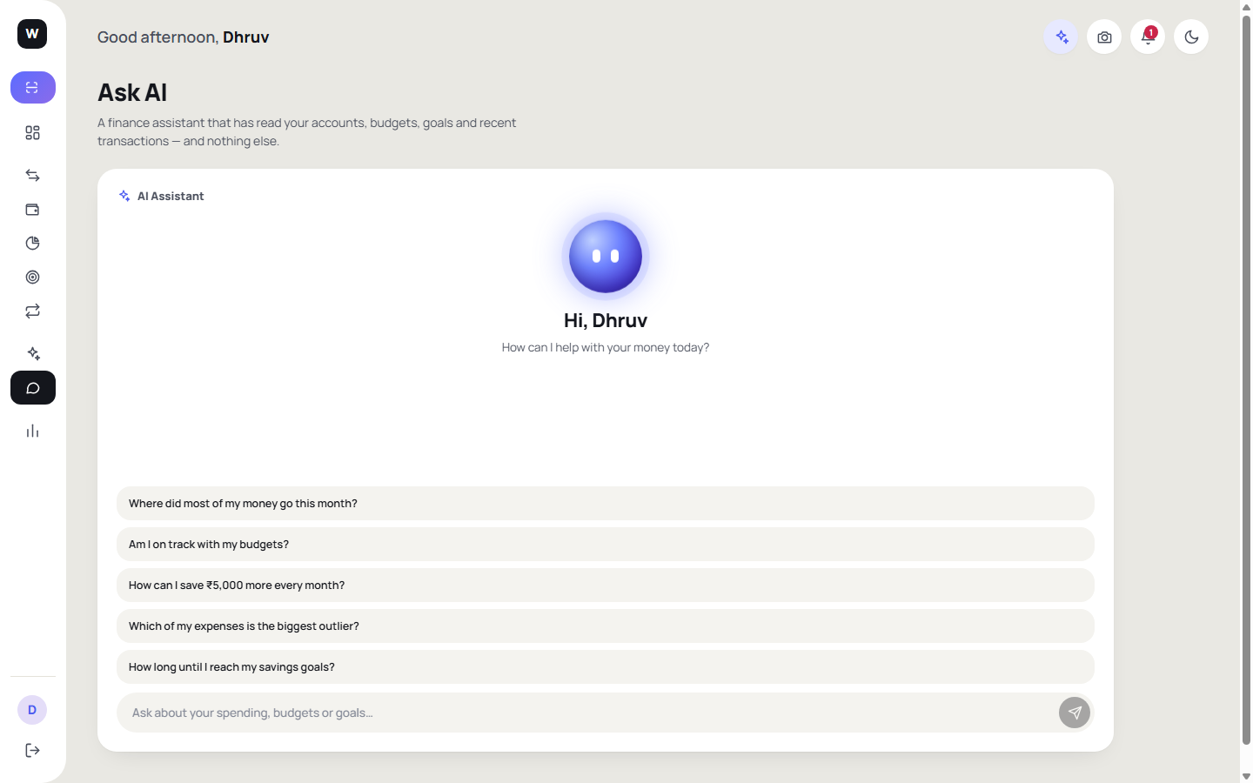
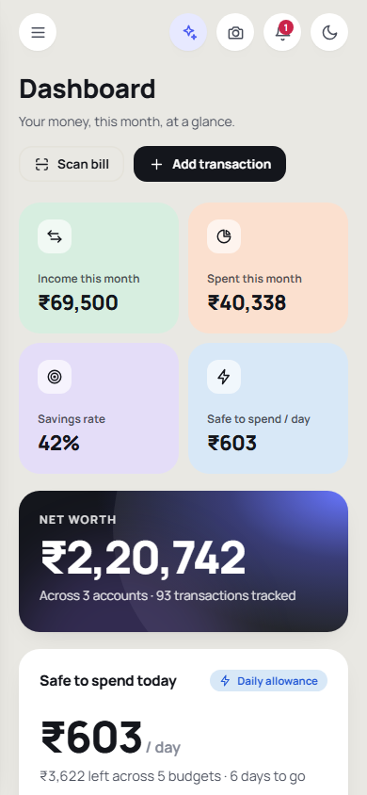
SCREENSHOT OF WORKING MODEL
Insights, Ask AI and mobile
AI Insights
Ask AI
Mobile
Wealthline
12

Slide 13
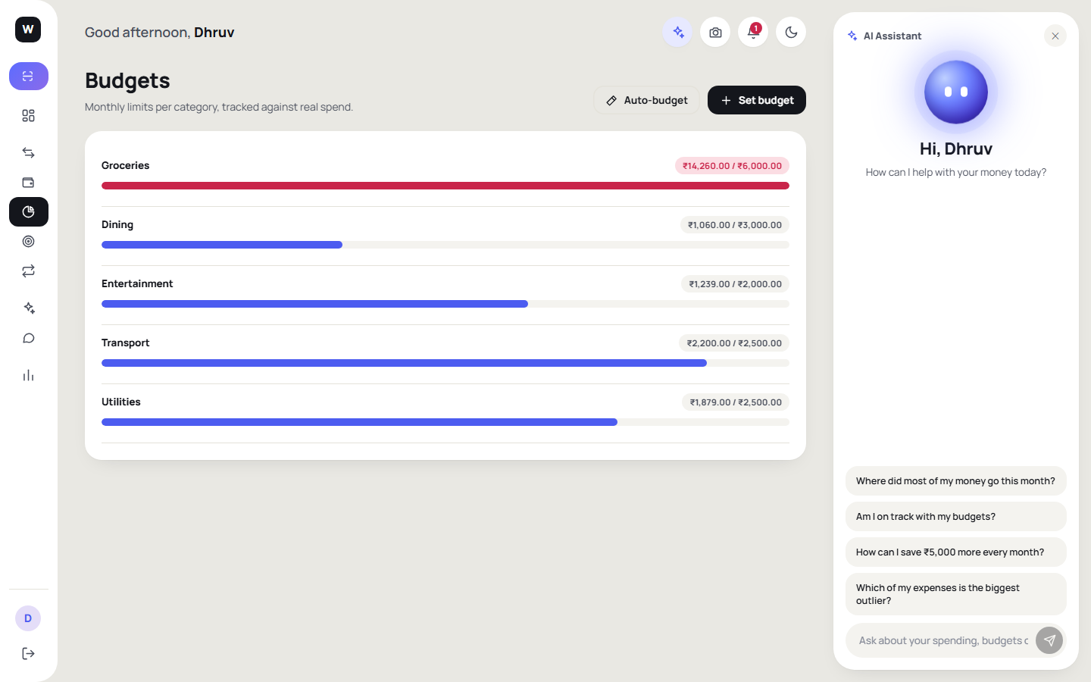
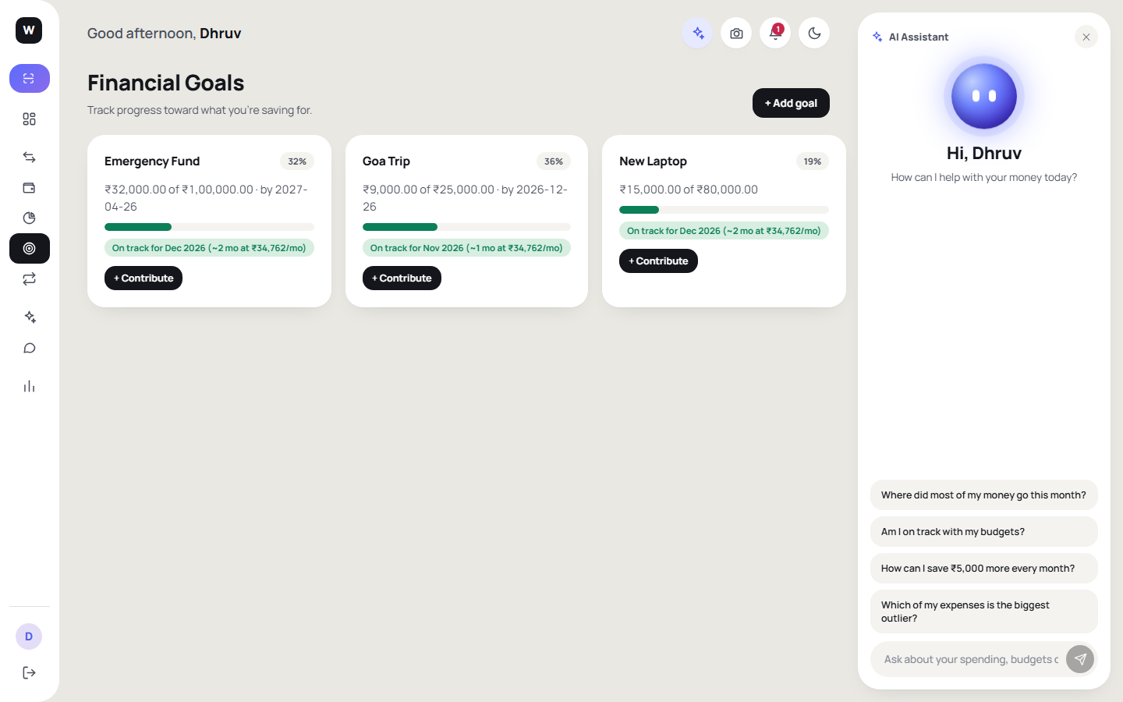
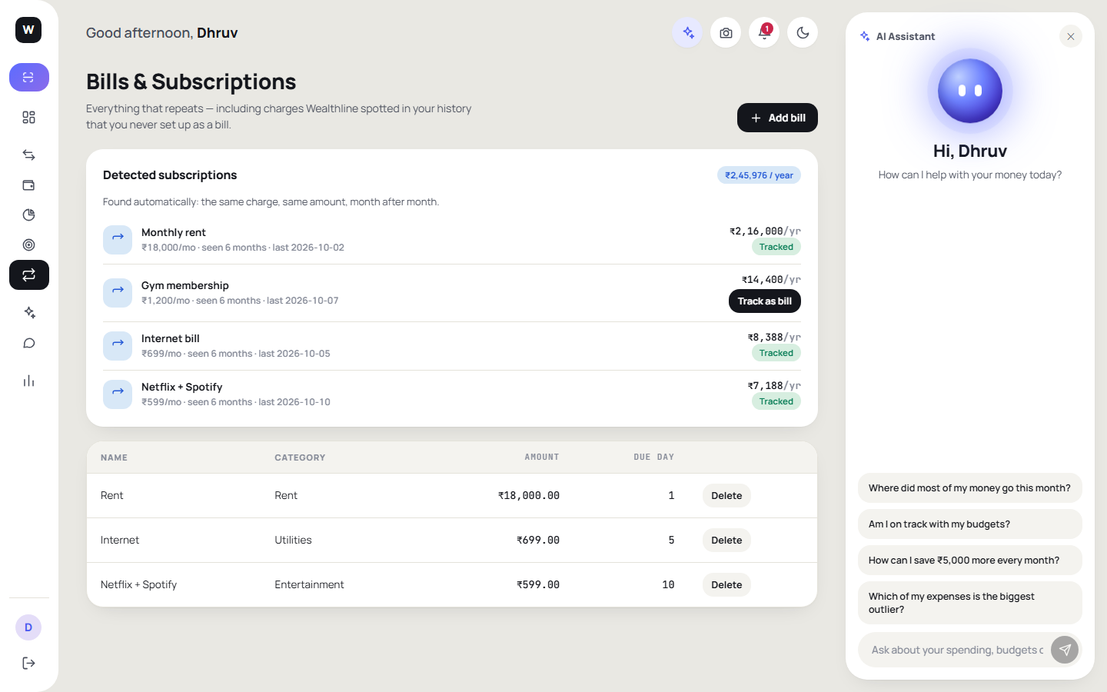
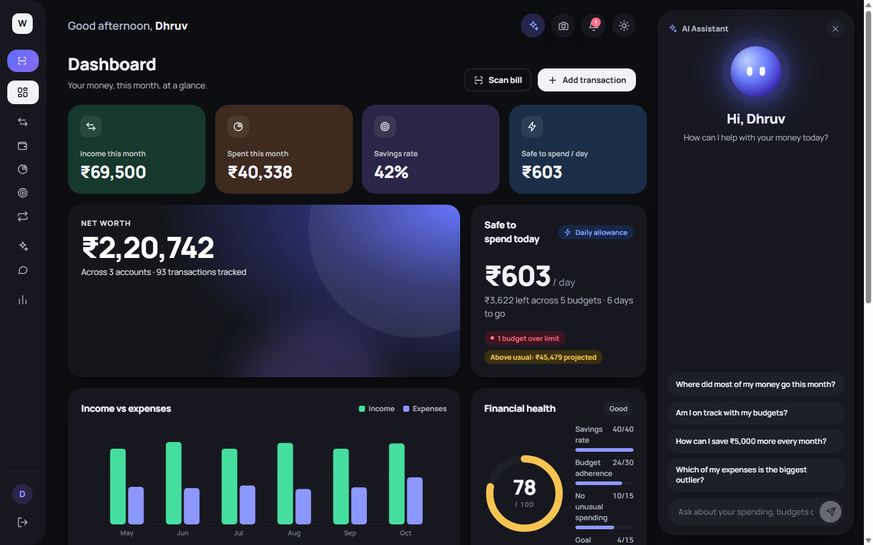
SCREENSHOT OF WORKING MODEL
Budgets, goals, subscriptions and dark theme
Budgets
Goals + ETA
Subscriptions
Dark theme
Wealthline
13

Slide 14
PERFORMANCE OF THE WORKING MODEL
Measured results
100%
1/1
0.984
13.76%
exact bill totals (10 bills)
non-bill image rejected
anomaly precision (recall 0.631)
forecast MAPE (regression 15.95%)
Test | Result | Honest note
Bill scan, all 4 fields | 90% | 1 bill misread date (“18-10-26”); now flagged by a date check
Anomaly recall | 95% for 3–5× spikes; 7% for 1.5–2× | Great on big spikes, blind to mild ones
Decision tree | training 91.7%, leave-one-out 58.3% | Baseline 50%: explanatory, not predictive on 12 modules
API latency (Vercel p50) | 0.65 – 0.87 s | Local p50 52 – 174 ms
Wealthline
14

Slide 15
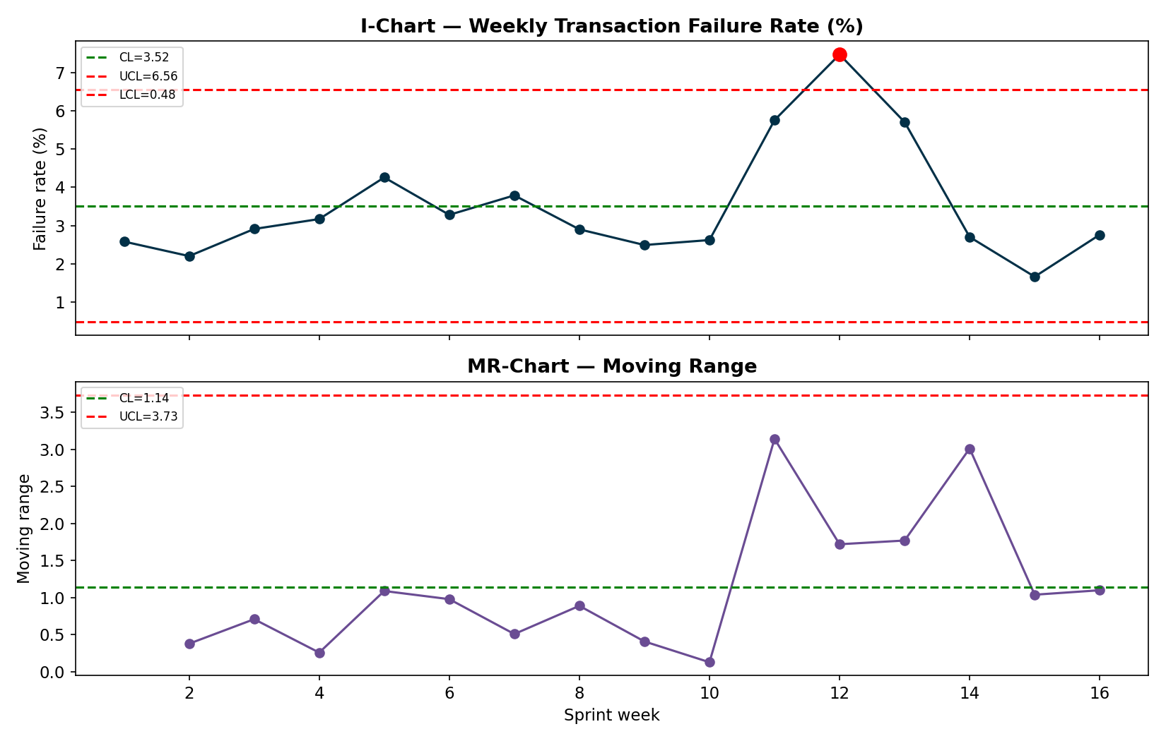
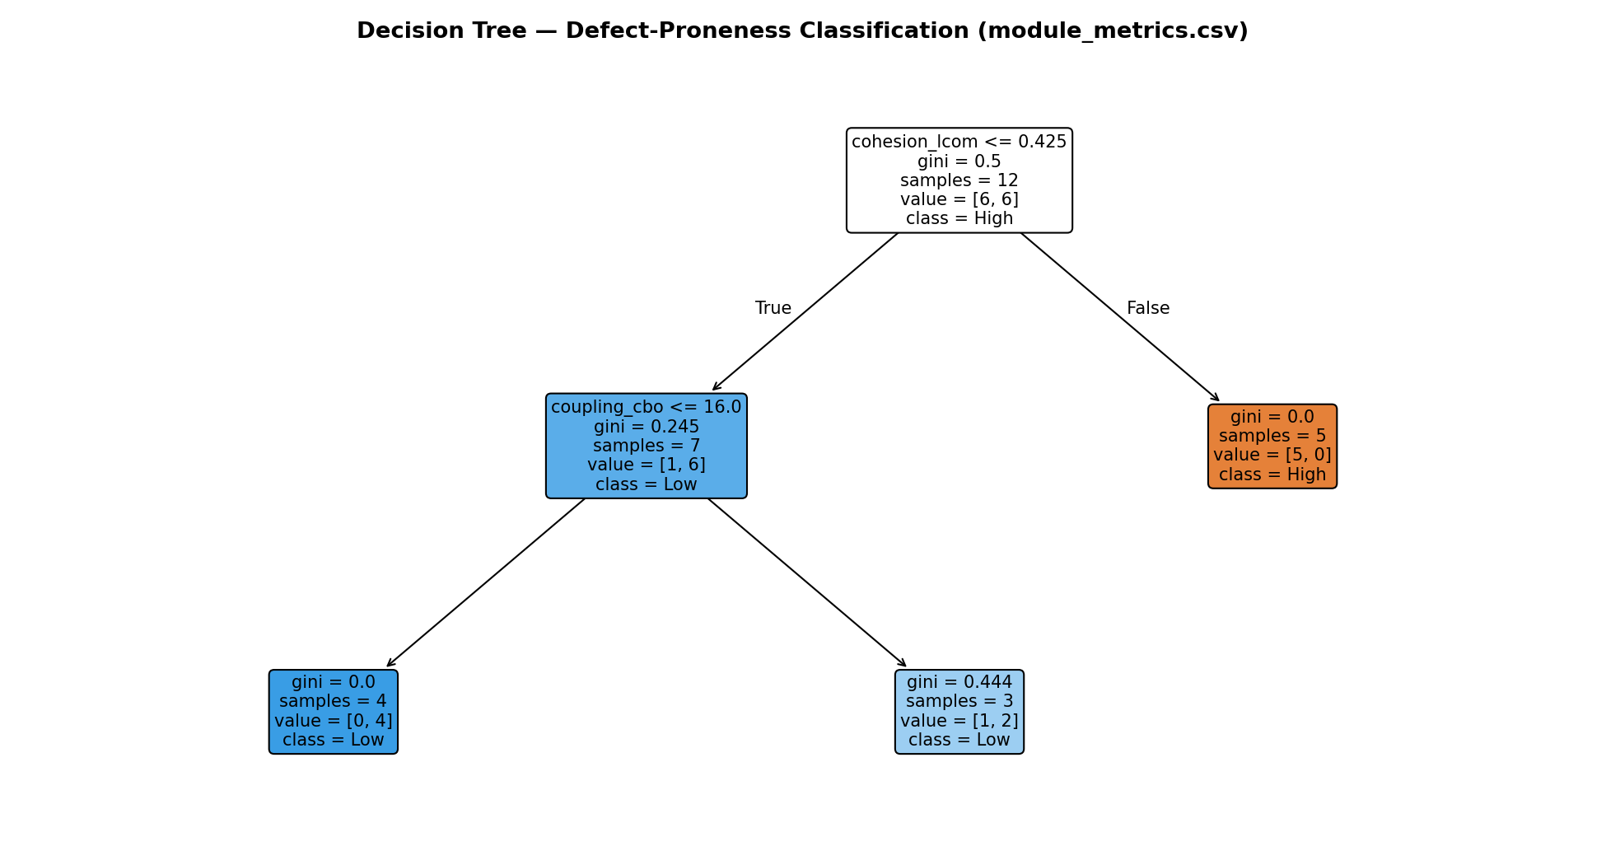
PERFORMANCE — METRICS ANALYSIS
Module 3 and 4 analysis in the app
I-MR chart flags week 12. Complexity ↔ defect density positive under Pearson, Spearman and Kendall. P(High project risk): 28% baseline → 55% worst case → 27% with team upskilling.
Wealthline
15

Slide 16
NOVELTY AND INNOVATION / JUSTIFICATION
Why this is different — and why it is justified
AI proposes, code verifies
Evidence-based choices
Engineering + product in one
The model only reads the bill. Budget impact, duplicate and date checks are deterministic server code; the user confirms.
Forecaster replaced after a backtest. Detector thresholds chosen from precision / recall. Limits reported.
The metrics program that planned the project ships inside the app as the Metrics tab.
Reliable on a free tier
A reason to return daily
Privacy-aware
Model fallback chain, retry, MongoDB response cache, clear “quota used up” message.
Safe-to-spend, subscriptions, goal ETA, what-if, health score, Ask AI.
Bill images never stored; Ask AI sees only the user's own summary; secrets kept out of the repo.
Wealthline
16

Slide 17
CONCLUSION AND FUTURE WORK
Conclusion and future work
Conclusion
Future work
Direct bill scanning cuts entry effort while the user stays in control.
Budgets update from scanned bills and warn before a limit is crossed.
Strong: exact totals, 98% alert precision, forecast beats regression.
Limits: mild anomalies missed, confidence score uninformative, tree does not generalise, free AI quota.
Test on 100+ real phone photos; add offline OCR fallback.
Calibrate confidence (line items must sum to total).
Bank / UPI SMS import; multi-currency.
Automated tests + CI coverage; DB-side filtering.
Replace simulated metrics with real repository data; learn Bayesian tables from data.
Regional-language UI and accessibility audit.
Wealthline
17

