Slide 1

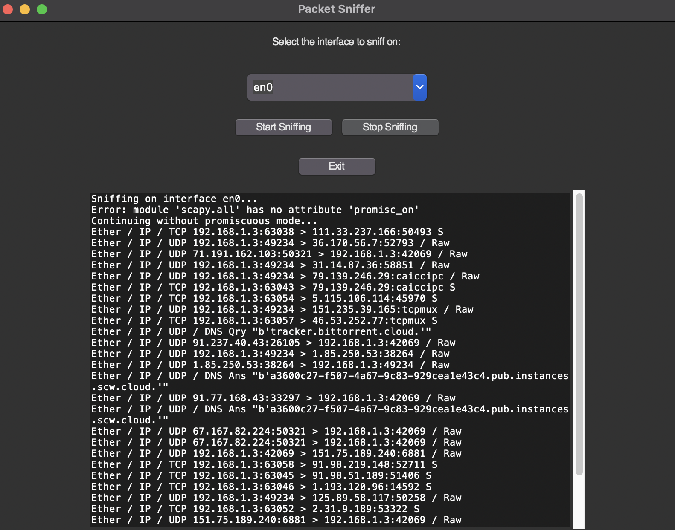
<Network Packet Sniffer>
<Pravin babu, Shriyadithya Nair>
<22011103042, 22011103054>
<Dhivya.S>
Overview
Scope & Literature review
Result & Conclusion
Network security is a critical concern in our interconnected world, and the effective monitoring of network traffic is paramount for safeguarding sensitive data and ensuring the integrity of digital operations. Our poster explores a solution that empowers network administrators, security professionals, and IT experts with a practical tool for real-time network packet analysis and monitoring.
Our project aims to develop and present a practical network packet sniffer solution that offers real-time packet analysis, focusing on its application in network security and troubleshooting. The scope of this research includes the design, implementation, and evaluation of the packet sniffer's performance, as well as its potential for enhancements and real-world applications. This section provides an overview of existing research, tools, and best practices related to network packet sniffing, network security, and network troubleshooting. It covers key topics such as:
Packet Sniffing Tools: An overview of popular packet sniffing tools, their capabilities, and limitations.
Network Security: The role of packet sniffers in intrusion detection, threat identification, and incident response.
Troubleshooting: The use of packet sniffers in diagnosing network issues, identifying bottlenecks, and optimizing network performance.
Enhancements: Discussion on potential improvements and future directions in packet sniffing technology.
In this section, we present the outcomes of our research and the practical application of the network packet sniffer. We illustrate real-time packet captures and showcase the packet analysis process, demonstrating how it aids in network security and troubleshooting.
Problem Statement
In today's dynamic digital landscape, network breaches, data exfiltration, and performance issues have become increasingly sophisticated and frequent. Network administrators face the challenge of effectively monitoring and analyzing the vast volume of network traffic for signs of anomalies, threats, or vulnerabilities. Traditional methods are often complex, costly, or insufficient. We aim to address this problem by providing a streamlined, user-friendly solution that enables real-time network packet analysis, thereby enhancing network security, troubleshooting, and performance optimization.
Data Collection
Research Methodology & Implementation
Our research methodology involves the development of a network packet sniffer, emphasizing real-time packet analysis for network security and troubleshooting. The implementation phase includes the creation of a user-friendly tool that empowers network administrators and security professionals. This implementation process comprises the design, coding, and deployment of the packet sniffer, with a strong emphasis on user-friendliness and real-time packet monitoring. By developing this tool, we aim to enhance network management and analysis capabilities while providing practical, efficient, and accessible solutions for the ever-evolving challenges in network security and optimization.
The research involves gathering data related to network packet captures, network configurations, and performance metrics. Data collection will be executed through:
Real-time Packet Capture: Using the developed packet sniffer to capture network traffic in controlled test environments.
Sample Network Configurations: Utilizing various network setups to evaluate the tool's performance under different conditions.
Performance Metrics: Collecting data on packet capture rates, resource utilization, and user experience during packet analysis.
Our research demonstrates that the developed network packet sniffer is a valuable asset for network administrators and security experts. It provides real-time monitoring capabilities for network security and efficient troubleshooting. With a user-friendly interface and practical functionalities, the tool proves to be a significant step forward in network management.
*
Future Scope
The presented network packet sniffer serves as a foundation for ongoing research and development. Future enhancements can explore features such as machine learning-based anomaly detection, advanced data visualization, and extended protocol compatibility.

