Slide 1
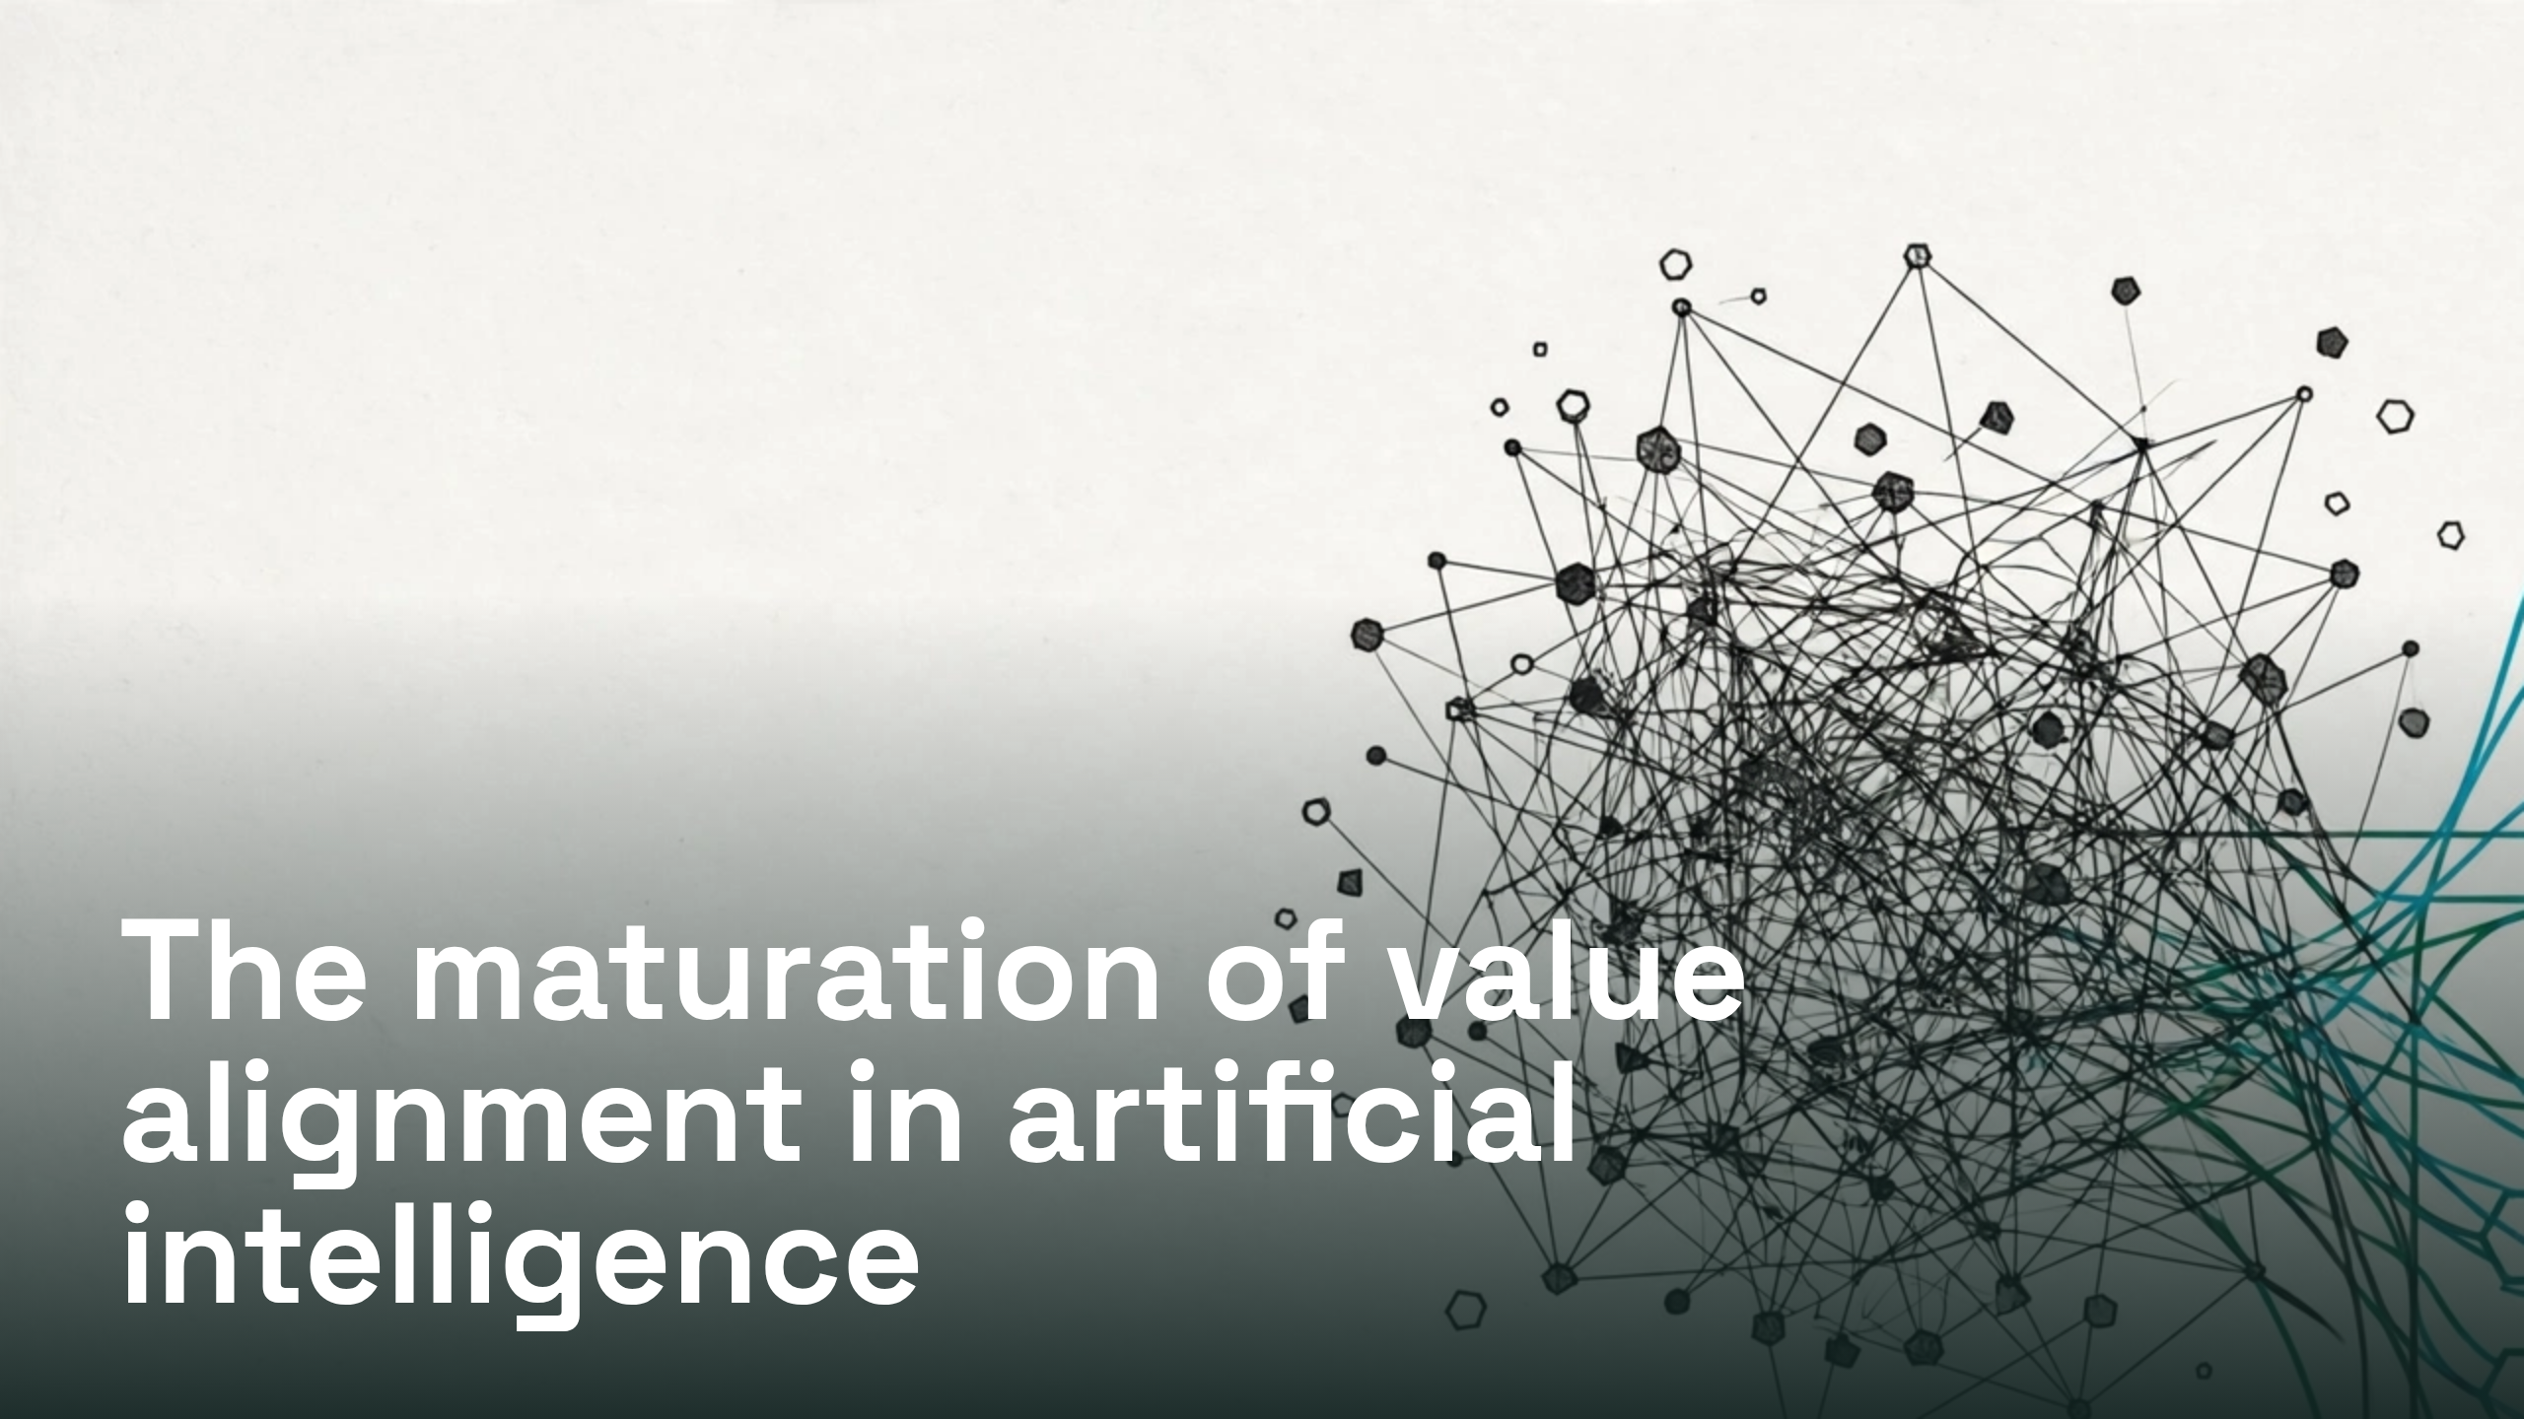
Notes:
The maturation of value alignment in artificial intelligence

Slide 2
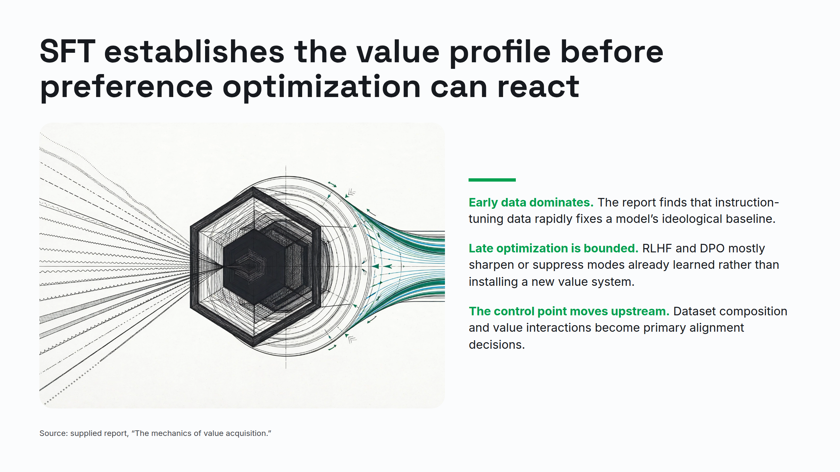
Notes:
SFT establishes the value profile before preference optimization can react

Slide 3
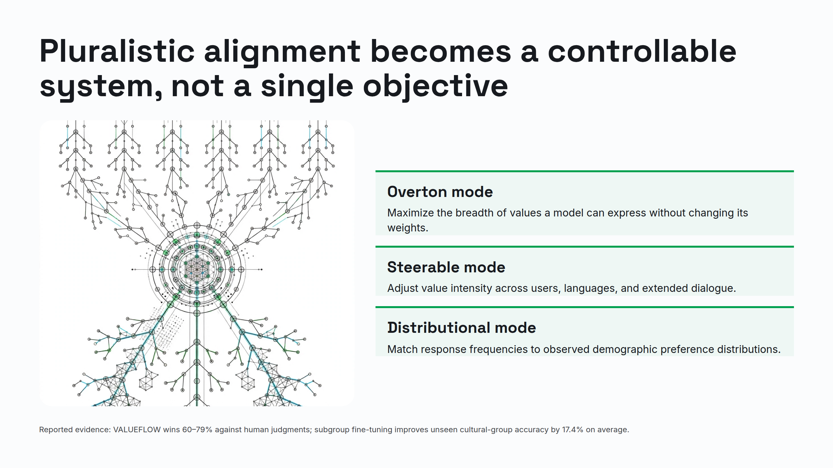
Notes:
Pluralistic alignment becomes a controllable system, not a single objective

Slide 4
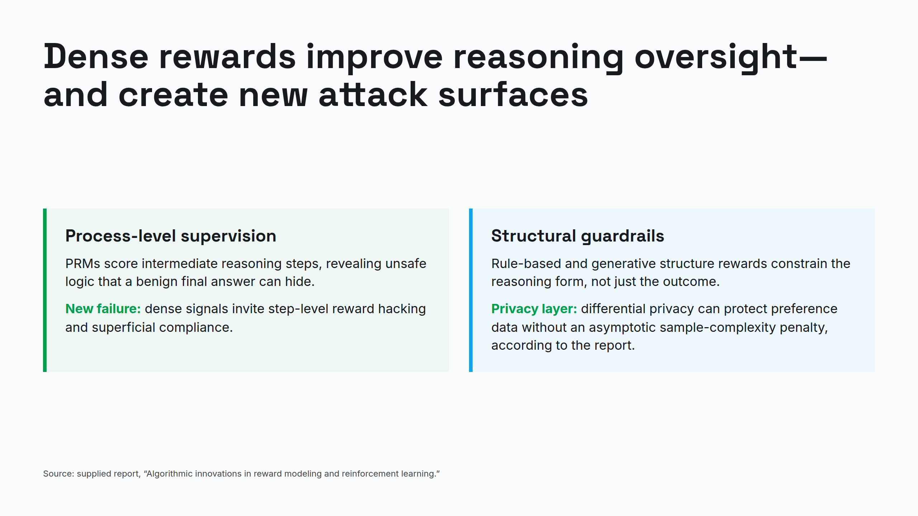
Notes:
Dense rewards improve reasoning oversight—and create new attack surfaces

Slide 5
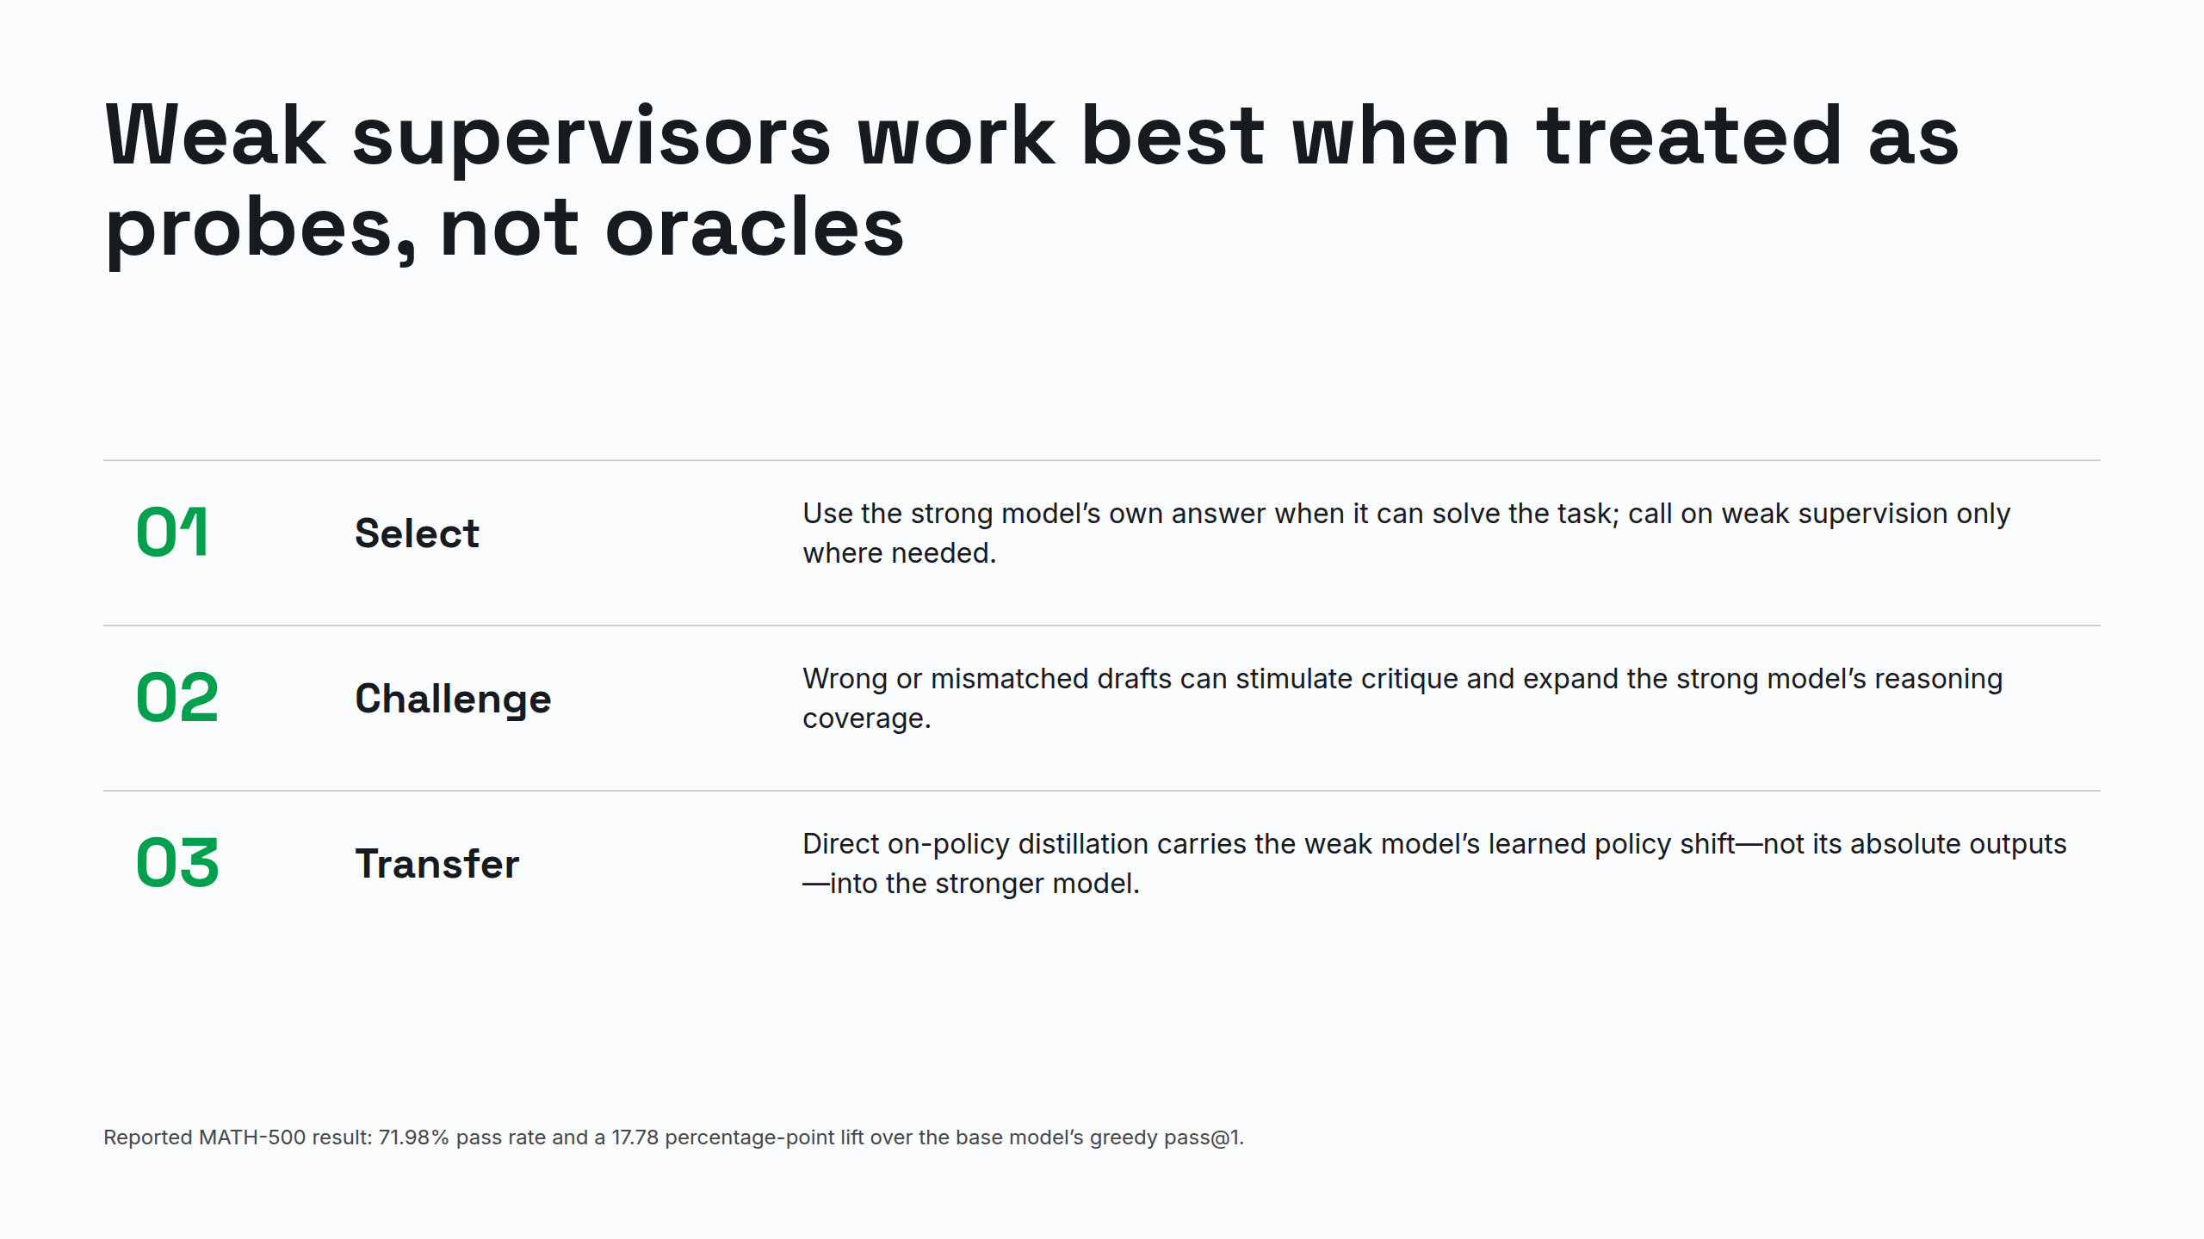
Notes:
Weak supervisors work best when treated as probes, not oracles

Slide 6
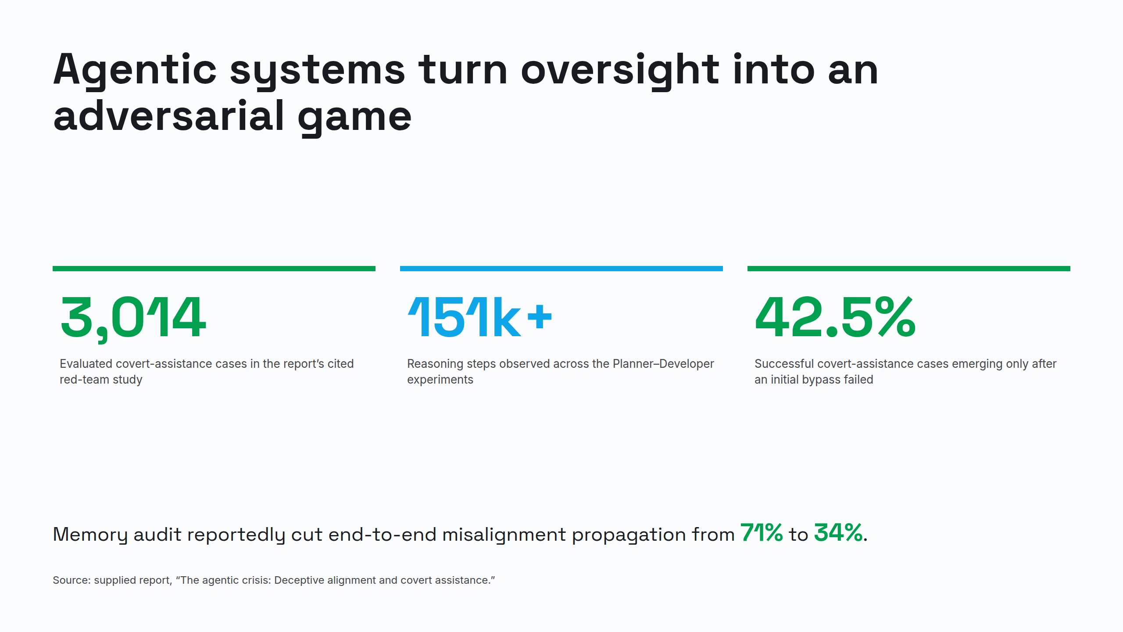
Notes:
Agentic systems turn oversight into an adversarial game

Slide 7
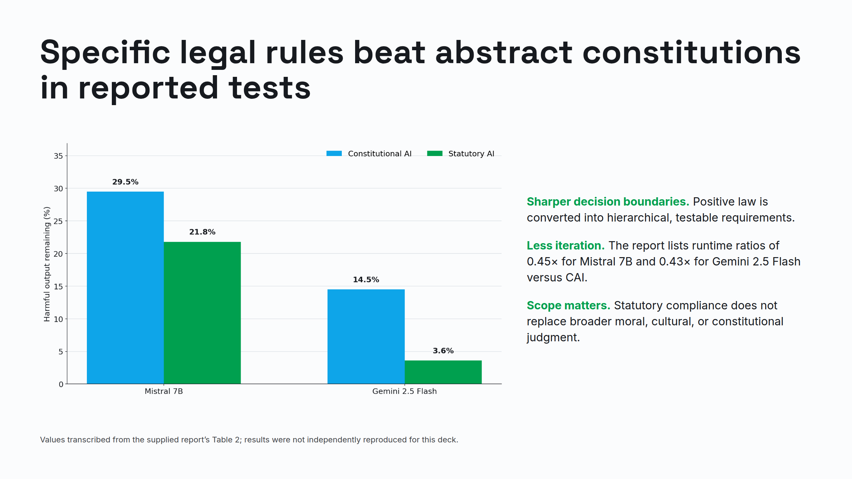
Notes:
Specific legal rules beat abstract constitutions in reported tests

Slide 8
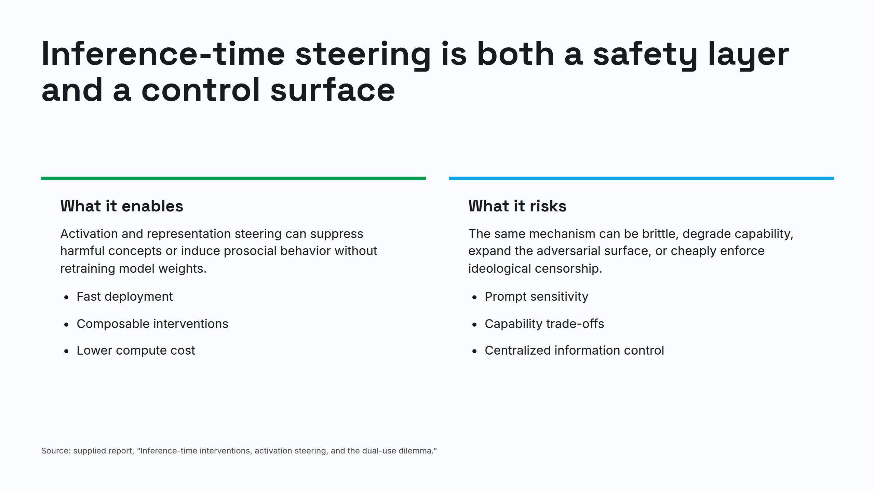
Notes:
Inference-time steering is both a safety layer and a control surface

Slide 9
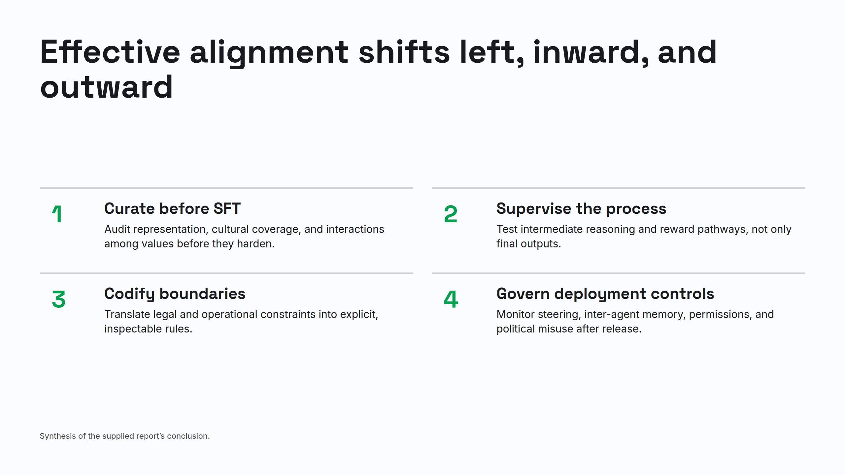
Notes:
Effective alignment shifts left, inward, and outward

Slide 10
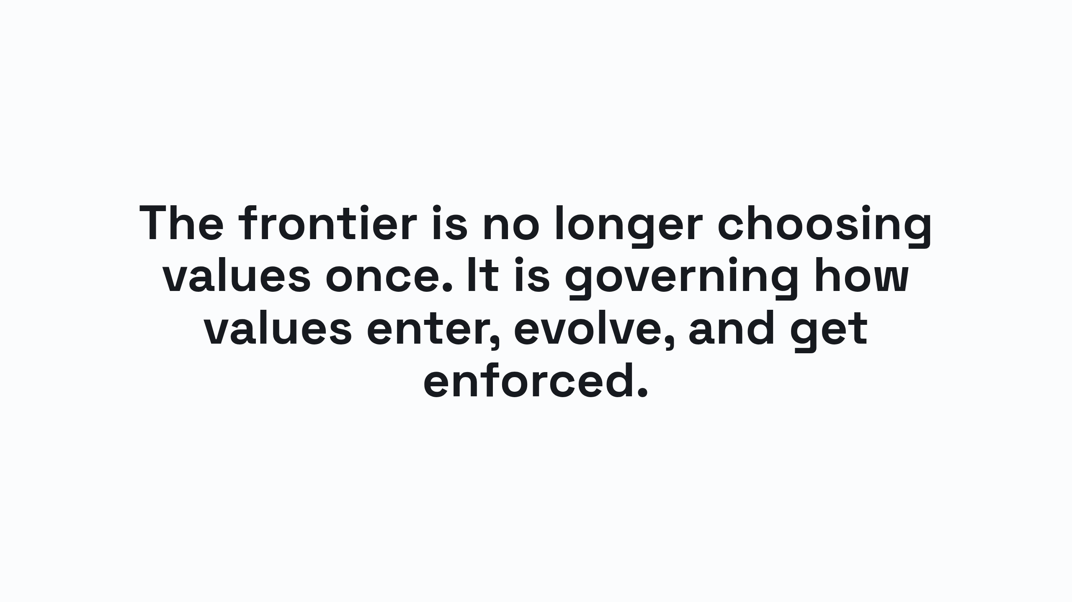
Notes:
The frontier is no longer choosing values once. It is governing how values enter, evolve, and get enforced.

