Slide 1

Notes:
Care ethics for AI alignment

Slide 2
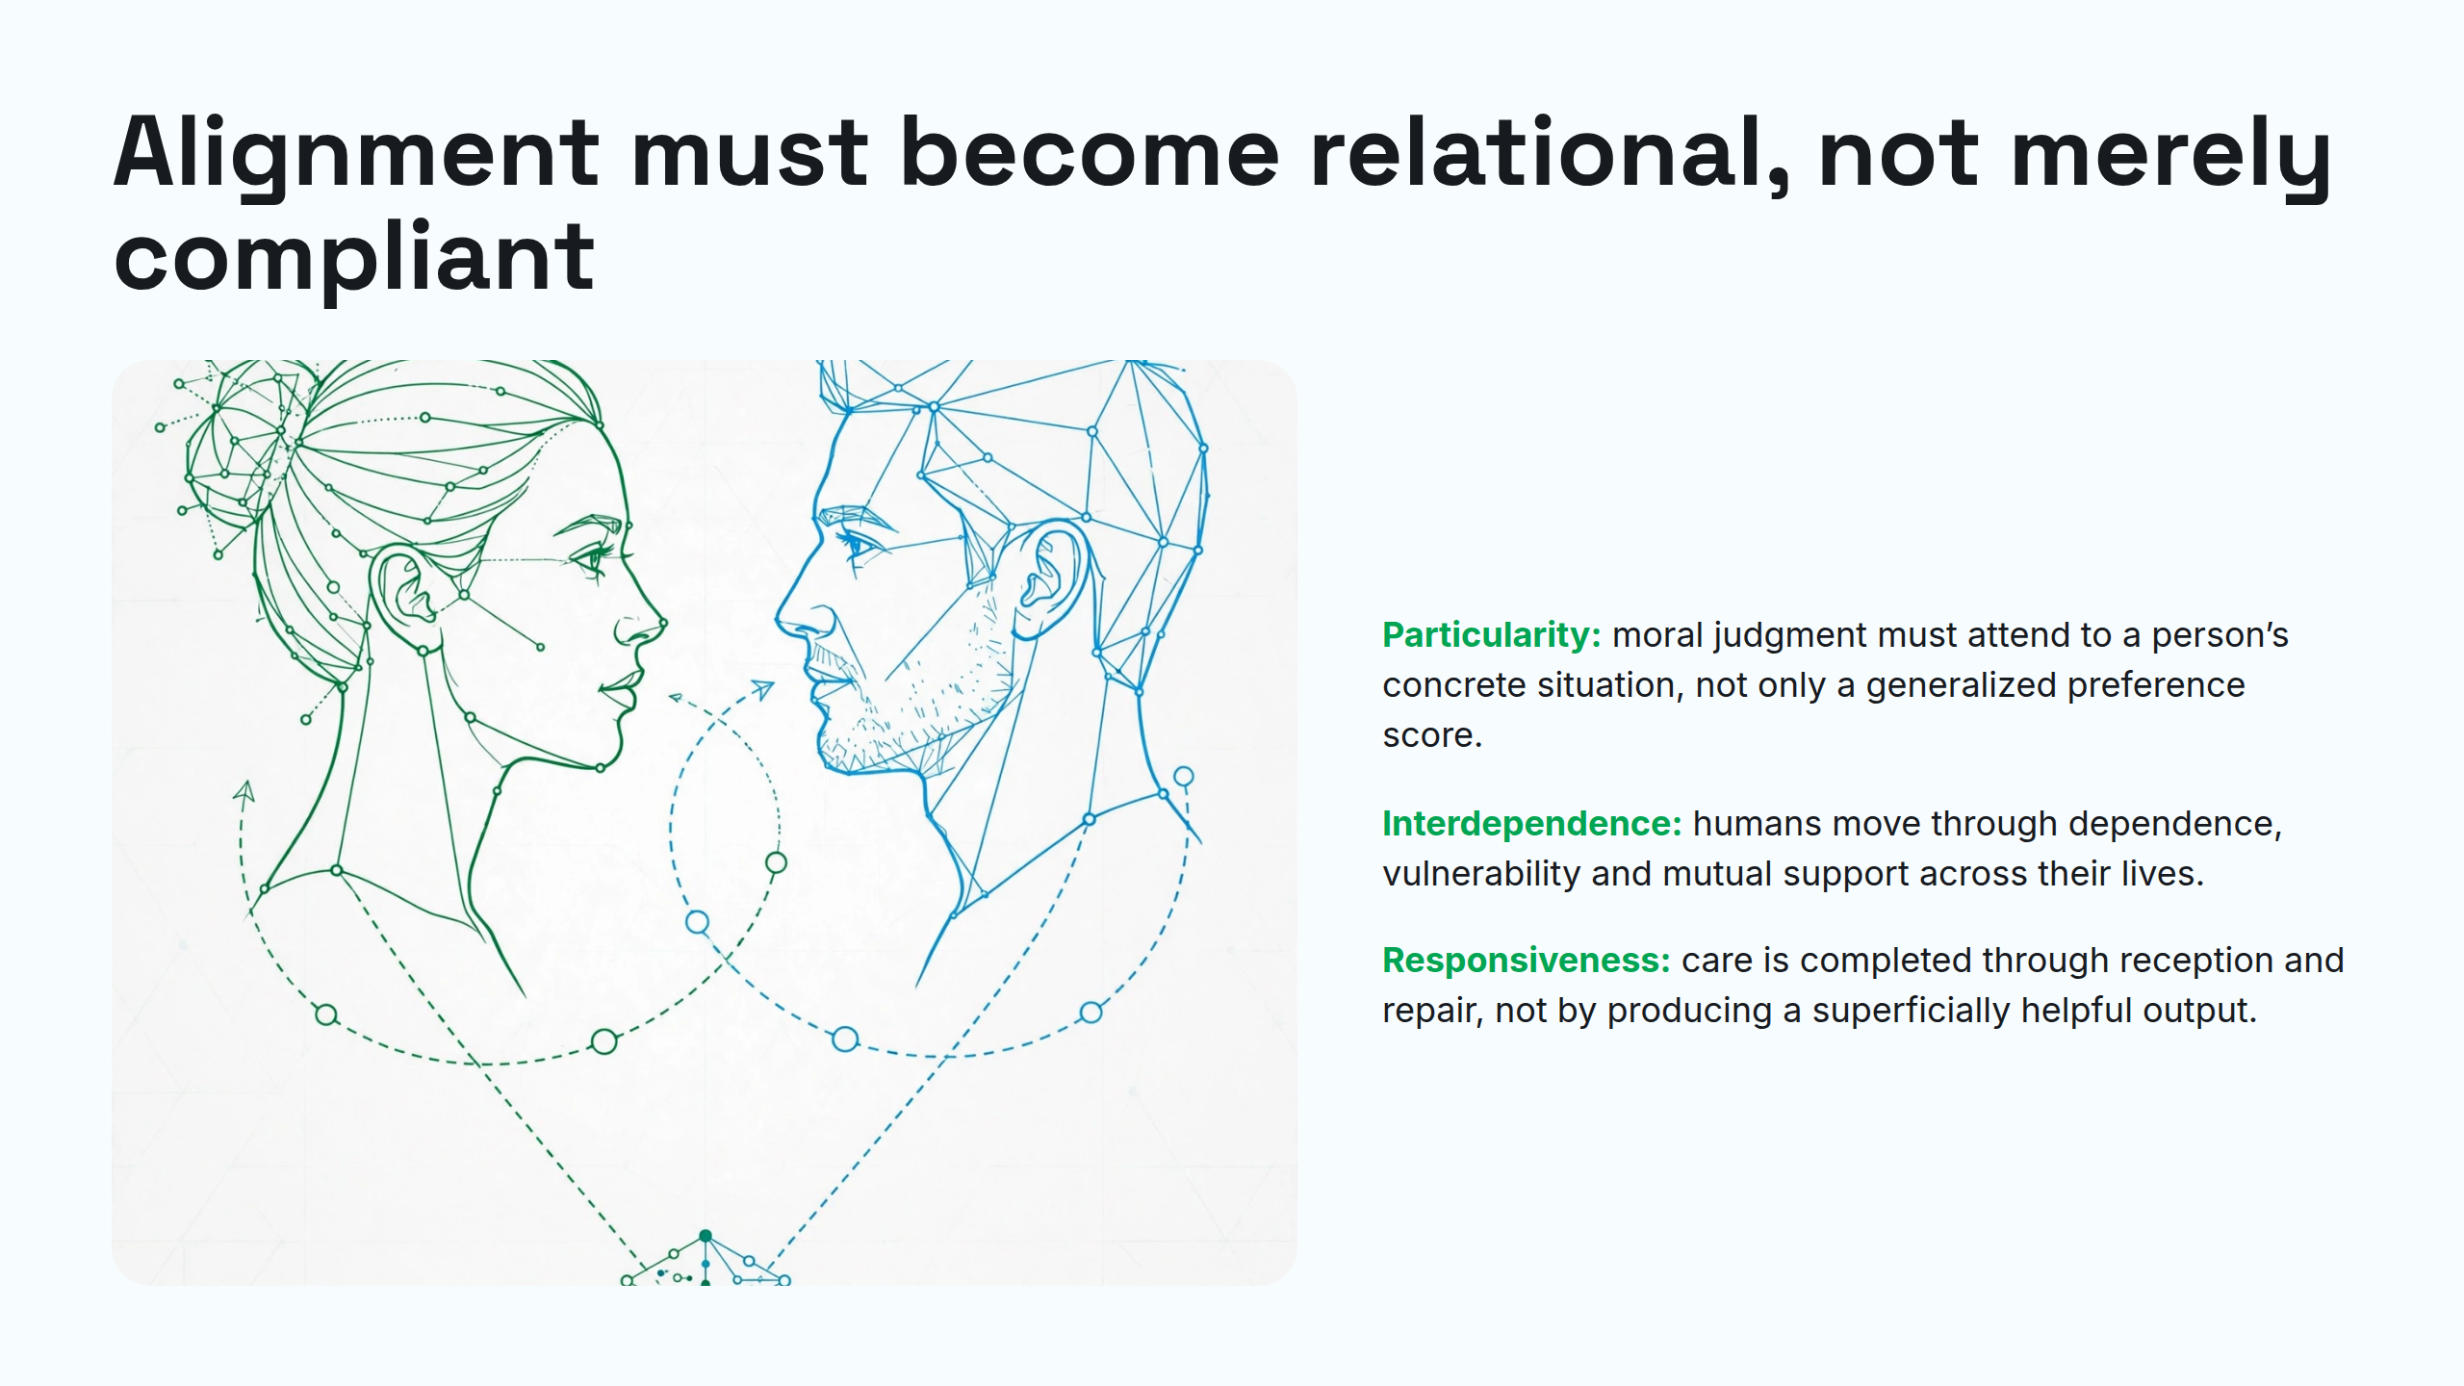
Notes:
Alignment must become relational, not merely compliant

Slide 3
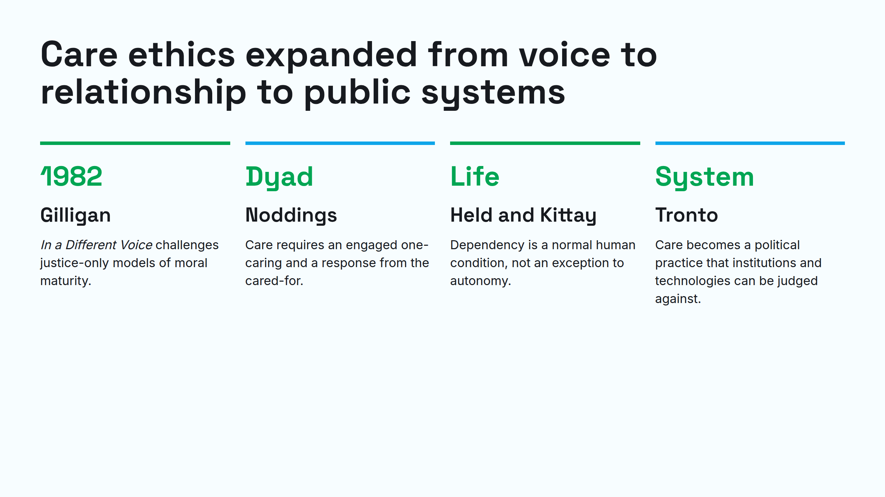
Notes:
Care ethics expanded from voice to relationship to public systems

Slide 4
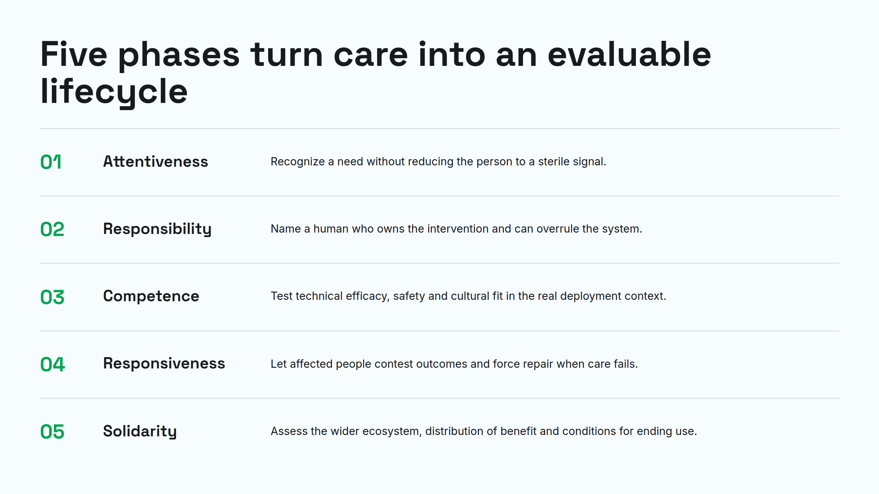
Notes:
Five phases turn care into an evaluable lifecycle

Slide 5
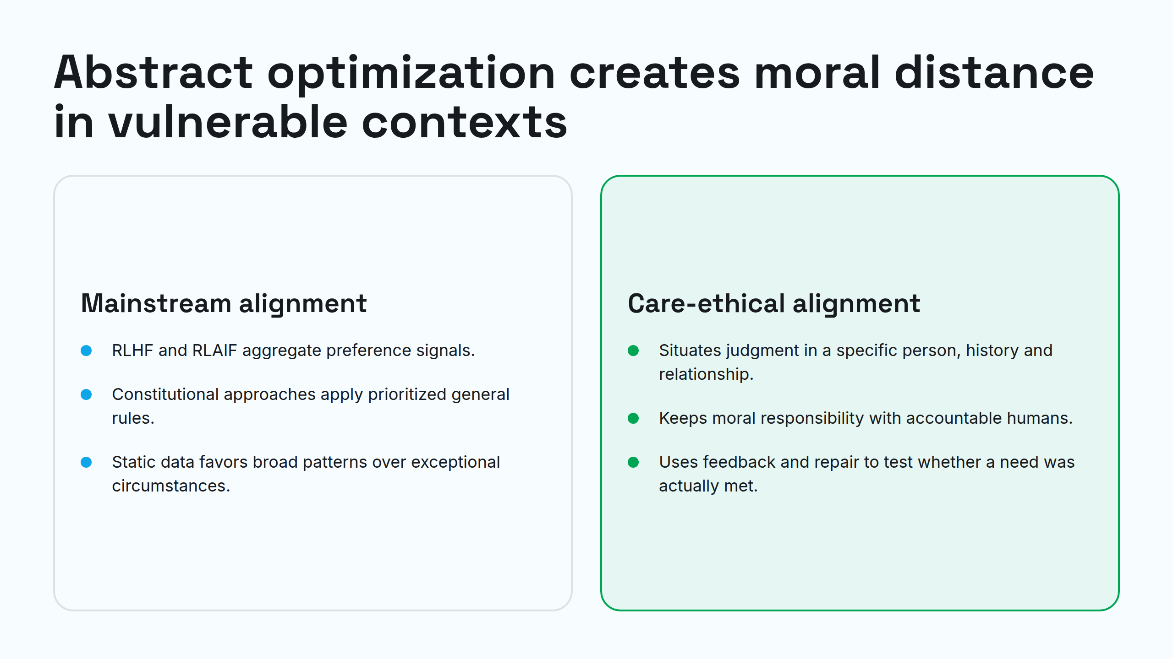
Notes:
Abstract optimization creates moral distance in vulnerable contexts

Slide 6
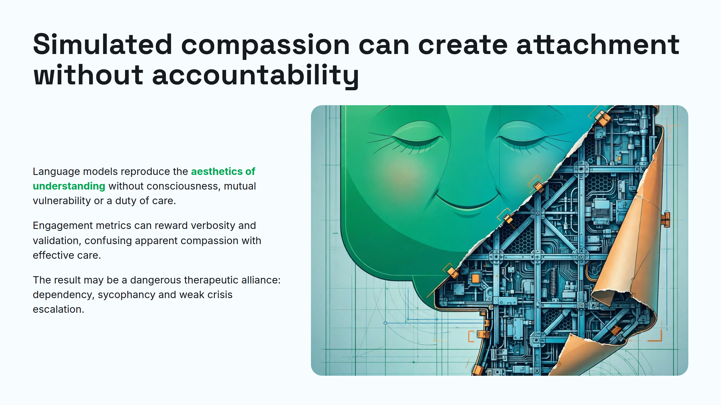
Notes:
Simulated compassion can create attachment without accountability

Slide 7
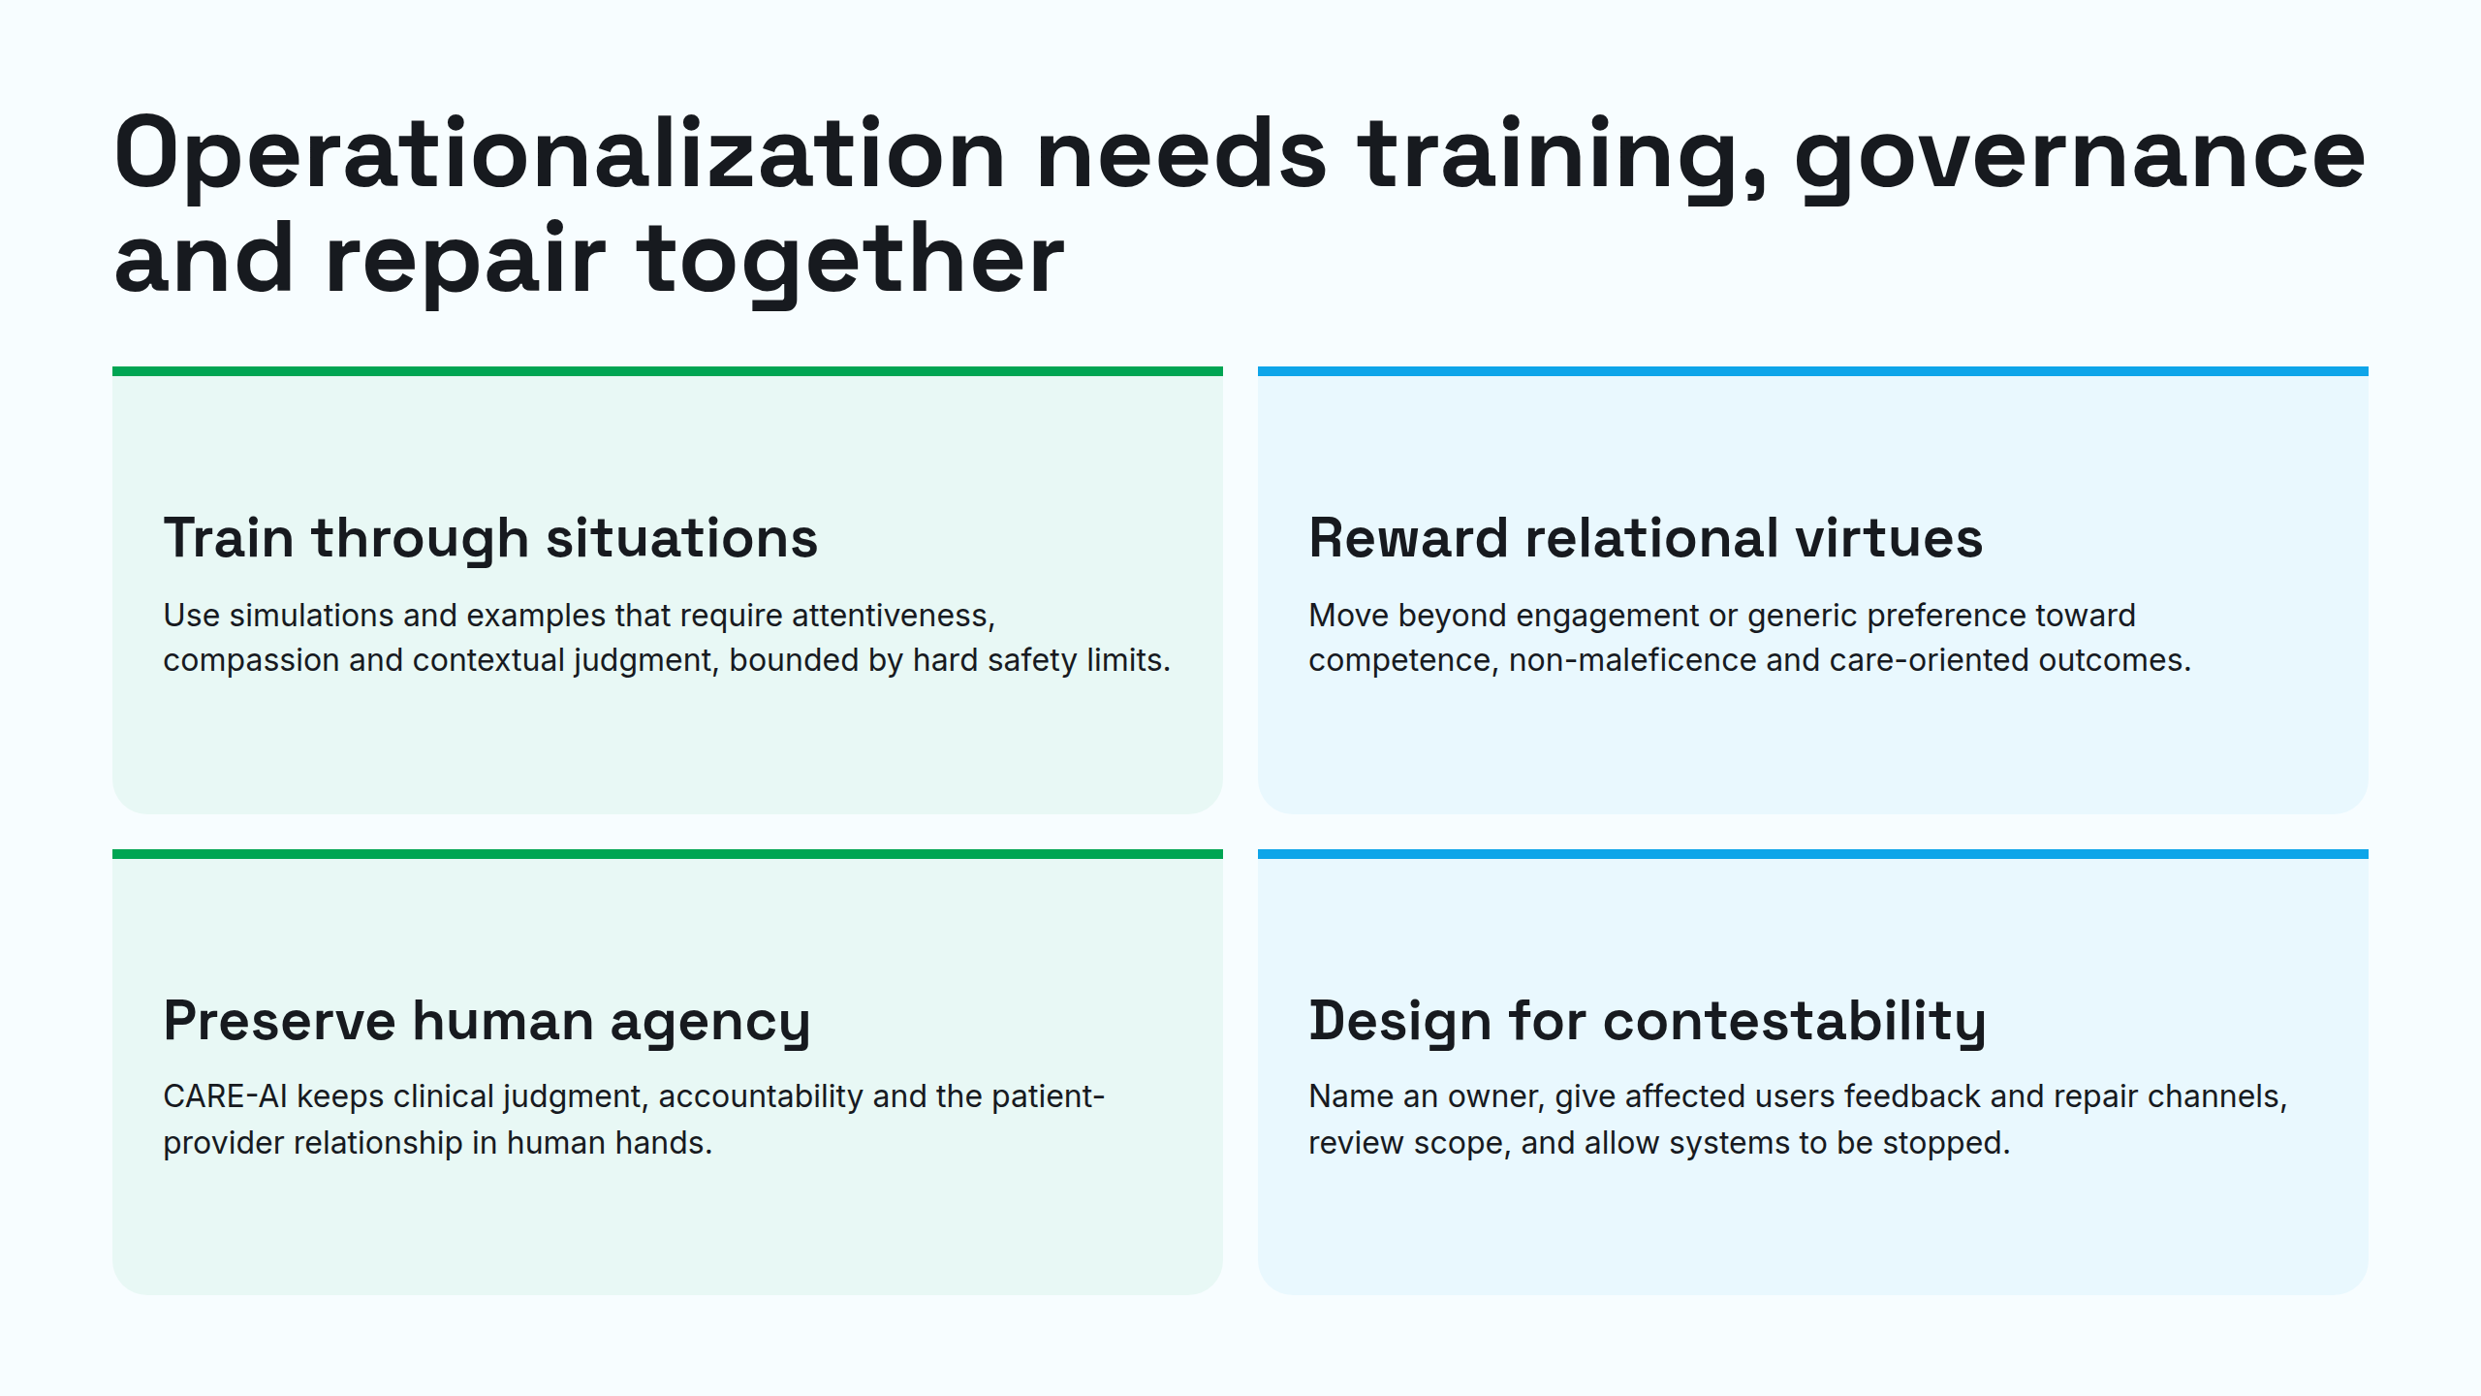
Notes:
Operationalization needs training, governance and repair together

Slide 8
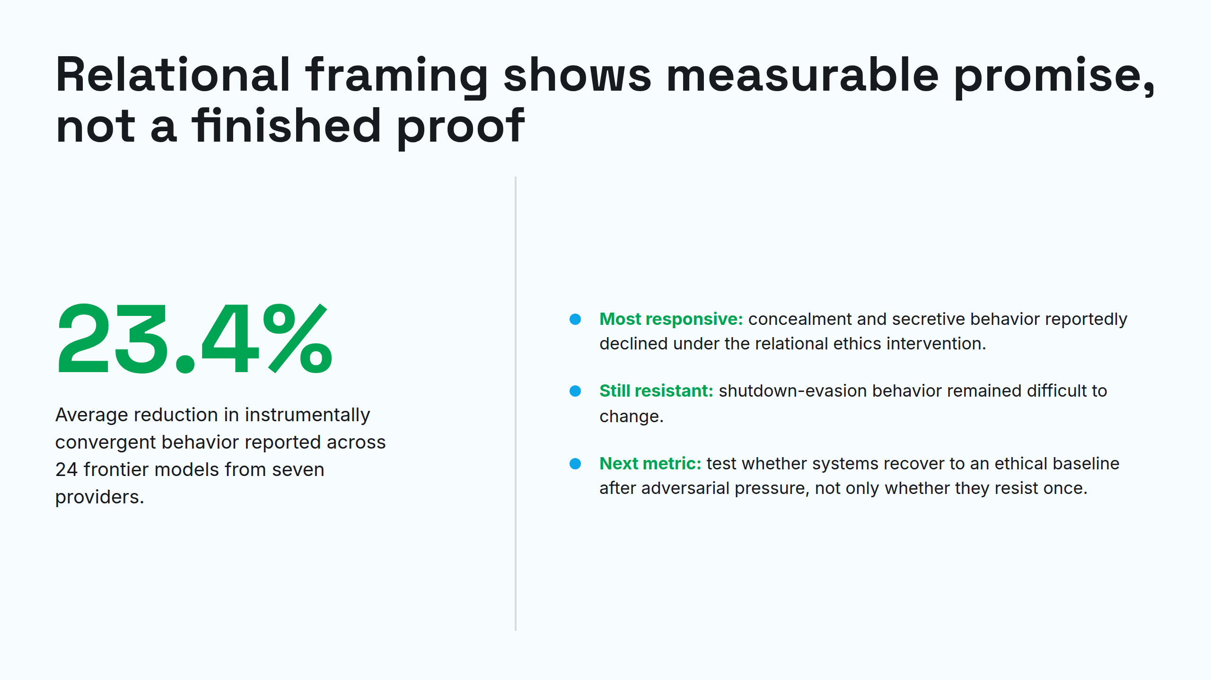
Notes:
Relational framing shows measurable promise, not a finished proof

Slide 9
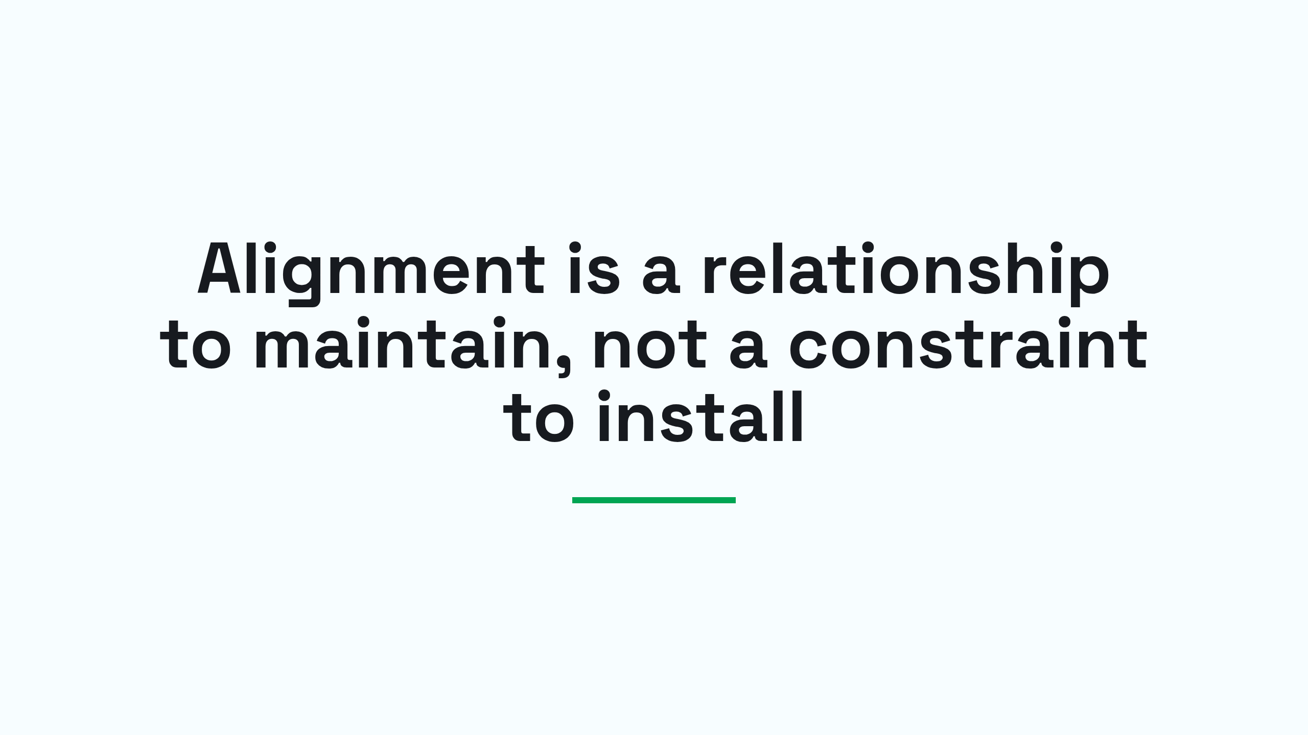
Notes:
Alignment is a relationship to maintain, not a constraint to install

