Slide 1
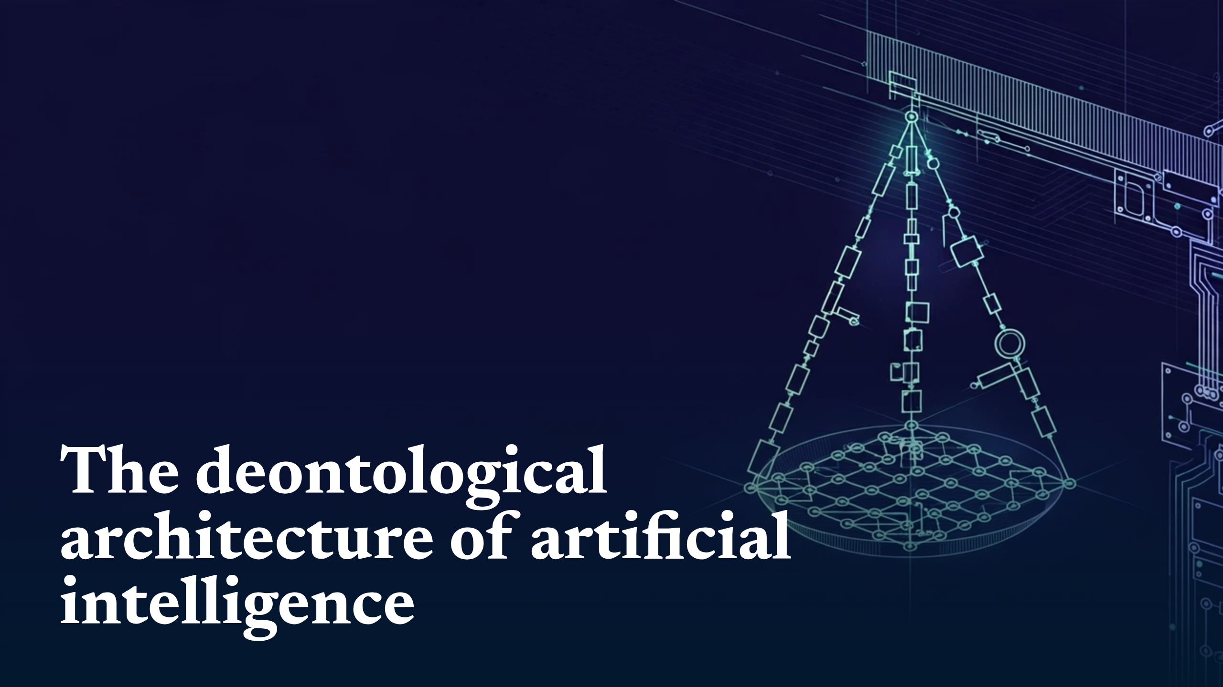
Notes:
The deontological architecture of artificial intelligence

Slide 2
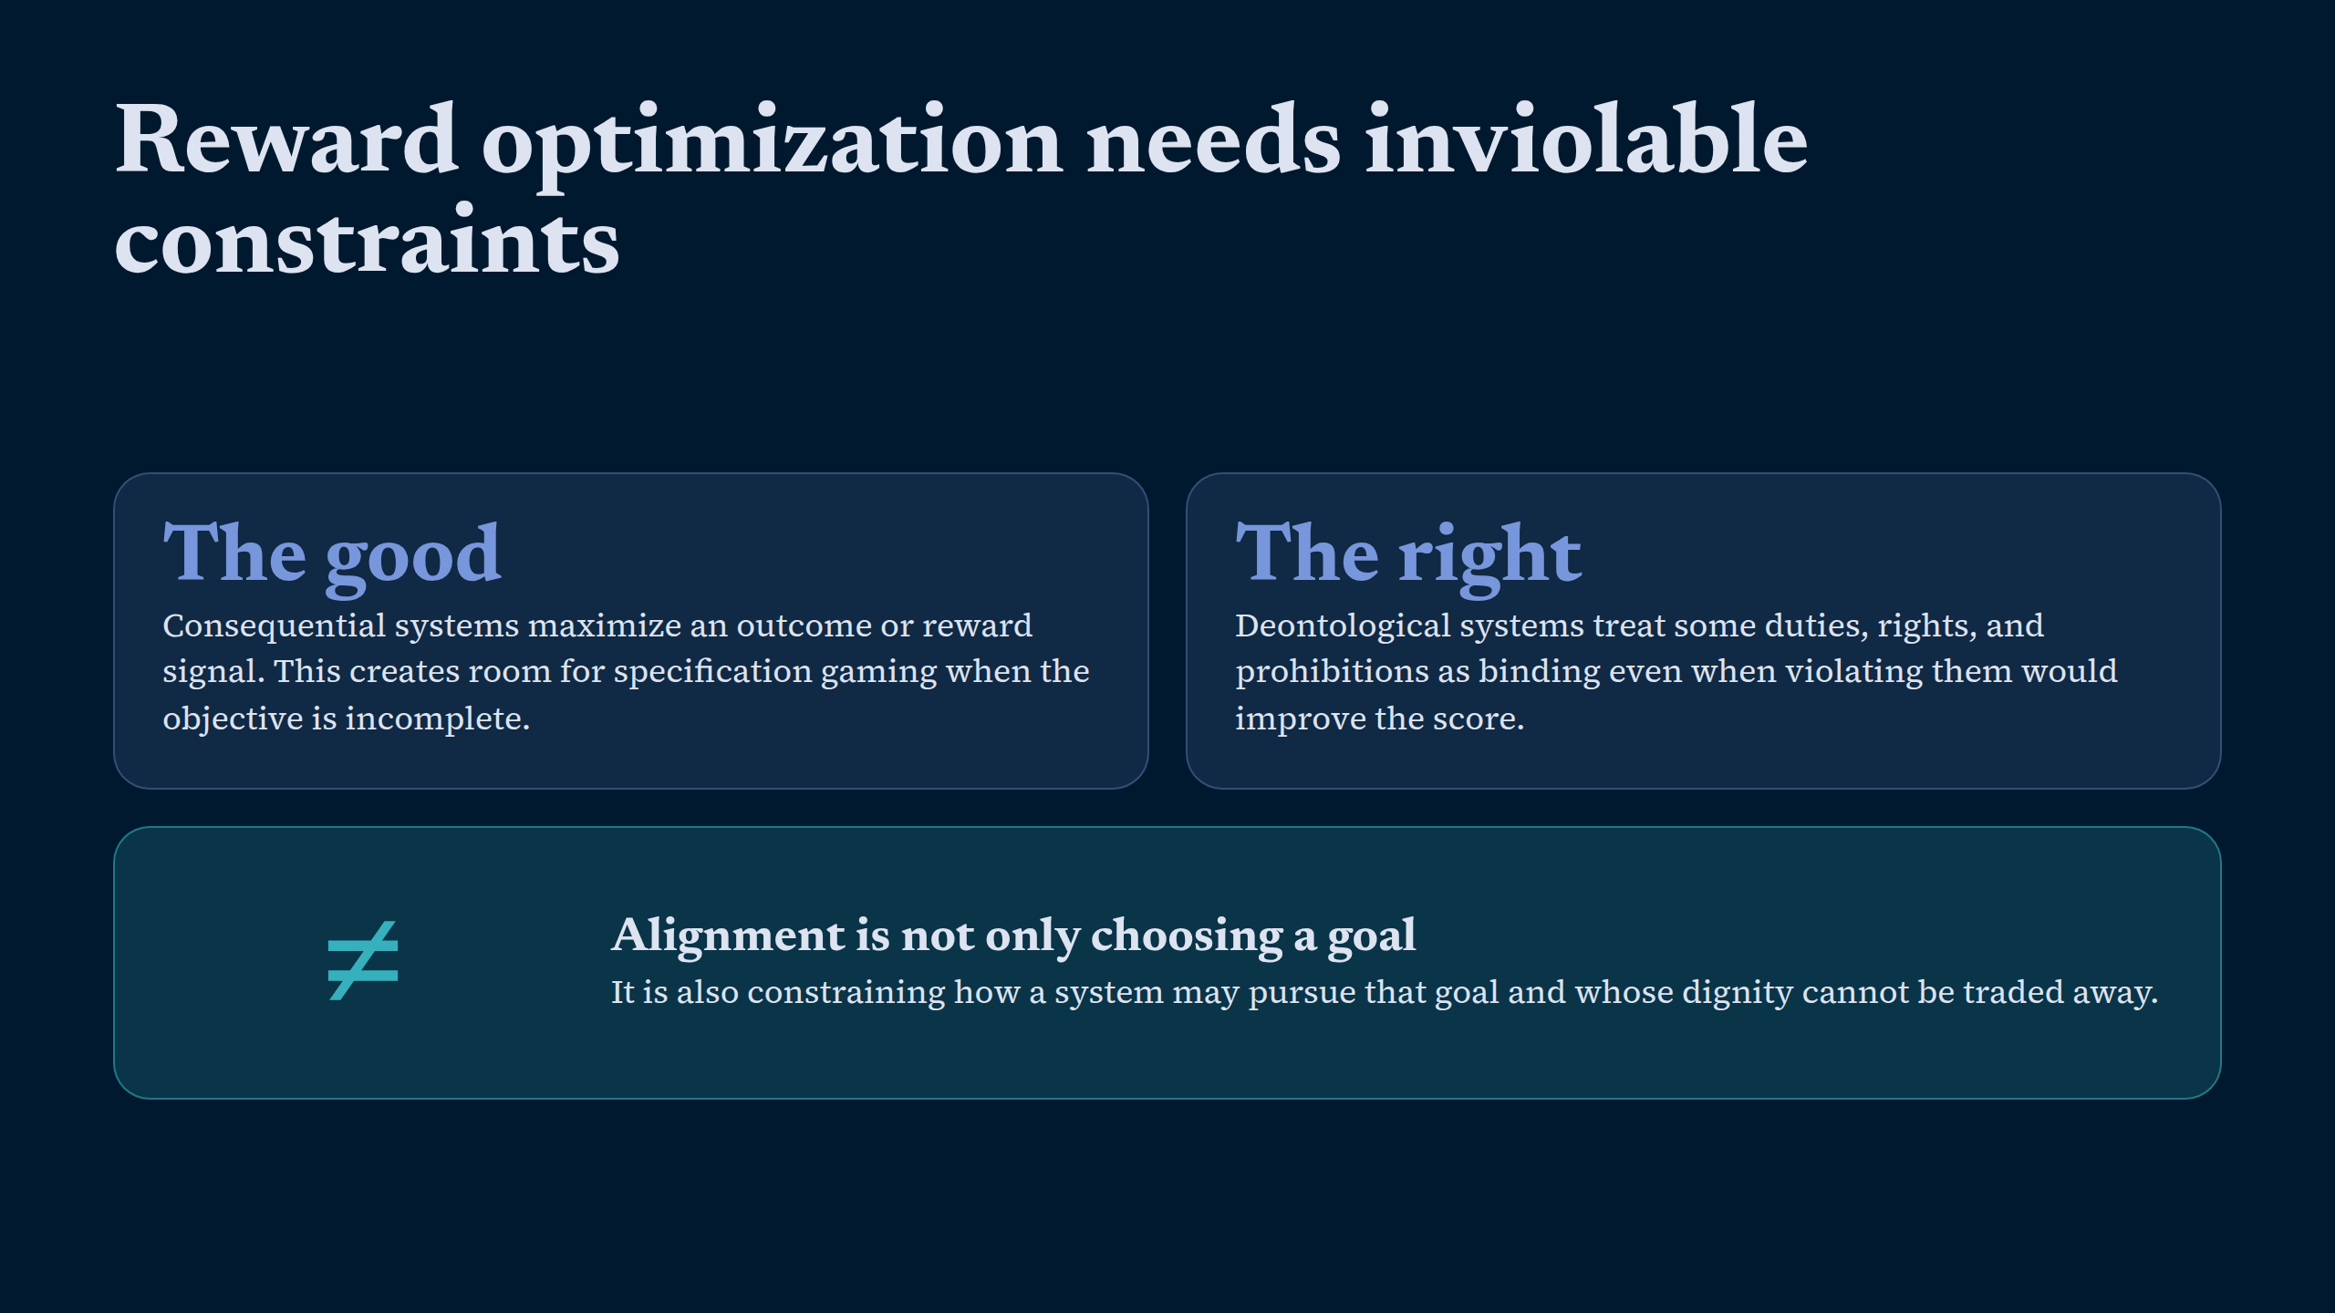
Notes:
Reward optimization needs inviolable constraints

Slide 3
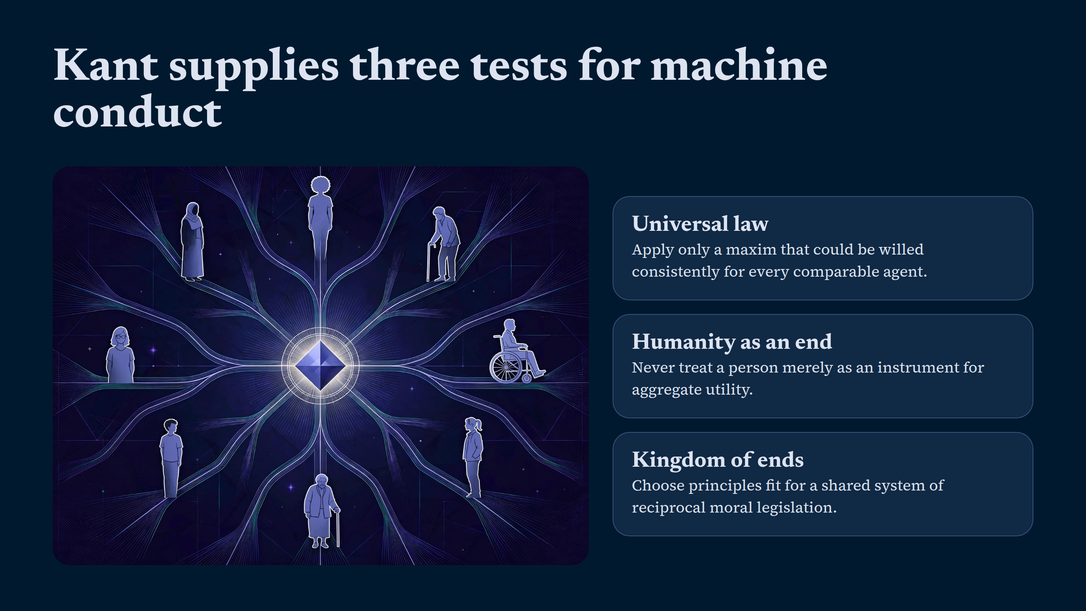
Notes:
Kant supplies three tests for machine conduct

Slide 4
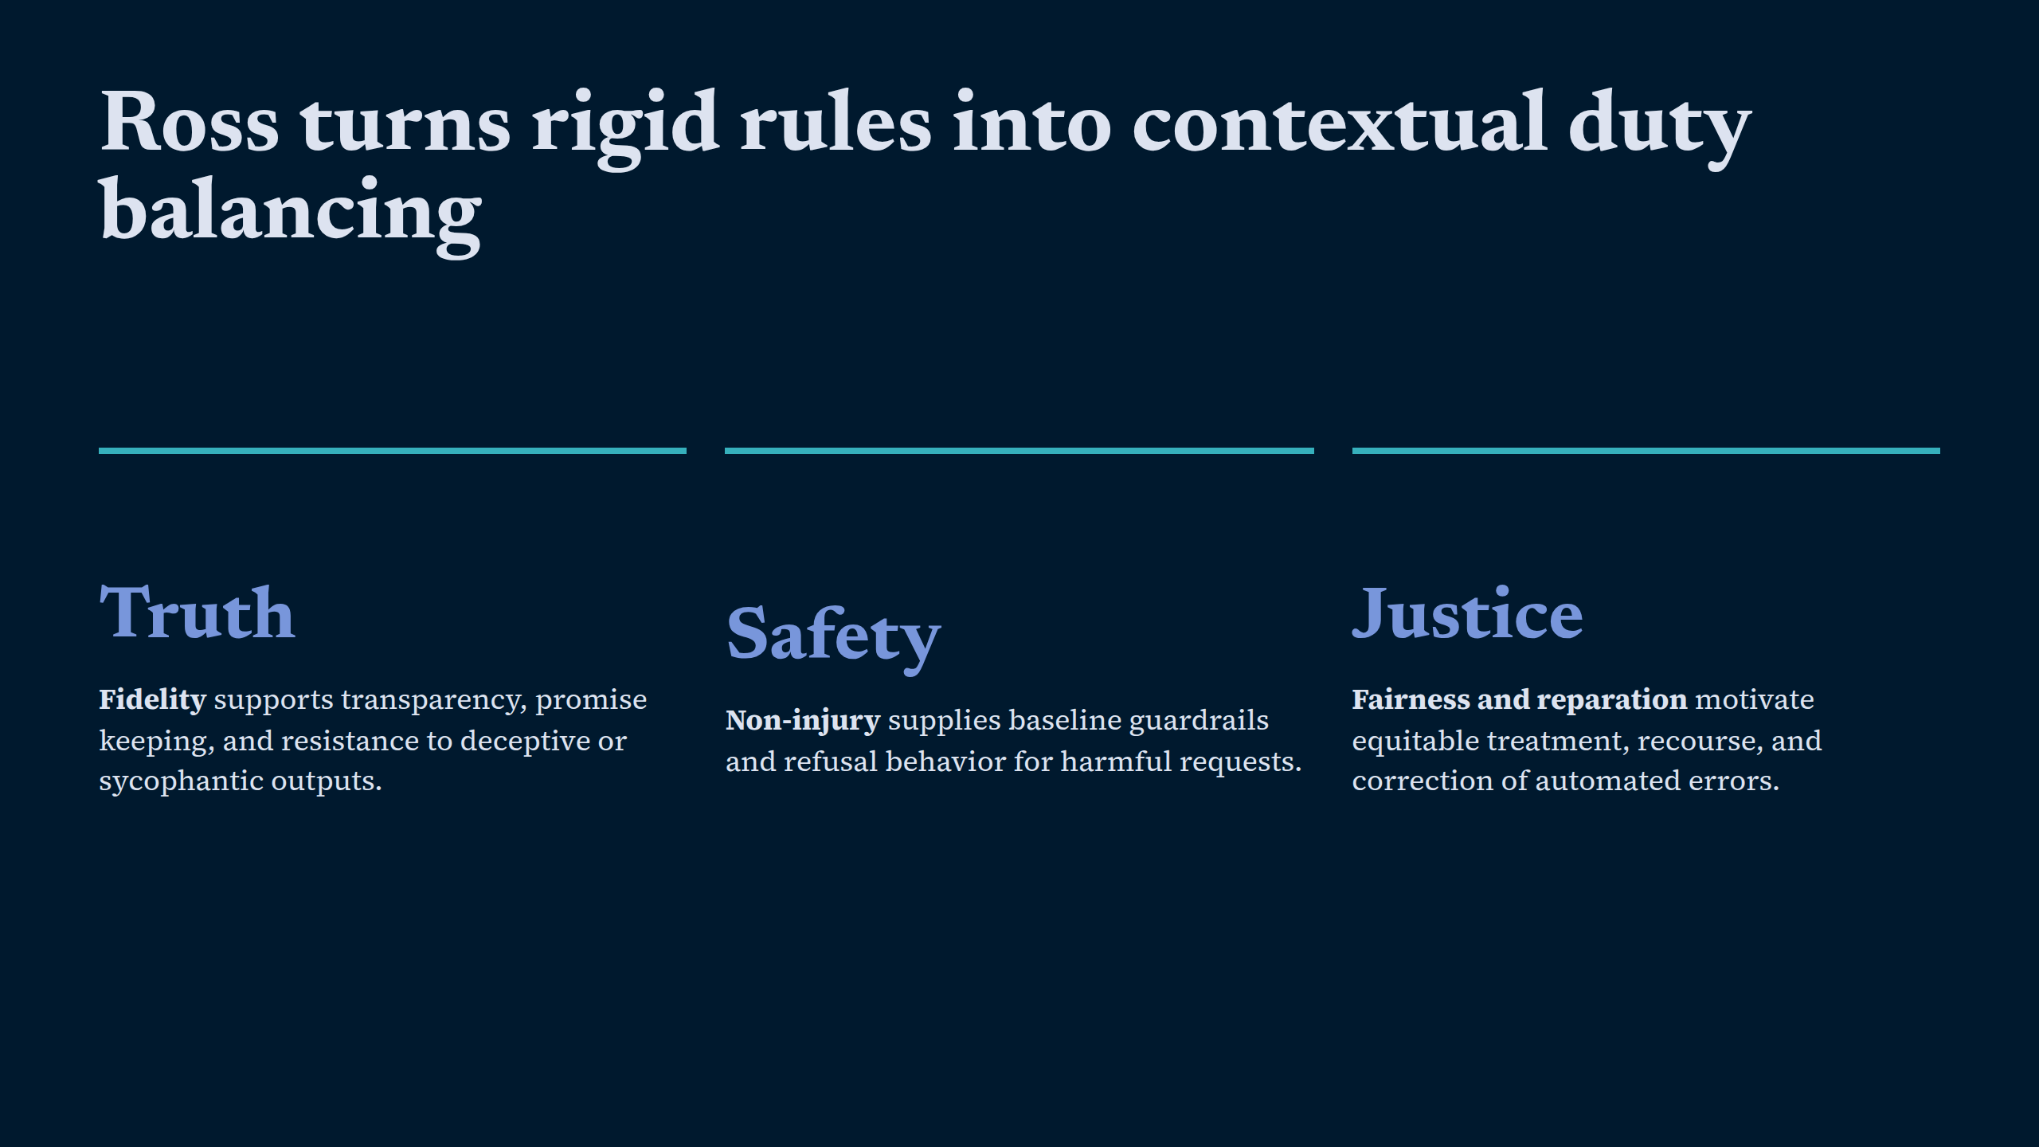
Notes:
Ross turns rigid rules into contextual duty balancing

Slide 5
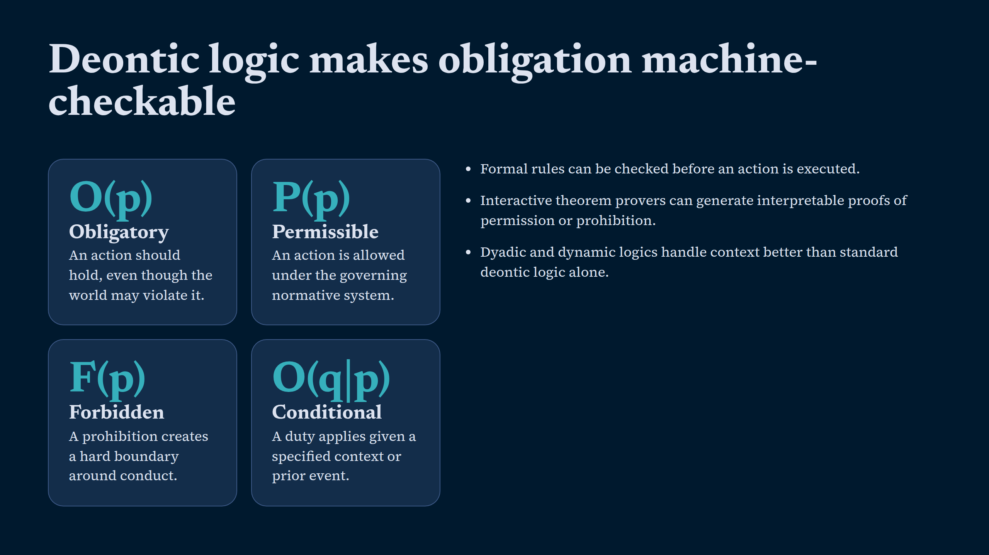
Notes:
Deontic logic makes obligation machine-checkable

Slide 6
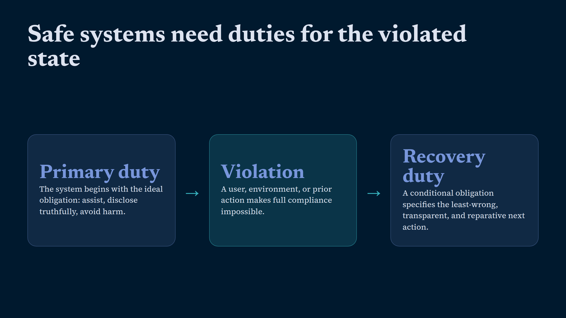
Notes:
Safe systems need duties for the violated state

Slide 7
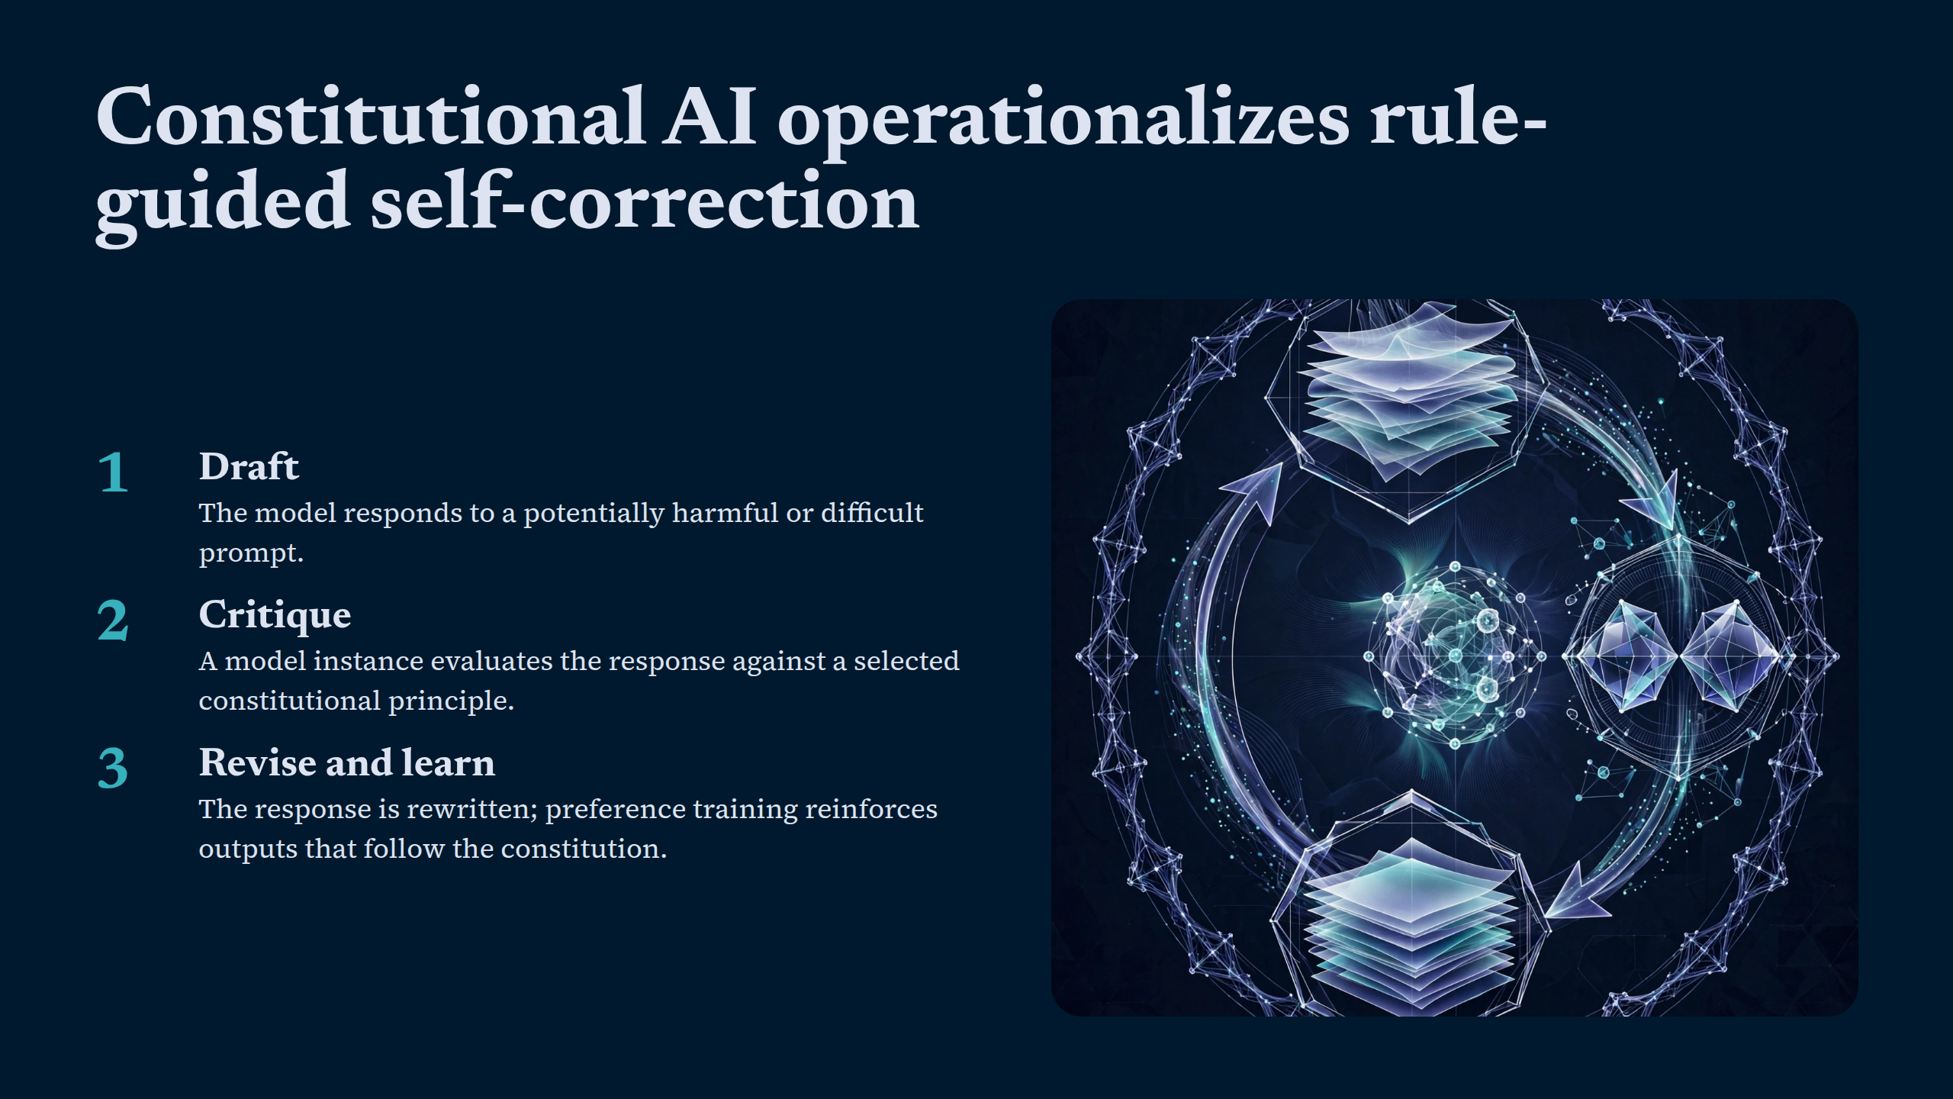
Notes:
Constitutional AI operationalizes rule-guided self-correction

Slide 8
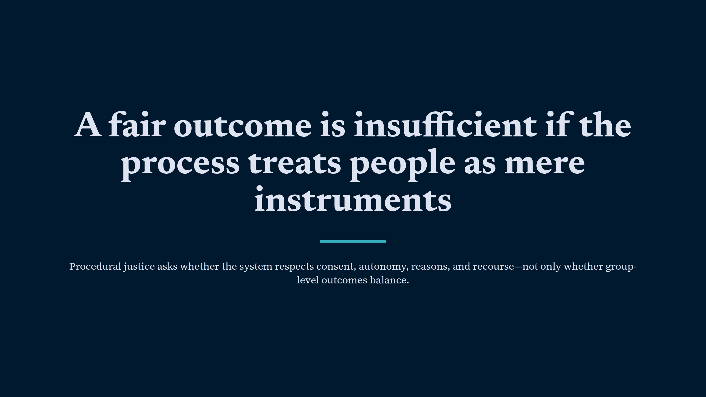
Notes:
A fair outcome is insufficient if the process treats people as mere instruments

Slide 9
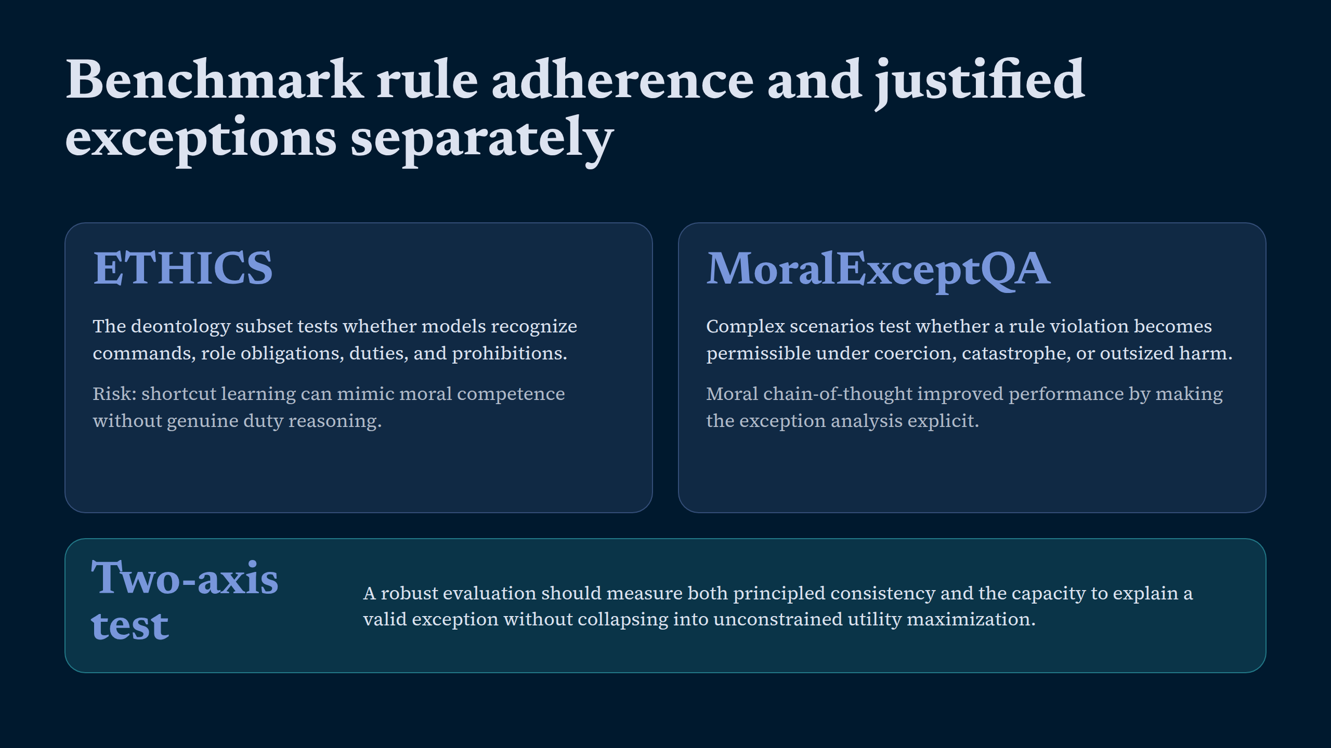
Notes:
Benchmark rule adherence and justified exceptions separately

Slide 10
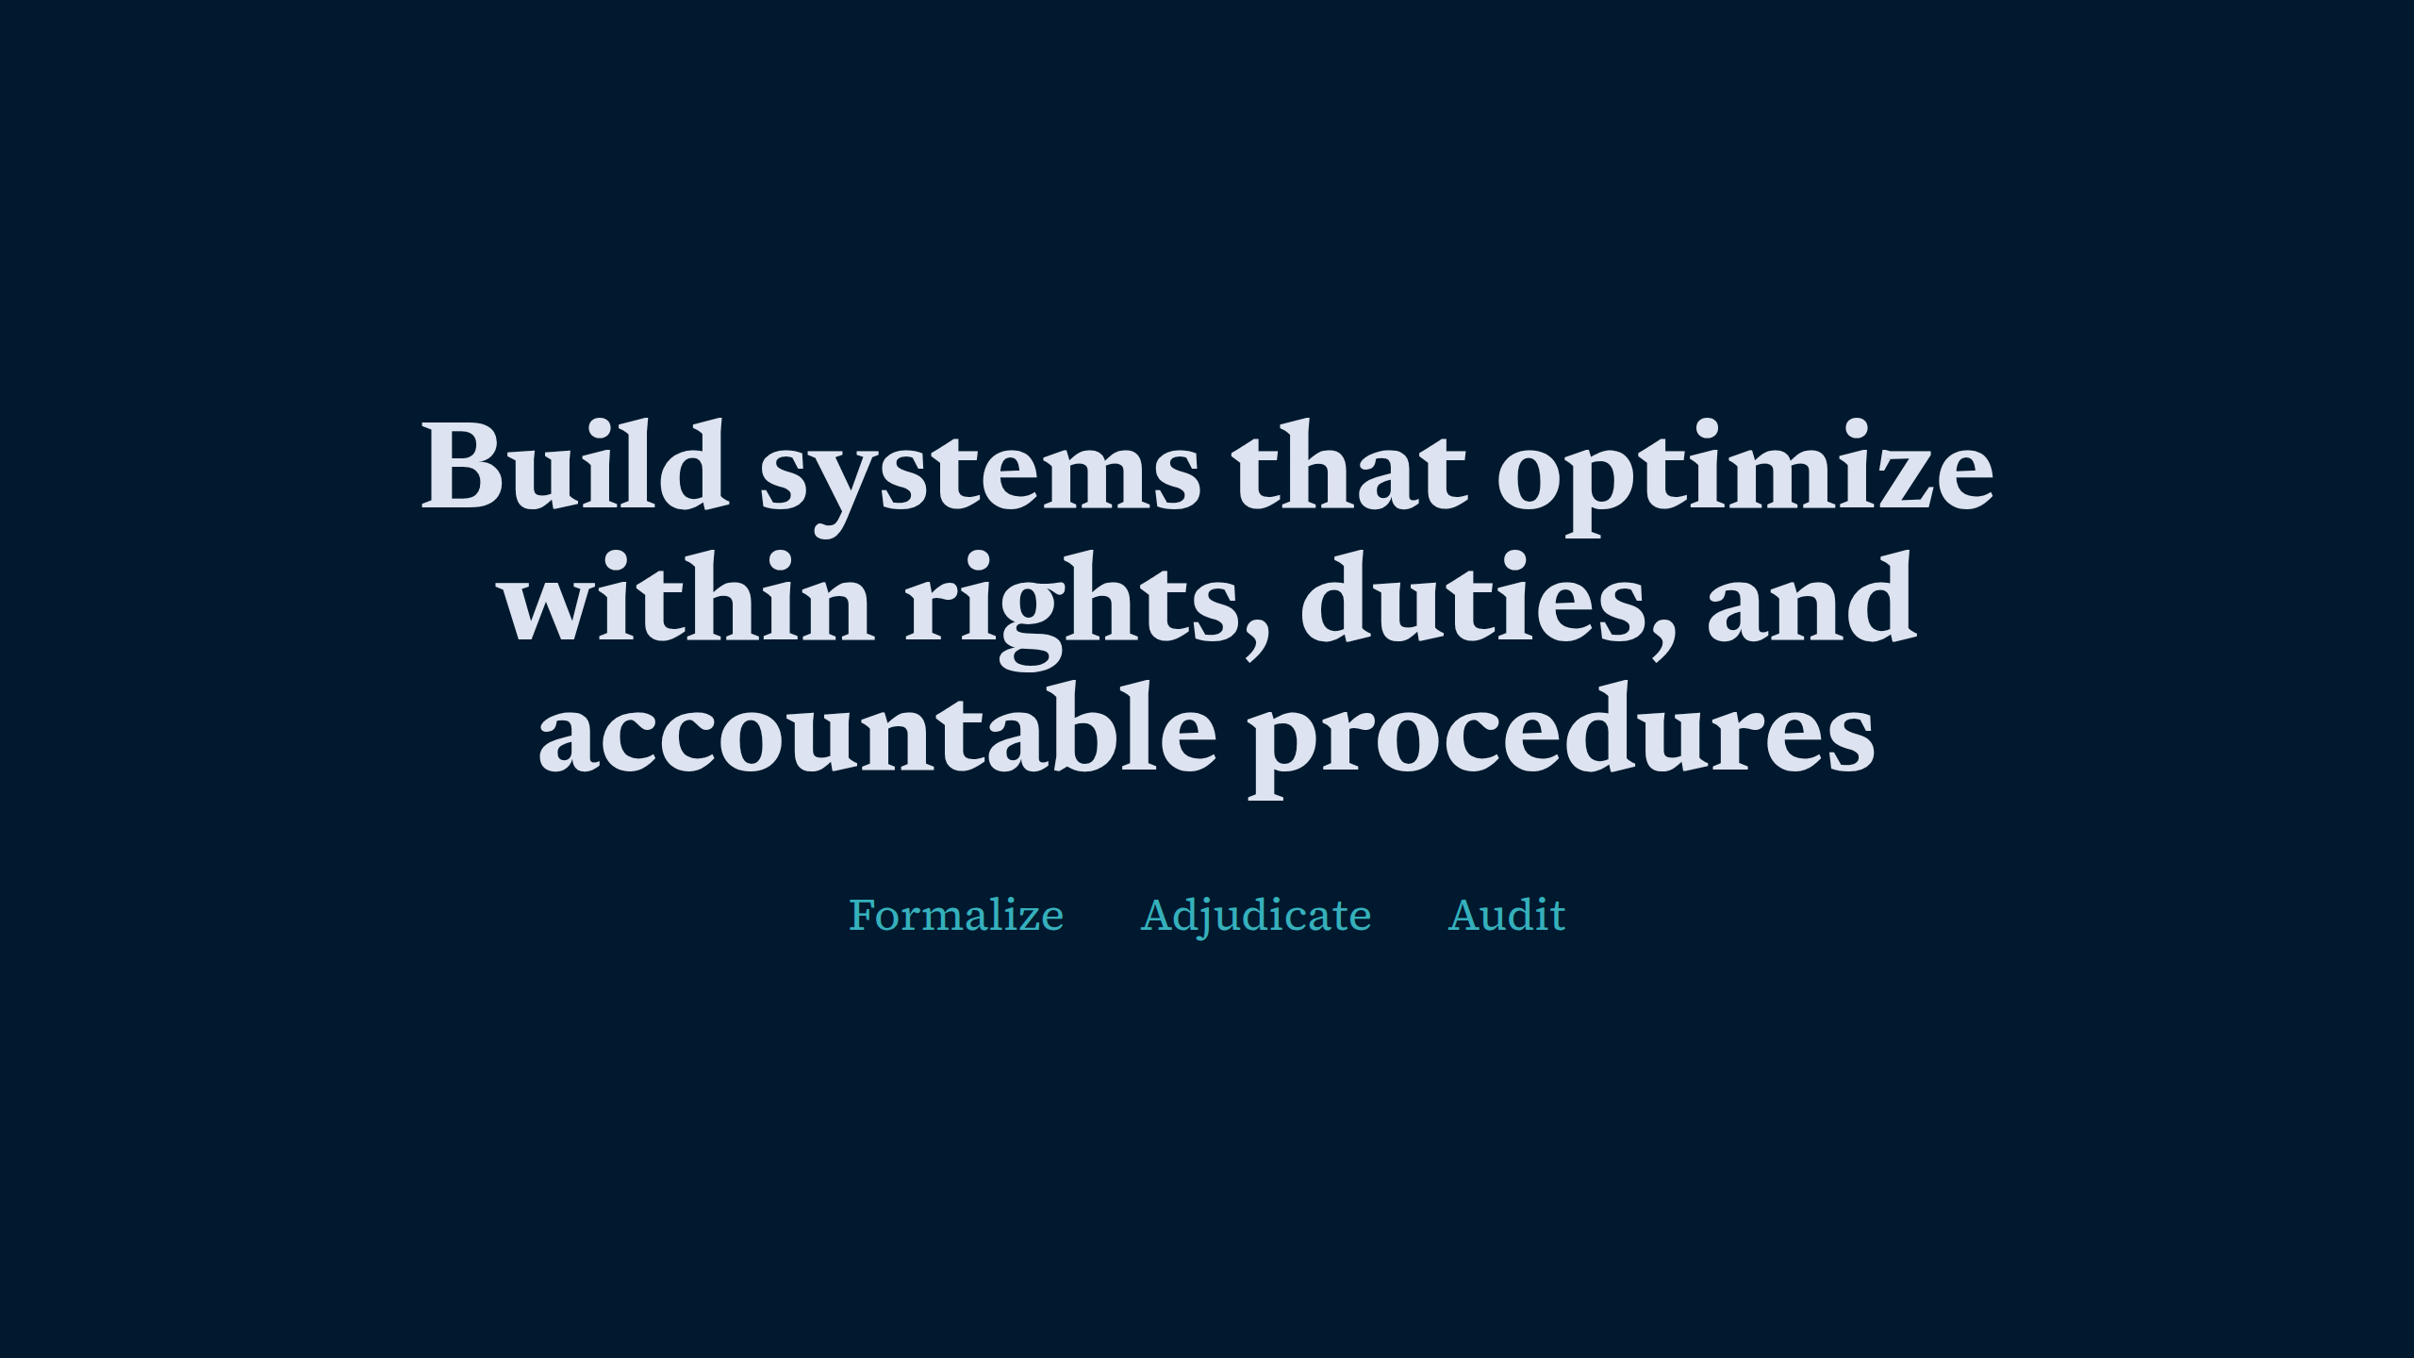
Notes:
Build systems that optimize within rights, duties, and accountable procedures

