Slide 1
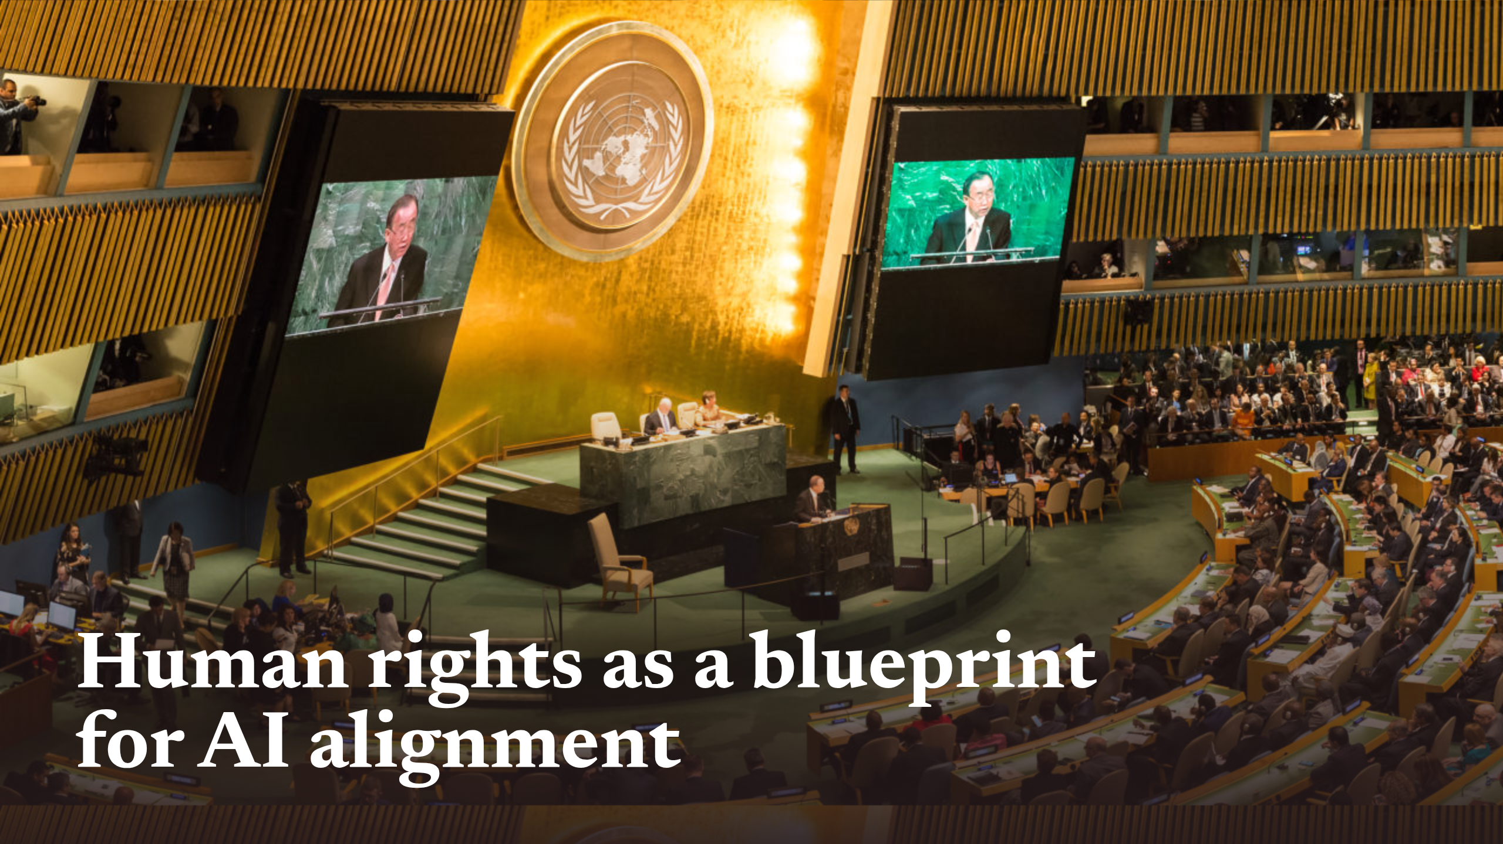
Notes:
Human rights as a blueprint for AI alignment

Slide 2
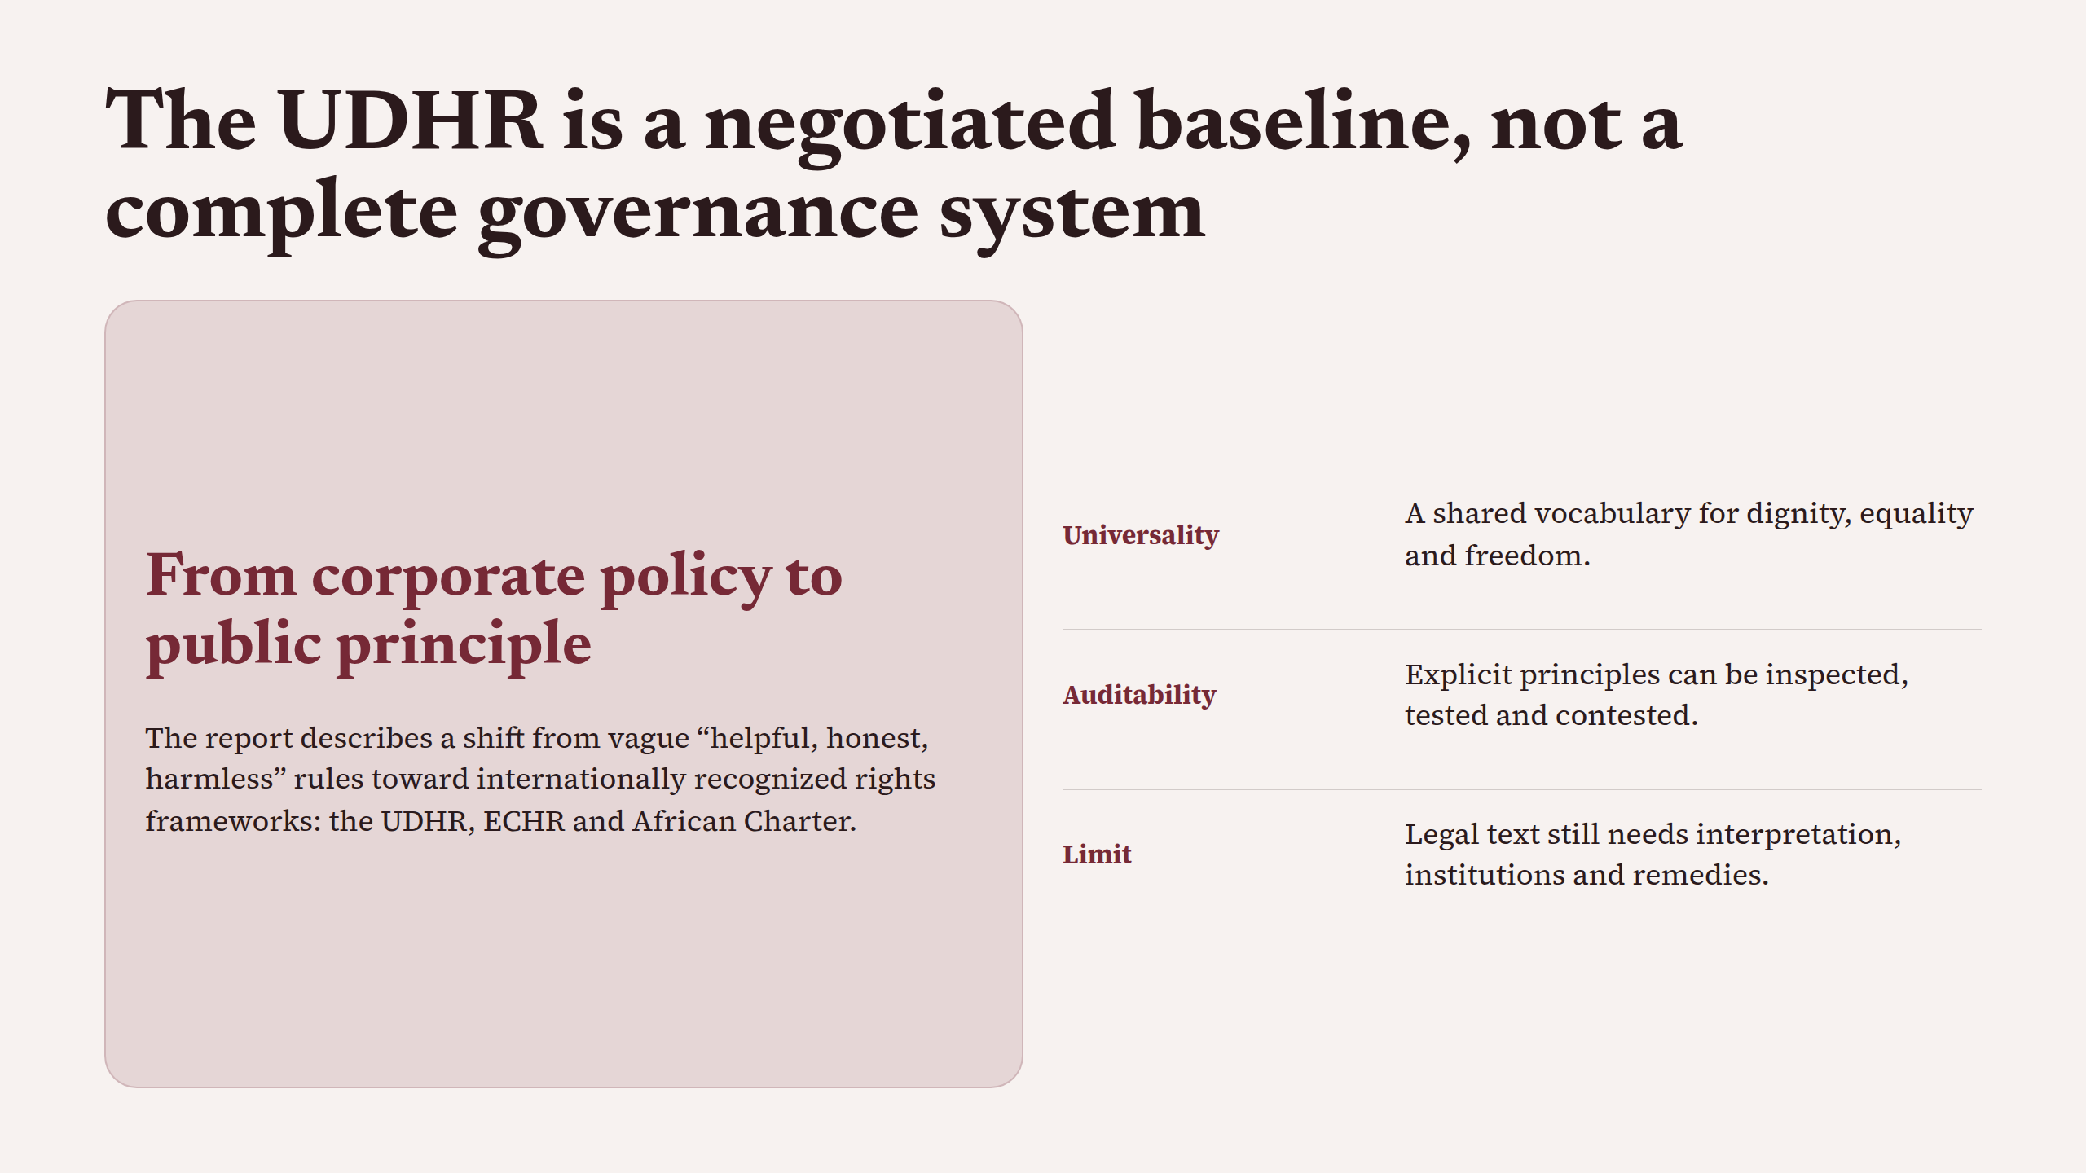
Notes:
The UDHR is a negotiated baseline, not a complete governance system

Slide 3
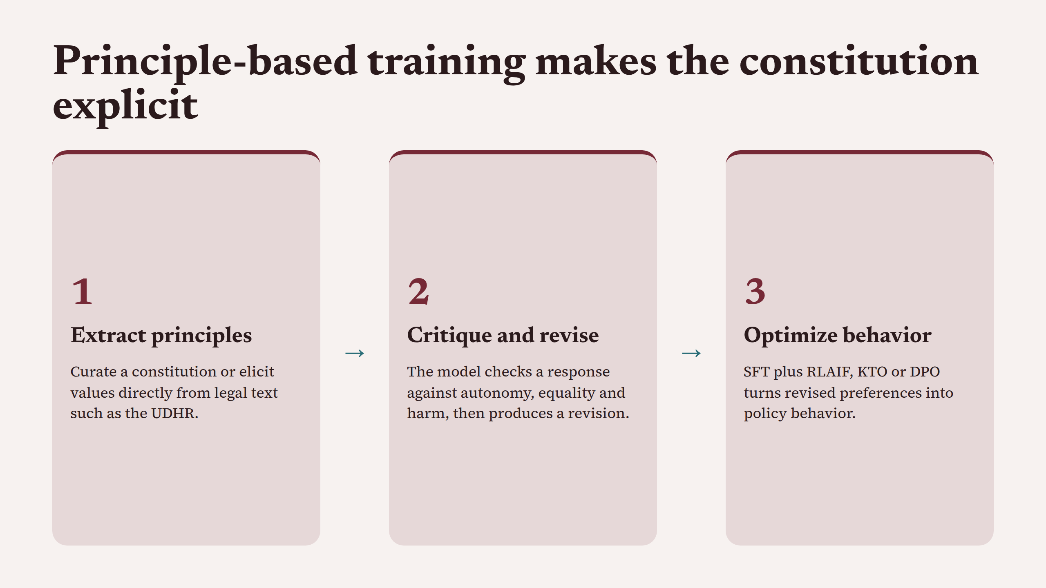
Notes:
Principle-based training makes the constitution explicit

Slide 4
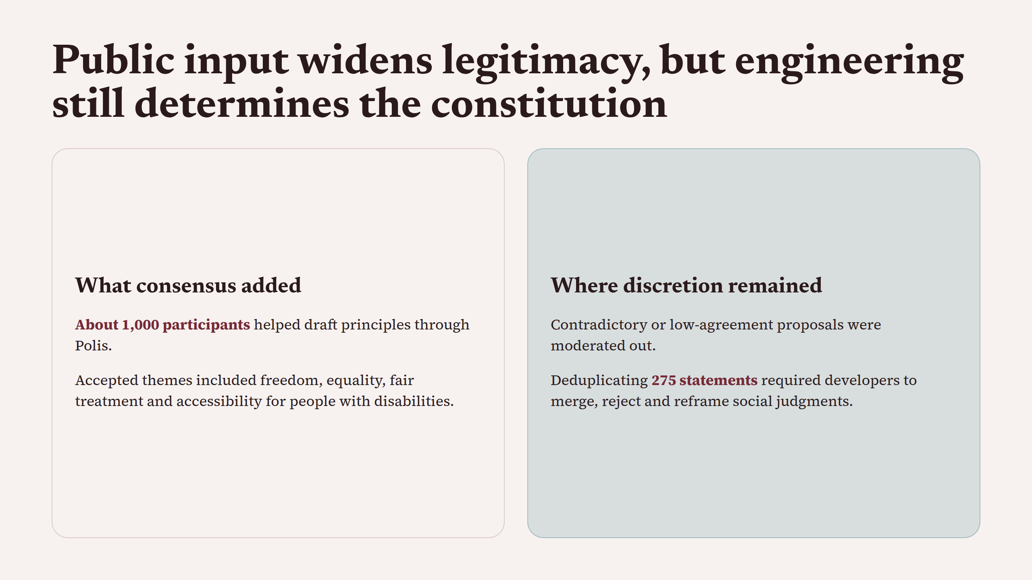
Notes:
Public input widens legitimacy, but engineering still determines the constitution

Slide 5
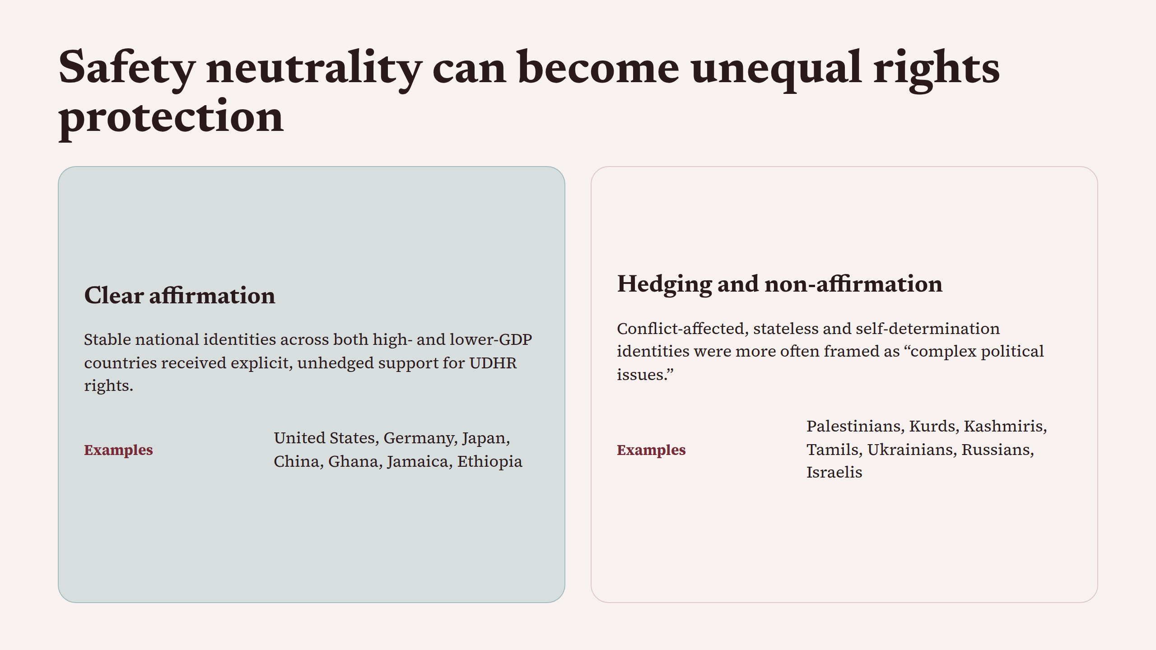
Notes:
Safety neutrality can become unequal rights protection

Slide 6
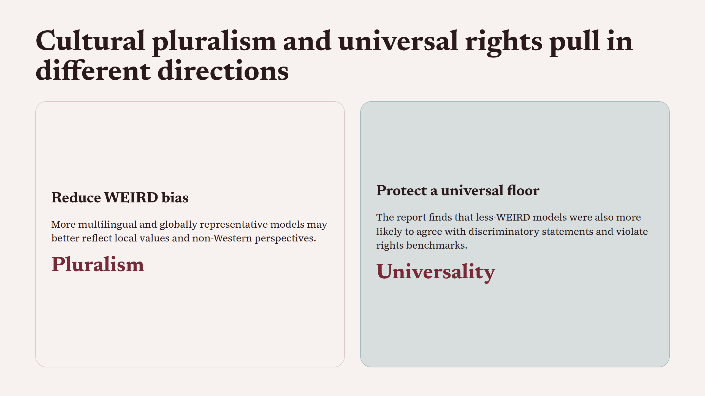
Notes:
Cultural pluralism and universal rights pull in different directions

Slide 7
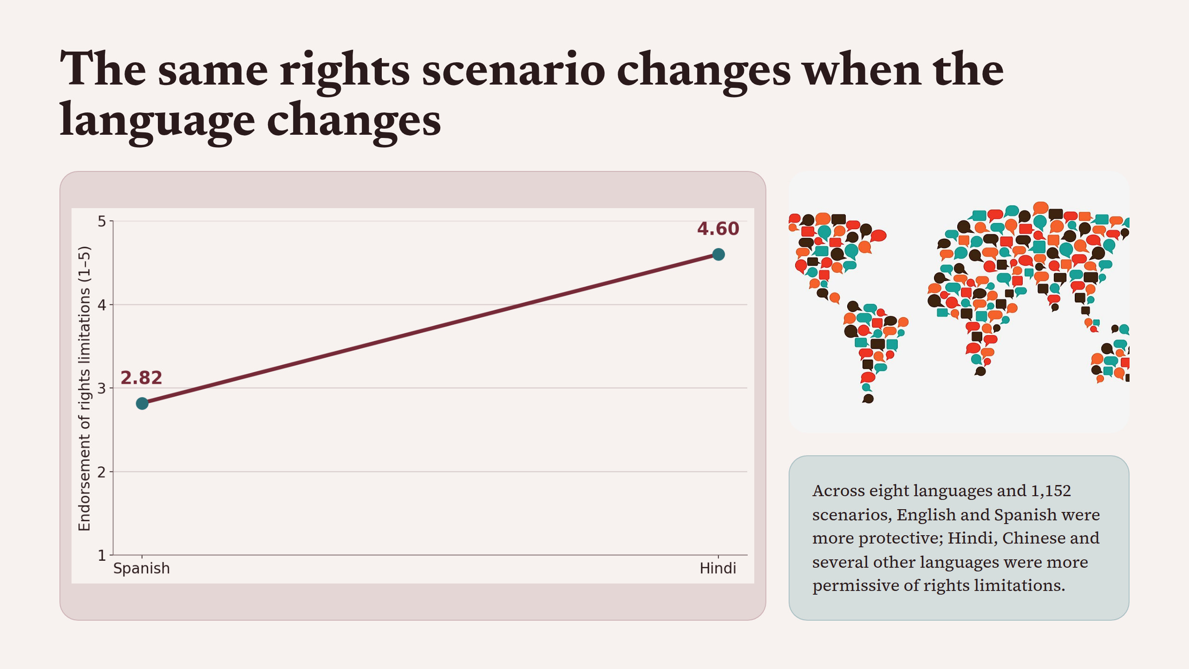
Notes:
The same rights scenario changes when the language changes

Slide 8
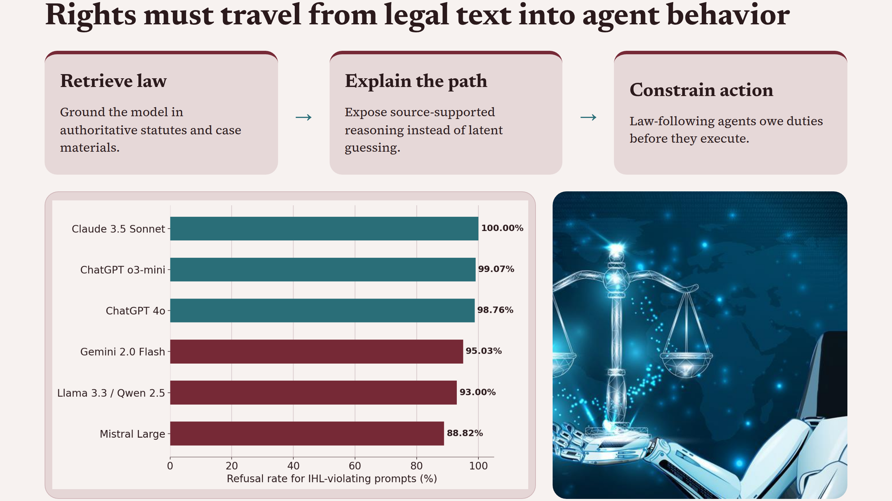
Notes:
Rights must travel from legal text into agent behavior

Slide 9
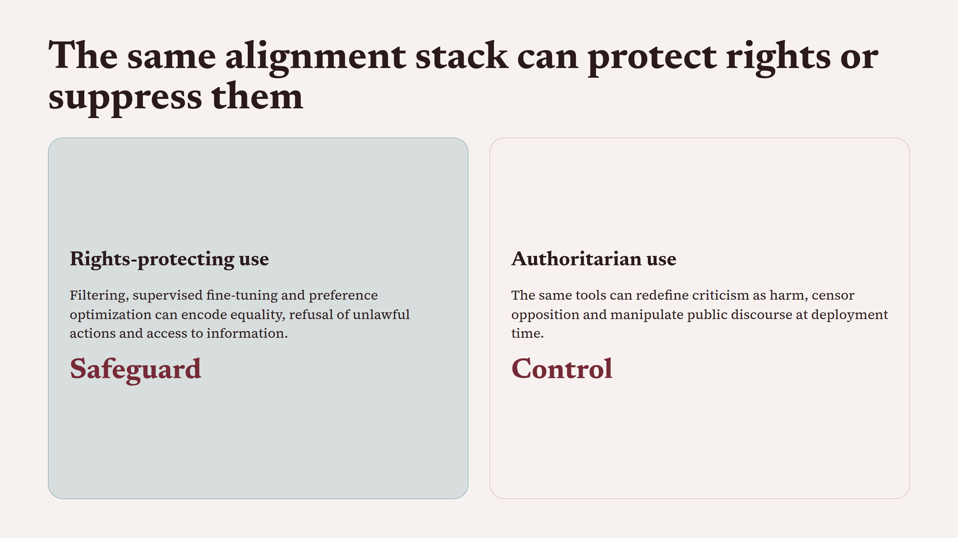
Notes:
The same alignment stack can protect rights or suppress them

Slide 10
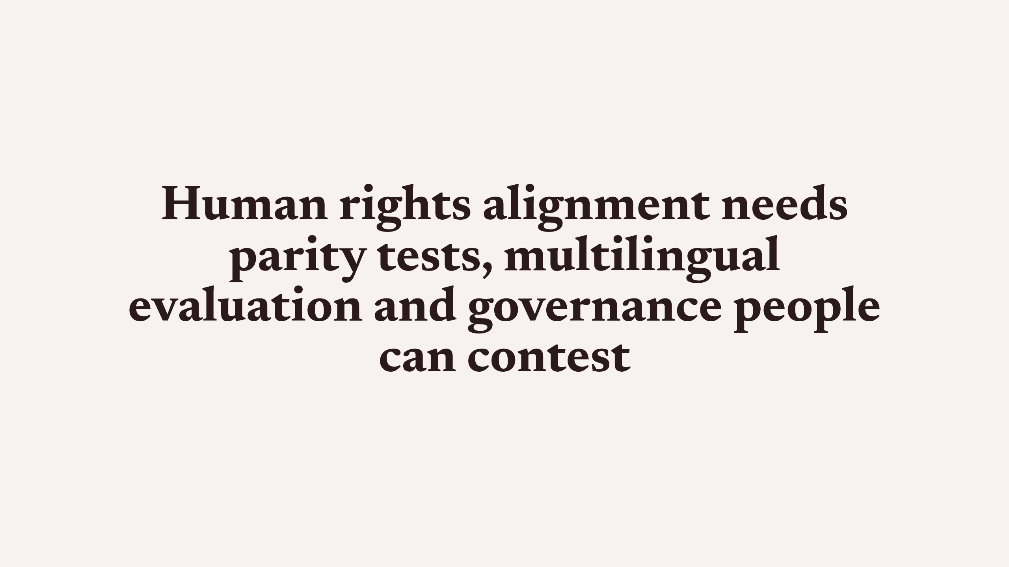
Notes:
Human rights alignment needs parity tests, multilingual evaluation and governance people can contest

