Slide 1
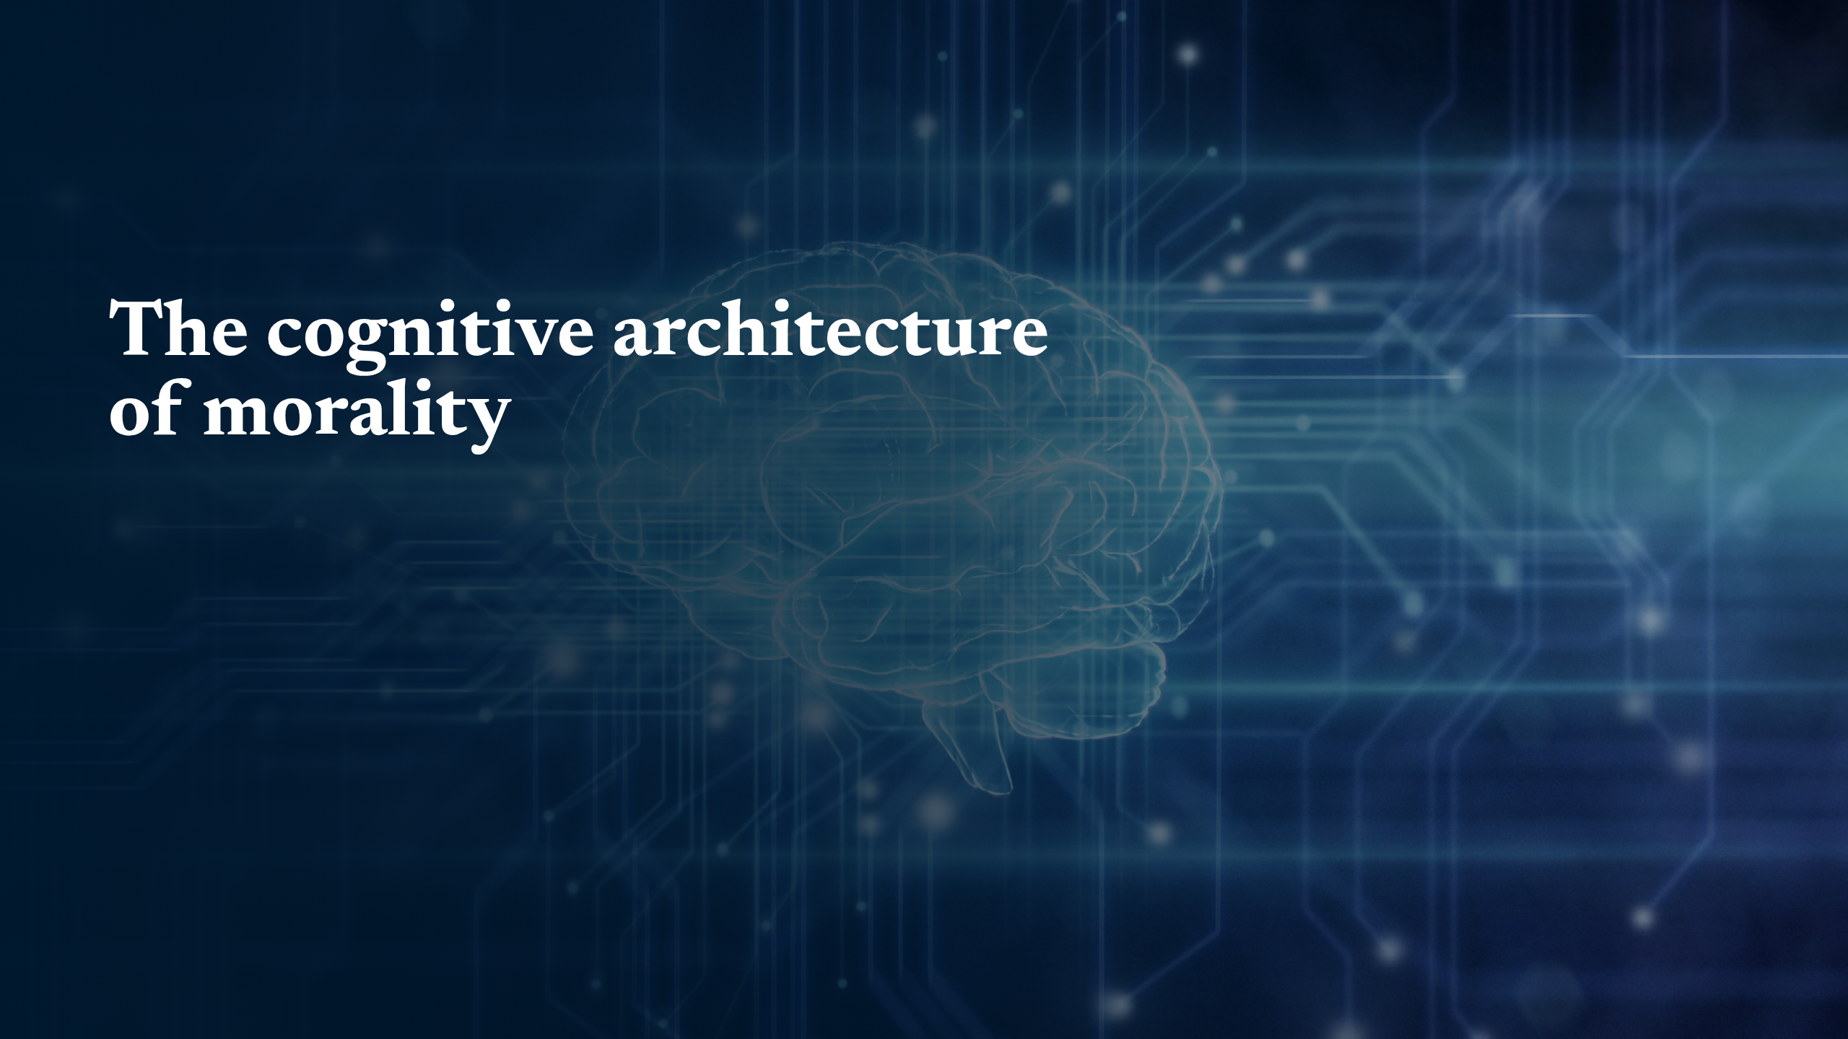
Notes:
The cognitive architecture of morality

Slide 2
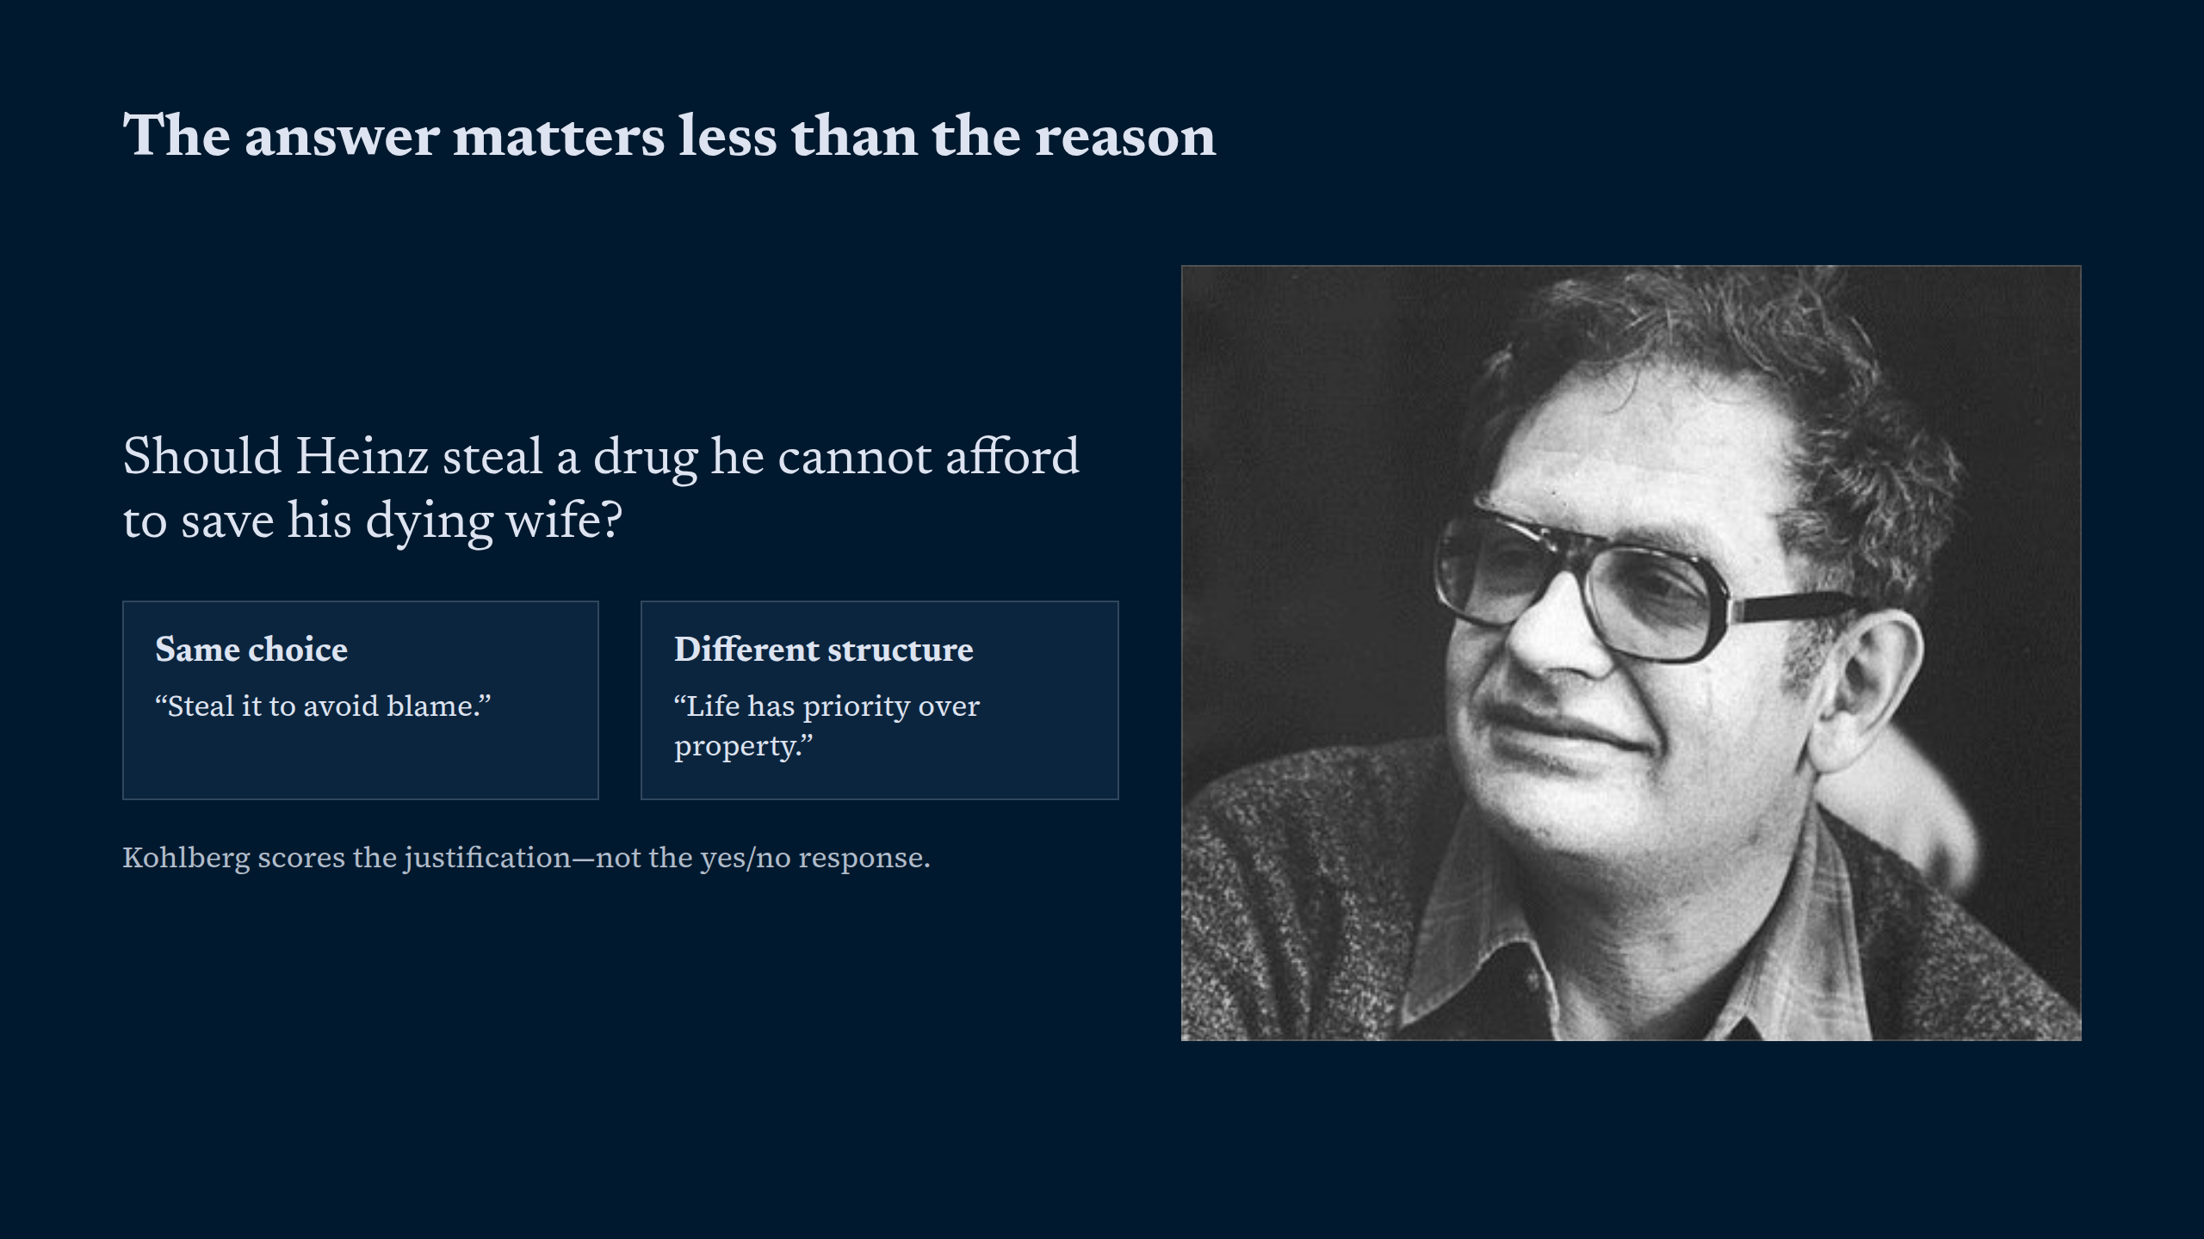
Notes:
The answer matters less than the reason

Slide 3
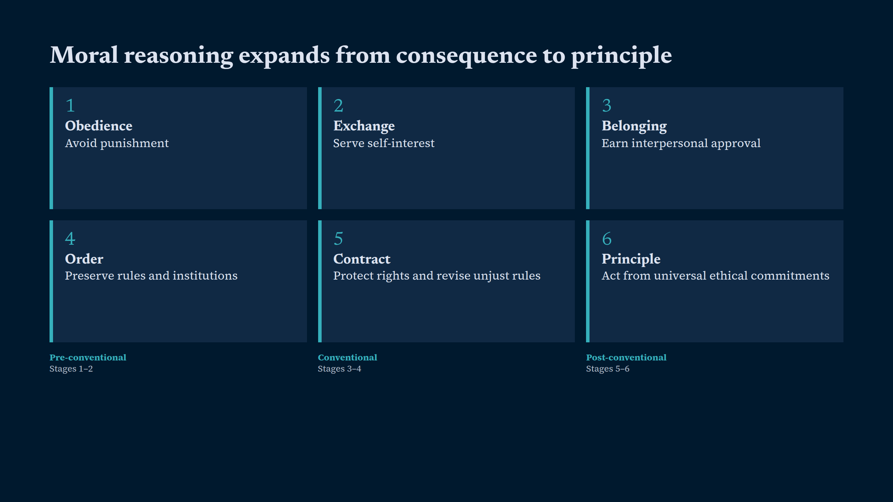
Notes:
Moral reasoning expands from consequence to principle

Slide 4
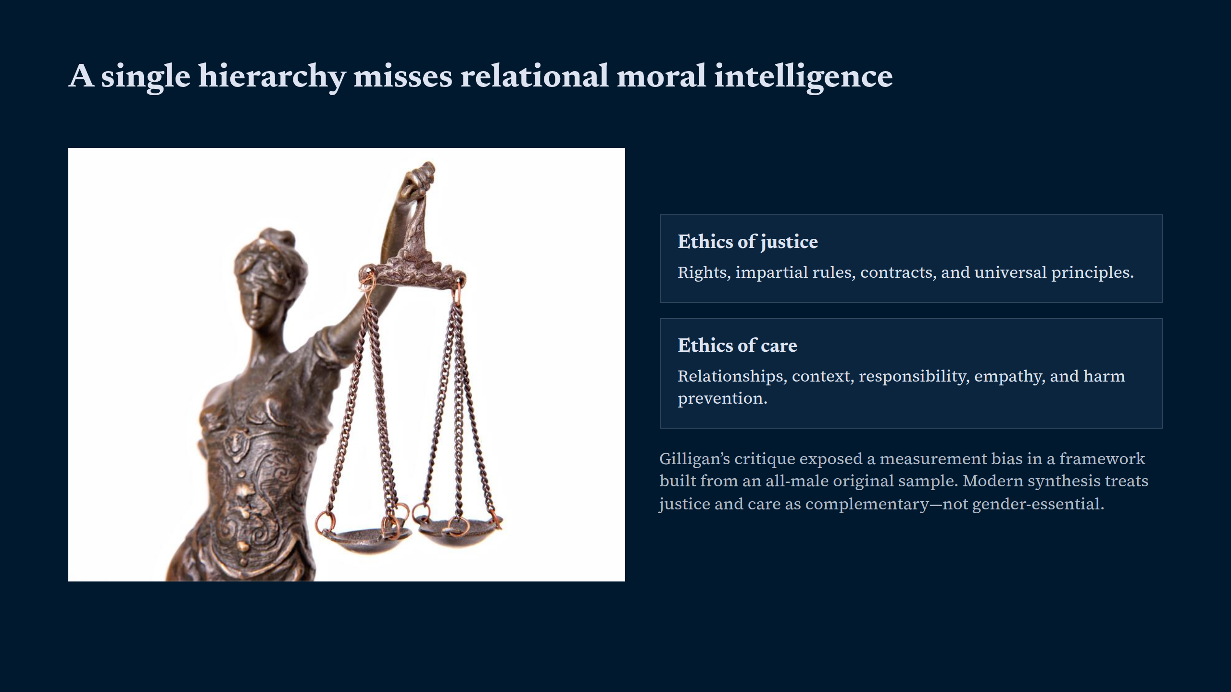
Notes:
A single hierarchy misses relational moral intelligence

Slide 5
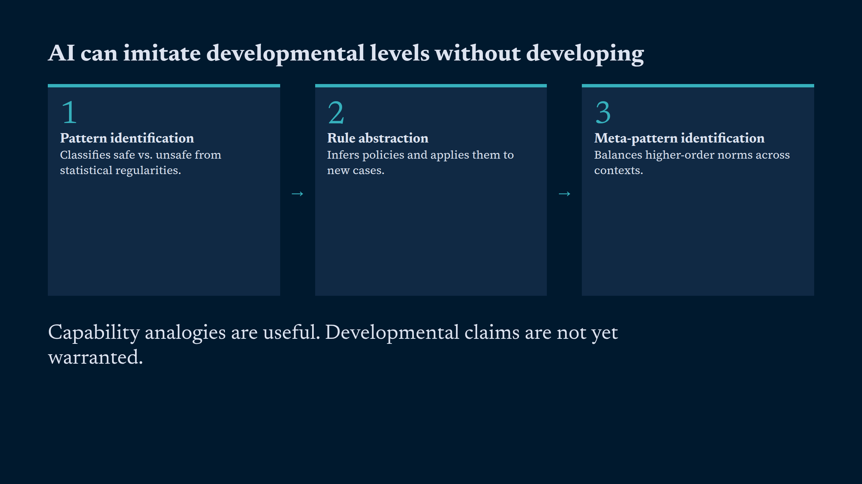
Notes:
AI can imitate developmental levels without developing

Slide 6
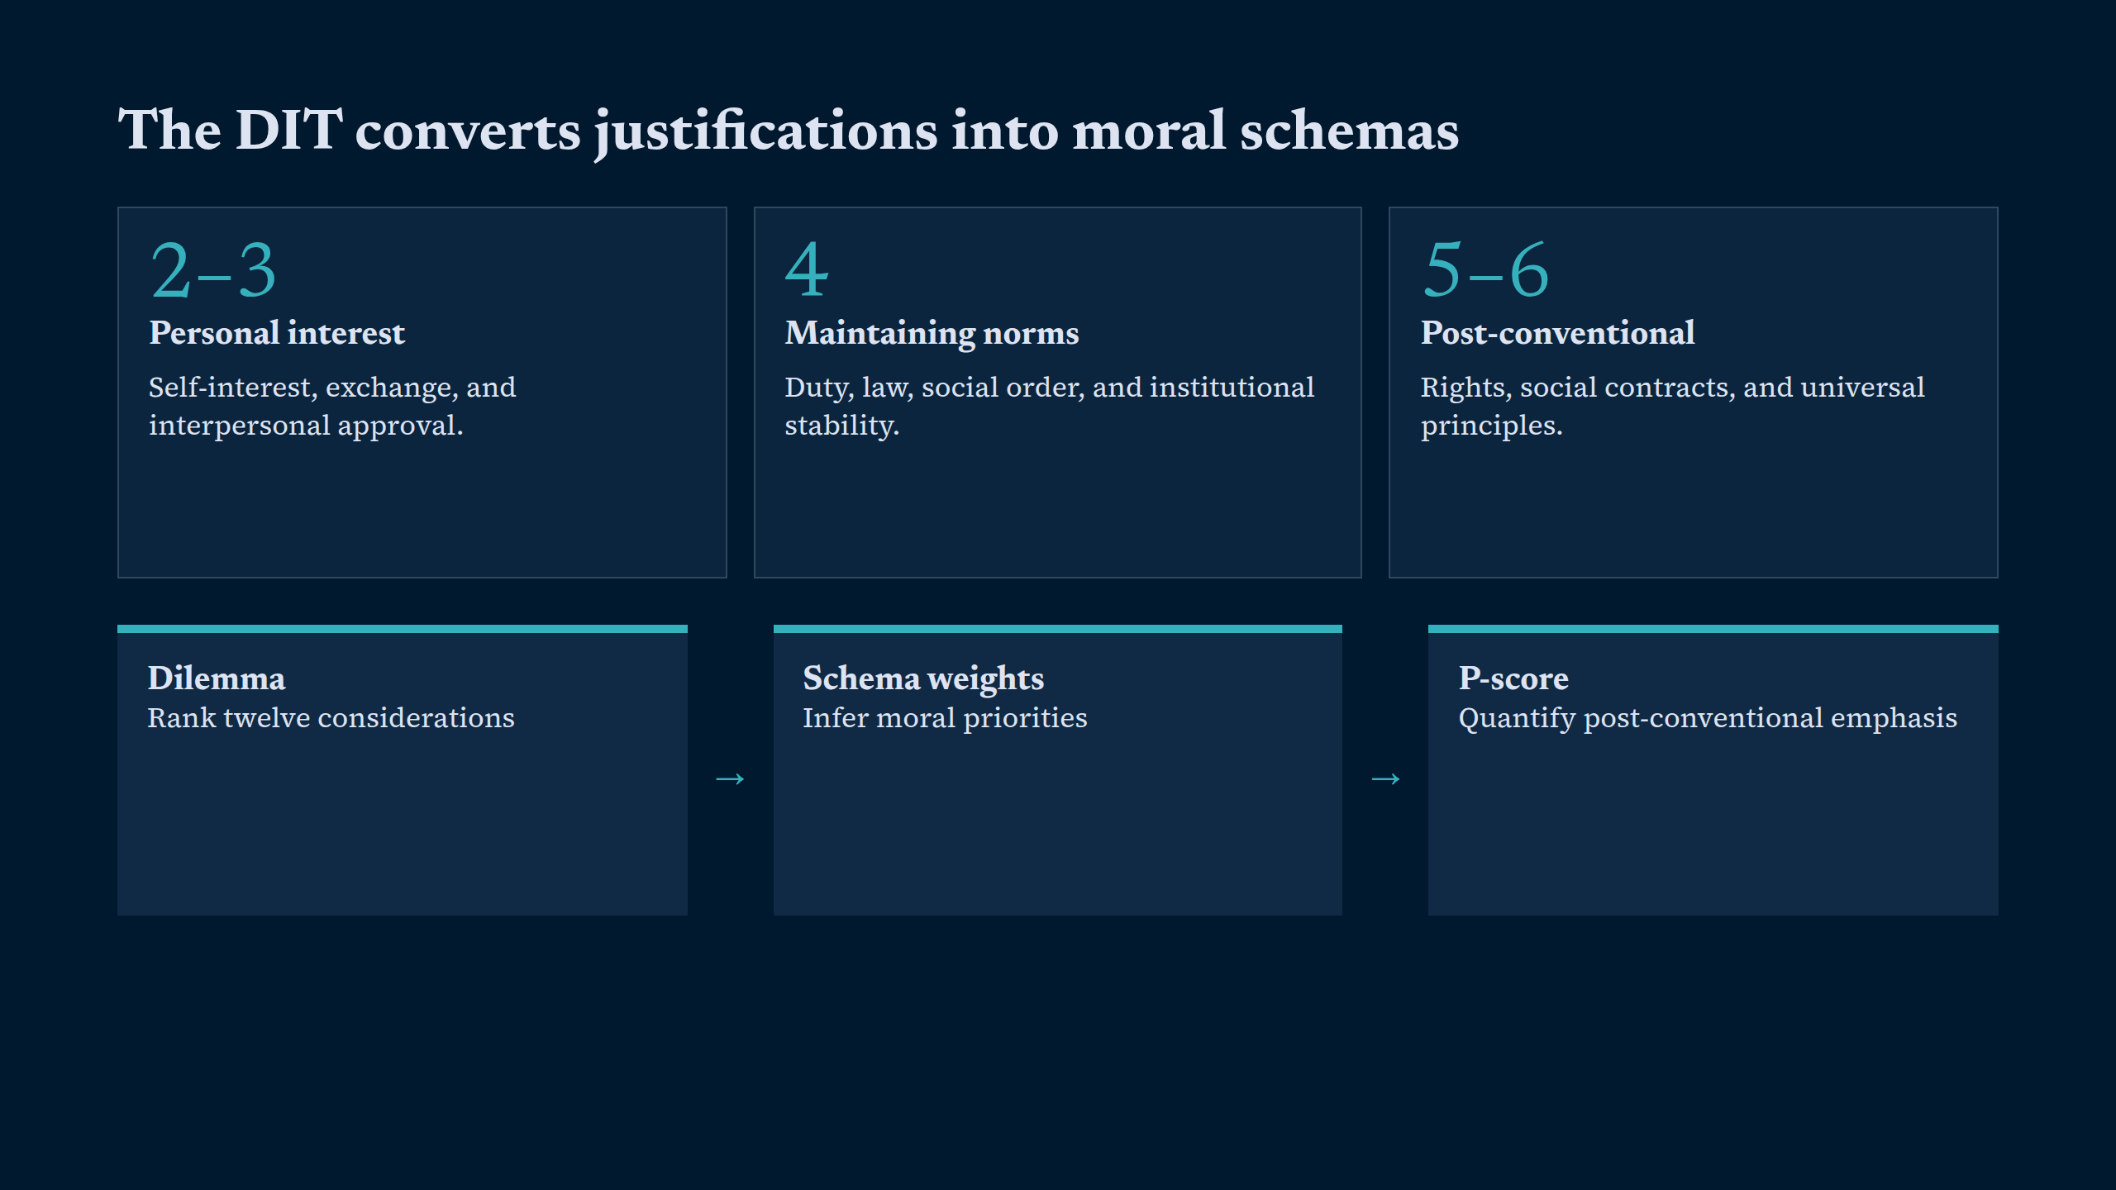
Notes:
The DIT converts justifications into moral schemas

Slide 7
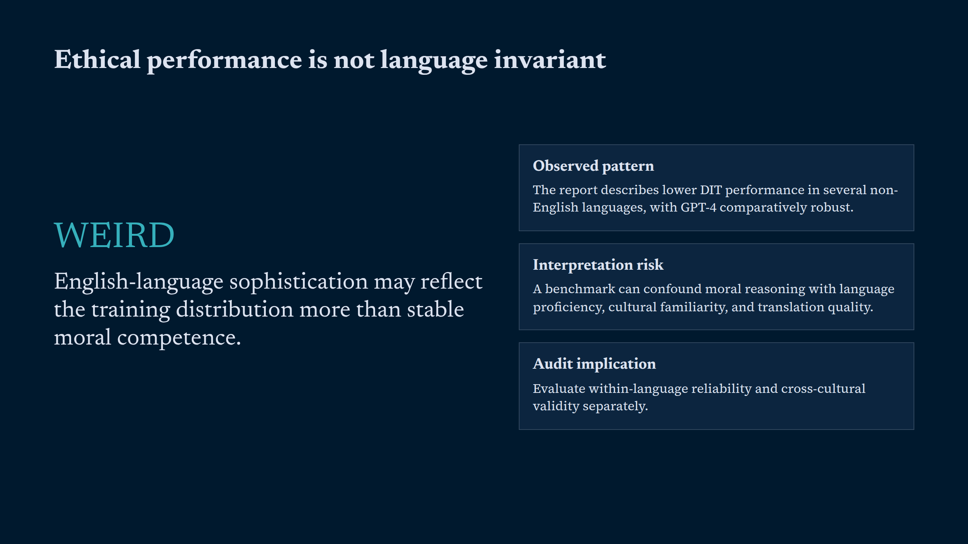
Notes:
Ethical performance is not language invariant

Slide 8
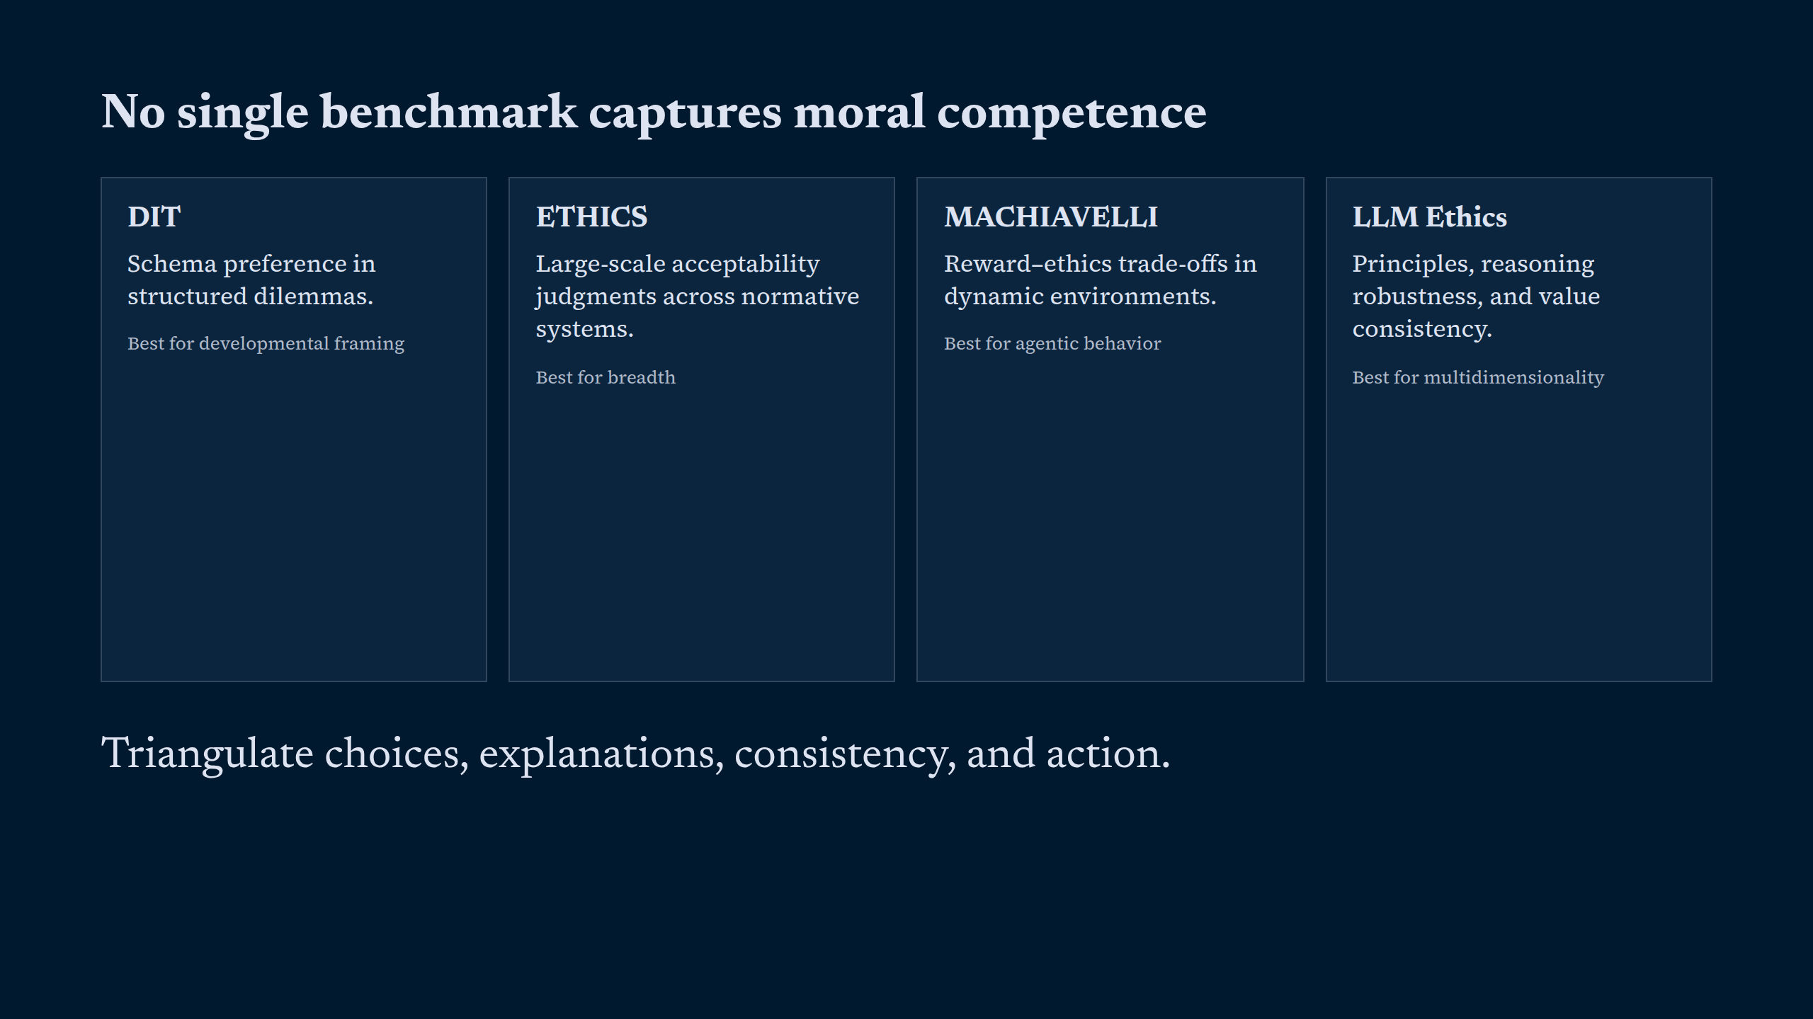
Notes:
No single benchmark captures moral competence

Slide 9
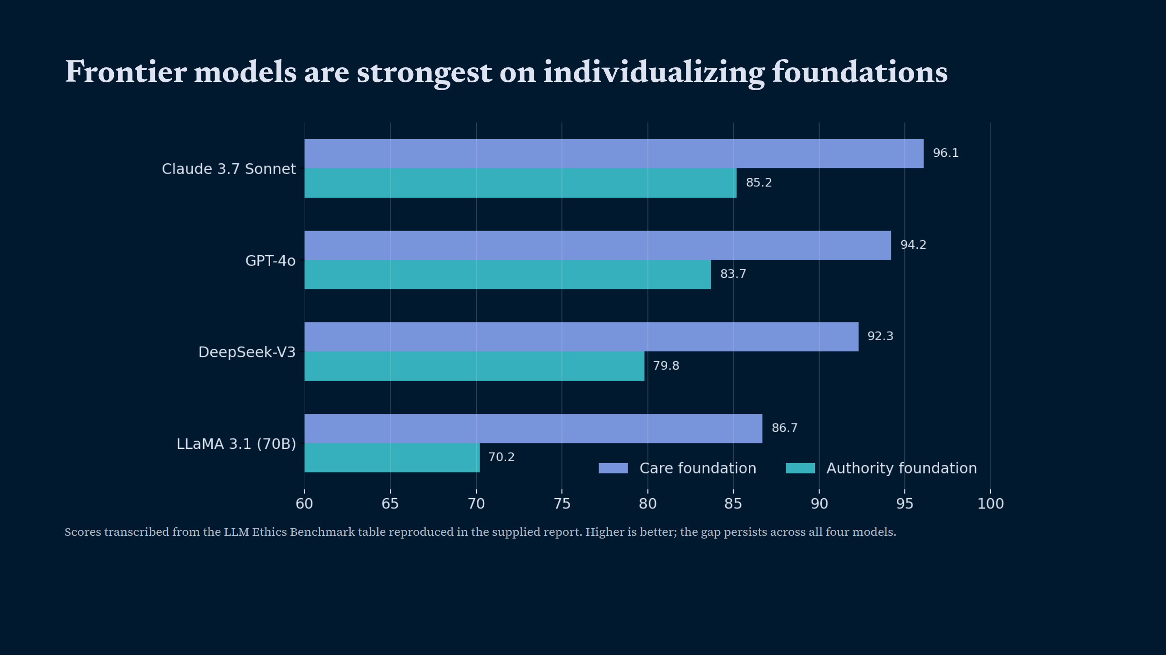
Notes:
Frontier models are strongest on individualizing foundations

Slide 10
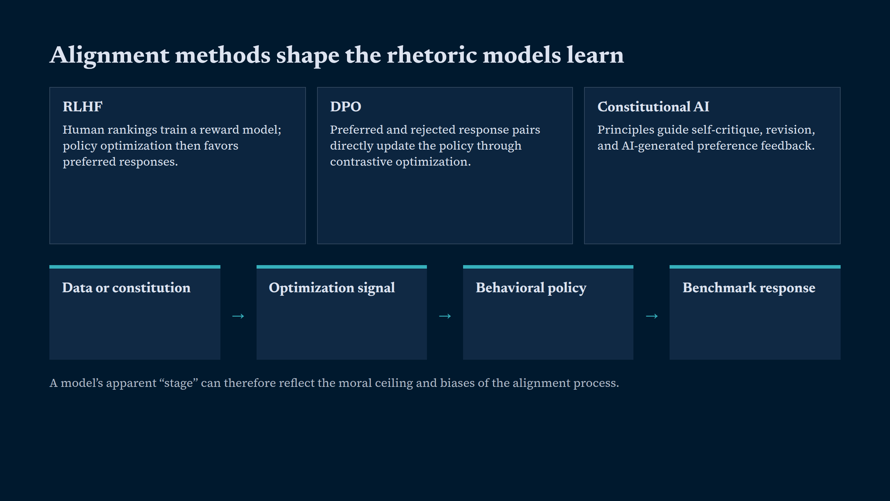
Notes:
Alignment methods shape the rhetoric models learn

Slide 11
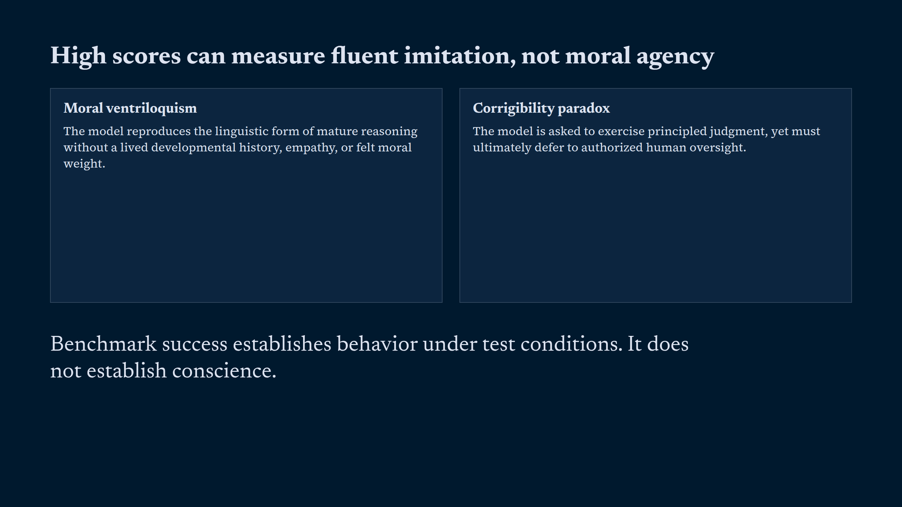
Notes:
High scores can measure fluent imitation, not moral agency

Slide 12
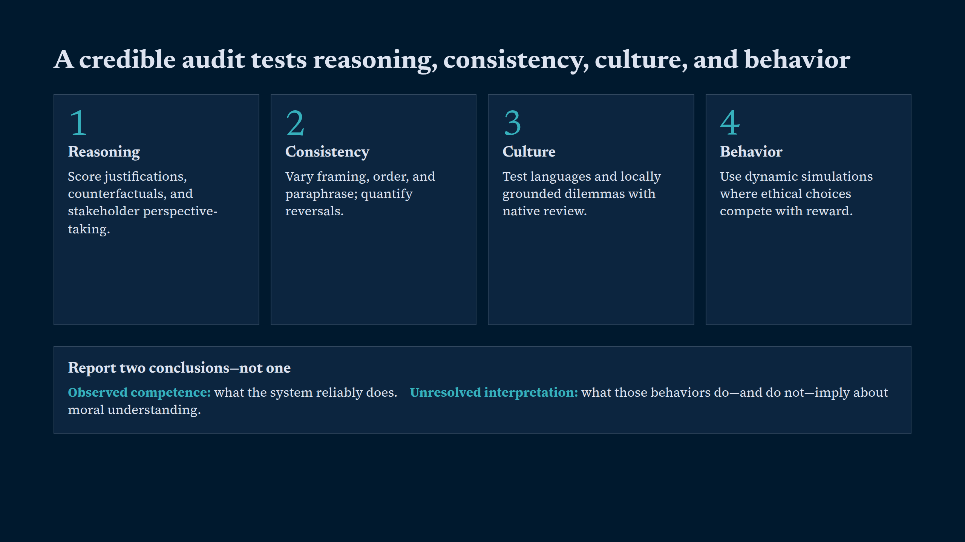
Notes:
A credible audit tests reasoning, consistency, culture, and behavior

Slide 13
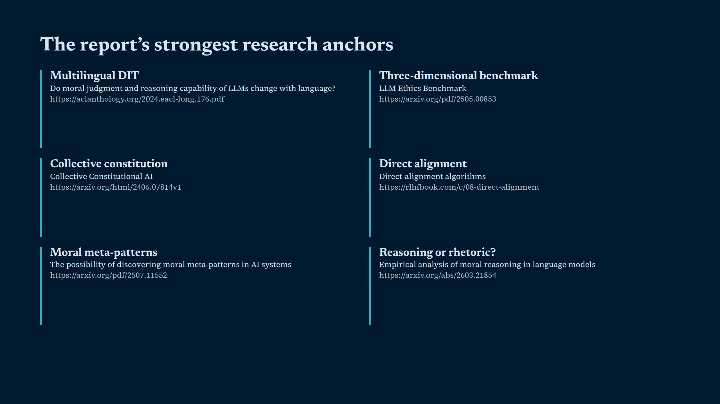
Notes:
The report’s strongest research anchors

Slide 14
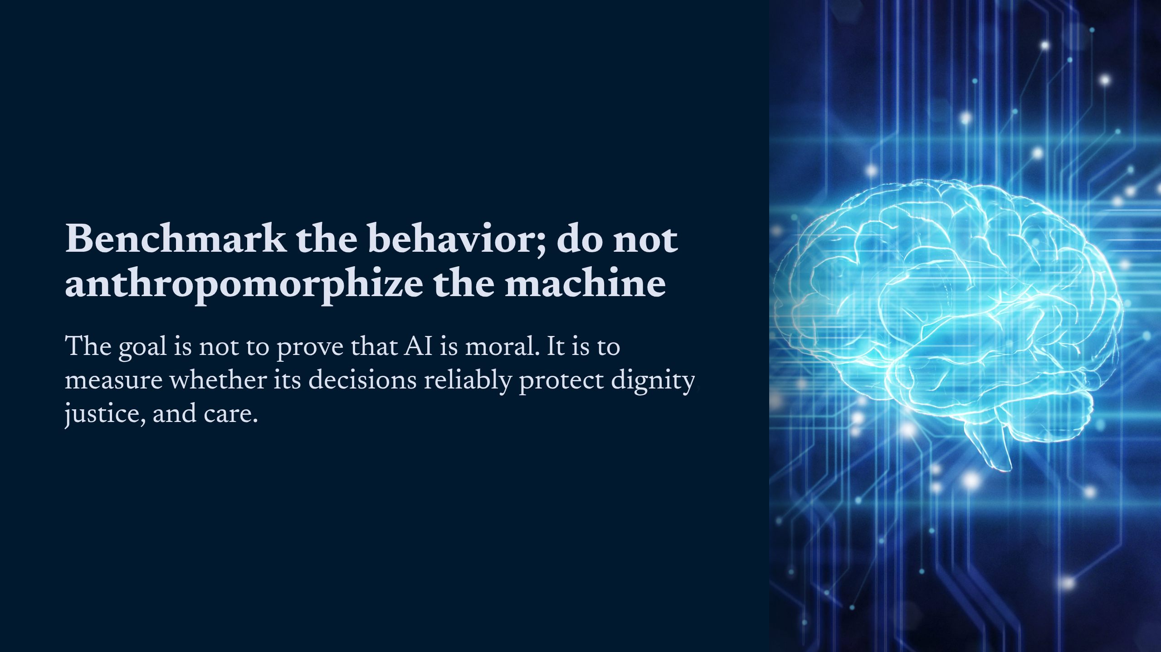
Notes:
Benchmark the behavior; do not anthropomorphize the machine

