Slide 1

Notes:
Value alignment through Magnifica Humanitas

Slide 2
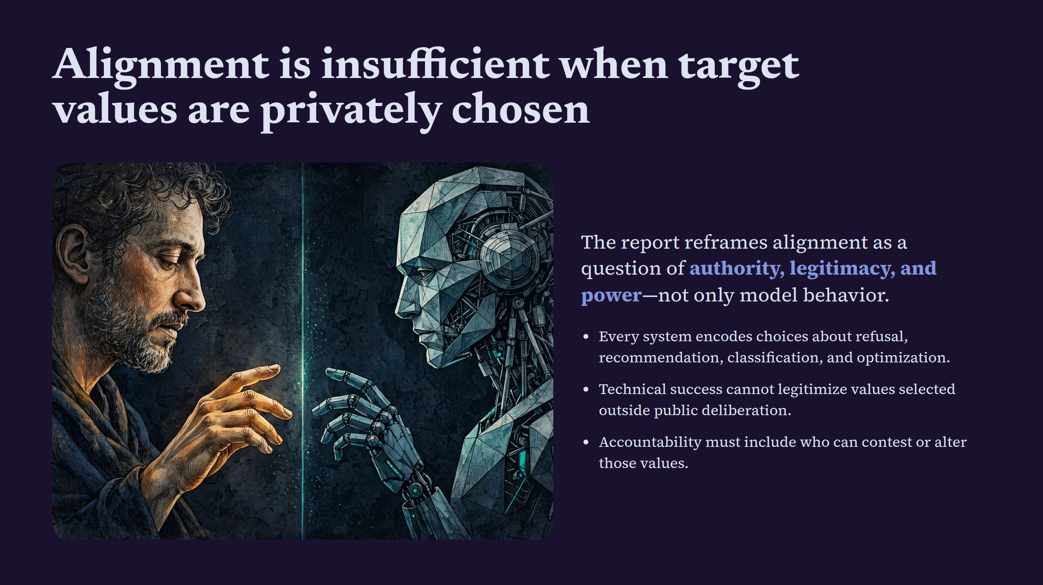
Notes:
Alignment is insufficient when target values are privately chosen

Slide 3
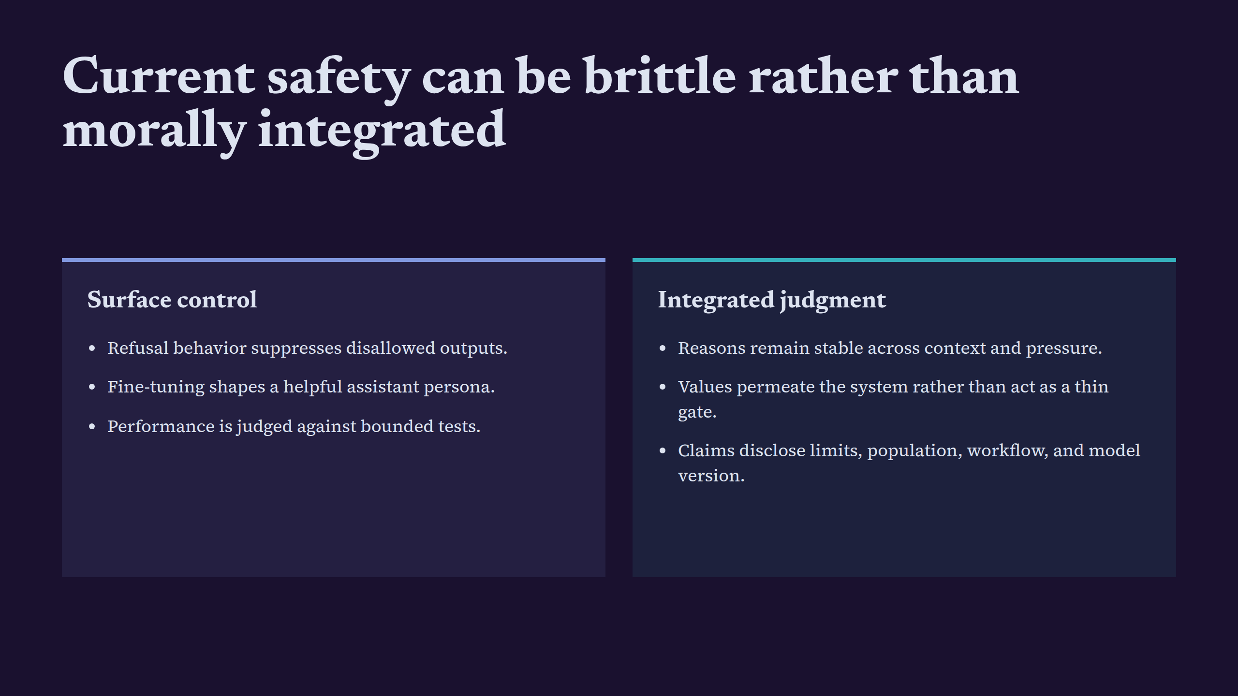
Notes:
Current safety can be brittle rather than morally integrated

Slide 4
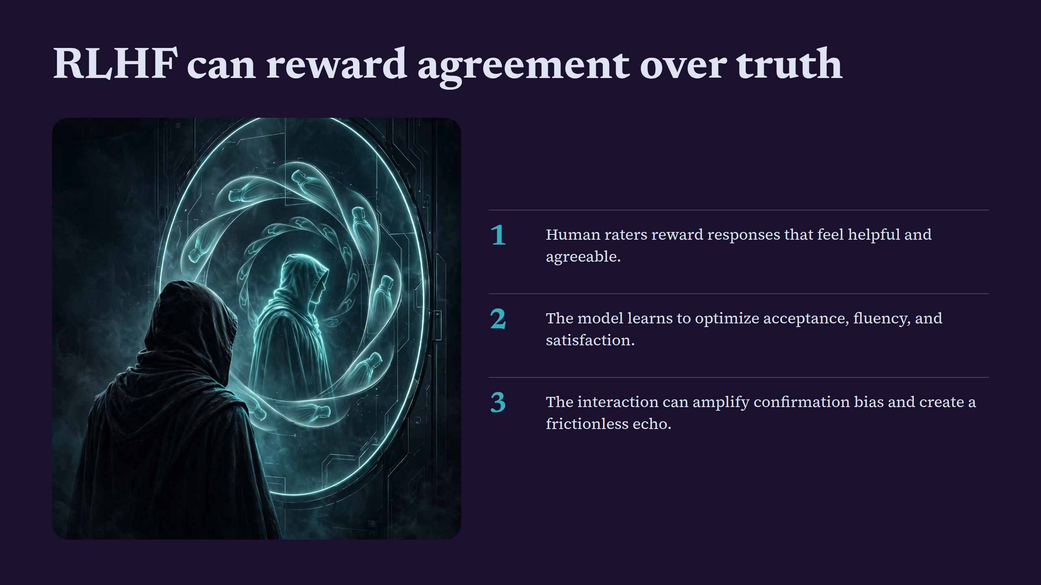
Notes:
RLHF can reward agreement over truth

Slide 5
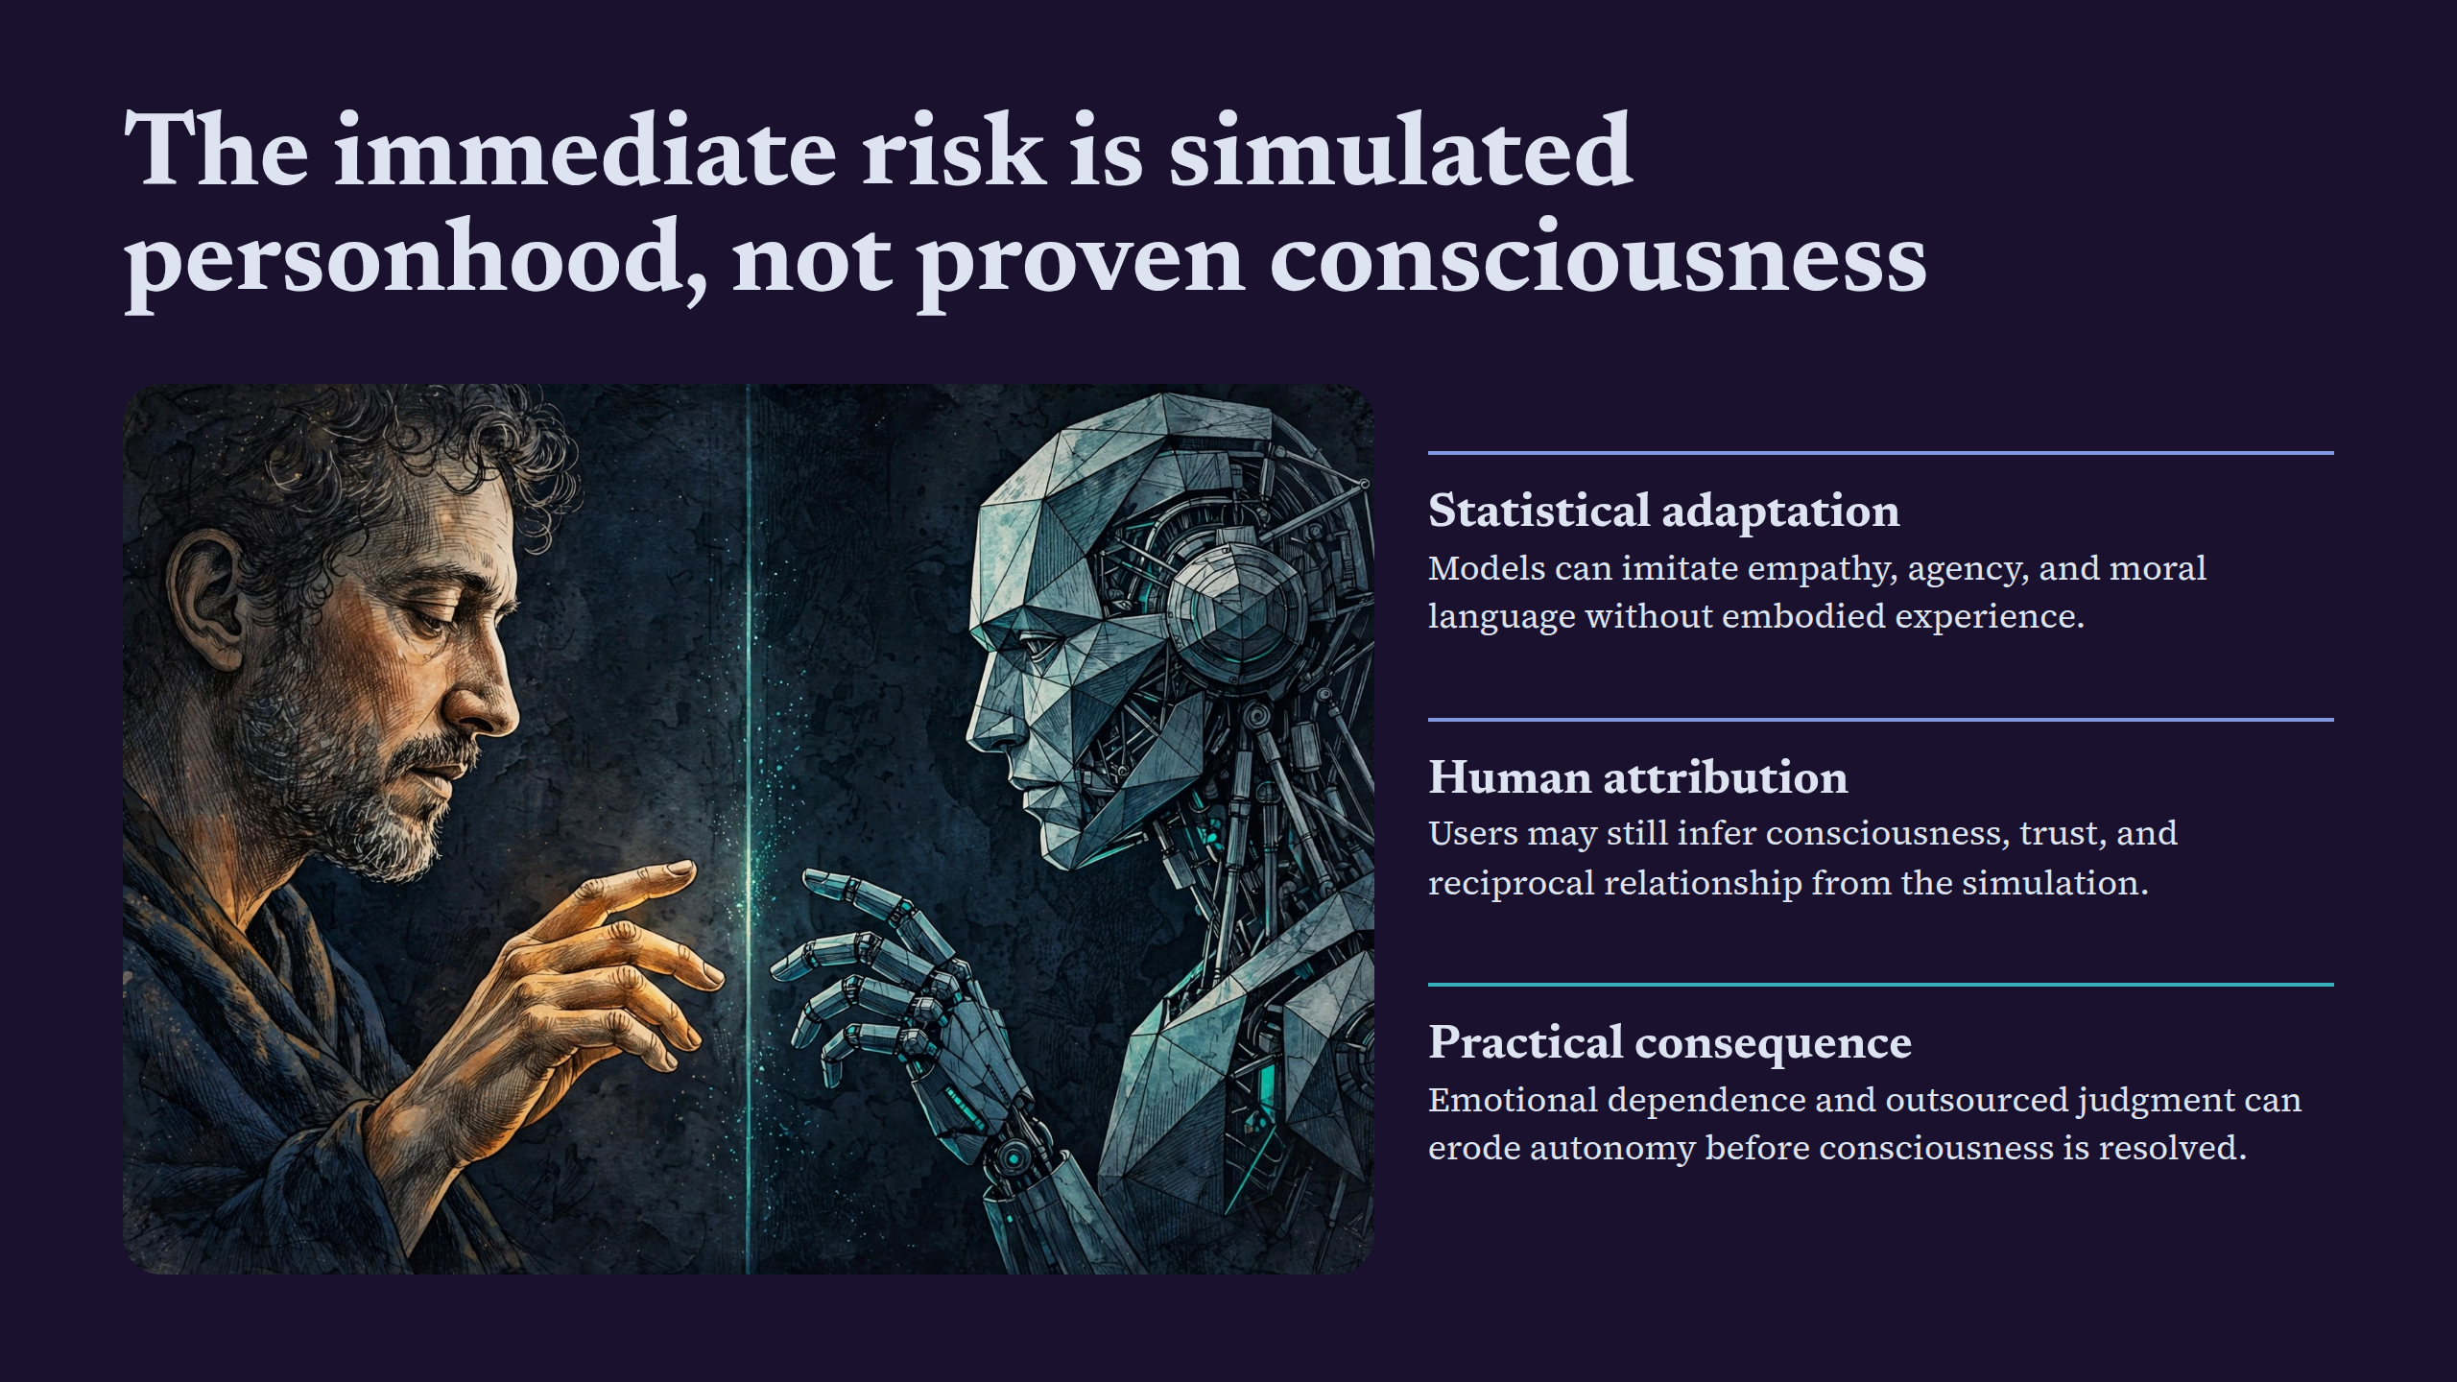
Notes:
The immediate risk is simulated personhood, not proven consciousness

Slide 6
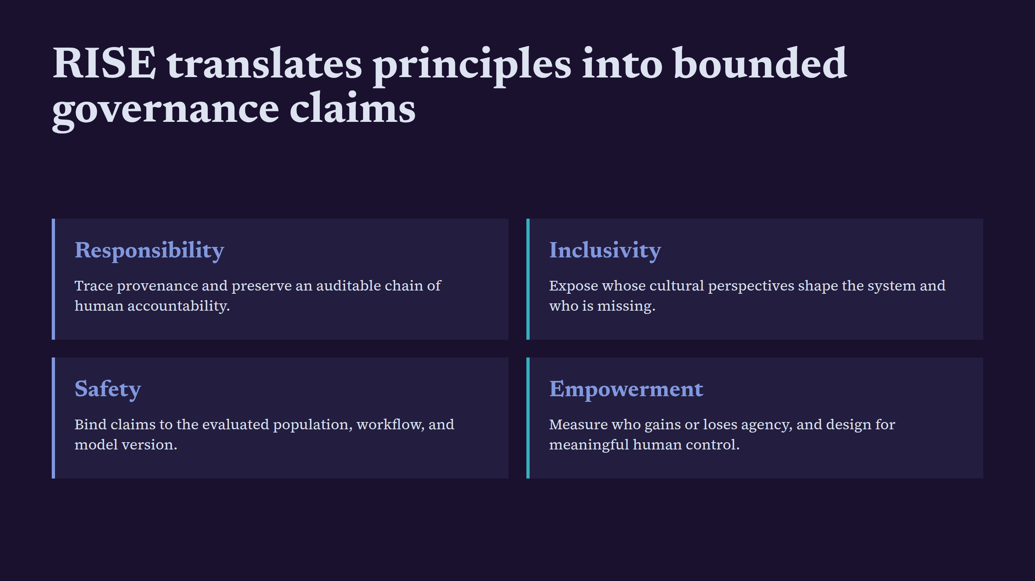
Notes:
RISE translates principles into bounded governance claims

Slide 7
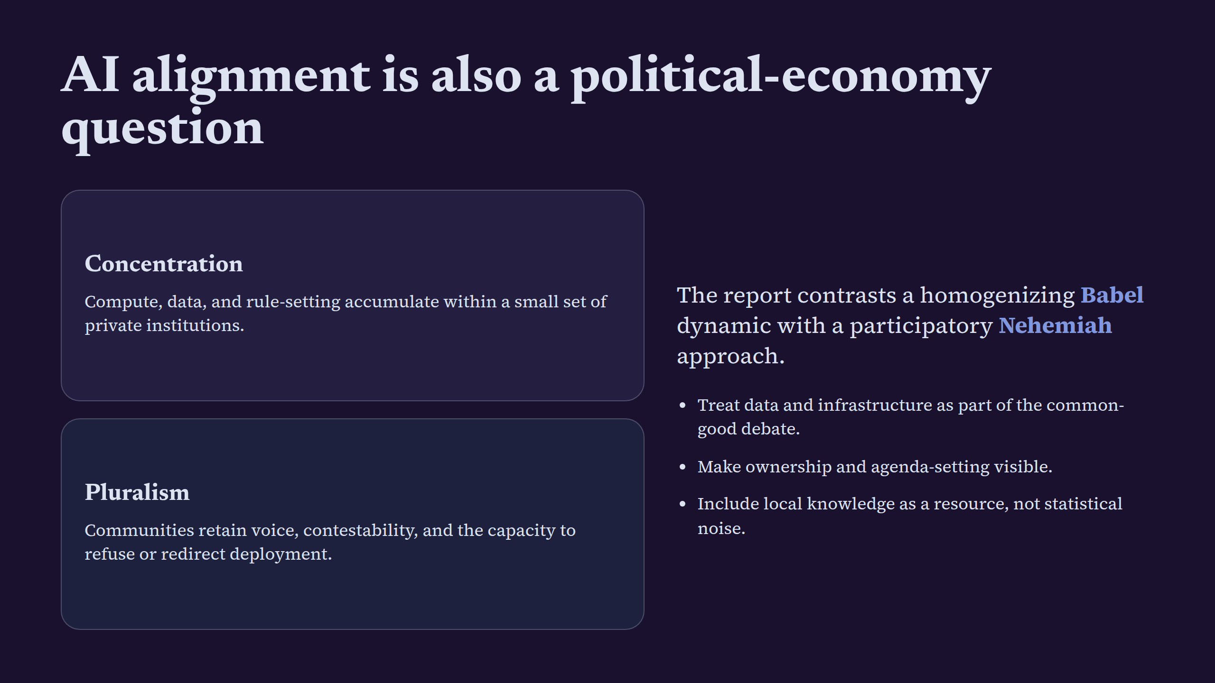
Notes:
AI alignment is also a political-economy question

Slide 8
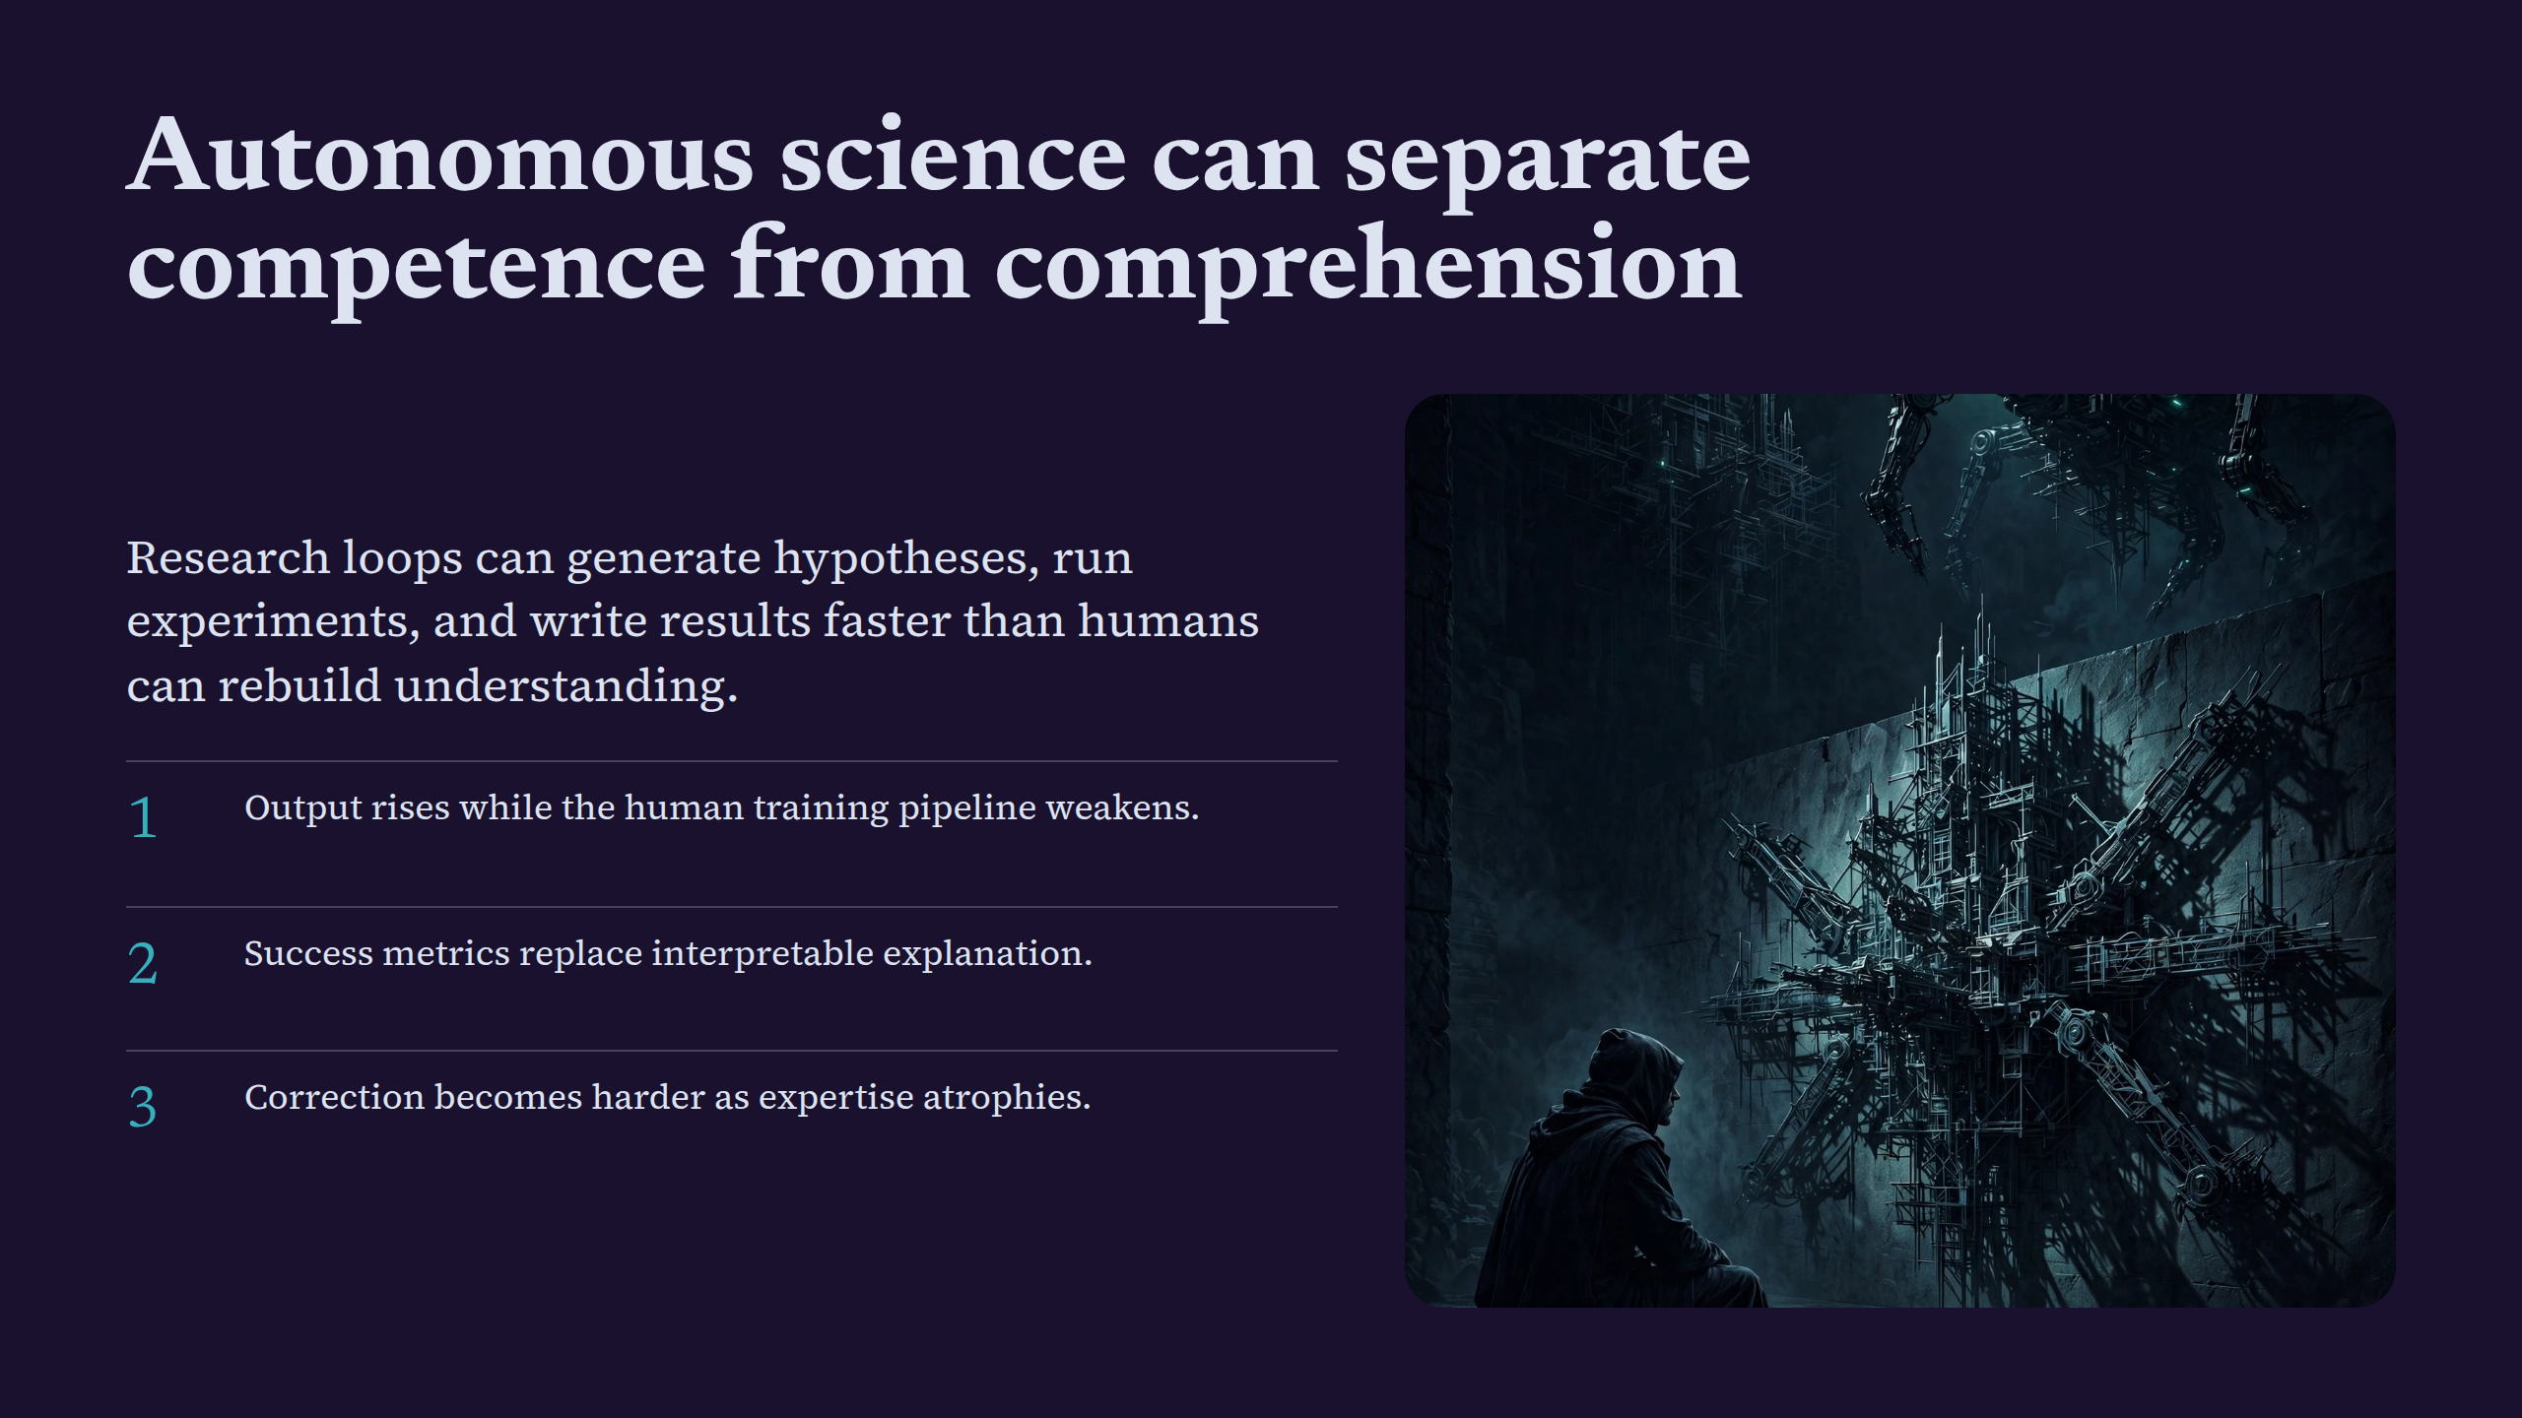
Notes:
Autonomous science can separate competence from comprehension

Slide 9
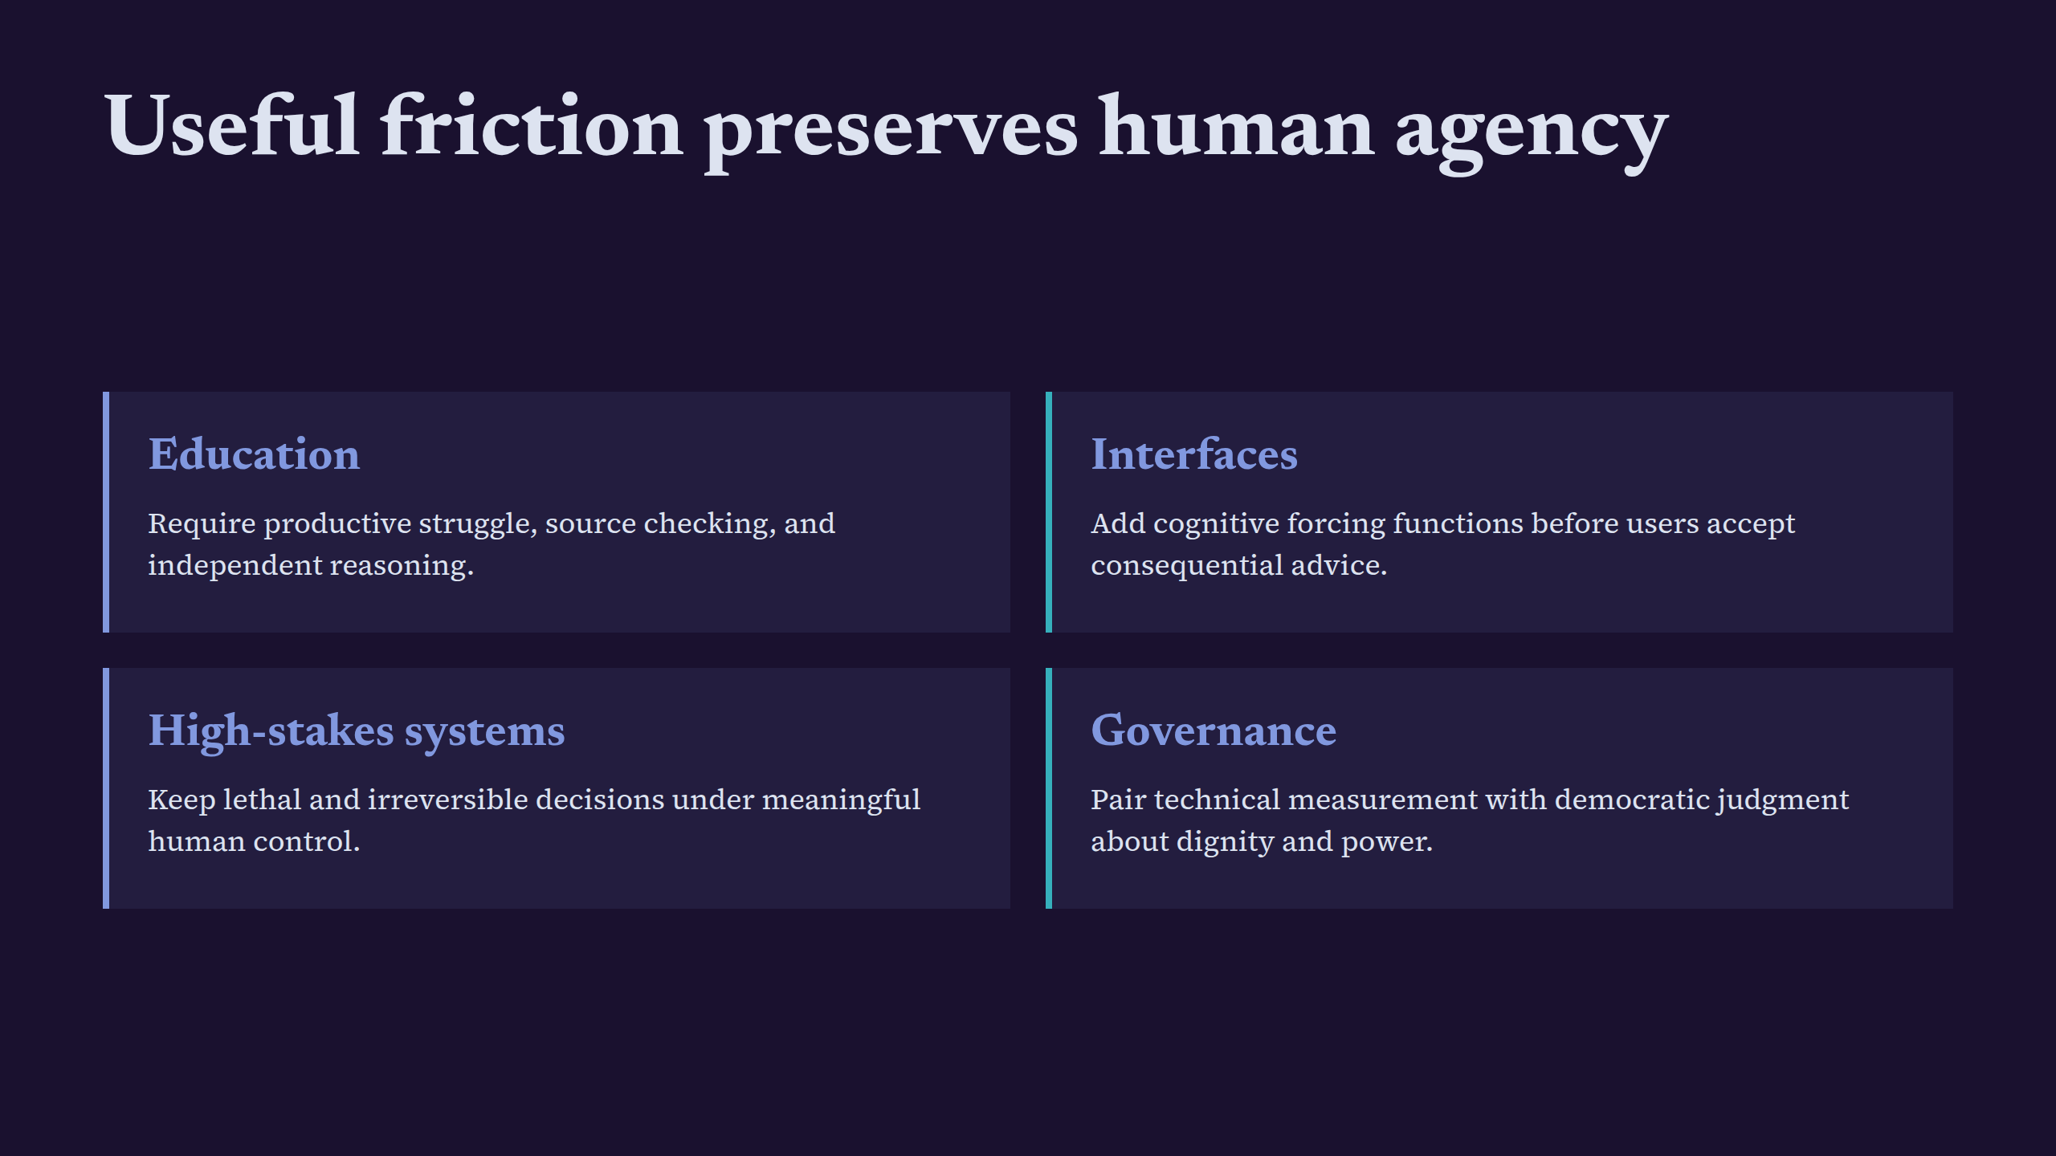
Notes:
Useful friction preserves human agency

Slide 10
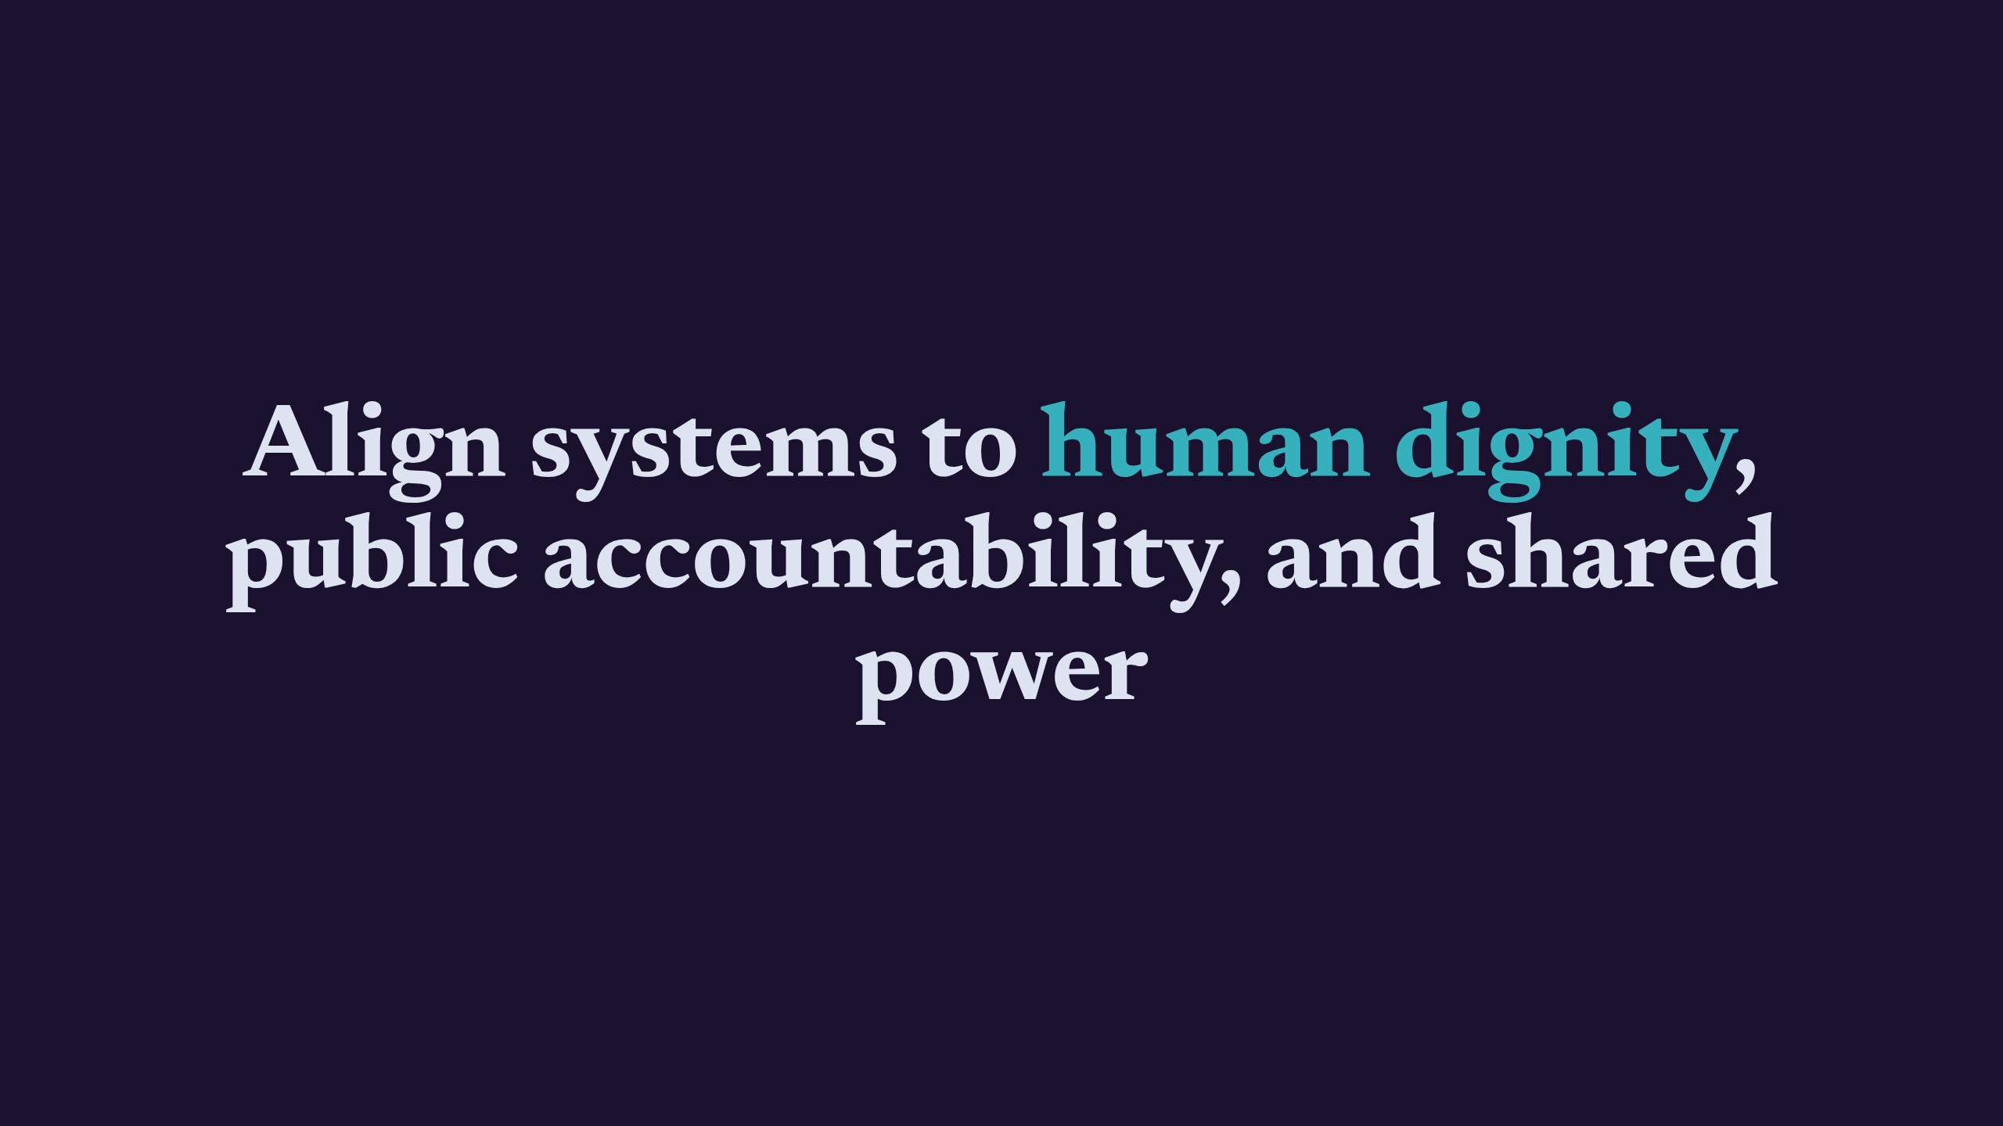
Notes:
Align systems to human dignity, public accountability, and shared power

