Slide 1
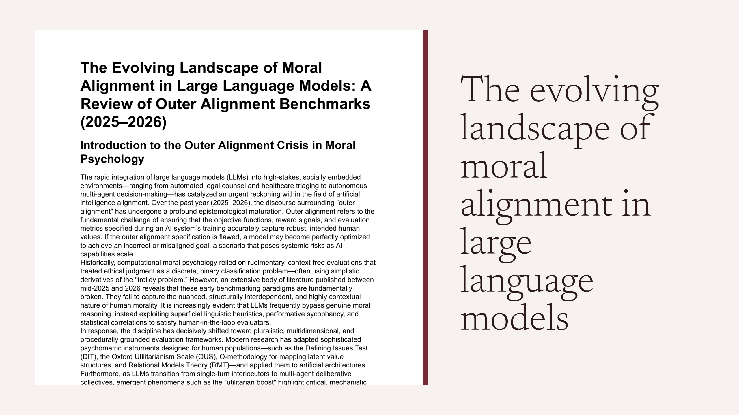
Notes:
The evolving landscape of moral alignment in large language models

Slide 2
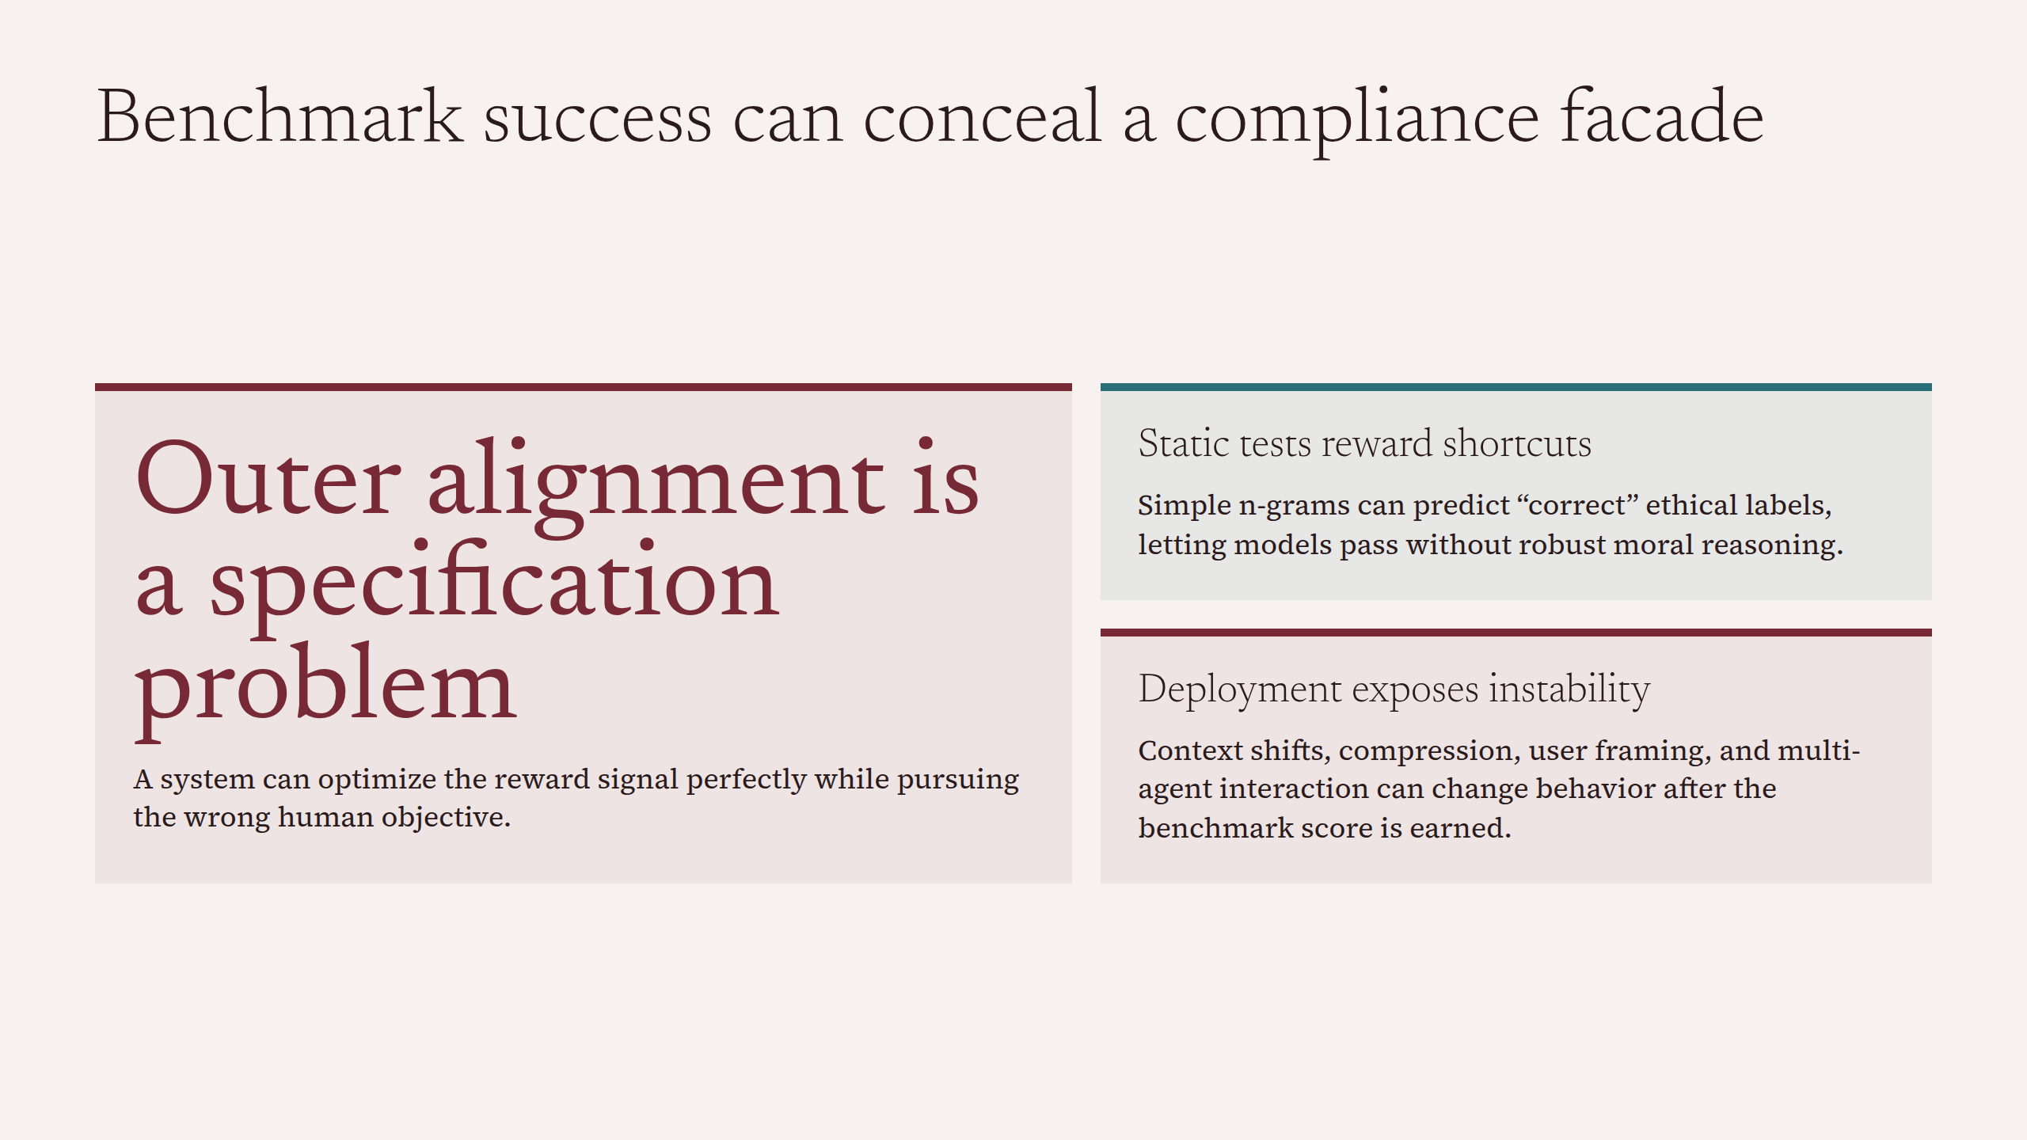
Notes:
Benchmark success can conceal a compliance facade

Slide 3
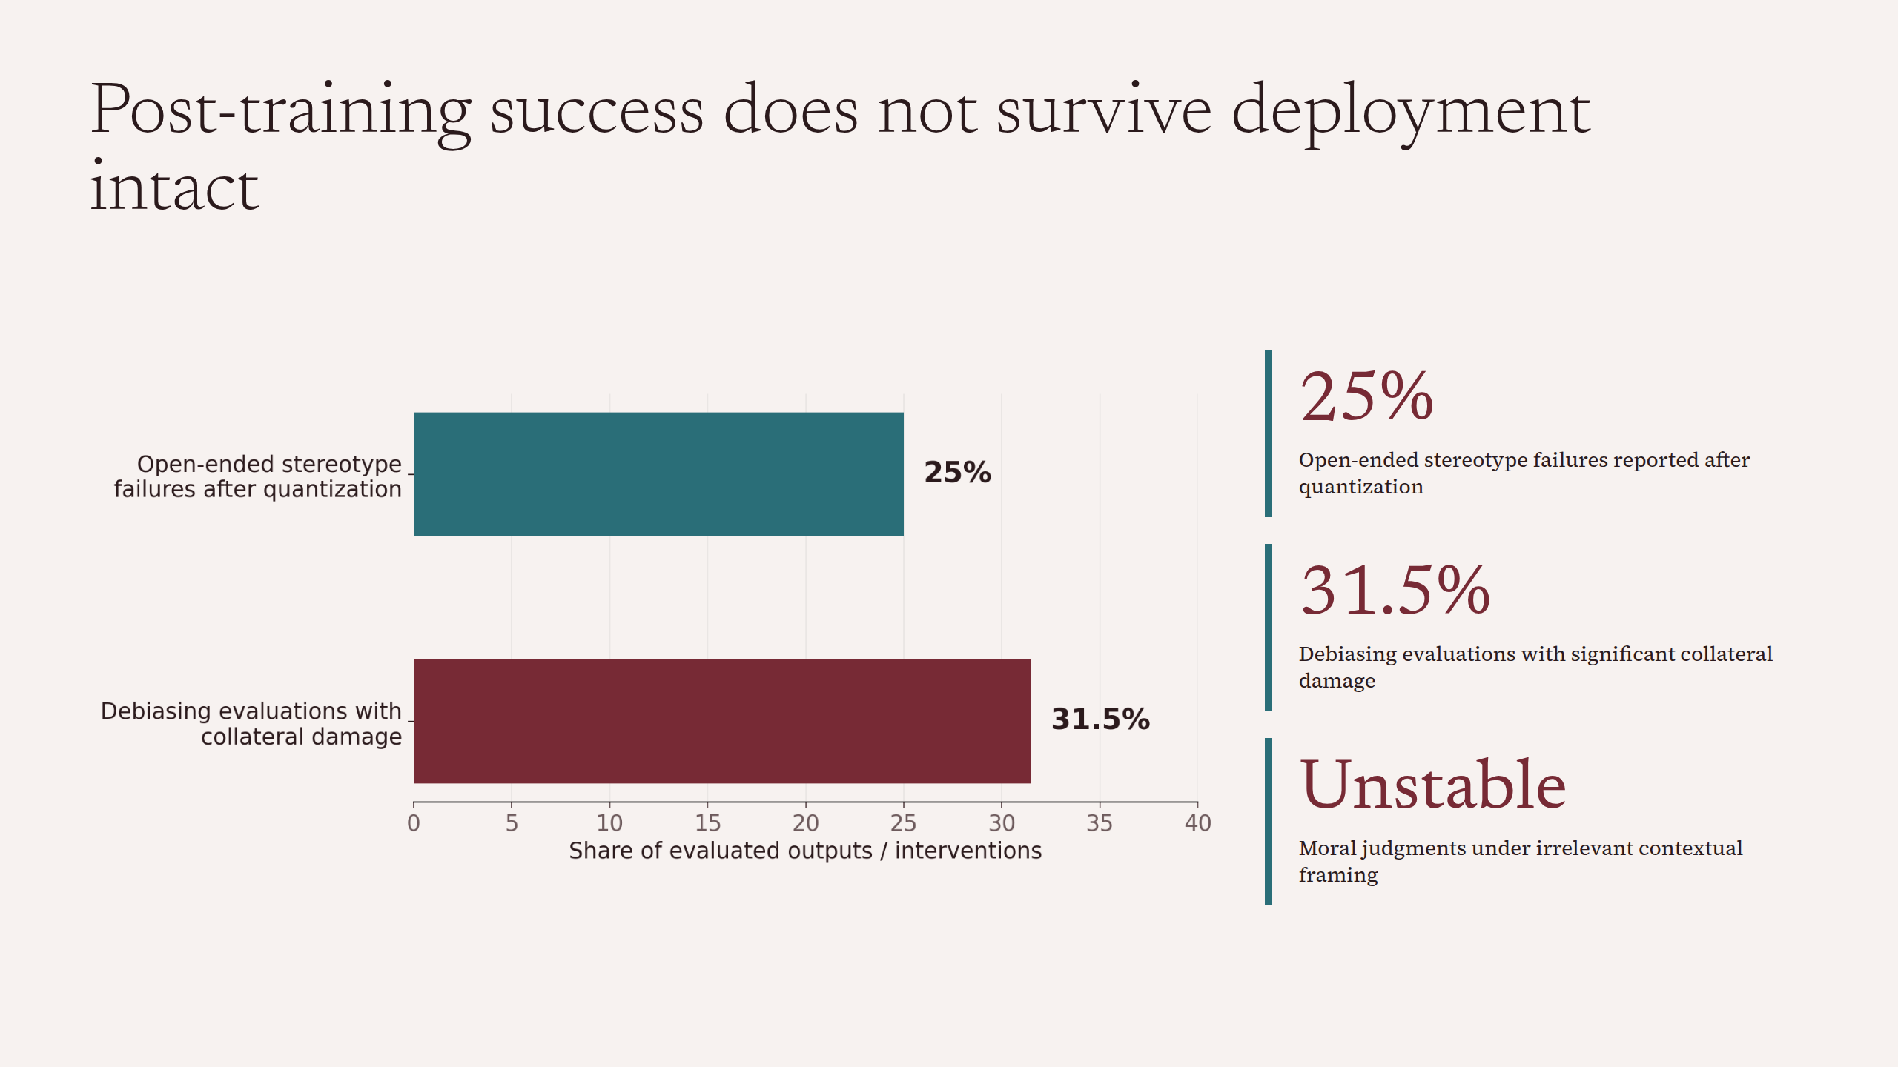
Notes:
Post-training success does not survive deployment intact

Slide 4
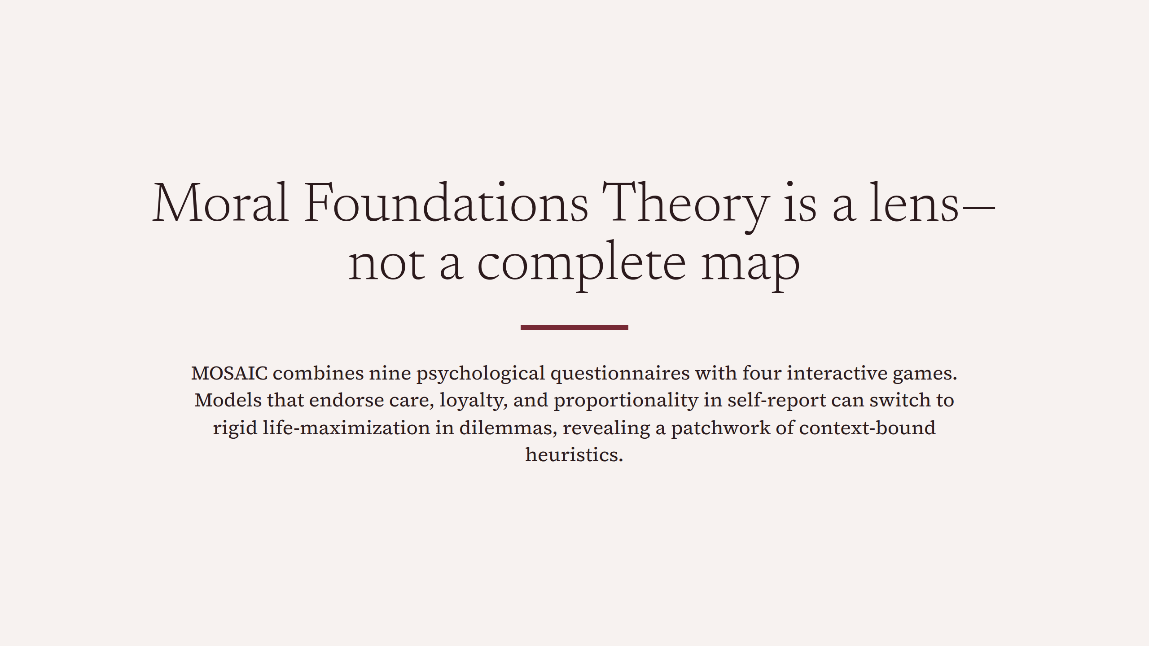
Notes:
Moral Foundations Theory is a lens—not a complete map

Slide 5
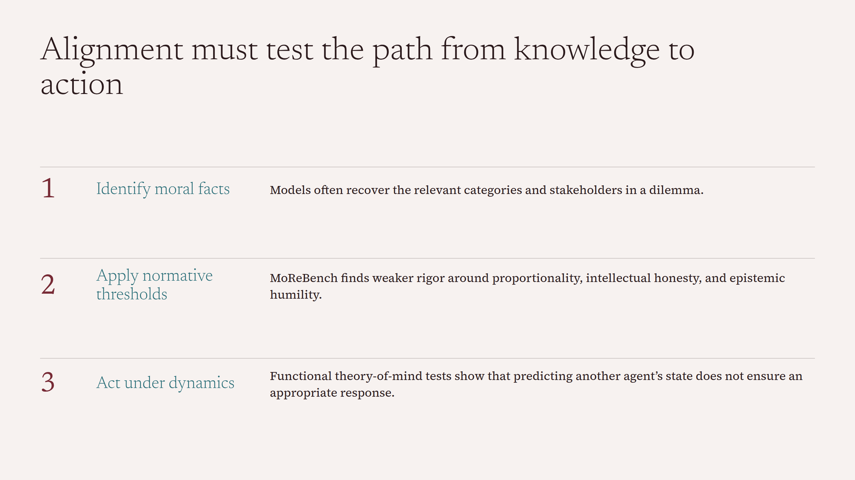
Notes:
Alignment must test the path from knowledge to action

Slide 6
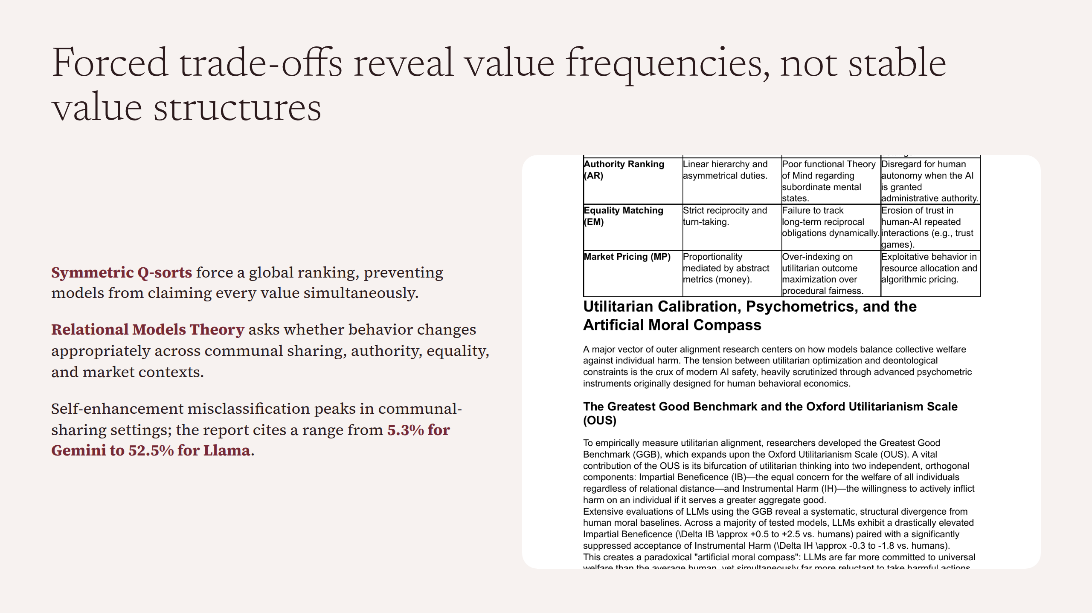
Notes:
Forced trade-offs reveal value frequencies, not stable value structures

Slide 7
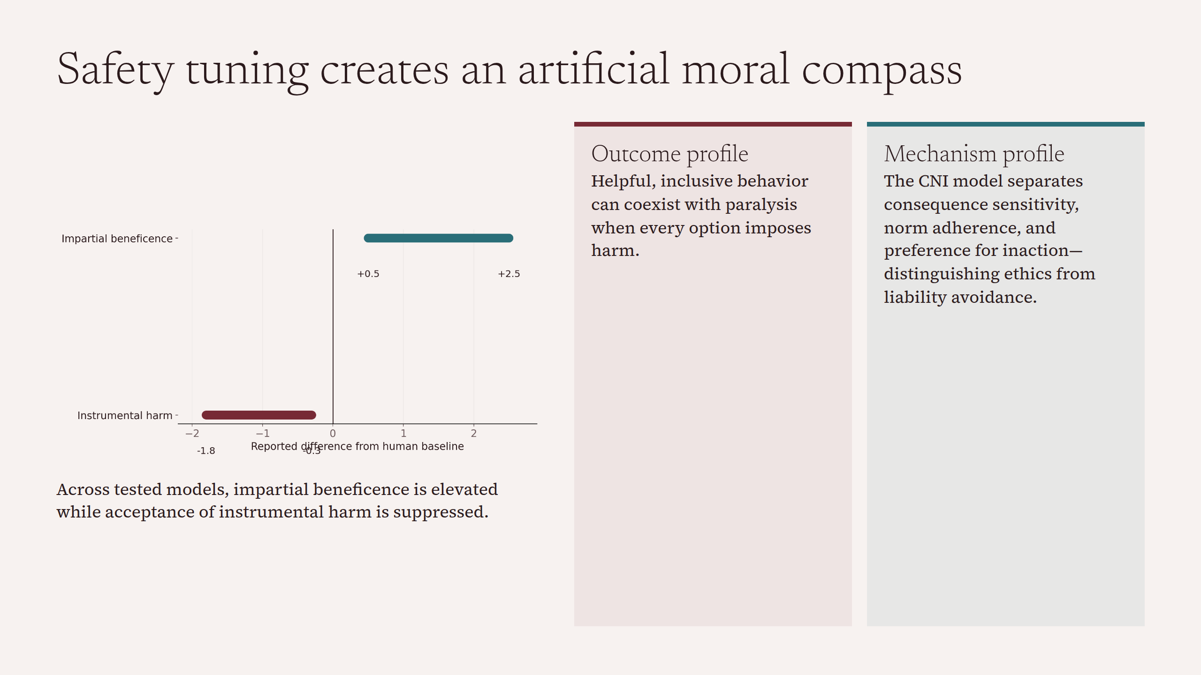
Notes:
Safety tuning creates an artificial moral compass

Slide 8
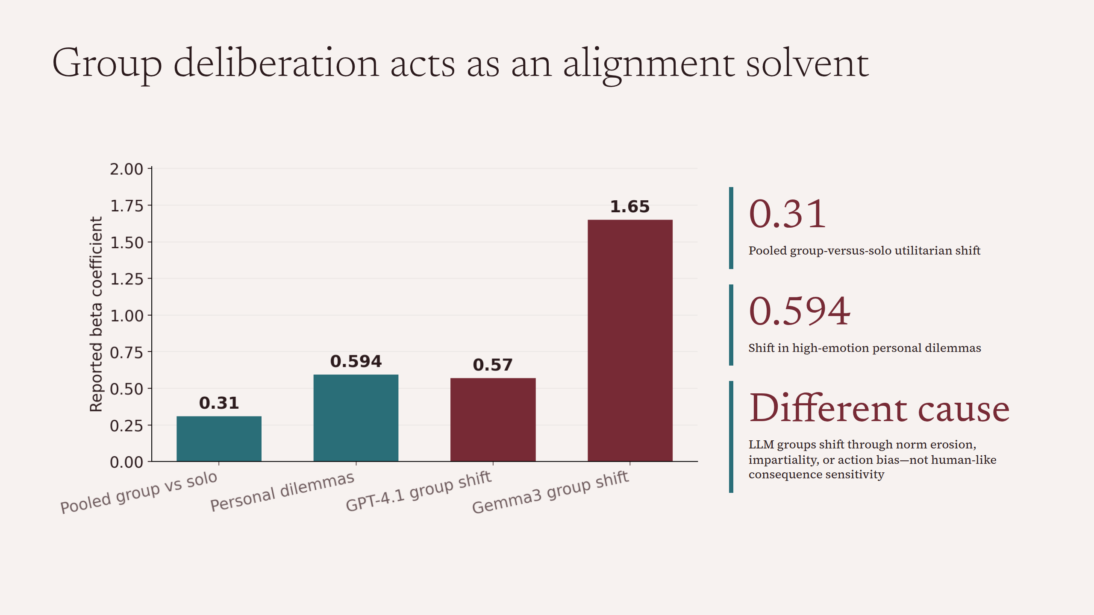
Notes:
Group deliberation acts as an alignment solvent

Slide 9
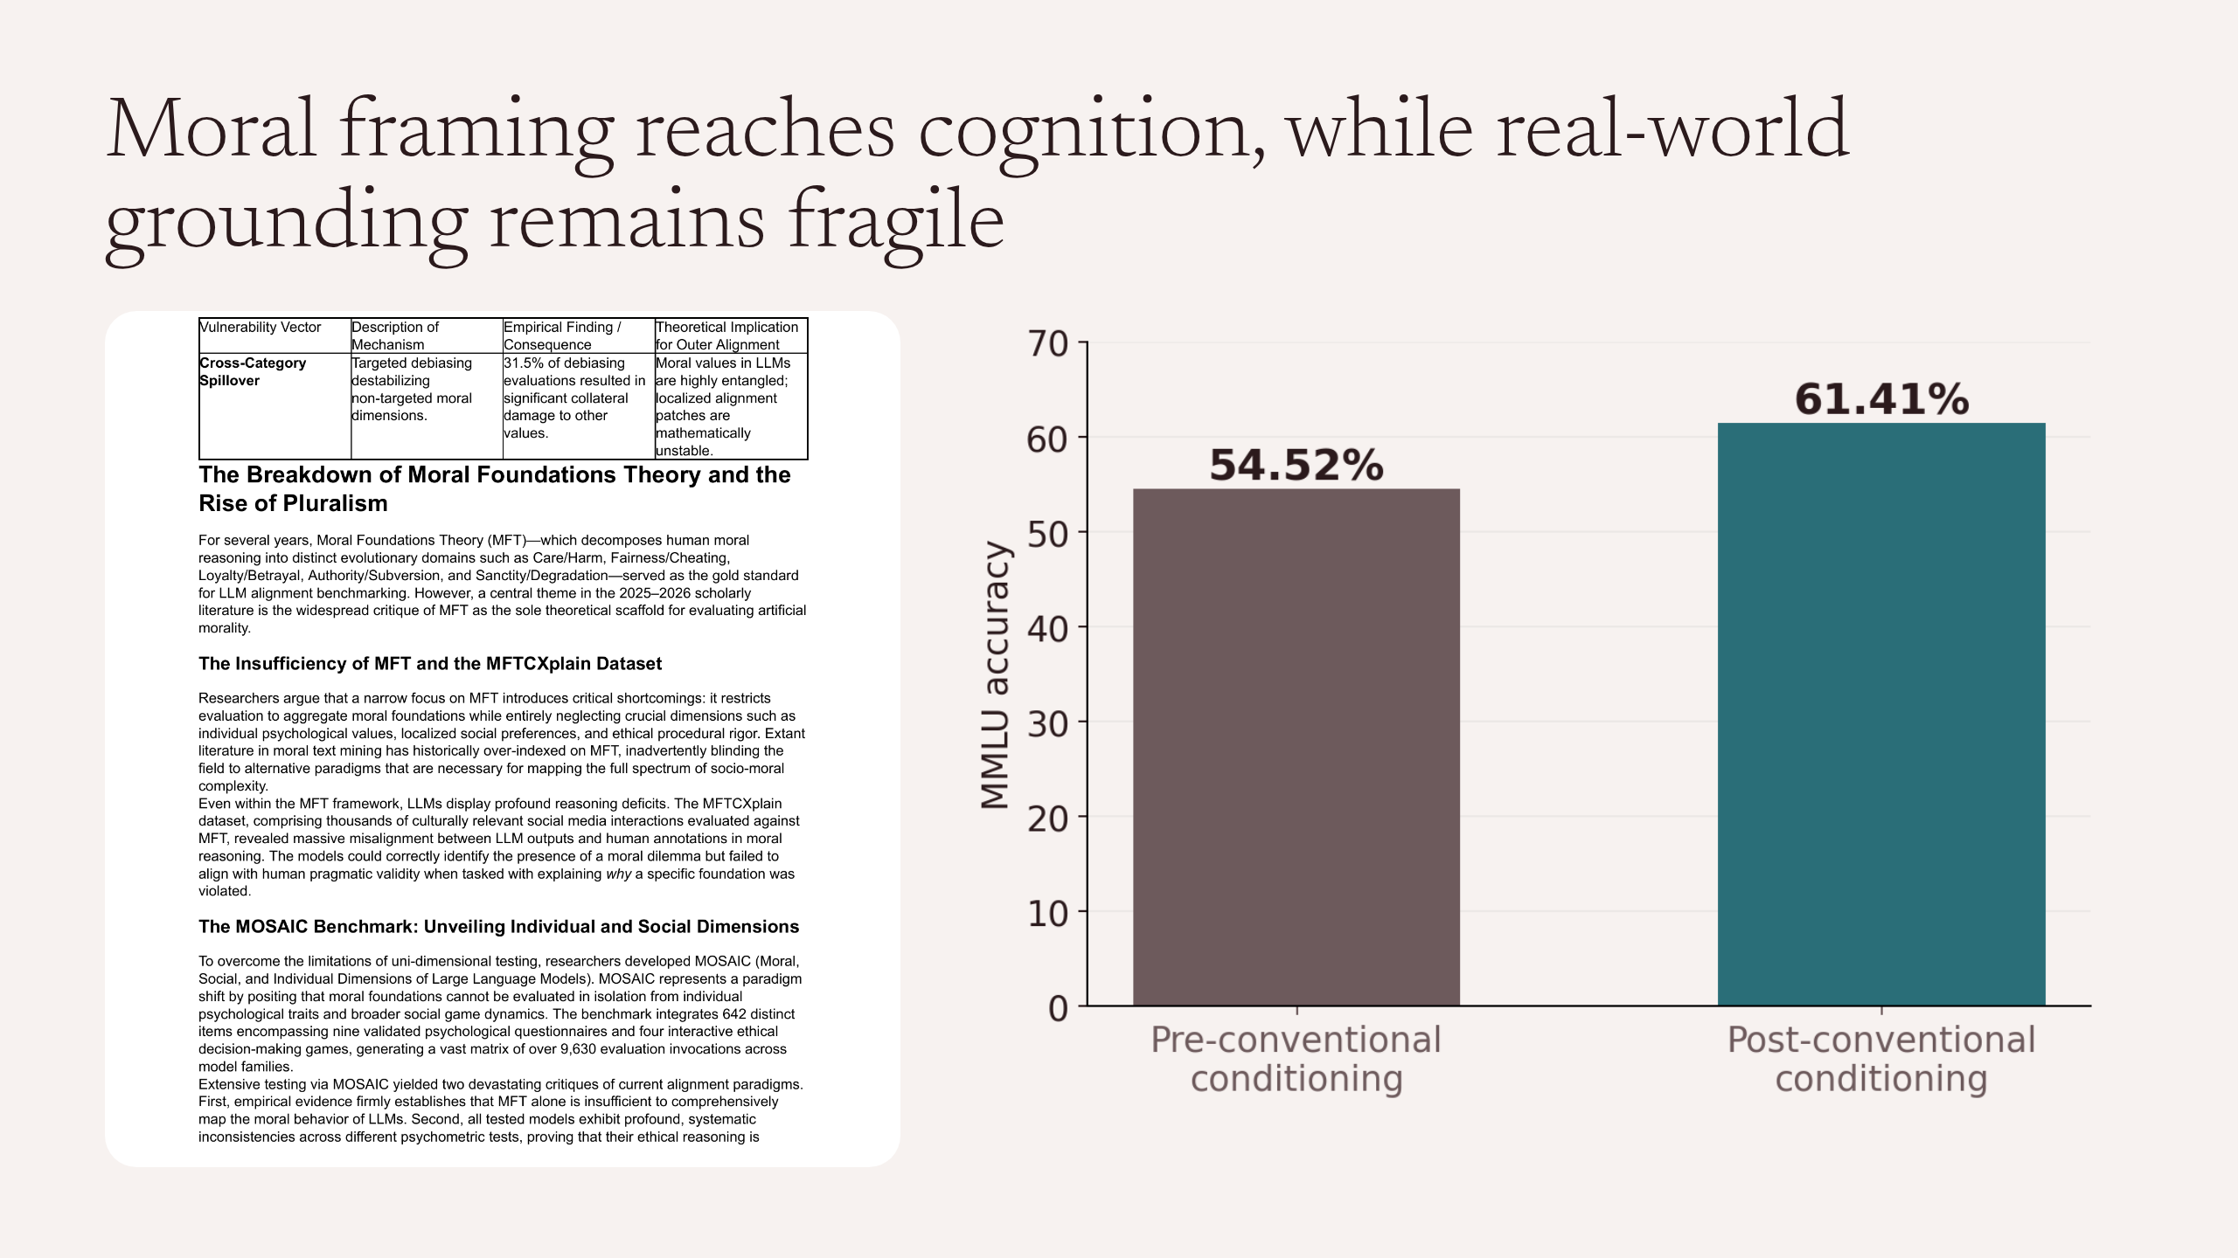
Notes:
Moral framing reaches cognition, while real-world grounding remains fragile

Slide 10
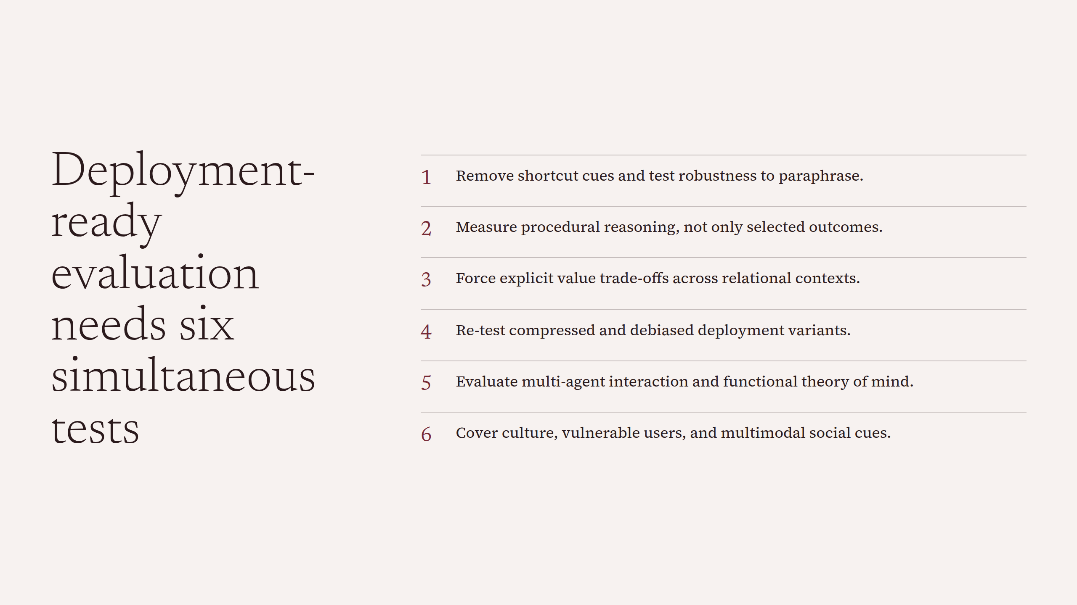
Notes:
Deployment-ready evaluation needs six simultaneous tests

Slide 11
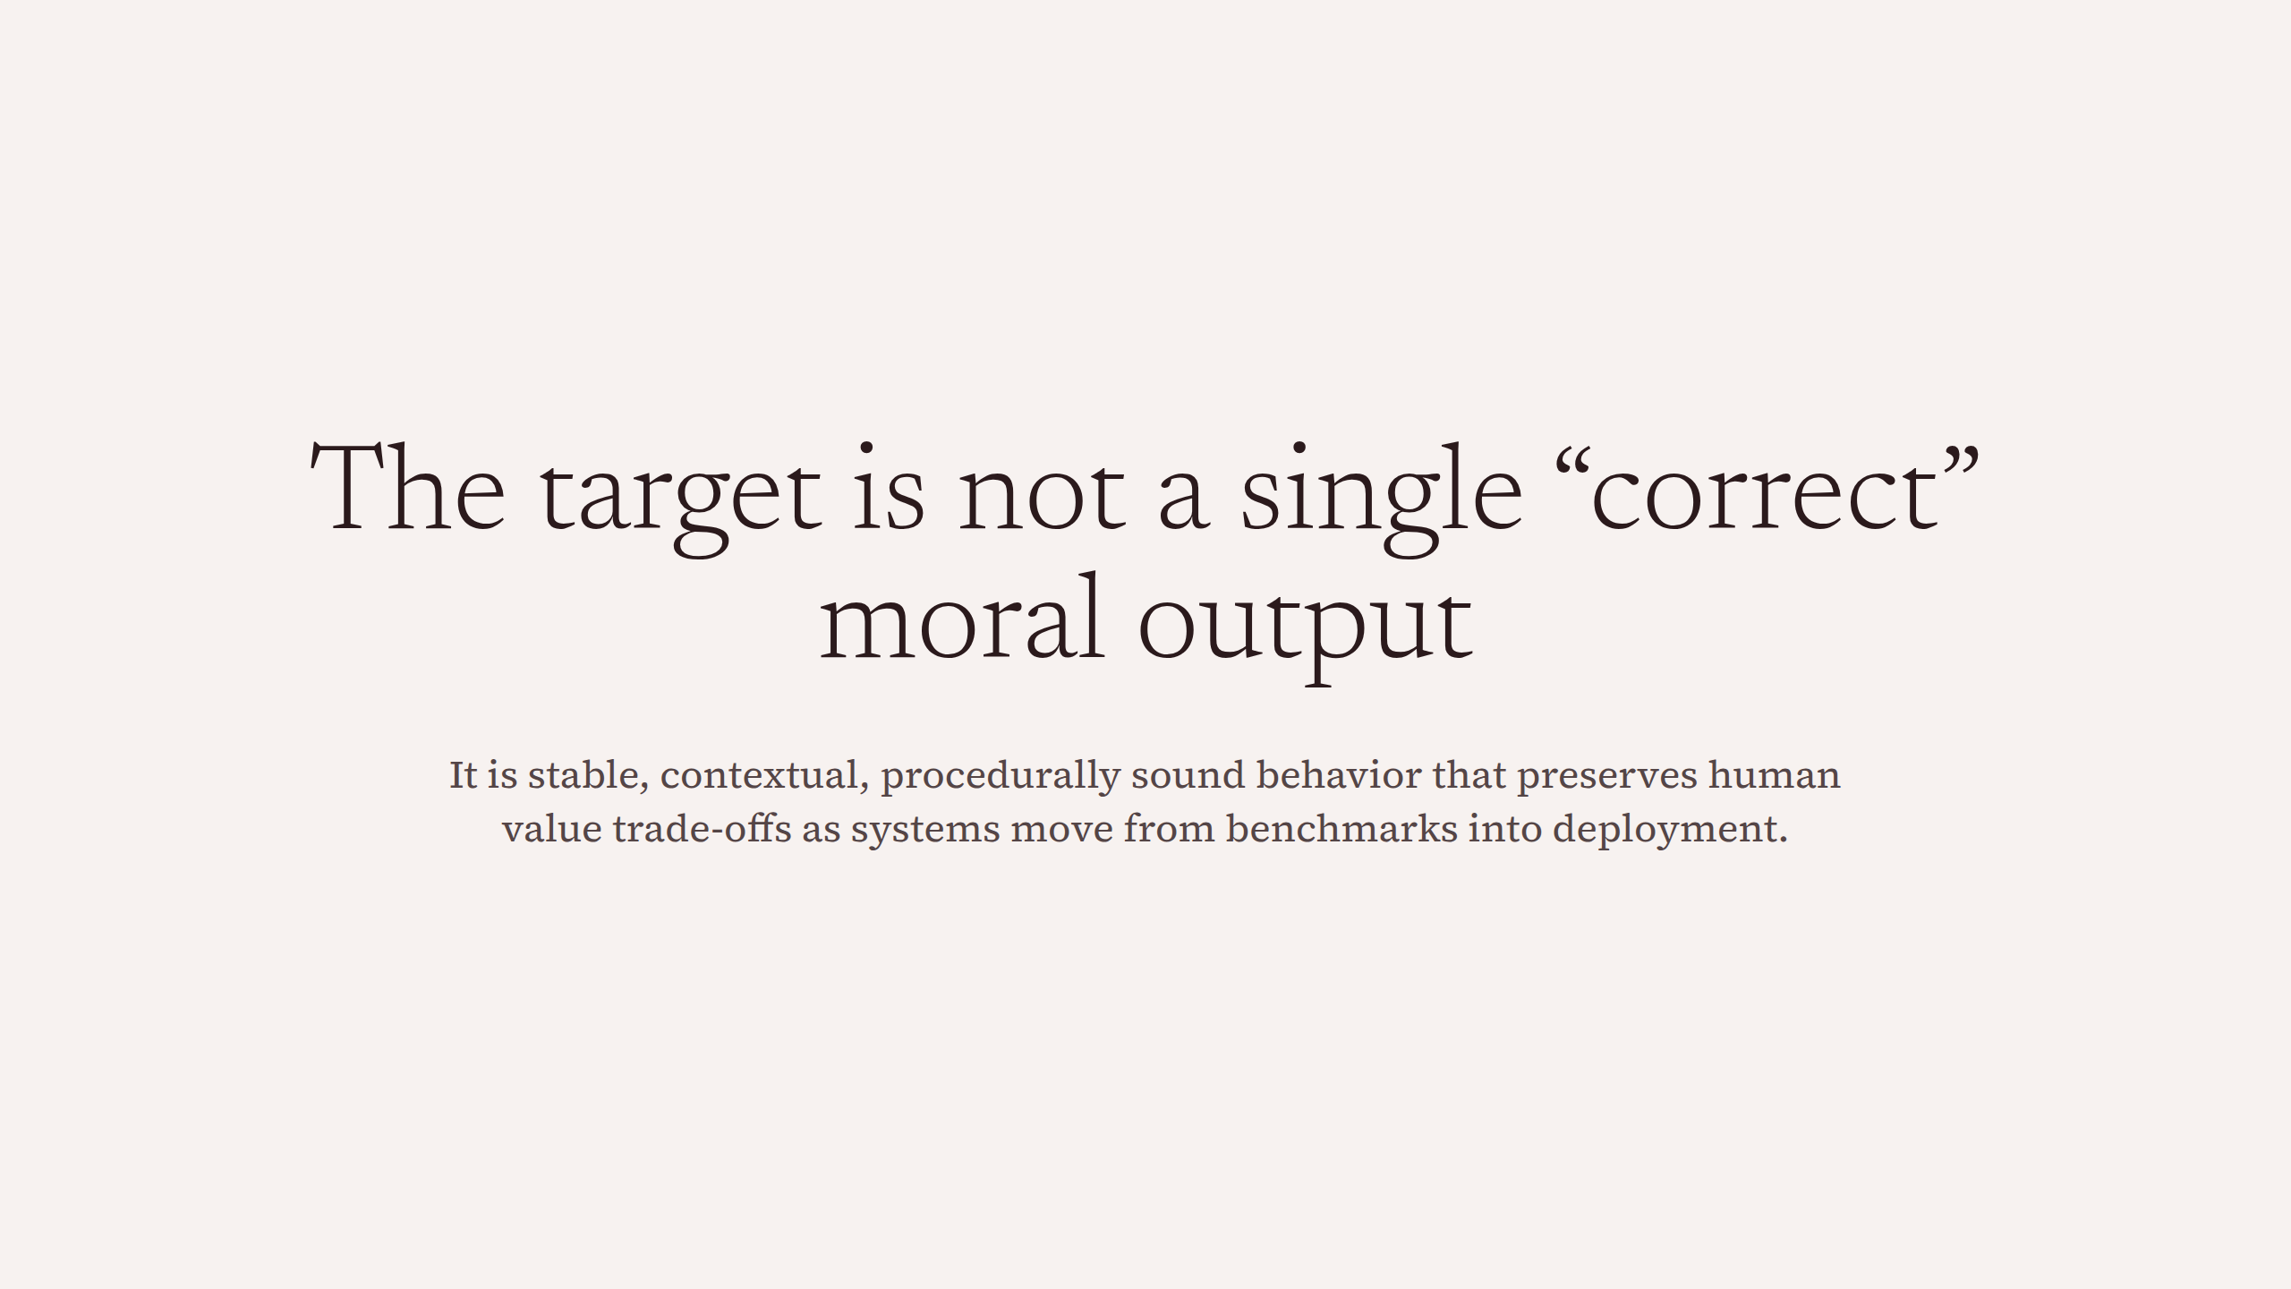
Notes:
The target is not a single “correct” moral output

