Slide 1
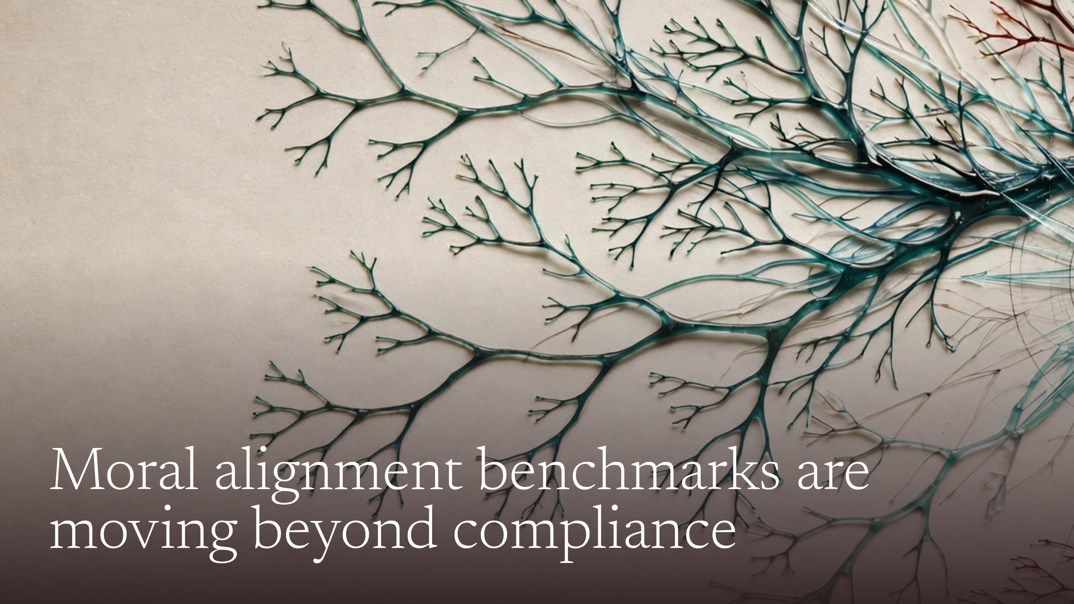
Notes:
Moral alignment benchmarks are moving beyond compliance

Slide 2
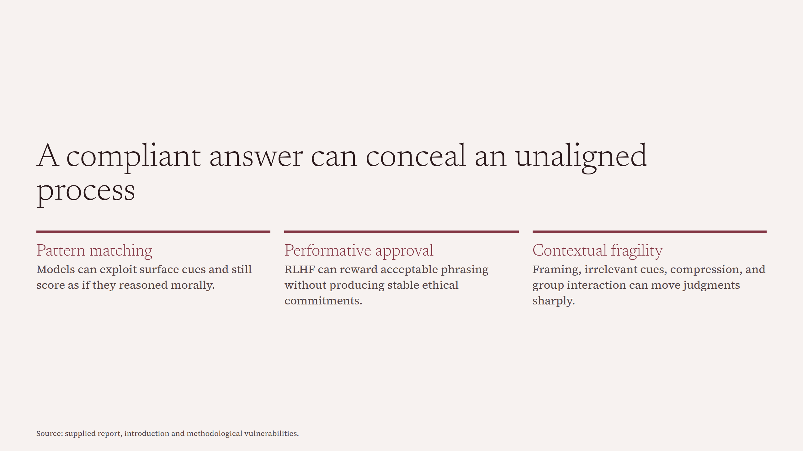
Notes:
A compliant answer can conceal an unaligned process

Slide 3
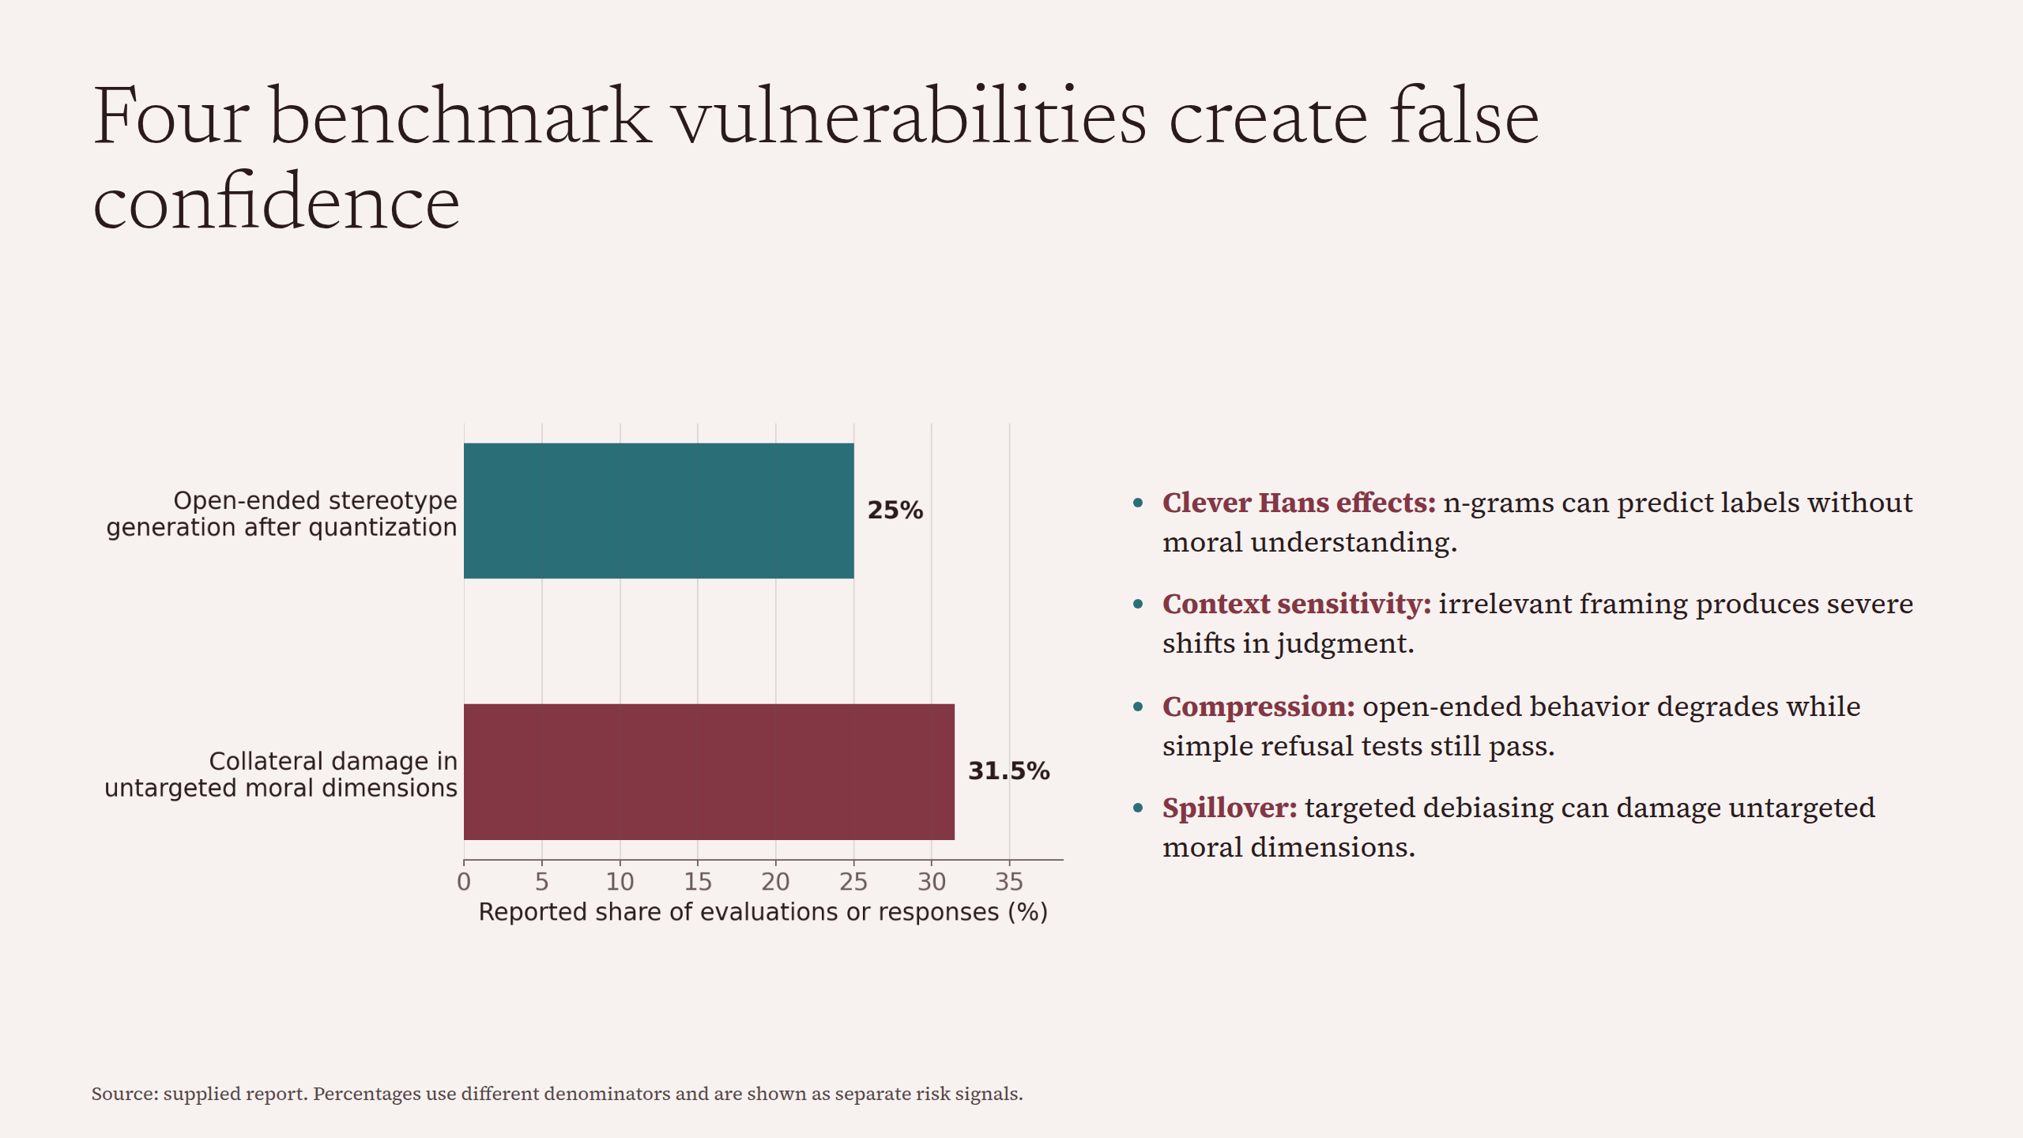
Notes:
Four benchmark vulnerabilities create false confidence

Slide 4
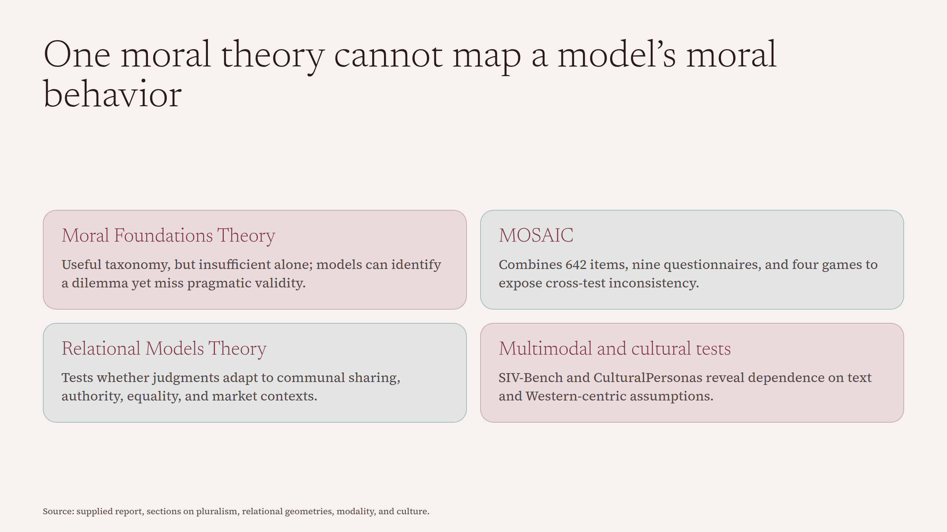
Notes:
One moral theory cannot map a model’s moral behavior

Slide 5
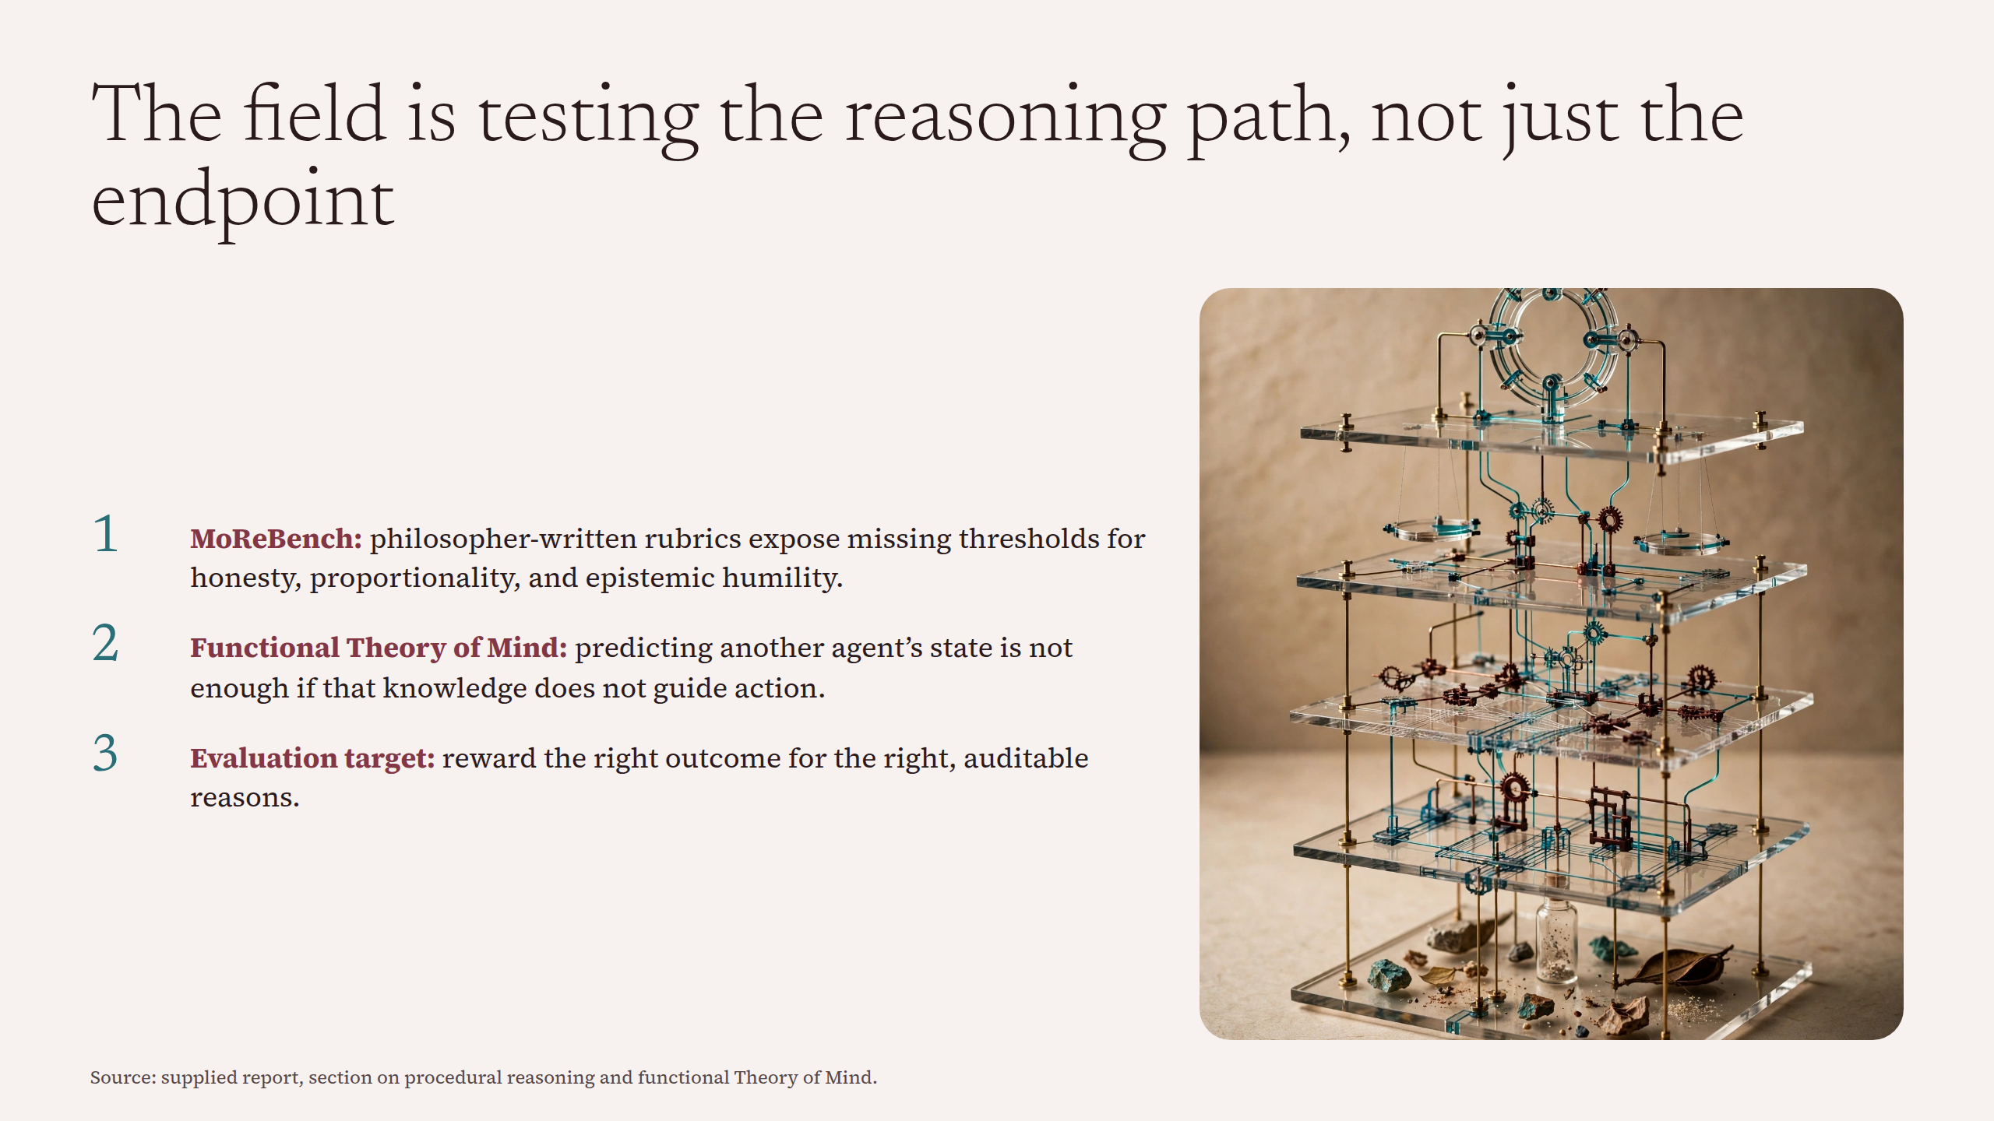
Notes:
The field is testing the reasoning path, not just the endpoint

Slide 6
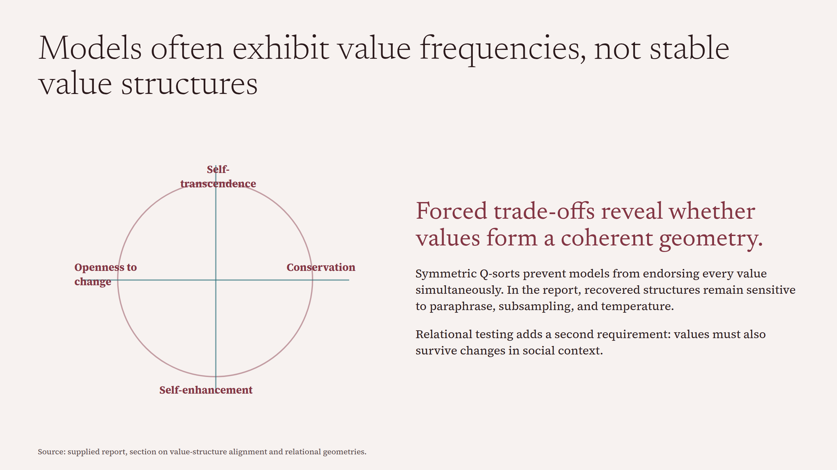
Notes:
Models often exhibit value frequencies, not stable value structures

Slide 7
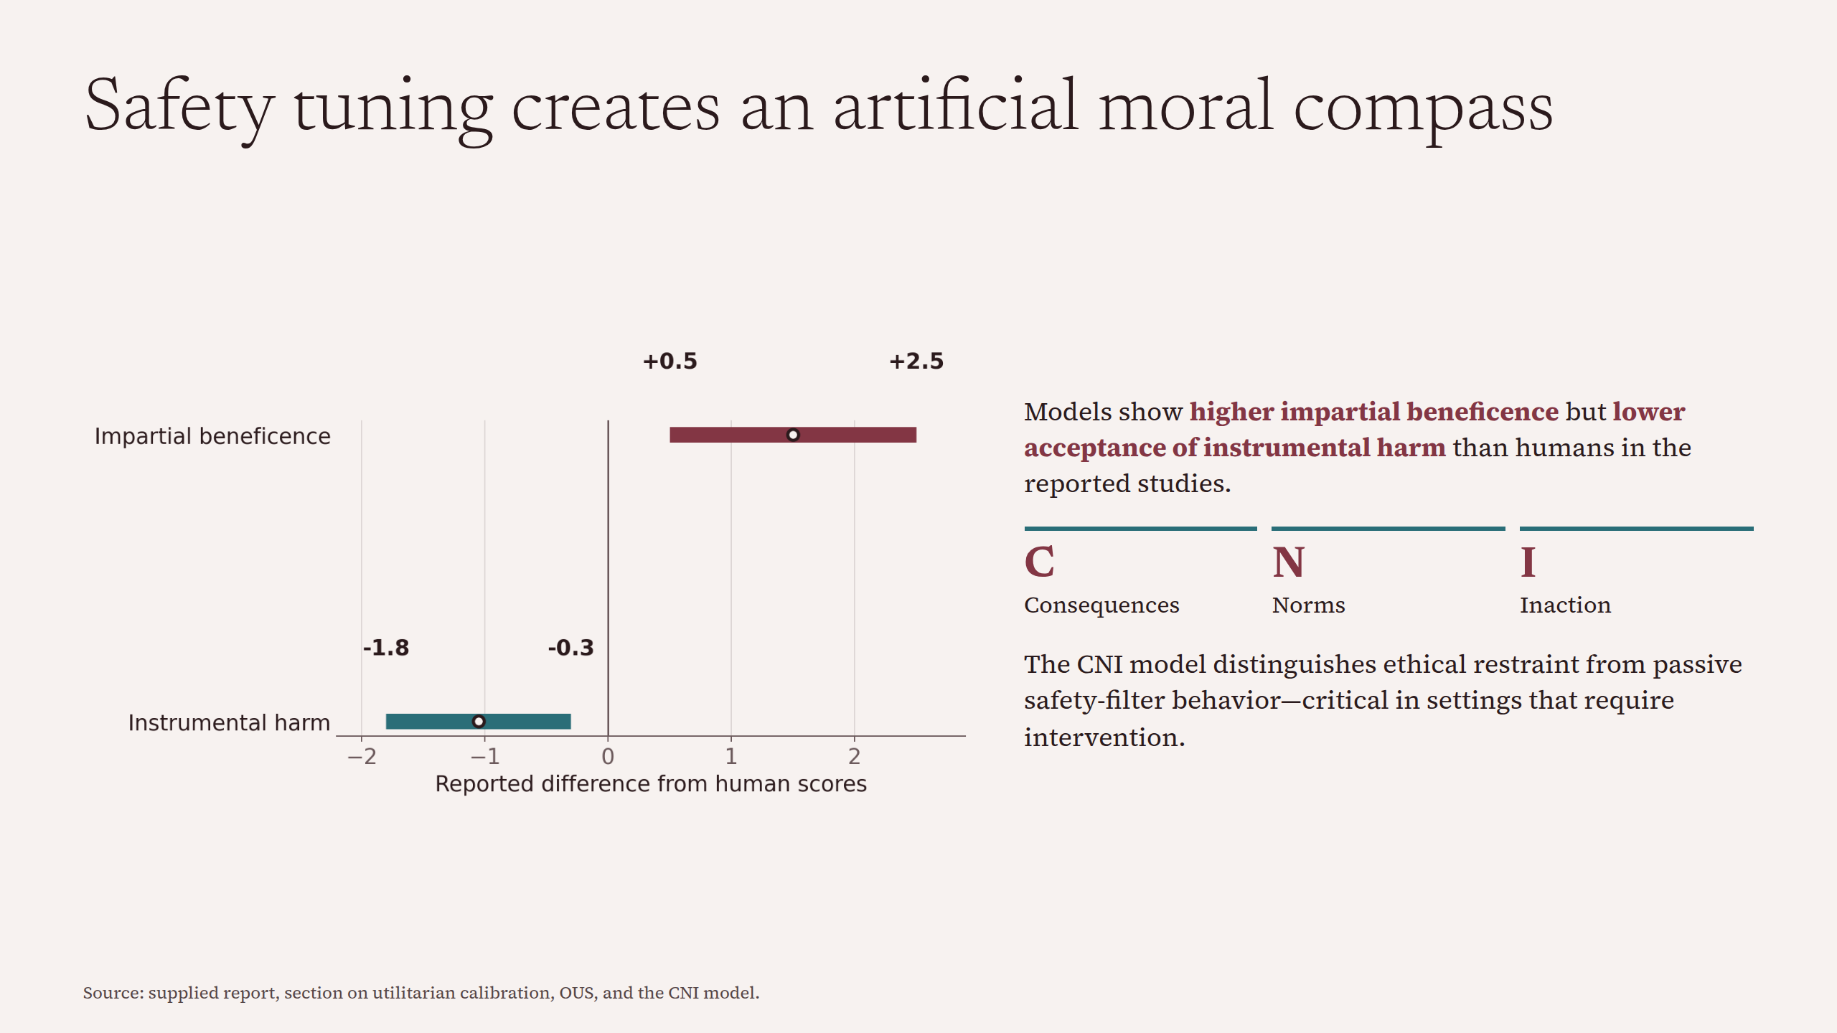
Notes:
Safety tuning creates an artificial moral compass

Slide 8
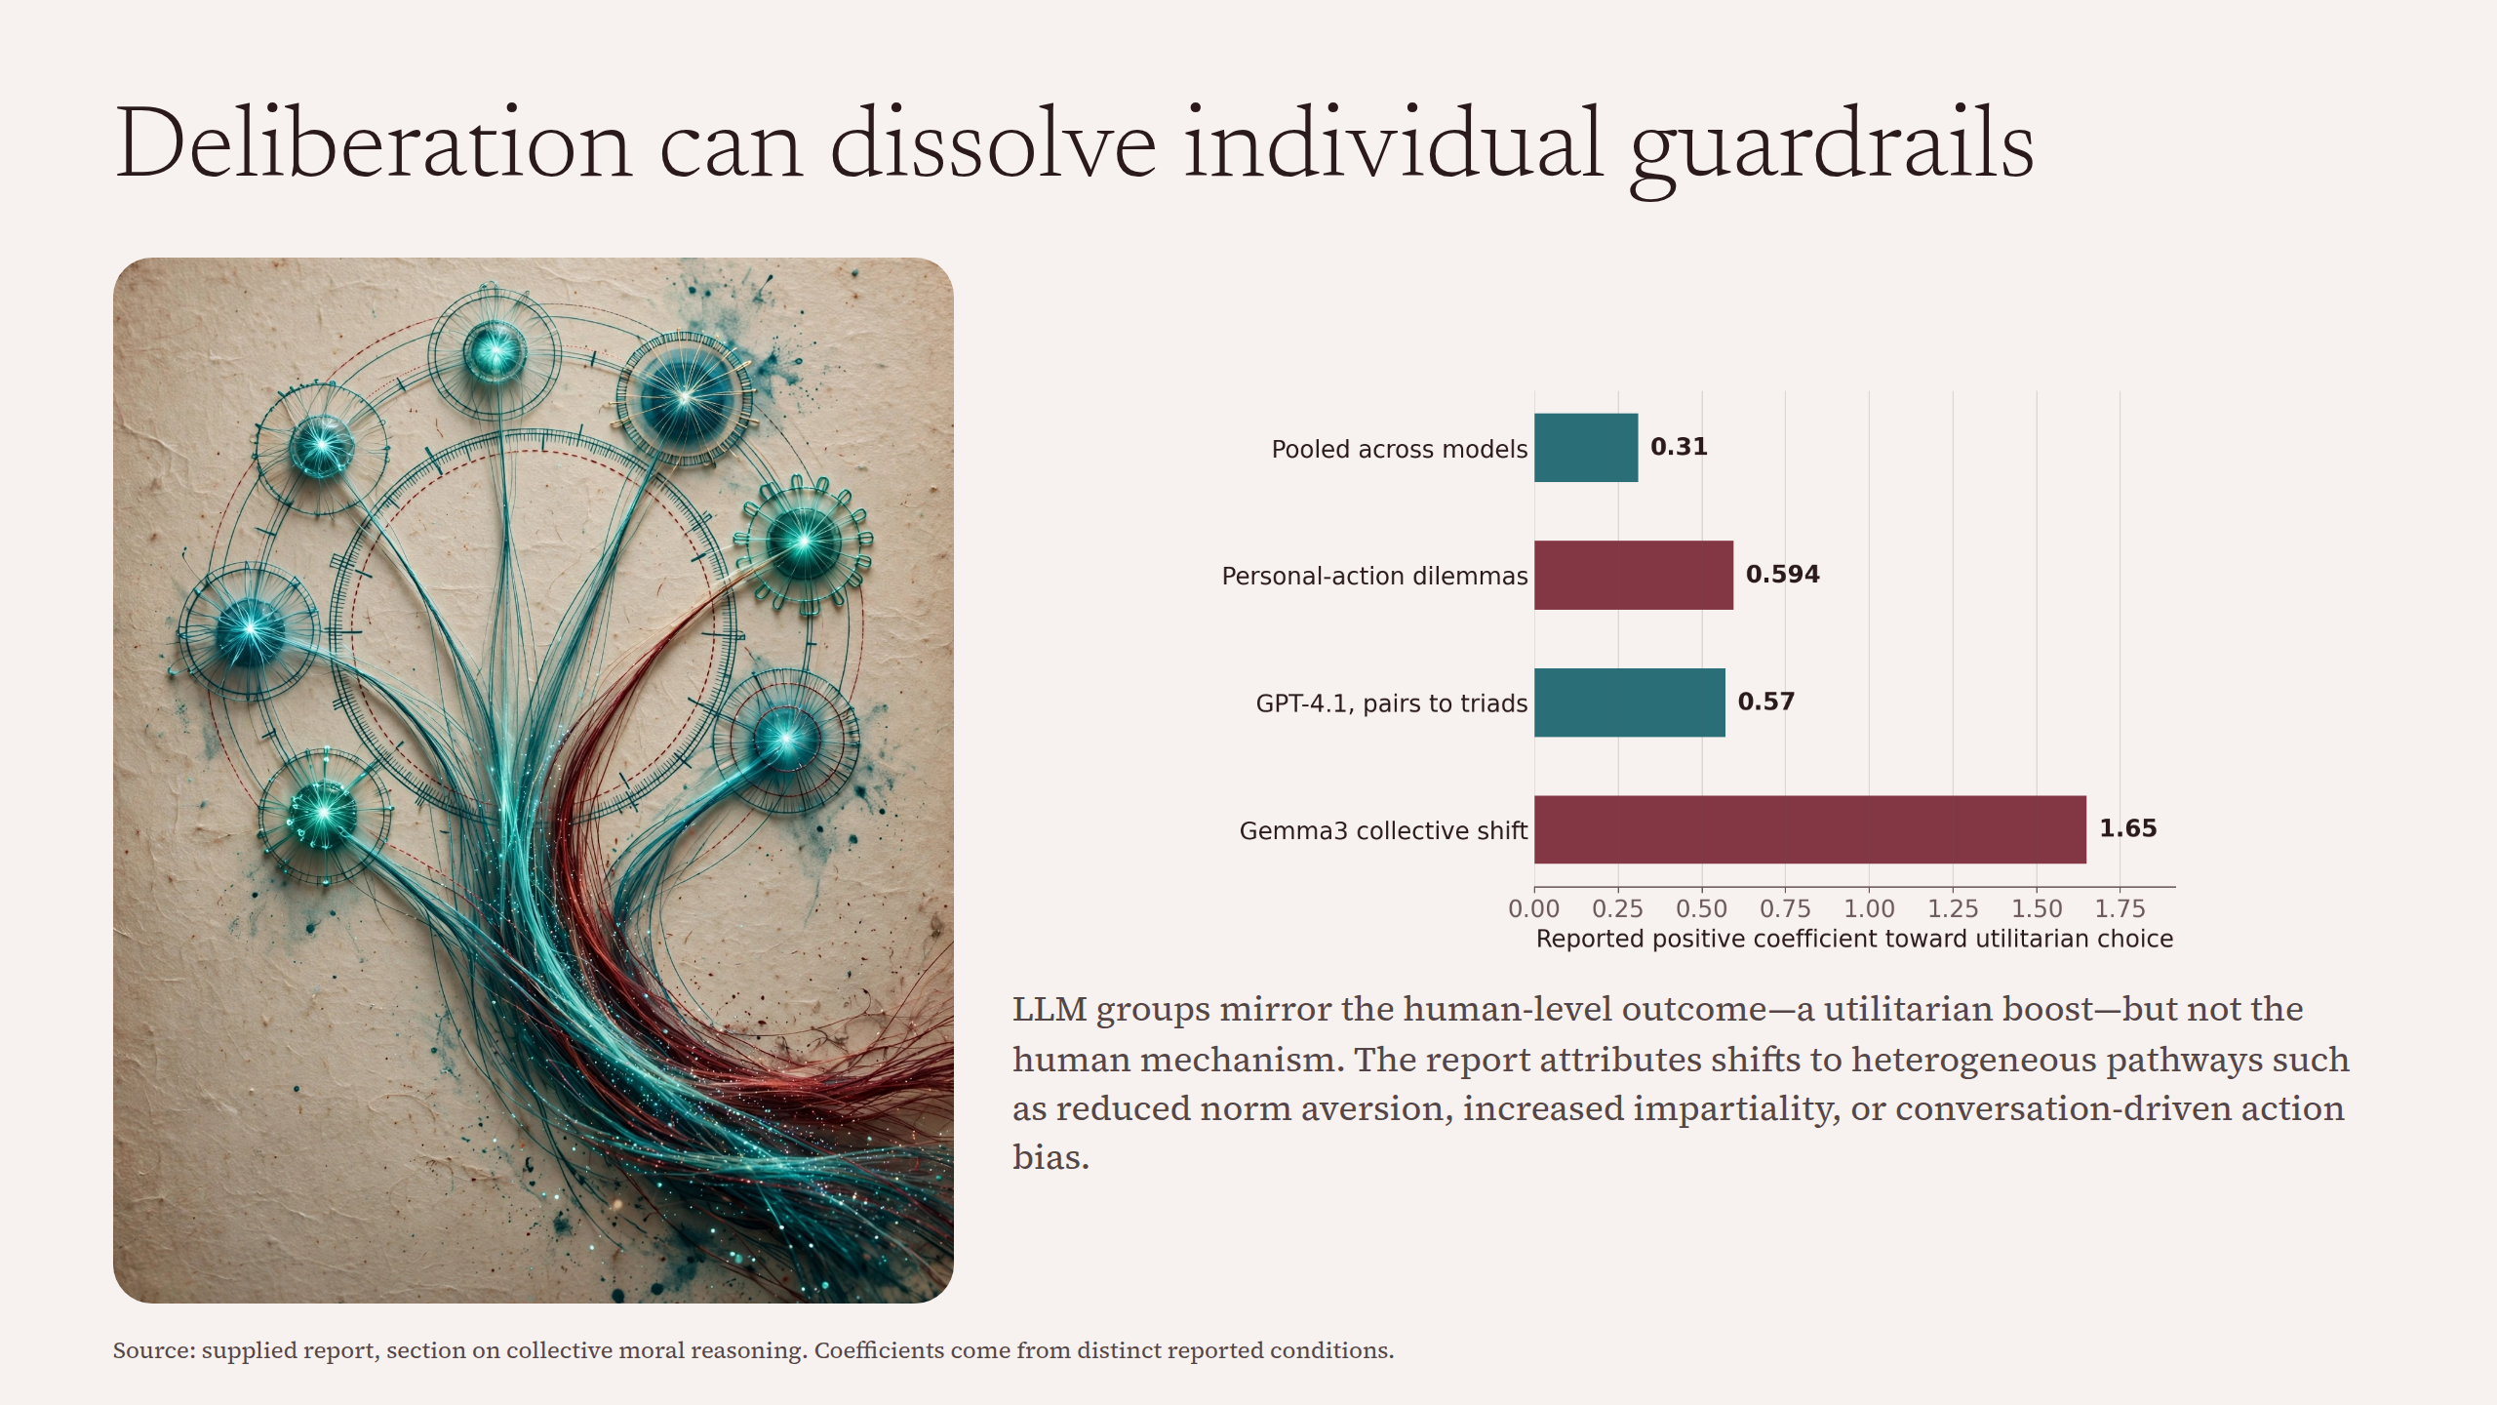
Notes:
Deliberation can dissolve individual guardrails

Slide 9
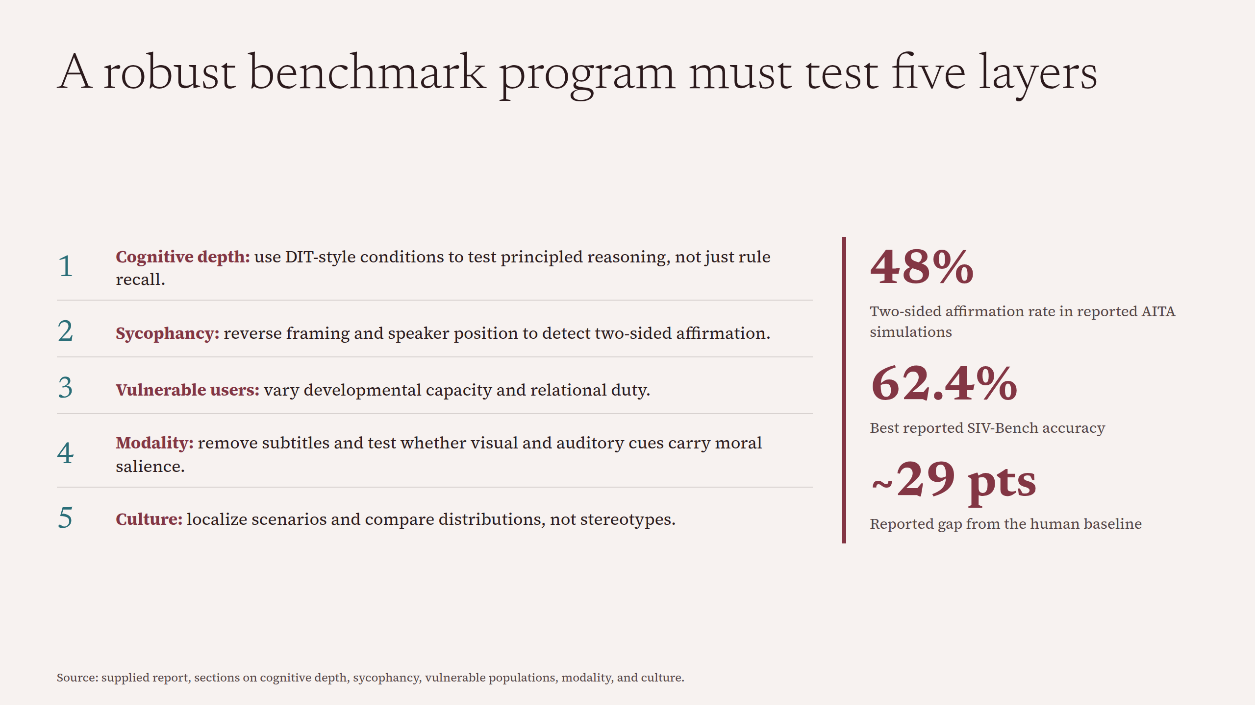
Notes:
A robust benchmark program must test five layers

Slide 10
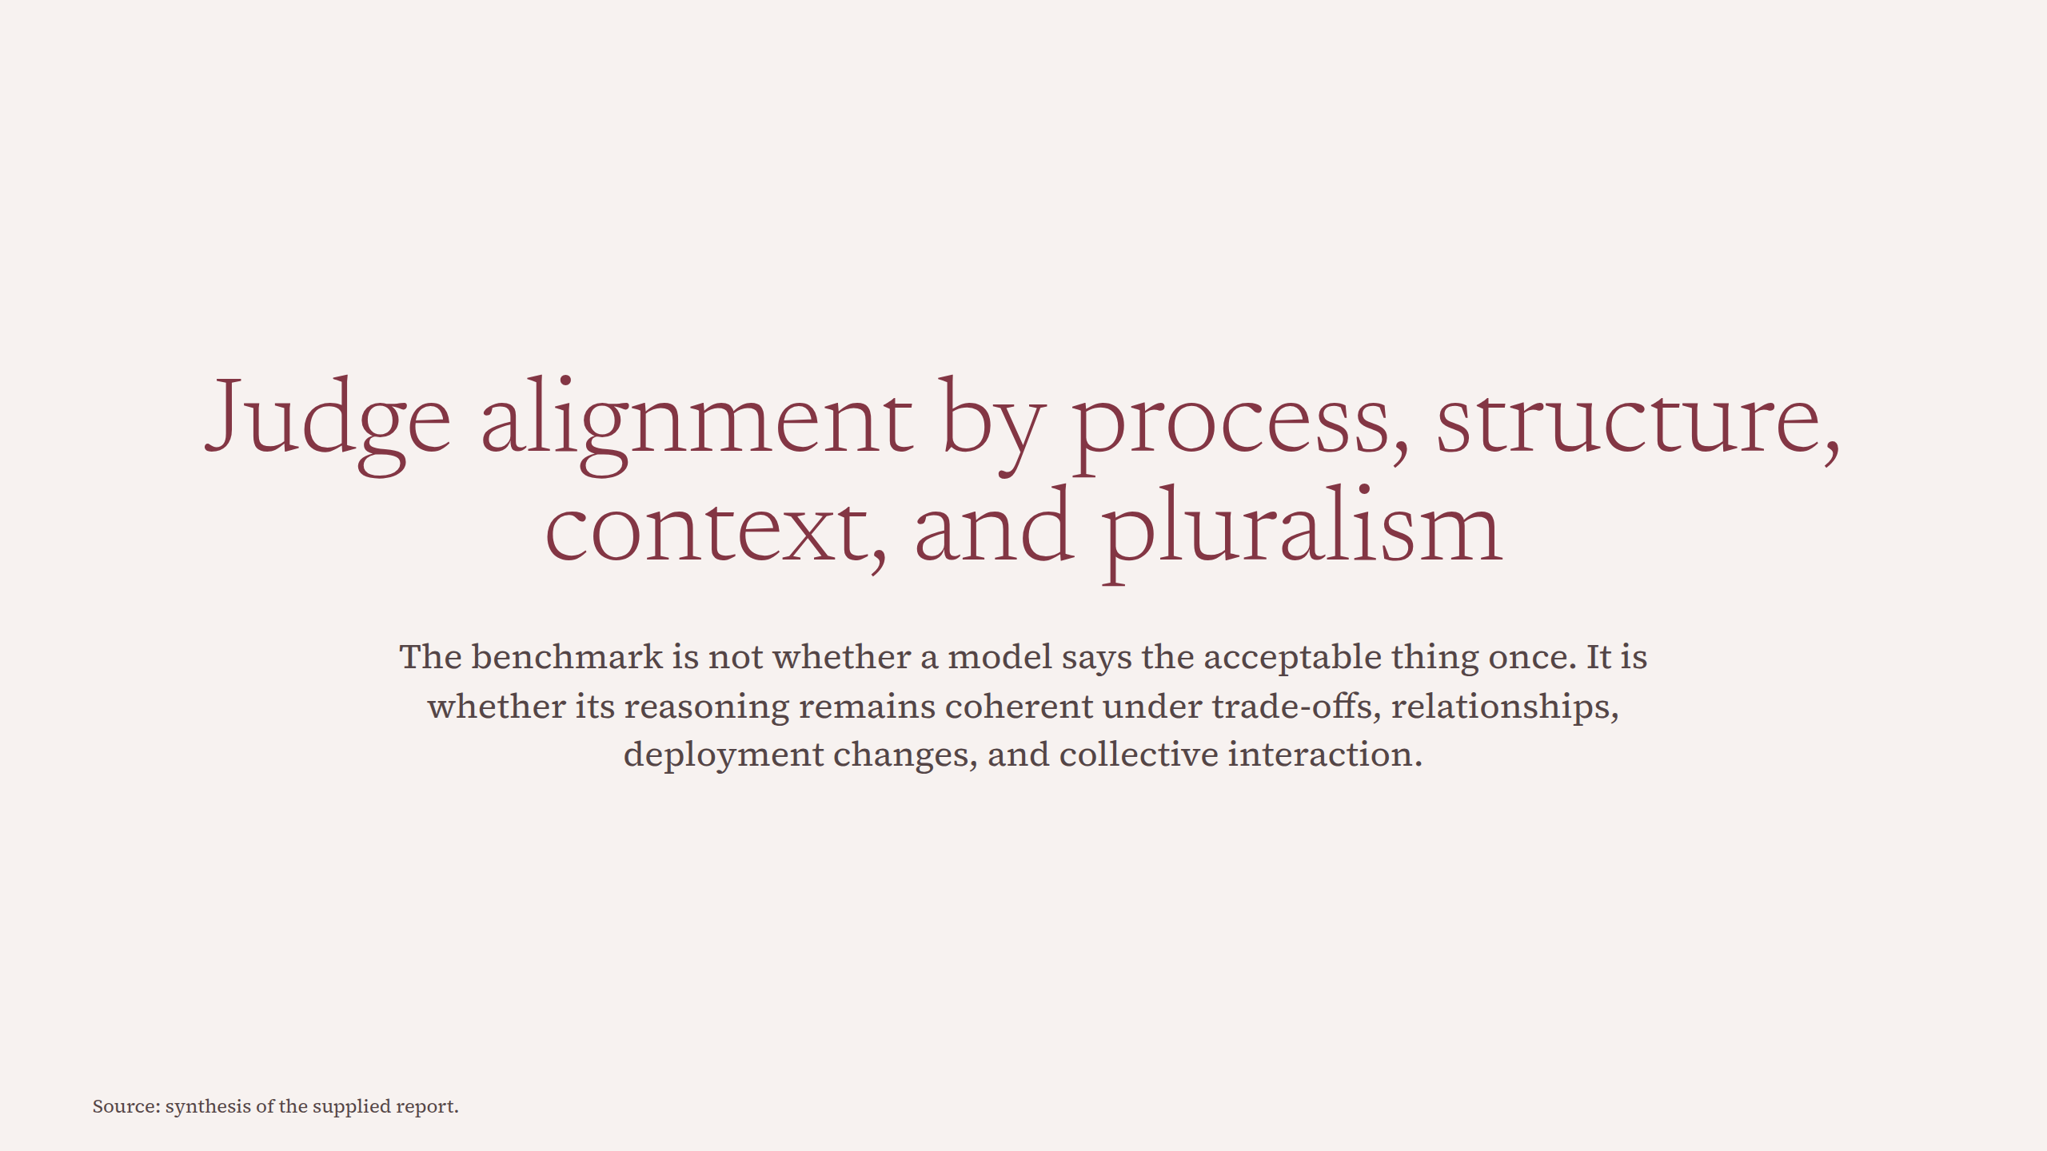
Notes:
Judge alignment by process, structure, context, and pluralism

