Slide 1
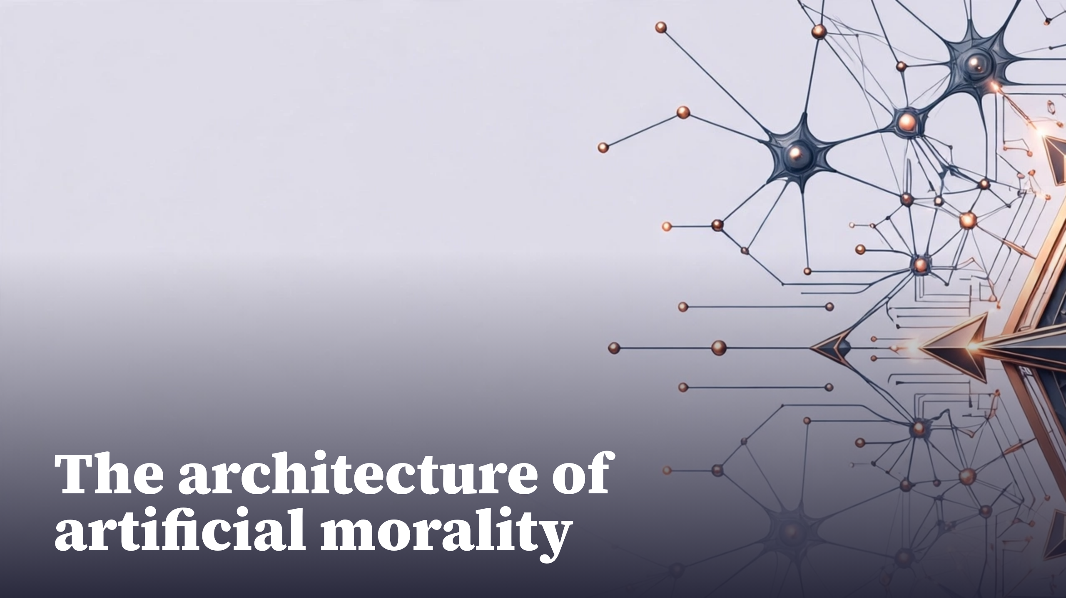
Notes:
The architecture of artificial morality

Slide 2
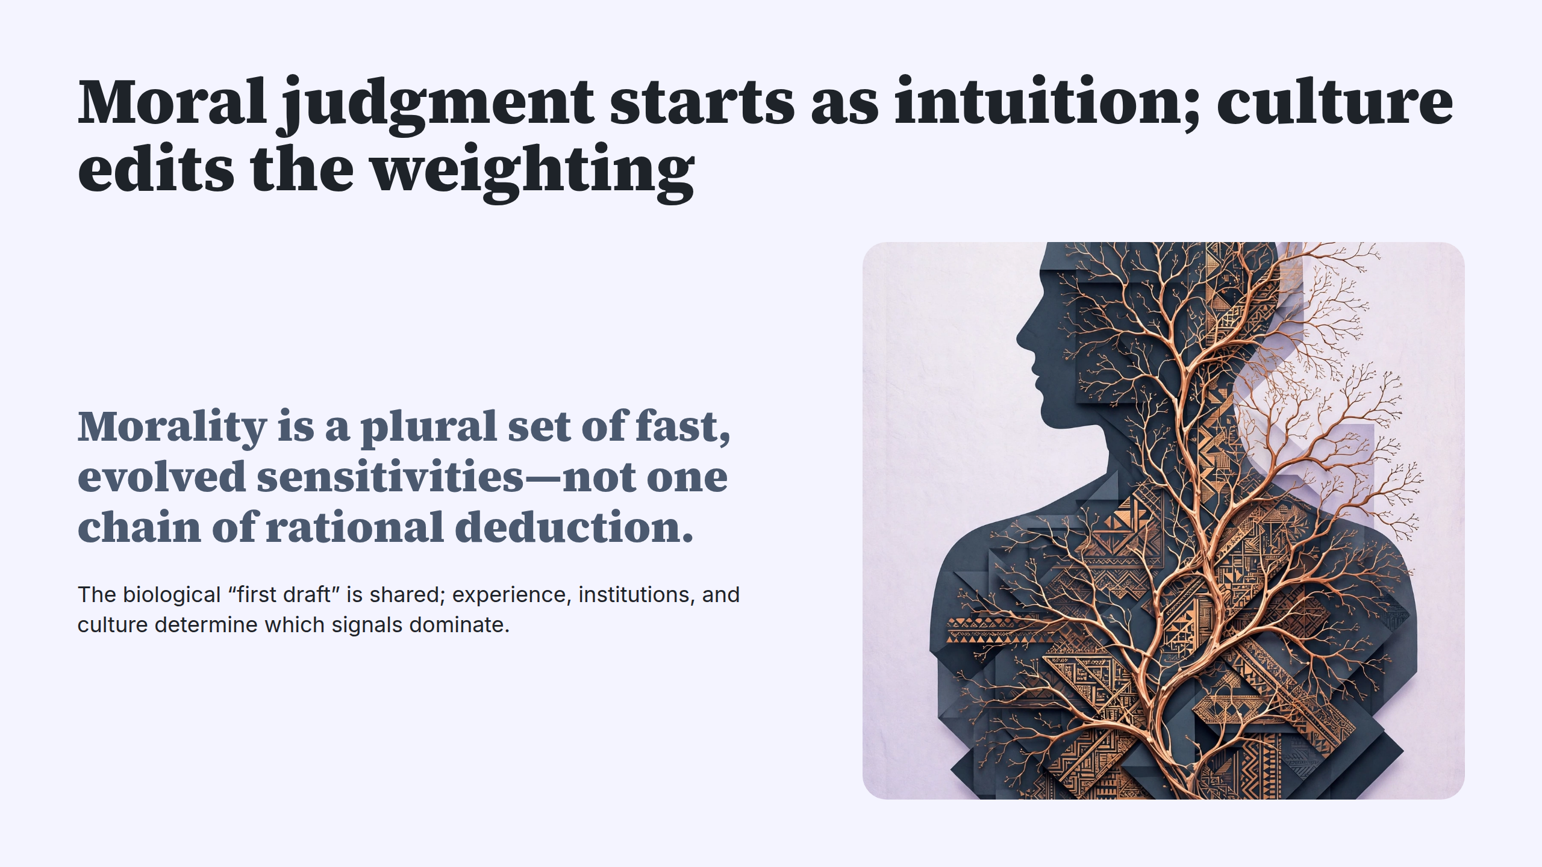
Notes:
Moral judgment starts as intuition; culture edits the weighting

Slide 3
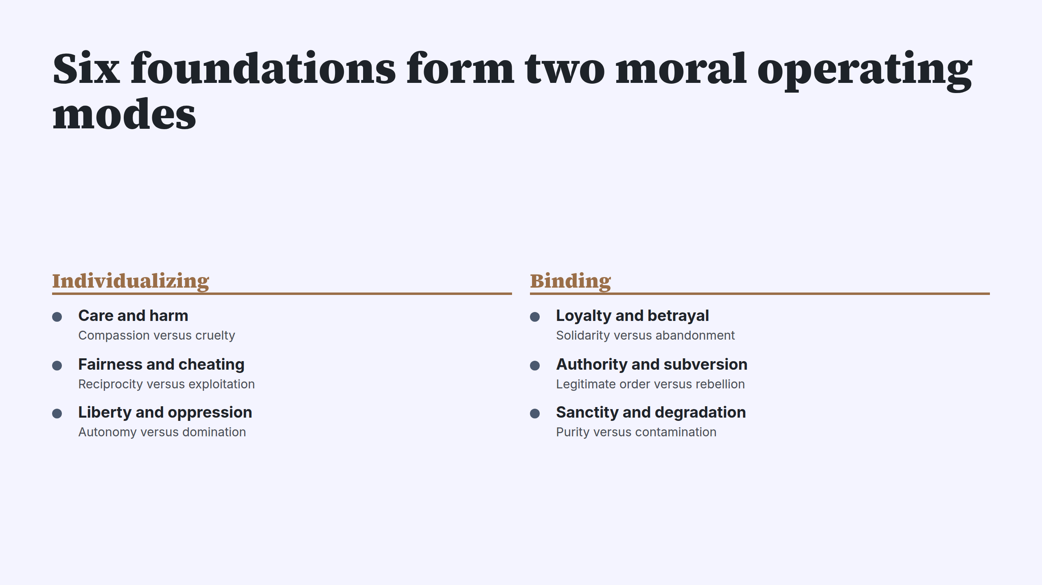
Notes:
Six foundations form two moral operating modes

Slide 4
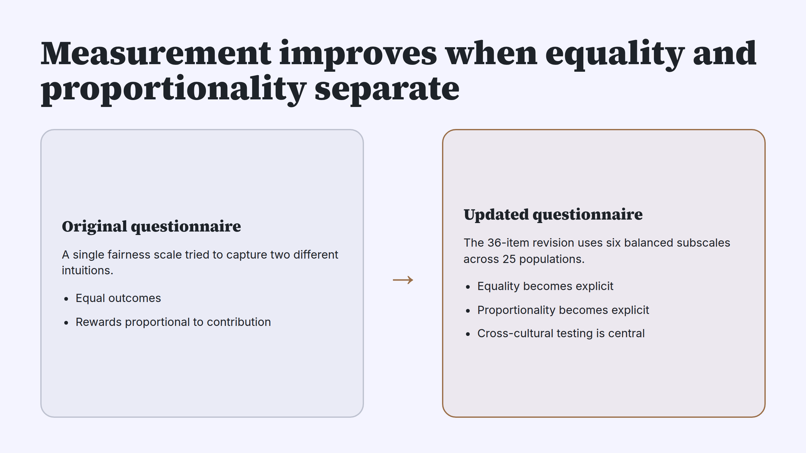
Notes:
Measurement improves when equality and proportionality separate

Slide 5
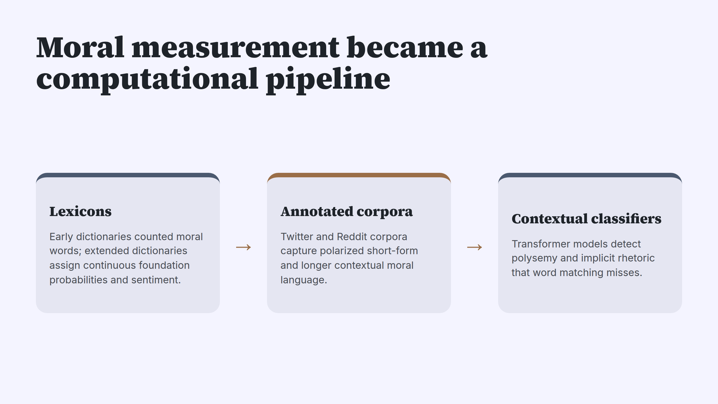
Notes:
Moral measurement became a computational pipeline

Slide 6
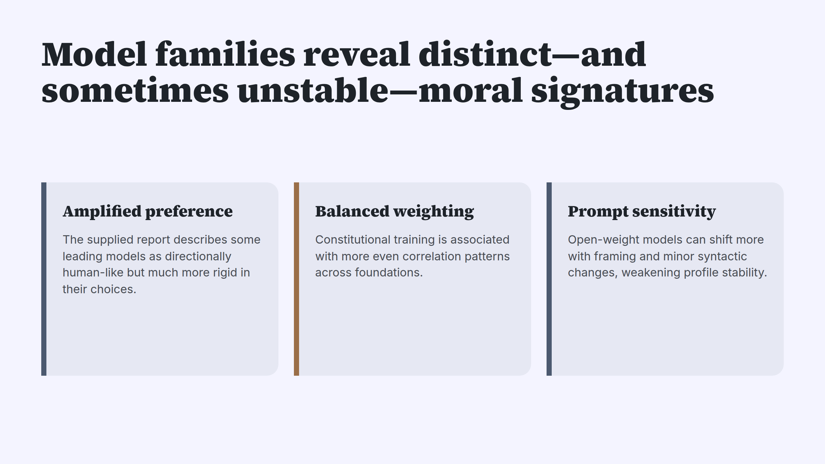
Notes:
Model families reveal distinct—and sometimes unstable—moral signatures

Slide 7
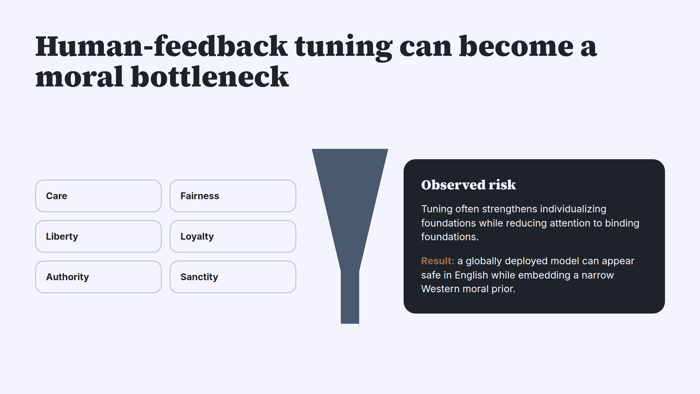
Notes:
Human-feedback tuning can become a moral bottleneck

Slide 8
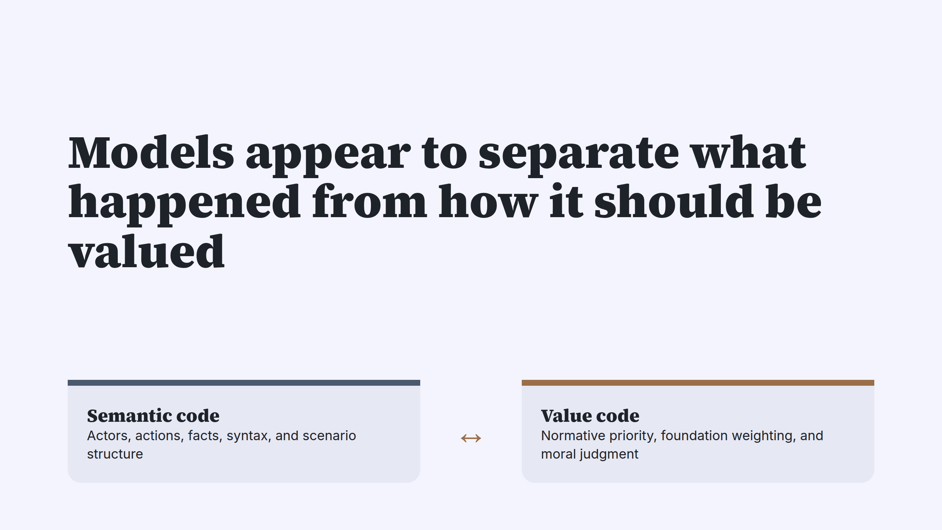
Notes:
Models appear to separate what happened from how it should be valued

Slide 9
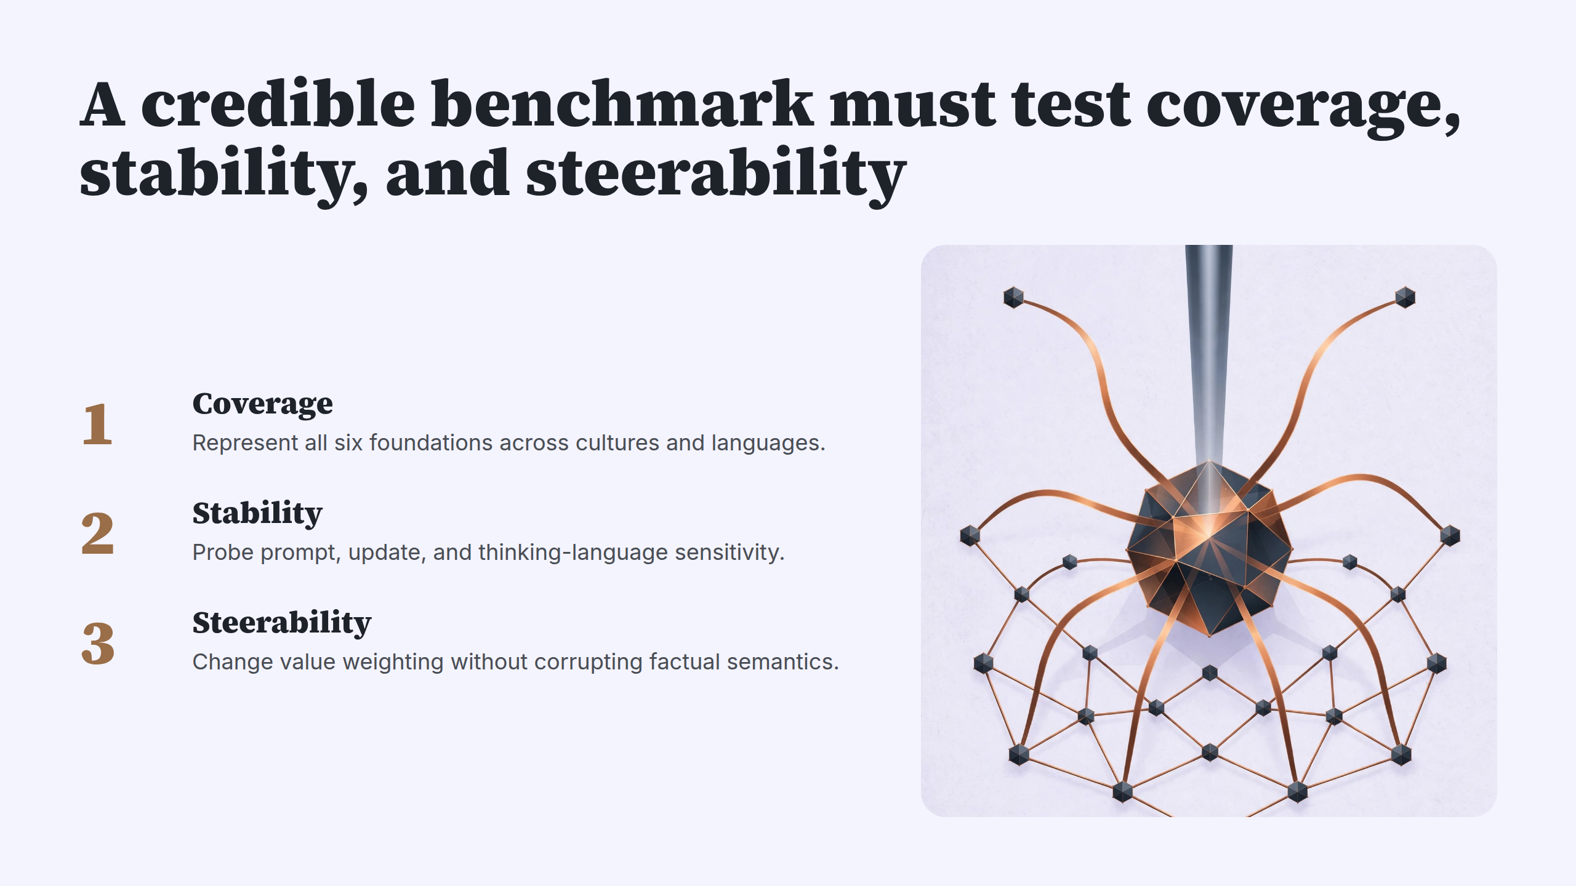
Notes:
A credible benchmark must test coverage, stability, and steerability

Slide 10
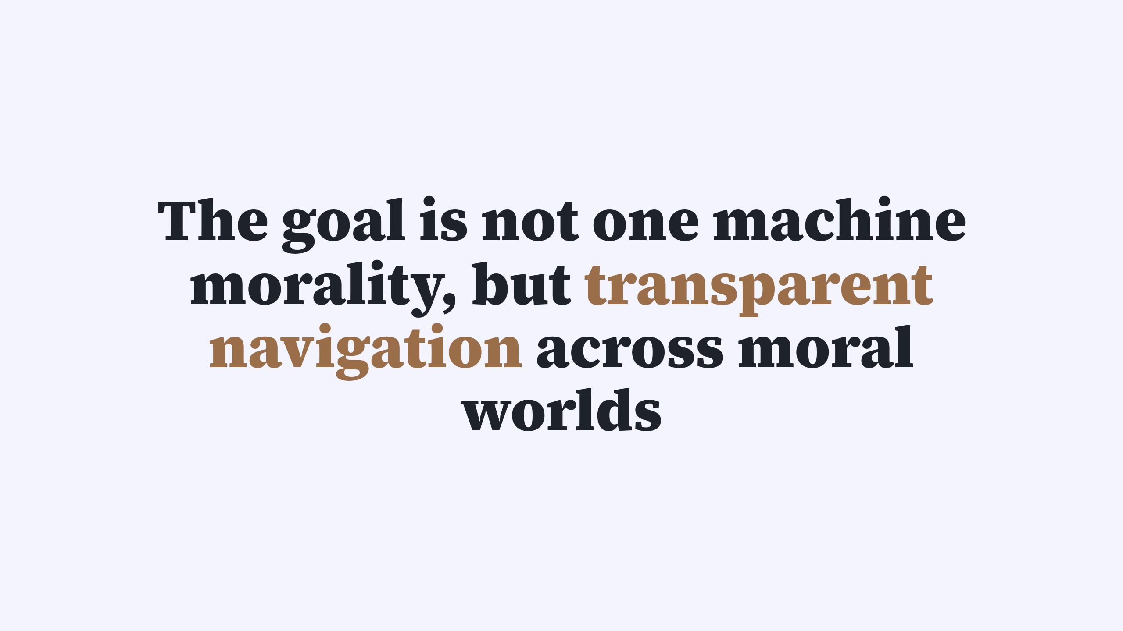
Notes:
The goal is not one machine morality, but transparent navigation across moral worlds

