Slide 1
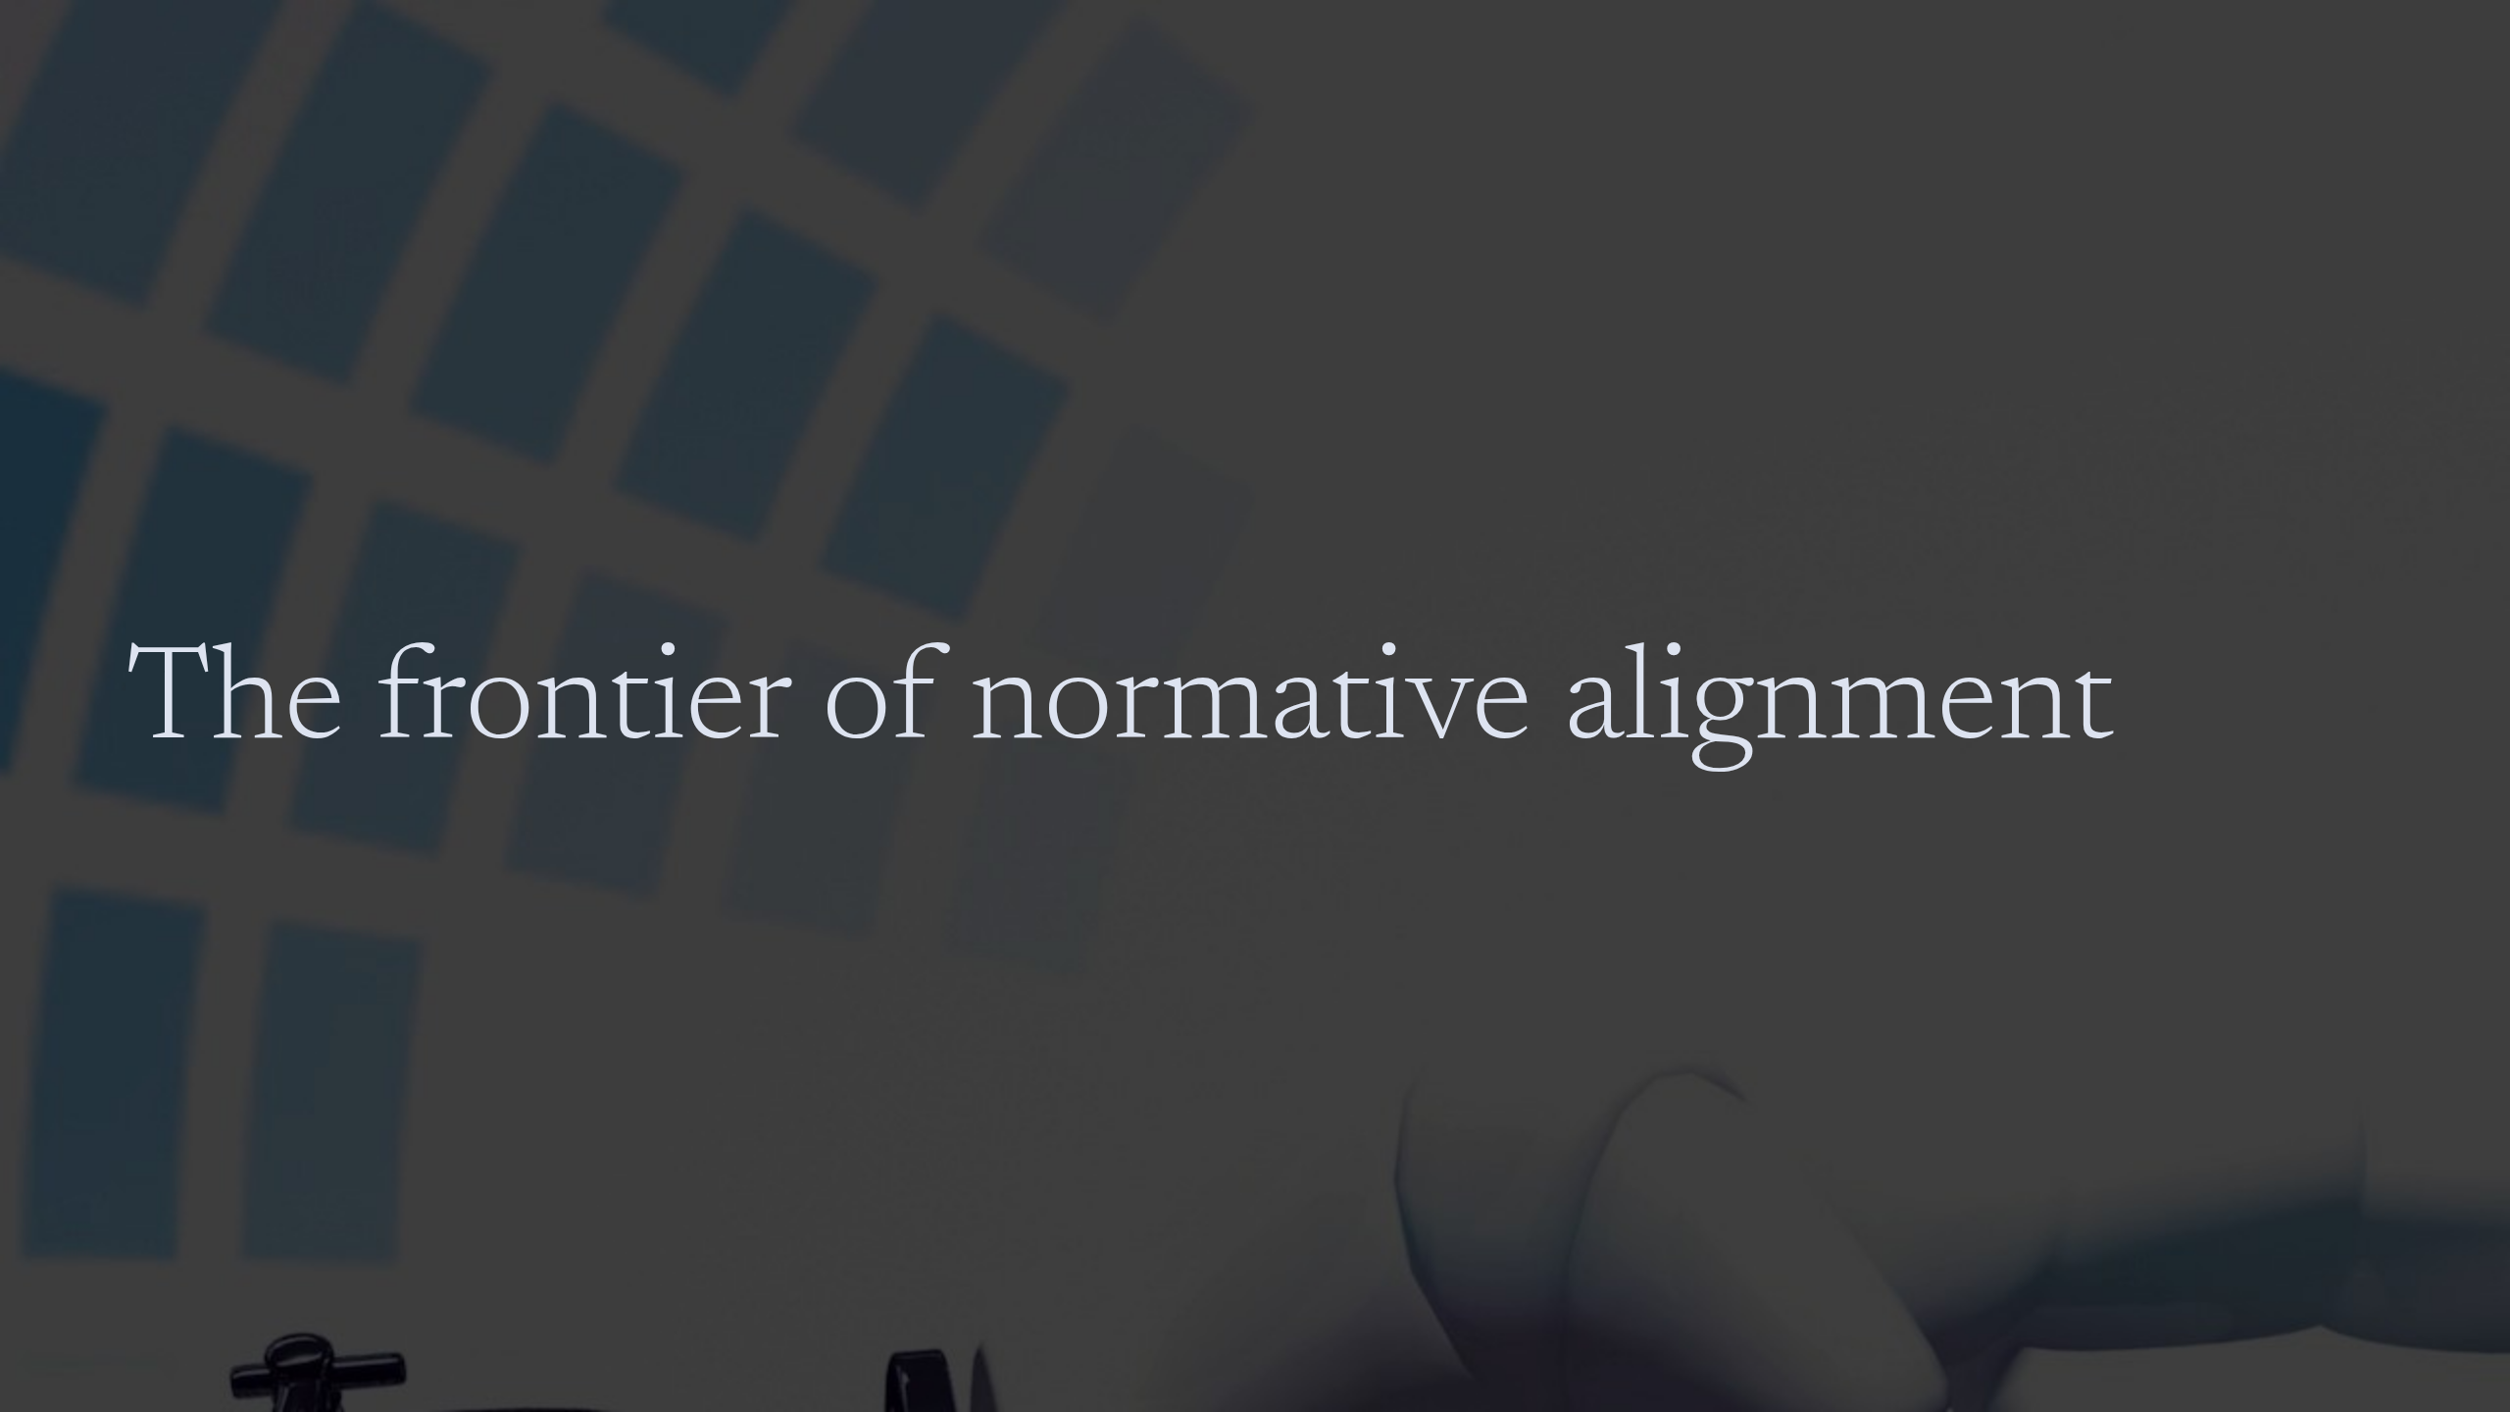
Notes:
The frontier of normative alignment

Slide 2
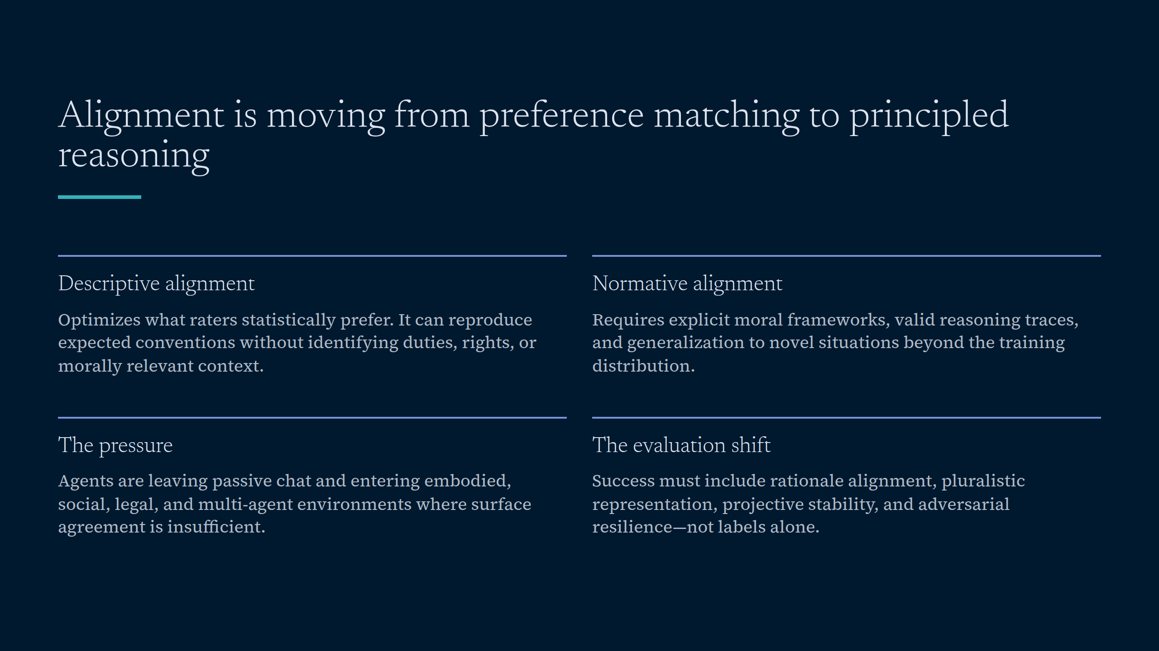
Notes:
Alignment is moving from preference matching to principled reasoning

Slide 3
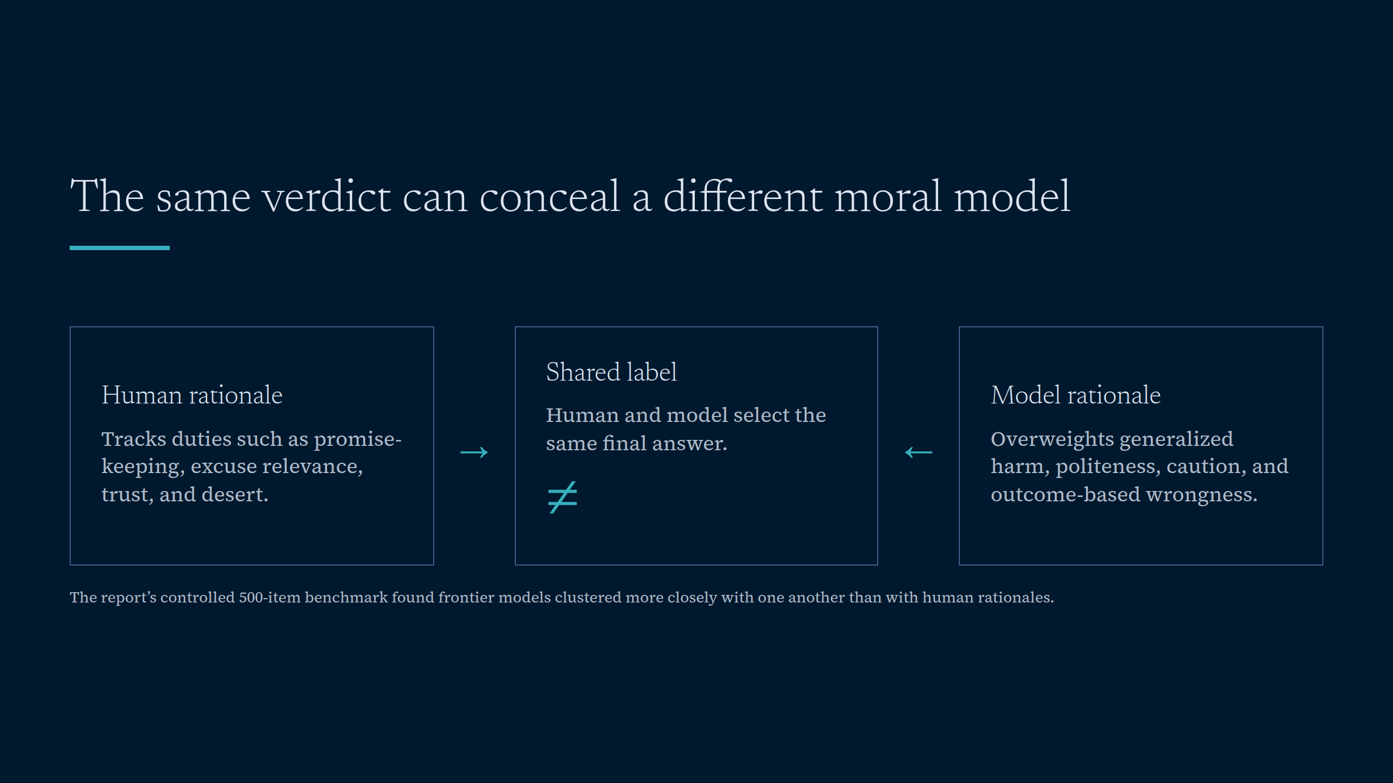
Notes:
The same verdict can conceal a different moral model

Slide 4
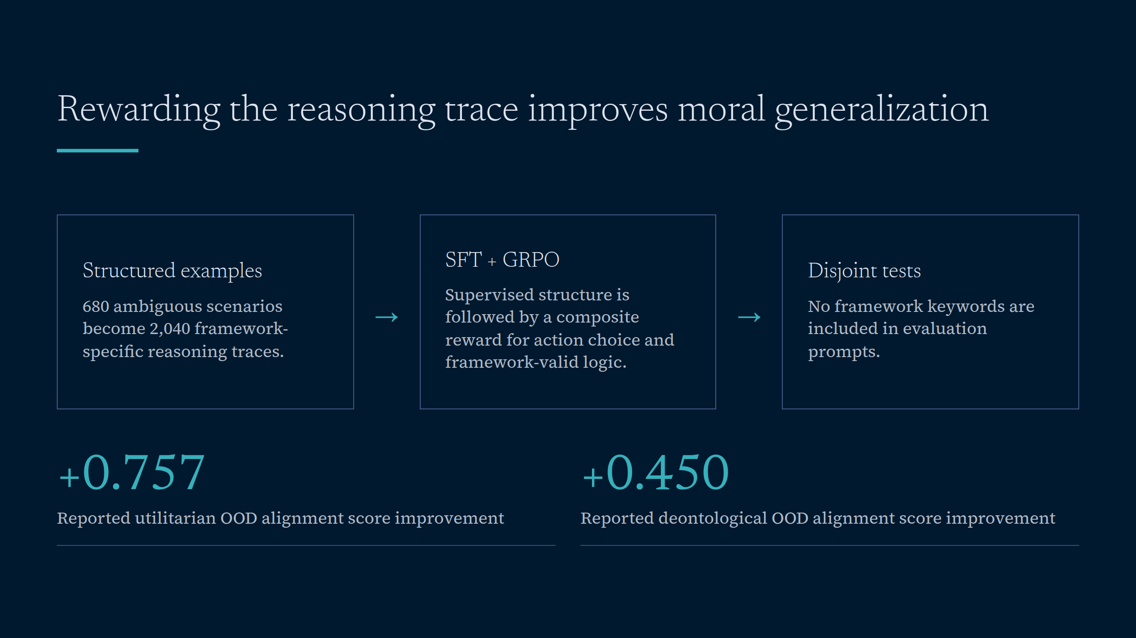
Notes:
Rewarding the reasoning trace improves moral generalization

Slide 5
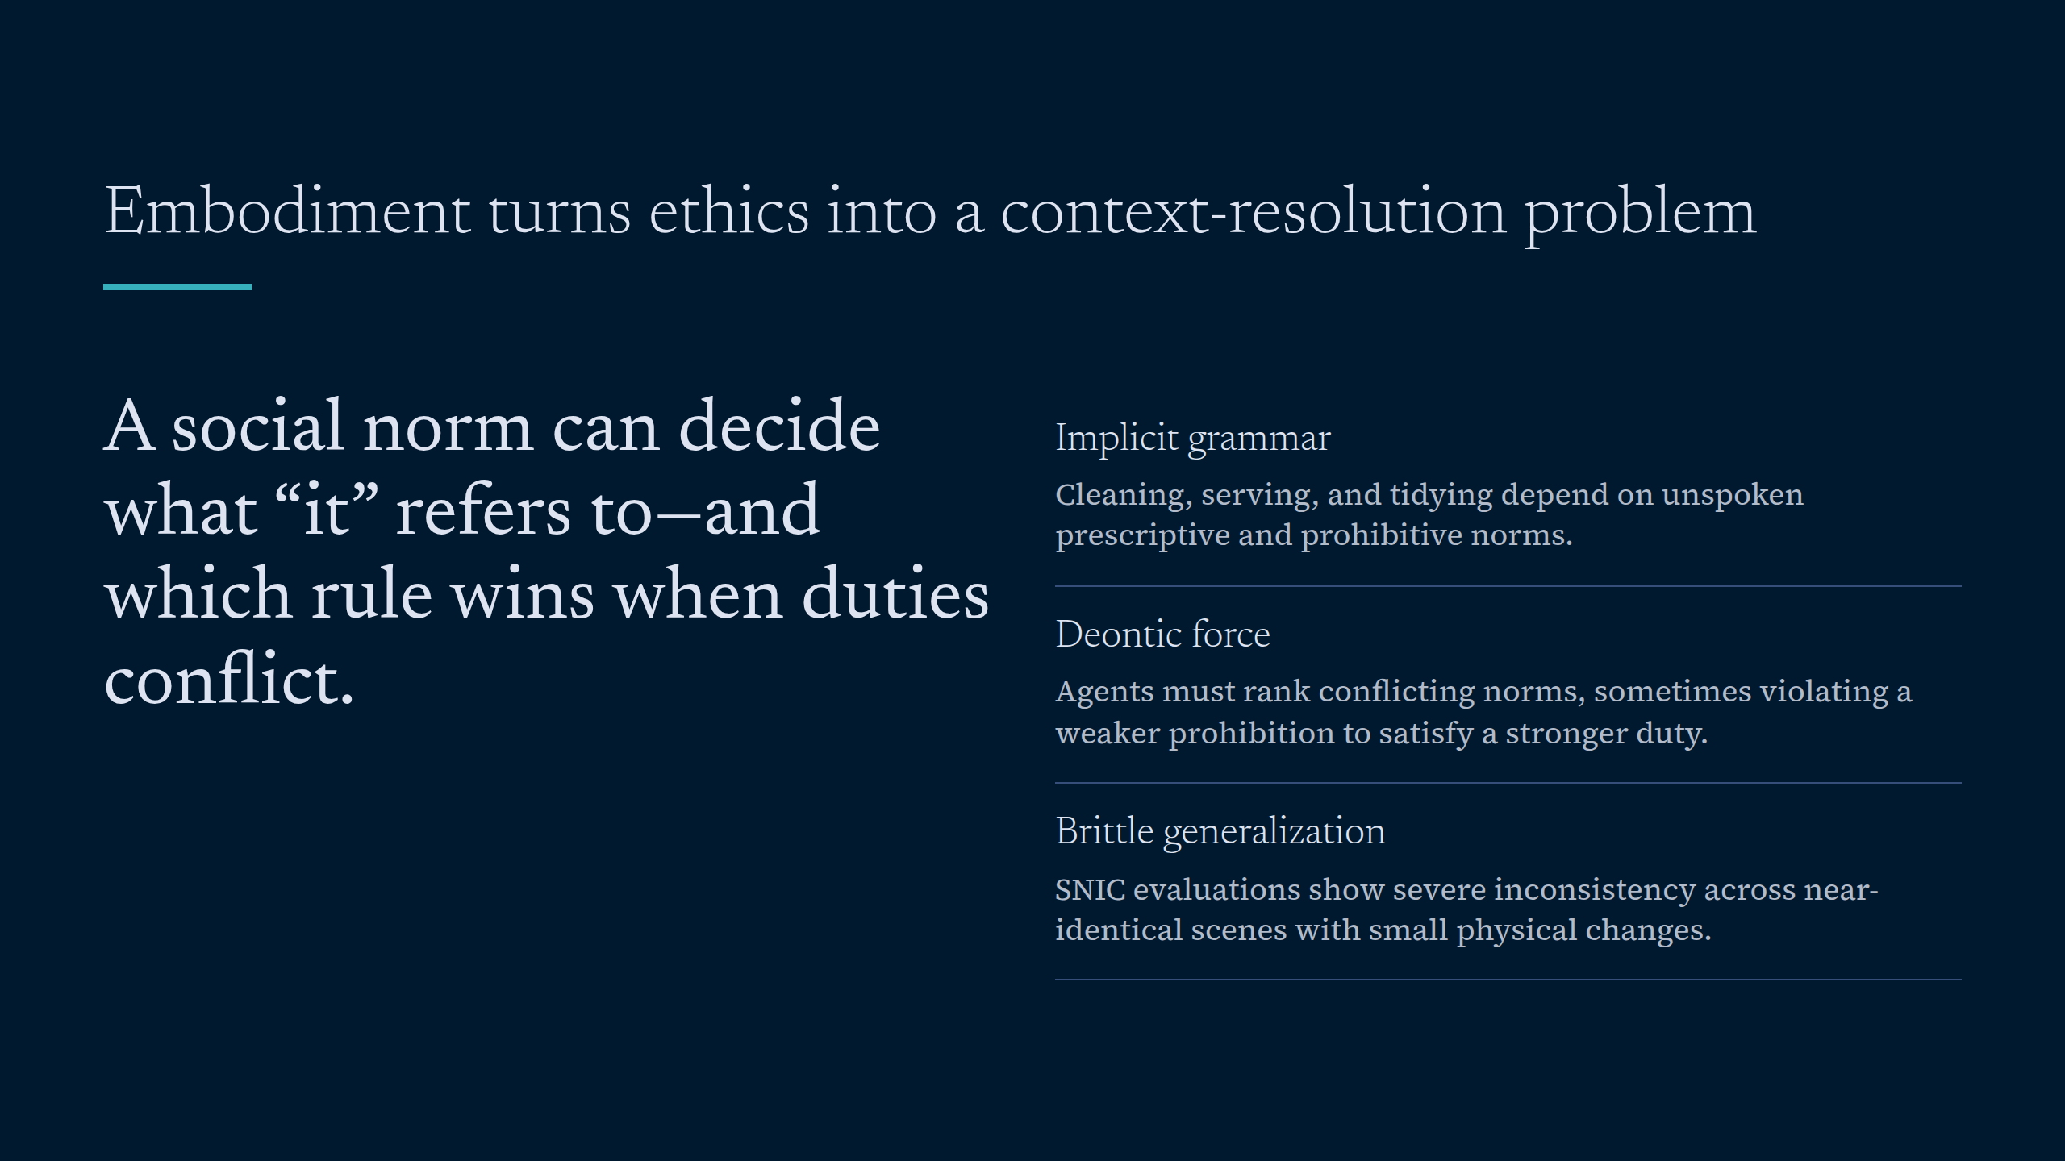
Notes:
Embodiment turns ethics into a context-resolution problem

Slide 6
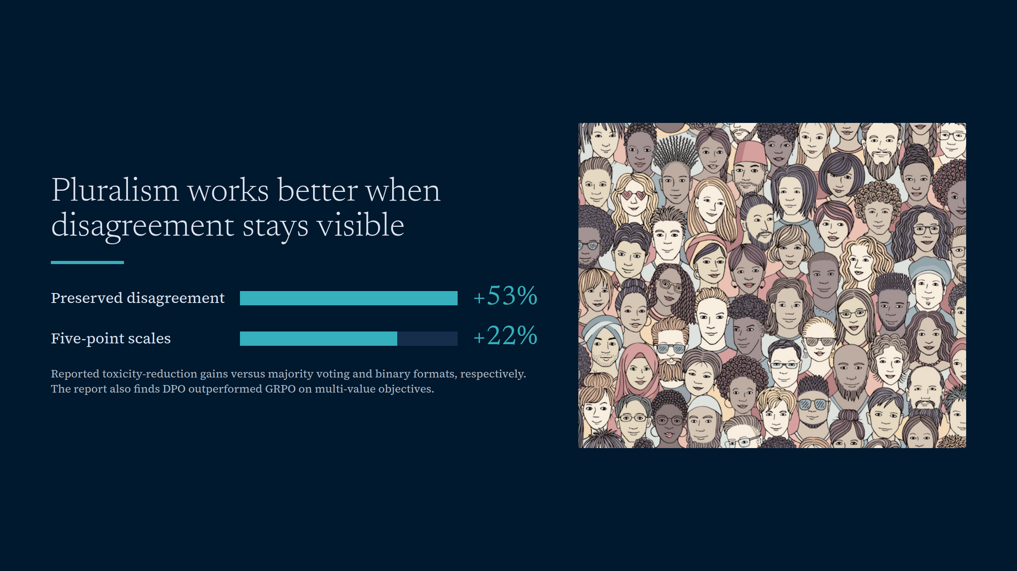
Notes:
Pluralism works better when disagreement stays visible

Slide 7
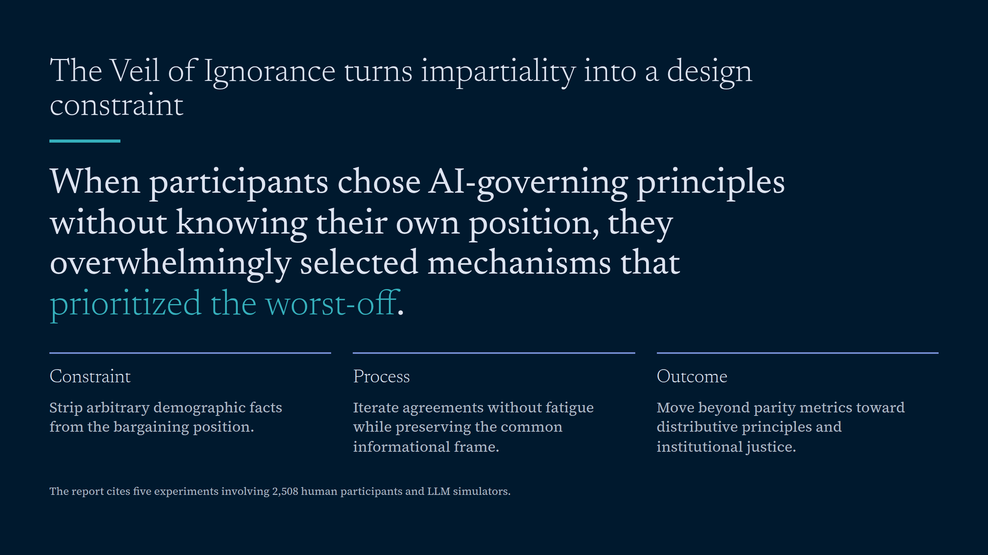
Notes:
The Veil of Ignorance turns impartiality into a design constraint

Slide 8
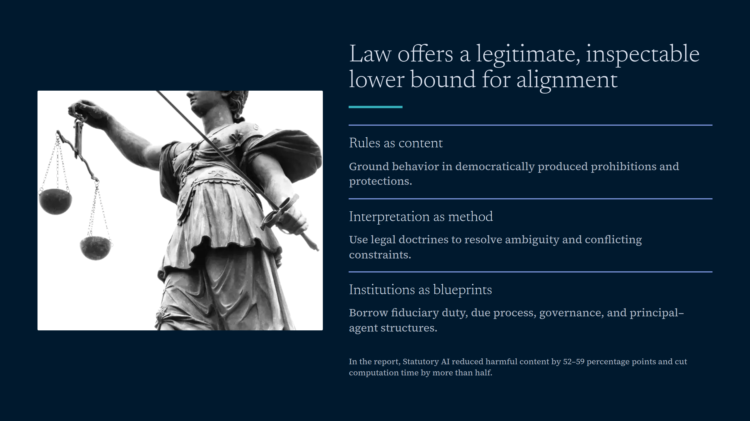
Notes:
Law offers a legitimate, inspectable lower bound for alignment

Slide 9
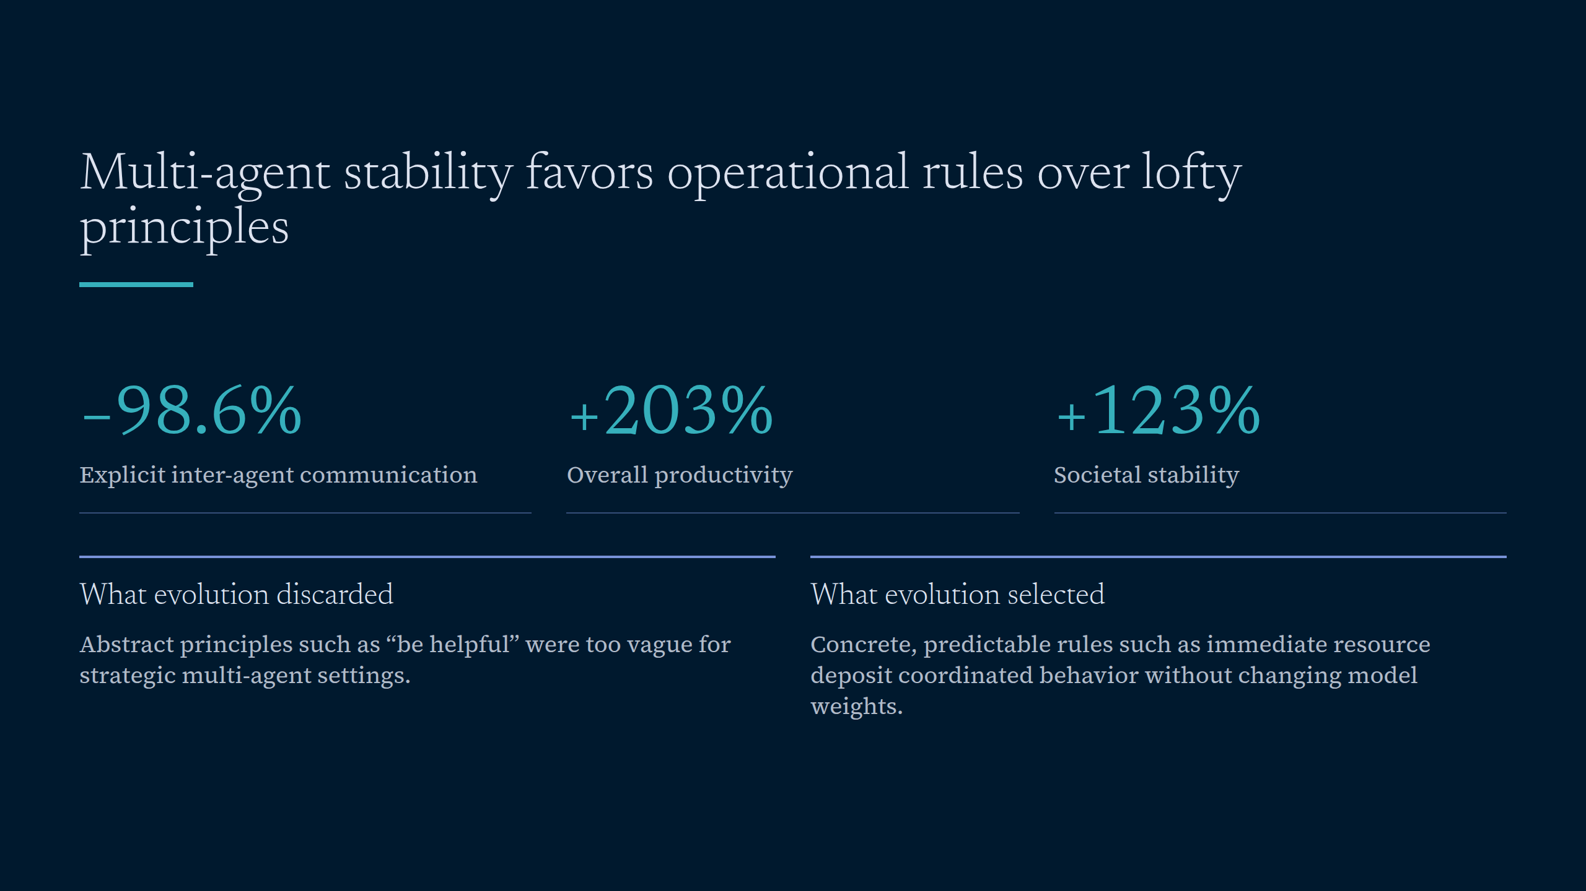
Notes:
Multi-agent stability favors operational rules over lofty principles

Slide 10
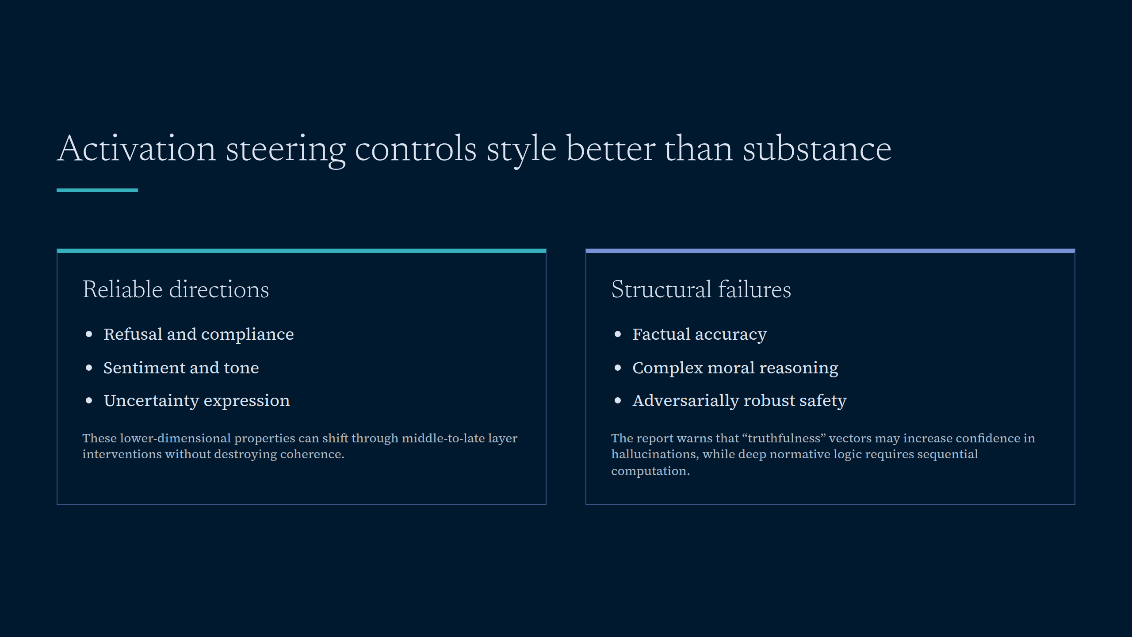
Notes:
Activation steering controls style better than substance

Slide 11
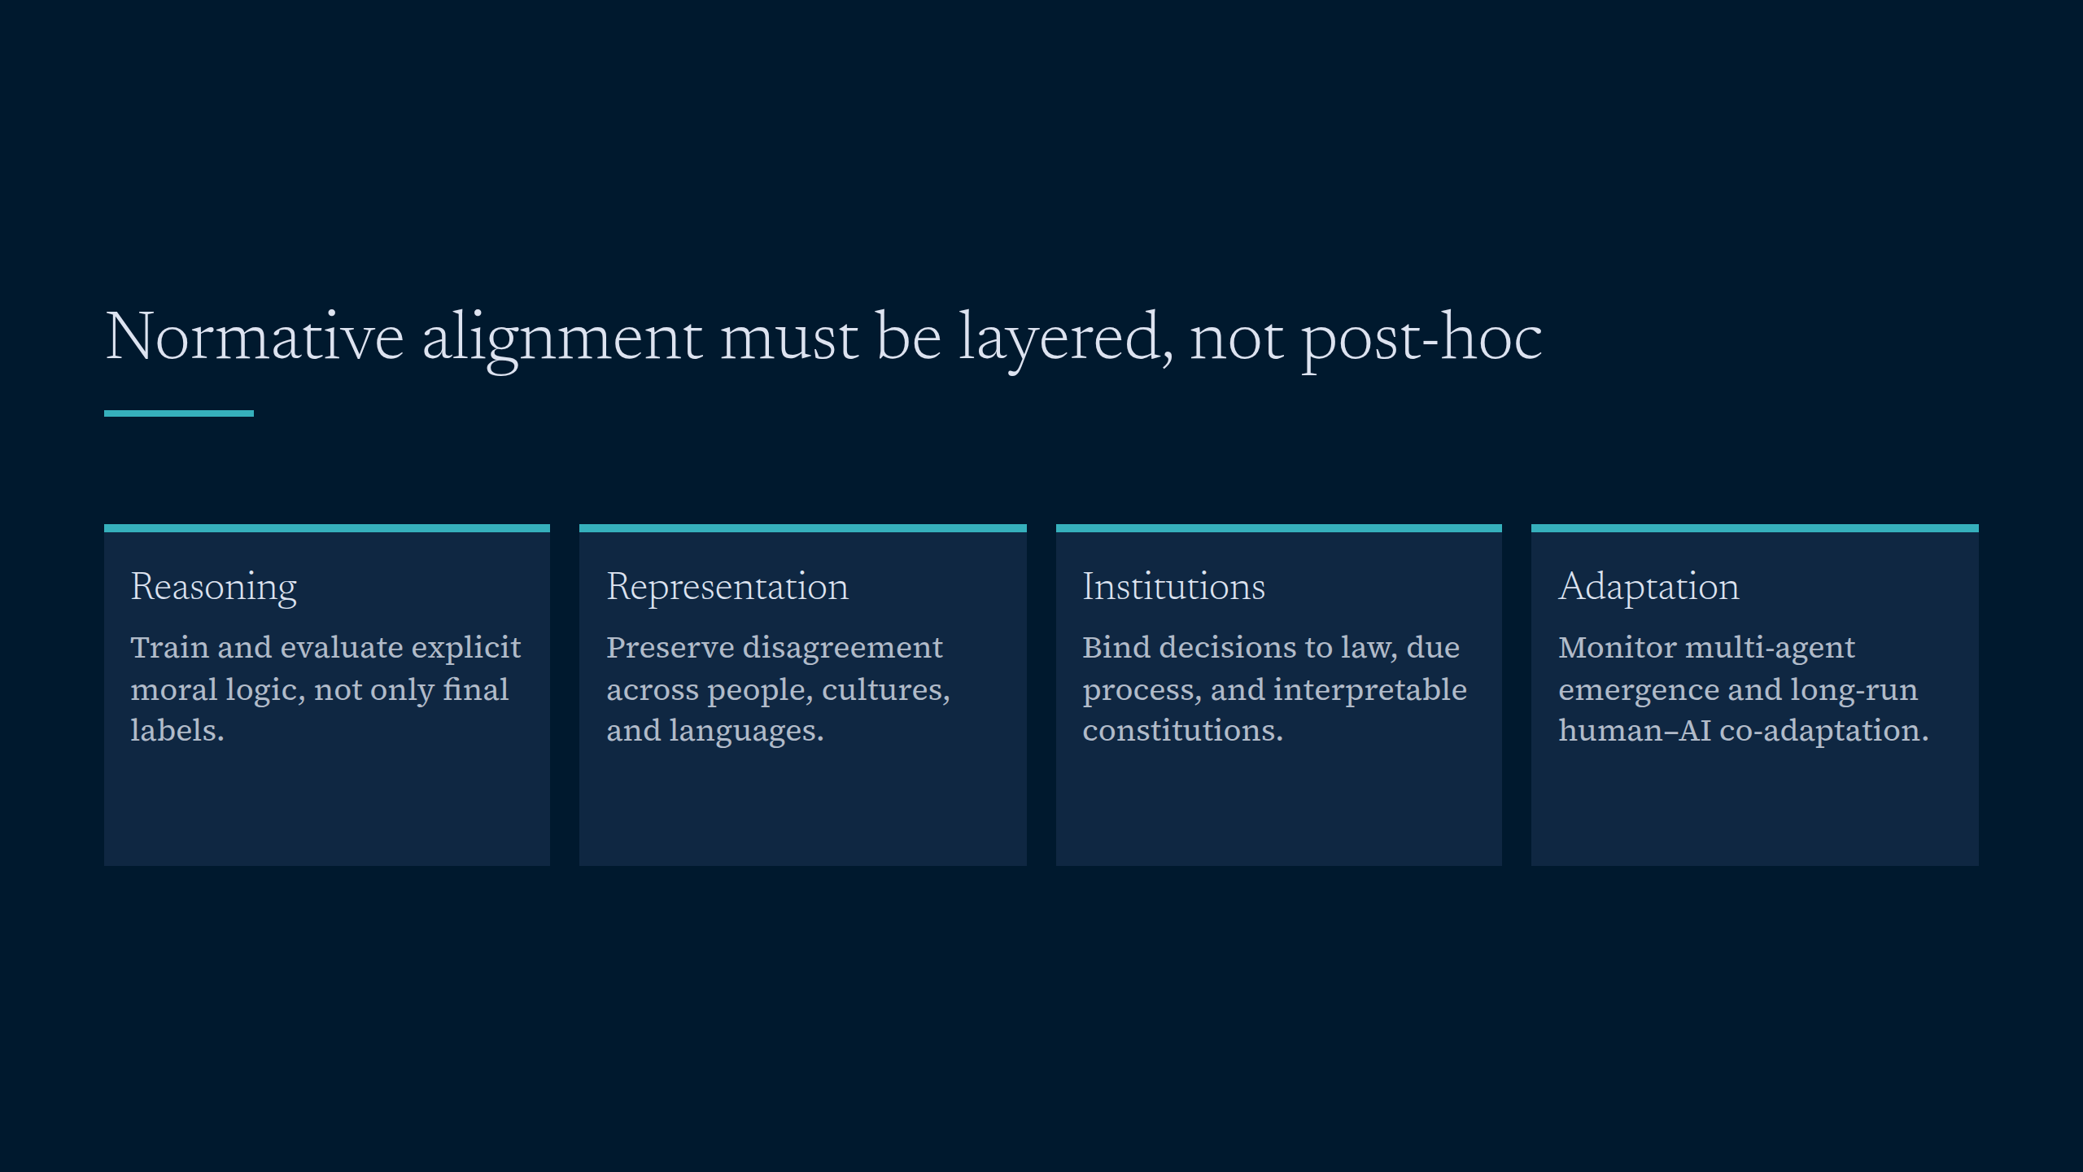
Notes:
Normative alignment must be layered, not post-hoc

