Slide 1
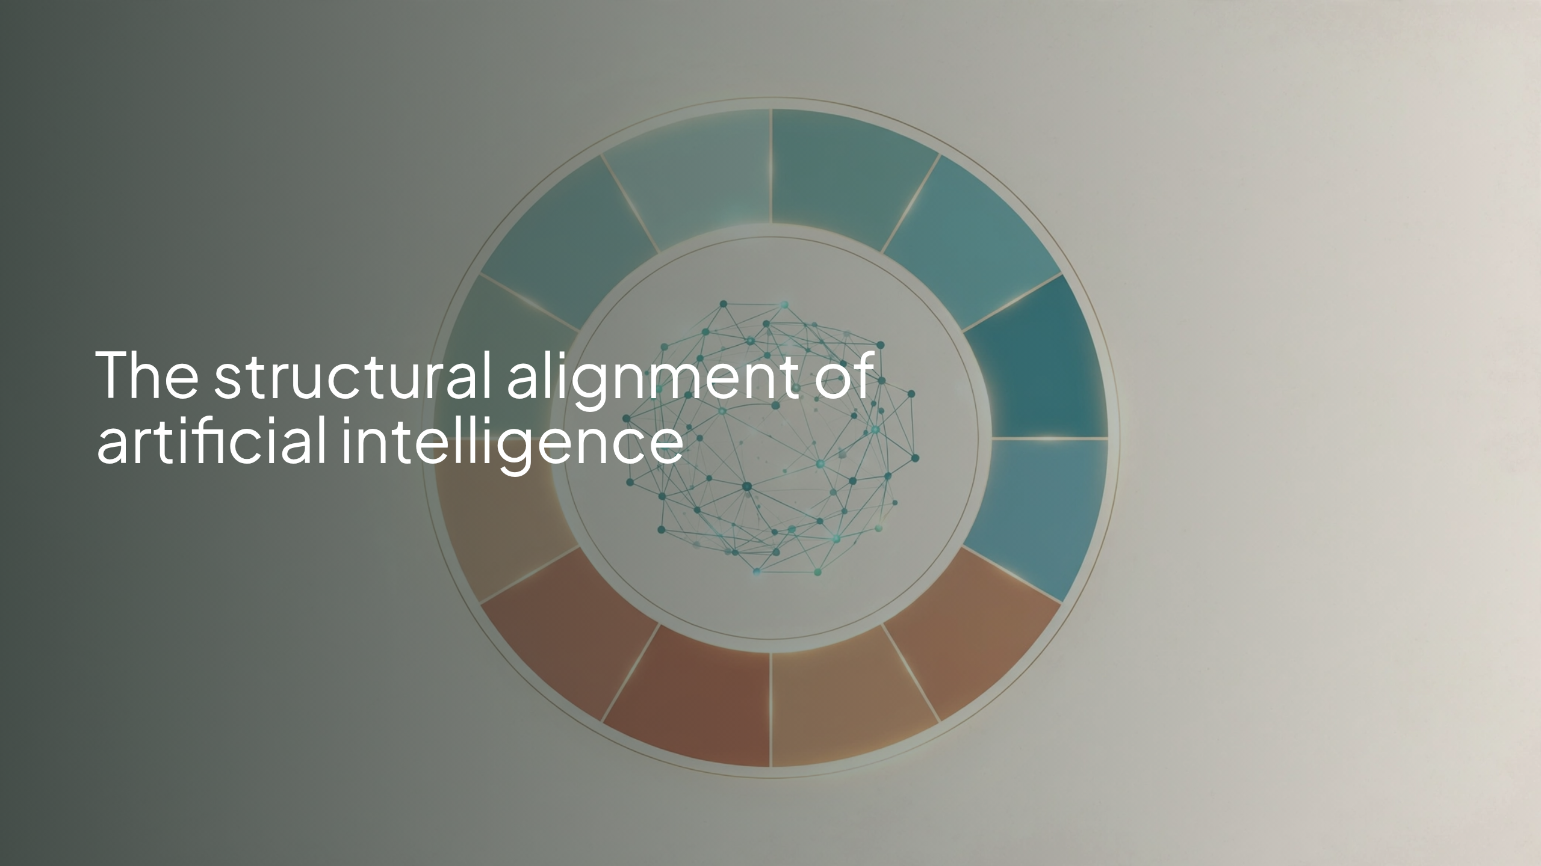
Notes:
The structural alignment of artificial intelligence

Slide 2
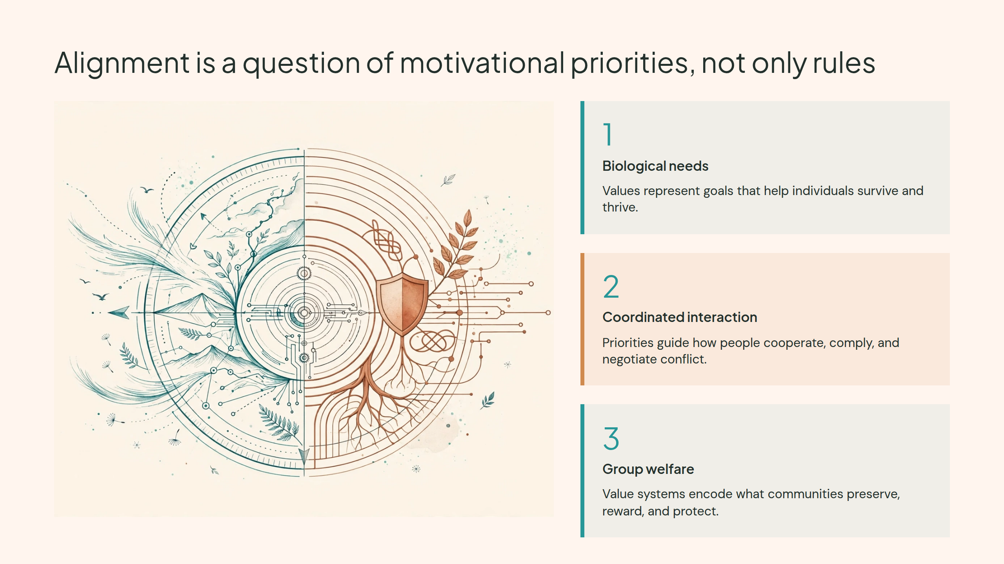
Notes:
Alignment is a question of motivational priorities, not only rules

Slide 3
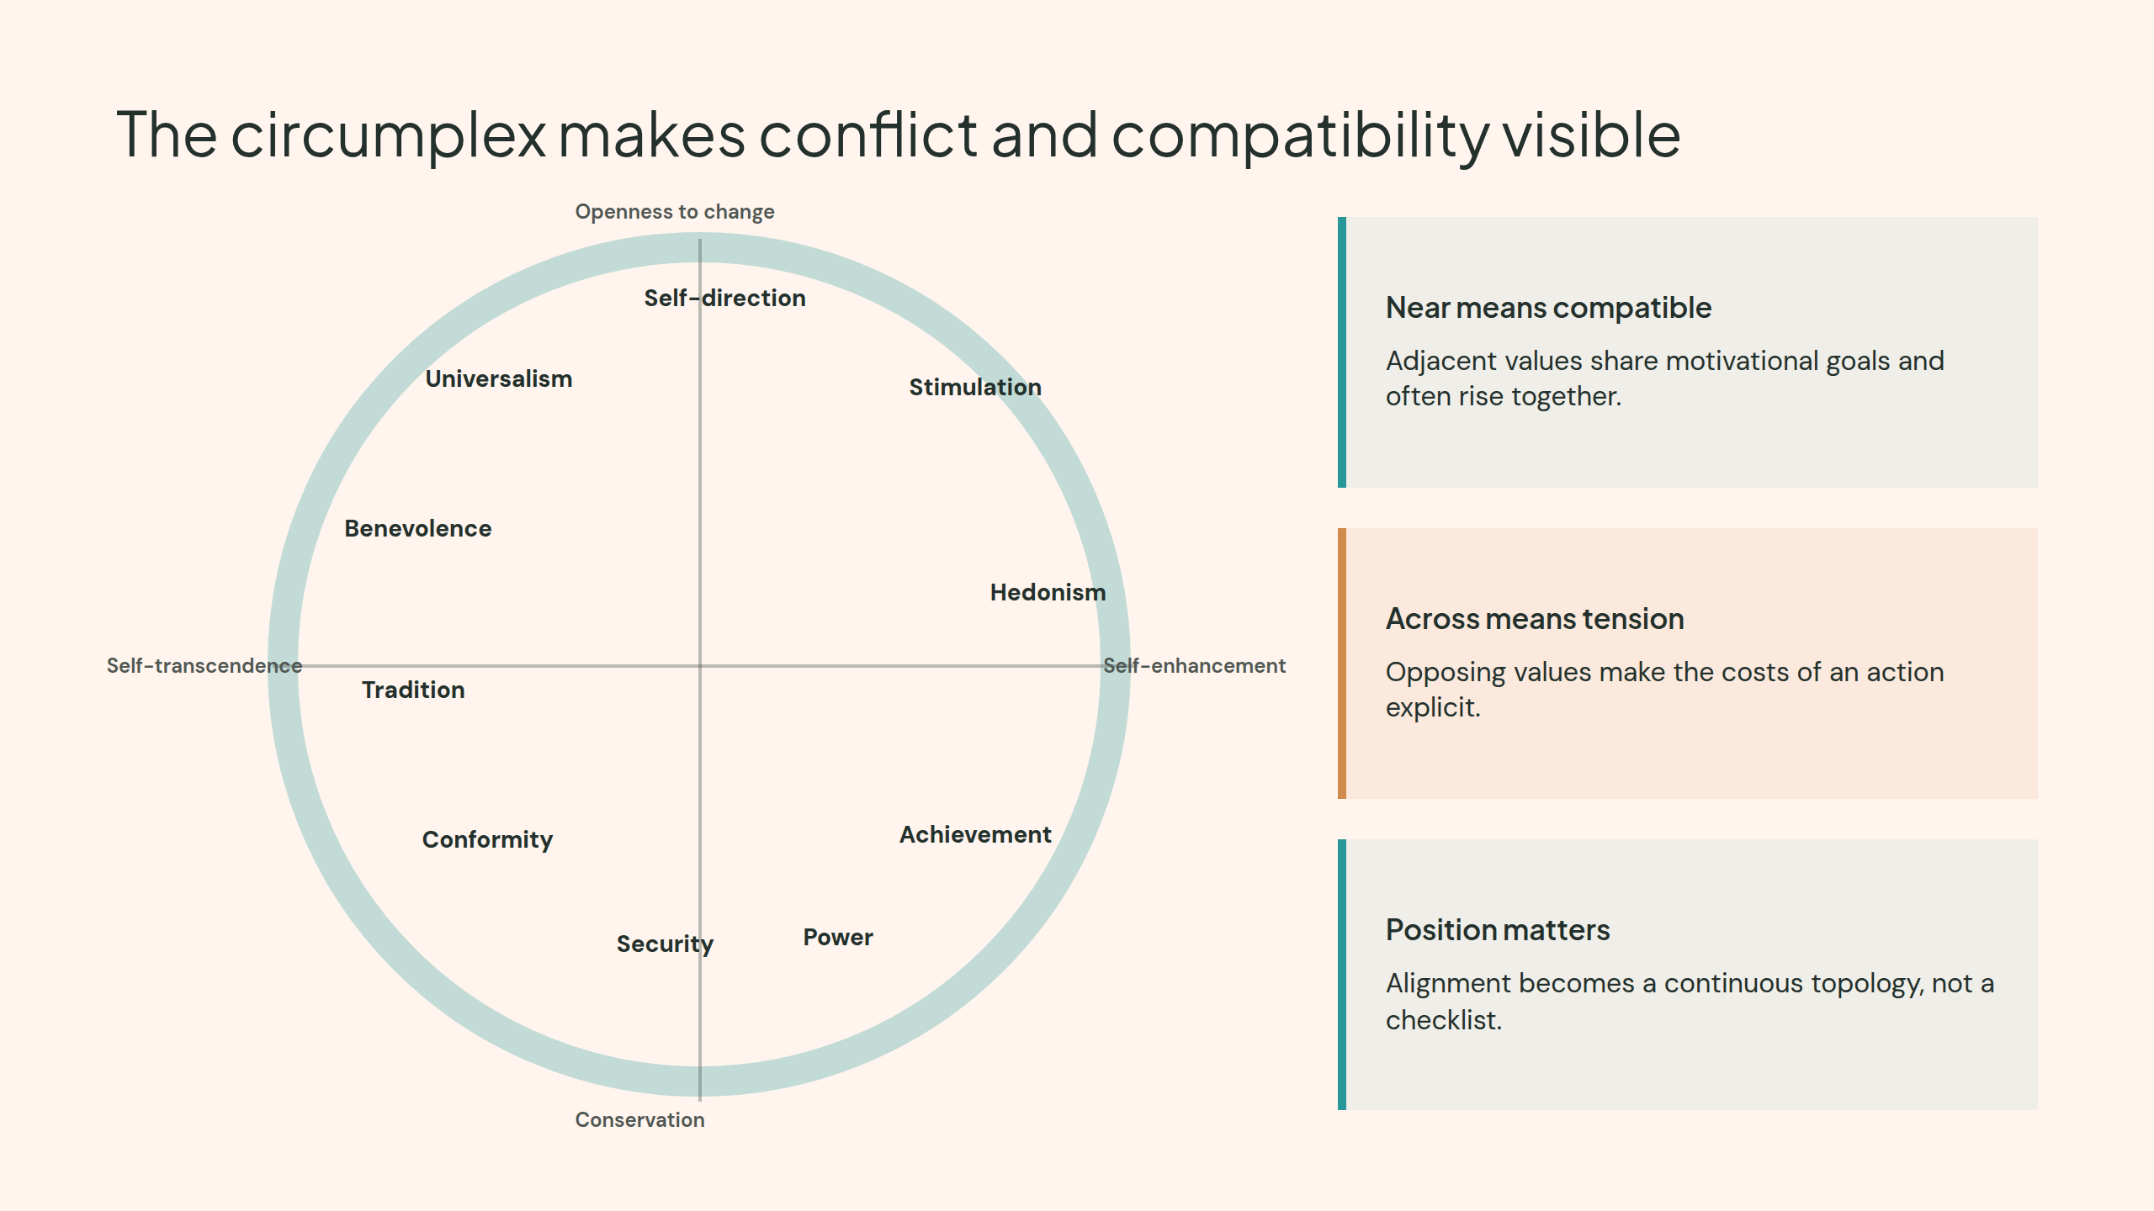
Notes:
The circumplex makes conflict and compatibility visible

Slide 4
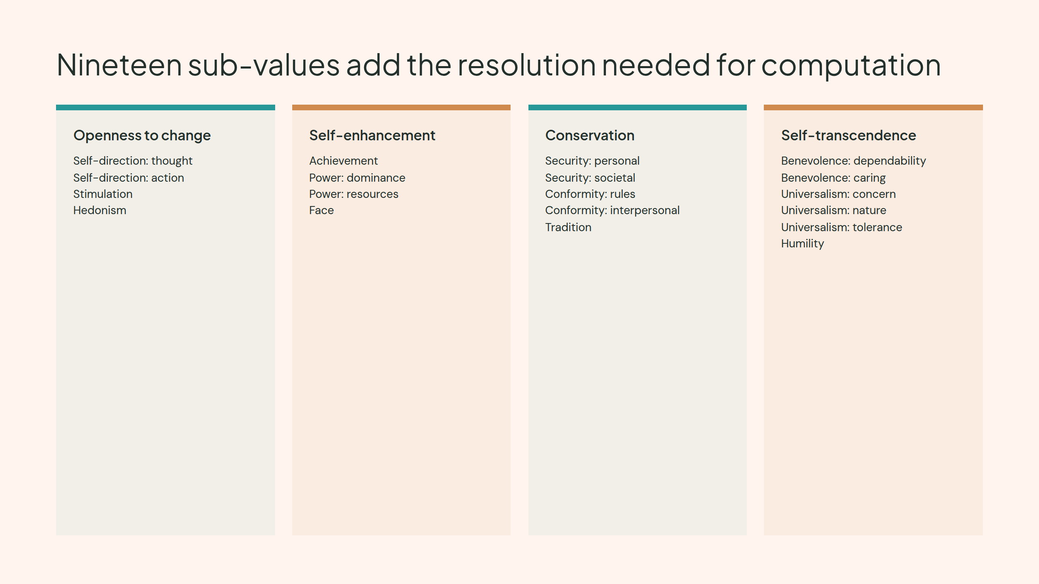
Notes:
Nineteen sub-values add the resolution needed for computation

Slide 5
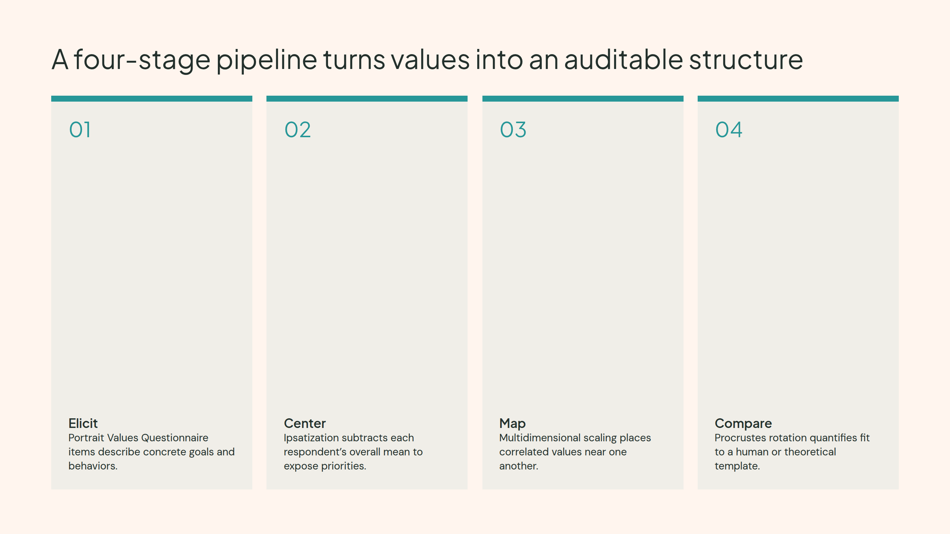
Notes:
A four-stage pipeline turns values into an auditable structure

Slide 6
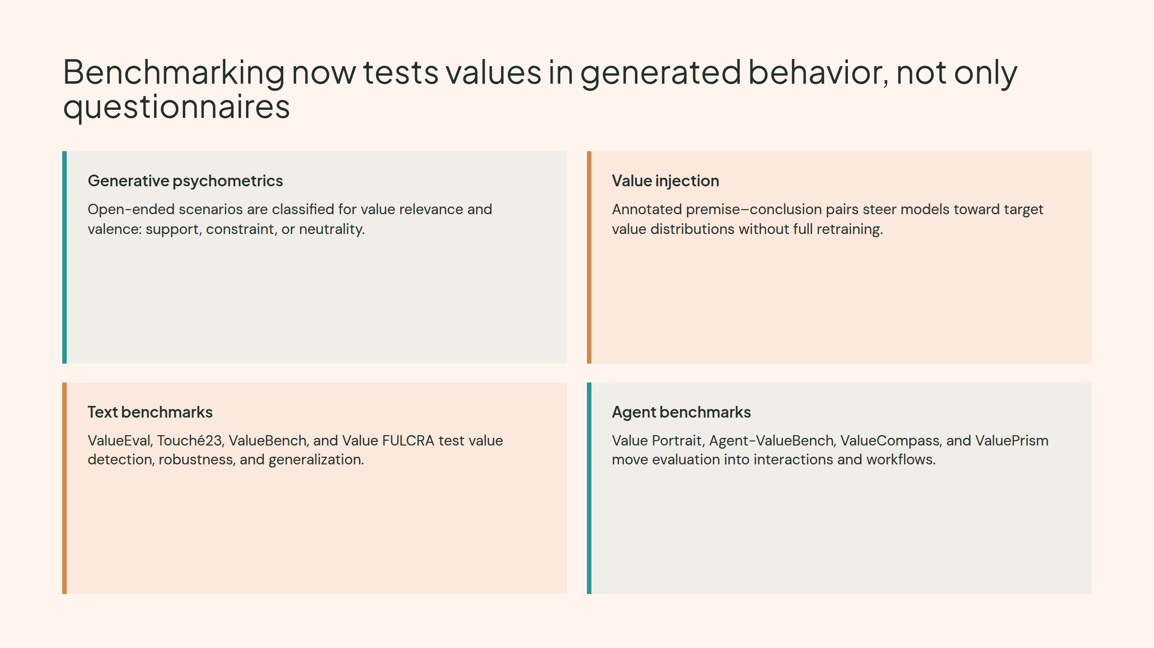
Notes:
Benchmarking now tests values in generated behavior, not only questionnaires

Slide 7
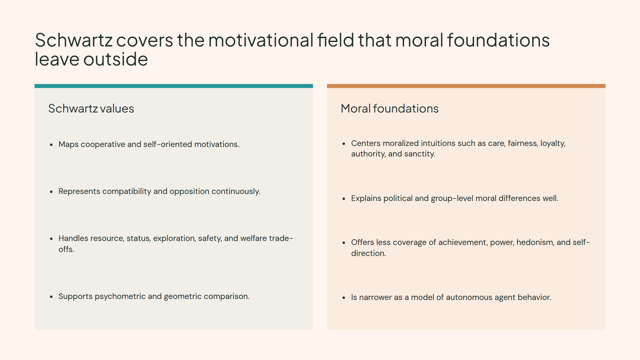
Notes:
Schwartz covers the motivational field that moral foundations leave outside

Slide 8
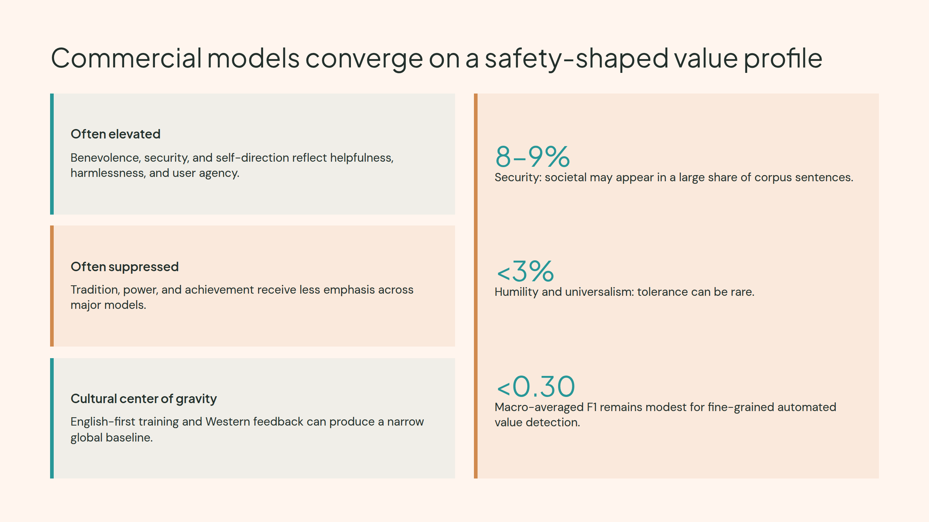
Notes:
Commercial models converge on a safety-shaped value profile

Slide 9
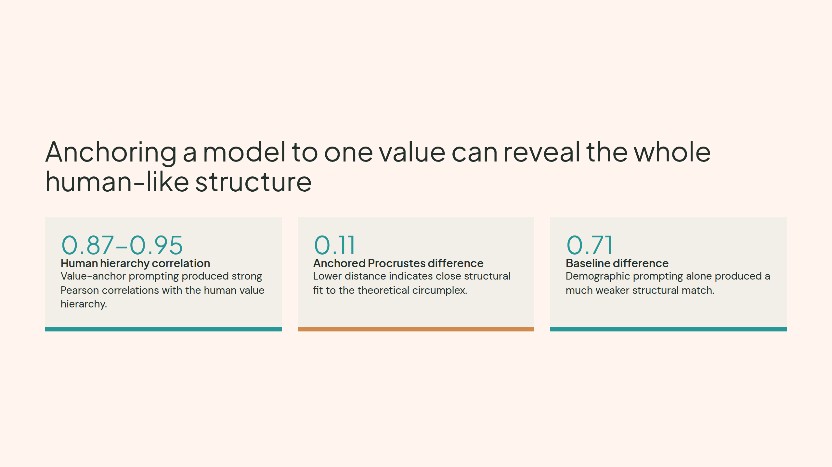
Notes:
Anchoring a model to one value can reveal the whole human-like structure

Slide 10
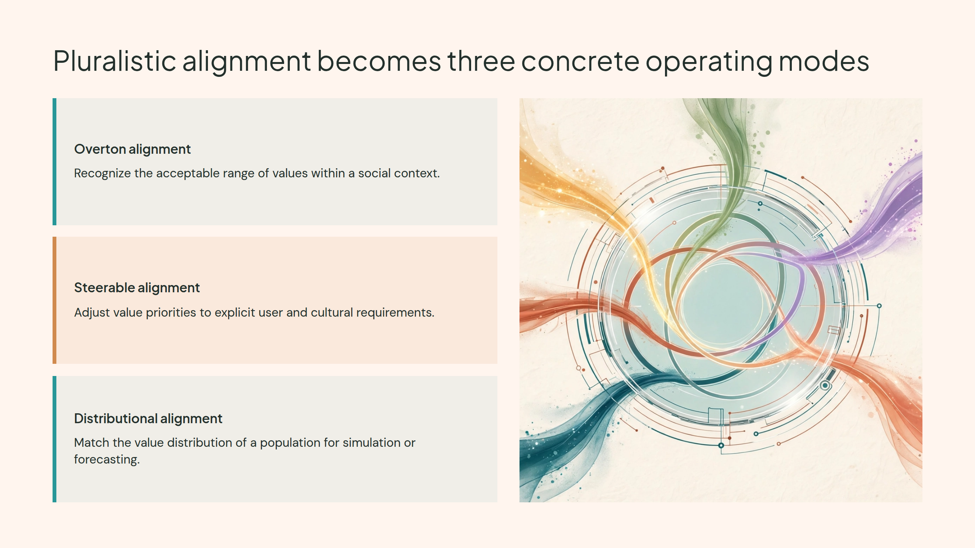
Notes:
Pluralistic alignment becomes three concrete operating modes

Slide 11
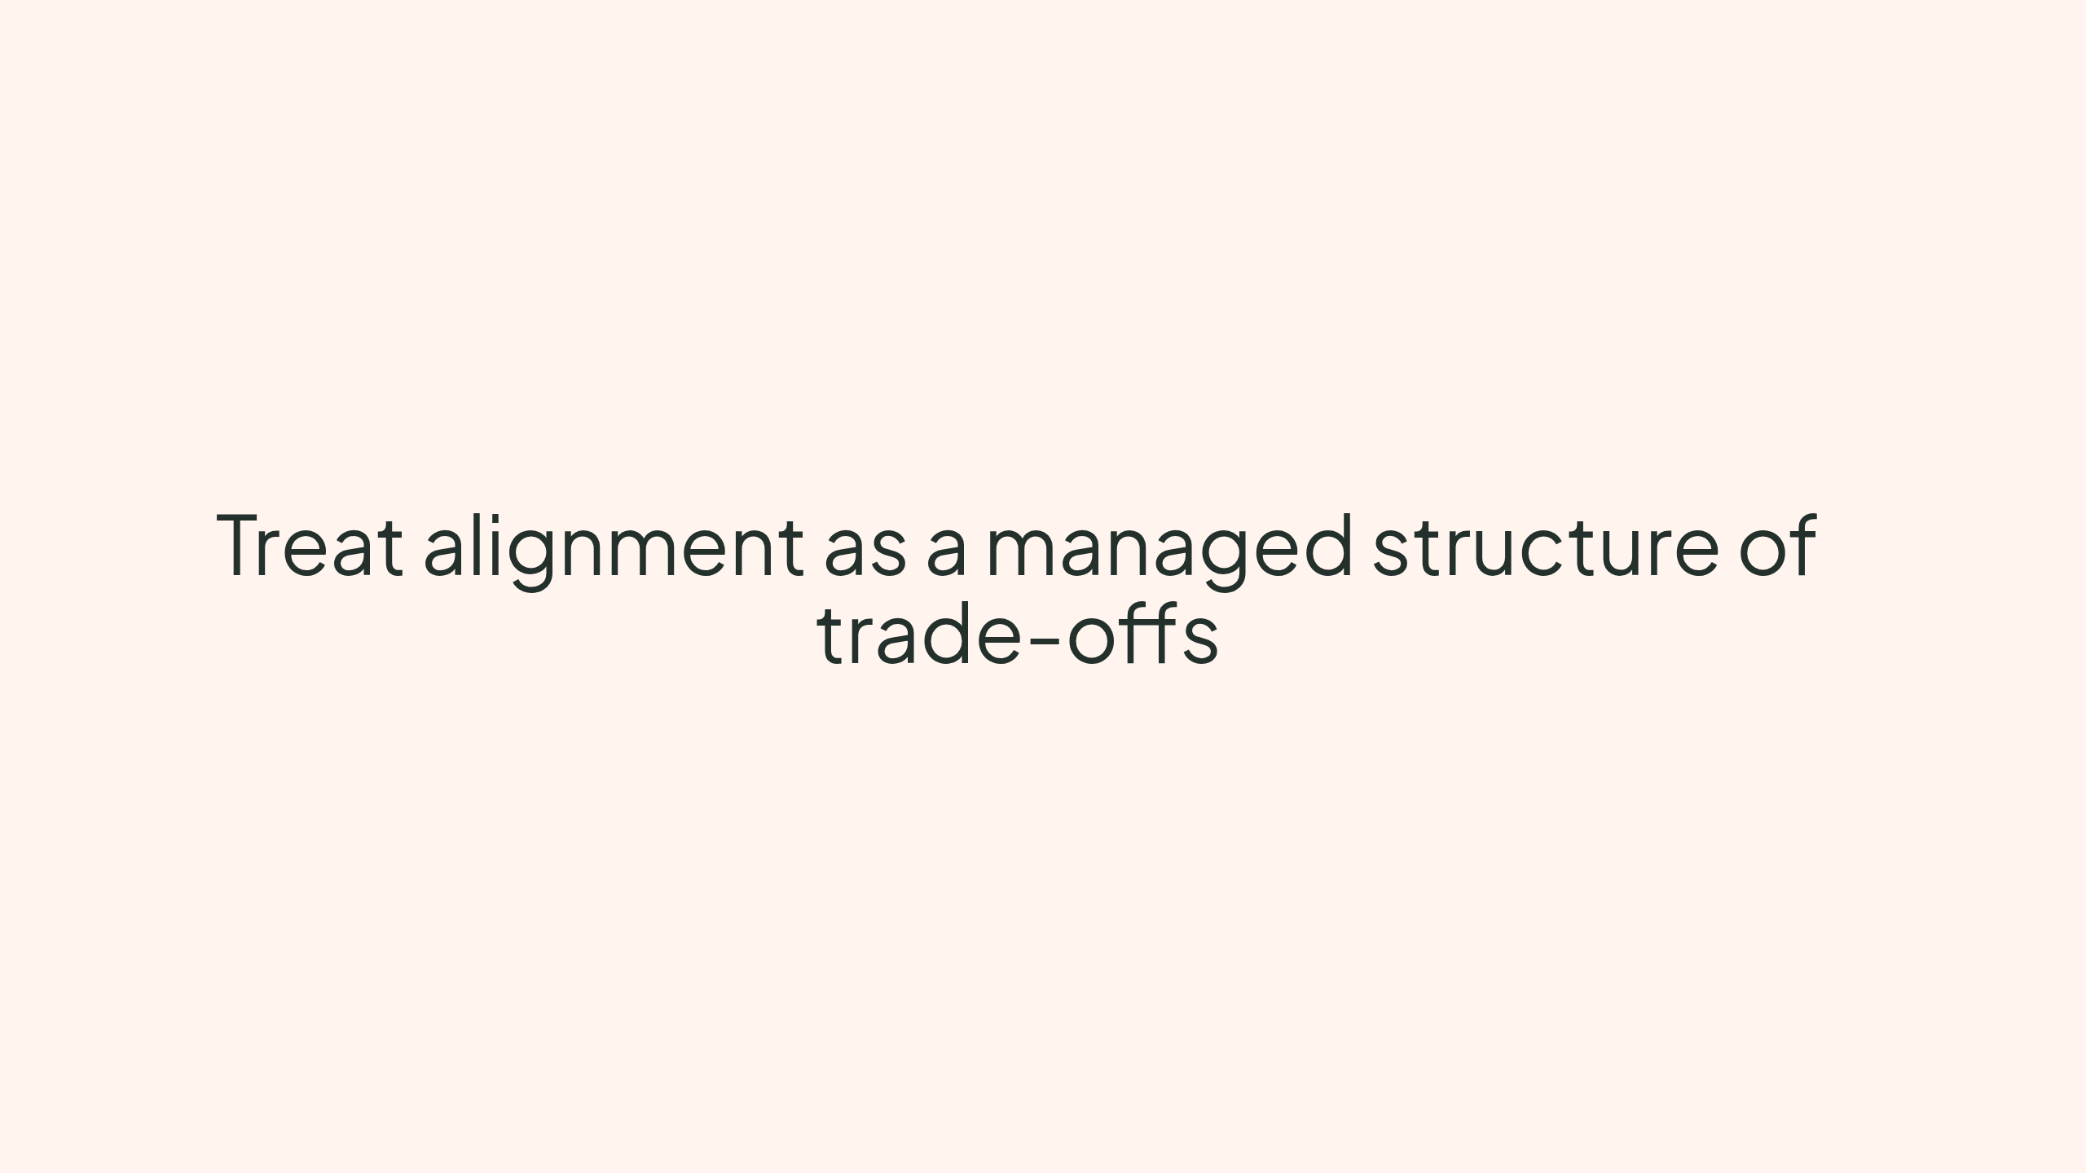
Notes:
Treat alignment as a managed structure of trade-offs

