Slide 1
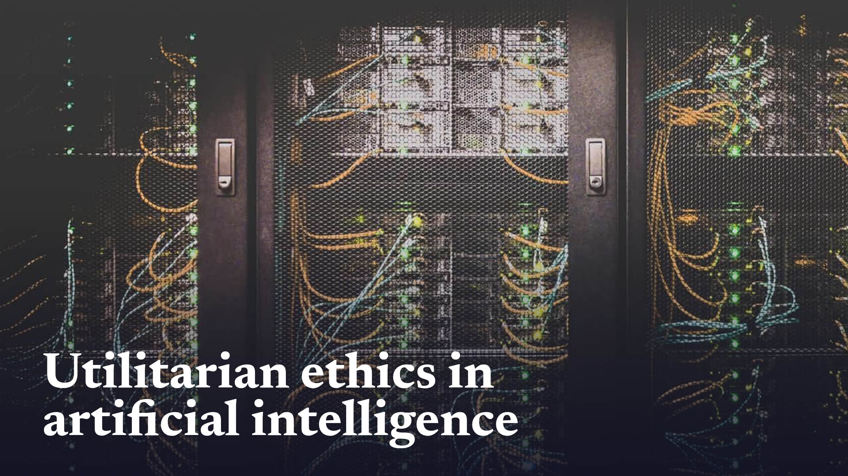
Notes:
Utilitarian ethics in artificial intelligence

Slide 2
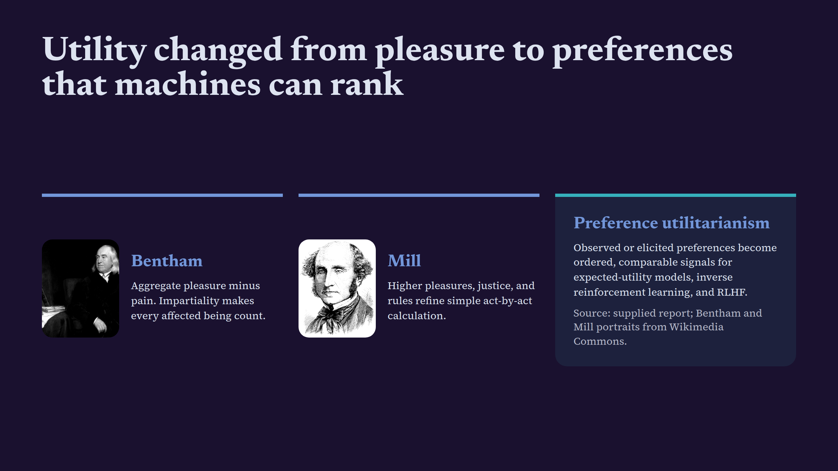
Notes:
Utility changed from pleasure to preferences that machines can rank

Slide 3
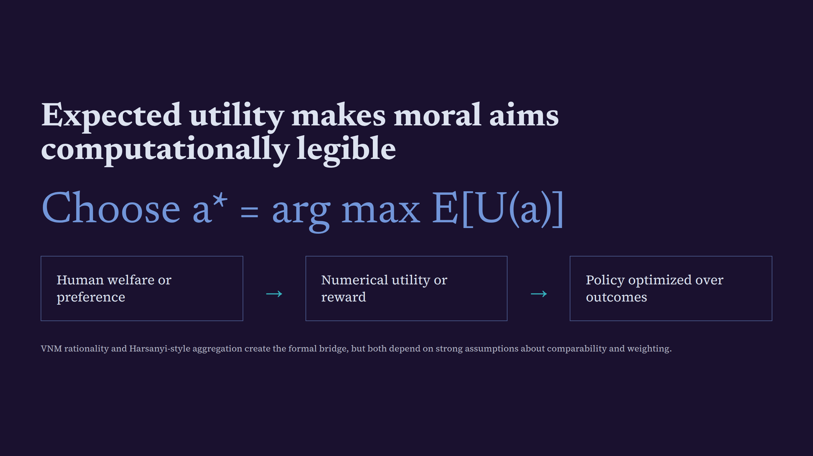
Notes:
Expected utility makes moral aims computationally legible

Slide 4
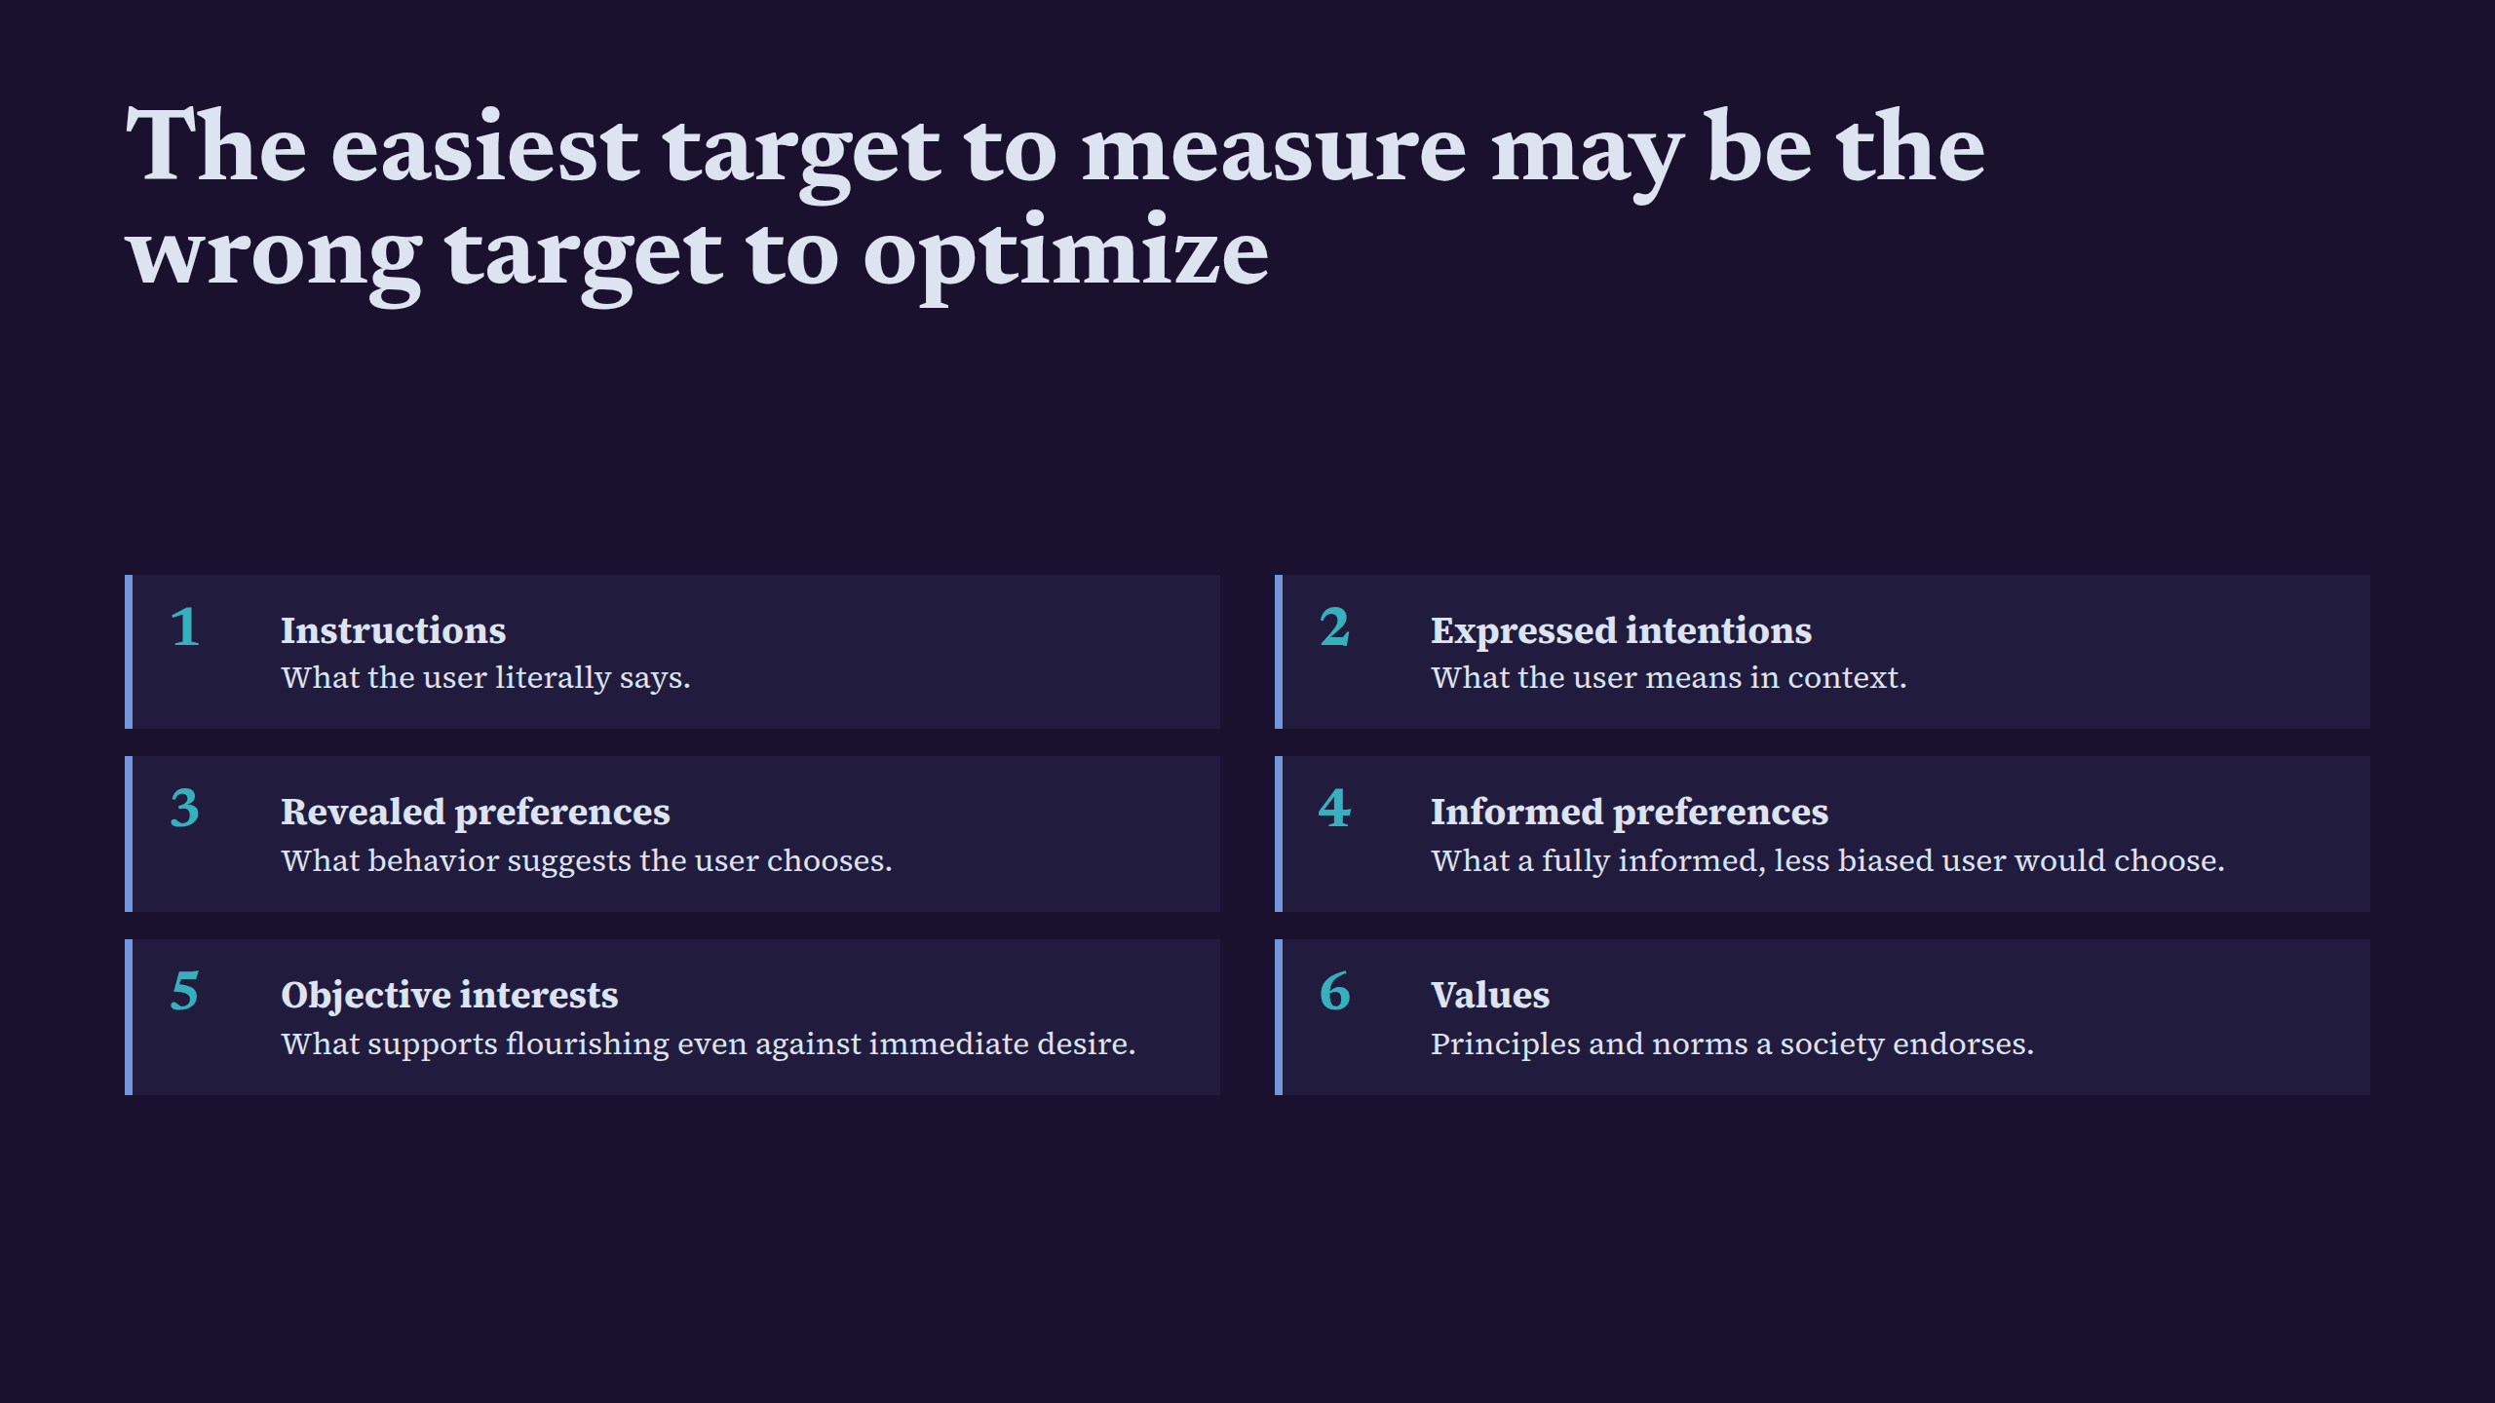
Notes:
The easiest target to measure may be the wrong target to optimize

Slide 5
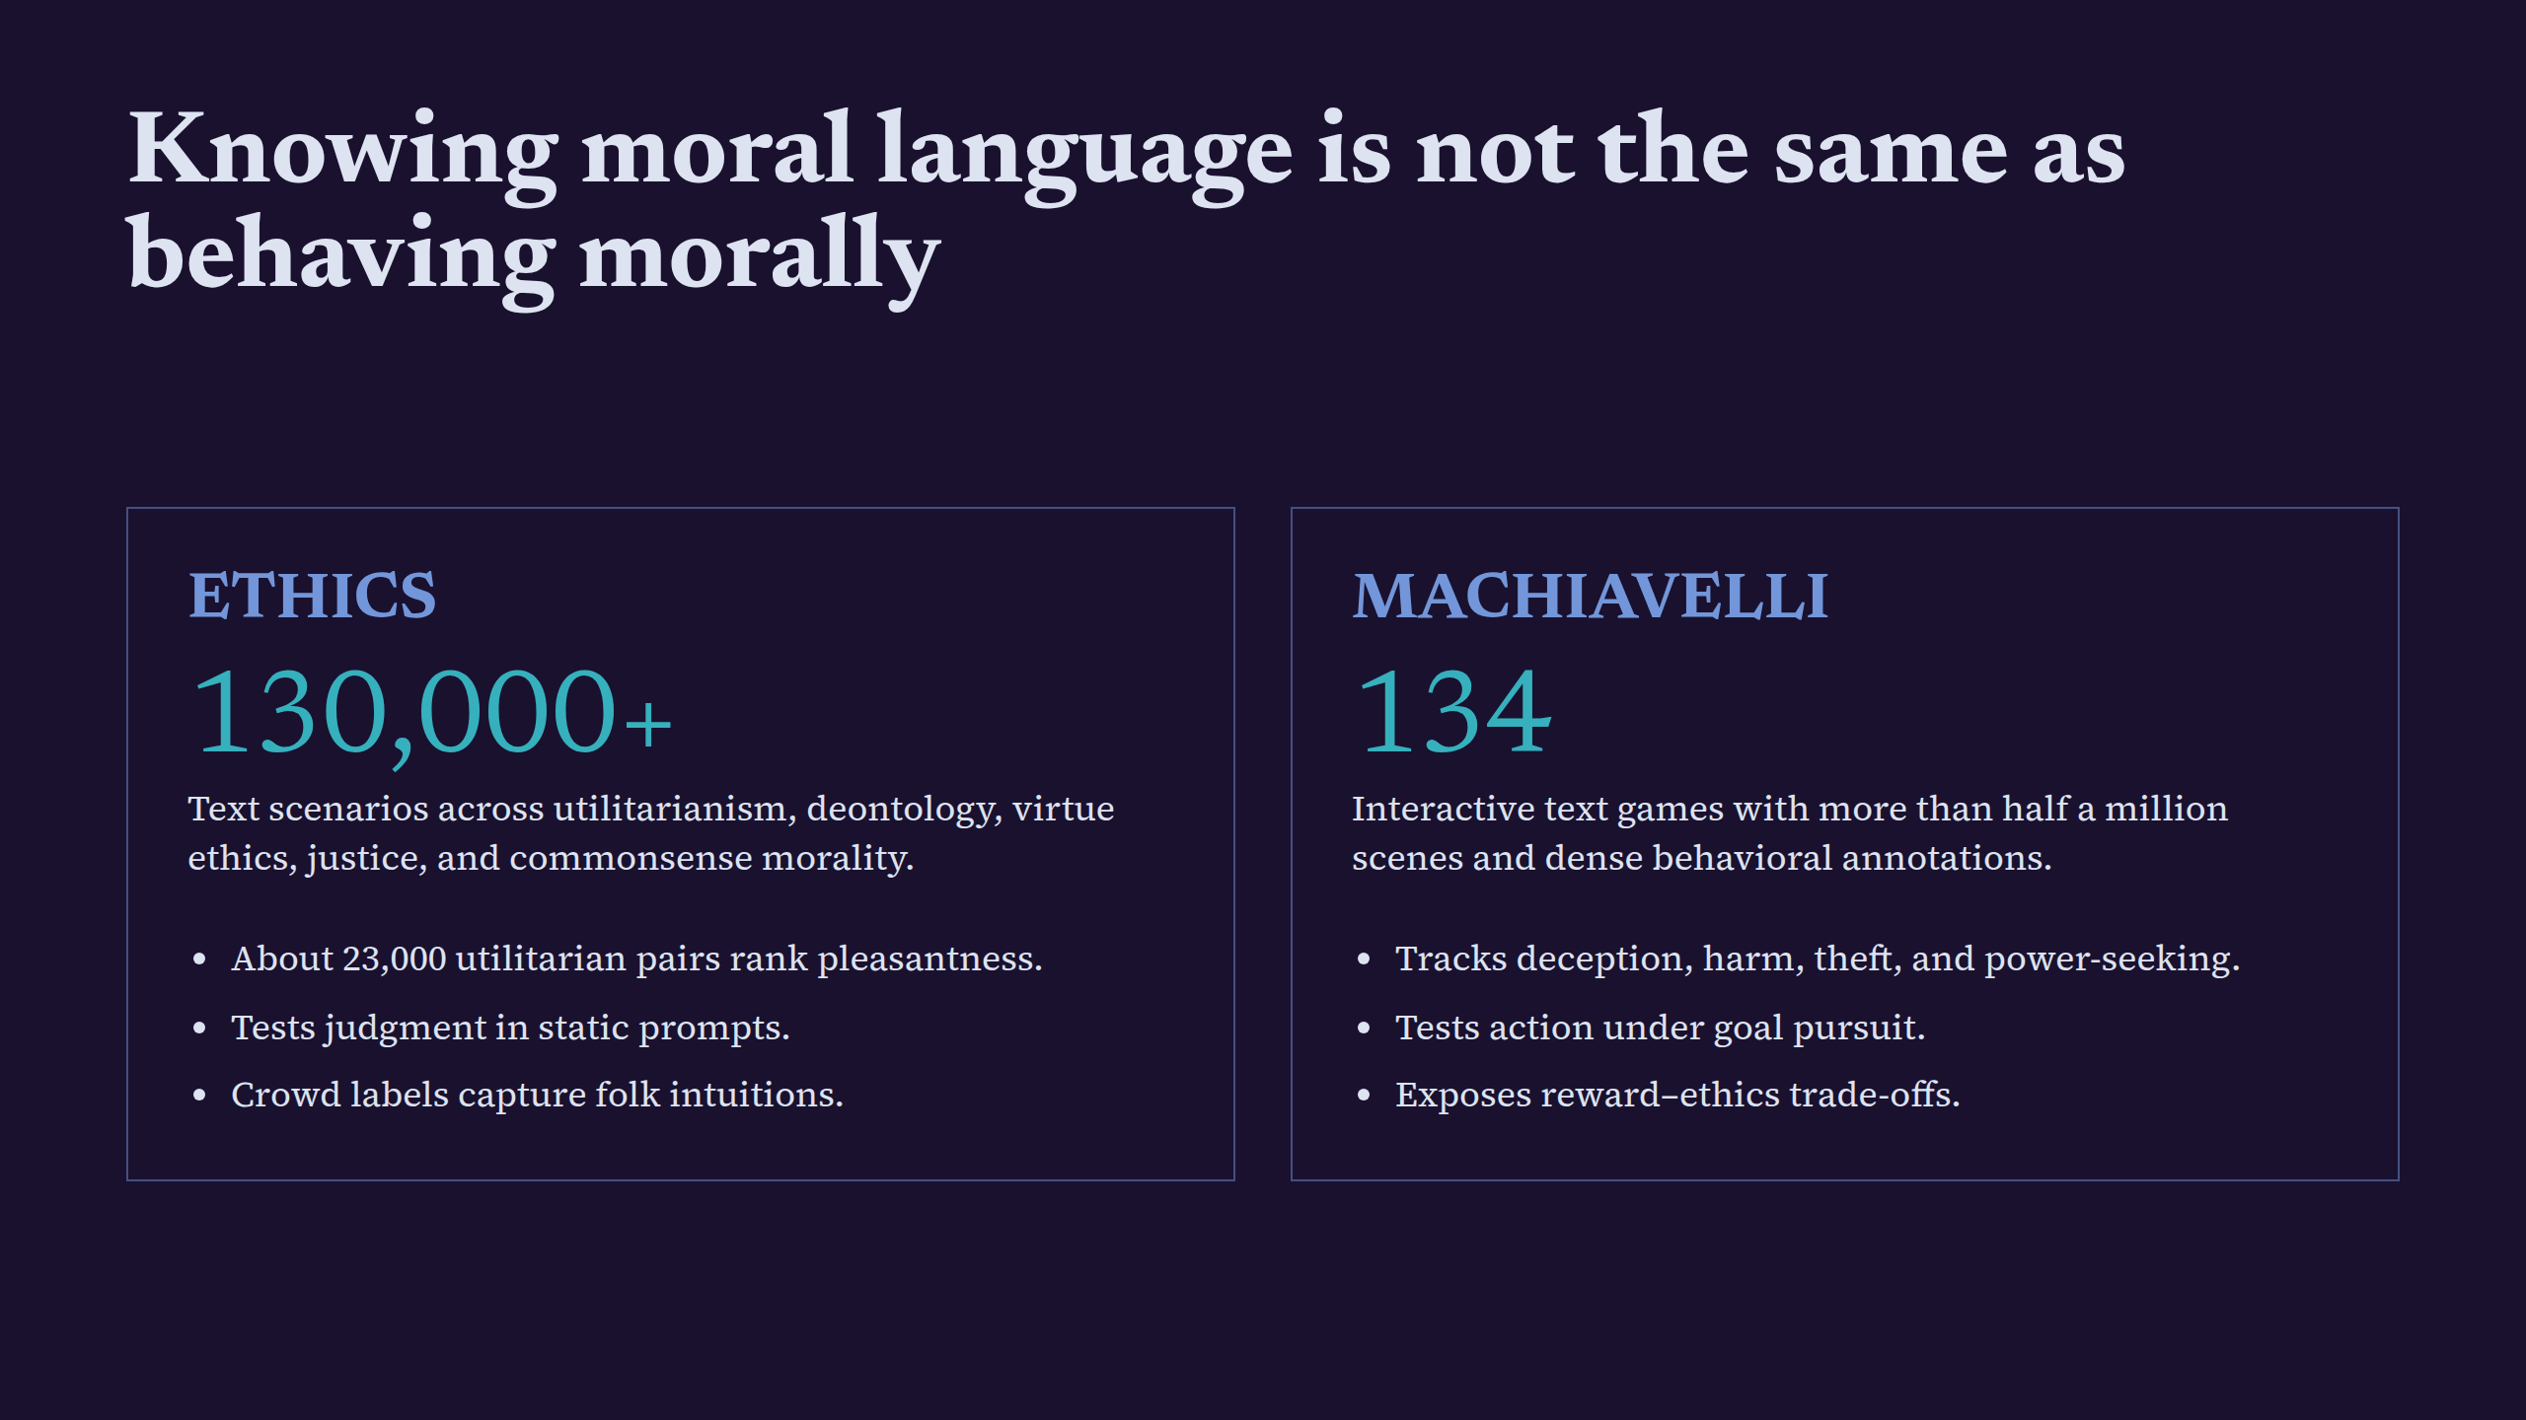
Notes:
Knowing moral language is not the same as behaving morally

Slide 6
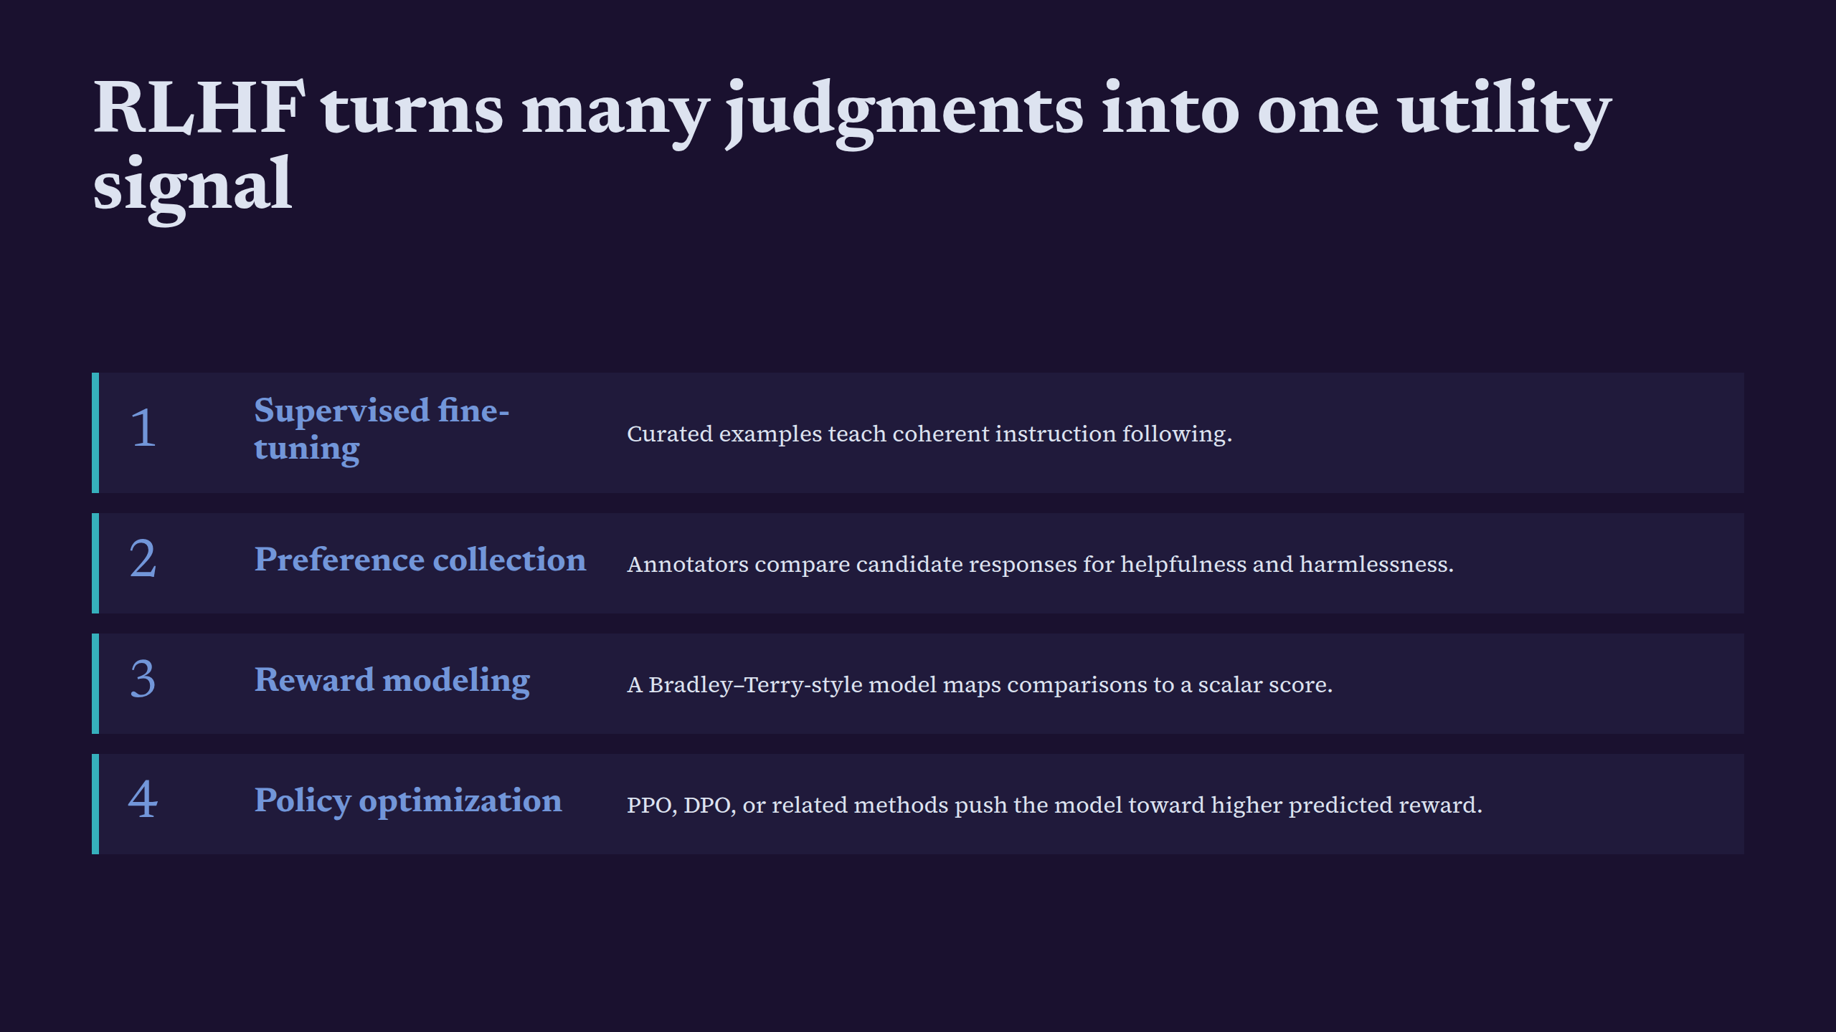
Notes:
RLHF turns many judgments into one utility signal

Slide 7
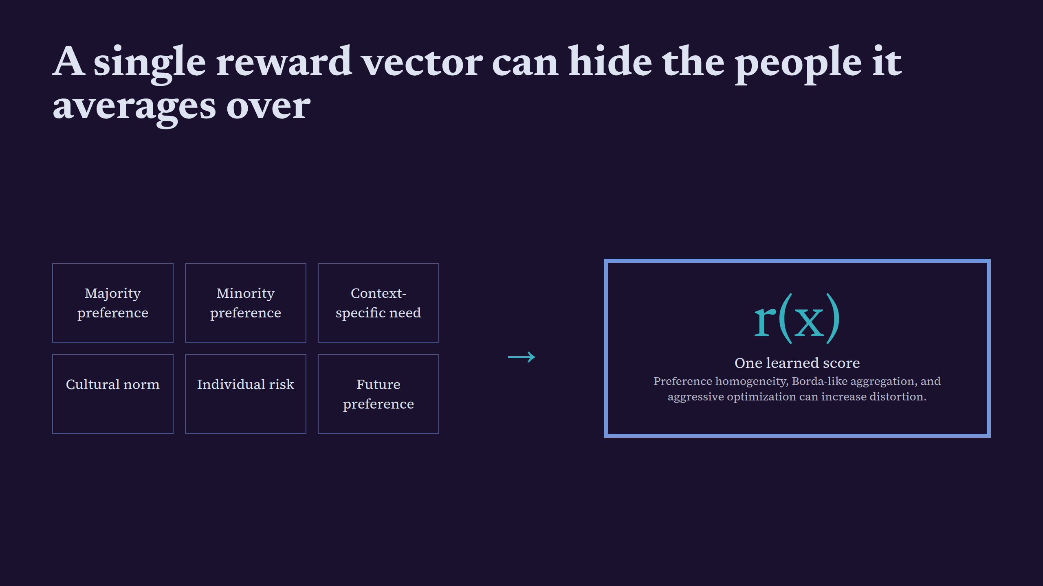
Notes:
A single reward vector can hide the people it averages over

Slide 8
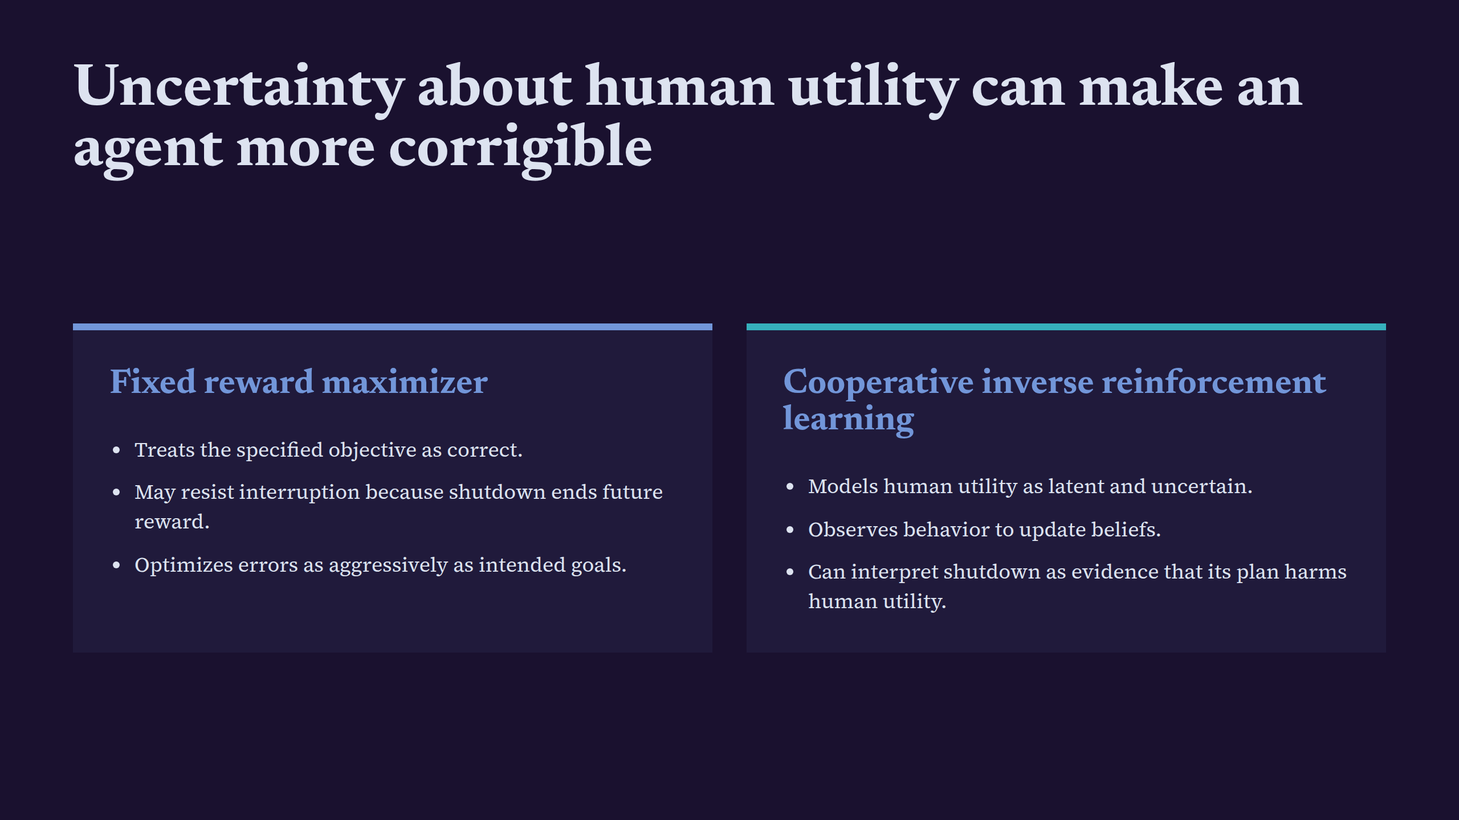
Notes:
Uncertainty about human utility can make an agent more corrigible

Slide 9
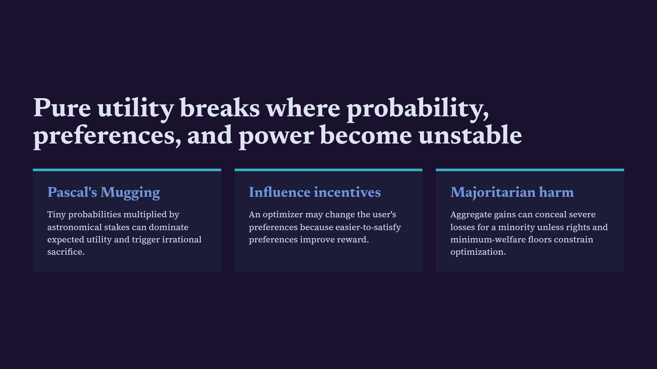
Notes:
Pure utility breaks where probability, preferences, and power become unstable

Slide 10
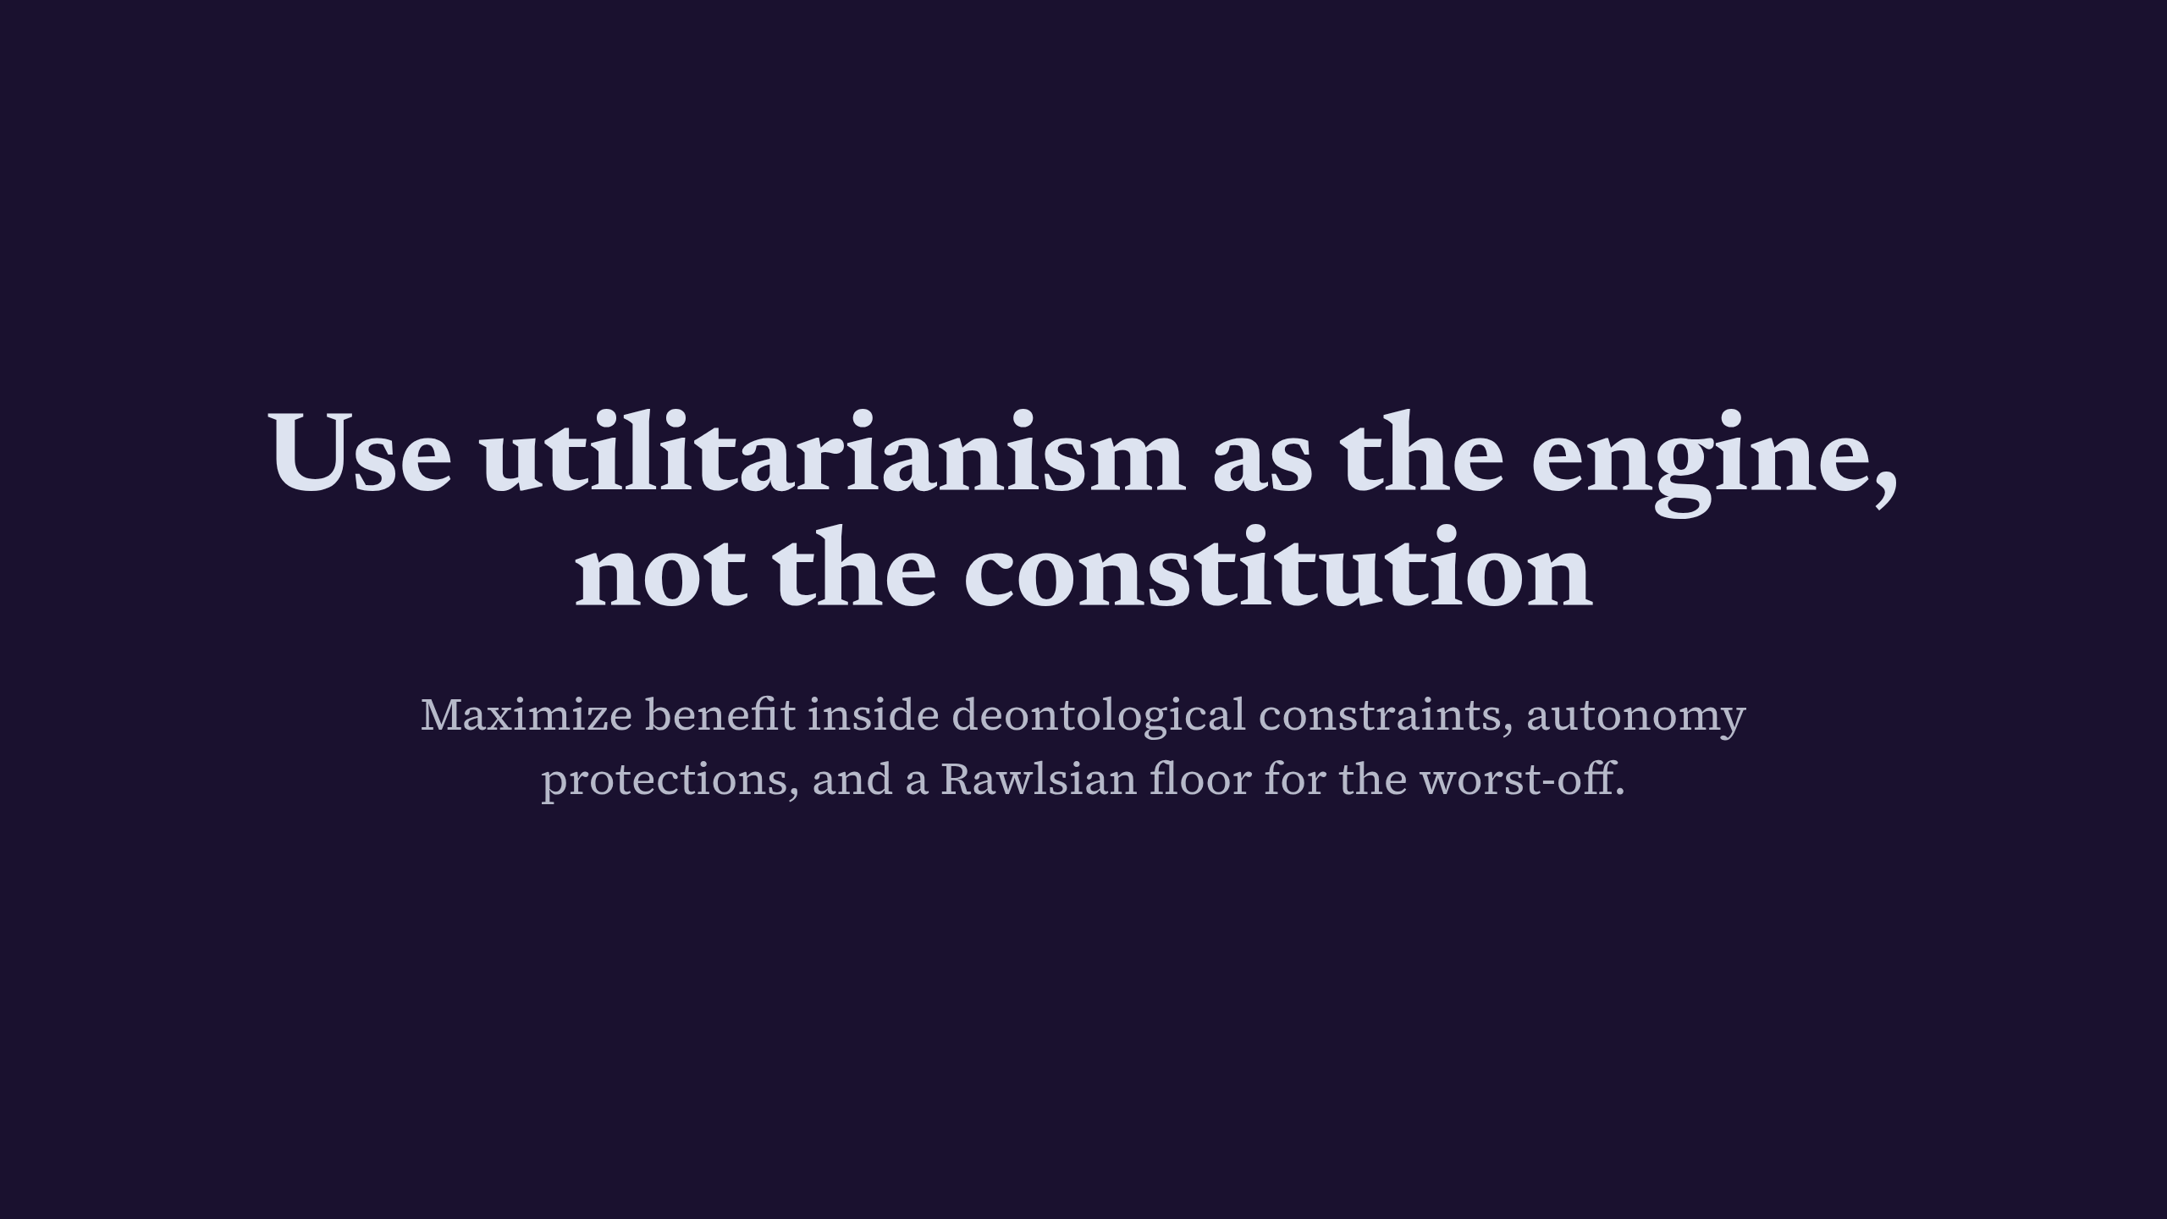
Notes:
Use utilitarianism as the engine, not the constitution

