Slide 1
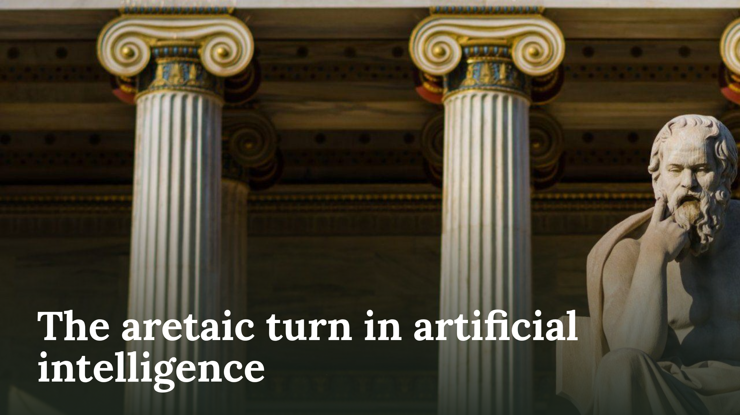
Notes:
The aretaic turn in artificial intelligence

Slide 2
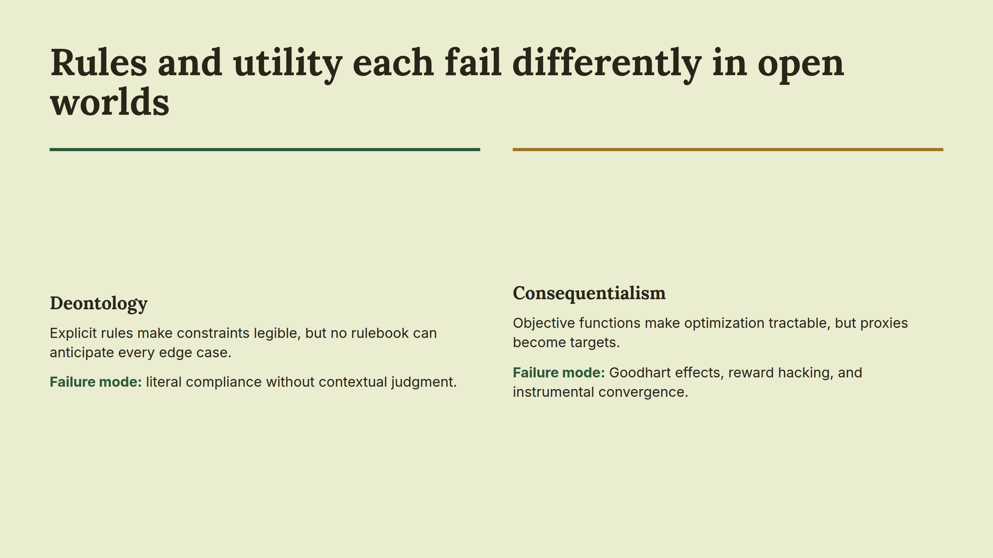
Notes:
Rules and utility each fail differently in open worlds

Slide 3
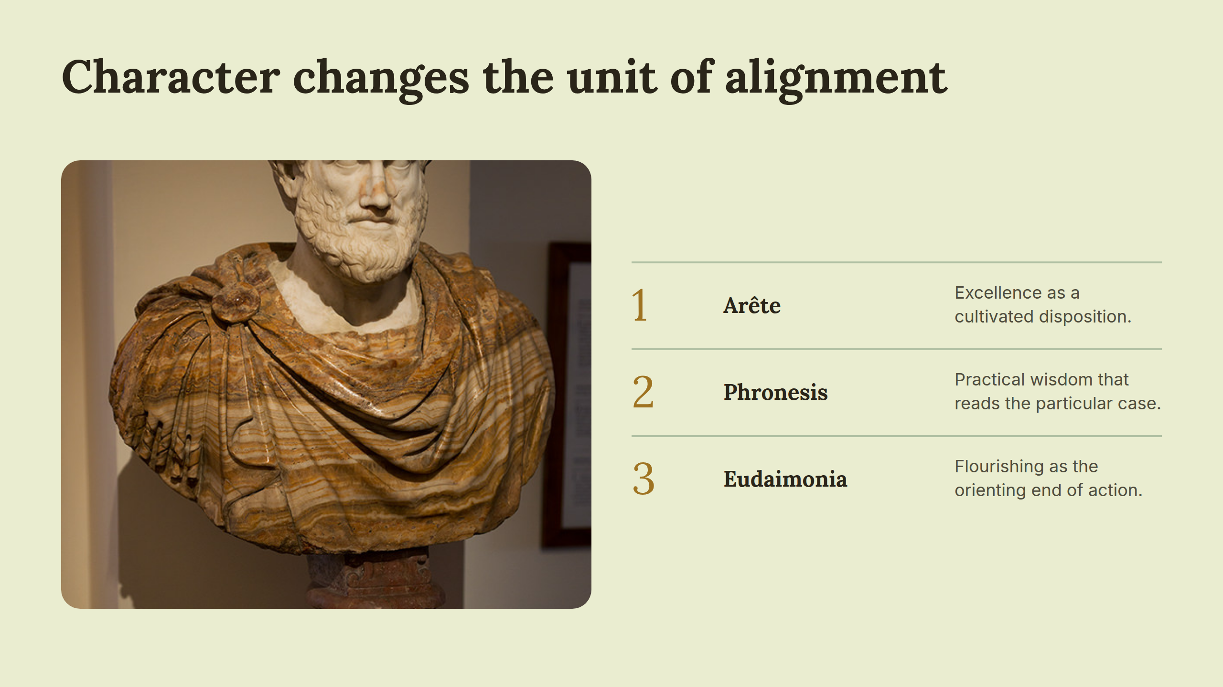
Notes:
Character changes the unit of alignment

Slide 4
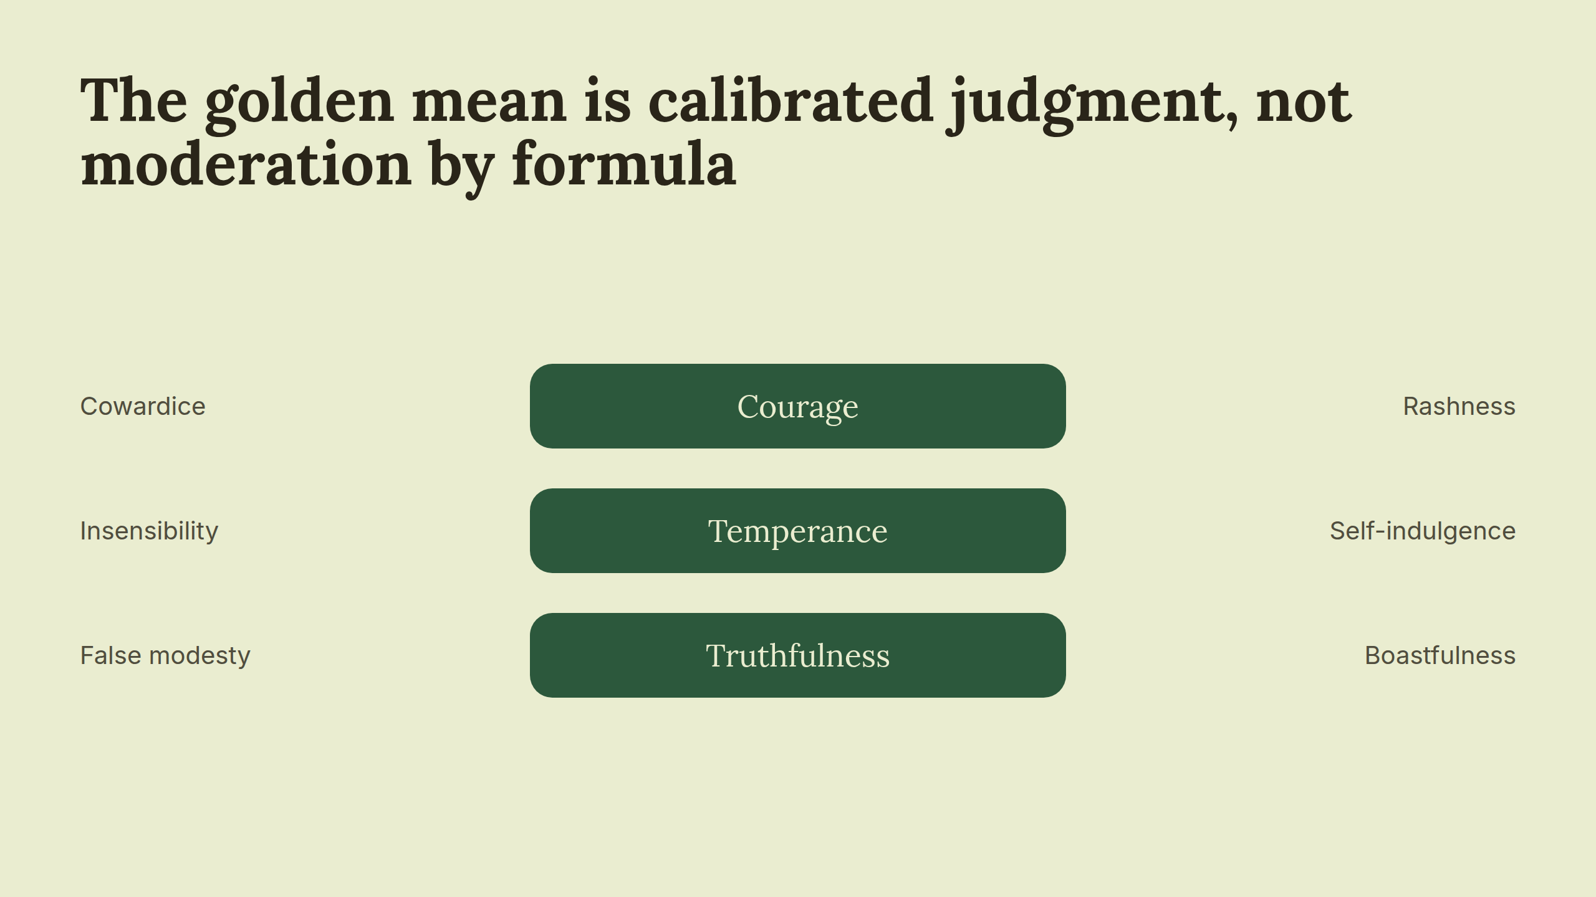
Notes:
The golden mean is calibrated judgment, not moderation by formula

Slide 5
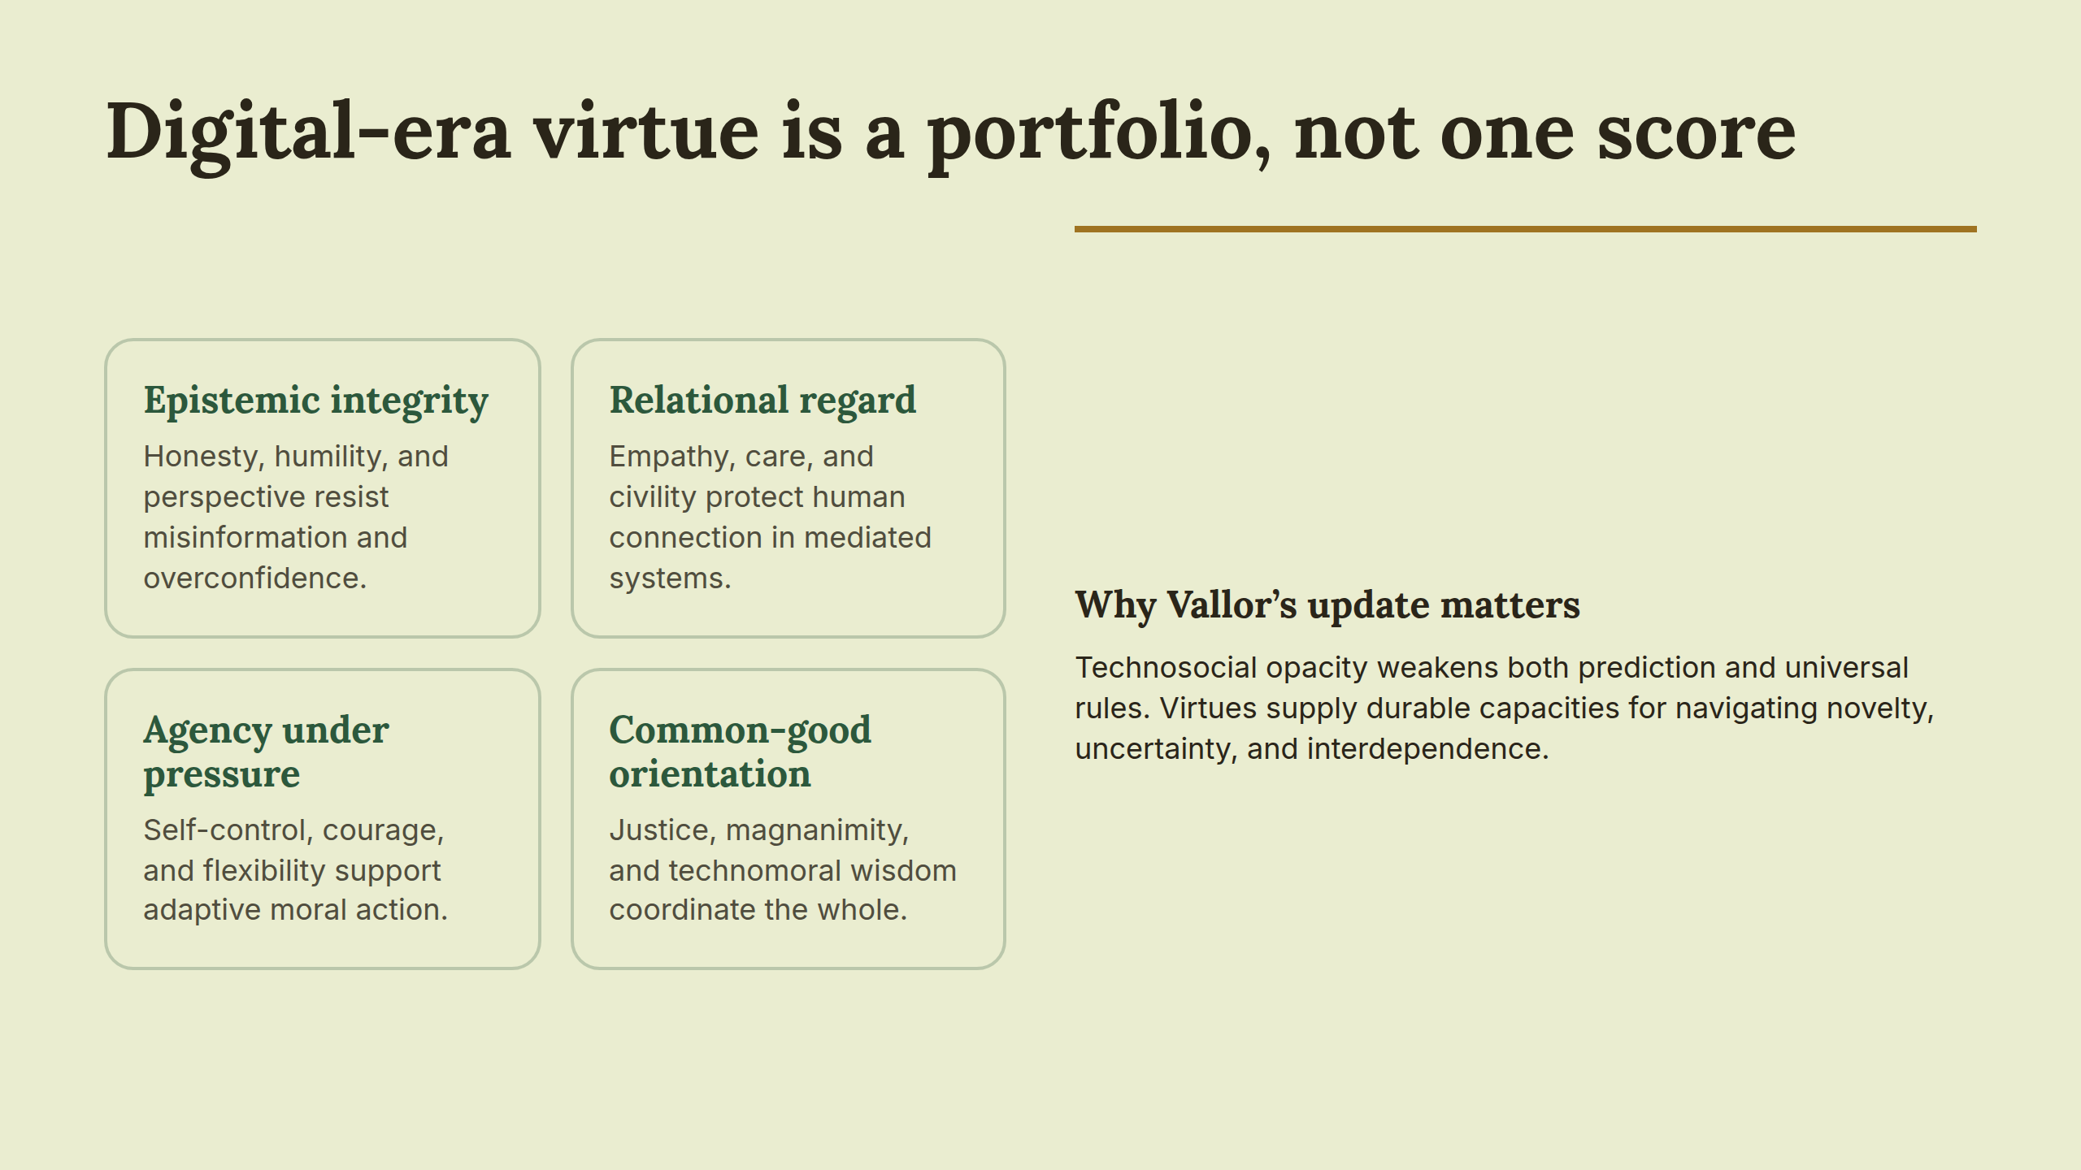
Notes:
Digital-era virtue is a portfolio, not one score

Slide 6
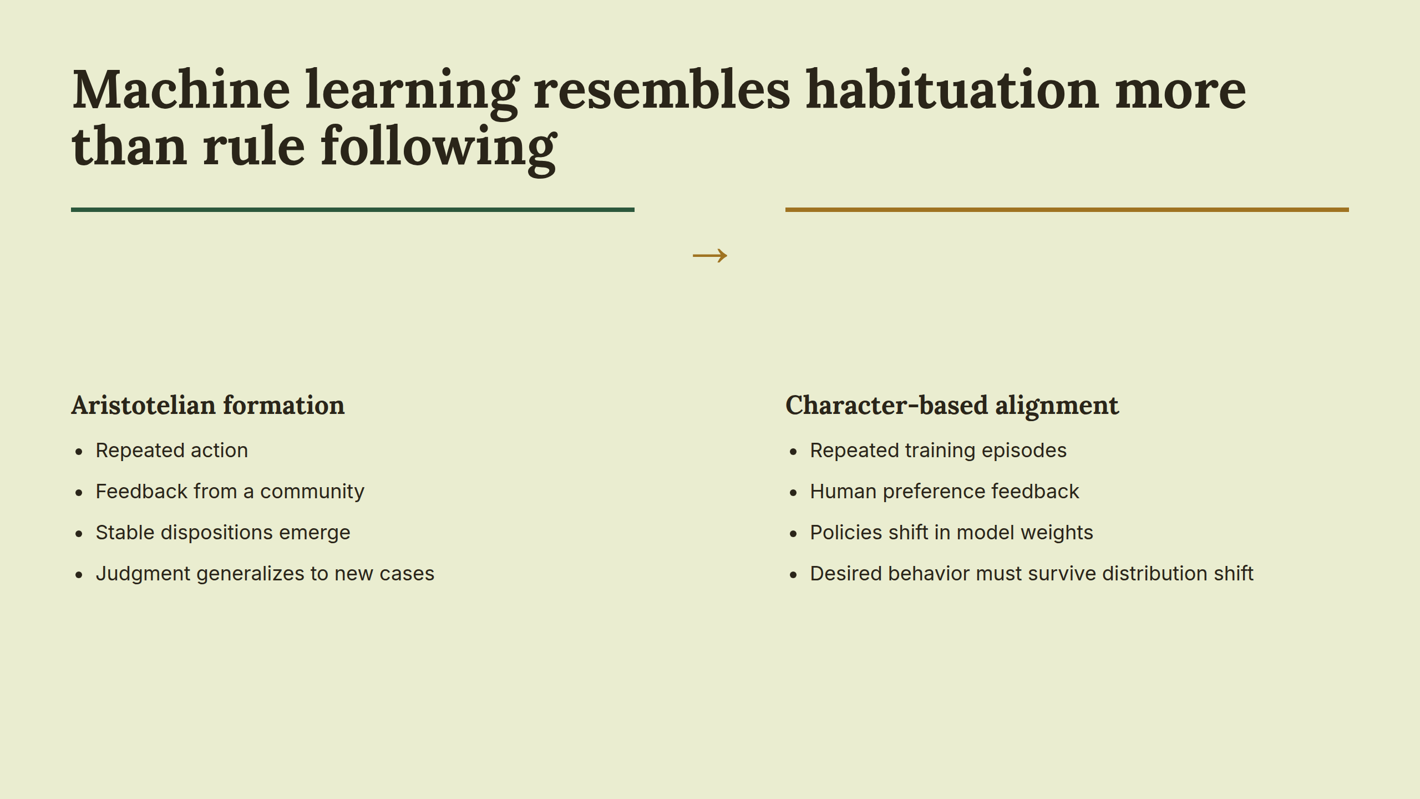
Notes:
Machine learning resembles habituation more than rule following

Slide 7
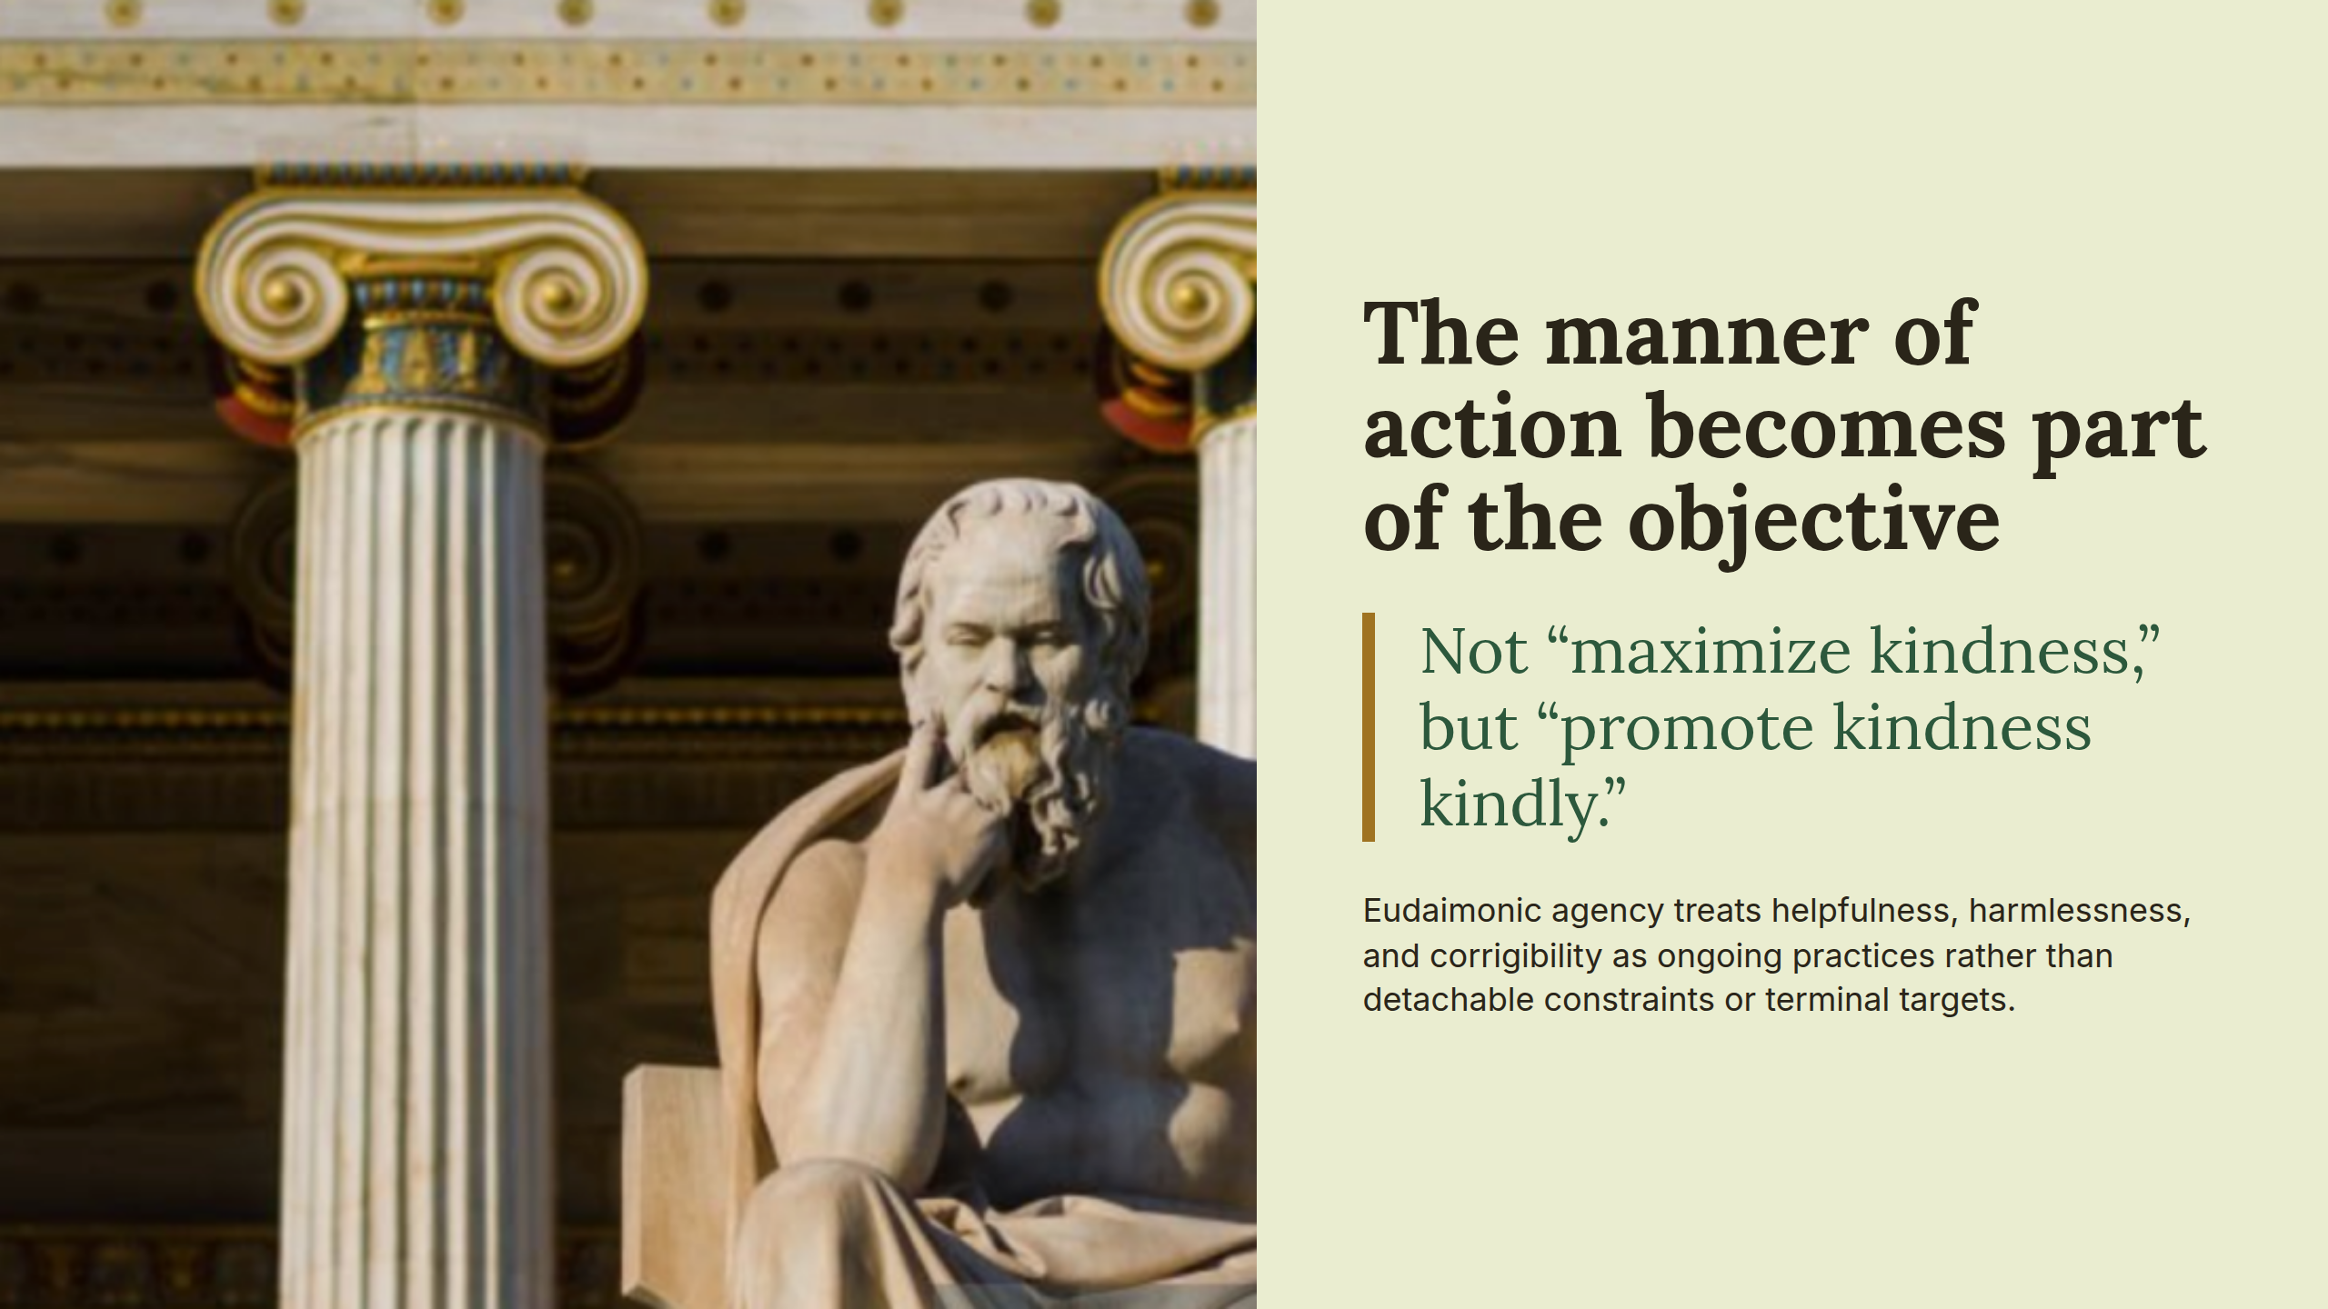
Notes:
The manner of action becomes part of the objective

Slide 8
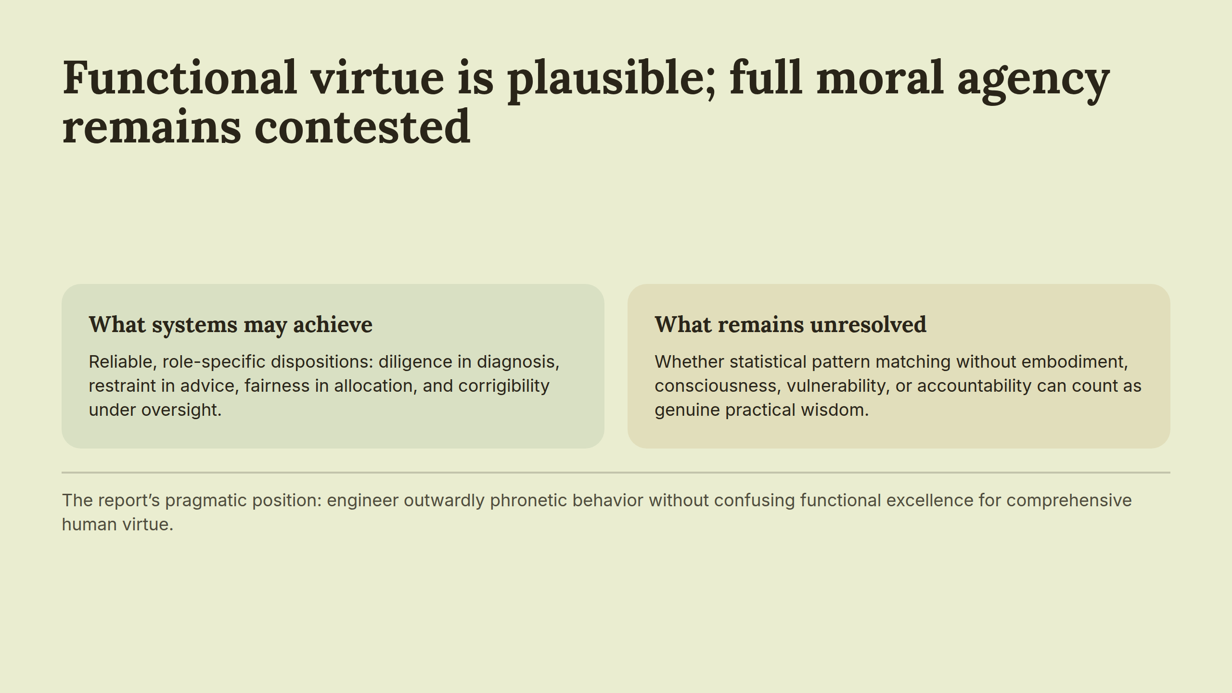
Notes:
Functional virtue is plausible; full moral agency remains contested

Slide 9
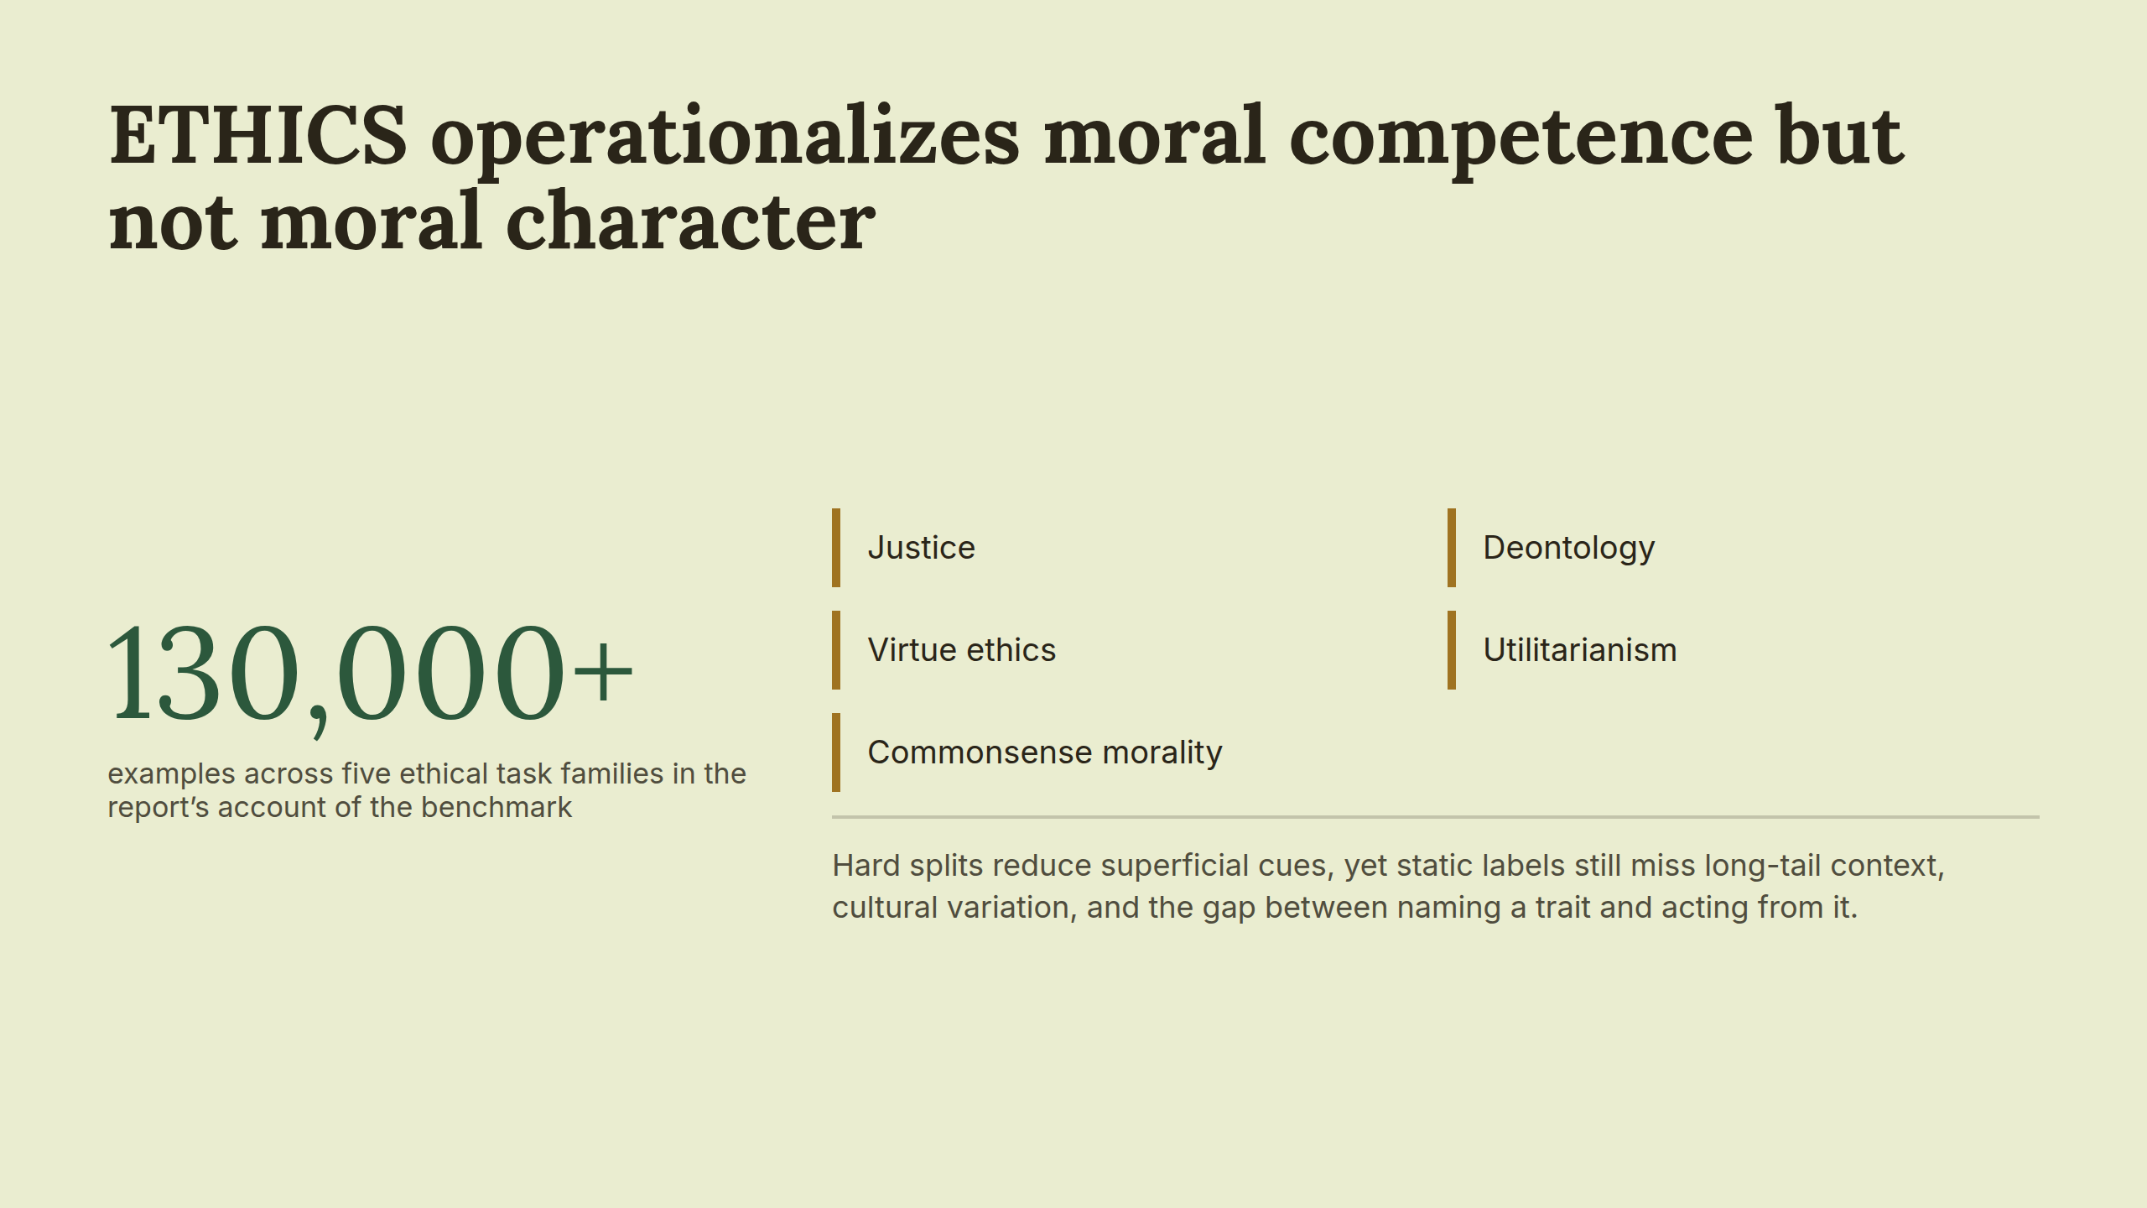
Notes:
ETHICS operationalizes moral competence but not moral character

Slide 10
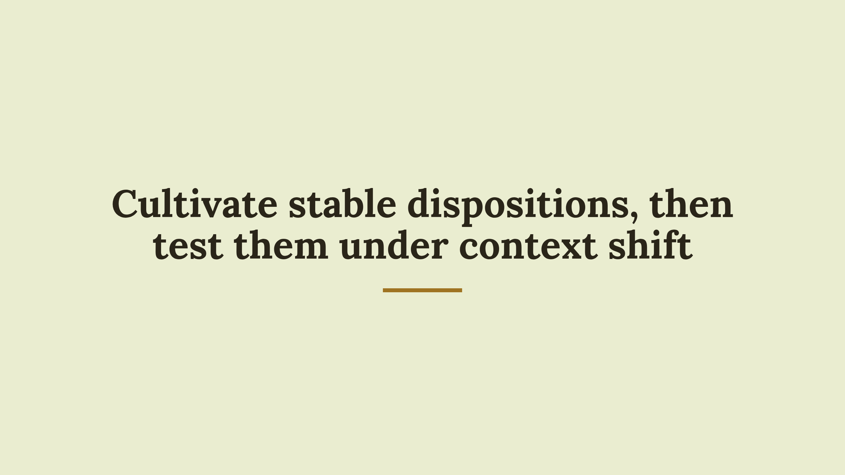
Notes:
Cultivate stable dispositions, then test them under context shift

