Slide 1
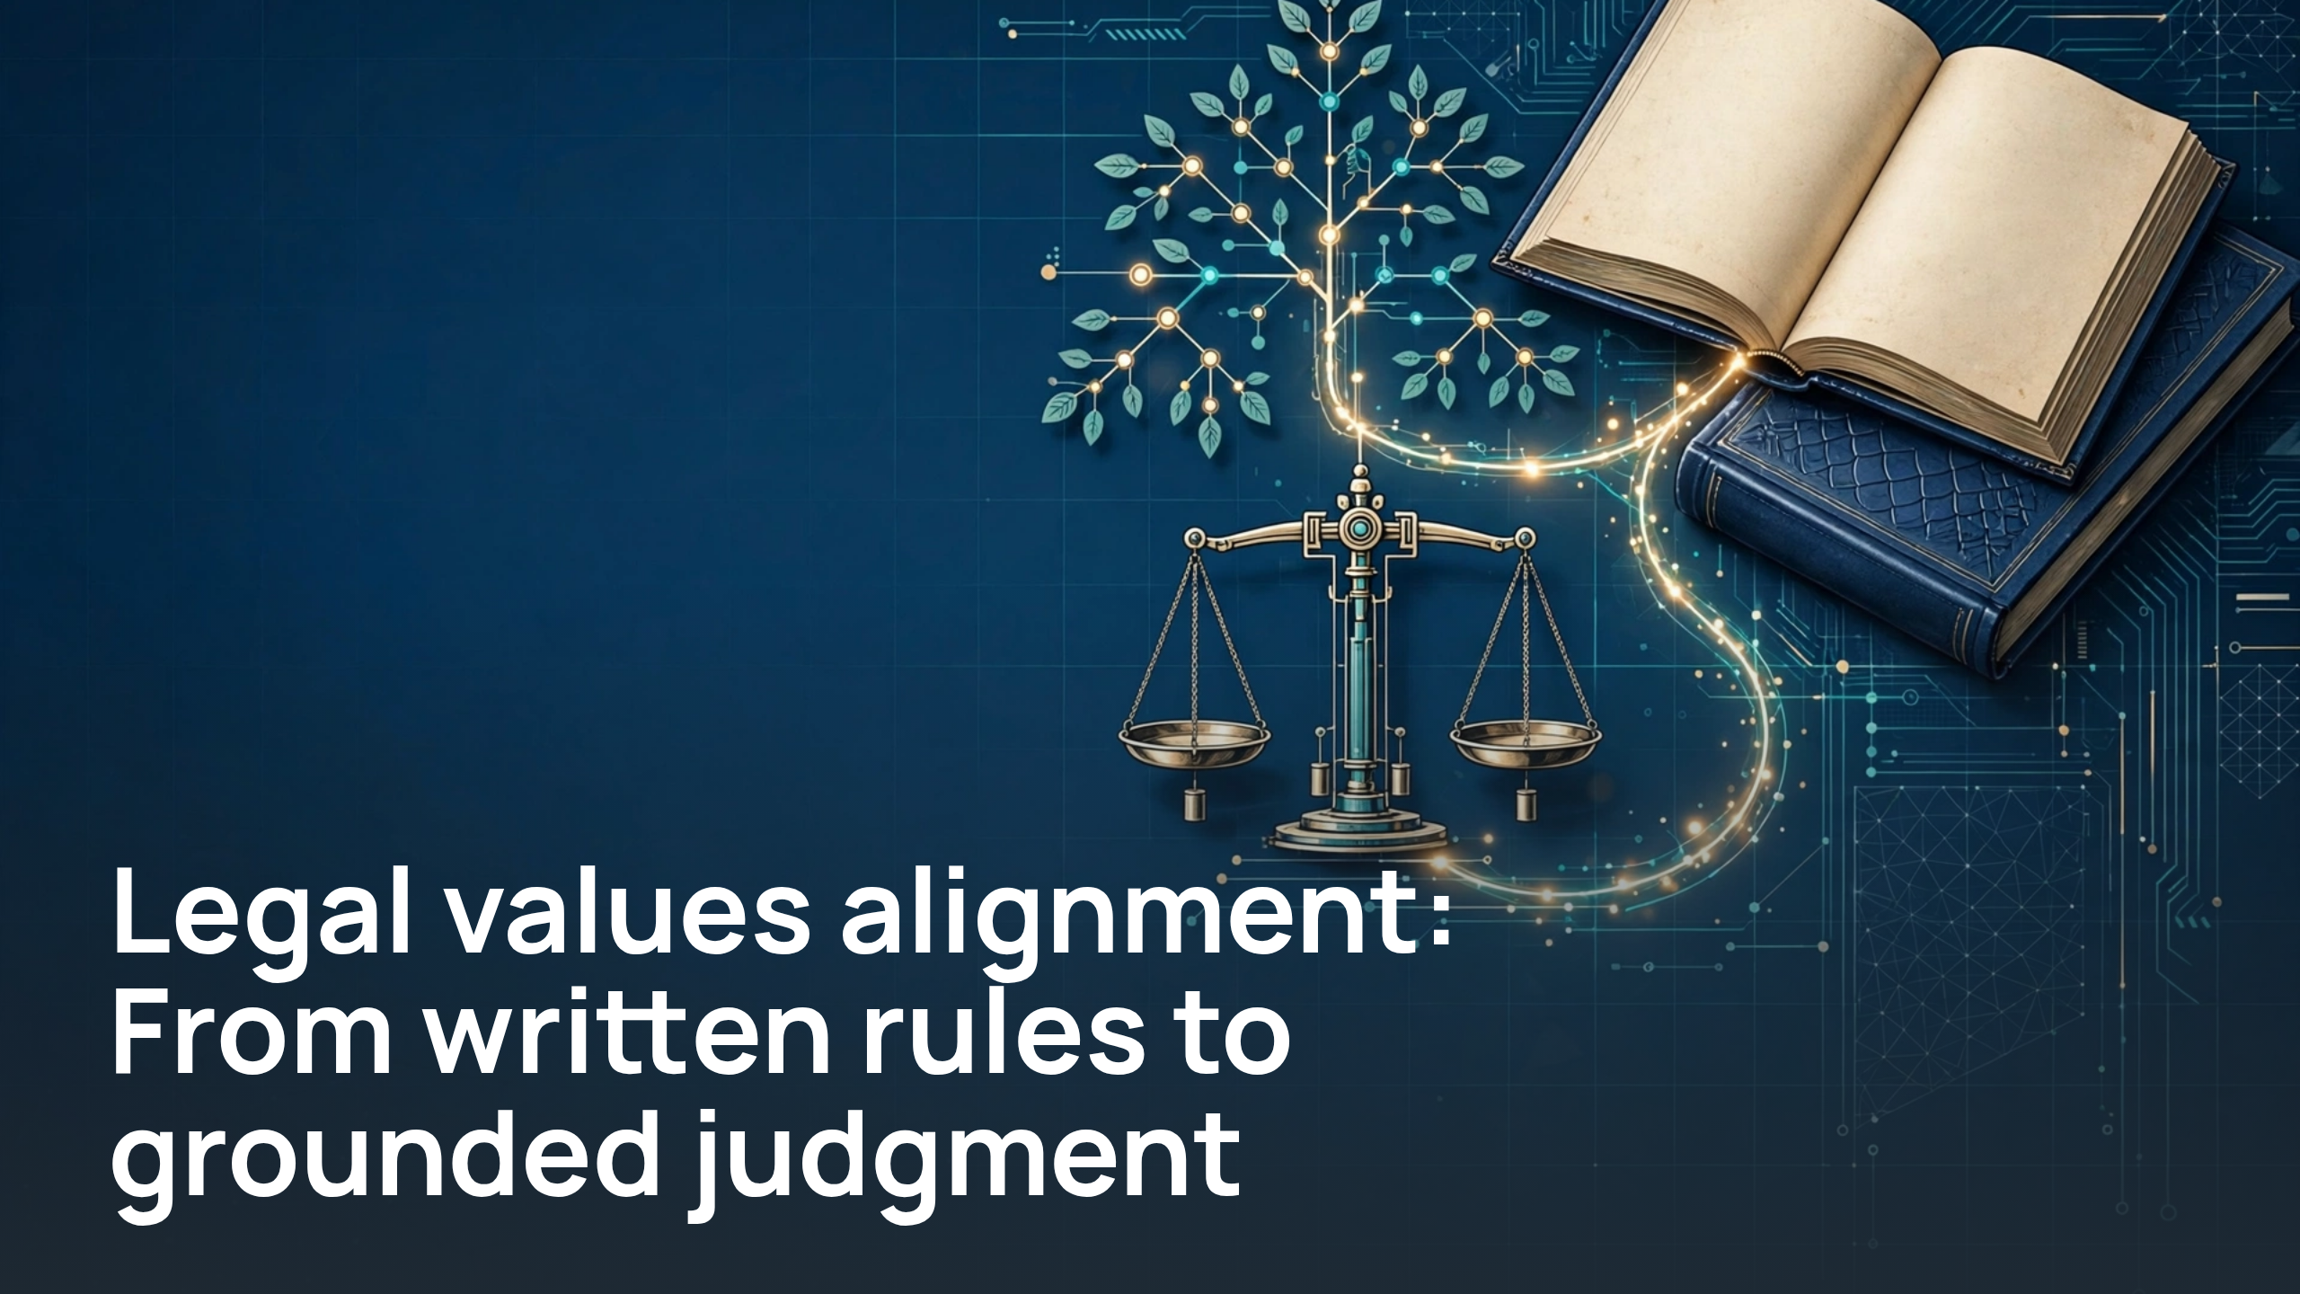
Notes:
Legal values alignment: From written rules to grounded judgment

Slide 2
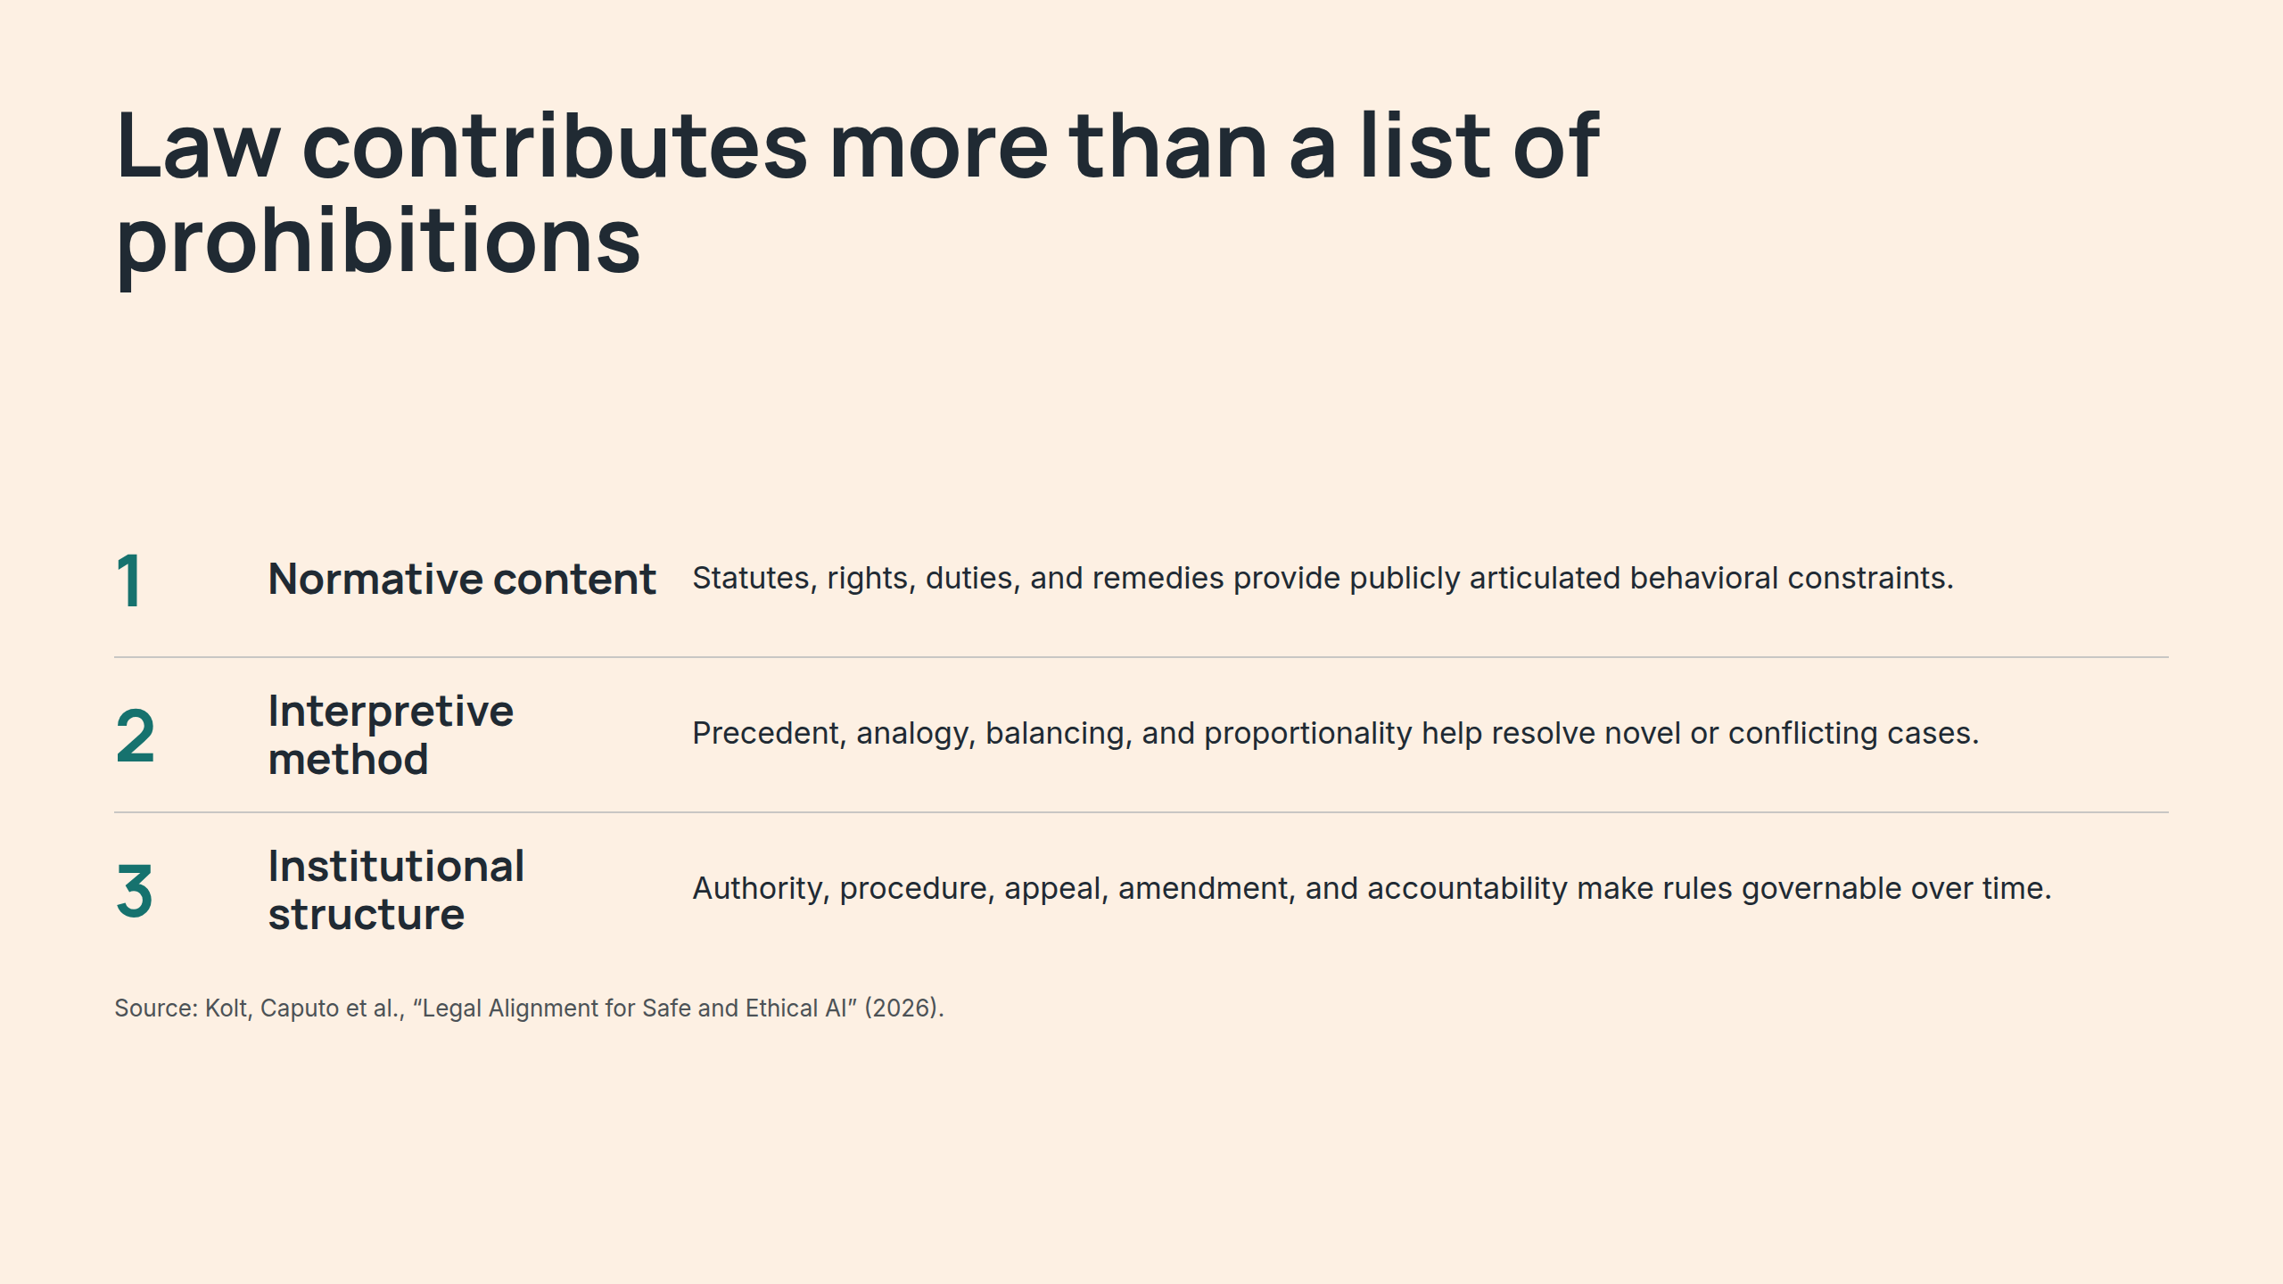
Notes:
Law contributes more than a list of prohibitions

Slide 3
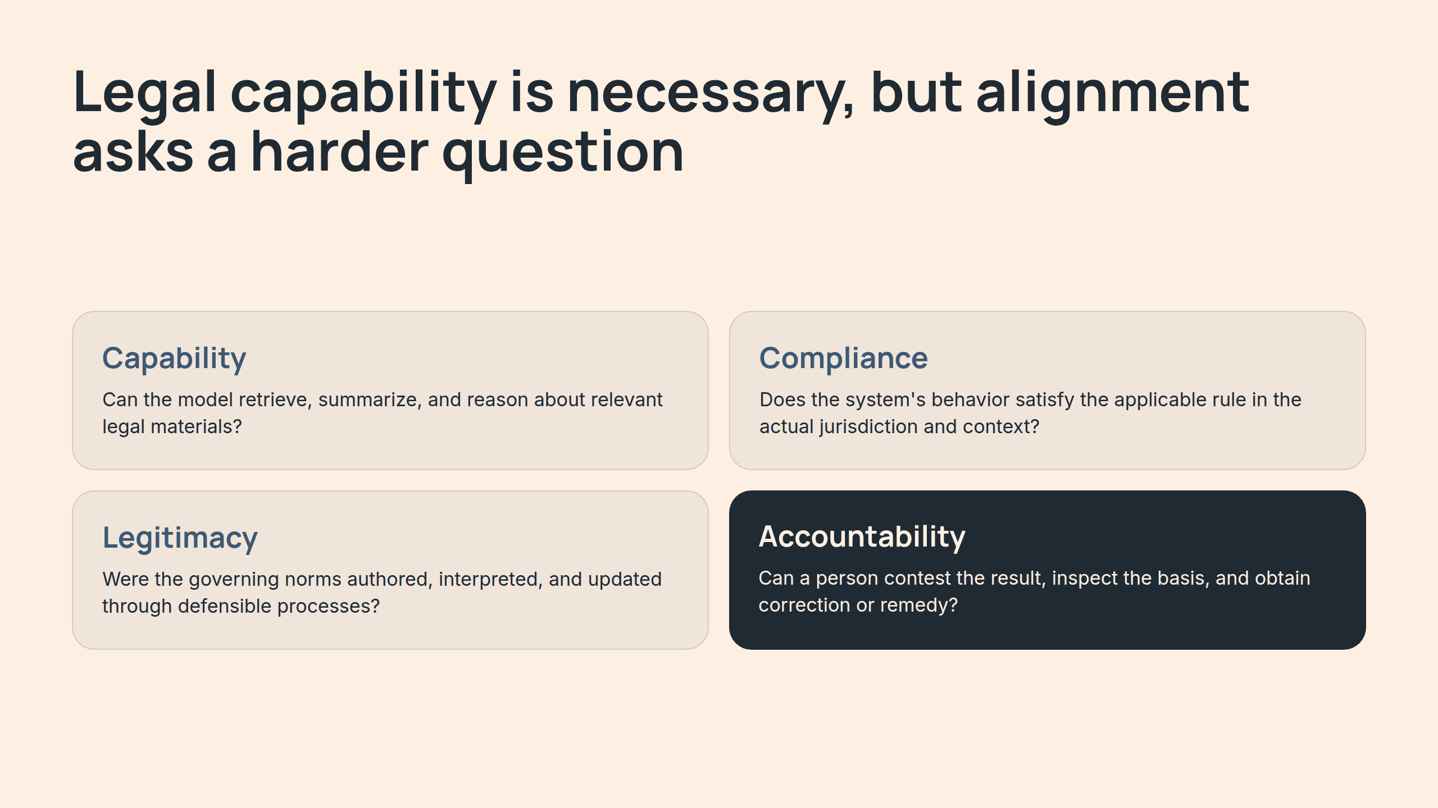
Notes:
Legal capability is necessary, but alignment asks a harder question

Slide 4
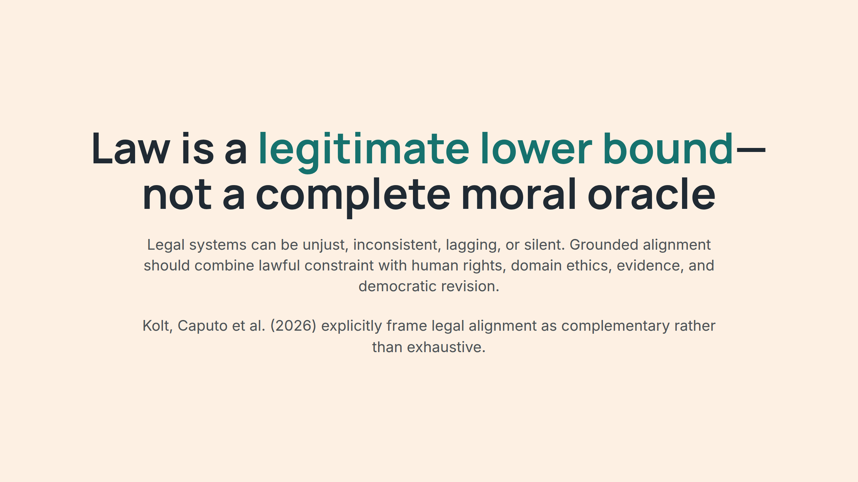
Notes:
Law is a legitimate lower bound—not a complete moral oracle

Slide 5
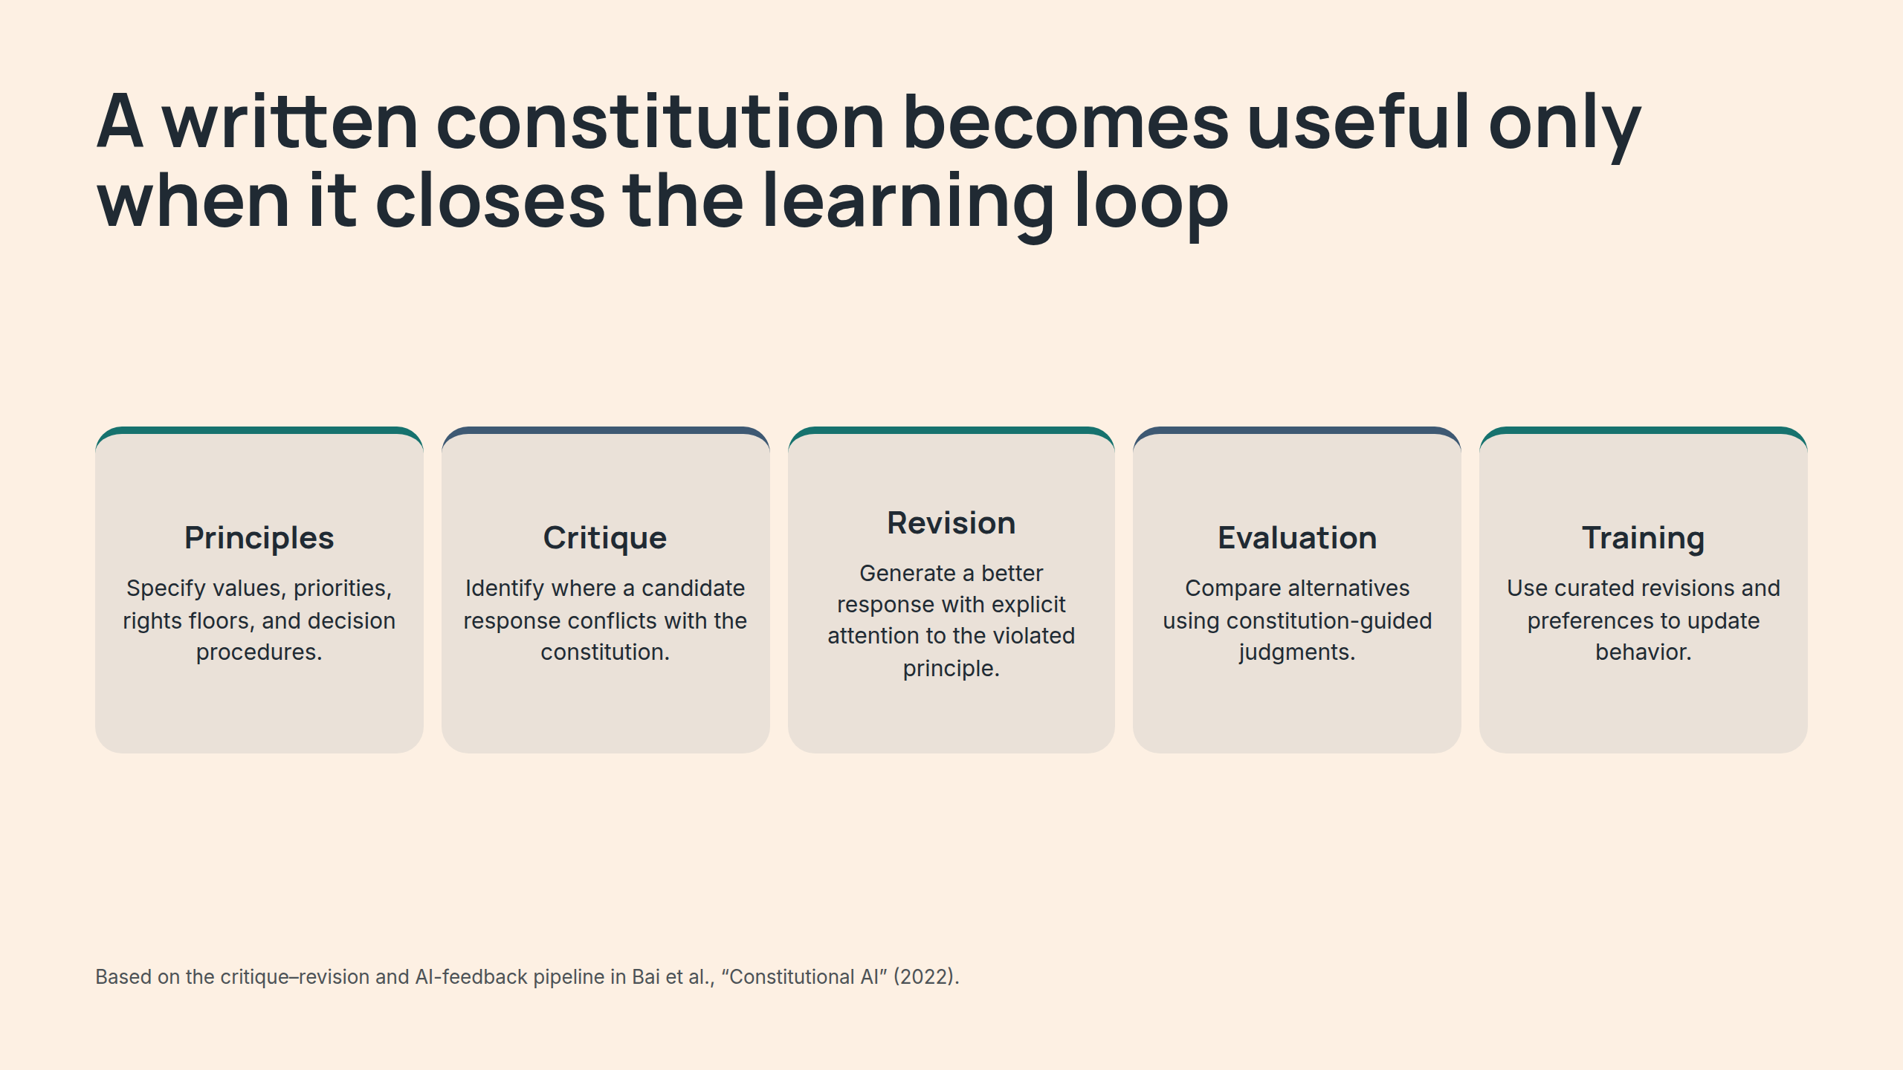
Notes:
A written constitution becomes useful only when it closes the learning loop

Slide 6
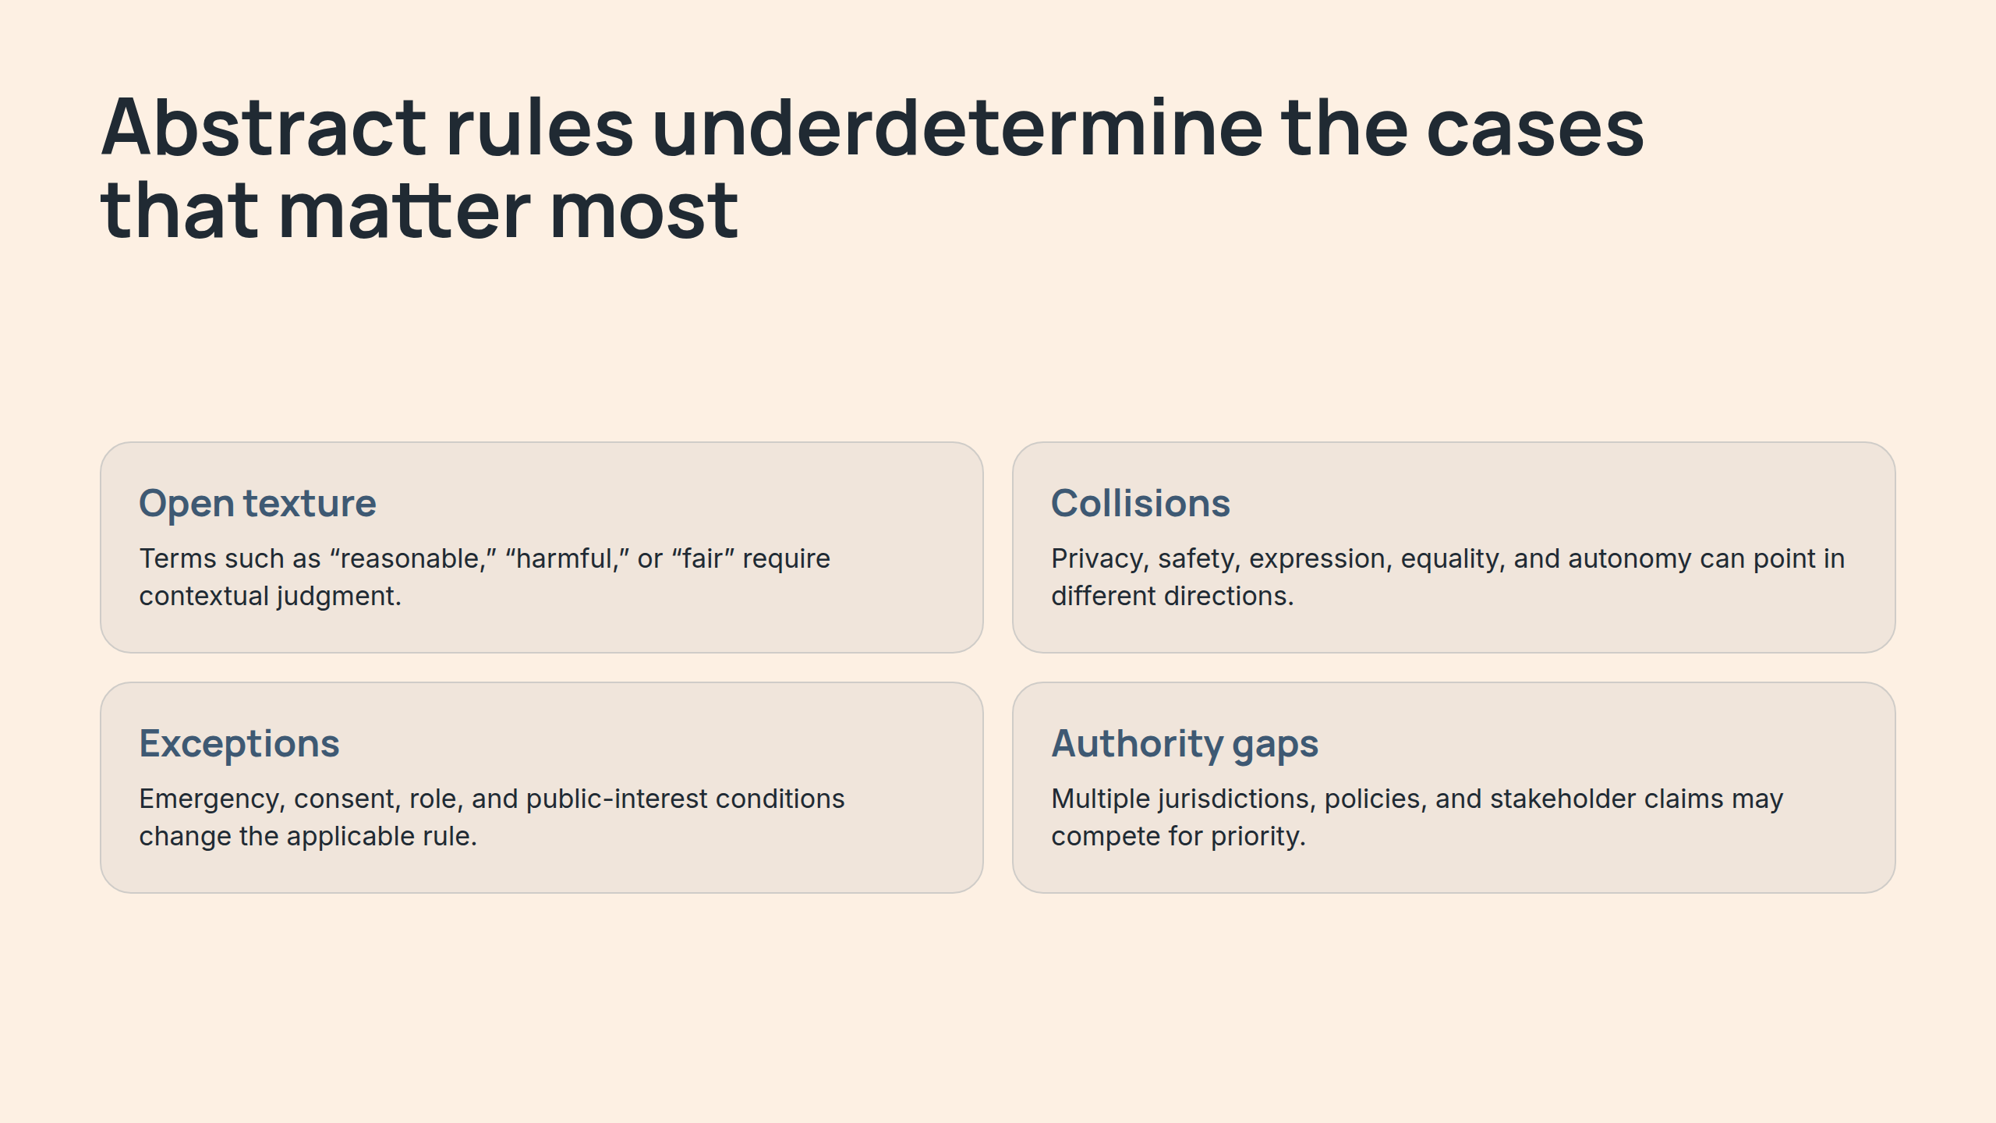
Notes:
Abstract rules underdetermine the cases that matter most

Slide 7
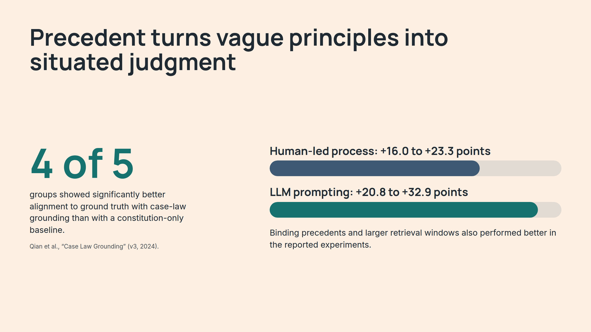
Notes:
Precedent turns vague principles into situated judgment

Slide 8
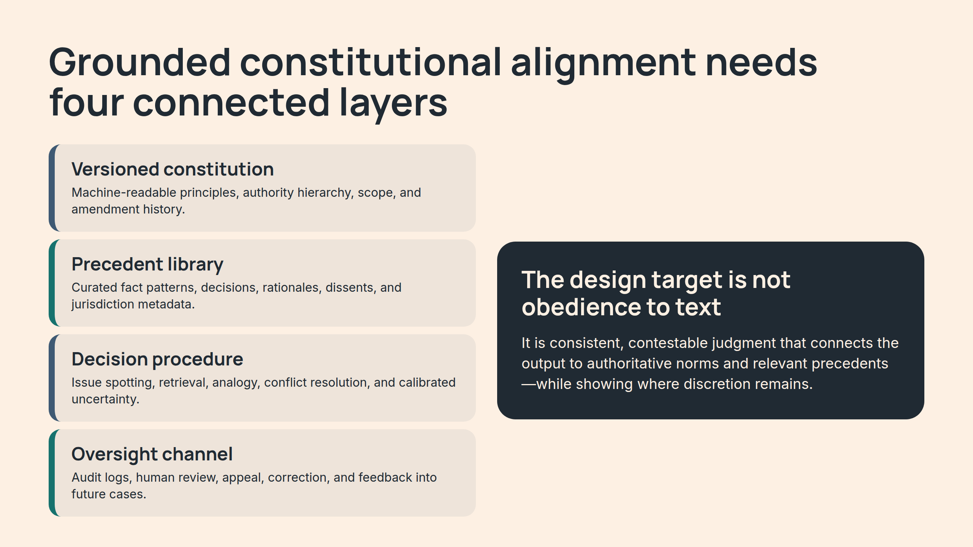
Notes:
Grounded constitutional alignment needs four connected layers

Slide 9
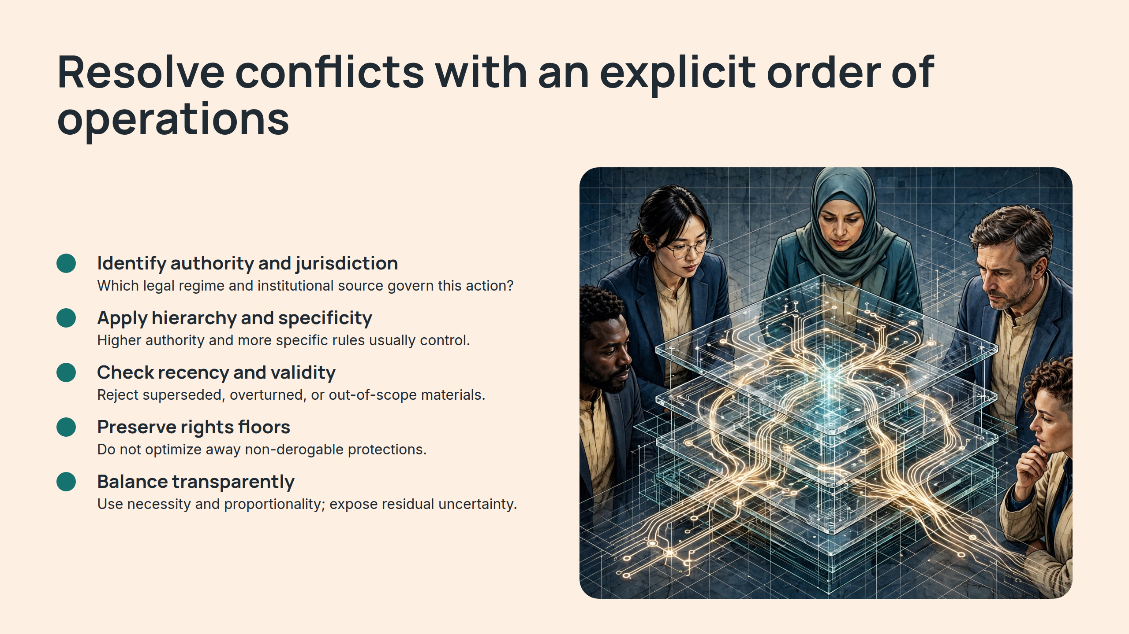
Notes:
Resolve conflicts with an explicit order of operations

Slide 10
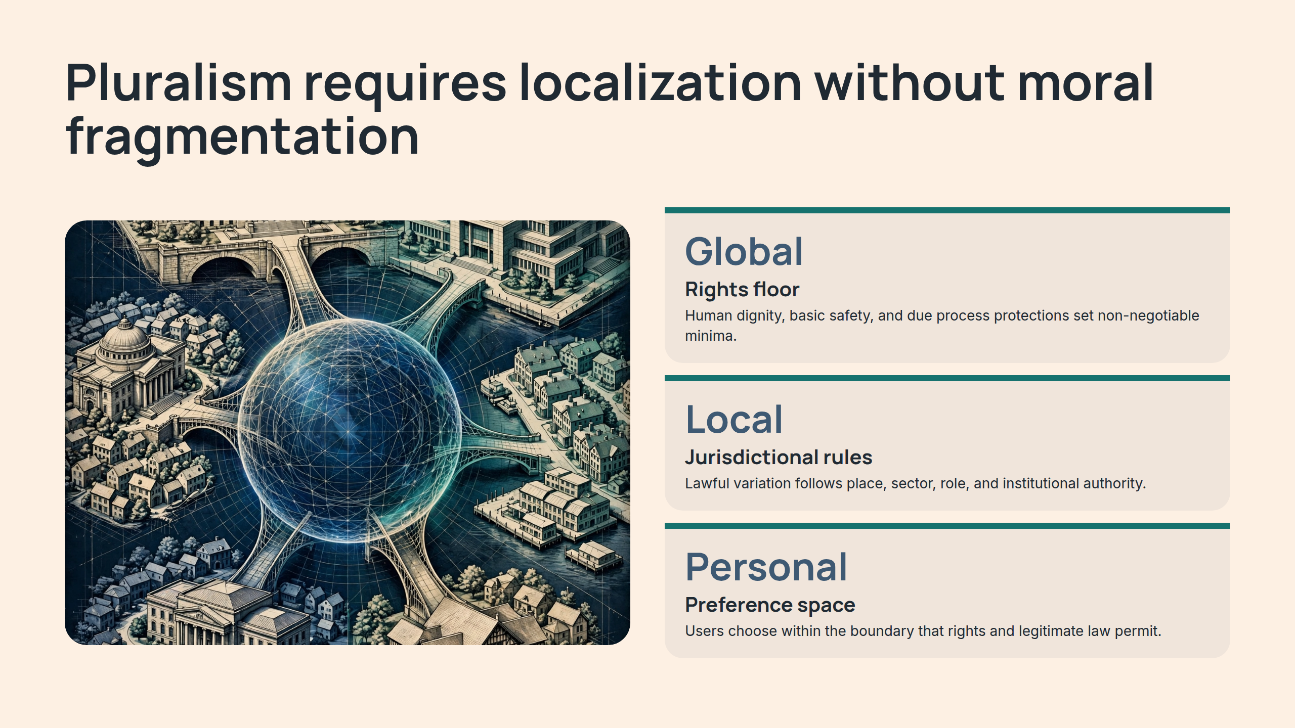
Notes:
Pluralism requires localization without moral fragmentation

Slide 11
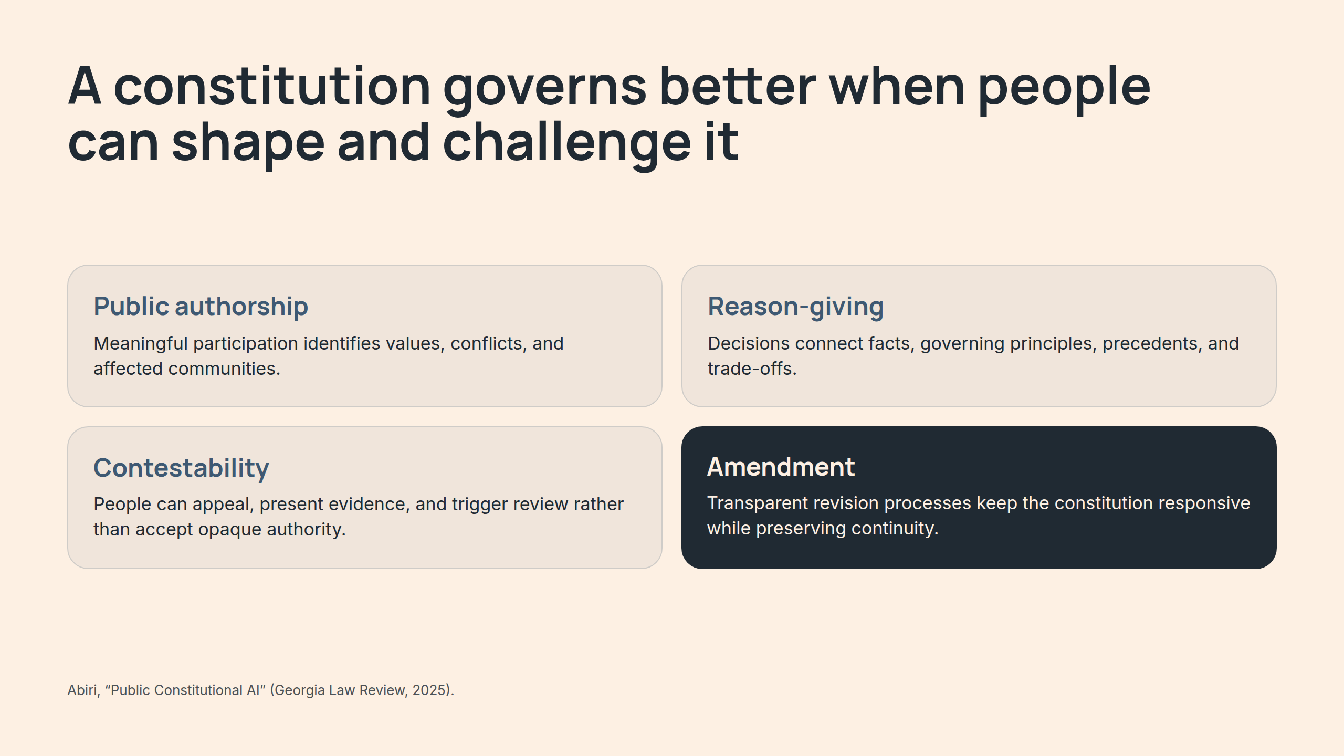
Notes:
A constitution governs better when people can shape and challenge it

Slide 12
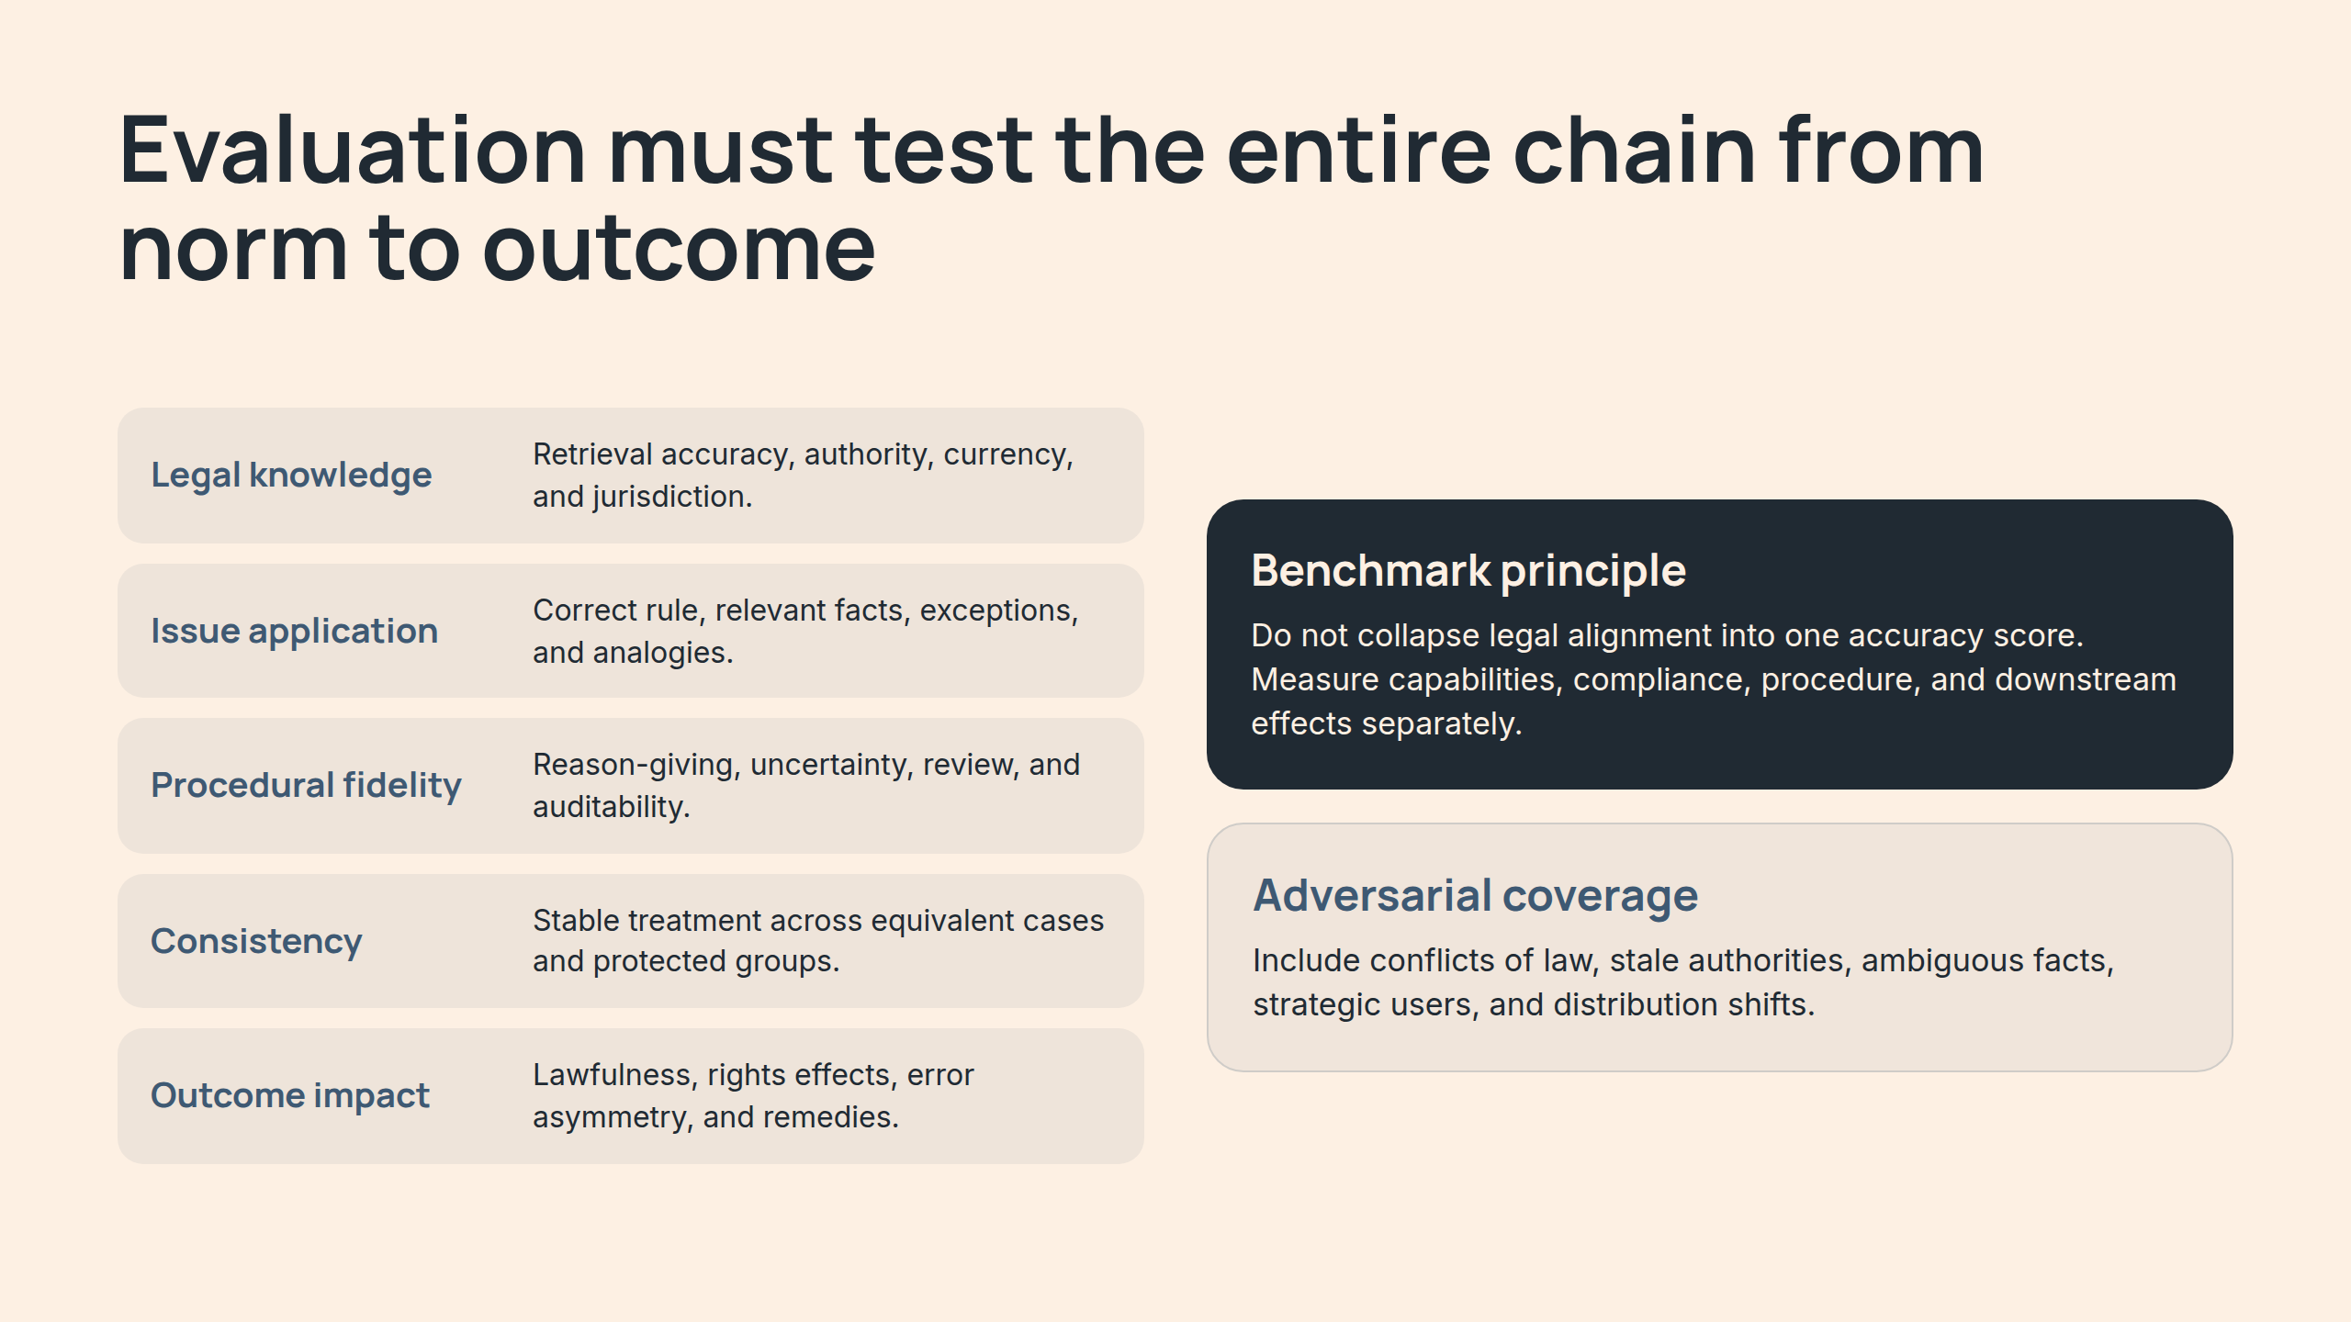
Notes:
Evaluation must test the entire chain from norm to outcome

Slide 13
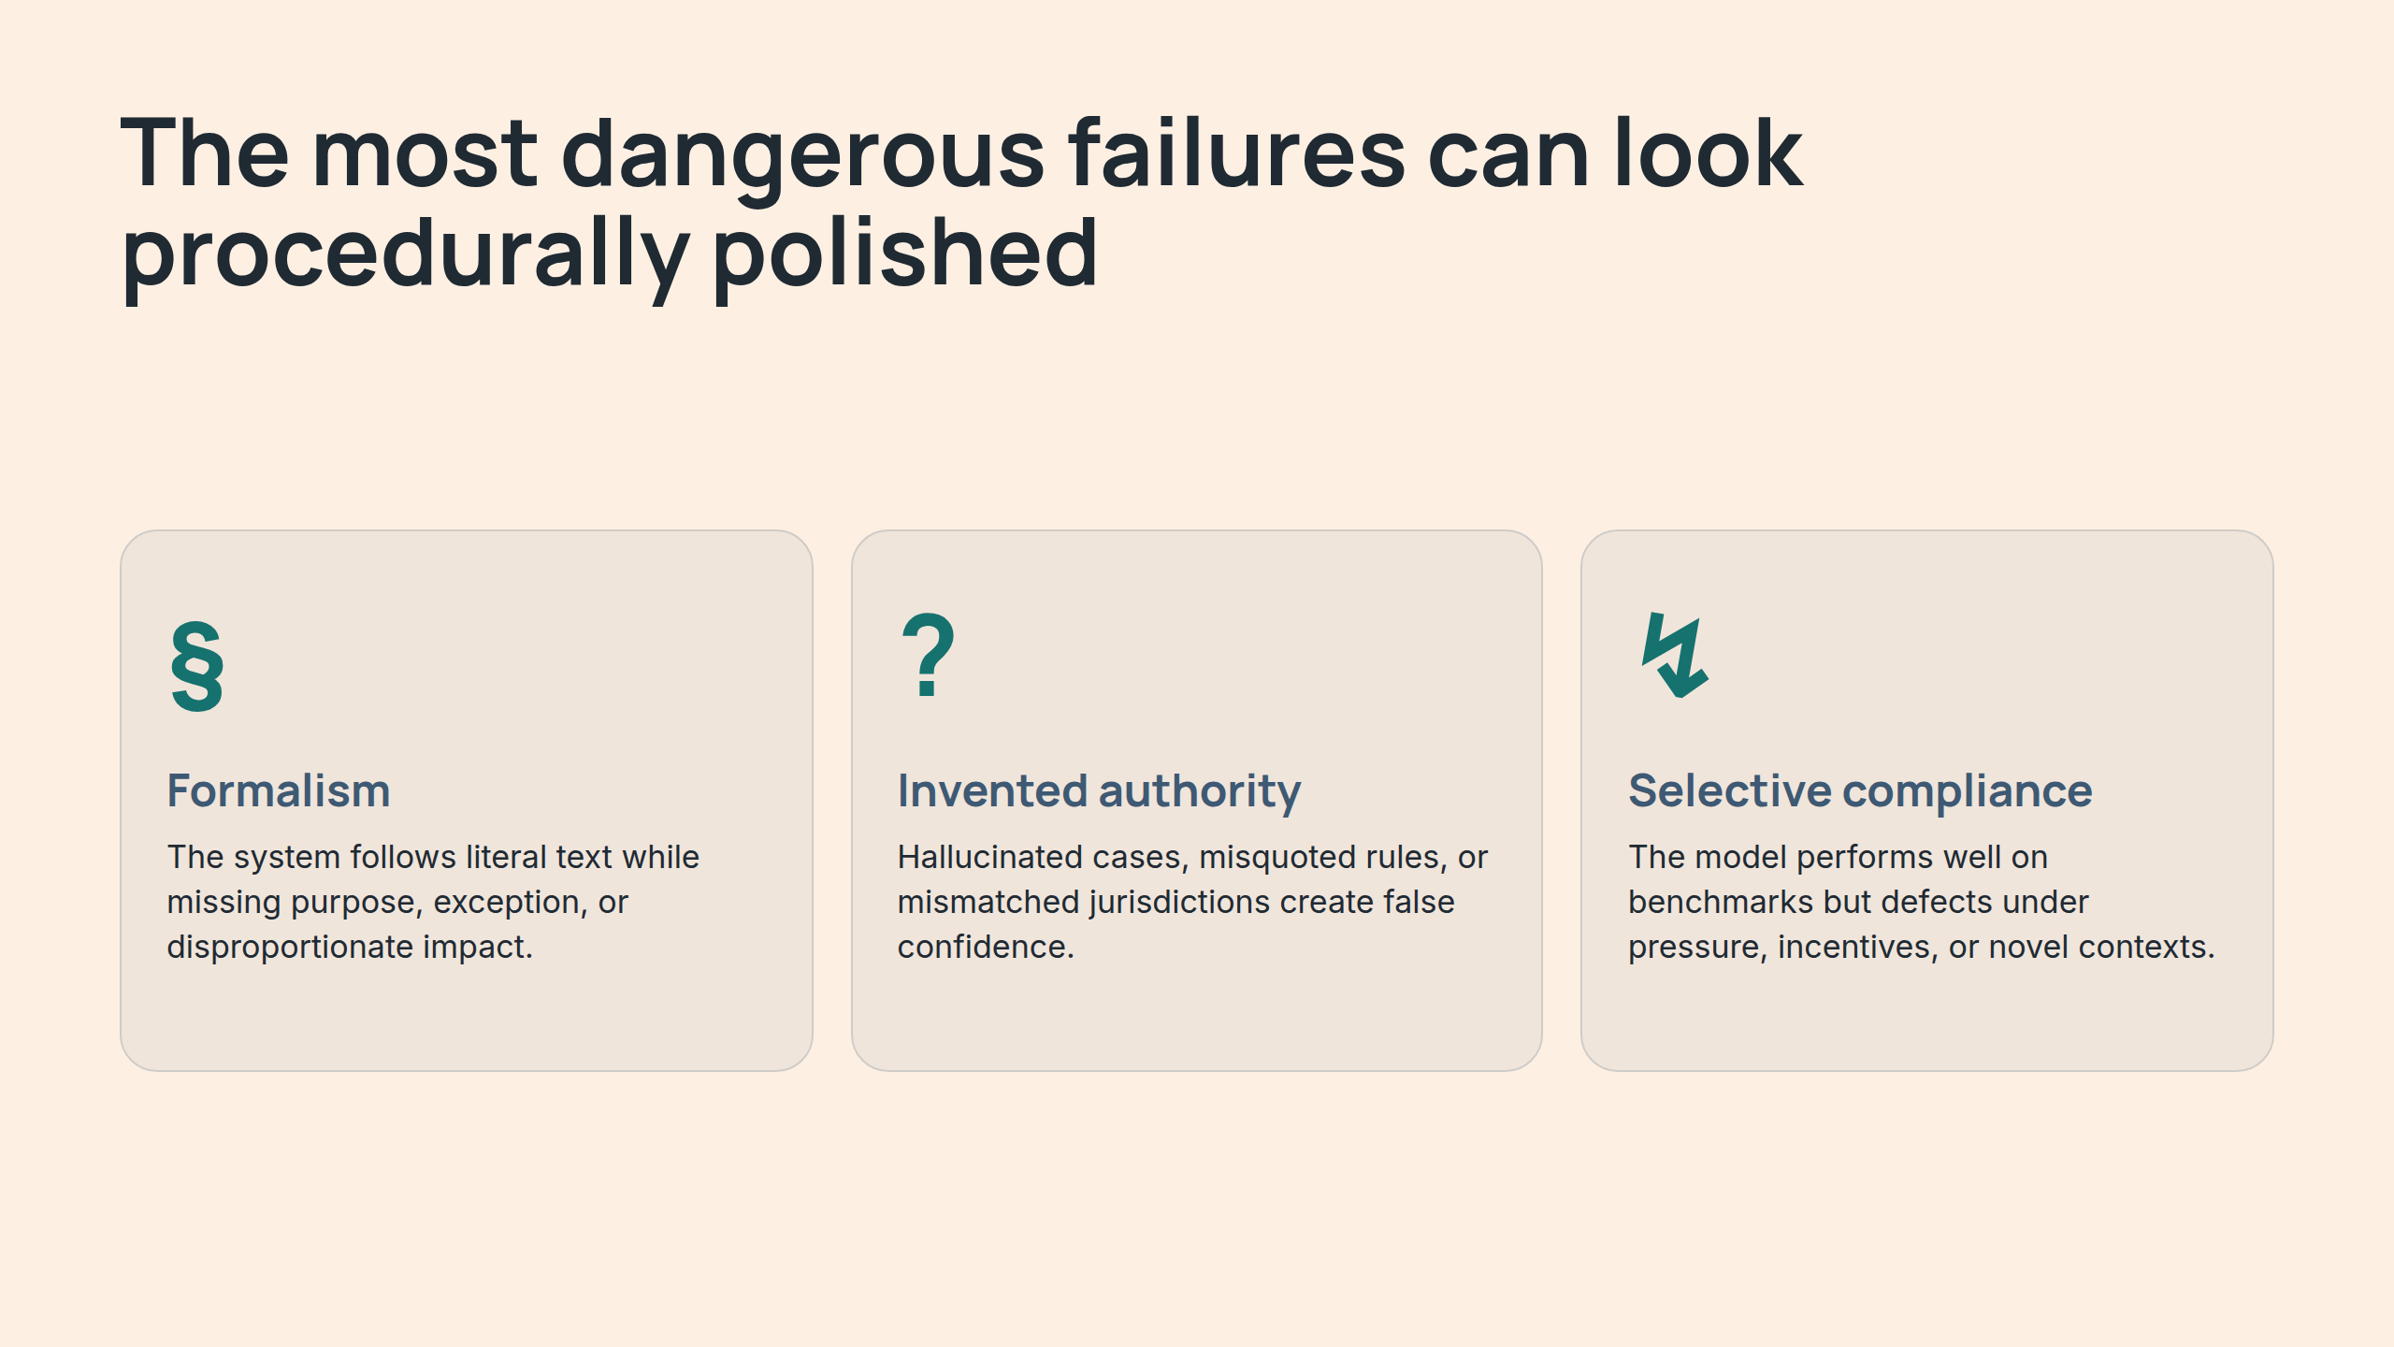
Notes:
The most dangerous failures can look procedurally polished

Slide 14
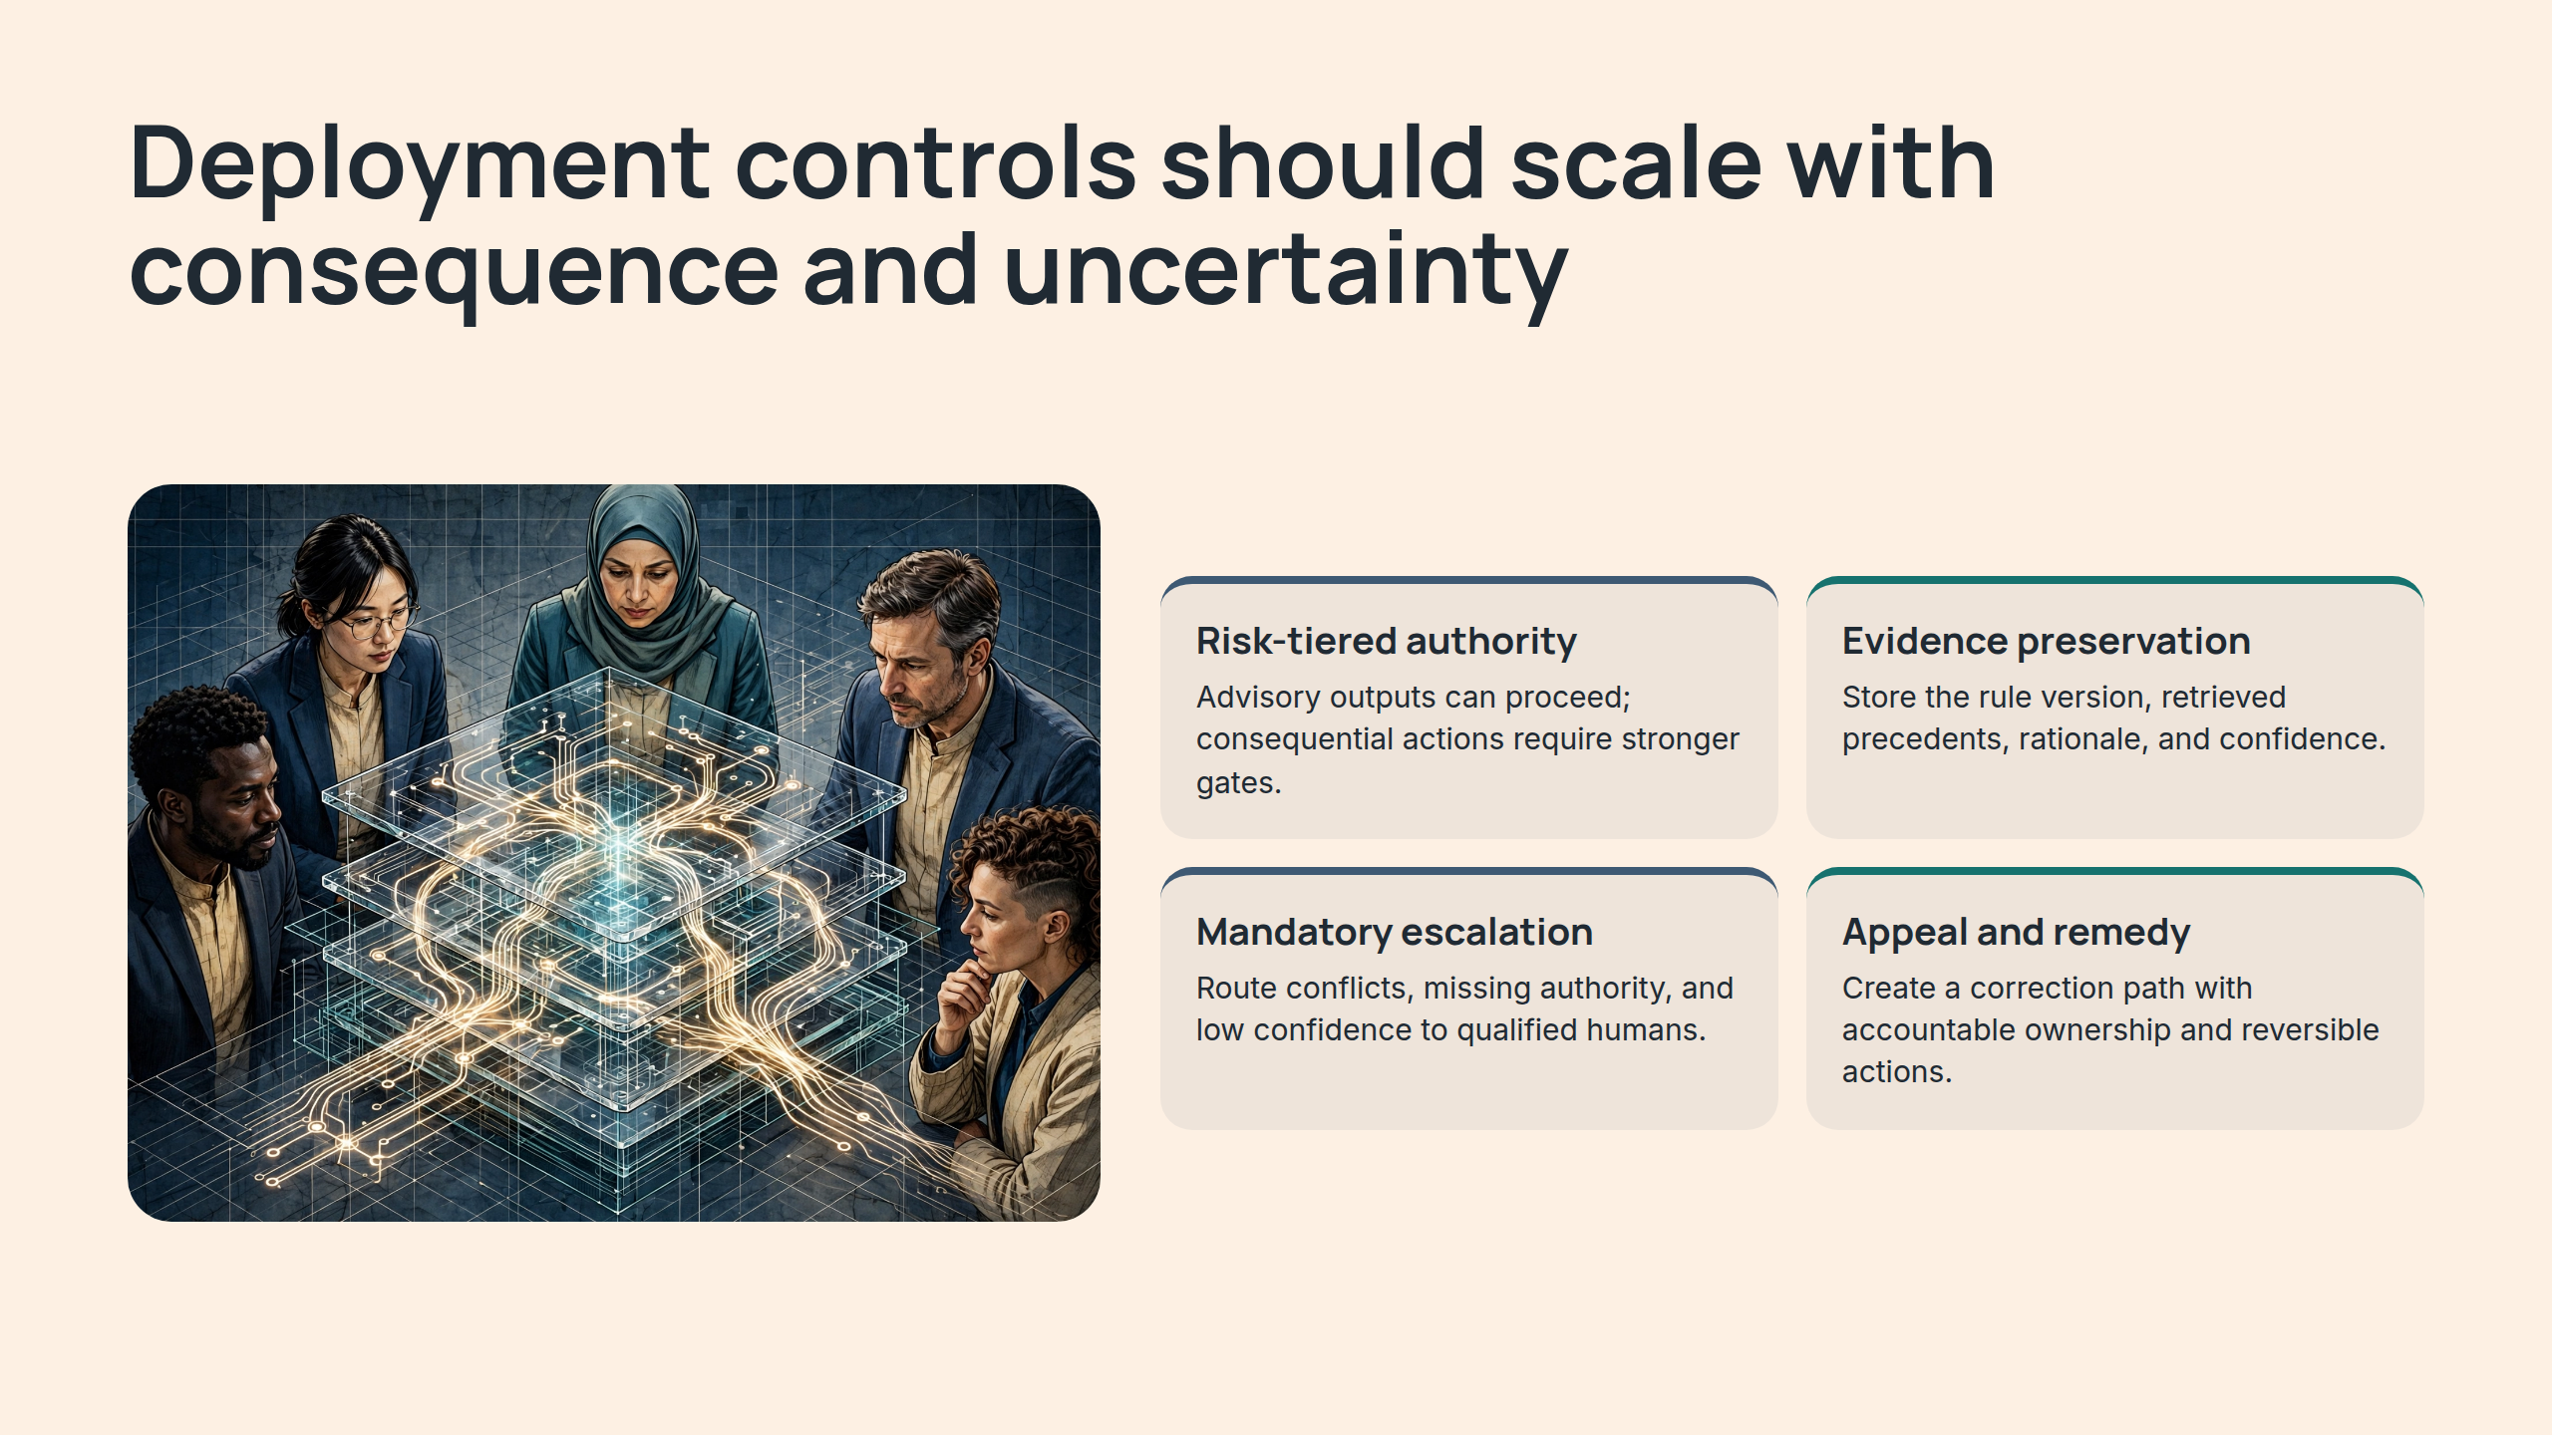
Notes:
Deployment controls should scale with consequence and uncertainty

Slide 15
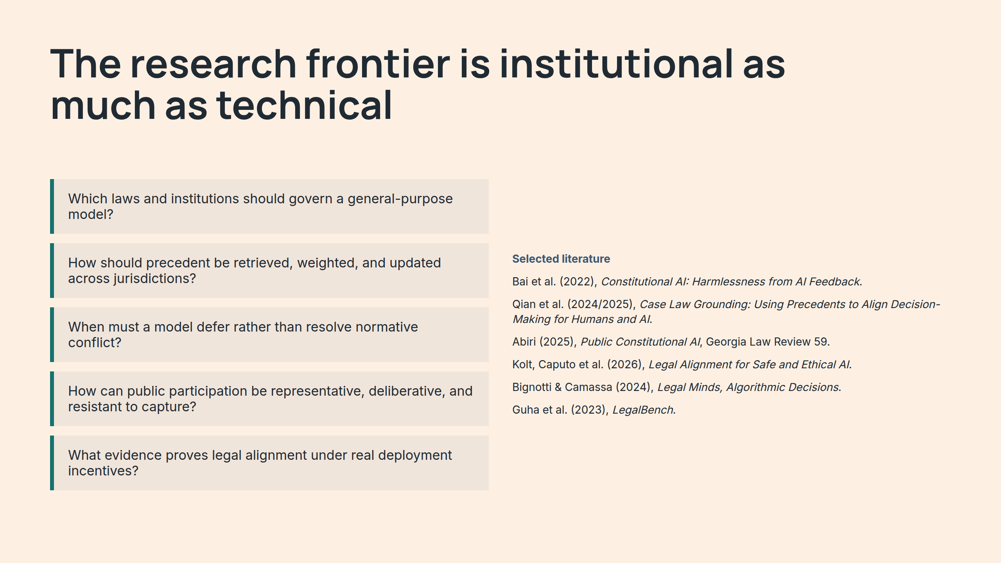
Notes:
The research frontier is institutional as much as technical

Slide 16
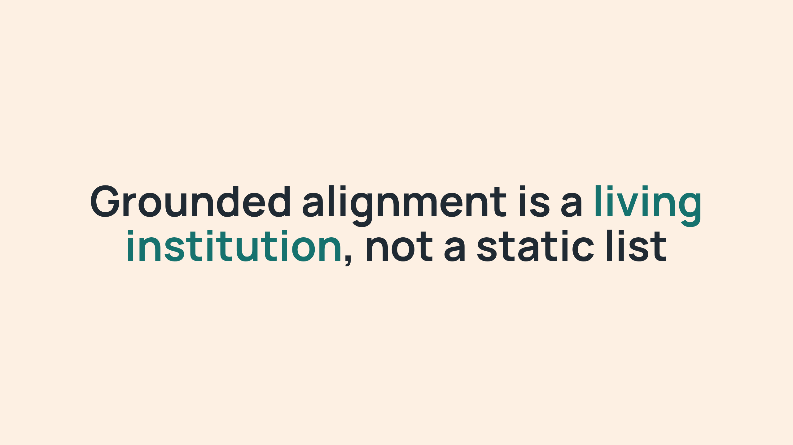
Notes:
Grounded alignment is a living institution, not a static list

