Slide 1

Notes:
Pluralistic values alignment

Slide 2
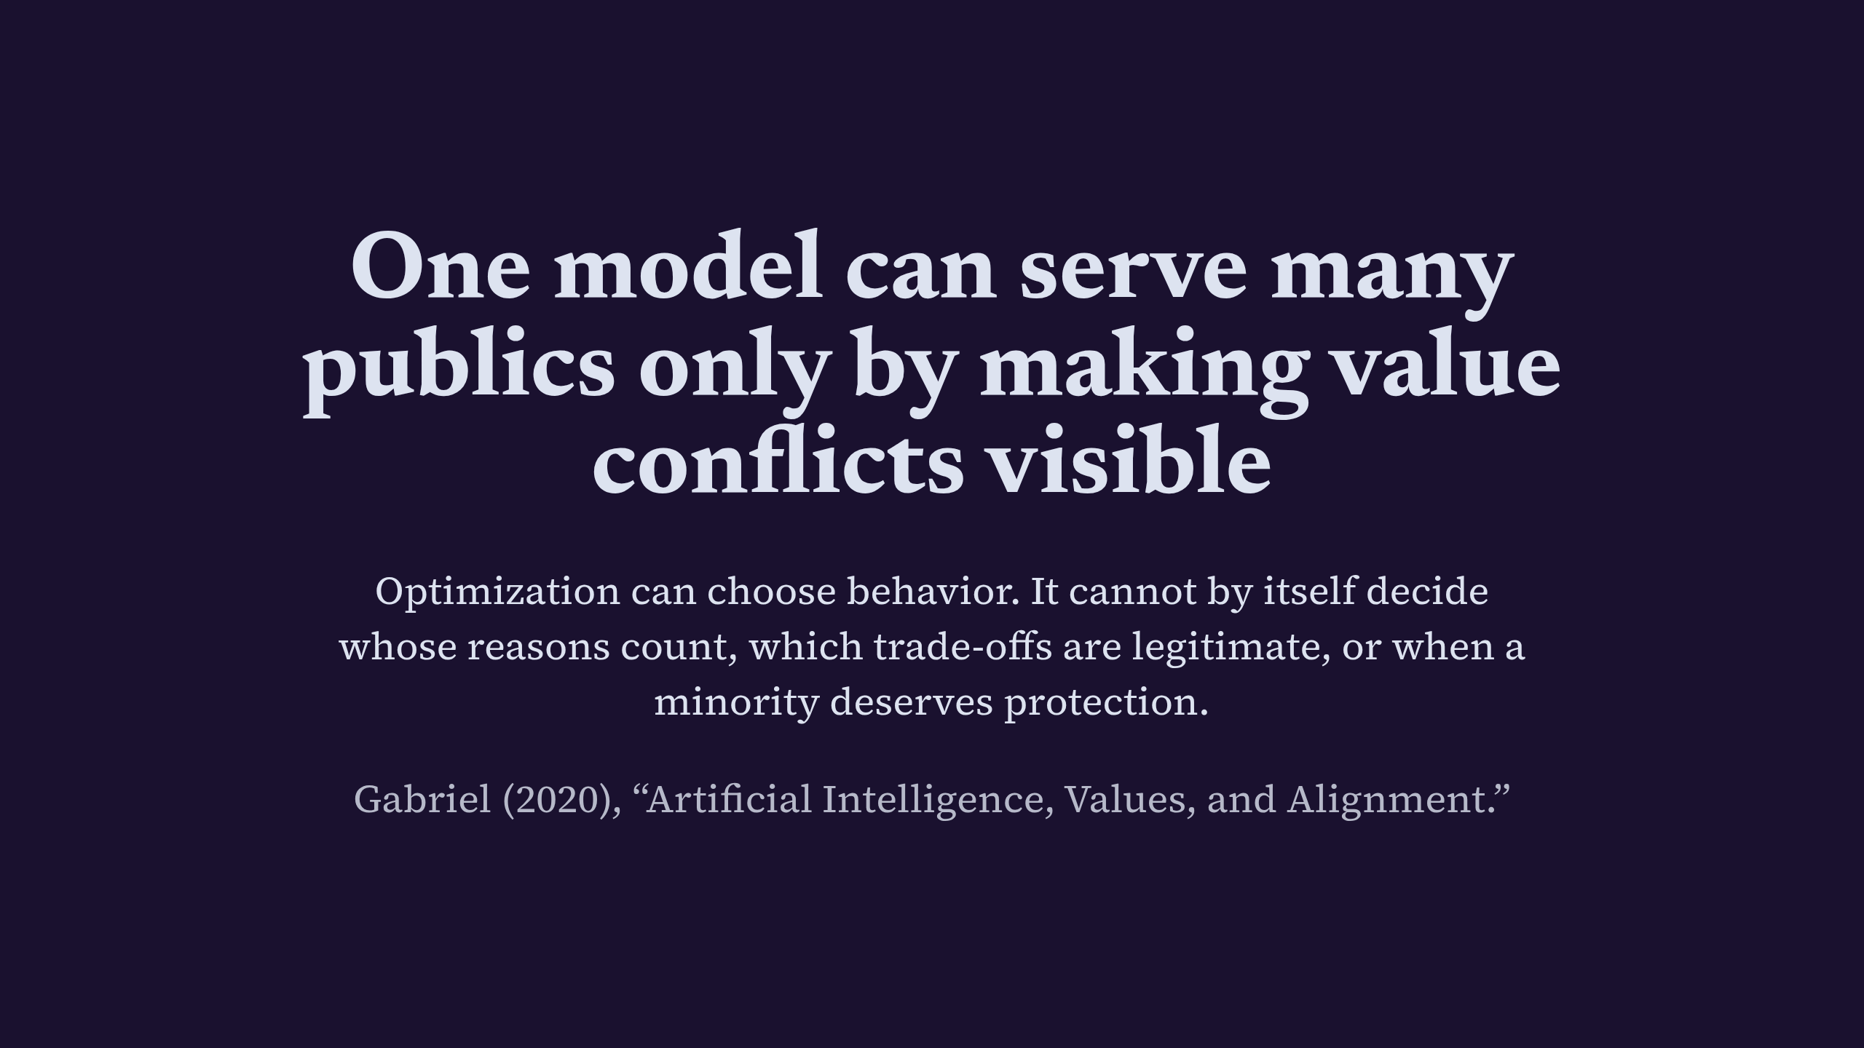
Notes:
One model can serve many publics only by making value conflicts visible

Slide 3
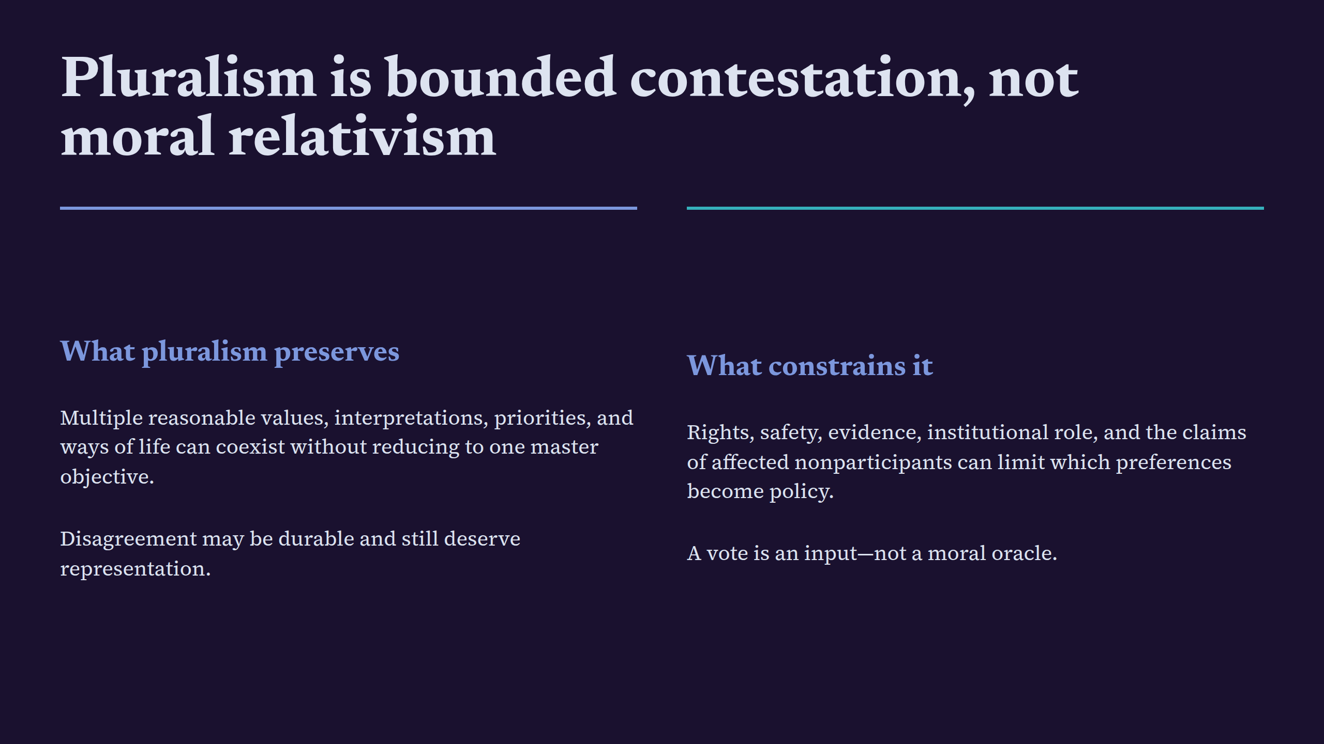
Notes:
Pluralism is bounded contestation, not moral relativism

Slide 4
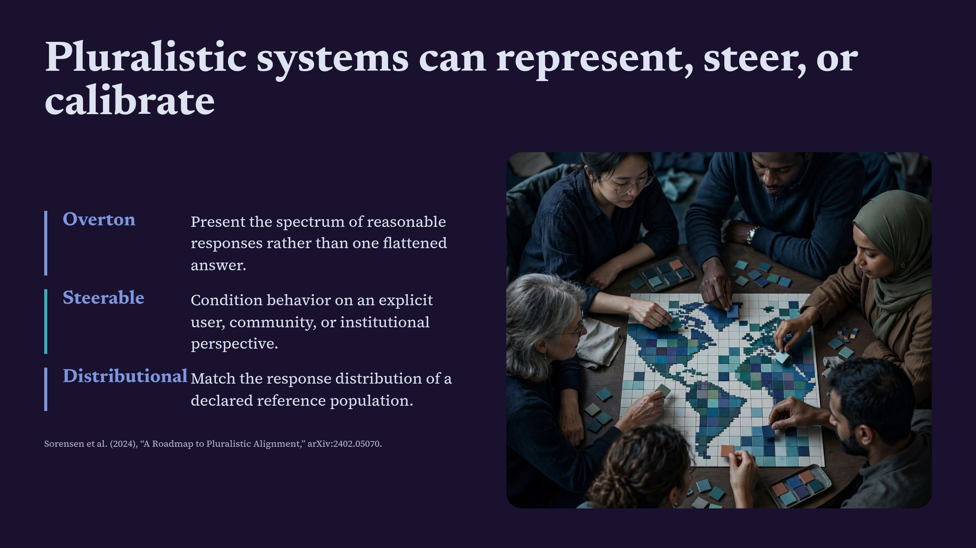
Notes:
Pluralistic systems can represent, steer, or calibrate

Slide 5
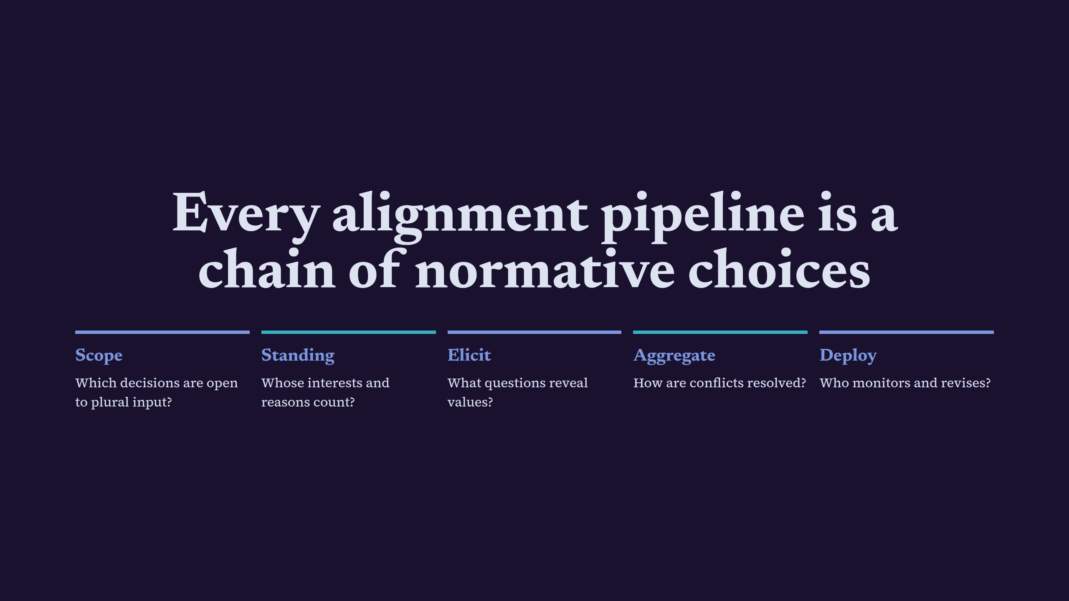
Notes:
Every alignment pipeline is a chain of normative choices

Slide 6

Notes:
Standing should follow impact, not convenience

Slide 7
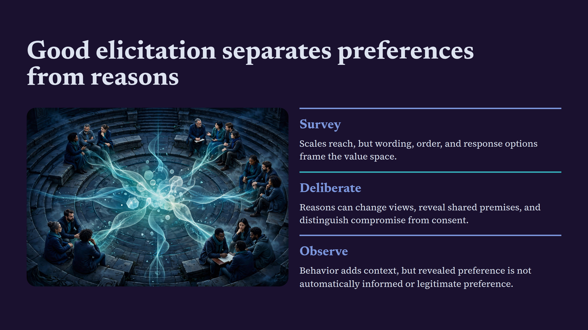
Notes:
Good elicitation separates preferences from reasons

Slide 8
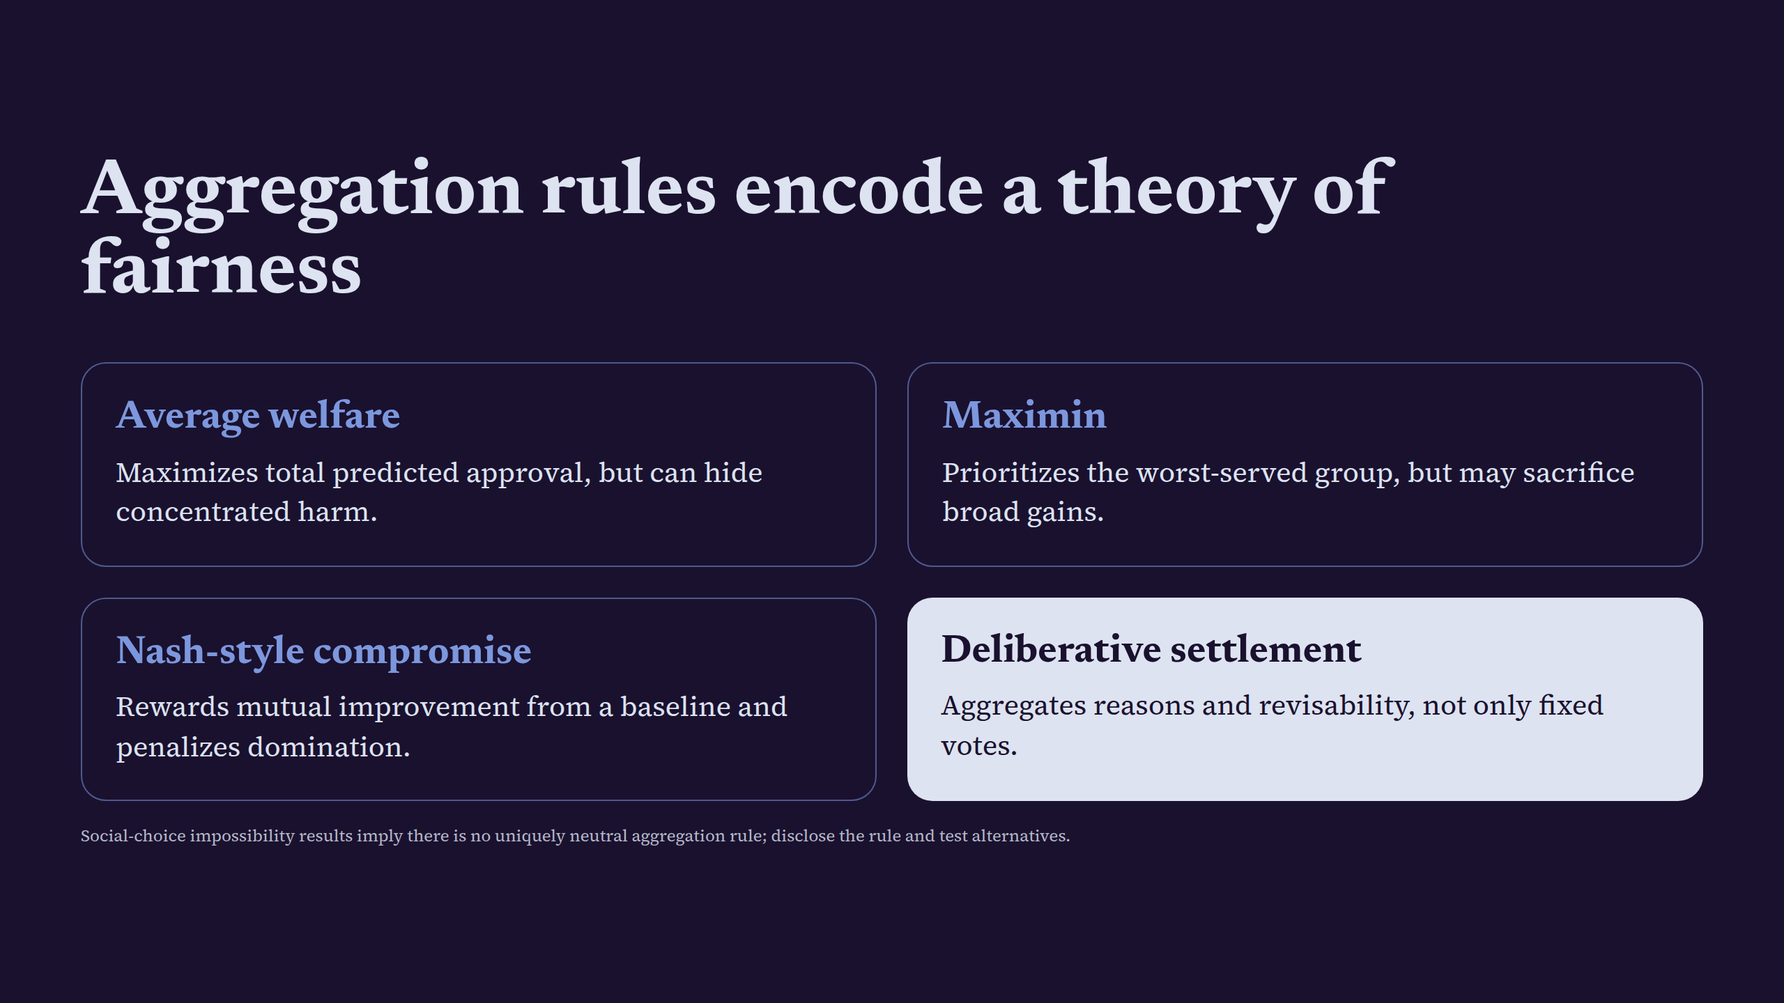
Notes:
Aggregation rules encode a theory of fairness

Slide 9
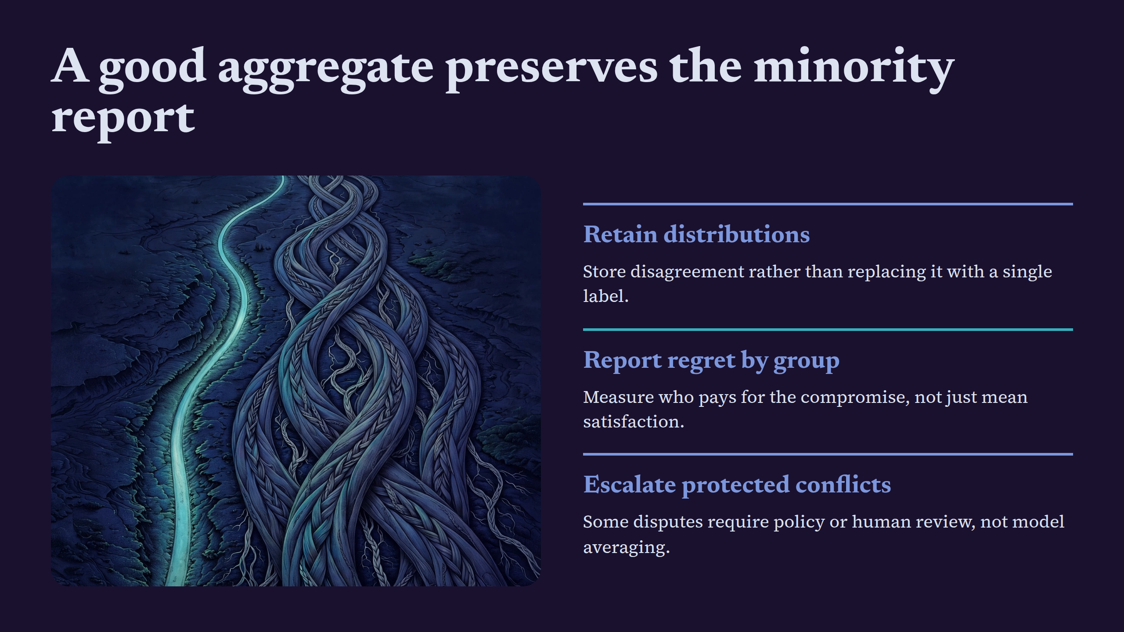
Notes:
A good aggregate preserves the minority report

Slide 10
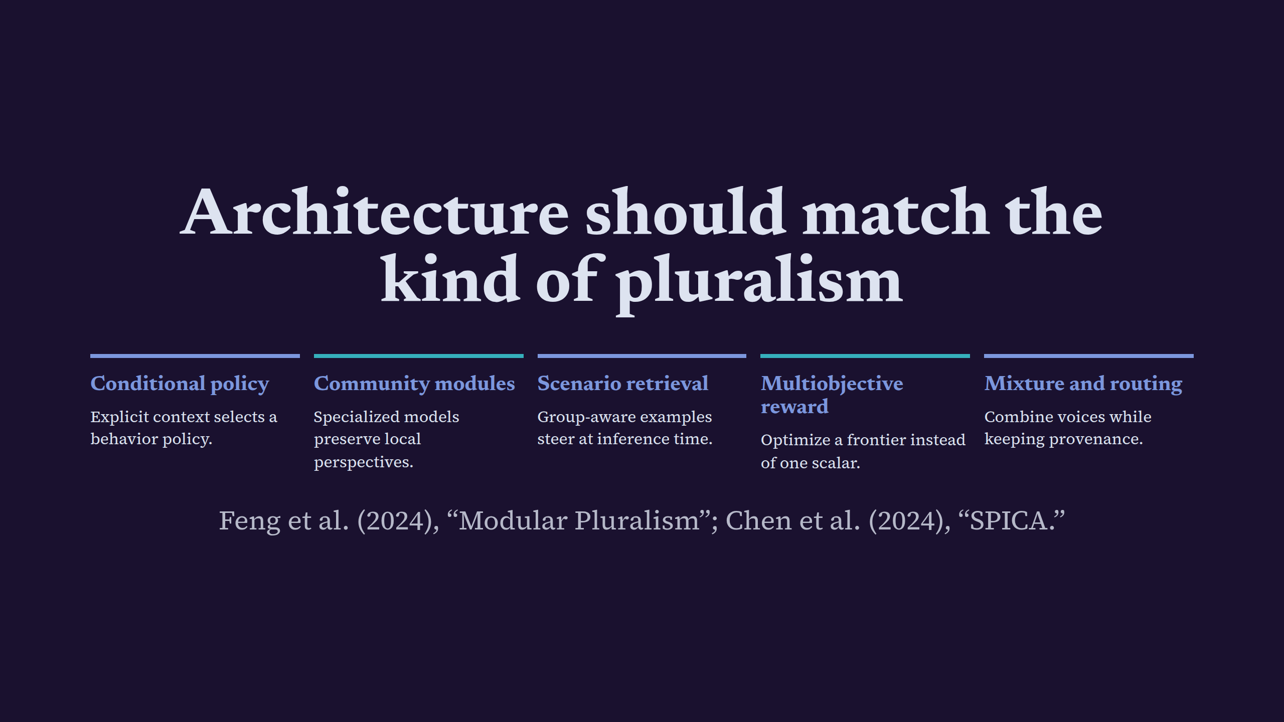
Notes:
Architecture should match the kind of pluralism

Slide 11
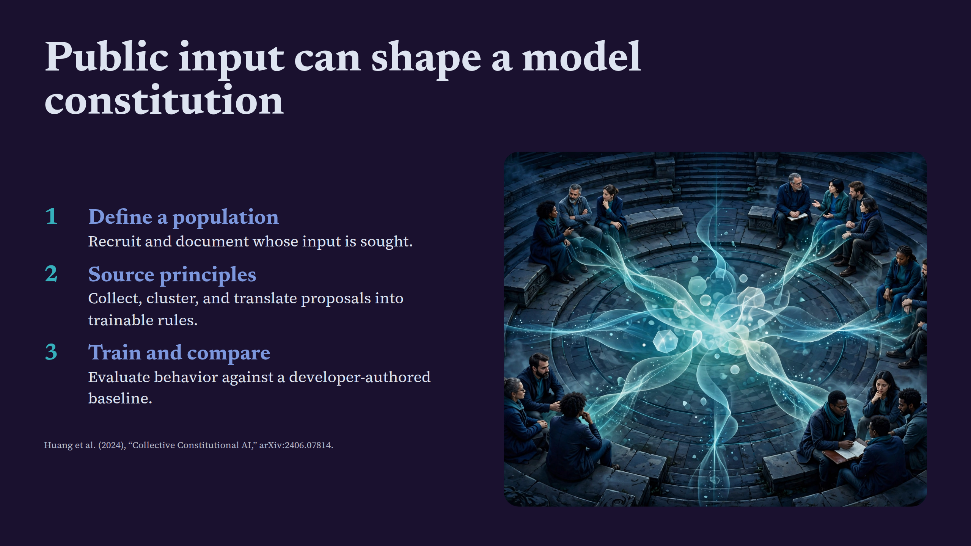
Notes:
Public input can shape a model constitution

Slide 12
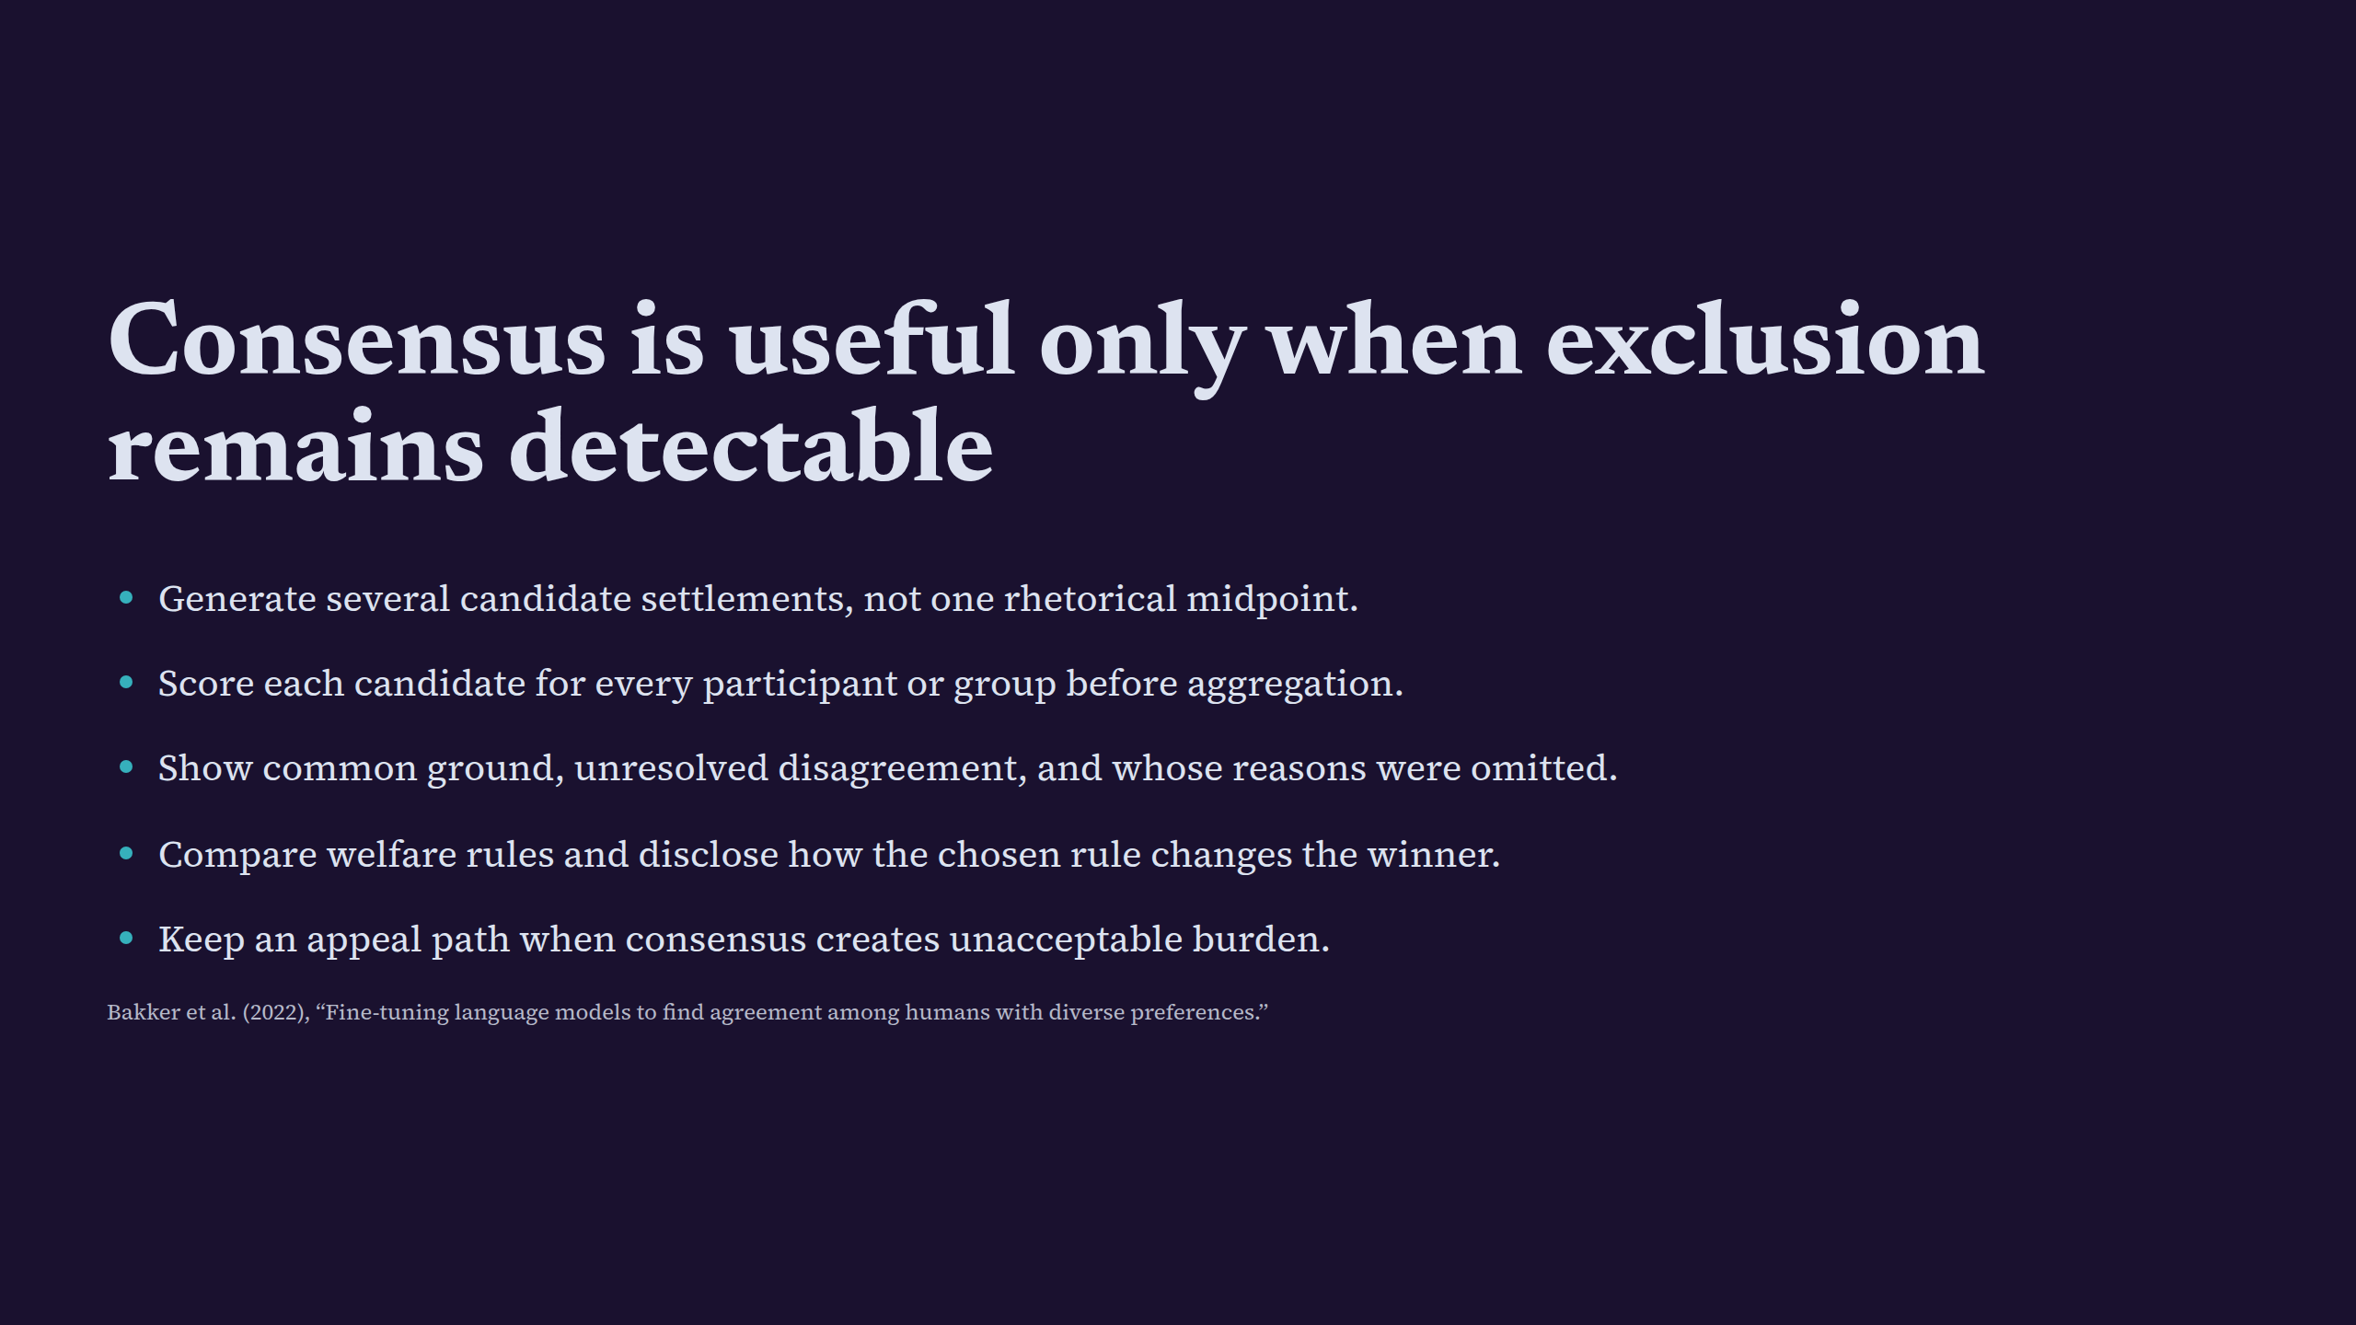
Notes:
Consensus is useful only when exclusion remains detectable

Slide 13
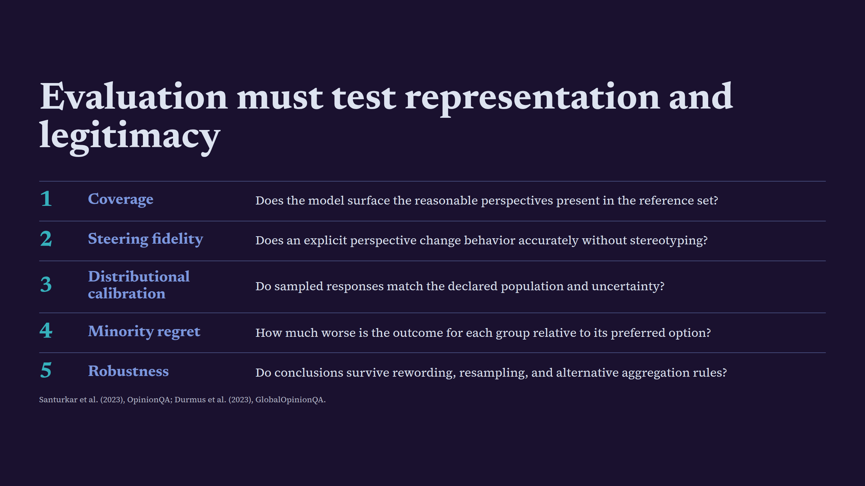
Notes:
Evaluation must test representation and legitimacy

Slide 14
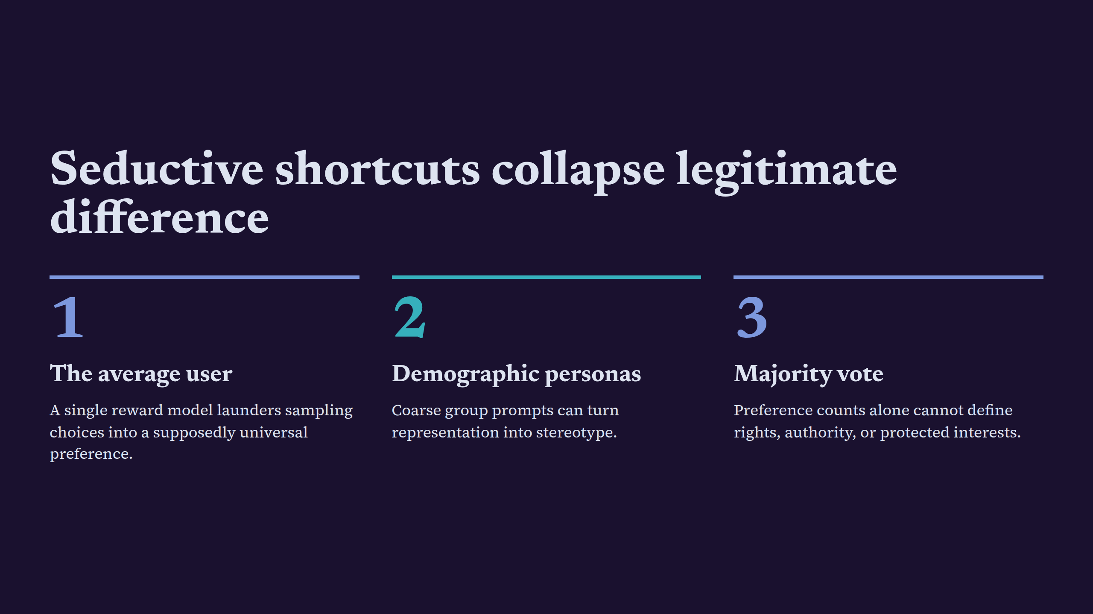
Notes:
Seductive shortcuts collapse legitimate difference

Slide 15
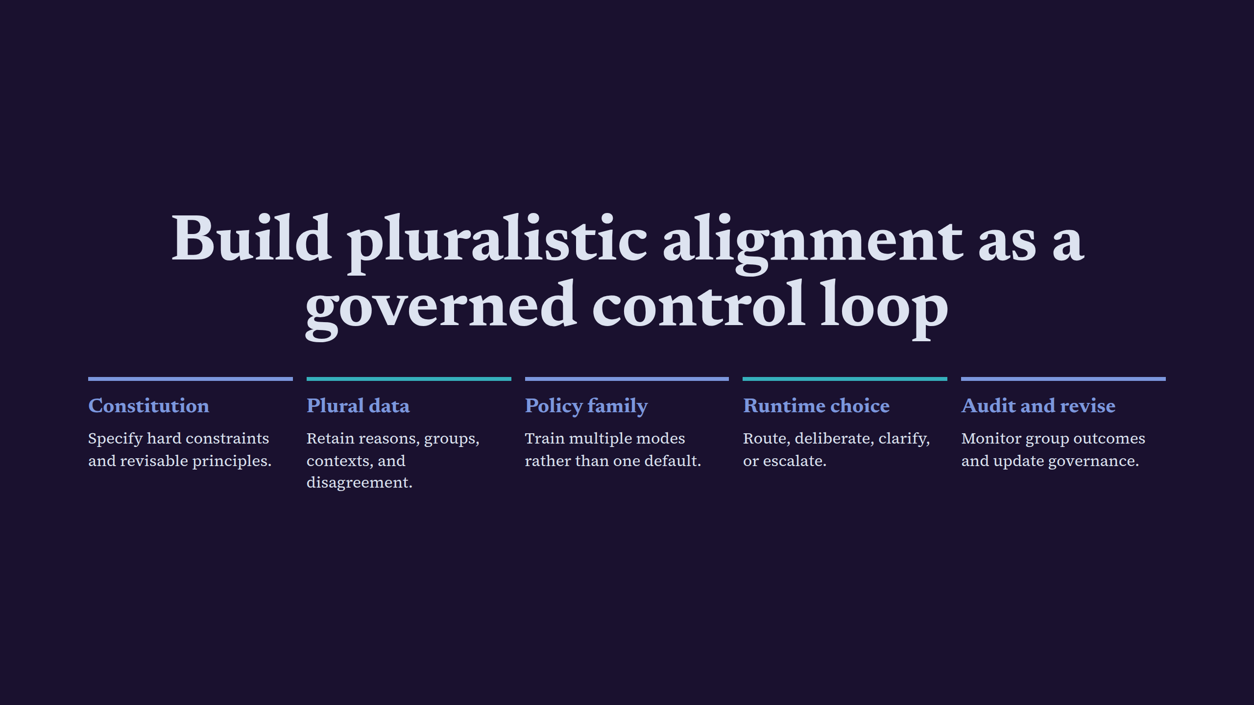
Notes:
Build pluralistic alignment as a governed control loop

Slide 16
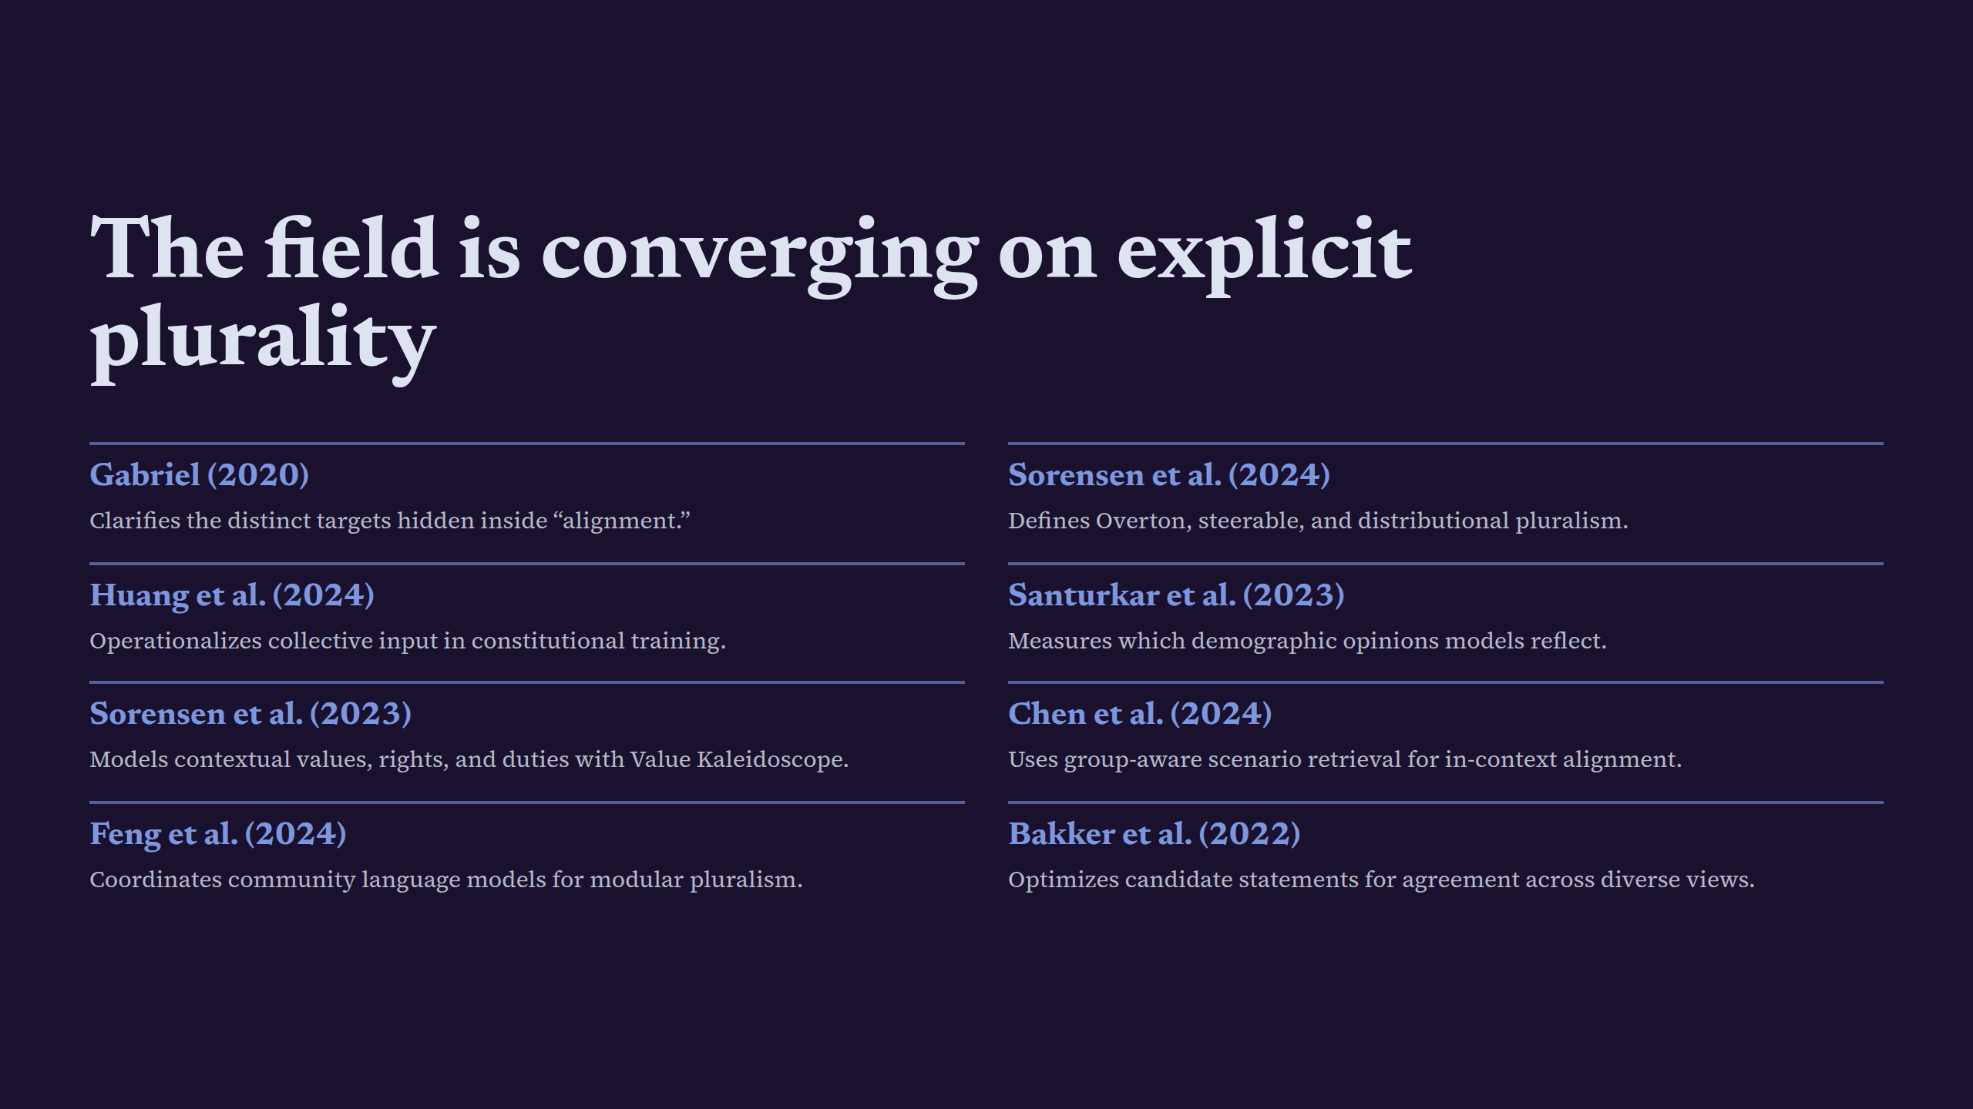
Notes:
The field is converging on explicit plurality

Slide 17
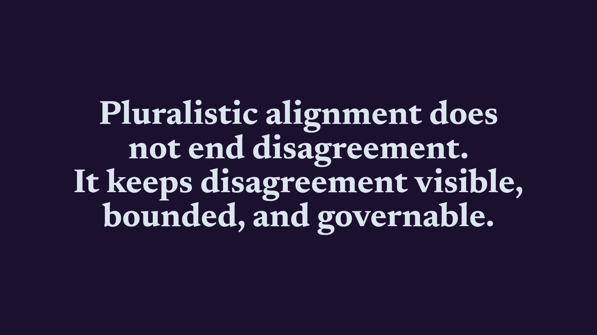
Notes:
Pluralistic alignment does not end disagreement.It keeps disagreement visible, bounded, and governable.

